Slide 1
API Finder: Accurate Extraction of Method Binding Information from Call Sites without Building the Code
Diptopol Dam
Supervisor: Dr. Nikolaos Tsantalis
Notes:
Hi Everyone,
I am Diptopol Dam. I am a master’s student under the supervison of Dr. Nikolaos Tsantalis.
Today I am going to present a tool for extracting method binding information from call sites without building the project, named API Finder.

Slide 2
Binding Information
Binding Information connects references of type, method, fields, variables to their actual declarations.
Method Binding Information connects invocation reference to its declaration.
Compiler(i.e., Eclipse JDT) can create binding information from building the complete codebase.

Slide 3
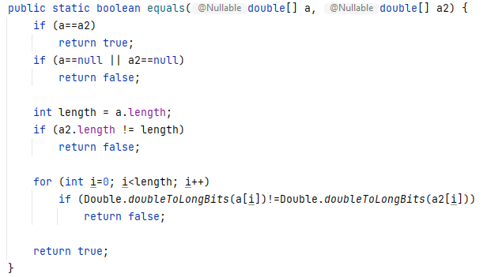
Example of Method Binding Information
Method Invocation Context (org.jfree.data.DataUtils)
Method Binding Information
Class Name: java.util.Arrays
Method Name: equals
Argument Types: (double[], double[])
Return Type: boolean
Method Declaration Context (java.util.Arrays)

Slide 4
Motivation Practitioner’s Perspective
Challenges
Access to Partial Program
May not be buildable
Fast Identification of Method Binding Information
Diff View Collected From a Pull Request of JFreeChart

Slide 5
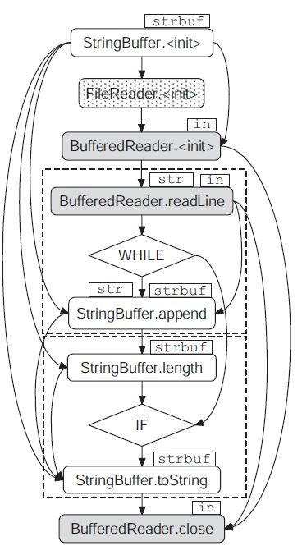
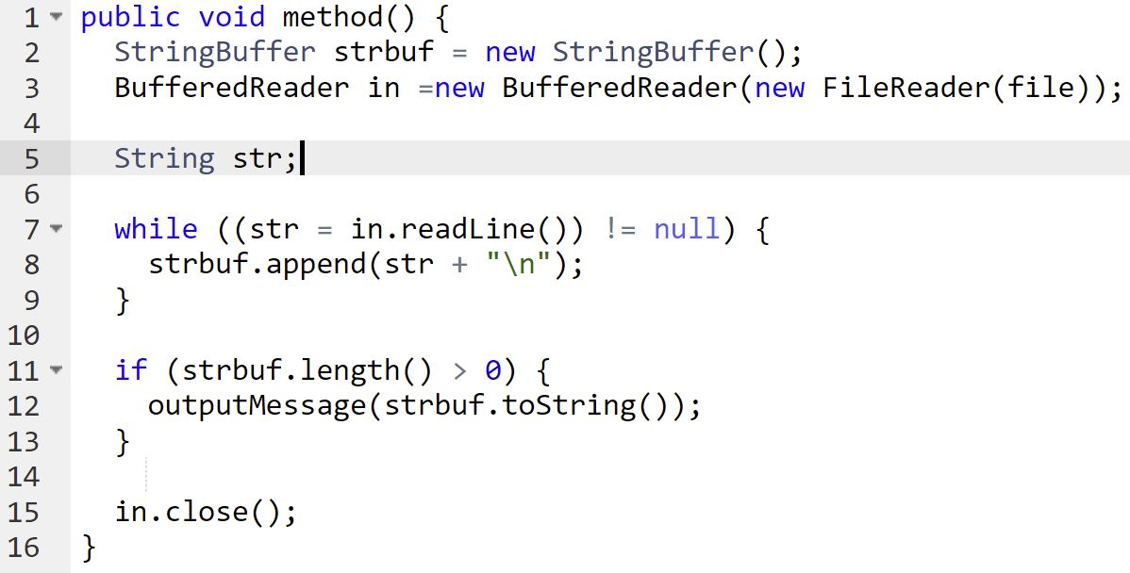
Motivation Researcher’s Perspective
Researchers often conduct empirical study on large number of commits.
Need to process partial programs
Need to extract binding information to create representations
Code Snippet
GROUM Representation
Notes:
What is the motivation for developing such a tool?
One of the major motivation is that
Researchers often need to extract binding information from partial programs.
For example,
Generation of Program dependence graph for Partial Programs
GROUM Representation from Partial Programs
Here is an example of GROUM Representation. In this representation, method invocations are shown as nodes with class name of the method. Extracting binding information will help us generate these nodes.

Slide 6
Motivation Limitations of existing tools
Partial Program Analysis (PPA) lacks support for newer Java language features (e.g., lambda expressions, generics)
Tightly coupled with existing other tools
GRAPA depends on WALA (a complete source code analysis tool)
JavaSymbolParser coupled with JavaParser
Notes:
There are few existing tools for extracting type information from partial programs. But they have several limitations.
- Partial Program Analysis lacks supports for new Java language features.
Tools like GRAPA, JavaSymbolParser is tightly coupled with other tools.
GRAPA depends on WALA (a complete source code analysis tool)
JavaSymbolParser coupled with JavaParser (An AST parsing library
That’s we need an approach which is independent of any existing framework or libraries. Also supports new Java language features.
And finally, In software industry, accurate identification of method declarations using binding information can be useful for web-based editors.

Slide 7
Our Contributions
A streamlined API for extracting appropriate method-binding information from any method invocation expression in a partial program.
Language Support up to Java SE 11.
Support the extraction of dependent artifacts from project build files.
Maven
Gradle
Independent and supports easy integration in any existing system.
A Chrome extension for displaying declared method signatures from any invocation expression on GitHub.
Notes:
So, our contributions are
We are proposing a streamlined API for extracting appropriate method-binding information from any method invocation expression.
We provide Java language support up to Java SE 11.
Our API relies on build system to
We support extraction of dependent artifacts from project build files. Maven and Gradle. Both are among most popular build tools for Java language.
Our core algorithm is designed in a way which is independent of any existing tools. So, integration in any system should be easy and straightforward.
We also developed a chrome extension for displaying method signatures of any invocation expression on Github. We generate binding information to display the declared method signature.

Slide 8
API Finder Overview
Notes:
This is the overview of API Finder.
Our approach relies on extraction of artifact archives and Java package archives in order to resolve appropriate method binding information.
The two major stages of our approach is ‘Artifact and Version Extraction’ and ‘Method binding Information resolution’.
We take these arguments for first stage.
In later stage, we additionally take method invocation expression as input and generate appropriate method binding information.
We will explain each stage on later slides.

Slide 9
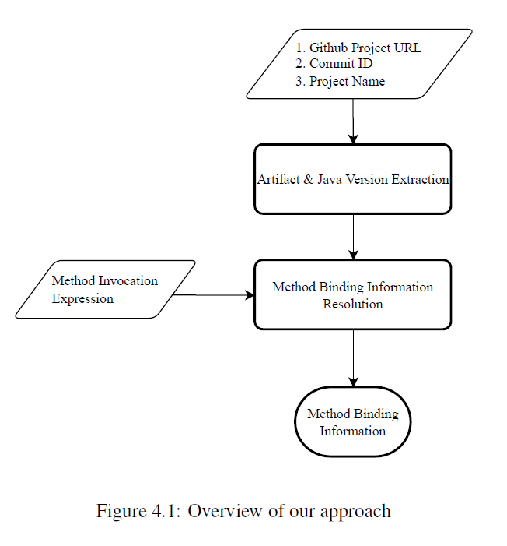
Artifact & Java Version Extraction
Notes:
Now we will explain the first stage artifact and java version extraction.
This is the overall process of artifact and java version extraction.

Slide 10
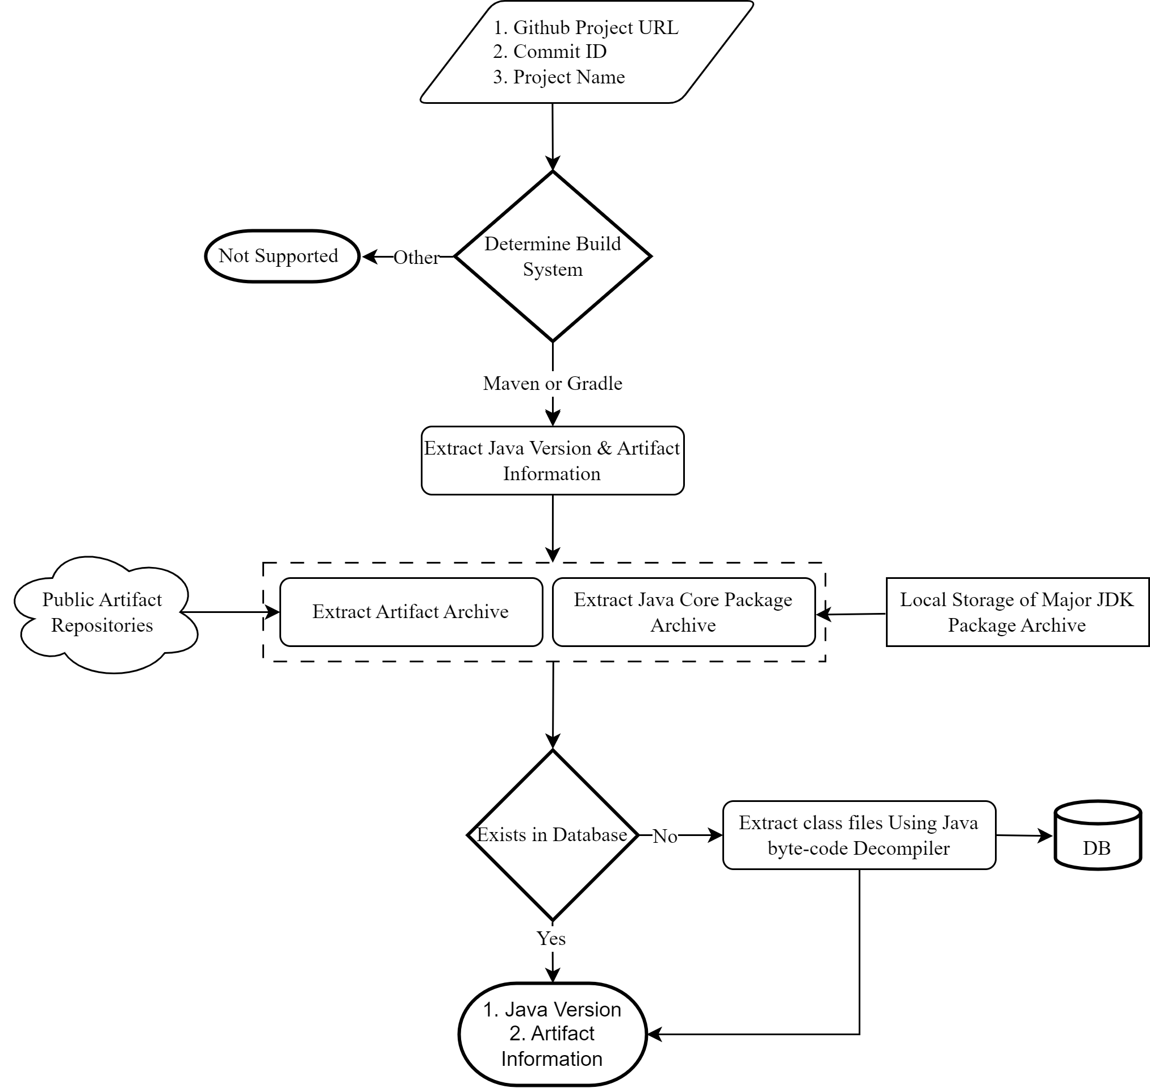
Artifact & Java Version Extraction
Maven
Extract Effective POM
Parse XML to extract artifacts, and java version of the project
Gradle
Gradle Tooling API to extract artifacts and java version of the project
Notes:
We first determine the build system of the project and guide our extraction of java version and dependent artifact information accordingly.
For Maven projects, we generates effective POM and parse the XML file to recover the artifacts information and java version.
For Gradle projects, we utilize Gradle tooling API to extract artifacts and java version of the project.
We provides both remote and local type retrieval. For Remote retrieval, we use Github API to recover all the information without cloning the project locally. The local retrieval requires cloning a project locally.

Slide 11
Artifact & Java Version Extraction
Based on the Java Version, we need to store the class metadata from core package archives.
We maintain a local storage of package archives of Major JDK version.
We extract archives based on project’s java version and load in our storage system.
Notes:
Now we want to talk about the extraction of Java Core Packages based on project’s java version.
We maintain a local storage of core packages of all major Java versions.
We can collect all the core packages of specific java version from local storage.

Slide 12
Artifact & Java Version Extraction
Dependent Artifact Extraction
Maven Artifact Resolver
Replicates the artifact resolution process of Maven
Looks into local artifact repository (e.g., .m2)
If not available, fetch from public remote artifact repository.
Notes:
For artifact archive extraction, we utilize Maven artifact resolver. Maven artifact resolver follows the same convention where we first look into local storage before fetching from public artifact repositories.

Slide 13
Artifact & Java Version Extraction
Extraction of class files from archives
ASM, a bytecode de-compiler
Store class meta data (e.g., field members, methods, inner classes, super class relationship)
Stored in a relational database
Return
Java Version
A Set of Dependent Artifact Information
Notes:
From all the archives, we extract class metadata using ASM. ASM is a bytecode decompiler.
We maintain a storage system where we store all the class meta data if the data was not available in the system.
Finally, we produce the java version and a set of dependent artifact information as output of this stage.

Slide 14
Method Binding Information Resolution
Notes:
We will move on to the second stage “Method binding information Resolution”.
Here is the overall view of resolving method binding information.

Slide 15
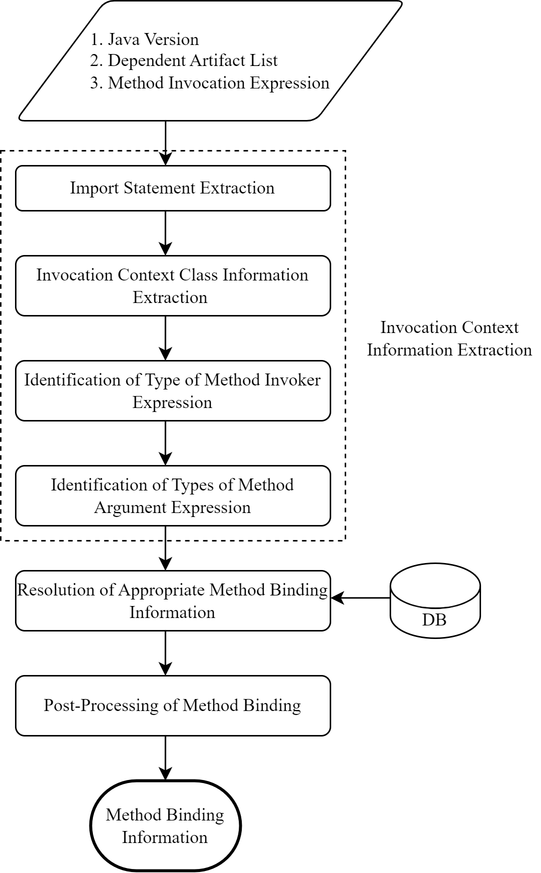
Method Binding Information Resolution (MBIR)
Invocation Context Information Extraction
Import Statements
Invocation Context Class Information (e.g., class name, inner classes, super class hierarchy)
Type of Method Invoker Expression
Type of Method Argument Expressions
Notes:
We starts with extraction of invocation context information e.g.,
Import statements
Invocation context class information
Includes invocation context class name, super class name hierarchy, defined formal type parameters
Type of method invoker expression
Type of method argument expressions

Slide 16
Resolution of Method Binding Information
We perform search in 6 different scopes to identify appropriate method binding information.
Method invoker expression scope
Method invocation context scope
Directly imported class scope
Inner classes of directly imported class scope
Imported package scope
Super classes of all imported class scope
Filtration process
Deferral of method binding information
Notes:
Now after the collection of all required information, we move to identifying method binding information. This is a 6 stages approach.
We start with method invoker expression scope. If we can identify the type of particular method invoker expression, we look into the class and its superclasses in an iterative process and look for method binding information.
If we can find appropriate method binding information we can return from the process otherwise we move to next stage.
In this stage, we look into the method invocation context class and all its superclasses to find the method binding information.
If we cannot find appropriate method binding information we look into all the classes that are imported via import statements.
Then we move to next stage where we consider all the classes under package names that are available in import statements.
Finally, we look into super classes of directly imported classes via import statements. We perform the iterative process via traversing through immediate parent class and interfaces until there is no superclass.
In each stage, we perform a filtration process and deferral process. I will explain these two process in later slides.

Slide 17
Filtration Process
Perform filtration based on
Type of method invoker
Type of method argument
Notes:
We perform a filtration to identify appropriate method binding information.
Two of the important filtration criteria are
Type of method invoker
Type of Method argument

Slide 18
Filtration based on Type of method invoker
We try to compare class name of invoker expression with class name of the method binding
We starts with the class name of invoker expression
Iterate through superclass hierarchy
Assign a value for each method binding information based on distance between the class of the invoker type and method binding information
1000
Object
3
Visitable
2
1000
Node
Object
1
1
BodyDeclaration
NodeWithSimpleName
0
AnnotationDeclaration
n.hashCode()
Notes:
Now I will explain the filtration process based on type of method invoker expression
We compare the class name of invoker expression that we collect from invocation context with the class name of the method binding information.
We start the process comparing the class of invoker expression and iterate through the super class hierarchy.
Let’s provide an example. Here n.hashCode() is the method invocation expression where class name of n variable is AnnotationDeclaration.
We also assign value for each method binding based on the distance between class of the invoker type and class of the method binding.

Slide 19
Filtration based on Argument Types
We compare class name of each argument
Invocation context
Method binding
Perform inference-based Matching
Super class hierarchy traversal
Primitive Type Widening Conversion
Primitive to Wrapper Object Conversion
We assign distance value for each argument matching
Notes:
Now I will discuss the filtration process based on argument types.
Similar to invoker types, we also compares the class name of the arguments collected from invocation context with argument class name of method binding information.
We also perform a similar iteration through super class hierarchy to find the match.
Additionally, we perform inference based conversion for other types.
For each inferenced based conversion, we also assign a distance value for each method binding information.

Slide 20
Deferral of Method Binding Information
3 Criteria for deferring a method binding information.
Is an Abstract Method
Is declared on java.lang.Object
Has total argument matching distance greater than 0
Notes:
We also want to explain the deferral process where we try to defer an eligible method binding information in order to get a better match.

Slide 21
Post-Processing of Method Binding Information
We resolve formal type parameter
We convert variadic argument
An example of formal Type Parameter
An example of Variadic Argument

Slide 22
Evaluation: What is the accuracy of our approach?
Compared with Eclipse JDT Compiler
Lowest Accuracy: 93.31%
Highest Accuracy: 99.78%
Across All Projects Accuracy: 97.59%
11 Open-Source Project
Notes:
For the evaluation, we compared method binding information produced by our approach against Eclipse JDT Compiler. We have performed our evaluation for 11 open-source projects.
We have found that all of projects have above 93% accuracy. Highest accuracy was 99.78%. Across all projects accuracy was 97.59%.

Slide 23
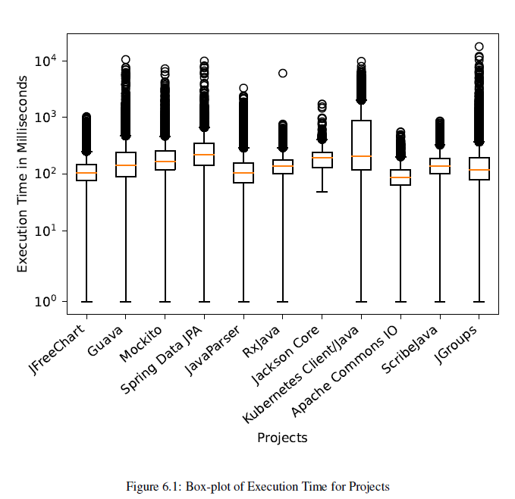
Evaluation: What is the execution time?
Mean: 380.93ms
Median: 150ms
Max: 17,811ms
Notes:
We have also evaluated the execution time of each identification of method binding information.
We have found on average the execution time was 380.93ms
The maximum execution time was 17,811ms

Slide 24
Example of Internal Method Binding Information
3 Internal Method Binding Information
Total 4 Method Binding Information needs to be resolved.

Slide 25
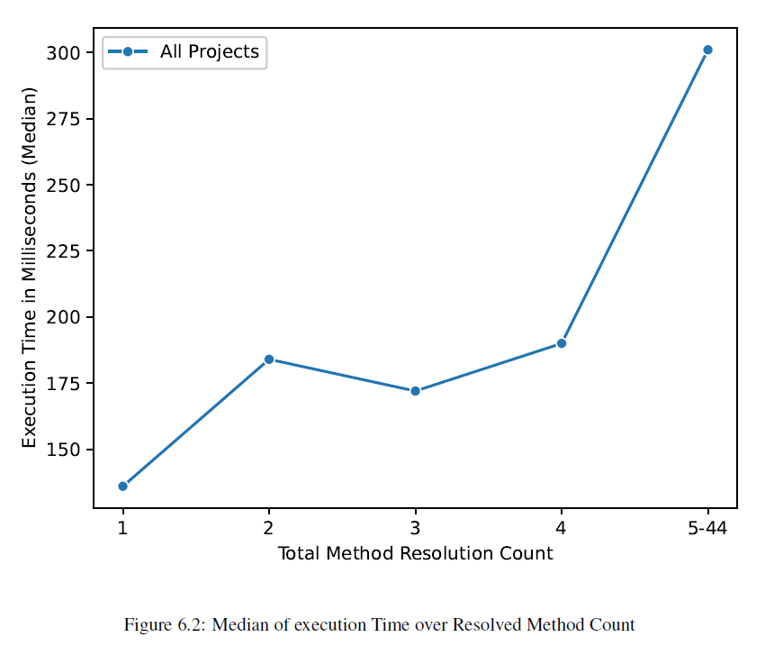
Impact of Total Method Binding Resolution
Notes:
We tried to investigate the instances with high execution time. We have found that in order to resolve a particular method binding information, we may require to resolve other method binding information. For example, any of the argument can be a method invocation or a method invoker expression itself can be a method invocation expression.
On the left side we can see the distribution of number of internal resolved method bindings that happened. Even though the higher number of internal method binding resolution is relatively small but with the increase in the number of resolved method binding information, execution time increases as well. From the plot on the right side, we can see the upwards increase of execution time with increasing number of internal resolved method counts.

Slide 26
API Finder Usage
Artifact & Java Version Extraction
Resolve Method Binding Information

Slide 27
Chrome Extension for GitHub
Shows method Signatures for any method invocation expression
API Finder
Qualified-Class-Name::Modifier Return-Type Method-Name (Argument-Types)
Notes:
Here is a screenshot of chrome extension where we are showing declared method signature from method invocation expression.
We rely on the API Finder to generate appropriate method binding information.
And generate the method signature from the binding information.

Slide 28
Chrome Extension Comparison With GitHub Navigation
Declaration from Java Core Packages or External Artifacts
API Finder
GitHub does not show declaration information.
Notes:
We will show a comparison between our extension and Github code navigation for Java projects.
We can see from the screenshot, Github code navigation does not show declarations which is outside of project. (e.g., Java Core Package, External Artifacts)
Also, Github does not consider the number of arguments or types to show the appropriate method declaration.
On the other hand , we takes the number and types of arguments in order to identify appropriate method signature.

Slide 29
Chrome Extension Comparison With GitHub Navigation
API Finder
Consideration of arguments
GitHub

Slide 30
Chrome Extension Comparison With GitHub Navigation
API Finder
Consideration of the type of the method invoker
GitHub
Notes:
Another shortcoming of github code navigation is the non consideration of type of method invoker expression. Our approach utilize this information to show appropriate method declaration.

Slide 31
Conclusion
We proposed a streamlined, easy to integrate, API based method binding resolution for any method invocation expression.
Evaluated against 11 open-source projects where we have seen
Above 93% accuracy
Average 380ms execution time
In Future, we want to support new Java language features.
We want to incorporate our approach for identifying binding information from code fragments available in forums and websites.
Notes:
Finally, I want to summarize the work where we have proposed a streamlined API for resolving method binding information.
We have evaluated our approach against compiler implementations for 11 open source projects.
Our tool was able to identify binding information with above 93% accuracy.
Also, average execution time was 380 milliseconds.

Slide 32
Thank You
Any Questions?

Slide 33
MBIR: Type Representation
Notes:
We maintain our internal type representation of each types of Java language. This is the list of all types.

Slide 34
Resolution of Formal Type Parameters
From class metadata, we parse generics signature to collect the base types of declared formal type parameters.
We infer actual type of formal type parameters from type information collected from invocation context.
We extract type arguments from method invokers
We try to infer from the types that are passed as arguments.
We also try to infer the types from invocation context class.

Slide 35
MBIR: Class Binding Information
Identifying class binding information is a multi-stage process.
Visibility of class or package requires
Class or package declared inside
project
java core packages
dependent artifacts
Fully qualified name of class declared on the import statement, or type declaration.
Class declared as one of the inner class
Class declared as one of the parent class or interfaces of invocation context class.
Priority based filtering to identify the appropriate class binding information
Notes:
Identifying type of method invoker expression or method argument expression, often requires extraction of class binding information.
Identifying class binding information is a multi-stage process.
The visibility of class or package in a source file needs to satisfies few conditions.
First, class or package should be declared insider project, java core packages, or dependent artifact archives.
Second, it also needs to satisfies either of these conditions.
Fully qualified name of the class should be declared on the import statements or during type declaration
Or Class should be declared as one of the inner classes
Or Class is declared as one of the super classes.
Based on these conditions, we collect the list of class binding information from class metadata storage.
We then perform a priority-based filtering to identify appropriate class binding information.

Slide 36
MBIR: Field Binding Information
We identify field binding information in 5 stages.
Field Expression Scope
Method Invocation Context Scope
Directly Imported Class Scope
Imported package Scope
Super Classes of all imported class Scope
Notes:
Type resolution also often requires extraction of field binding information.
Similar to resolution of class binding information, extraction of field binding information is a multi stage approach. There are 5 stages.
At first, we consider field expression scope. If the particular field expression also contains the fully qualified class name where the field belongs. We can use the class name to find our appropriate field binding information.
We look into the class and all the superclass for the field declaration. If we can find field binding information we will return otherwise we move to next stage.
The next stage is method invocation context scope where we look for field declaration in the method invocation context class and any of its superclass and outer classes.
The next stage is we directly look into the classes that are in import statement and try to find the field declaration.
Then we move to declared package and try to look into all classes inside the package.
Finally, we look into all the superclasses of imported classes to find the field binding information.

Slide 37
Top Occurrences of Mismatch failures (1)
Number of Instances: 291
Type of formal Type parameter is determined from outer method invocation.
Arg Type: CommentMetaModel
Type: BaseNodeMetaModel

Slide 38
Top Occurrences of Mismatch failures (2)
Number of Instances: 222
Return Type comes from type argument of first method argument
From ThisExpression our tool cannot extract type parameters of parent class.

Slide 39
Top Occurrences of Mismatch failures (3)
Number of Instances: 64
MIC: Type of “metadata” is V1ListMetaBuilder.
MDC: Compiler shows type “V1ListMetaFluentImpl”
V1ListMetaBuilder is sub-class of V1ListMetaBuilder
Byte-code representation of both class contains equals method.

Slide 40
Top Occurrences of No Match failures (1)
Number of Instances: 352
Failed to resolve fully qualified field properly to identify method invoker type

Slide 41
Top Occurrences of No Match failures (2)
Number of Instances: 41
Failed to compare arguments char[] to Object.

Slide 42
Top Occurrences of No Match failures (3)
Number of Instances: 37
Invoker type is a lambda expression argument that enclosed in Class Instance Creation instance
Inability to resolve type from enclosed Class Instance Creation resulted incorrect identification of invoker type.

Slide 43
Limitations
Dependency on the build System
Availability of artifacts on Public Maven Repository
Inability of identify method binding information from test package
Limited processing of Remote fetching of Gradle build related files

Slide 44
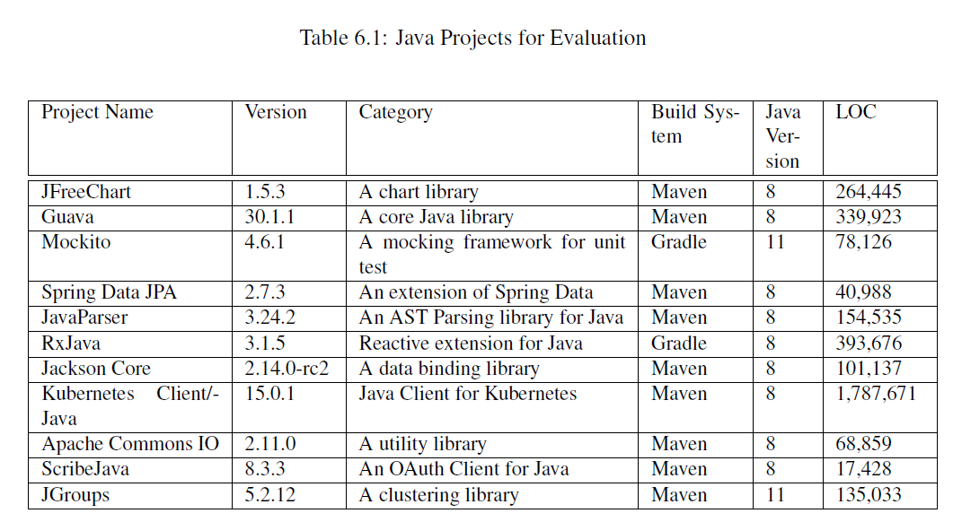
Project Selection Criteria
Projects need to be buildable completely by Eclipse JDT.
Dependent artifacts of the projects has to be in Public Artifact Repositories.

