Slide 1

Applied Statistics and Probability for Engineers
Sixth Edition
Douglas C. Montgomery George C. Runger
Chapter 3
Discrete Random Variables and Probability Distributions

Slide 2
3
Discrete Random Variables and Probability Distributions
CHAPTER OUTLINE
3-1 Discrete Random Variables
3-2 Probability Distributions and
Probability Mass Functions
3-3 Cumulative Distribution
Functions
3-4 Mean and Variance of a
Discrete Random Variable
3-5 Discrete Uniform Distribution
3-6 Binomial Distribution
3-7 Geometric and Negative
Binomial Distributions
3-8 Hypergeometric Distribution
3-9 Poisson Distribution

Slide 3
Learning Objectives for Chapter 3
After careful study of this chapter, you should be able to do the
following:
Determine probabilities from probability mass functions and the reverse.
Determine probabilities and probability mass functions from cumulative distribution functions and the reverse.
Calculate means and variances for discrete random variables.
Understand the assumptions for discrete probability distributions.
Select an appropriate discrete probability distribution to calculate probabilities.
Calculate probabilities, means and variances for discrete probability distributions.

Slide 4
Discrete Random Variables
Physical systems can be modeled by the same or similar random experiments and random variables. The distribution of the random variable involved in each of these common systems can be analyzed. The results can be used in different applications and examples.
We often omit a discussion of the underlying sample space of the random experiment and directly describe the distribution of a particular random variable.

Slide 5
Example 3-2: Camera Flash Tests
The time to recharge the flash is tested in three cell-phone cameras. The probability that a camera passes the test is 0.8, and the cameras perform independently. See Table
3-1 for the sample space for the experiment and associated probabilities. For example, because the cameras are independent, the probability that the first and second cameras pass the test and the third one fails, denoted as ppf, is
P(ppf) = (0.8)(0.8)(0.2) = 0.128
The random variable X denotes the number of cameras that pass the test. The last column of the table shows the values of X assigned to each outcome of the experiment.

Slide 6
Probability Distributions
A random variable is a function that assigns a
real number to each outcome in the sample
space of a random experiment.
The probability distribution of a random variable
X gives the probability for each value of X.

Slide 7
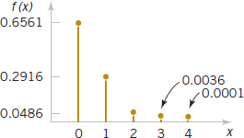
Example 3-4: Digital Channel
There is a chance that a bit transmitted through a digital transmission channel is received in error.
Let X equal the number of bits received in error in the next 4 bits transmitted.
The associated probability distribution of X is shown in the table.
The probability distribution of X is given by the possible values along with their probabilities.
Figure 3-1 Probability distribution for bits in error.

Slide 8
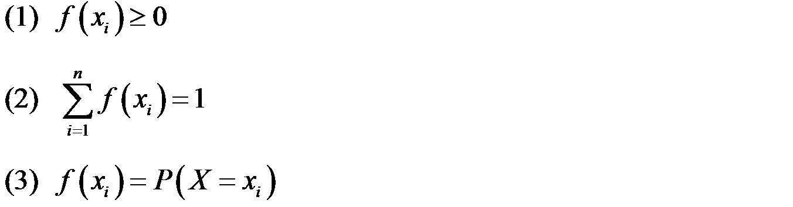
Probability Mass Function
For a discrete random variable X with possible values
x₁, x₂, …, x_{n}, a probability mass function is a function such that:

Slide 9
Example 3-5: Wafer Contamination
Let the random variable X denote the number of wafers that need to be analyzed to detect a large particle of contamination. Assume that the probability that a wafer contains a large particle is 0.01, and that the wafers are independent. Determine the probability distribution of X.
Let p denote a wafer in which a large particle is present & let a denote a wafer in which it is absent.
The sample space is: S = {p, ap, aap, aaap, …}
The range of the values of X is: x = 1, 2, 3, 4, …

Slide 10
Cumulative Distribution Functions
Example 3-6: Consider the probability distribution for the digital channel
example.
Find the probability of three or fewer bits in error.
The event (X ≤ 3) is the total of the events: (X = 0), (X = 1), (X = 2), and (X = 3).
From the table:
P(X ≤ 3) = P(X = 0) + P(X = 1) + P(X = 2) + P(X = 3) = 0.9999

Slide 11
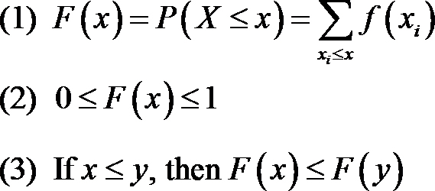
Cumulative Distribution Function and Properties
The cumulative distribution function, is the probability that a random
variable X with a given probability distribution will be found at a value
less than or equal to x.
Symbolically,
For a discrete random variable X, F(x) satisfies the following properties:

Slide 12
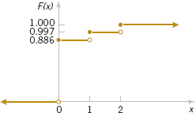
Example 3-8: Sampling without Replacement
A day’s production of 850 parts contains 50 defective parts. Two parts are selected at random without replacement. Let the random variable X equal the number of defective parts in the sample. Find the cumulative distribution function of X.
The probability mass function is calculated as follows:
Figure 3-4 Cumulative Distribution Function

Slide 13
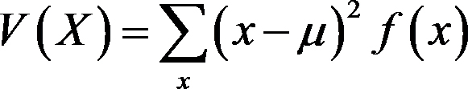
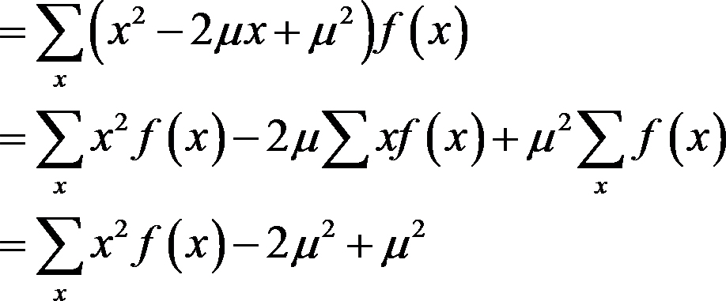
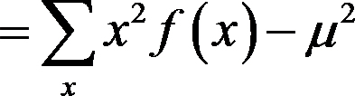
Variance Formula Derivations
is the definitional formula
is the computational formula
The computational formula is easier to calculate manually.

Slide 14
Example 3-9: Digital Channel
In Example 3-4, there is a chance that a bit transmitted through a digital transmission channel is received in error. X is the number of bits received in error of the next 4 transmitted. The probabilities are
P(X = 0) = 0.6561, P(X = 2) = 0.0486, P(X = 4) = 0.0001,
P(X = 1) = 0.2916, P(X = 3) = 0.0036
Use table to calculate the mean & variance.

Slide 15


Expected Value of a Function of a Discrete Random Variable
If X is a discrete random variable with probability mass function f (x),
then its expectation is the variance of X.

Slide 16
Example 3-12: Digital Channel
In Example 3-9, X is the number of bits in error in the next four bits transmitted. What is the expected value of the square of the number of bits in error?
Here h(X) = X²
Answer:
E(X²) = X² · f(X) = 0² х 0.6561 + 1² х 0.2916 + 2² х 0.0486 + 3² х 0.036 + 4² х 0.0001
= 0.5200

Slide 17
Discrete Uniform Distribution
If the random variable X assumes the values x₁, x₂,
…, x_{n}, with equal probabilities, then the discrete
uniform distribution is given by
f(x_{i}) = 1/n

Slide 18
Discrete Uniform Distribution
Let X be a discrete random variable ranging from a,a+1,a+2,…,b, for a ≤ b. There are b – (a-1) values in the inclusive interval. Therefore:
f(x) = 1/(b-a+1)
Its measures are:
μ = E(x) = (b+a)/2
σ² = V(x) = [(b-a+1)²–1]/12
Note that the mean is the midpoint of a & b.

Slide 19
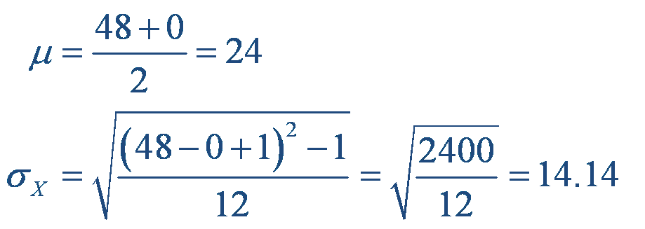
Example 3-14: Number of Voice Lines
Let the random variable X denote the number of
the 48 voice lines that are in use at a particular
time. Assume that X is a discrete uniform random
variable with a range of 0 to 48. Find E(X) & σ.
Answer:

Slide 20
Binomial Distribution
The random variable X that equals the number
of trials that result in a success is a binomial
random variable with parameters 0 < p < 1 and
n = 1, 2, ....
The probability mass function is:
For constants a and b, the binomial expansion is

Slide 21
Example 3-17: Binomial Coefficient

Slide 22


Exercise 3-18: Organic Pollution-1
Each sample of water has a 10% chance of containing a particular
organic pollutant. Assume that the samples are independent with
regard to the presence of the pollutant. Find the probability that, in the
next 18 samples, exactly 2 contain the pollutant.
Answer:
Let X denote the number of samples that contain the pollutant in the
next 18 samples analyzed. Then X is a binomial random variable with
p = 0.1 and n = 18

Slide 23
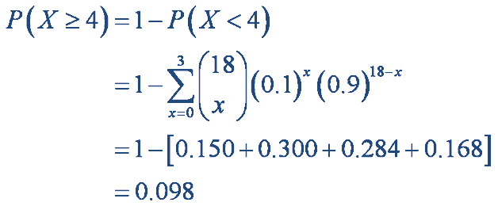

Exercise 3-18: Organic Pollution-2
Determine the probability that at least 4
samples contain the pollutant.
Answer:

Slide 24
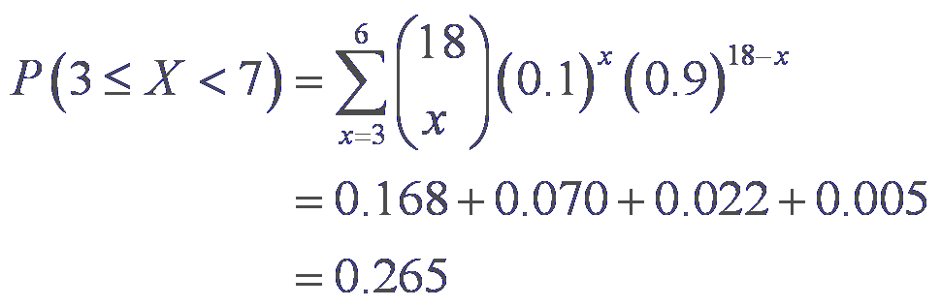
Exercise 3-18: Organic Pollution-3
Now determine the probability that 3 ≤ X < 7.
Answer:
Appendix A, Table II (pg. 705) is a cumulative binomial table for selected values of p and n.

Slide 25
Binomial Mean and Variance
If X is a binomial random variable with
parameters p and n,
μ = E(X) = np
and
σ² = V(X) = np(1-p)

Slide 26
Example 3-19:
For the number of transmitted bit received in error
in Example 3-16, n = 4 and p = 0.1. Find the mean
and variance of the binomial random variable.
Answer:
μ = E(X) = np = 4*0.1 = 0.4
σ² = V(X) = np(1-p) = 4*0.1*0.9 = 0.36
σ = SD(X) = 0.6

Slide 27
Geometric Distribution
Binomial distribution has:
  Fixed number of trials.
  Random number of successes.
Geometric distribution has reversed roles:
  Random number of trials.
  Fixed number of successes, in this case 1.
The probability density function of Geometric distribution is
  f(x) = p(1-p)^{x-1}
  x = 1, 2, … , the number of failures until the 1st success. 0 < p < 1, the probability of success.

Slide 28
Example 3.21: Wafer Contamination
The probability that a wafer contains a large particle of
contamination is 0.01. Assume that the wafers are
independent. What is the probability that exactly 125
wafers need to be analyzed before a particle is
detected?
Answer:
Let X denote the number of samples analyzed until a large particle is detected. Then X is a geometric random variable with parameter p = 0.01.
P(X=125) = (0.99)¹²⁴(0.01) = 0.00288.

Slide 29
Geometric Mean & Variance
If X is a geometric random variable with
parameter p,

Slide 30
Exercise 3-22: Mean and Standard Deviation
The probability that a bit transmitted through a digital transmission
channel is received in error is 0.1. Assume that the transmissions are
independent events, and let the random variable X denote the number
of bits transmitted until the first error. Find the mean and standard
deviation.
Answer:
Mean = μ = E(X) = 1 / p = 1 / 0.1 = 10
Variance = σ² = V(X) = (1-p) / p² = 0.9 / 0.01 = 90
Standard deviation = √90 = 9.49

Slide 31
Lack of Memory Property
For a geometric random variable, the trials are
independent. Thus the count of the number of
trials until the next success can be started at any
trial without changing the probability distribution of
the random variable.
The implication of using a geometric model is that
the system presumably will not wear out. For all
transmissions the probability of an error remains
constant. Hence, the geometric distribution is said
to lack any memory.

Slide 32
Example 3-23: Lack of Memory Property
In Example 3-21, the probability that a bit is
transmitted in error is 0.1. Suppose 50 bits have
been transmitted. What is the mean number of
bits transmitted until the next error?
Answer:
The mean number of bits transmitted until the next error, after 50 bits have already been transmitted, is
1 / 0.1 = 10.
the same result as the mean number of bits until the first error.

Slide 33
Negative Binomial Distribution
In a series of independent trials with constant
probability of success p, the random variable X
which equals the number of trials until r successes
occur is a negative binomial random variable with
parameters 0 < p < 1 and r = 1, 2, 3, ....
The probability mass function is:

Slide 34
Mean & Variance of Negative Binomial
If X is a negative binomial random variable
with parameters p and r,

Slide 35
Example 3-25: Camera Flashes
The probability that a camera passes a particular test is 0.8, and the
cameras perform independently. What is the probability that the third
failure is obtained in five or fewer tests?
Let X denote the number of cameras tested until three failures have
been obtained. The requested probability is P(X ≤ 5). Here X has a
negative binomial distribution with p = 0.2 and r = 3. Therefore,

Slide 36
Hypergeometric Distribution
A set of N objects contains:
  K objects classified as success
  N - K objects classified as failures
A sample of size n objects is selected without replacement from the N objects randomly, where K ≤ N and n ≤ N.
Let the random variable X denote the number of successes in the sample. Then X is a hypergeometric random variable with probability density function

Slide 37
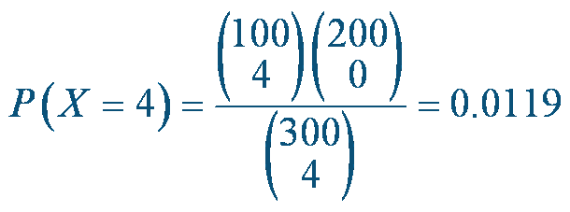
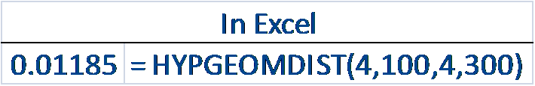
Example 3-27: Parts from Suppliers-1
A batch of parts contains 100 parts from supplier A
and 200 parts from Supplier B. If 4 parts are
selected randomly, without replacement, what is
the probability that they are all from Supplier A?
Answer:
Let X equal the number of parts in the sample from Supplier A.

Slide 38
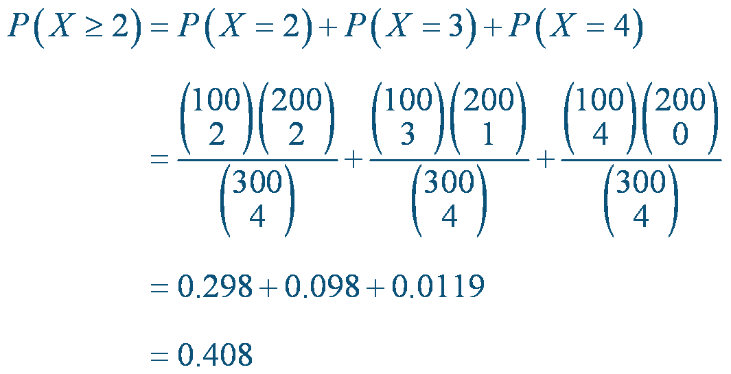
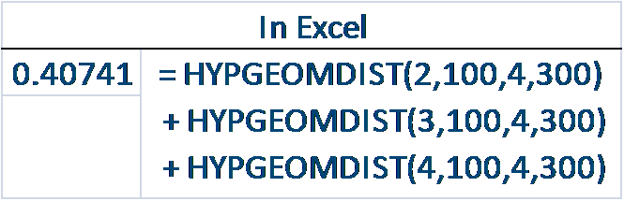
Example 3-27: Parts from Suppliers-2
What is the probability that two or more parts are from supplier A?
Answer:

Slide 39
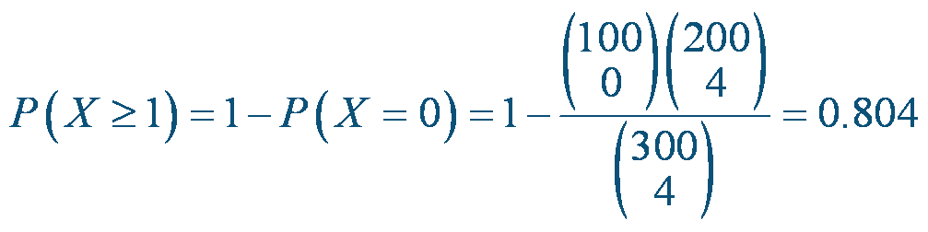
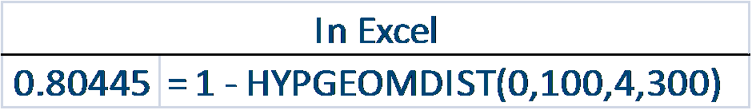
Example 3-27: Parts from Suppliers-3
What is the probability that at least one part in the
sample is from Supplier A?
Answer:

Slide 40
Hypergeometric Mean & Variance
If X is a hypergeometric random variable
with parameters N, K, and n, then
σ² approaches the binomial variance as n /N becomes small.

Slide 41
Example 3-29: Customer Sample-1
A list of customer accounts at a large company contains
1,000 customers. Of these, 700 have purchased at least
one of the company’s products in the last 3 months. To
evaluate a new product, 50 customers are sampled at
random from the list. What is the probability that more than
45 of the sampled customers have purchased from the
company in the last 3 months?
Let X denote the number of customers in the sample who have
purchased from the company in the last 3 months. Then X is a
hypergeometric random variable with N = 1,000, K = 700, n = 50.
This a lengthy problem! ☹

Slide 42
Example 3-29: Customer Sample-2
Using the binomial approximation to the distribution of
X results in

Slide 43
Poisson Distribution
The random variable X that equals the
number of events in a Poisson process is a
Poisson random variable with parameter λ > 0,
and the probability density function is:

Slide 44
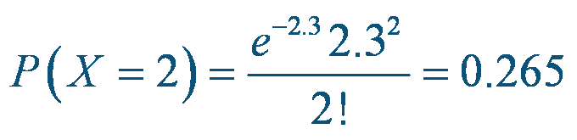
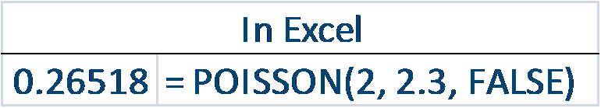
Example 3-31: Calculations for Wire Flaws-1
For the case of the thin copper wire, suppose that
the number of flaws follows a Poisson distribution
With a mean of 2.3 flaws per mm. Find the
probability of exactly 2 flaws in 1 mm of wire.
Answer:
Let X denote the number of flaws in 1 mm of wire

Slide 45
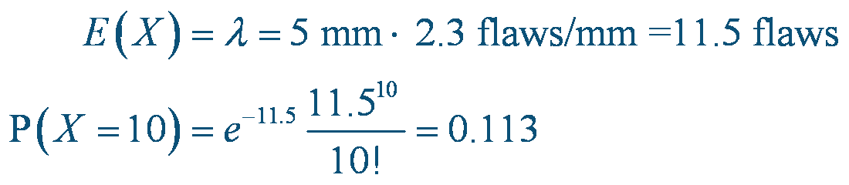
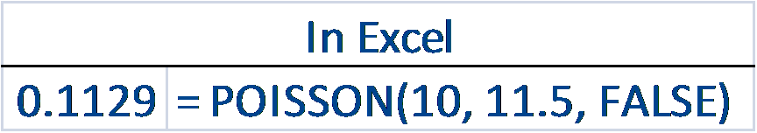
Example 3-31: Calculations for Wire Flaws-2
Determine the probability of 10 flaws in 5 mm of
wire.
Answer :
Let X denote the number of flaws in 5 mm of wire.

Slide 46
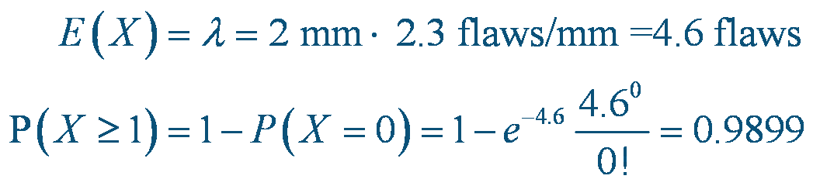
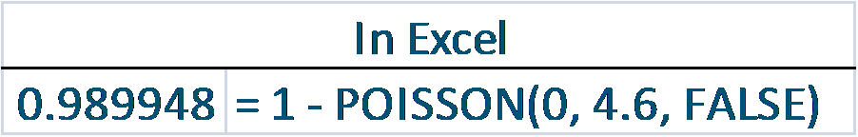
Example 3-31: Calculations for Wire Flaws-3
Determine the probability of at least 1 flaw in 2 mm
of wire.
Answer :
Let X denote the number of flaws in 2 mm of wire.
Note that P(X ≥ 1) requires  terms. ☹

Slide 47
Poisson Mean & Variance
If X is a Poisson random variable with parameter λ, then
μ = E(X) = λ and σ²=V(X) = λ
The mean and variance of the Poisson model are the same.
For example, if particle counts follow a Poisson distribution with a mean
of 25 particles per square centimeter, the variance is also 25 and the
standard deviation of the counts is 5 per square centimeter.
If the variance of a data is much greater than the mean, then the
Poisson distribution would not be a good model for the distribution of
the random variable.

Slide 48
Important Terms & Concepts of Chapter 3

