Slide 1
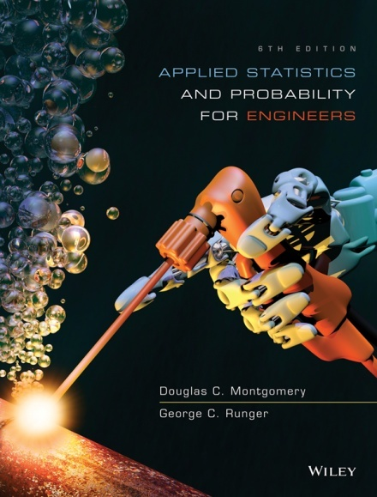
Applied Statistics and Probability for Engineers
Sixth Edition
Douglas C. Montgomery George C. Runger
Chapter 4
Continuous Random Variables and Probability Distributions

Slide 2
4
Continuous Random Variables and Probability Distributions
CHAPTER OUTLINE
4-1 Continuous Random Variables
4-2 Probability Distributions and Probability
Density Functions
4-3 Cumulative Distribution Functions
4-4 Mean and Variance of a Continuous
Random Variable
4-5 Continuous Uniform Distribution
4-6 Normal Distribution
4-7 Normal Approximation to the Binomial
and Poisson Distributions
4-8 Exponential Distribution
4-9 Erlang and Gamma Distributions
4-10 Weibull Distribution
4-11 Lognormal Distribution
4-12 Beta Distribution

Slide 3
Learning Objectives for Chapter 4
After careful study of this chapter, you should be able to do the following:
Determine probabilities from probability density functions.
Determine probabilities from cumulative distribution functions, and cumulative distribution functions from probability density functions, and the reverse.
Calculate means and variances for continuous random variables.
Understand the assumptions for continuous probability distributions.
Select an appropriate continuous probability distribution to calculate probabilities for specific applications.
Calculate probabilities, means and variances for continuous probability distributions.
Standardize normal random variables.
Use the table for the cumulative distribution function of a standard normal distribution to calculate probabilities.
Approximate probabilities for Binomial and Poisson distributions.

Slide 4
Continuous Random Variables
A continuous random variable is one which
takes values in an uncountable set.
They are used to measure physical characteristics such as height, weight, time, volume, position, etc...
Examples
Let Y be the height of a person (a real number).
Let X be the volume of juice in a can.
Let Y be the waiting time until the next person arrives at the server.

Slide 5
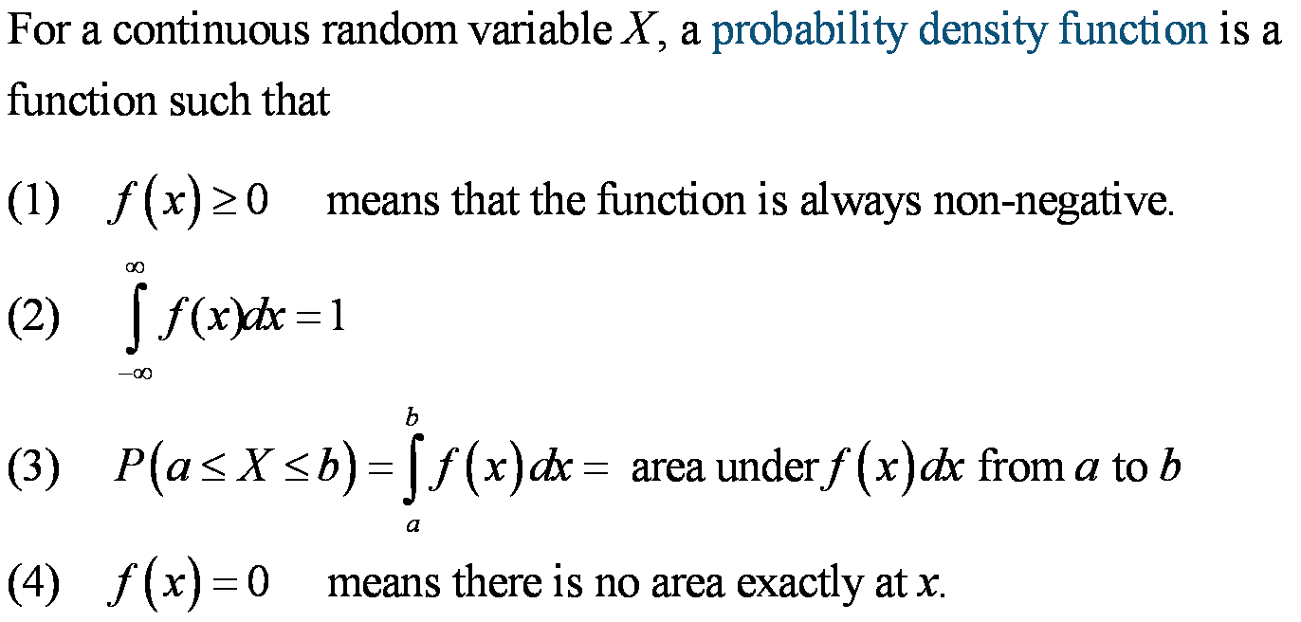
Probability Density Function

Slide 6
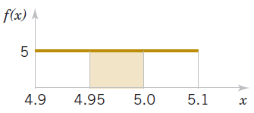
Example 4-1: Electric Current
Let the continuous random variable X denote the current
measured in a thin copper wire in milliamperes(mA).
Assume that the range of X is 4.9 ≤ x ≤ 5.1 and f(x) = 5.
What is the probability that a current is less than 5mA?
Answer:
Figure 4-4 P(X < 5)
illustrated.

Slide 7
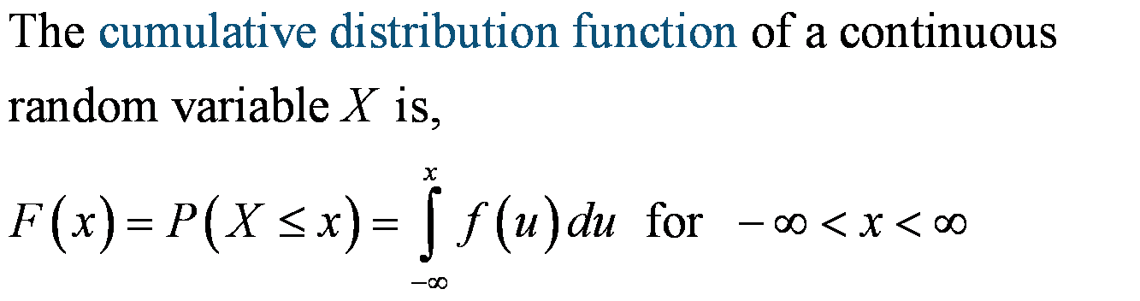
Cumulative Distribution Functions
The cumulative distribution function is defined for all real numbers.

Slide 8
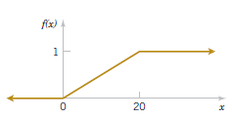
Example 4-3: Electric Current
For the copper wire current measurement in
Exercise 4-1, the cumulative distribution
function consists of three expressions.
The plot of F(x) is shown in Figure 4-6.
Figure 4-6 Cumulative distribution function

Slide 9
Probability Density Function from the Cumulative Distribution Function
The probability density function (PDF) is the derivative of the cumulative distribution function (CDF).
The cumulative distribution function (CDF) is the integral of the probability density function (PDF).

Slide 10
Exercise 4-5: Reaction Time
The time until a chemical reaction is complete (in milliseconds, ms) is approximated by this cumulative distribution function:
What is the Probability density function?
What proportion of reactions is complete within 200 ms?

Slide 11
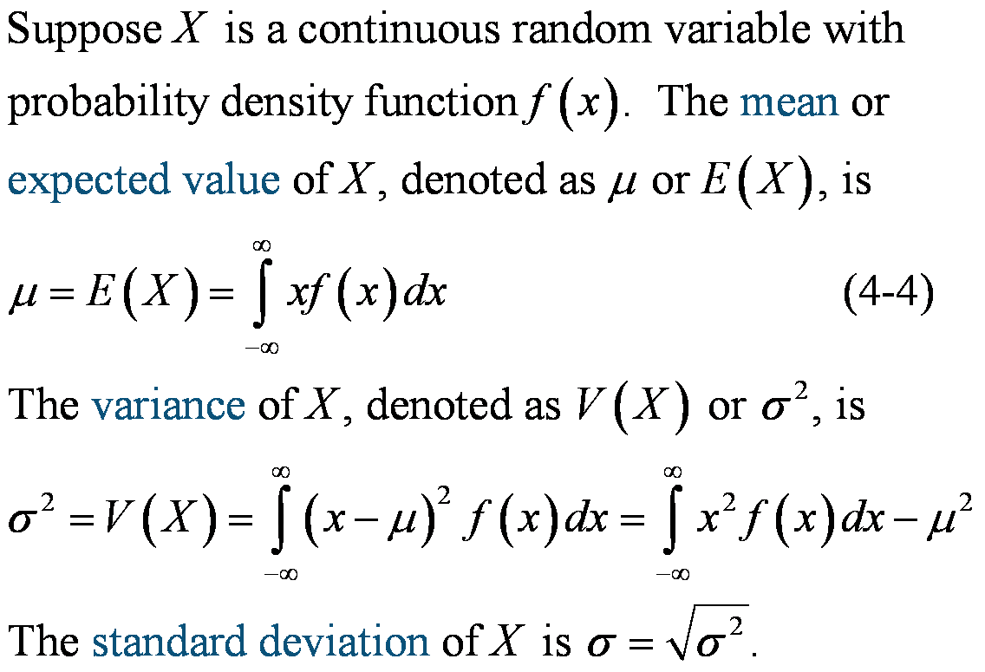
Mean & Variance

Slide 12
Example 4-6: Electric Current
For the copper wire current measurement, the
PDF is f(x) = 0.05 for 0 ≤ x ≤ 20. Find the mean
and variance.

Slide 13
Mean of a Function of a Continuous Random Variable
Example 4-7:
Let X be the current measured in mA. The PDF is f(x) = 0.05 for 0 ≤ x ≤ 20. What is the expected value of power when the resistance is 100 ohms? Use the result that power in watts P = 10⁻⁶RI², where I is the current in milliamperes and R is the resistance in ohms. Now, h(X) = 10⁻⁶100X².

Slide 14
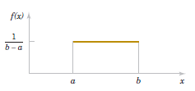
Continuous Uniform Distribution
This is the simplest continuous distribution and analogous to its discrete counterpart.
A continuous random variable X with probability density function
f(x) = 1 / (b-a) for a ≤ x ≤ b
Figure 4-8 Continuous uniform Probability Density Function

Slide 15
Mean & Variance
Mean & variance are:

Slide 16

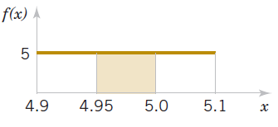
Example 4-9: Uniform Current
The random variable X has a continuous uniform distribution on
[4.9, 5.1]. The probability density function of X is f(x) = 5, 4.9 ≤ x
≤ 5.1. What is the probability that a measurement of current is
between 4.95 & 5.0 mA?
The mean and variance formulas can be applied with a = 4.9 and b = 5.1. Therefore,
Figure 4-9

Slide 17
Cumulative distribution function of Uniform distribution
Figure 4-6 Cumulative distribution function

Slide 18
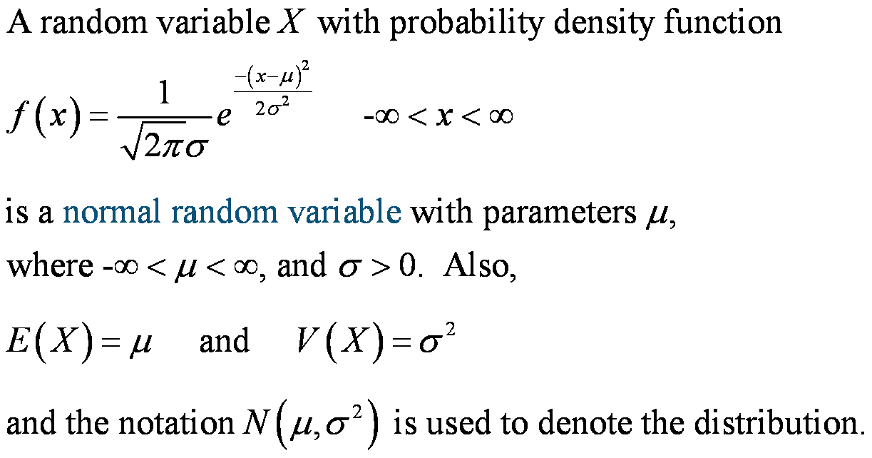
Normal Distribution

Slide 19
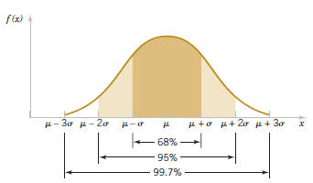
Empirical Rule
For any normal random variable,
P(μ – σ < X < μ + σ) = 0.6827
P(μ – 2σ < X < μ + 2σ) = 0.9545
P(μ – 3σ < X < μ + 3σ) = 0.9973
Figure 4-12 Probabilities associated with a normal distribution

Slide 20
Standard Normal Random Variable
A normal random variable with
μ = 0 and σ² = 1
is called a standard normal random variable
and is denoted as Z. The cumulative
distribution function of a standard normal
random variable is denoted as:
Φ(z) = P(Z ≤ z)
Values are found in Appendix Table III and
by using Excel and Minitab.

Slide 21

Example 4-11: Standard Normal Distribution
Assume Z is a standard normal random variable.
Find P(Z ≤ 1.50). Answer: 0.93319
Find P(Z ≤ 1.53). Answer: 0.93699
Find P(Z ≤ 0.02). Answer: 0.50398
Figure 4-13 Standard normal Probability density function
NOTE : The column headings refer to the hundredths digit of the value of z in P(Z ≤ z).
For example, P(Z ≤ 1.53) is found by reading down the z column to the row 1.5 and then selecting the probability from the column labeled 0.03 to be 0.93699.

Slide 22
Standardizing a Normal Random Variable

Slide 23
Example 4-14: Normally Distributed Current-1
Suppose that the current measurements in a strip of wire are assumed
to follow a normal distribution with μ = 10 and σ = 2 mA, what is the
probability that the current measurement is between 9 and 11 mA?
Answer:

Slide 24
Example 4-14: Normally Distributed Current-2
Determine the value for which the probability that a current
measurement is below 0.98.
Answer:

Slide 25
Normal Approximations
The binomial and Poisson distributions become more bell-shaped and symmetric as their mean value increase.
For manual calculations, the normal approximation is practical – exact probabilities of the binomial and Poisson, with large means, require technology (Minitab, Excel).
The normal distribution is a good approximation for:
  Binomial if np > 5 and n(1-p) > 5.
  Poisson if λ > 5.

Slide 26
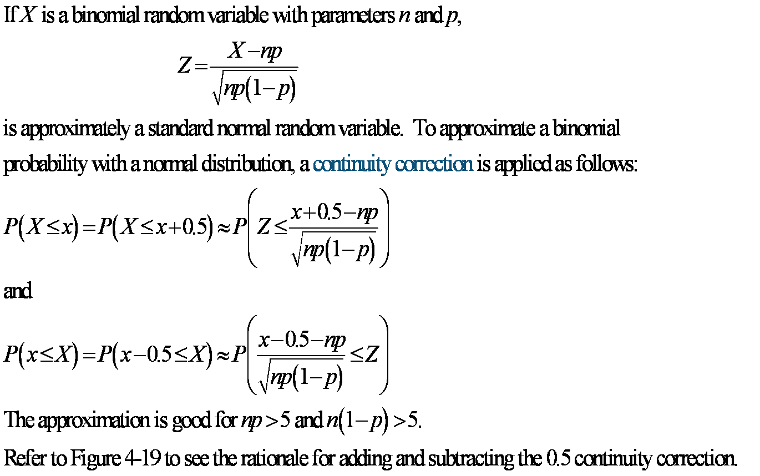
Normal Approximation to the Binomial Distribution

Slide 27
Example 4-18: Applying the Approximation
In a digital communication channel, assume that the number of bits received in
error can be modeled by a binomial random variable. The probability that a bit
is received in error is 10⁻⁵. If 16 million bits are transmitted, what is the
probability that 150 or fewer errors occur?

Slide 28
Normal Approximation to Hypergeometric
Recall that the hypergeometric distribution is
similar to the binomial such that p = K / N and
when sample sizes are small relative to population
size. Thus the normal can be used to approximate
the hypergeometric distribution.

Slide 29
Normal Approximation to the Poisson

Slide 30
Example 4-20: Normal Approximation to Poisson
Assume that the number of asbestos particles in a square meter of dust
on a surface follows a Poisson distribution with a mean of 1000. If a
square meter of dust is analyzed, what is the probability that 950 or
fewer particles are found?

Slide 31
Exponential Distribution Definition
The random variable X that equals the distance
between successive events of a Poisson
process with mean number of events λ > 0 per
unit interval is an exponential random variable
with parameter λ. The probability density
function of X is:
f(x) = λe^{-λx} for 0 ≤ x < 

Slide 32
Exponential distribution - Mean & Variance
Note:
Poisson distribution : Mean and variance are same.
Exponential distribution : Mean and standard deviation
are same.

Slide 33
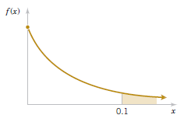
Example 4-21: Computer Usage-1
In a large corporate computer network, user log-ons to the system can be
modeled as a Poisson process with a mean of 25 log-ons per hour. What is
the probability that there are no log-ons in the next 6 minutes (0.1 hour)?
Let X denote the time in hours from the start of the interval until the first
log-on.
Figure 4-23 Desired probability

Slide 34
Example 4-21: Computer Usage-2
Continuing, what is the probability that the time
until the next log-on is between 2 and 3 minutes
(0.033 & 0.05 hours)?

Slide 35
Example 4-21: Computer Usage-3
Continuing, what is the interval of time such that the probability that no log-on occurs during the interval is 0.90?
What is the mean and standard deviation of the time until the next log-in?

Slide 36
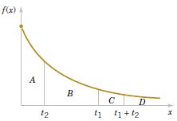
Lack of Memory Property
An interesting property of an exponential random variable
concerns conditional probabilities.
For an exponential random variable X,
P(X<t₁+t₂|X>t₁)= P(X < t₂)
Figure 4-24 Lack of memory property of an exponential distribution.

Slide 37
Example 4-22: Lack of Memory Property
Let X denote the time between detections of a particle with a Geiger
counter. Assume X has an exponential distribution with E(X) = 1.4
minutes. What is the probability that a particle is detected in the next
30 seconds?
No particle has been detected in the last 3 minutes. Will the probability
increase since it is “due”?
No, the probability that a particle will be detected depends only on the
interval of time, not its detection history.

Slide 38
Erlang & Gamma Distributions
The Erlang distribution is a generalization of the exponential distribution.
The exponential distribution models the interval to the 1st event, while the Erlang distribution models the interval to the r^{th} event, i.e., a sum of exponentials.
If r is not required to be an integer, then the distribution is called gamma.
The exponential, as well as its Erlang and gamma generalizations, is based on the Poisson process.

Slide 39
Example 4-23: Processor Failure
The failures of CPUs of large computer systems are often modeled as
a Poisson process. Assume that units that fail are repaired immediately
and the mean number of failures per hour is 0.0001. Let X denote the
time until 4 failures occur. What is the probability that X exceed 40,000
hours?
Let the random variable N denote the number of failures in 40,000
hours. The time until 4 failures occur exceeds 40,000 hours if and only
if the number of failures in 40,000 hours is ≤ 3.

Slide 40
Erlang Distribution
Generalizing from the prior exercise:

Slide 41
Gamma Function
The gamma function is the generalization of the
factorial function for r > 0, not just non-negative
integers.

Slide 42
Gamma Distribution
The random variable X with probability
density function:
is a gamma random variable with parameters
λ > 0 and r > 0. If r is an integer, then X has
an Erlang distribution.

Slide 43
Mean & Variance of the Gamma
If X is a gamma random variable with
parameters λ and r,
μ = E(X) = r / λ
and
σ² = V(X) = r / λ²

Slide 44
Example 4-24: Gamma Application-1
The time to prepare a micro-array slide for high-output genomics is a Poisson
process with a mean of 2 hours per slide. What is the probability that 10 slides
require more than 25 hours?
Let X denote the time to prepare 10 slides. Because of the assumption of a
Poisson process, X has a gamma distribution with λ = ½, r = 10, and the
requested probability is P(X > 25).
Using the Poisson distribution, let the random variable N denote the number of
slides made in 10 hours. The time until 10 slides are made exceeds 25 hours if
and only if the number of slides made in 25 hours is ≤ 9.

Slide 45
Example 4-24: Gamma Application-2
Using the gamma distribution, the same result is obtained.
What is the mean and standard deviation of the time to prepare 10 slides?

Slide 46
Example 4-24: Gamma Application-3
The slides will be completed by what length of time with 95% probability? That is: P(X ≤ x) = 0.95
Minitab: Graph > Probability Distribution Plot > View Probability

Slide 47
Weibull Distribution

Slide 48
Example 4-25: Bearing Wear
The time to failure (in hours) of a bearing in a mechanical shaft is modeled as a Weibull random variable with β = ½ and δ = 5,000 hours.
What is the mean time until failure?
What is the probability that a bearing will last at least 6,000 hours?
Only 33.4% of all bearings last at least 6000 hours.

Slide 49
Lognormal Distribution
Let W denote a normal random variable with mean θ and
variance ω², then X = exp(W) is a lognormal random
variable with probability density function

Slide 50
Example 4-26: Semiconductor Laser-1
The lifetime of a semiconductor laser has a lognormal
distribution with θ = 10 and ω = 1.5 hours.
What is the probability that the lifetime exceeds 10,000 hours?

Slide 51
Example 4-26: Semiconductor Laser-2
What lifetime is exceeded by 99% of lasers?
What is the mean and variance of the lifetime?

Slide 52
Beta Distribution
The random variable X with probability density function
is a beta random variable with parameters α > 0 and β > 0.

Slide 53
Example 4-27: Beta Computation-1
Consider the completion time of a large commercial real estate
development. The proportion of the maximum allowed time to
complete a task is a beta random variable with α = 2.5 and β = 1.
What is the probability that the proportion of the maximum time
exceeds 0.7?
Let X denote the proportion.

Slide 54
Mean & Variance of the Beta Distribution
If X has a beta distribution with parameters α and β,
Example 4-28: In the above example, α = 2.5 and β = 1. What are the mean and variance of this distribution?

Slide 55
Mode of the Beta Distribution
If α >1 and β > 1, then the beta distribution is mound-shaped and has
an interior peak, called the mode of the distribution. Otherwise, the
mode occurs at an endpoint.
For the above Example 4.28 the mode is

Slide 56
Important Terms & Concepts of Chapter 4
Beta distribution
Chi-squared distribution
Continuity correction
Continuous uniform distribution
Cumulative probability distribution for a continuous random variable
Erlang distribution
Exponential distribution
Gamma distribution
Lack of memory property of a continuous random variable
Lognormal distribution
Mean for a continuous random variable
Mean of a function of a continuous random variable
Normal approximation to binomial & Poisson probabilities
Normal distribution
Probability density function
Probability distribution of a continuous random variable
Standard deviation of a continuous random variable
Standardizing
Standard normal distribution
Variance of a continuous random variable
Weibull distribution

