Slide 1

Applied Statistics and Probability for Engineers
Sixth Edition
Douglas C. Montgomery George C. Runger
Chapter 5
Joint Probability Distributions

Slide 2
5
Joint Probability Distributions
CHAPTER OUTLINE
5-1 Two or More Random Variables
5-1.1 Joint Probability Distributions
5-1.2 Marginal Probability Distributions
5-1.3 Conditional Probability Distributions
5-1.4 Independence
5-1.5 More Than Two Random Variables
5-2 Covariance and Correlation
5-3 Common Joint Distributions
5-3.1 Multinomial Probability Distribution
5-3.2 Bivariate Normal Distribution
5-4 Linear Functions of Random Variables
5-5 General Functions of Random Variables
5-6 Moment Generating Functions

Slide 3
Learning Objectives for Chapter 5
After careful study of this chapter, you should be able to do the
following:
Use joint probability mass functions and joint probability density functions to calculate probabilities.
Calculate marginal and conditional probability distributions from joint probability distributions.
Interpret and calculate covariances and correlations between random variables.
Use the multinomial distribution to determine probabilities.
Properties of a bivariate normal distribution and to draw contour plots for the probability density function.
Calculate means and variances for linear combinations of random variables, and calculate probabilities for linear combinations of normally distributed random variables.
Determine the distribution of a general function of a random variable.
Calculate moment generating functions and use them to determine moments and distributions

Slide 4
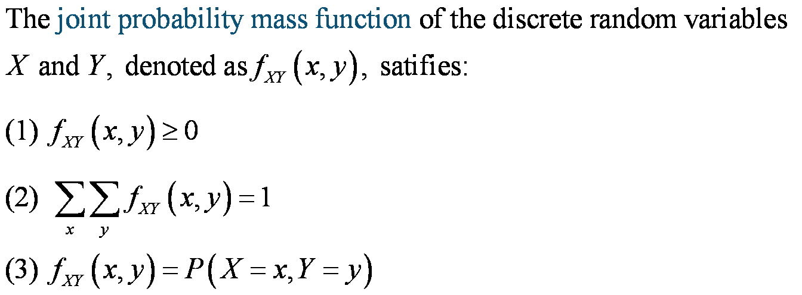
Joint Probability Mass Function

Slide 5
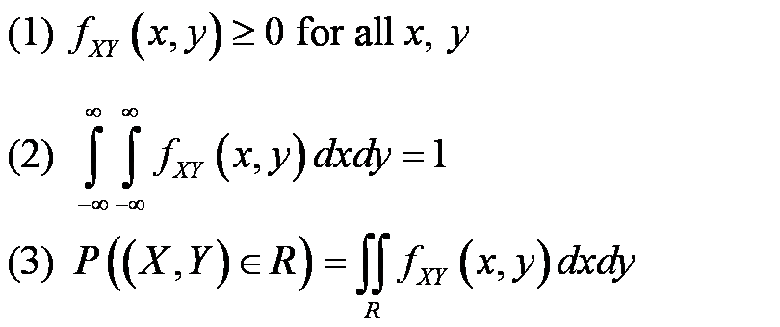
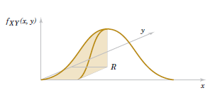
Joint Probability Density Function
The joint probability density function for the continuous random variables X and Y, denotes as f_{XY}(x,y), satisfies the following properties:
Figure 5-2 Joint probability density function for the random variables X and Y. Probability that (X, Y) is in the region R is determined by the volume of f_{XY}(x,y) over the region R.

Slide 6
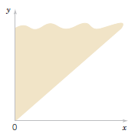
Example 5-2: Server Access Time-1
Let the random variable X denote the time until a computer
server connects to your machine (in milliseconds), and let Y
denote the time until the server authorizes you as a valid user (in
milliseconds). X and Y measure the wait from a common
starting point (x < y). The joint probability density function for X
and Y is
Figure 5-4 The joint probability density function of X and Y is nonzero over the shaded region where x < y.

Slide 7
Example 5-2: Server Access Time-2
The region with nonzero probability is shaded in
Fig. 5-4. We verify that it integrates to 1 as follows:

Slide 8
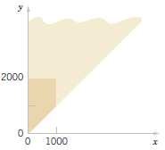
Example 5-2: Server Access Time-3
Now calculate a probability:
Figure 5-5 Region of integration for the probability that X < 1000 and Y < 2000 is darkly shaded.

Slide 9
Marginal Probability Distributions (discrete)
The marginal probability distribution for X is found by summing the probabilities
in each column whereas the marginal probability distribution for Y is found by
summing the probabilities in each row.
Marginal probability distributions of X and Y

Slide 10
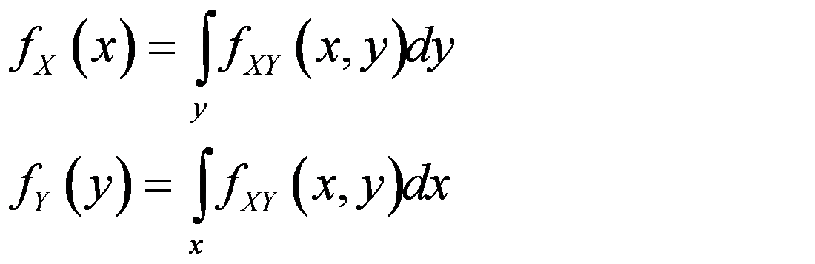
Marginal Probability Density Function (continuous)
If the joint probability density function of
random variables X and Y is f_{XY}(x,y), the
marginal probability density functions of X
and Y are:

Slide 11
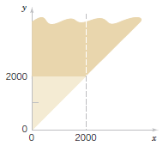
Example 5-4: Server Access Time-1
For the random variables that
denotes times in Example 5-2,
find the probability that Y
exceeds 2000 milliseconds.
Integrate the joint PDF directly
using the picture to determine
the limits.

Slide 12
Example 5-4: Server Access Time-2
Alternatively, find the marginal PDF and then integrate that to find the desired probability.

Slide 13
Mean & Variance of a Marginal Distribution
E(X) and V(X) can be obtained by first calculating the marginal
probability distribution of X and then determining E(X) and V(X) by
the usual method.

Slide 14
Mean & Variance for Example 5-1
E(X) = 2.35 V(X) = 6.15 – 2.35² = 6.15 – 5.52 = 0.6275
E(Y) = 2.49 V(Y) = 7.61 – 2.49² = 7.61 – 16.20 = 1.4099

Slide 15
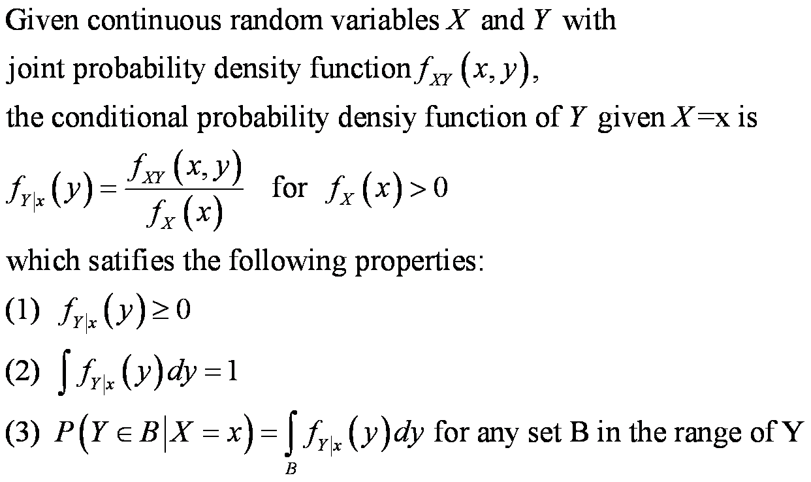
Conditional Probability Density Function

Slide 16
Example 5-6: Conditional Probability-1
From Example 5-2, determine the conditional PDF for Y given X=x.

Slide 17
Example 5-6: Conditional Probability-2
Now find the probability that Y exceeds 2000 given that X=1500:

Slide 18
Mean & Variance of Conditional Random Variables
The conditional mean of Y given X = x, denoted as E(Y|x) or μ_{Y|x} is
The conditional variance of Y given X = x, denoted as V(Y|x) or σ²_{Y|x} is

Slide 19
Example 5-8: Conditional Mean And Variance
From Example 5-2 & 5-6, what is the conditional mean for
Y given that x = 1500?
If the connect time is 1500 ms, then the expected time to be authorized is 2000 ms.

Slide 20
Example 5-9
For the discrete random variables in Exercise 5-1,
what is the conditional mean of Y given X=1?
The mean number of attempts given one bar is 3.55 with variance of 0.7475.

Slide 21
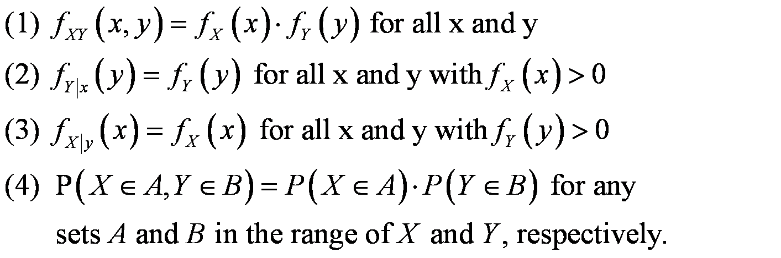
Independent Random Variables
For random variables X and Y, if any one of the
following properties is true, the others are also true.
Then X and Y are independent.

Slide 22
Example 5-11: Independent Random Variables
Suppose the Example 5-2 is modified such that the joint PDF is:
Are X and Y independent?
Find the probability

Slide 23
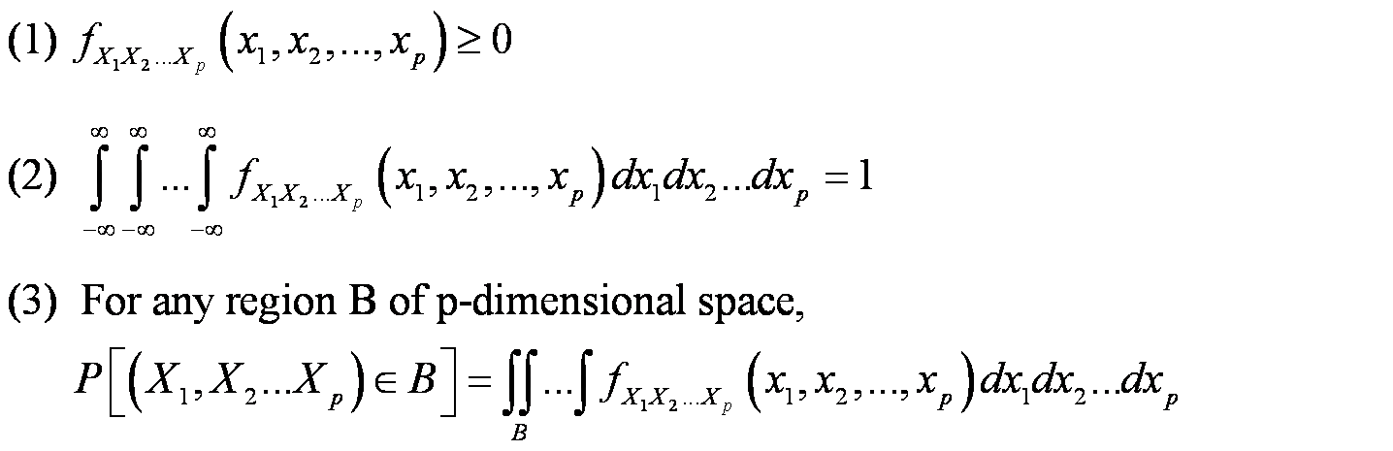
Joint Probability Density Function
The joint probability density function for the continuous random variables X₁, X₂, X₃, …X_{p}, denoted as
satisfies the following properties:

Slide 24
Example 5-14: Component Lifetimes
In an electronic assembly, let X₁, X₂, X₃, X₄ denote
the lifetimes of 4 components in hours. The joint
PDF is:
What is the probability that the device operates
more than 1000 hours?
The joint PDF is a product of exponential PDFs.
  P(X₁ > 1000, X₂ > 1000, X₃ > 1000, X₄ > 1000)
  = e^{-1-2-1.5-3} = e^{-7.5} = 0.00055

Slide 25
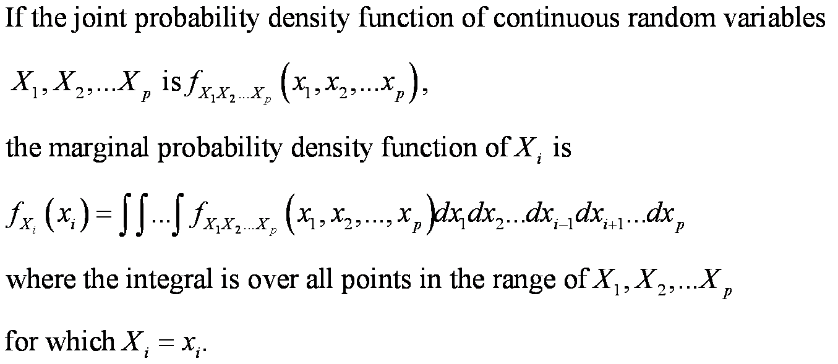
Marginal Probability Density Function

Slide 26
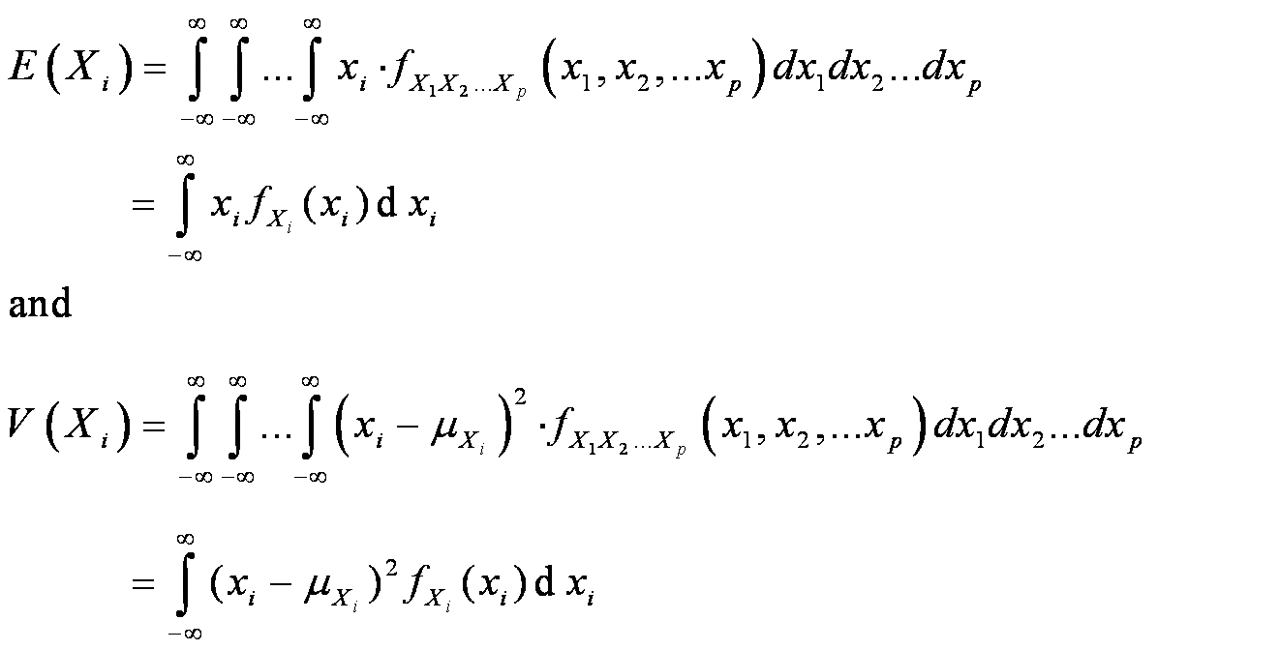
Mean & Variance of a Joint Distribution
The mean and variance of X_{i} can be
determined from either the marginal PDF, or
the joint PDF as follows:

Slide 27
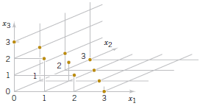
Example 5-16
Points that have positive probability in the
joint probability distribution of three random
variables X1 , X2 , X3 are shown in Figure.
Suppose the 10 points are equally likely
with probability 0.1 each. The range is the
non-negative integers with x₁+x₂+x₃ = 3
List the marginal PDF of X₂
Also, E(x₂) = 0(0.4) + 1(0.3) + 2(0.2) + 3(0.1) = 1

Slide 28
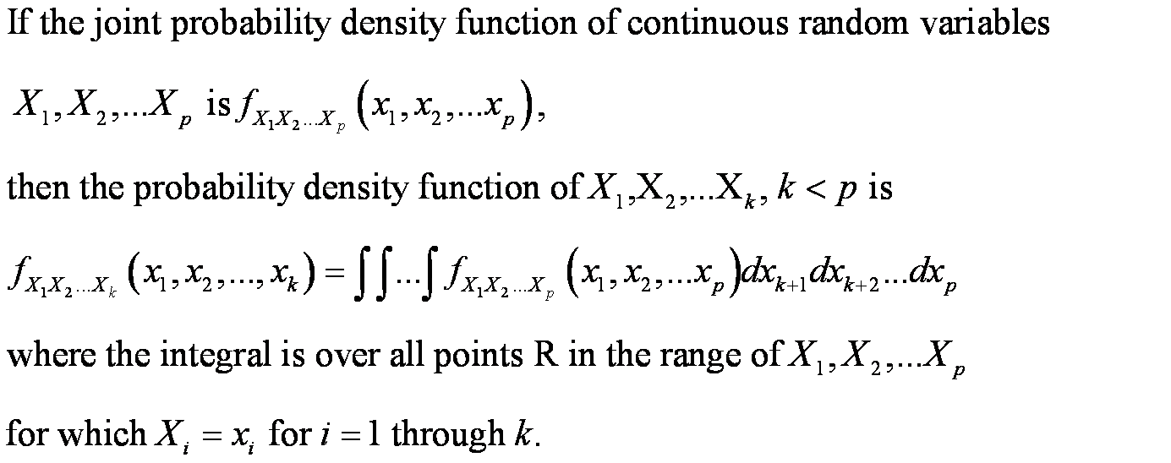
Distribution of a Subset of Random Variables

Slide 29
Conditional Probability Distributions
Conditional probability distributions can be developed for multiple random variables by extension of the ideas used for two random variables.
Suppose p = 5 and we wish to find the distribution conditional on X₄ and X₅.

Slide 30
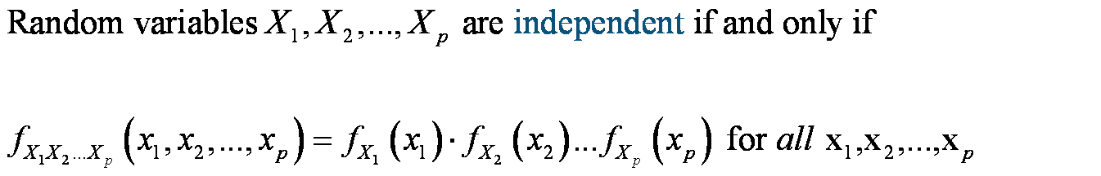
Independence with Multiple Variables
The concept of independence can be extended to
multiple variables.

Slide 31
Example 5-18: Layer Thickness
Suppose X₁,X₂, and X₃ represent the thickness in μm of a
substrate, an active layer and a coating layer of a chemical
product. Assume that these variables are independent and
normally distributed with parameters and specified limits as
tabled.
What proportion of the product meets all specifications?
Answer: 0.7783, 3 layer product.
Which one of the three thicknesses has the least probability of meeting specs?
Answer: Layer 3 has least prob.

Slide 32
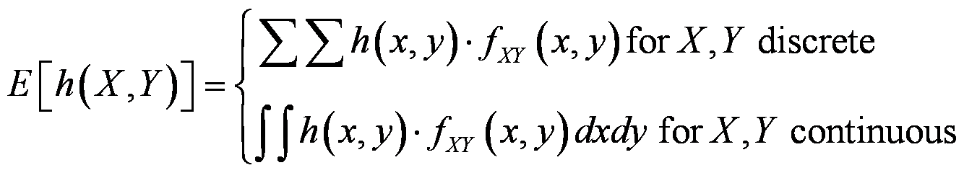
Covariance
Covariance is a measure of the relationship between two random variables.
First, we need to describe the expected value of a function of two random variables. Let h(X, Y) denote the function of interest.

Slide 33
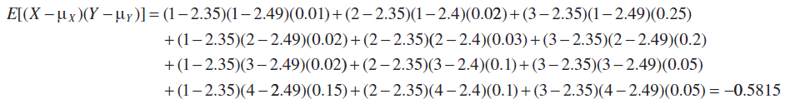
Example 5-19: Expected Value of a Function of Two Random Variables
For the joint probability distribution of the two random variables in Example 5-1, calculate E [(X-μ_{X})(Y-μ_{Y})].
The result is obtained by multiplying x - μ_{X} times y - μ_{Y}, times f_{xy}(X,Y) for each point in the range of (X,Y). First, μ_{X} and μ_{y} were determined previously from the marginal distributions for X and Y:
μ_{X} = 2.35 and μ_{y} = 2.49
Therefore,

Slide 34
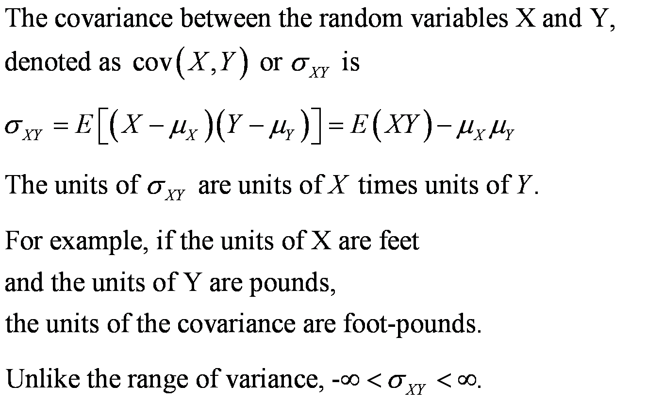
Covariance Defined

Slide 35
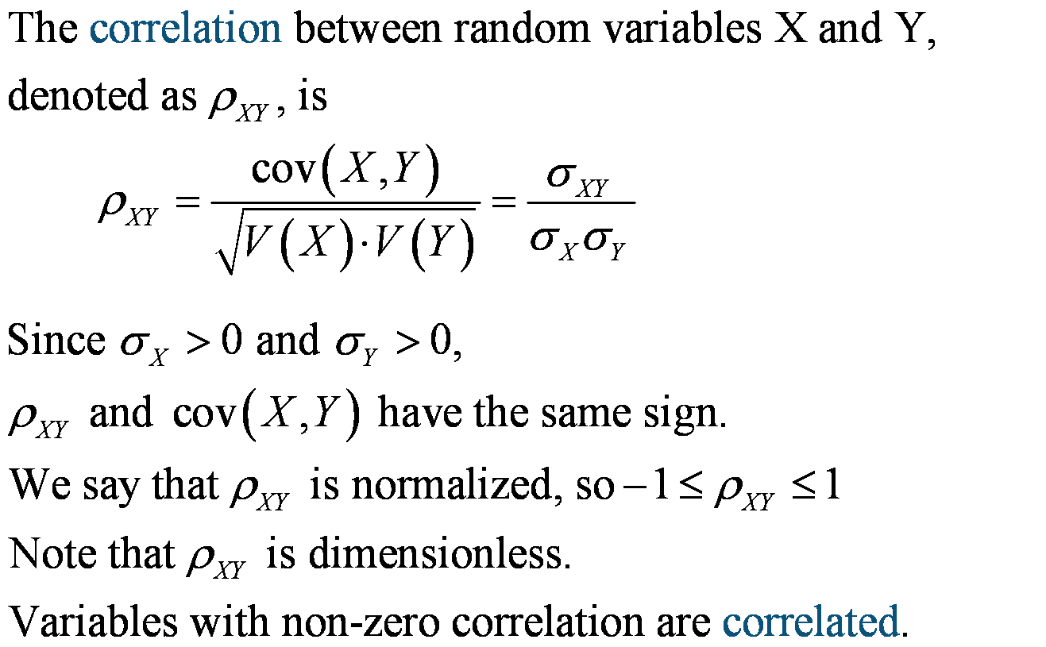
Correlation (ρ = rho)

Slide 36
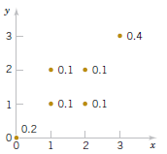
Example 5-21: Covariance & Correlation
Determine the covariance
and correlation to the figure
below.
Figure 5-13 Discrete joint distribution, f(x, y).

Slide 37
Independence Implies ρ = 0
If X and Y are independent random variables,
σ_{XY} = ρ_{XY} = 0
ρ_{XY} = 0 is necessary, but not a sufficient condition for independence.

Slide 38
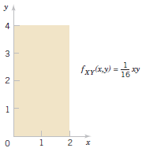
Example 5-23: Independence Implies Zero Covariance
Figure 5-15 A planar joint distribution.

Slide 39
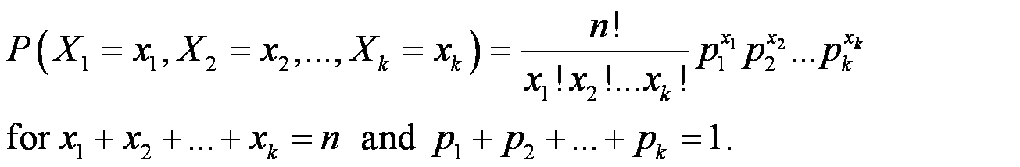
Multinomial Probability Distribution
Suppose a random experiment consists of a series of n trials. Assume that:
  The outcome of each trial can be classifies into one of k classes.
  The probability of a trial resulting in one of the k outcomes is constant, and equal to p₁, p₂, …, p_{k}.
  The trials are independent.
The random variables X₁, X₂,…, X_{k} denote the number of outcomes in each class and have a multinomial distribution and probability mass function:

Slide 40
Example 5-25: Digital Channel
Of the 20 bits received over a digital channel, 14 are of excellent
quality, 3 are good, 2 are fair, 1 is poor. The sequence received was
EEEEEEEEEEEEEEGGGFFP. Let the random variables X1 , X2 , X3,
and X4 denote the number of bits that are E, G, F , and P, respectively,
in a transmission of 20 bits. What is the probability that 12 bits are E, 6
bits are G, 2 are F, and 0 are P?

Slide 41
Multinomial Mean and Variance
The marginal distributions of the multinomial
are binomial.
If X₁, X₂,…, X_{k} have a multinomial distribution,
the marginal probability distributions of X_{i} is
binomial with:
E(X_{i}) = np_{i} and V(X_{i}) = np_{i}(1-p_{i})

Slide 42
Bivariate Normal Probability Density Function
The probability density function of a bivariate normal distribution is

Slide 43
Marginal Distributions of the Bivariate Normal Random Variables
If X and Y have a bivariate normal distribution with
joint probability density function
f_{XY}(x,y;σ_{X},σ_{Y},μ_{X},μ_{Y},ρ)
the marginal probability distributions of X and Y
are normal with means μ_{X} and μ_{Y} and standard
deviations σ_{X} and σ_{Y}, respectively.

Slide 44
Conditional Distribution of Bivariate Normal Random Variables
If X and Y have a bivariate normal distribution with
joint probability density f_{XY}(x,y;σ_{X},σ_{Y},μ_{X},μ_{Y},ρ), the
conditional probability distribution of Y given X = x is
normal with mean and variance as follows:

Slide 45
Correlation of Bivariate Normal Random Variables
If X and Y have a bivariate normal
distribution with joint probability density
function f_{XY}(x,y;σ_{X},σ_{Y},μ_{X},μ_{Y},ρ), the
correlation between X and Y is ρ.

Slide 46
Bivariate Normal Correlation and Independence
In general, zero correlation does not imply independence.
But in the special case that X and Y have a bivariate normal distribution, if ρ = 0, then X and Y are independent.
If X and Y have a bivariate normal
distribution with ρ=0, X and Y are
independent.

Slide 47
Linear Functions of Random Variables
A function of random variables is itself a random variable.
A function of random variables can be formed by either linear or nonlinear relationships. We limit our discussion here to linear functions.
Given random variables X₁, X₂,…,X_{p} and constants c₁, c₂, …, c_{p} Y= c₁X₁ + c₂X₂ + … + c_{p}X_{p} is a linear combination of X₁, X₂,…,X_{p}.

Slide 48
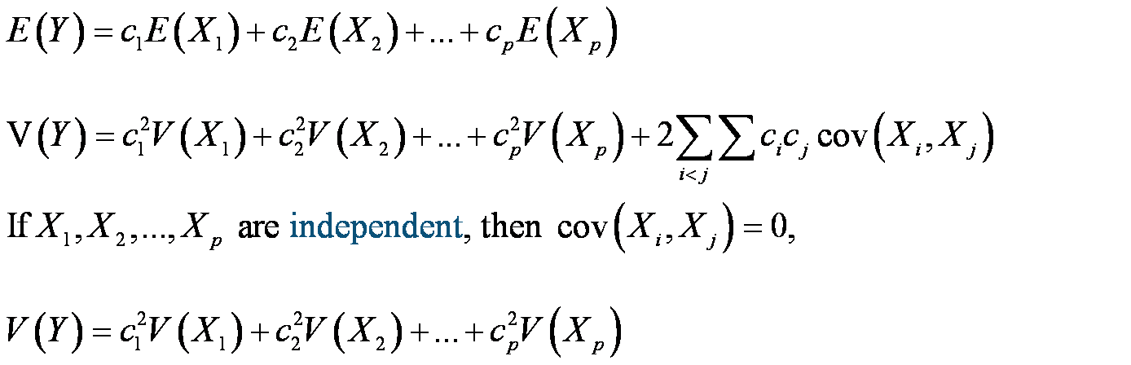
Mean and Variance of a Linear Function
If X₁, X₂,…,X_{p} are random variables, and Y= c₁X₁ + c₂X₂ +
… + c_{p}X_{p} , then

Slide 49
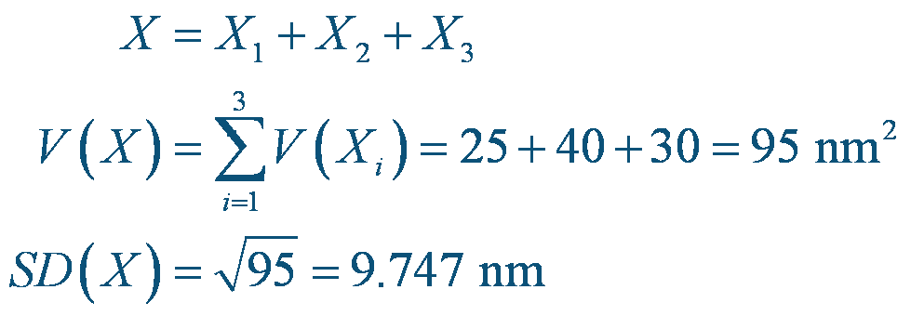
Example 5-31: Error Propagation
A semiconductor product consists of three layers.
The variances of the thickness of each layer is 25,
40 and 30 nm. What is the variance of the finished
product?
Answer:

Slide 50
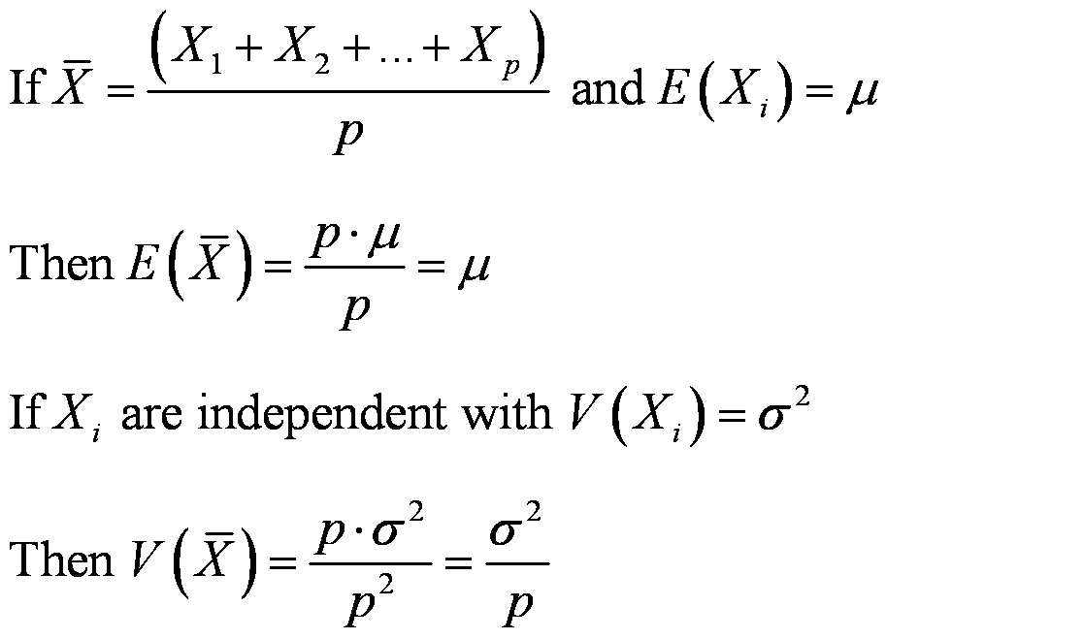
Mean and Variance of an Average

Slide 51
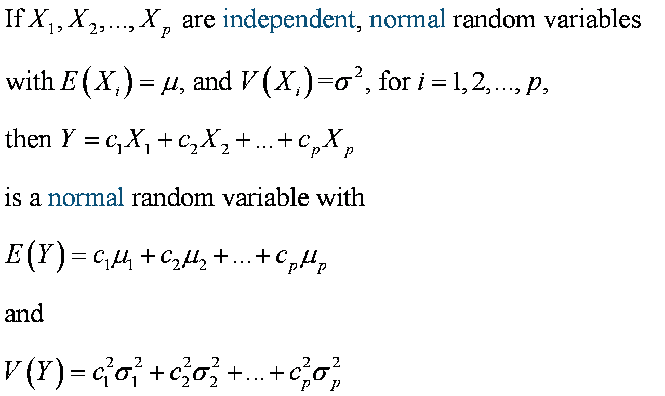
Reproductive Property of the Normal Distribution

Slide 52
Example 5-32: Linear Function of Independent Normal Random variables
Let the random variables X₁ and X₂ denote
the length and width of a manufactured
part. Their parameters are shown in the
table. What is the probability that the
perimeter exceeds 14.5 cm?

Slide 53
General Function of a Discrete Random Variable
Suppose that X is a discrete random variable with probability distribution f_{X}(x). Let Y = h(X) define a one-to-one transformation between the values of X and Y so that the equation y = h(x) can be solved uniquely for x in terms of y. Let this solution be x = u(y), the inverse transform function. Then the probability mass function of the random variable Y is
f_{Y}(y) = f_{X}[u(y)]

Slide 54
Example 5-34: Function of a Discrete Random Variable
Let X be a geometric random variable with probability
distribution
f_{X}(x) = p(1-p)^{x-1} , x = 1, 2, …
Find the probability distribution of Y = X₂.
Solution:
  Since X ≥ 0, the transformation is one-to-one.
  The inverse transform function is X = .
  f_{Y}(y) = p(1-p) ⁻¹ , y = 1, 4, 9, 16,…

Slide 55
General Function of a Continuous Random Variable
Suppose that X is a continuous random variable with probability distribution f_{X}(x). Let Y = h(X) define a one-to-one transformation between the values of X and Y so that the equation y = h(x) can be solved uniquely for x in terms of y. Let this solution be x = u(y), the inverse transform function. Then the probability distribution of Y is
f_{Y}(y) = f_{X}[u(y)]∙|J|
where J = u’(y) is called the Jacobian of the transformation and the absolute value of J is used.

Slide 56
Example 5-35: Function of a Continuous Random Variable
Let X be a continuous random variable with probability distribution:
Find the probability distribution of Y = h(X) = 2X + 4

Slide 57
Definition of Moments about the Origin
The rth moment about the origin of the random variable X is

Slide 58
Definition of a Moment-Generating Function
The moment-generating function of the random variable X is the expected value of e^{tX} and is denoted by M_{X} (t). That is,
Let X be a random variable with moment-generating function M_{X} (t). Then

Slide 59
Example 5-36 Moment-Generating Function for a Binomial Random Variable-1
Let X follows a binomial distribution, that is
Determine the moment generating function and use it to verify that the mean and variance of the binomial random variable are μ=np and σ²=np(1-p).
The moment-generating function is
which is the binomial expansion of
Now the first and second order derivatives will be

Slide 60
Example 5-36 Moment-Generating Function for a Binomial Random Variable-2
If we set t = 0 in the above two equations we get
Now the variance is

Slide 61
Properties of Moment-Generating Function

Slide 62
Example 5-38 Distribution of a Sum of Poisson Random Variables
Suppose that X₁ and X₂ are two independent Poisson random variables with parameters λ₁ and λ₂, respectively. Determine the probability
distribution of Y = X₁ + X₂.
The moment-generating function of a Poisson random variable with
parameter λ is
Hence for X₁ and X_{2,}
Using , the moment-generating function of Y = X₁ + X₂ is

Slide 63
Important Terms & Concepts for Chapter 5
Bivariate distribution
Bivariate normal distribution
Conditional mean
Conditional probability density function
Conditional probability mass function
Conditional variance
Contour plots
Correlation
Covariance
Error propagation
General functions of random variables
Independence
Joint probability density function
Joint probability mass function
Linear functions of random variables
Marginal probability distribution
Multinomial distribution
Reproductive property of the normal distribution

