Slide 1

Applied Statistics and Probability for Engineers
Sixth Edition
Douglas C. Montgomery George C. Runger
Chapter 6
Descriptive Statistics

Slide 2
6
Descriptive Statistics
CHAPTER OUTLINE
6-1 Numerical Summaries of
Data
6-2 Stem-and-Leaf Diagrams
6-3 Frequency Distributions
and Histograms
6-4 Box Plots
6-5 Time Sequence Plots
6-6 Probability Plots

Slide 3
Learning Objectives for Chapter 6
After careful study of this chapter, you should be able to do
the following:
Compute and interpret the sample mean, variance, standard deviation, median, and range.
Explain the concepts of sample mean, variance, population mean, and variance.
Construct and interpret visual data displays, including stem-and-leaf display, histogram, and box plot.
Concept of random sampling.
Construct and interpret normal probability plots.
How to use box plots, and other data displays, to visually compare two or more samples of data.
How to use simple time series plots to visually display the important features of time-oriented data.

Slide 4
Numerical Summaries of Data
Data are the numeric observations of a phenomenon of interest. The totality of all observations is a population. A portion used for analysis is a random sample.
We gain an understanding of this collection, possibly massive, by describing it numerically and graphically, usually with the sample data.
We describe the collection in terms of shape, outliers, center, and spread (SOCS).
The center is measured by the mean.
The spread is measured by the variance.

Slide 5
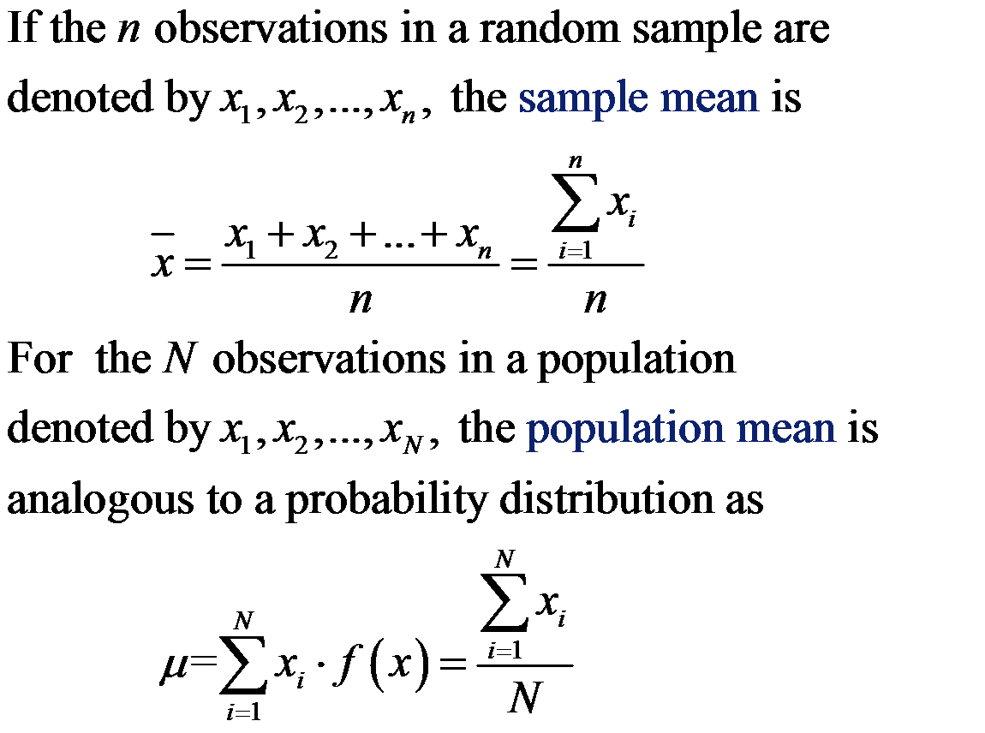
Sample Mean

Slide 6
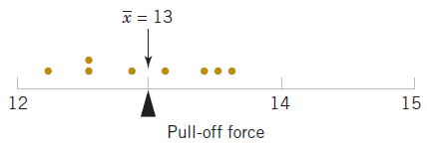
Example 6-1: Sample Mean
Consider 8 observations (x_{i}) of pull-off force from
engine connectors as shown in the table.
Figure 6-1 The sample mean is the balance point.

Slide 7
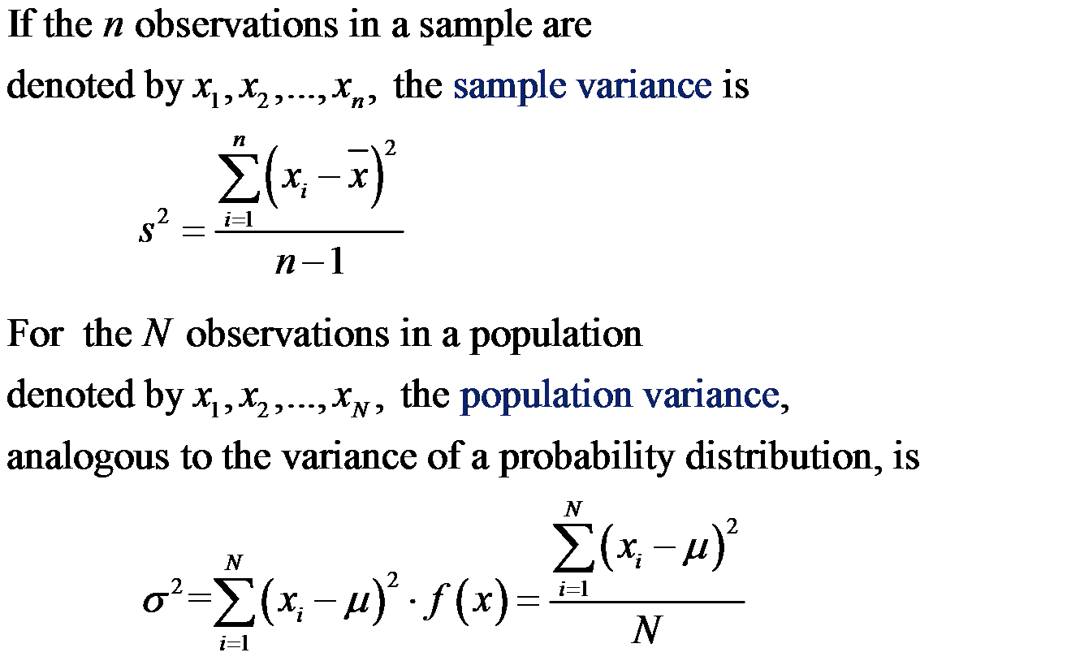
Variance Defined

Slide 8
Standard Deviation Defined
The standard deviation is the square root of the variance.
σ is the population standard deviation symbol.
s is the sample standard deviation symbol.

Slide 9
Example 6-2: Sample Variance
Table 6-1 displays the quantities needed to calculate the
sample variance and sample standard deviation.
Dimension of:
x_{i} is pounds
Mean is pounds.
Variance is pounds².
Standard deviation is pounds.
Desired accuracy is generally accepted to be one more place than the data.
Table 6-1

Slide 10
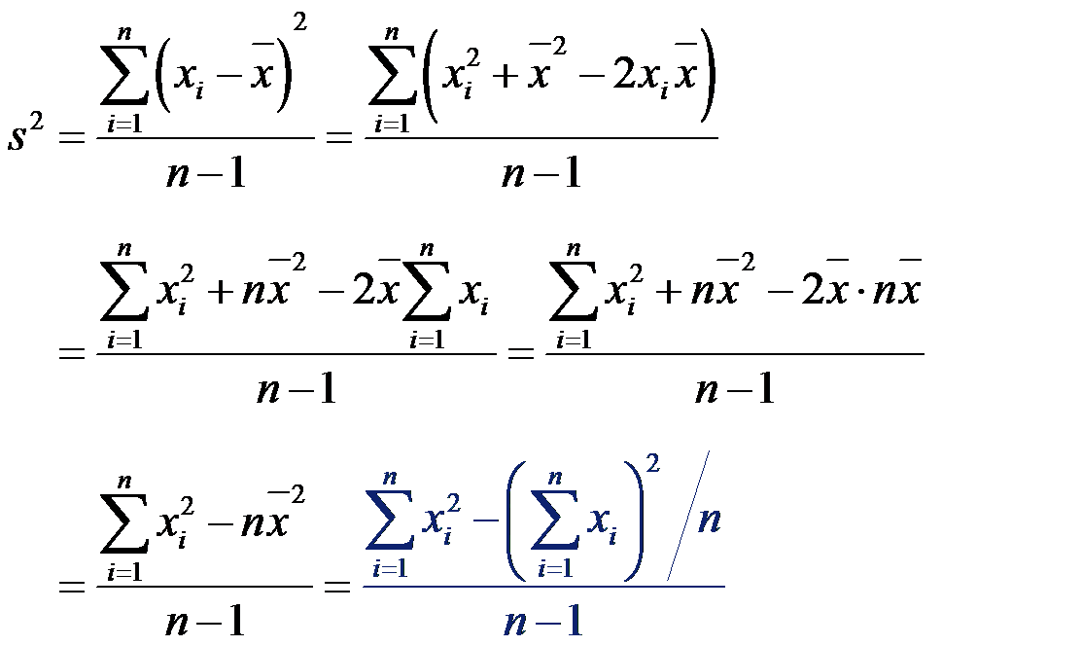
Computation of s²
The prior calculation is definitional and tedious. A
shortcut is derived here and involves just 2 sums.

Slide 11
Example 6-3: Variance by Shortcut

Slide 12
What is this “n–1”?
The population variance is calculated with N, the population size. Why isn’t the sample variance calculated with n, the sample size?
The true variance is based on data deviations from the true mean, μ.
The sample calculation is based on the data deviations from x-bar, not μ. X-bar is an estimator of μ; close but not the same. So the n-1 divisor is used to compensate for the error in the mean estimation.

Slide 13
Degrees of Freedom
The sample variance is calculated with the quantity n-1.
This quantity is called the “degrees of freedom”.
Origin of the term:
  There are n deviations from x-bar in the sample.
  The sum of the deviations is zero.
  n-1 of the observations can be freely determined, but the n^{th} observation is fixed to maintain the zero sum.

Slide 14
Sample Range
If the n observations in a sample are denoted
by x₁, x₂, …, x_{n}, the sample range is:
r = max(x_{i}) – min(x_{i}) (6-6)
It is the largest observation in the sample minus
the smallest observation.
From Example 6-3:
r = 13.6 – 12.3 = 1.30
Note that: population range ≥ sample range

Slide 15
Stem-and-Leaf Diagrams
Dot diagrams (dotplots) are useful for small data sets. Stem & leaf diagrams are better for large sets.
Steps to construct a stem-and-leaf diagram:
  Divide each number (x_{i}) into two parts: a stem, consisting of the leading digits, and a leaf, consisting of the remaining digit.
  List the stem values in a vertical column.
  Record the leaf for each observation beside its stem.
  Write the units for the stems and leaves on the display.

Slide 16
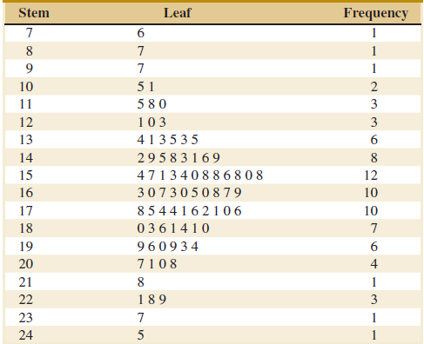
Example 6-4: Alloy Strength
To illustrate the construction of a stem-and-leaf diagram, consider the alloy compressive strength data in Table 6-2.
Figure 6-4 Stem-and-leaf diagram for Table 6-2 data. Center is about 155 and most data is between 110 and 200. Leaves are unordered.

Slide 17
Quartiles
The three quartiles partition the data into four equally sized counts or segments.
  First or lower quartile : 25% of the data is less than q₁.
  Second quartile : 50% of the data is less than q₂, the median.
  Third or upper quartile : 75% of the data is less than q₃.
For the Table 6-2 data:

Slide 18
Percentiles and Interquartile Range
Percentiles are a special case of the quartiles.
Percentiles partition the data into 100 segments.
The interquartile range (IQR) is defined as:
IQR = q₃ – q₁.
From the Quartiles example:
IQR = 181.00 – 143.25 = 37.75 = 37.8
Impact of outlier data:
  IQR is not affected
  Range is directly affected.

Slide 19
Minitab Descriptives
The Minitab selection menu:
Stat > Basic Statistics > Display Descriptive Statistics
calculates the descriptive statistics for a data
set.
For the Table 6-2 data, Minitab produces:

Slide 20
Frequency Distributions
A frequency distribution is a compact summary of data, expressed as a table, graph, or function.
The data is gathered into bins or cells, defined by class intervals.
The number of classes, multiplied by the class interval, should exceed the range of the data. The square root of the sample size is a guide.
The boundaries of the class intervals should be convenient values, as should the class width.

Slide 21
Frequency Distribution Table
Frequency Distribution for the data in Table 6-2
Considerations:
Range = 245 – 76 = 169
Sqrt(80) = 8.9
Trial class width = 18.9
Decisions:
Number of classes = 9
Class width = 20
Range of classes = 20 * 9 = 180
Starting point = 70

Slide 22
Histograms
A histogram is a visual display of a frequency distribution, similar to a bar chart or a stem-and-leaf diagram.
Steps to construct a histogram with equal bin widths:
  Label the bin boundaries on the horizontal scale.
  Mark & label the vertical scale with the frequencies or relative frequencies.
  Above each bin, draw a rectangle whose height is equal to the frequency corresponding to that bin.

Slide 23
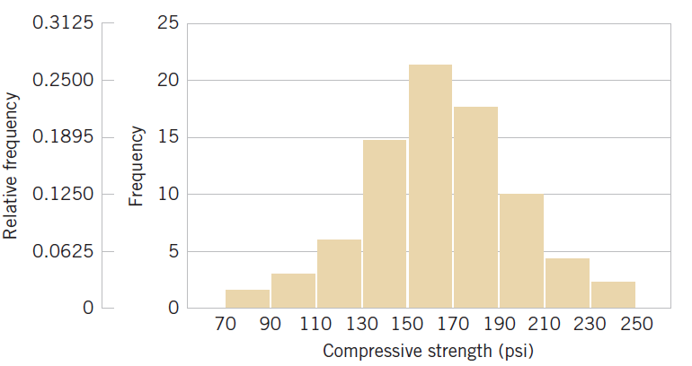
Histogram of the Table 6-2 Data
Figure 6-7 Histogram of compressive strength of 80 aluminum-lithium alloy specimens. Note these features – (1) horizontal scale bin boundaries & labels with units, (2) vertical scale measurements and labels, (3) histogram title at top or in legend.

Slide 24
Histograms with Unequal Bin Widths
If the data is tightly clustered in some regions and scattered in others, it is visually helpful to use narrow class widths in the clustered region and wide class widths in the scattered areas.
In this approach, the rectangle area, not the height, must be proportional to the class frequency.

Slide 25
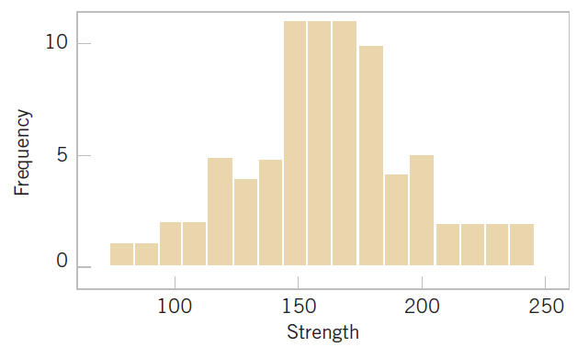
Poor Choices in Drawing Histograms
Figure 6-8 Histogram of compressive strength of 80 aluminum-lithium alloy specimens. Errors: too many bins (17) create jagged shape, horizontal scale not at class boundaries, horizontal axis label does not include units.

Slide 26
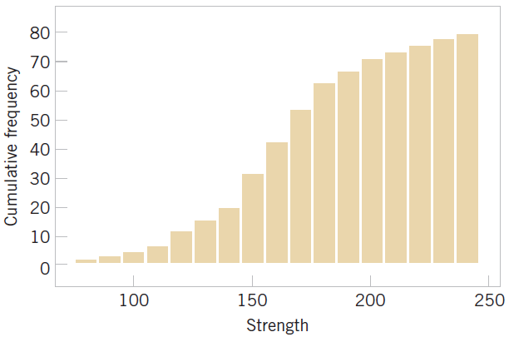
Cumulative Frequency Plot
Figure 6-10 Cumulative histogram of compressive strength of 80 aluminum-lithium alloy specimens. Comment: Easy to see cumulative probabilities, hard to see distribution shape.

Slide 27
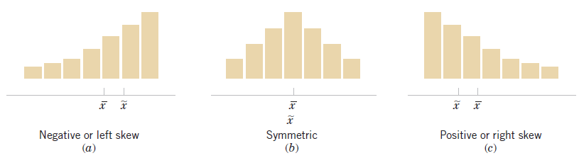
Shape of a Frequency Distribution
Figure 6-11 Histograms of symmetric and skewed distributions.
(b) Symmetric distribution has identical mean, median and mode measures.
(a & c) Skewed distributions are positive or negative, depending on the direction of the long tail. Their measures occur in alphabetical order as the distribution is approached from the long tail.☺

Slide 28
Histograms for Categorical Data
Categorical data is of two types:
  Ordinal: categories have a natural order, e.g., year in college, military rank.
  Nominal: Categories are simply different, e.g., gender, colors.
Histogram bars are for each category, are of equal width, and have a height equal to the category’s frequency or relative frequency.
A Pareto chart is a histogram in which the categories are sequenced in decreasing order. This approach emphasizes the most and least important categories.

Slide 29
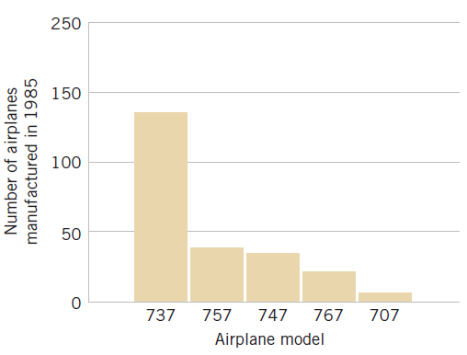
Example 6-6: Categorical Data Histogram
Figure 6-12 Airplane production in 1985. (Source: Boeing Company) Comment: Illustrates nominal data in spite of the numerical names, categories are shown at the bin’s midpoint, a Pareto chart since the categories are in decreasing order.

Slide 30
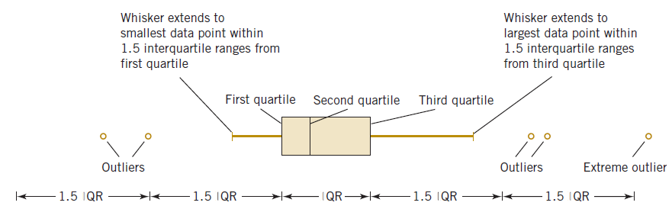
Box Plot or Box-and-Whisker Chart
A box plot is a graphical display showing center, spread, shape, and outliers (SOCS).
It displays the 5-number summary: min, q₁, median, q₃, and max.
Figure 6-13 Description of a box plot.

Slide 31
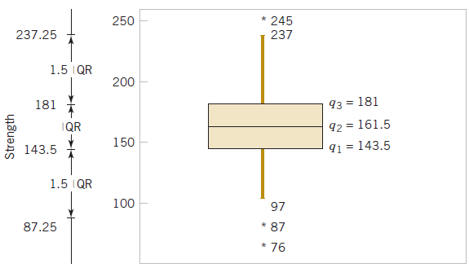
Box Plot of Table 6-2 Data
Figure 6-14 Box plot of compressive strength of 80 aluminum-lithium alloy specimens. Comment: Box plot may be shown vertically or horizontally, data reveals three outliers and no extreme outliers. Lower outlier limit is: 143.5 – 1.5*(181.0-143.5) = 87.25.

Slide 32
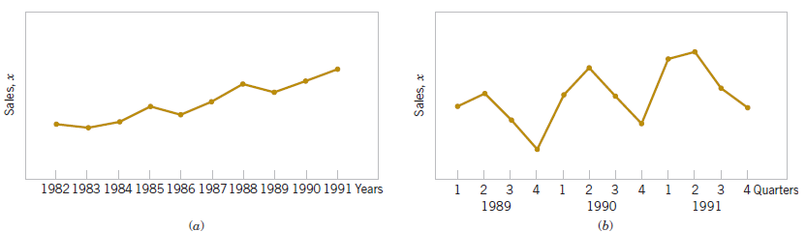
Time Sequence Plots
A time series plot shows the data value, or statistic, on the vertical axis with time on the horizontal axis.
A time series plot reveals trends, cycles or other time-oriented behavior that could not be seen in the data.
Figure 6-16 Company sales by year (a). By quarter (b).

Slide 33
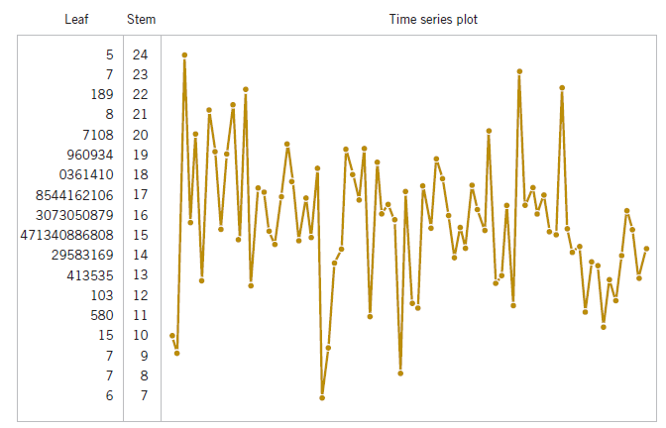
Digidot Plot
Combining a time series plot with some of the other graphical displays that we have considered previously will be very helpful sometimes. The stem-and-leaf plot combined with a time series Plot forms a digidot plot.
Figure 6-17 A digidot plot of the compressive strength data in Table 6-2.

Slide 34
Constructing a Probability Plot
To construct a probability plot:
  Sort the data observations in ascending order: x₍₁₎, x₍₂₎,…, x_{(n)}.
  The observed value x_{(j)} is plotted against the observed cumulative frequency (j – 0.5)/n.
  The paired numbers are plotted on the probability paper of the proposed distribution.
If the paired numbers form a straight line, then the hypothesized distribution adequately describes the data.

Slide 35
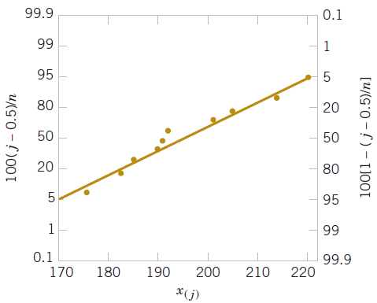
Example 6-7: Battery Life
The effective service life (X_{j} in minutes) of batteries used in a laptop are given in the table. We hypothesize that battery life is adequately modeled by a normal distribution. To this hypothesis, first arrange the observations in ascending order and calculate their cumulative frequencies and plot them.
Figure 6-22 Normal probability plot for battery life.

Slide 36
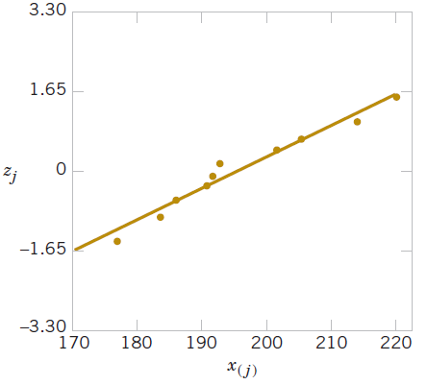
Probability Plot on Standardized Normal Scores
A normal probability plot can be plotted on ordinary axes using z-values. The normal probability scale is not used.
Figure 6-23 Normal Probability plot obtained from standardized normal scores. This is equivalent to Figure 6-19.

Slide 37
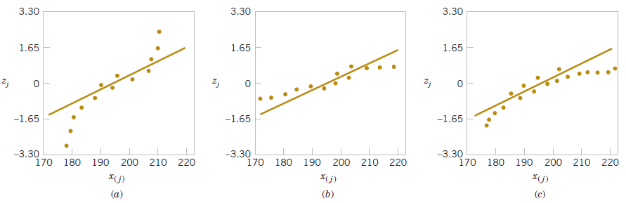
Probability Plot Variations
Figure 6-24 Normal probability plots indicating a non-normal distribution.
Light tailed distribution
Heavy tailed distribution
Right skewed distribution

Slide 38
Probability Plots with Minitab
Obtained using Minitab menu: Graphics > Probability Plot. 14 different
distributions can be used.
The curved bands provide guidance whether the proposed distribution is
acceptable – all observations within the bands is good.

Slide 39
Important Terms & Concepts of Chapter 6
Box plot
Frequency distribution & histogram
Median, quartiles & percentiles
Multivariate data
Normal probability plot
Pareto chart
Population:
  Mean
  Standard deviation
  Variance
Probability plot
Relative frequency distribution
Sample:
  Mean
  Standard deviation
  Variance
Stem-and-leaf diagram
Time series plots

