Slide 1
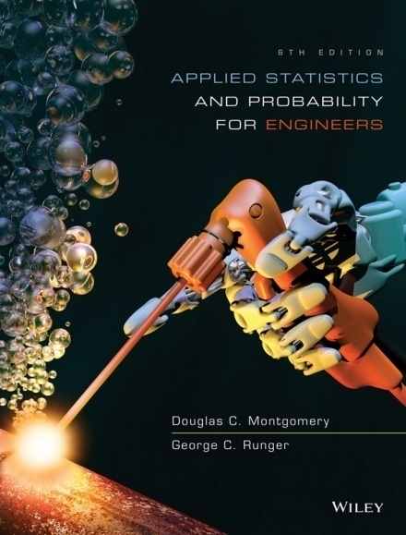
Applied Statistics and Probability for Engineers
Sixth Edition
Douglas C. Montgomery George C. Runger
Chapter 7
Point Estimation of Parameters and Sampling Distributions

Slide 2
7
Point Estimation of Parameters and Sampling Distributions
CHAPTER OUTLINE
7-1 Point Estimation
7-2 Sampling Distributions and
the Central Limit Theorem
7-3 General Concepts of Point
Estimation
7-3.1 Unbiased Estimators
7-3.2 Variance of a Point
Estimator
7-3.3 Standard Error: Reporting
a Point Estimate
7-3.4 Mean Squared Error of an
Estimator
7-4 Methods of Point Estimation
7-4.1 Method of Moments
7-4.2 Method of Maximum
Likelihood
7-4.3 Bayesian Estimation of
Parameters

Slide 3
Learning Objectives for Chapter 7
After careful study of this chapter, you should be able to do the following:
General concepts of estimating the parameters of a population or a probability distribution.
Important role of the normal distribution as a sampling distribution.
The central limit theorem.
Important properties of point estimators, including bias, variances, and mean square error.
Constructing point estimators using the method of moments, and the method of maximum likelihood.
Compute and explain the precision with which a parameter is estimated.
Constructing a point estimator using the Bayesian approach.

Slide 4
Point Estimation
A point estimate is a reasonable value of a population parameter.
X₁, X₂,…, X_{n} are random variables.
Functions of these random variables, x-bar and s², are also random variables called statistics.
Statistics have their unique distributions which are called sampling distributions.

Slide 5
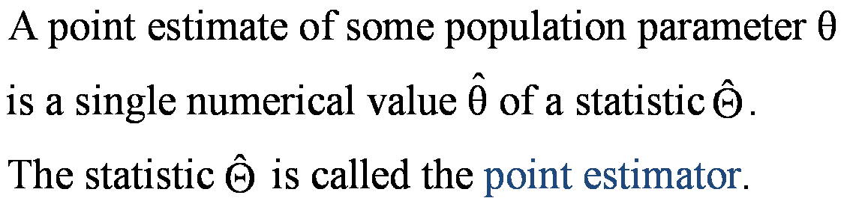
Point Estimator

Slide 6
Some Parameters & Their Statistics
There could be choices for the point estimator of a parameter.
To estimate the mean of a population, we could choose the:
  Sample mean.
  Sample median.
  Average of the largest & smallest observations in the sample.

Slide 7
Some Definitions
The random variables X₁, X₂,…,X_{n} are a random sample of size n if:
  The X_{i} ‘s are independent random variables.
  Every X_{i} has the same probability distribution.
A statistic is any function of the observations in a random sample.
The probability distribution of a statistic is called a sampling distribution.

Slide 8
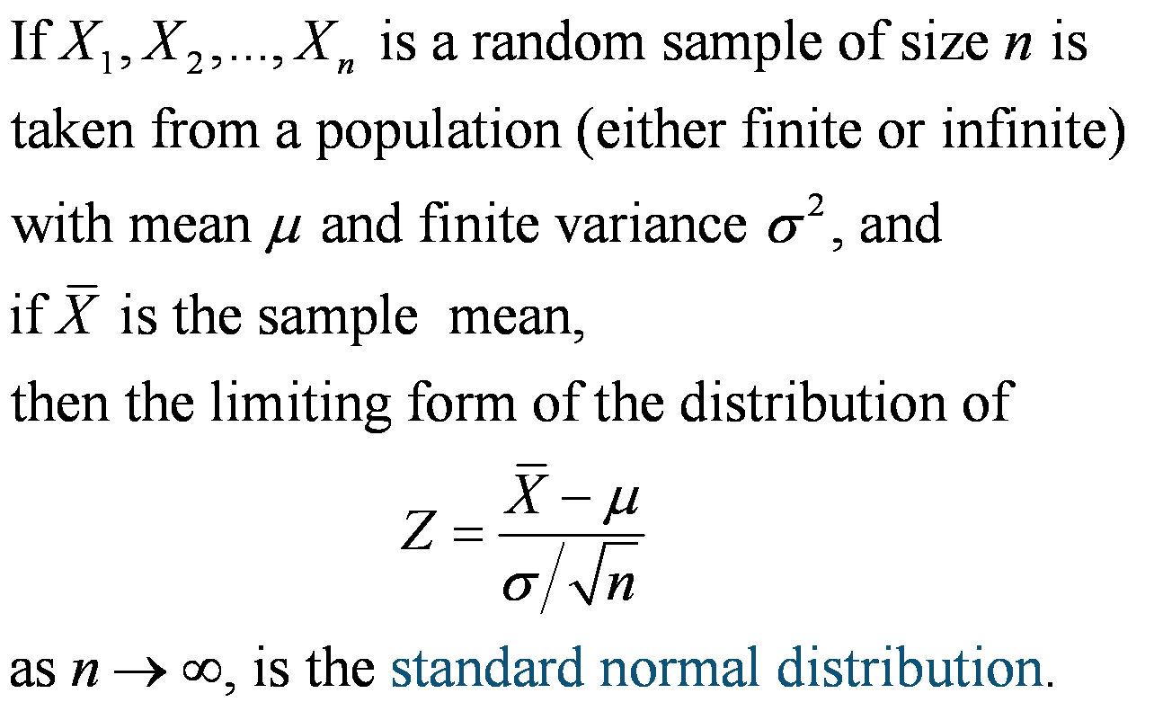
Central Limit Theorem

Slide 9
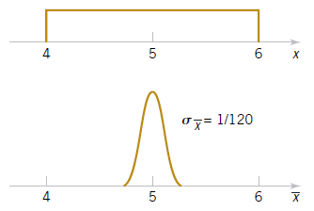
Example 7-2: Central Limit Theorem
Suppose that a random variable X has a continuous
uniform distribution:
Find the distribution of the sample mean of a random
sample of size n = 40.
Figure 7-5 The distribution of X and X for Example 7-2.

Slide 10
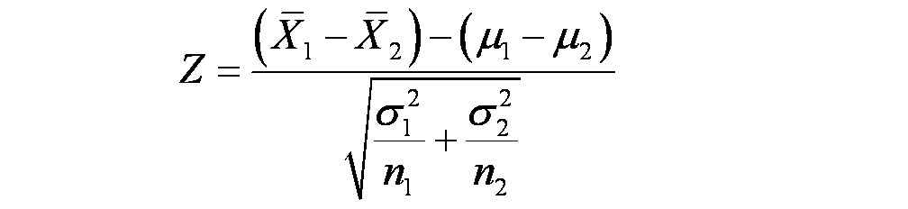
Sampling Distribution of a Difference in Sample Means
If we have two independent populations with means μ₁ and μ₂, and variances σ₁² and σ₂², and
If X-bar₁ and X-bar₂ are the sample means of two independent random samples of sizes n₁ and n₂ from these populations:
Then the sampling distribution of:
is approximately standard normal, if the conditions of the central limit theorem apply.
If the two populations are normal, then the sampling distribution of Z is exactly standard normal.

Slide 11
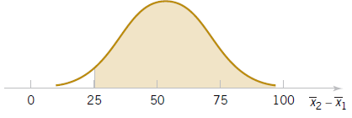
Example 7-3: Aircraft Engine Life
The effective life of a component used
in jet-turbine aircraft engine is a
random variable with mean 5000 and
SD 40 hours and is close to a normal
distribution. The engine manufacturer
introduces an improvement into the
Manufacturing process for this
component that changes the
parameters to 5050 and 30. Random
samples of size 16 and 25 are
selected.
What is the probability that the
difference in the two sample means is
at least 25 hours?
Figure 7-6 The sampling distribution of X2 − X1 in Example 7-3.

Slide 12
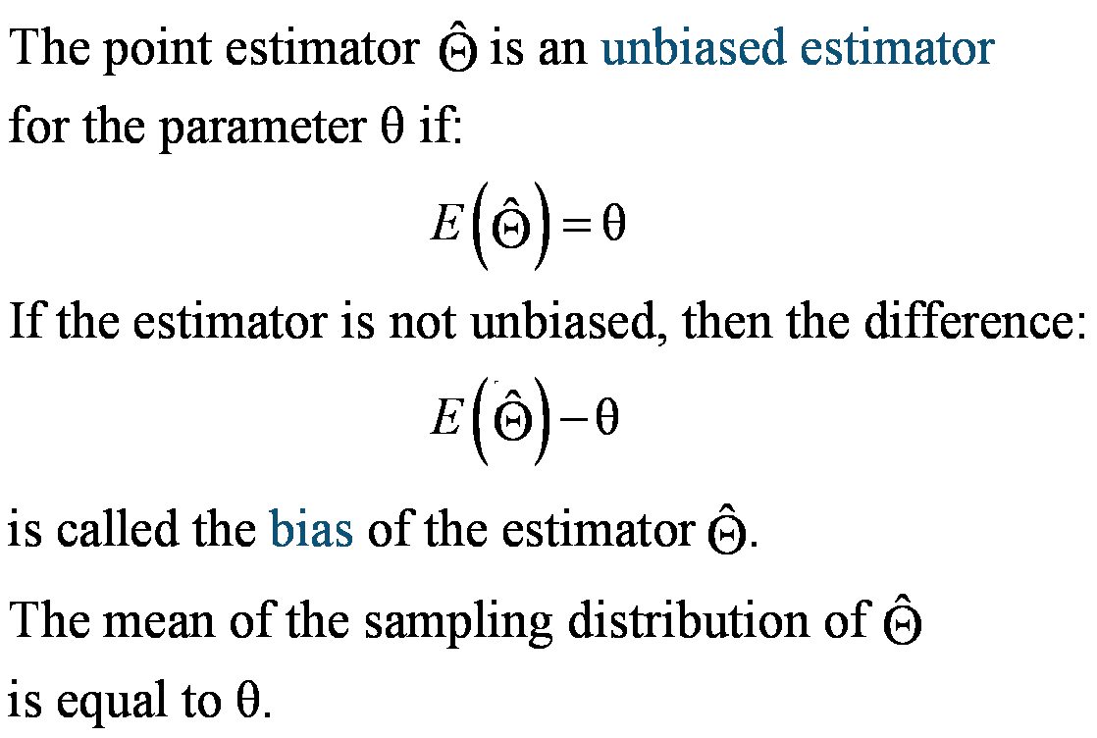
Unbiased Estimators Defined

Slide 13
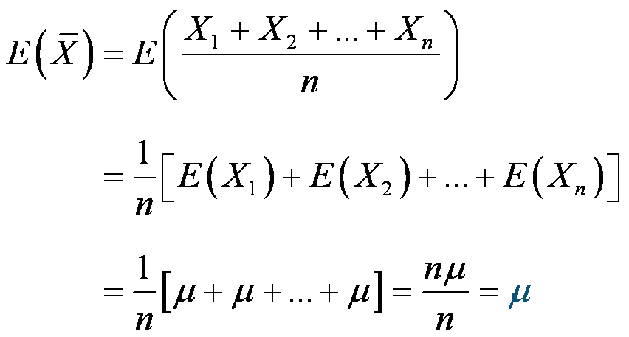
Example 7-4: Sample Mean & Variance Are Unbiased-1
X is a random variable with mean μ and variance σ². Let X₁, X₂,…,X_{n} be a random sample of size n.
Show that the sample mean (X-bar) is an unbiased estimator of μ.

Slide 14
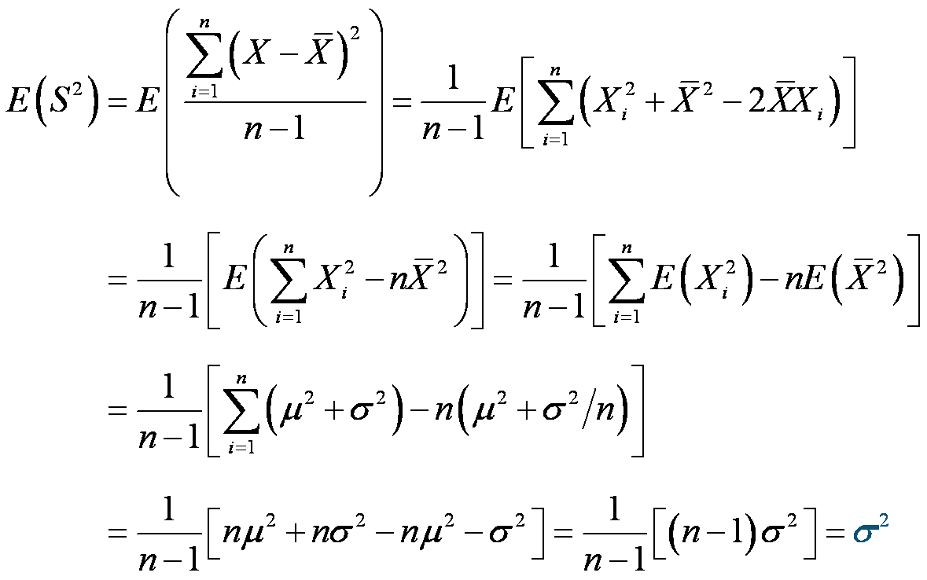
Example 7-4: Sample Mean & Variance Are Unbiased-2
Show that the sample variance (S²) is a unbiased estimator of σ².

Slide 15
Minimum Variance Unbiased Estimators
If we consider all unbiased estimators of θ, the one with the smallest variance is called the minimum variance unbiased estimator (MVUE).
If X₁, X₂,…, X_{n} is a random sample of size n from a normal distribution with mean μ and variance σ², then the sample X-bar is the MVUE for μ.

Slide 16
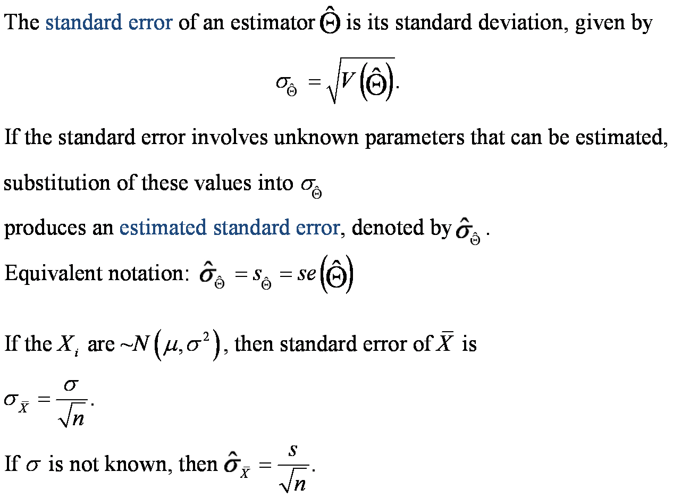
Standard Error of an Estimator

Slide 17
Example 7-5: Thermal Conductivity
These observations are 10 measurements of thermal conductivity of Armco iron.
Since σ is not known, we use s to calculate the standard error.
Since the standard error is 0.2% of the mean, the mean estimate is fairly precise. We can be very confident that the true population mean is 41.924 ± 2(0.0898) or between 41.744 and 42.104.

Slide 18
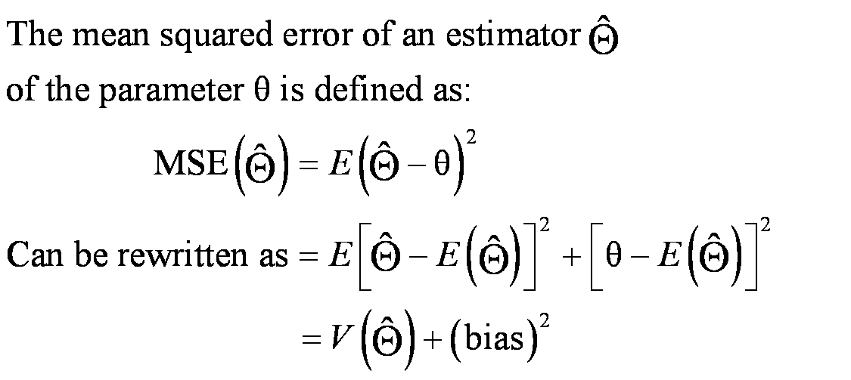
Mean Squared Error
Conclusion: The mean squared error (MSE) of
the estimator is equal to the variance of the
estimator plus the bias squared.

Slide 19
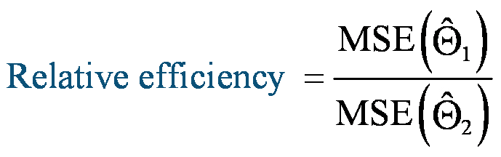
Relative Efficiency
The MSE is an important criterion for comparing two estimators.
If the relative efficiency is less than 1, we conclude that the 1st estimator is superior than the 2nd estimator.

Slide 20
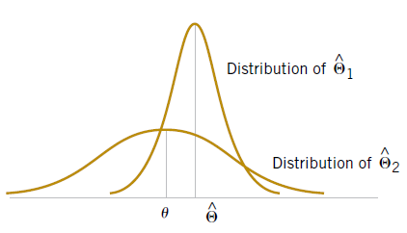
Optimal Estimator
A biased estimator can be preferred than an unbiased estimator if it has a smaller MSE.
Biased estimators are occasionally used in linear regression.
An estimator whose MSE is smaller than that of any other estimator is called an optimal estimator.
Figure 7-8 A biased estimator that has a smaller variance than the unbiased estimator .

Slide 21
Moments Defined
Let X₁, X₂,…,X_{n} be a random sample from the probability distribution f(x), where f(x) can be either a:
  Discrete probability mass function, or
  Continuous probability density function
The k^{th} population moment (or distribution moment) is E(X^{k}), k = 1, 2, ….
If k = 1 (called the first moment), then:
  Population moment is μ.
  Sample moment is x-bar.
The sample mean is the moment estimator of the population mean.

Slide 22
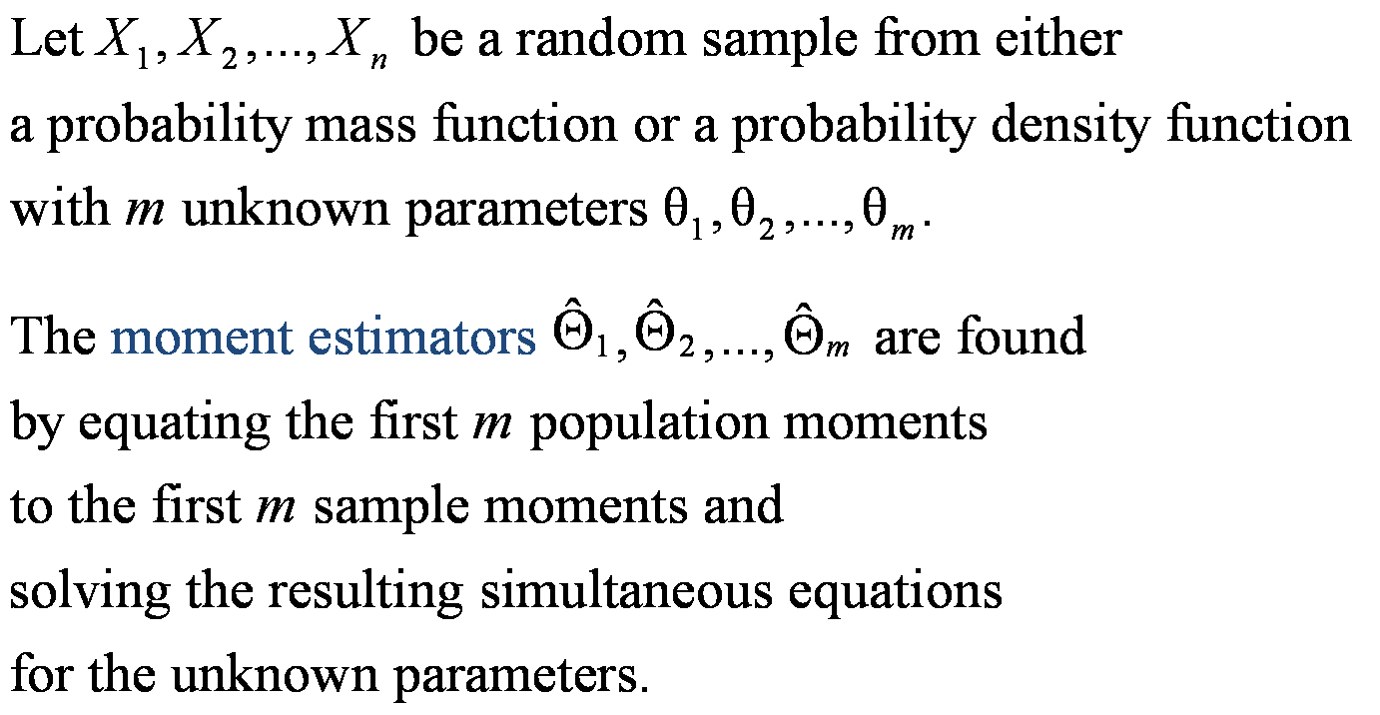
Moment Estimators

Slide 23


Example 7-8: Normal Distribution Moment Estimators
Suppose that X₁, X₂, …, X_{n} is a random sample from a normal distribution with parameter μ and σ² where E(X) = μ and E(X²) = μ² + σ².

Slide 24
Example 7-9: Gamma Distribution Moment Estimators-1
Suppose that X₁, X₂, …, X_{n} is a random sample from a gamma distribution with
parameter r and λ where E(X) = r/ λ and E(X²) = r(r+1)/ λ² .

Slide 25
Example 7-9: Gamma Distribution Moment Estimators-2
Using the time to failure data in
the table. We can estimate the
parameters of the gamma
distribution.

Slide 26
Maximum Likelihood Estimators
Suppose that X is a random variable with probability distribution f(x;θ), where θ is a single unknown parameter. Let x₁, x₂, …, x_{n} be the observed values in a random sample of size n. Then the likelihood function of the sample is:
L(θ) = f(x₁;θ) ∙ f(x₂; θ) ∙…∙ f(x_{n}; θ)
Note that the likelihood function is now a function of only the unknown parameter θ. The maximum likelihood estimator (MLE) of θ is the value of θ that maximizes the likelihood function L(θ).

Slide 27
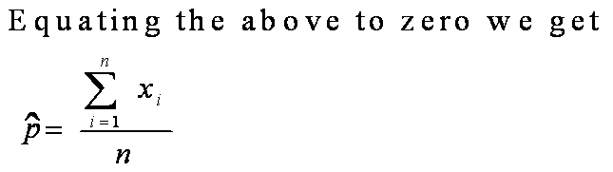
Example 7-10: Bernoulli Distribution MLE
Let X be a Bernoulli random variable. The probability mass function is
f(x;p) = p^{x}(1-p)^{1-x}, x = 0, 1 where P is the parameter to be estimated.
The likelihood function of a random sample of size n is:

Slide 28
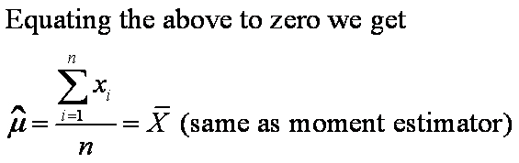
Example 7-11: Normal Distribution MLE for μ
Let X be a normal random variable with unknown mean μ and
known variance σ². The likelihood function of a random sample of
size n is:

Slide 29
Example 7-12: Exponential Distribution MLE
Let X be a exponential random variable with parameter λ.
The likelihood function of a random sample of size n is:

Slide 30


Example 7-13: Normal Distribution MLEs for μ & σ²
Let X be a normal random variable with both unknown mean μ
and variance σ². The likelihood function of a random sample of
size n is:

Slide 31
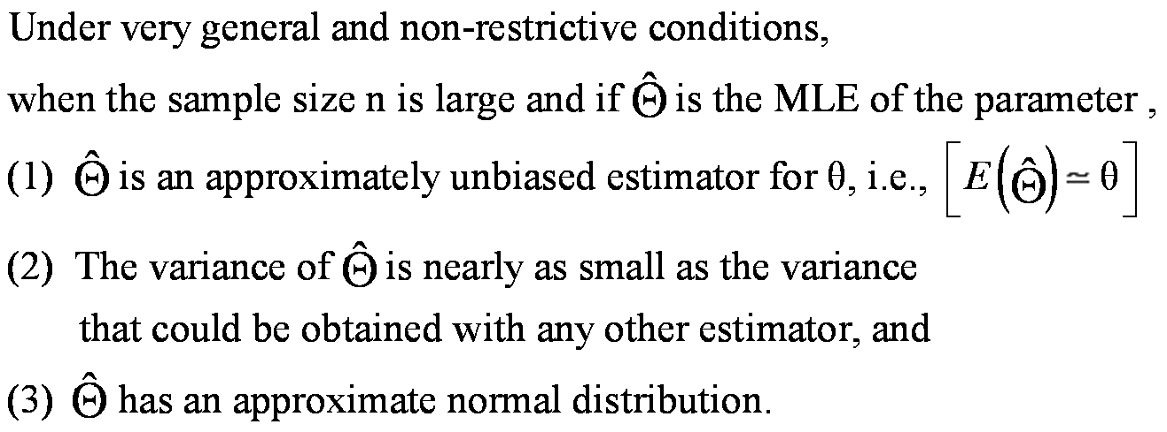
Properties of an MLE
Notes:
Mathematical statisticians will often prefer MLEs because of
these properties. Properties (1) and (2) state that MLEs are
MVUEs.
To use MLEs, the distribution of the population must be known
or assumed.

Slide 32
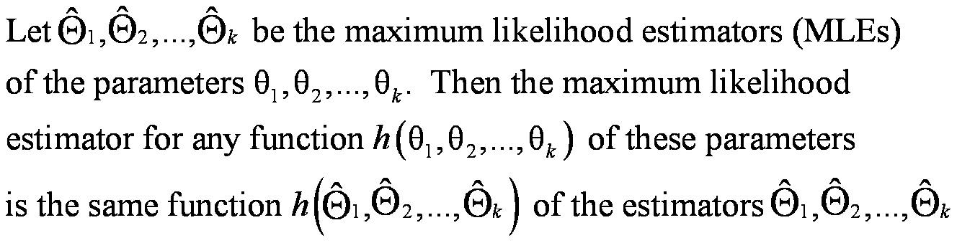
Invariance Property
This property is illustrated in Example 7-13.

Slide 33
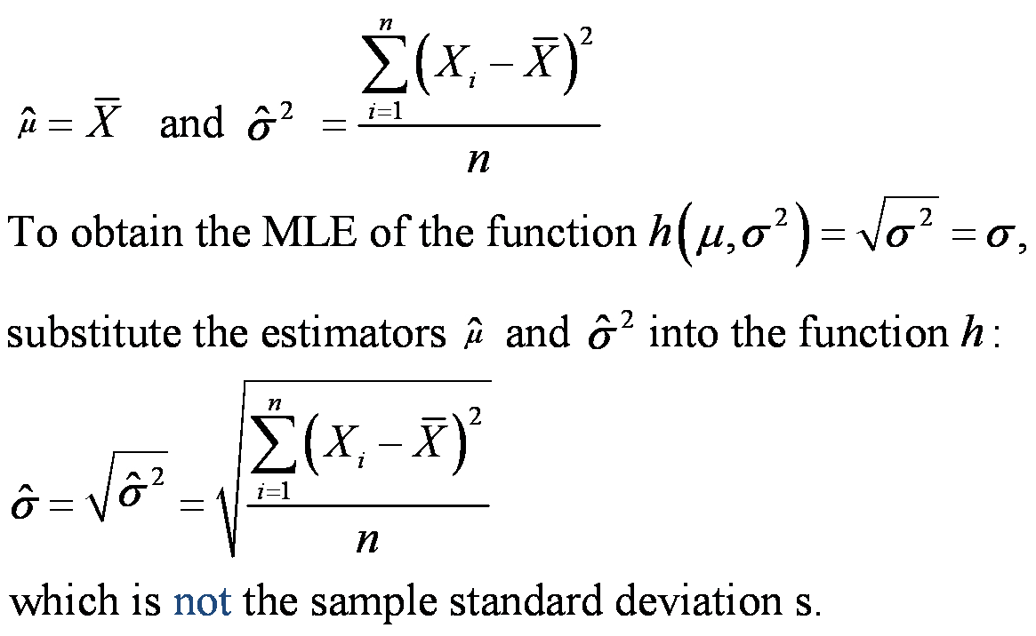
Example 7-14: Invariance
For the normal distribution, the MLEs were:

Slide 34
Complications of the MLE Method
The method of maximum likelihood is an
excellent technique, however there are two
complications:
1. It may not be easy to maximize the likelihood function because the derivative function set to zero may be difficult to solve algebraically.
It may not always be possible to use
calculus methods directly to determine the
maximum of L(ѳ).
The following example illustrate this.

Slide 35
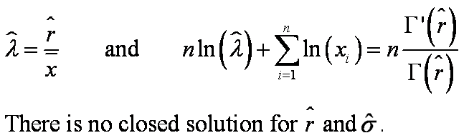
Example 7-16: Gamma Distribution MLE-1
Let X₁, X₂, …, X_{n} be a random sample from a gamma
distribution. The log of the likelihood function is:
Equating the above derivative to zero we get

Slide 36
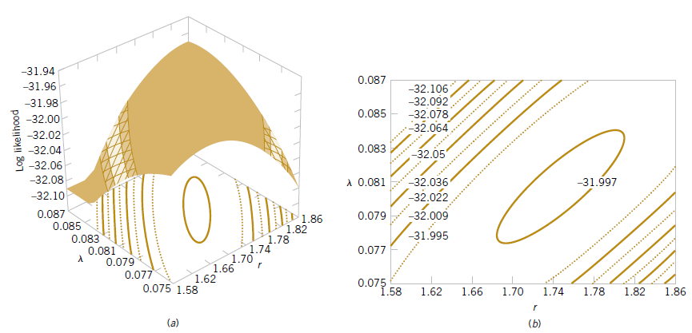
Example 7-16: Gamma Distribution MLE-2
Figure 7-11 Log likelihood for the gamma distribution using the failure time data. (a) Log likelihood surface. (b) Contour plot.

Slide 37
Bayesian Estimation of Parameters-1
The moment and likelihood methods interpret probabilities as relative frequencies and are called objective frequencies.
The random variable X has a probability distribution of parameter θ called f(x|θ).
Additional information about θ is that it can be summarized as f(θ), the prior distribution, with mean μ₀ and variance σ₀². Probabilities associated with f(θ) are subjective probabilities.
The joint distribution is f(x₁, x₂, …, x_{n}|θ).
The posterior distribution is f(θ|x₁, x₂, …, x_{n}) is our degree of belief regarding θ after observing the sample data.

Slide 38
Bayesian Estimation of Parameters-2
Now the joint probability distribution of the sample is
  f(x₁, x₂, …, x_{n}, θ) = f(x₁, x₂, …, x_{n} |θ) ∙ f(θ)
The marginal distribution is:
The desired posterior distribution is:

Slide 39
Example 7-16: Bayes Estimator for the mean of a Normal Distribution -1
Let X₁, X₂, …, X_{n} be a random sample from a normal distribution unknown mean μ and known variance σ². Assume that the prior distribution for μ is:
The joint probability distribution of the sample is:

Slide 40
Example 7-17: Bayes Estimator for the mean of a Normal Distribution-2
Now the joint probability distribution of the sample and μ is:
Upon completing the square in the exponent,

Slide 41
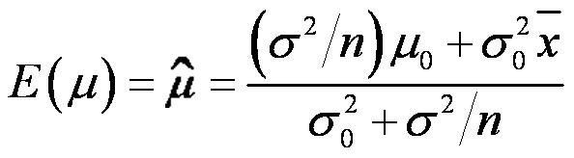
Example 7-17: Bayes Estimator for the mean of a Normal Distribution-3
which is recognized as a normal probability density
function with posterior mean
and posterior variance

Slide 42

Example 7-17: Bayes Estimator for the mean of a Normal Distribution-4
To illustrate:
  The parameters are: μ₀ = 0, σ₀²= 1
  Sample: n = 10, x-bar = 0.75, σ² = 4

Slide 43
Important Terms & Concepts of Chapter 7
Bayes estimator
Bias in parameter estimation
Central limit theorem
Estimator vs. estimate
Likelihood function
Maximum likelihood estimator
Mean square error of an estimator
Minimum variance unbiased estimator
Moment estimator
Normal distribution as the sampling distribution of the:
  sample mean
  difference in two sample means
Parameter estimation
Point estimator
Population or distribution moments
Posterior distribution
Prior distribution
Sample moments
Sampling distribution
An estimator has a:
  Standard error
  Estimated standard error
Statistic
Statistical inference
Unbiased estimator

