Slide 1
Mid-Term

Slide 2
Question 1
What is the difference between a host and an end-system? Is a Web server an end-system or a host? List 4 types of host and 4 types of end-system.

Slide 3
Question 1
There is no difference
A Web server is both an end-system and a hot
End systems / hosts include PCs, workstations, Web servers, mail servers, PDAs, Internet-connected game consoles, fun Internet appliances ..etc
Notes:
Explicitly discussed during lectures
Could be derived from slide 1.19 and 1.20
Explicitly stated in the text book.

Slide 4
Question 1
What is the difference between a host and an end-system? Is a Web server an end-system or a host? List 4 types of host and 4 types of end-system.

Slide 5
Question 2
Consider an HTTP client that wants to retrieve a Web document at a given URL. The IP address of the HTTP server is initially unknown. What transport and application layer protocols are needed in the scenario besides HTTP? .

Slide 6
Question 2
DNS
UDP (TCP accepted as answer)

Slide 7
Question 3

Slide 8
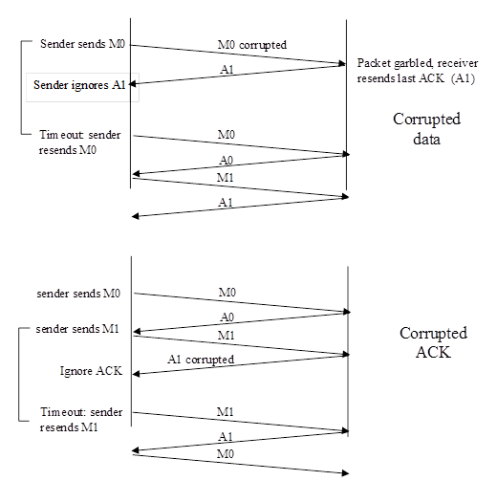
Question 3
.

Slide 9
Question 4
What are the differences (if any) between TCP receive window (rwnd) and TCP receive buffer (RCVbuffer)?
Let us now assume an exchange between sender A and receiver B, with rwnd = RCVbuffer=10 and sequence number = 0 as initial values at the receiver side.
If sender A send segment 0, with 5 bytes that are successfully received by B (but not yet processed), what will be the new values of rwnd and RCVbuffer at the sender side?
If the receiver B sends an ACK to the sender A, including the value of rwnd, before processing the 5 bytes, and if A does not detect any error in the ACK it receives, could the value of rwnd be 10? Explain why.
Assuming that rwnd=10 and the sender A, sends segment 1, with 10 bytes, what will happen at receiver B side if we further assume that the 5 bytes sent in segment 0 were still not yet processed?
What will happen next on the receiver side?
.

Slide 10
Question 4
Notes
Discussed at length during lecture
Explained in details in textbook
.

Slide 11
Question 4
TCP receive buffer: (RCVbuffer )
The total number of buffers available at the receiver side. At any point in time some of them might be in use while others might be available for use.
This value never changes during exchanges
TCP receive window total number (rwnd)
Total number of buffers available for use at receiver side
The total number of buffers available at the receiver side. At any point in time some of them might be in use while others might be available for use.
This value changes during exchanges
.

Slide 12
Question 4
1. RCV buffer will remain at 10 because the value never changes during an exchange – On the other hand rwnd will become 5 because there will be only 5 buffers left for use.
Yes, it will become 10 only if there is an error that has not been dectected (i.e. error that changes 5 into 10, but could not be detected by the cheksum)
The segment will be thrown away
The receiver will send a duplicate ACK for segment o and things will be back to normal is the duplicate ACK is not corrupted.
.

