Slide 1
Data Center Basics (ENCS 691K – Chapter 5)
Roch Glitho, PhD
Associate Professor and Canada Research Chair
My URL - http://users.encs.concordia.ca/~glitho/

Slide 2
References
MD. Bari et al., Data Center Networking Virtualization: A Survey, IEEE Communications Surveys & Tutorials, Vol.15, No2, Second Quarter 2013

Slide 3
Data Center Networking - Basics
Basic Concepts
Data Center Topology
Data Center Virtualization

Slide 4
Basic Concepts

Slide 5
Data Center
Consists of:
Servers (Physical machines)
Storage
Network devices (switch, router, cables)
Power distribution systems
Cooling systems

Slide 6
Data Center Network
Communications infrastructure – Could be described by:
Topology
Routing / switching equipment
Protocols

Slide 7
Data Center Network
Data Center Network vs. ISP Networks:
Number of nodes
ISPs backbones (hundreds)
487 for AT&T – Ref. 1
Data centers (thousands)
Google (12 000) Ref. 1
Topology
Topology with specific properties are used for data center in order to allow topology specific routing optimization

Slide 8
Data Center Network Topology

Slide 9
Conventional Topology
Three layers:
Access layer with Top of the Rack (ToR) switches
Aggregation layer
Core layer

Slide 10
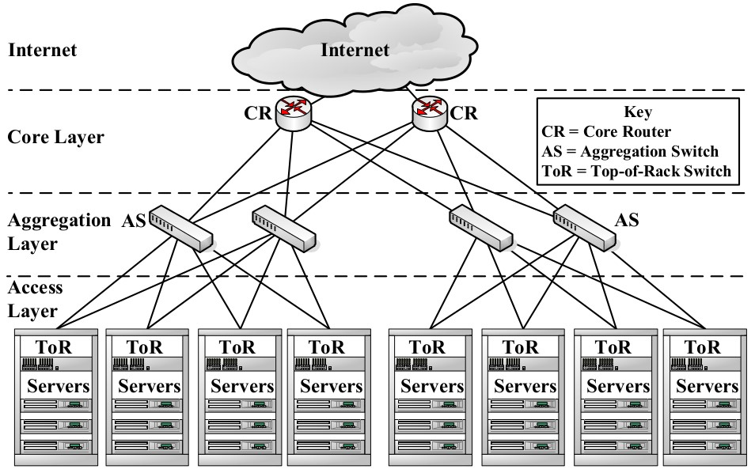
Conventional Topology (REf1)

Slide 11
Conventional Topology
Specific case:
Flat layer 2 topology: Only layer 2 switches

Slide 12
Clos Topology
Hierarchical / staged/layered:
Each switch in a stage is connected to all the switches in the next stage
Key benefit:
Extensive path diversity

Slide 13
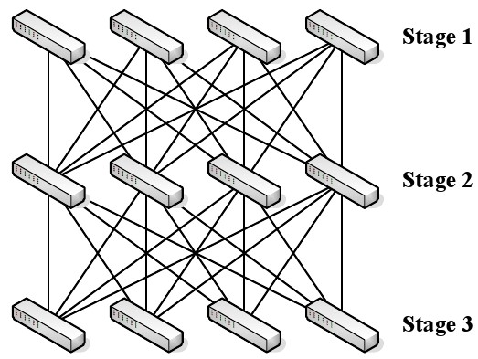
Clos Topology (Ref. 1)

Slide 14
Clos Topology
Specific case: Fat tree
Built in a tree like structure

Slide 15
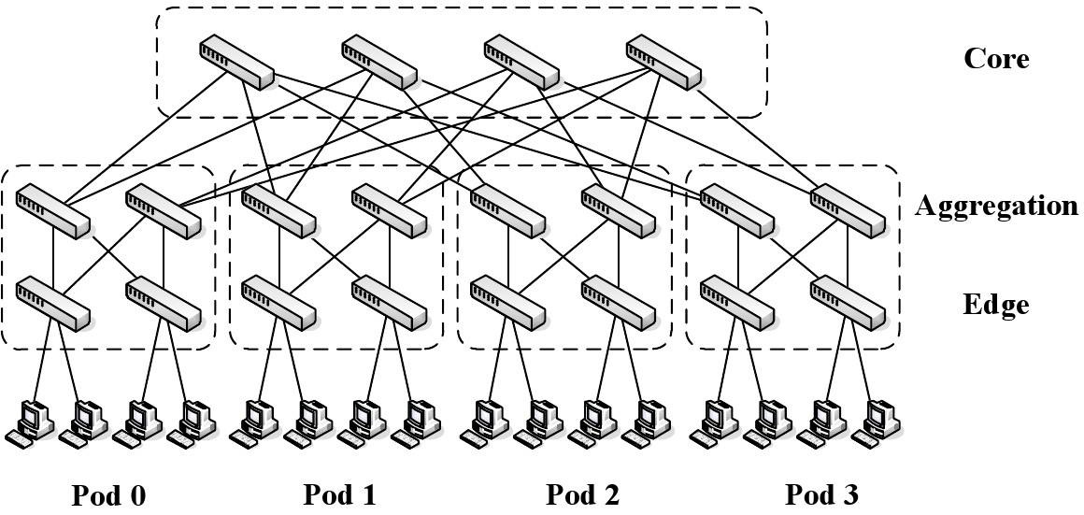
Clos Topology – Fat tree (Ref. 1)

Slide 16
Data Center Virtualization

Slide 17
Virtualized Data Center
Data center with some or all the hardware virtualized
Servers (Physical machines)
Storage
Network devices (switch, router)
Power distribution systems
Cooling systems

Slide 18
Virtual Data Center
Collection of virtual resources, e.g.
Virtual machine
Virtual switches
Virtual links

Slide 19
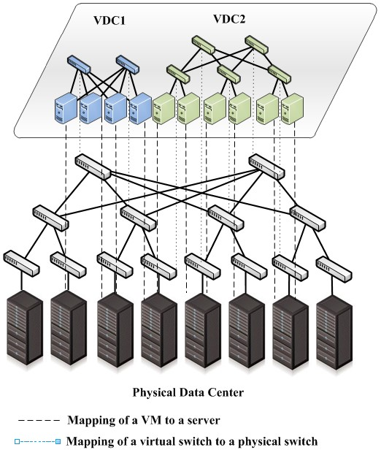
Virtual Data Center (Ref. 1)

Slide 20
The End
A
.

