Slide 1
COEN 445 Communication Networks and Protocols Lab 5
Socket Programming with Python: SMTP Mail Client
Claude Fachkha

Slide 2
Introduction
By the end of this lab, you will have acquired a better understanding of SMTP protocol. You will also gain experience in implementing a standard protocol using Python.
Your task is to develop a simple mail client that sends email to any recipient. Your client will need to connect to a mail server, dialogue with the mail server using the SMTP protocol, and send an email message to the mail server. Python provides a module, called smtplib, which has built in methods to send mail using SMTP protocol. However, we will not be using this module in this lab, because it hide the details of SMTP and socket programming.
In order to limit spam, some mail servers do not accept TCP connection from arbitrary sources. For the experiment described below, you may want to try connecting both to your university mail server and to a popular Webmail server, such as a AOL mail server. You may also try making your connection both from your home and from your university campus.

Slide 3
Introduction
Code
In the next slide, you will find the skeleton code for the client. You are to complete the skeleton code. The places where you need to fill in code are marked with #Fill in start and #Fill in end. Each place may require one or more lines of code.
Additional Notes
In some cases, the receiving mail server might classify your e-mail as junk. Make sure you check the junk/spam folder when you look for the e-mail sent from your client. An alternative solution is to use the SMTP server of Concordia University.

Slide 4
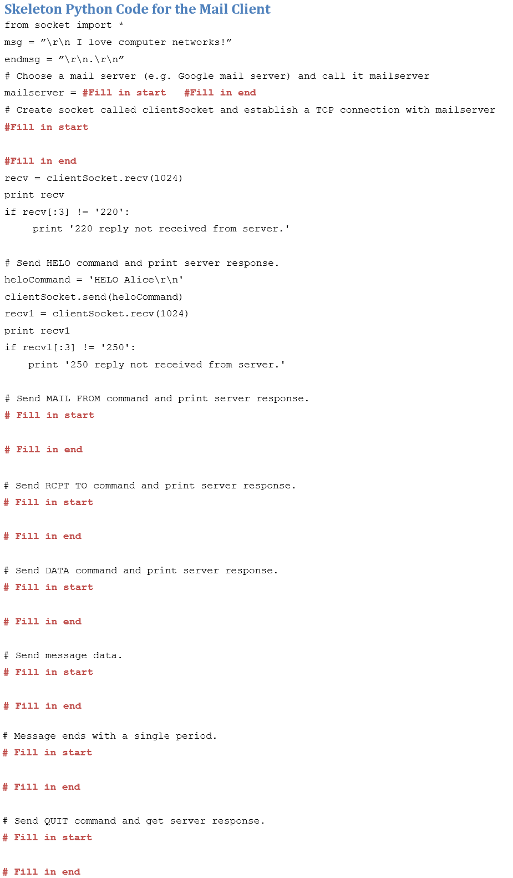
Introduction

Slide 5
References
Online services - Computer Networking: A Top-Down Approach, 6/E James F. Kurose, University of Massachusetts, Amherst - See more at: Keith W. Ross, Polytechnic University, Brooklyn

Slide 6
Claude Fachkha c_fachkh@encs.concordia.ca

