Slide 1
A Multidimensional Empirical Study on Refactoring Activity
Most Influential Paper Award CASCON 2023
Nikolaos Tsantalis, Victor Guana, Eleni Stroulia, and Abram Hindle
Department of Computer Science and Software Engineering - Concordia University,
Department of Computing Science - University of Alberta, Edmonton, Alberta, Canada

Slide 2
Nikolaos Tsantalis
Victor Guana
Eleni Stroulia
Abram Hindle

Slide 3
Research Questions
Do software developers perform different types of refactoring operations on test code and production code?
Which developers are responsible for refactorings?
Is there more refactoring activity before major project releases than after?
Is refactoring activity on production code preceded by the addition or modification of test code?
What is the purpose of the applied refactorings?

Slide 4
Novelties
The first refactoring detection tool to operate on Git commits
Challenge: partial code
Solution: Inspired from UMLDiff (Xing and Stroulia)
The first study on the motivations driving refactoring activity, based on actual refactoring instances found in open-source projects

Slide 5
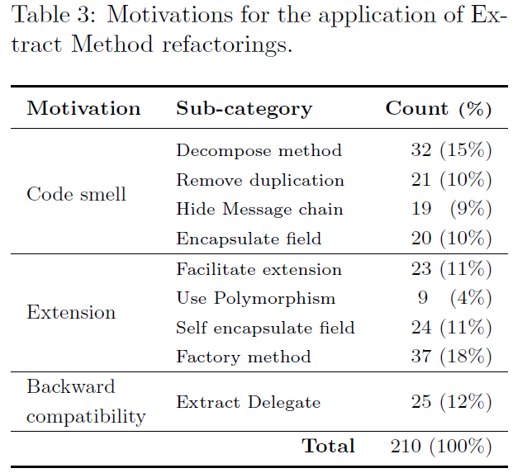
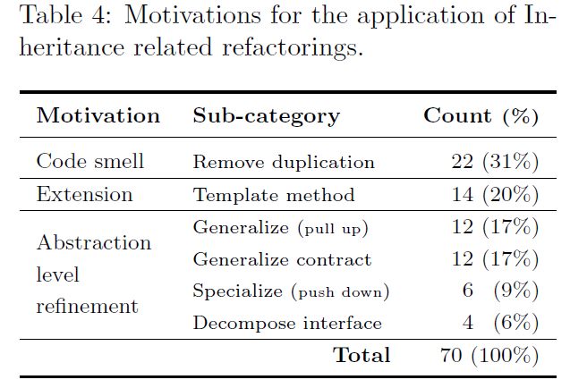
RQ5: Refactoring motivations

Slide 6
Limitations
Only the precision of tool is provided
The detection rules were quite strict (low false positive rate)
Likely to have low recall
The study include only 3 systems
External validity
The motivations were labeled by the authors
Bias

Slide 7
Most important contribution
This work inspired future research on refactoring detection tools that operate at commit level

Slide 8
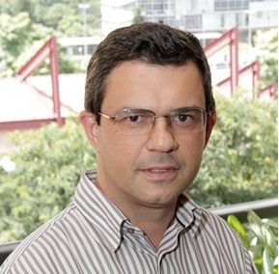
Danilo Silva
Marco Tulio Valente

Slide 9
Where was the code?

Slide 10
Why We Refactor?
Danilo developed the API of RefactoringMiner
Tooling for checking out and parsing Git commits
Infrastructure for monitoring GitHub projects
Automatic generation of emails to contact developers
A web app for thematic analysis

Slide 11
Firehouse interview
Monitored 124 GitHub projects between June 8th and August 7th, 2015
Sent 465 emails and received 195 responses (42%)
+27 commits with a description explaining the reasons
Compiled a catalogue of 44 distinct motivations for 12 well-known refactoring types

Slide 12
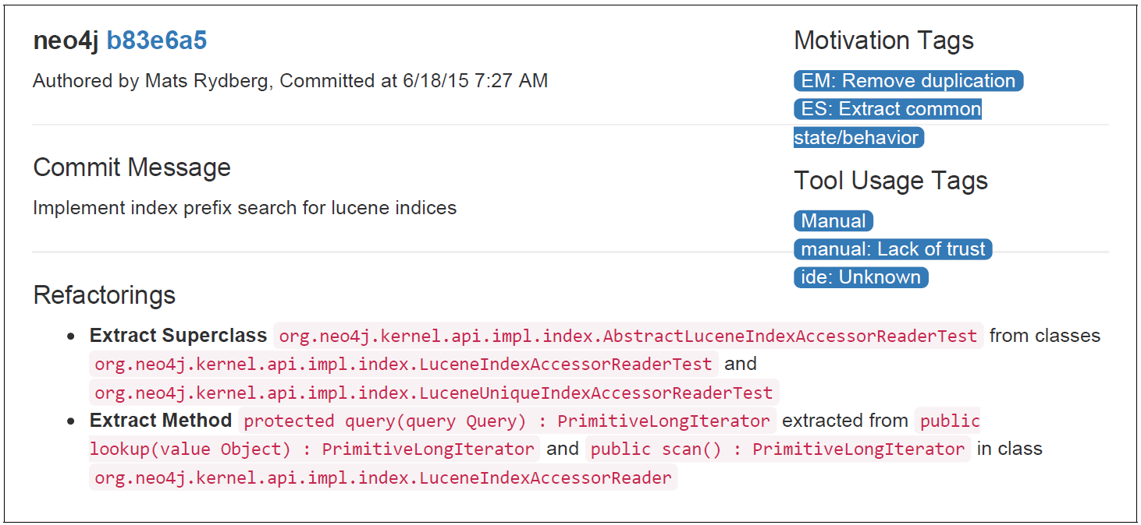
Motivation Catalogue
Artifact https://github.com/aserg-ufmg/why-we-refactor

Slide 13
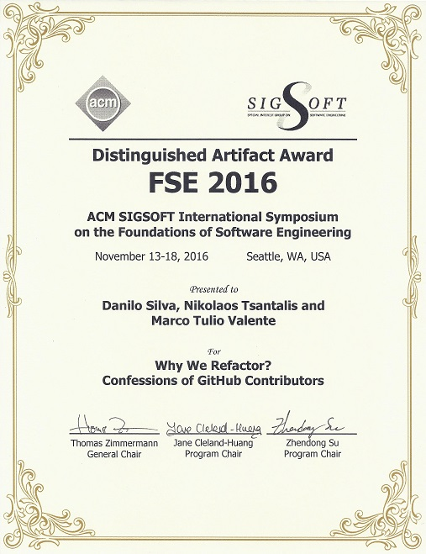

Slide 14
RefactoringMiner ...
RefDiff

Slide 15
Limitations of previous refactoring detection tools
Dependence on similarity thresholds
thresholds need calibration for projects with different characteristics
Dependence on built versions
only 38% of the change history can be successfully compiled [Tufano et al., 2017]
Unreliable oracles for evaluating precision/recall
Incomplete (refactorings found in release notes or commit messages)
Biased (applying a single tool with two different similarity thresholds)
Artificial (seeded refactorings)

Slide 16
Refactoring Mining Tools
citations
304
134
282
62
123
905
RefactoringMiner 0.1 (Silva, Tsantalis, Valente, FSE 2016)
RefDiff 1.0 (Silva & Valente, MSR 2017)
RefactoringMiner 1.0 (Tsantalis et al., ICSE 2018)
RefDiff 2.0 (Silva et al., TSE 2020)
RefactoringMiner 2.0 (Tsantalis, Ketkar, Dig, TSE 2020)

Slide 17
Current state-of-the-art
 | RefMiner 2.0 | RefMiner 1.0 | RefDiff 2.0 | RefDiff 1.0
Precision | 99.7% | 96.5% | 93.8% | 88.3%
Recall | 94.2% | 81.3% | 76.9% | 60.7%
Average execution time | 253 ms | 1482 ms | 297 ms | 2906 ms
Supported refactorings | 100 | 15 | 13 | 16

Slide 18
RefactoringMiner Impact
Hundreds of empirical studies on refactoring
Identifier renaming (Peruma et al., JSS 2020)
Refactoring documentation (AlOmar et al., ASE 2022)
Refactoring-aware merging (Ellis, Nadi, Dig, TSE 2023)
Decomposition of commits to activities (Shen et al., FSE 2021)
Automatic source code comment updating (Liu et al., ASE 2020)
Automatic clean-up of bug-fixing patches from overlapping refactoring edits (Jiang et al., TSE 2023)
Refactoring-aware program element tracking (Jodavi, Tsantalis, FSE 2022)

Slide 19
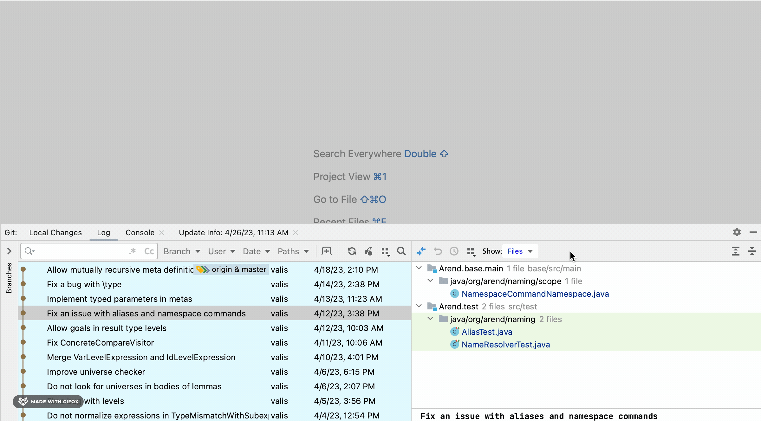

Slide 20
Thank you

