Slide 1





Identification of Extract Method Refactoring Opportunities
IEEE TCSE Most Influential Paper
Nikolaos Tsantalis
Alexander Chatzigeorgiou
February 27, 2019
Notes:
First of all, I would like thank the PC members and the MIP Chair for the great honor to select our paper among the most influential ones. The goal of this talk is to provide insights not only to the research behind this work, but all the experiences and lessons learned gained through this work, hoping they will be useful for the students in the audience.

Slide 2
Year 2008
What are we doing next?
Something challenging
Learn new
things
Notes:
We are going back to year 2008. This was the second year of my PhD. In terms of publications, I had only two tool demo papers, because I invested a lot of time on tool and infrastructure development. I had already two journal papers in the review pipeline, one related to moving misplaced methods to the right classes, which was eventually accepted at TSE, and the other related to replacing conditional logic with polymorphism, which was eventually accepted at JSS. So, we were discussing what to do next with my supervisor, and I remember I wanted to work on something more challenging that would give me the opportunity to learn new theory and program analysis techniques.

Slide 3
Year 2008
Let’s try to solve the Extract Method problem
Notes:
Eventually, we decided to work on the Extract Method problem.
In the past, I tried to investigate ways to extract a part of a method that is misplaced and needs to be moved to another class. However, based on the reviews I received it was clear I was lacking the required background on program analysis techniques, such as slicing.

Slide 4
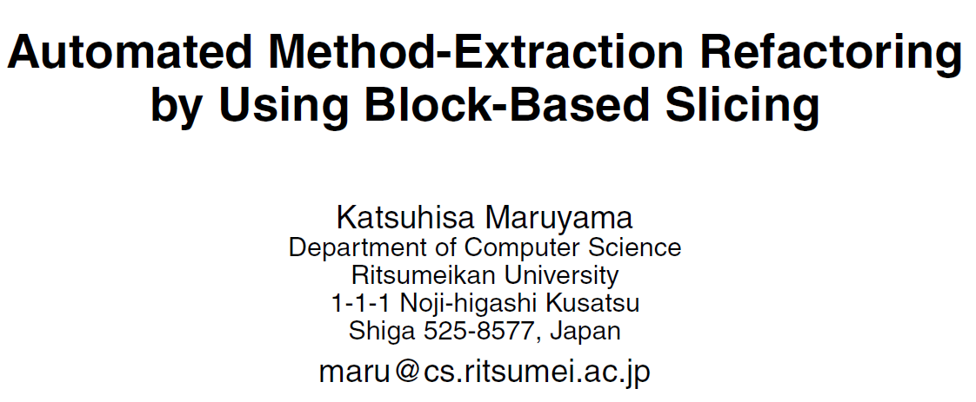

@SSR2001
The programmer:
indicates a variable of interest at a specific program point
selects a suitable method from among the candidates created by the tool
names the selected method
Notes:
While I was studying the related work, one of the papers that influenced me was Block-based slicing by Maruyama. The goal of this work was to reduce the effort needed by a programmer to extract a method. Typically, a programmer needs to select some consecutive statements, and then the IDE can determine the required input parameters, return type of the extracted method. Maruyama simplified this process by asking the programmer to…

Slide 5
@SSR2001
The programmer:
indicates a variable of interest at a specific program point
selects a suitable method from among the candidates created by the tool
names the selected method
Elegant solution both
theoretically and
practically
Notes:
Maruyama’s solution was elegant both theoretically and practically.

Slide 6

Notes:
The way it works is that the developer selects first a variable of interest in a specific program statement.
The tool first computes the block-based regions the computation of the variable can be extracted from.
The first region is the body of the while loop, the second is the entire while loop and the code that follows, the final region is the entire method.

Slide 7
Notes:
Then, the developer selects one of the regions and the tool computes the block-based slice.
The block-based slice is a regular static slice that is restricted within the selected region.

Slide 8
Notes:
Next, the tool computes the statements that need to be duplicated, so that the original method remains functional.
Here we see that these two statements highlighted in red are needed for the computation of variables thisAmount, result and totalAmount.

Slide 9
Notes:
Finally, the tool determines the parameters of the extracted method, performs the extraction and placed the call to the extracted method right before the block-based region.
Here we see that the statements highlighted in red are duplicated on both methods.

Slide 10
Limitations
Does not support extraction opportunities for objects, but only variables of primitive type
Does not handle behavior preservation issues
Does not guarantee that the complete computation of the variable indicated by the user will be extracted.
Composite variables
Notes:
Despite the elegance of Maruyama’s work, it was very clear it had some limitations.
The first one was it didn’t support the extraction of objects. To overcome this limitation we proposed the concept of composite variables.

Slide 11

Notes:
The idea is that objects have state represented by the field values of an instance.

Slide 12
Enumeration rentals = _rentals.elements();
count is read
count is read
& modified
Notes:
In this example, when the enumeration rentals is instantiated from a vector, internally it has state count which is read when hasMoreElements() is called, and read + modified when nextElement() is called.

Slide 13
Enumeration rentals = _rentals.elements();
R: rentals.count
while(rentals.hasMoreElements()) {
Rental each = (Rental) rentals.nextElement();
R+W: rentals.count
Notes:
By performing some method call graph analysis we are able to extract the object state and represent it as composite variables. A composite variable is a variable composed by a variable and states.
Therefore, the while statement reads variable rentals.count and the next statement reads and modifies variable rentals.count. The composite variables help us to extract additional data dependencies between the program statements, and thus compute slices for objects.

Slide 14
Limitations
Does not support extraction opportunities for objects, but only variables of primitive type
Does not handle behavior preservation issues
Does not guarantee that the complete computation of the variable indicated by the user will be extracted.
Behavior preservation rules
Notes:
The second limitation was the Maruyama’s work did not deal with behavior preservation issues, which is a fundamental property of refactoring. To overcome this limitation, we proposed some behavior preservation rules.

Slide 16
Enumeration rentals = _rentals.elements();
renterPoints = renterPoints(renterPoints, rentals);
while(rentals.hasMoreElements()) {
rentals has no
more elements
int renterPoints(int renterPoints, Enumeration rentals) {
while(rentals.hasMoreElements()) {
All rentals
elements are
enumerated
Rental each = (Rental) rentals.nextElement();
Notes:
When the extracted method is called, enumeration rentals is passed as an argument.
Inside the extracted method all elements are enumerated.
Therefore, after the execution of the extracted methods there are no more elements to be enumerated in the original method. This is causing a change in the program behavior.

Slide 17
Rule #1
A duplicated statement should not
modify the state of an object

Slide 18
Limitations
Does not support extraction opportunities for objects, but only variables of primitive type
Does not handle behavior preservation issues
Does not guarantee that the complete computation of the variable indicated by the user will be extracted.
Union of block-based slices
Notes:
The final limitation was that Maruyama’s work did not guarantee that the complete computation of a variable will be extracted. To overcome this limitation we proposed the union of block-based slices.

Slide 19
Slicing criteria for variables
Notes:
For variables of primitive type, such as dy, we use as starting points for slicing, all the statements assigning the variable, and then we take the union of all block-based slices.

Slide 20
Slicing criteria for objects
Notes:
For variables that are objects, such as area, we use as starting points for slicing, all the statements modifying the state of the object, and then we take the union of all block-based slices.

Slide 21


Tool support
17K installations
40K recommended refactorings
20K Extract Method refactorings
Notes:
The proposed solution was implemented as an Eclipse plug-in named JDeodorant.

Slide 22
Evaluation (1)
JFreeChart v1.0
Independent expert assessed 64 recommendations
57 (89%) implemented a distinct functionality
27 (42%) resolved a code smell
  15 eliminated duplicated code
  11 decomposed complex methods
  1 was part of method suffering from Feature Envy

Slide 23
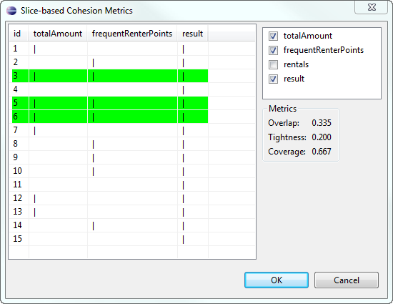
Evaluation (1)
Overlap +0.29
Tightness +0.19
Coverage ~
Notes:
We also used slice-based cohesion metrics to evaluate the recommendations.
These metrics show how cohesive a function or method is and range between [0, 1].
We compared the metric values of the original methods before and after refactoring.

Slide 24
Evaluation (2)
2 developers found manually refactoring opportunities in their own projects
We compared their findings with JDeodorant
  TP: An opportunity identified by human and tool
  FP: An opportunity identified only by tool
  FN: An opportunity identified only by human
Average Precision: 51%
Average Recall: 69%

Slide 27


Slide 28
How this work affected my
research and career?
Notes:
Next, I am going to talk about how this work affected my research and career.

Slide 29

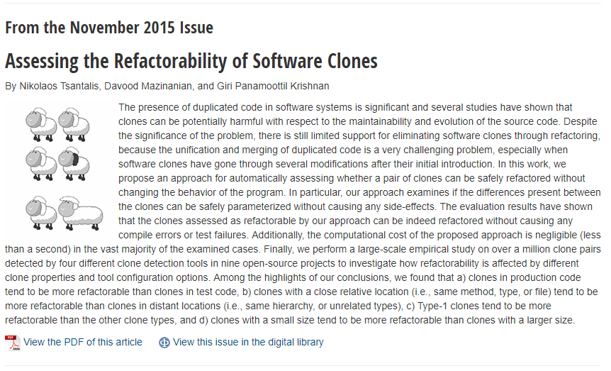
Notes:
A research work that came naturally to me after studying Extract Method was the Refactoring of clones, because the extraction of clones is an extension of the Extract Method problem with the additional challenge of detecting and handling the differences that may exist between the clones. This work was published at the IEEE TSE and was the featured article of November 2015.

Slide 30
Assessing the Refactorability of Software Clones
First approach to automatically assess whether a pair of clones can be safely refactored
Optimize statement matching of the clones
  Maximize the number of matched statements
  Minimize the number of differences between them
List of preconditions to ensure that the differences can be safely parameterized

Slide 31
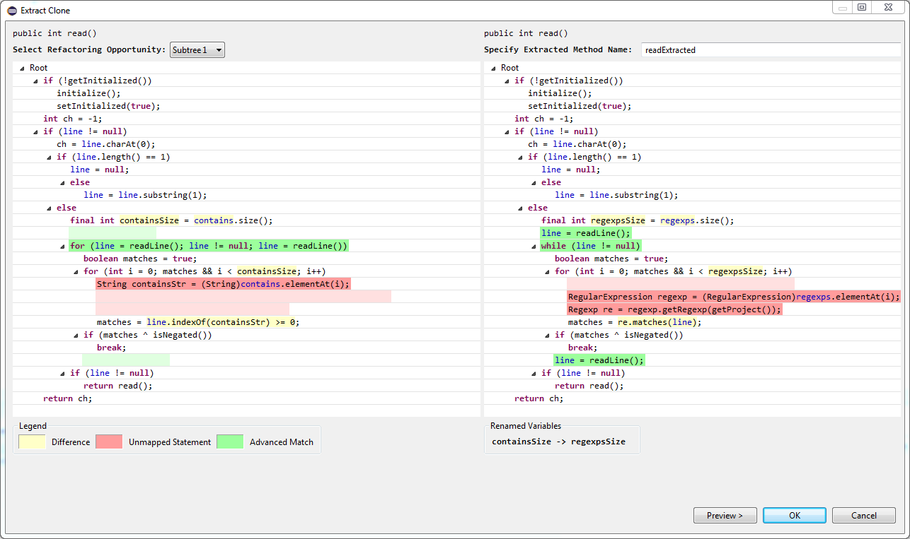

Slide 32
Large-scale Empirical Study
Studied 1M+ clones detected by 4 clone detectors in 9 open-source projects
94% of the clones are either Type-2 or Type-3
Out of those, only 14% could be safely refactored using regular parameters

Slide 33
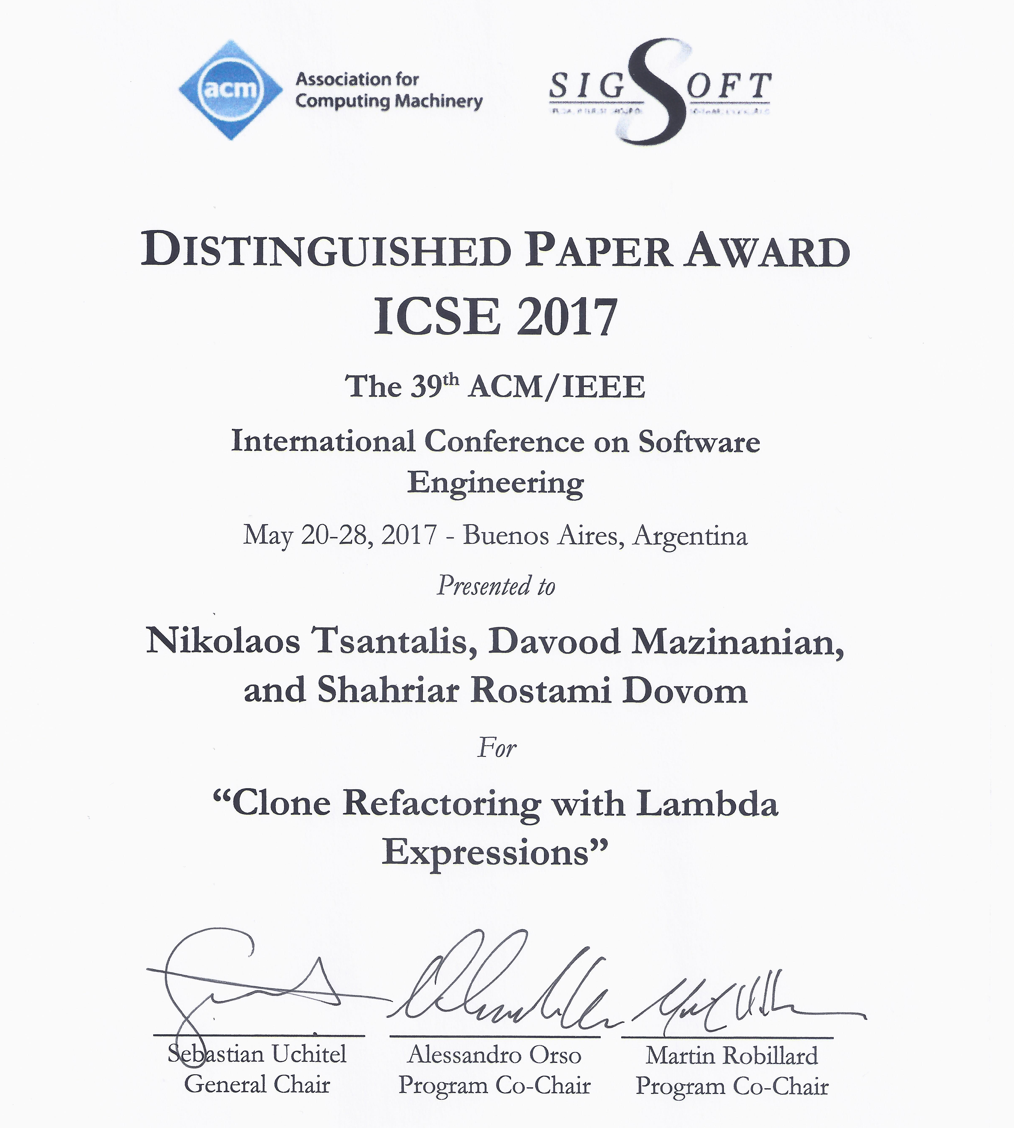

Slide 34
Clone Refactoring with Lambda Expressions
First approach to assess the applicability of Lambda expressions for clone refactoring
Studied 46K+ Type-2 & Type-3 clones that were not refactorable with regular parameters
58% of these clones could be safely refactored with Lambda expressions

Slide 35
How this work affected
other researchers?

Slide 36
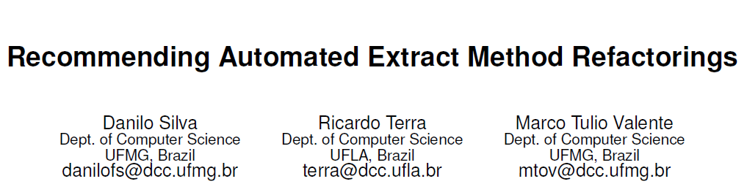



@22nd International Conference on
Program Comprehension (ICPC 2014)

Slide 37
01 | public String execute() throws Exception {
02 |  | logger.info("Starting execute()");
03 |  | Session sess = HibernateUtil.getSessionFactory().openSession();
04 |  | Transaction t = sess.beginTransaction();
05 |  | Criteria criteria = sess.createCriteria(User.class);
06 |  | criteria.add(Restrictions.idEq(this.user.getUsername()));
07 |  | criteria.add(Restrictions.eq("password", this.user.getPassword()));
08 |  | User user = (User) criteria.uniqueResult();
09 |  | t.commit();
10 |  | sess.close();
11 |  | if (user != null) {
12 |  |  | ActionContext.getContext().getSession().put(AUTHENTICATED_USER, user);
13 |  |  | logger.info("Finishing execute() -- Success");
14 |  |  | return SUCCESS;
15 |  | }
16 |  | this.addActionError(this.getText("login.failure"));
17 |  | logger.info("Finishing execute() -- Failure");
18 |  | return INPUT;
19 | }
Types Session, Transaction, Criteria are interfaces

Slide 38
Generation of candidates for extraction
Generate all possible combinations of statements:
Syntactical preconditions:
  ONLY consecutive statements
  control statements should include all their child statements
Behavioral preconditions:
  a single variable must be assigned, if it is returned
Quality preconditions:
  Filter-out very small or very large candidates in size
Notes:
JExtract generates all possible combinations of statements by applying some preconditions to eliminate invalid candidates.

Slide 39
Ranking of candidates
Extract the dependencies of:
The code fragment to be extracted Dep
    The remaining statements Dep’
Dependencies are:
Variables
Types
Packages
Dep’
(Remaining)
Dep
(Extracted)
Notes:
The smaller the intersection between the dependencies of the code fragment to be extracted and the remaining statements, the higher the candidate is ranked in the list.

Slide 40
Oracle for Evaluation
Retrieve all methods with N>3 statements
Retrieve all invoked methods
  Check inline method refactoring preconditions
Inline the methods passing the criteria
Add the Extract Method refactoring reverting the Inline in the oracle
Notes:
One of the most important contributions of this work was the methodology used to create an oracle for the evaluation.

Slide 41
Oracle for Evaluation
Retrieve all methods with N>3 statements
Retrieve all invoked methods
  Check inline method refactoring preconditions
Inline the methods passing the criteria
Add the Extract Method refactoring reverting the Inline in the oracle
Scale-up the evaluation to more cases
Unknown if these methods
were actually extracted
Notes:
This approach for generating oracles has the advantage of scaling-up the evaluation to more cases, but it is unknown whether these methods were actually or intentionally extracted.

Slide 42
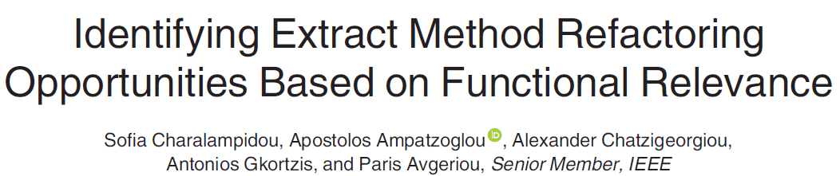
@IEEE Transactions on Software Engineering
vol. 43, no. 10, October 2017

Slide 43
Coherent statements
accessing the same variable (attributes, local variables and method parameters)
calling a method for the same object
calling the same method for a different object of the same type

Slide 44
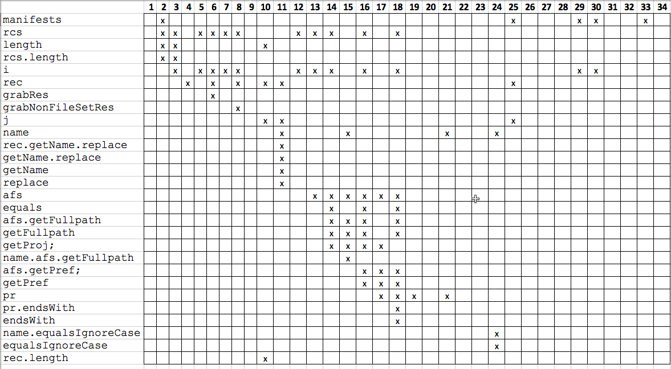
accessible variables and method calls per statement

Slide 45
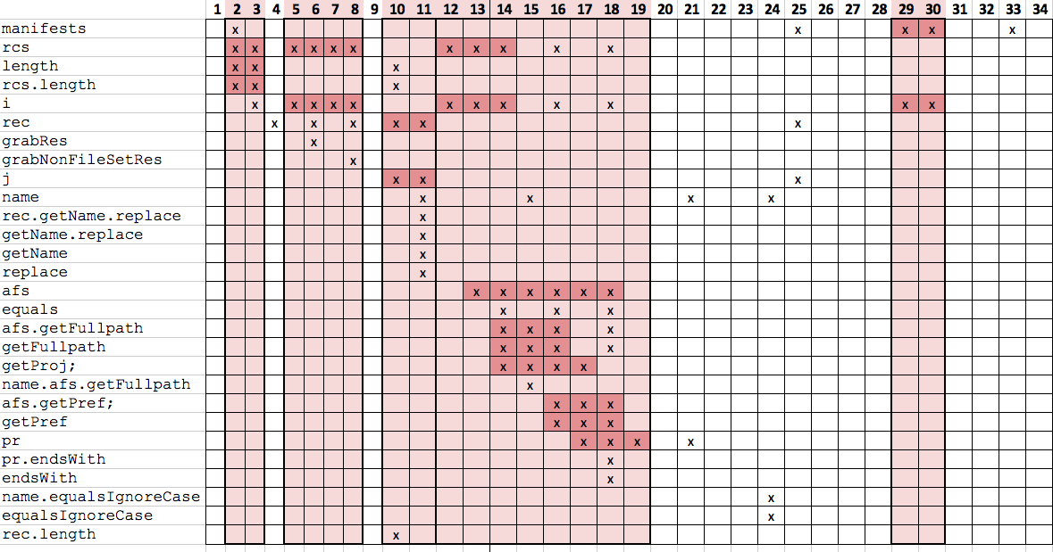
Clusters of coherent statements with distance = 1

Slide 46
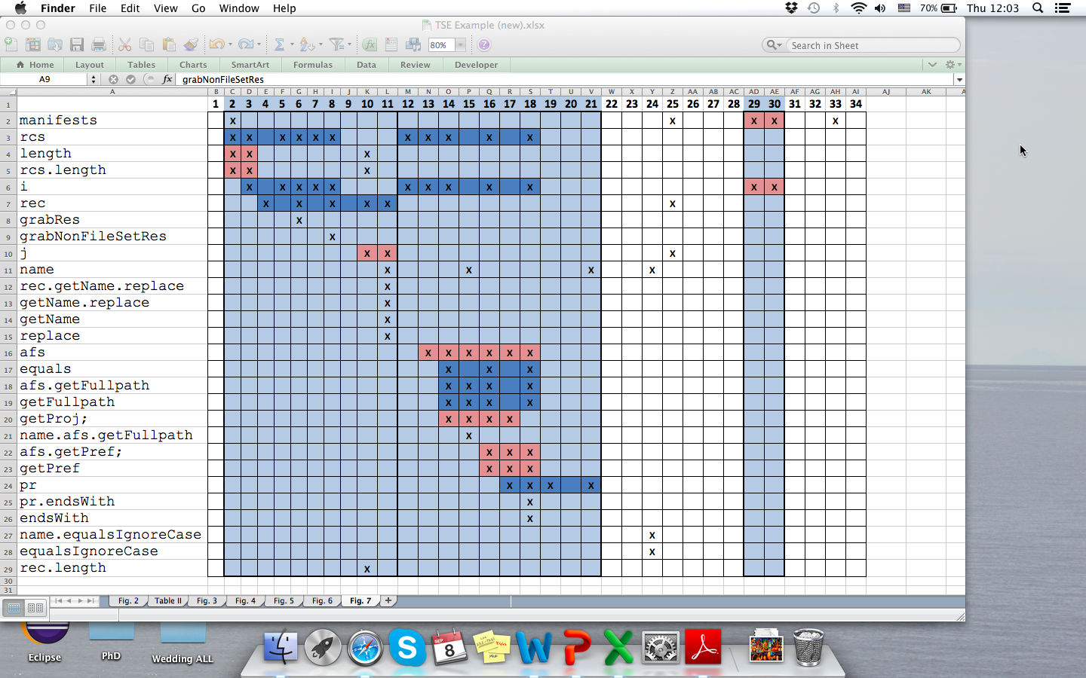
Clusters of coherent statements with distance = 2

Slide 47
Extract Method opportunities
In each iteration, the distance is increased by 1, until we reach the maximum, i.e., method size
Each formed cluster is a candidate refactoring opportunity
Remove candidates
  Duplicate clusters
  Clusters violating preconditions

Slide 48
Evaluation
Tools | Tolerance | Recall | Precision | F-Measure
SEMI | 1% | 38,0% | 12,9% | 19,2%
 | 2% | 47,0% | 14,6% | 22,3%
 | 3% | 55,5% | 18,8% | 28,1%
JDeodorant | 1% | 14,8% | 17,4% | 16,0%
 | 2% | 18,4% | 21,1% | 19,7%
 | 3% | 23,8% | 28,0% | 25,7%
JExtract | 1% | 52,2% | 12,6% | 20,4%
 | 2% | 59,3% | 13,1% | 21,5%
 | 3% | 61,9% | 15,0% | 24,2%
Notes:
The authors selected the same case studies as those used for the evaluation of JDeodorant and JExtract.
Tolerance is the percentage of statements that could differ from the golden standard (Lines of code to be extracted in a new method, as suggested by experts).

Slide 49
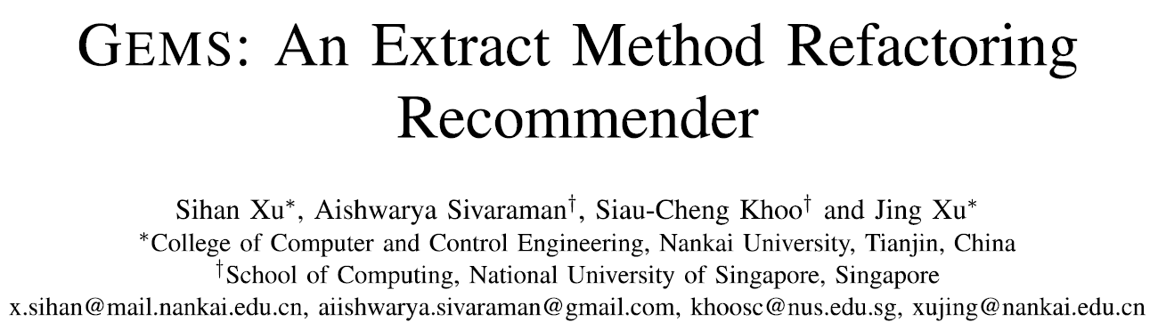
@IEEE 28th International Symposium on
Software Reliability Engineering (ISSRE 2017)
Notes:
GEMS is a machine-learning based approach

Slide 50
Feature Extraction
Structural features: number of control flow statements, variables, method invocations, packages, ratio of total lines of code
Functional features:
  Find program elements (invocations, packages, variable accesses, type accesses) only/mainly used in extracted code (likely functionality)
  Calculate the ratio of statements involved in this functionality within the extracted code (cohesion)

Slide 51
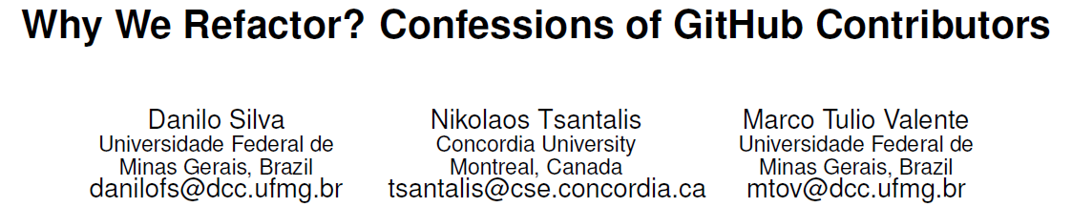

Training GEMS
267 Extract Method refactorings from open-source projects that were confirmed from the developers who applied them
5598 inlined methods that were invoked only once in the source code of the projects

Slide 52
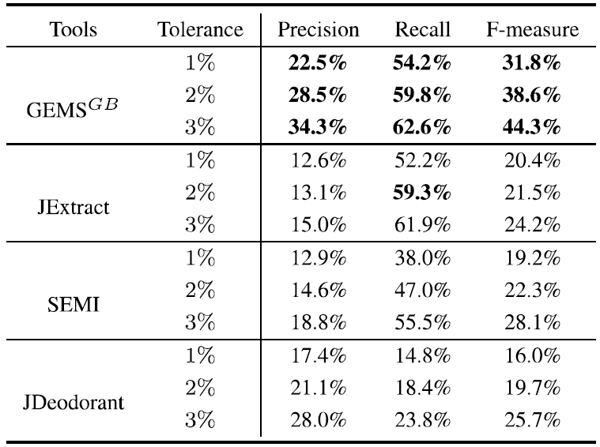
Evaluation

Slide 53
Overall comparison
JDeodorant is still the only tool that can recommend Extract Method refactoring opportunities for non-consecutive statements
JDeodorant still has very competitive precision
Machine learning beats everything, but needs lots of training data

Slide 54
Lessons learned – How to impact
Find a challenging topic with practical impact
  The right topic can build your career up to tenure
Don’t be afraid to build on previous ideas
  As long as the increments are not trivial
Tools + data
  Maintain your tools & support your users
  Research that cannot be reproduced is not science
Listen to your reviewers, despite the pain
  Get inspired from their feedback and push the bar
Notes:
1. It’s very important to find a topic that will give you the opportunity to study a research area in depth. The knowledge and skills you will gain can build your career up to tenure and even further.
2. It’s important to study well the related work, find good ideas that are perhaps not mature enough and build on them.
3. Make your tools and data publicly available.

