Slide 1
A Refactoring Technique for Large Groups of Software Clones
(Master thesis defense)
Asif AlWaqfi
Supervised by: Dr. Nikolaos Tsantalis
Department of Computer Science and Software Engineering
Faculty of Engineering and Computer Science
Concordia University

Slide 2
Introduction
Software Maintenance is the last step in System Development Life Cycle (SDLC)
Duplicate Code
Increase maintenance effort and cost [LozanoICSM2008]
Error proneness when clones are updated inconsistently [JuergensICSE2009]
Code instability [MondalACM2012]
Software Refactoring

Slide 3
Motivation
Amount of clones in the systems
Researchers reported that clones in systems range between 5% to 50% of the systems code base.
Lack of mature and reliable clone refactoring tools
Support specific clone types
Other limitations
Developers care about duplicate code and they try to avoid duplicate code when performing maintenance tasks. [YamashitaUSER2013, SilvaFSE2016]
Notes:
Make it small it

Slide 4
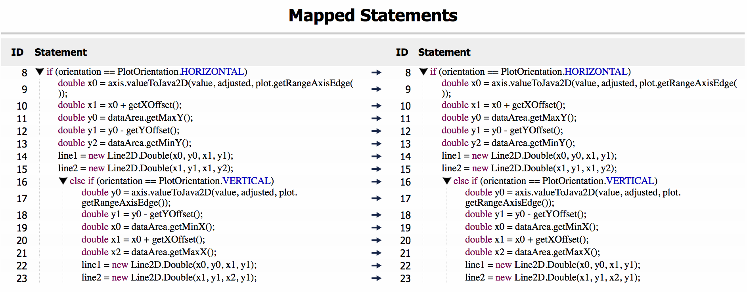
Clone Types
Clone Type I

Slide 5
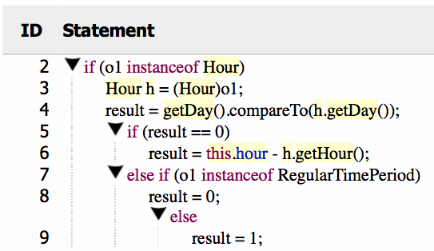
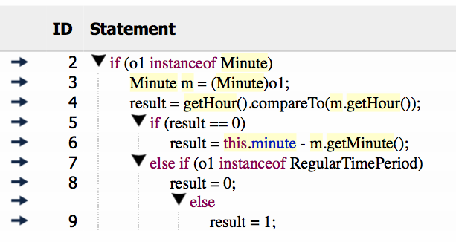
Clone Types
Clone Type II

Slide 6
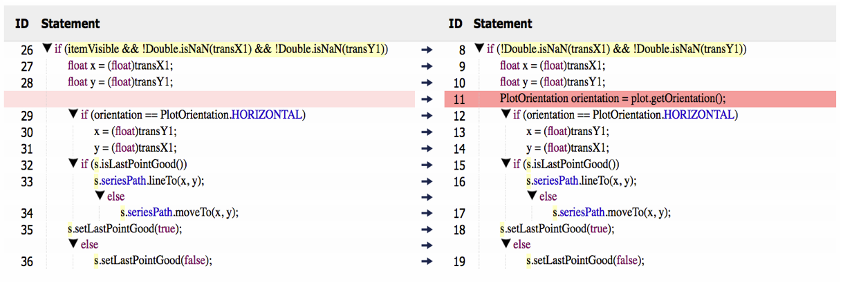
Clone Types
Clone Type III

Slide 7
Clone Types
Clone Type IV
void loopOver (int var){ while(var > 0) { System.out.println(var); var--; } } | void loopOver (int var){ if(var > 0) { System.out.println(var); loopOver(--var); } }

Slide 8
Thesis goal
We ran 4 clone detection tools on 9 open source projects: 31% of the reported clone groups contain more than 2 clone instances.
Refactoring Clone Groups

Slide 9
Approach

Slide 10
Approach
Clone Detection Tool
Clone Parsing
Project Parsing
Project
Common Structure
Clone Groups
Information Extraction
Sub Groups
Clustering
Differences
Refactorability Assessment
Statement Alignment
Pairwise Matching

Slide 11
Approach
Clone Detection Tool
Clone Parsing
Project Parsing
Project
Common Structure
Clone Groups
Information Extraction
Sub Groups
Clustering
Differences
Refactorability Assessment
Statement Alignment
Pairwise Matching

Slide 12
Information extraction (Data type, Example)
url = getItemURLGenerator(row, column).generateURL(dataset, row, column);
Assignment Left-Side:
Identifier name: url
Data Types (Including Super types): CharSequence, String
Assignment Right-Side (Method Call):
Method name: getItemURLGenerator(row, column).generateURL
Return Data Types (Including Super types): CharSequence, String
Parameters Data Types: ({IntervalCategoryDataset, KeyedValues2D, Dataset, CategoryDataset, GanttCategoryDataset, Values2D}, {int}, {int})

Slide 13
Approach
Clone Detection Tool
Clone Parsing
Project Parsing
Project
Common Structure
Clone Groups
Information Extraction
Sub Groups
Clustering
Differences
Refactorability Assessment
Statement Alignment
Pairwise Matching

Slide 14
Clustering
Clone detection tools might report clone groups having dissimilar clone instances, affecting the refactorability of the group as a whole.
For instance, token-based and text-based detectors don’t validate the control statements in the clones, one could be an If while the other is a For.
The goal of clustering step is to create smaller groups that their clone instances:
Have a common control structure.
Less different.

Slide 15
Clone (1)
Clone (2)
if (state.getInfo() != null) {
EntityCollection entities = state.getEntityCollection();
if (entities != null) {
String tip = null;
if (getToolTipGenerator(row, column) != null) {
tip = getToolTipGenerator(row, column).generateToolTip(
dataset, row, column);
}
String url = null;
if (getItemURLGenerator(row, column) != null) {
url = getItemURLGenerator(row, column).generateURL(dataset, row, column);
}
CategoryItemEntity entity = new CategoryItemEntity(bar, tip,url, dataset, dataset.getRowKey(row),dataset.getColumnKey(column));
entities.add(entity);
}
}
if (state.getInfo() != null) {
EntityCollection entities = state.getEntityCollection();
if (entities != null) {
String tip = null;
CategoryToolTipGenerator tipster = getToolTipGenerator(row,column);
if (tipster != null) {
tip = tipster.generateToolTip(dataset, row, column);
}
String url = null;
if (getItemURLGenerator(row, column) != null) {
url = getItemURLGenerator(row, column).generateURL(dataset, row, column);
}
CategoryItemEntity entity =new CategoryItemEntity(bar,tip,url, dataset, dataset.getRowKey(row), dataset.getColumnKey(column));
entities.add(entity);
}
}
EXAMPLE
Clone (3)
Clone (4)
if (state.getInfo() != null) {
EntityCollection entities = state.getEntityCollection();
if (entities != null) {
String tip = null;
CategoryToolTipGenerator tipster= getToolTipGenerator(row, column);
if (tipster != null) {
tip = tipster.generateToolTip(data, row, column);
}
String url = null;
if (getItemURLGenerator(row, column) != null) {
url= getItemURLGenerator(row,column).generateURL(data,row, column);
}
CategoryItemEntity entity = new CategoryItemEntity(bar,tip, url, data, data.getRowKey(row), data.getColumnKey(column));
entities.add(entity);
}
}
if (state.getInfo() != null) {
EntityCollection entities = state.getEntityCollection();
if (entities != null) {
String tip = null;
CategoryToolTipGenerator tipster = getToolTipGenerator(row, column);
if (tipster != null) {
tip = tipster.generateToolTip(data, row, column);
}
String url = null;
if (getItemURLGenerator(row, column) != null) {
url = getItemURLGenerator(row, column).generateURL(data, row, column);
}
CategoryItemEntity entity = new CategoryItemEntity(bar, tip, url, data, data.getRowKey(row),data.getColumnKey(column));
entities.add(entity);
}
}

Slide 16
Clustering (common structure)
Clone (1)
Clone (2)
if (state.getInfo() != null) {
EntityCollection entities = state.getEntityCollection();
if (entities != null) {
String tip = null;
if (getToolTipGenerator(row, column) != null) {
tip = getToolTipGenerator(row, column).generateToolTip(
dataset, row, column);
}
String url = null;
if (getItemURLGenerator(row, column) != null) {
url = getItemURLGenerator(row, column).generateURL(dataset, row, column);
}
CategoryItemEntity entity = new CategoryItemEntity(bar, tip, url,
dataset, dataset.getRowKey(row),dataset.getColumnKey(column));
entities.add(entity);
}
}
if (state.getInfo() != null) {
EntityCollection entities = state.getEntityCollection();
if (entities != null) {
String tip = null;
CategoryToolTipGenerator tipster= getToolTipGenerator(row, column);
if (tipster != null) {
tip = tipster.generateToolTip(data, row, column);
}
String url = null;
if (getItemURLGenerator(row, column) != null) {
url= getItemURLGenerator(row,column).generateURL( data,row,column);
}
CategoryItemEntity entity = new CategoryItemEntity (bar,tip, url, data, data.getRowKey(row), data.getColumnKey(column));
entities.add(entity);
}
}
1
1
3
3
5
8
6
9

Slide 17
Clustering (common structure)
Clone (1)
Clone (2)
1
1
3
3
5
8
6
9

Slide 18
1
1
1
3
3
3
5
Clone 1
8
Clone 2
6
Clone 3
9
?
6
9
?
=
=
1
1
1
3
3
3
6
Clone 2
9
6
Clone 3
9
6
Clone 4
9
Clone 1, Clone 2
Clone 1, Clone 2, Clone 3
Clone 1, Clone 2, Clone 3, Clone 4

Slide 19
Approach
Clone Detection Tool
Clone Parsing
Project Parsing
Project
Common Structure
Clone Groups
Information Extraction
Sub Groups
Clustering
Differences
Refactorability Assessment
Statement Alignment
Pairwise Matching

Slide 20
Clustering (Differences)
This step of clustering is done by:
Compute distance matrix.
Apply Hieratical clustering.
In each round in Hieratical clustering a merge is done and Silhouette Coefficient is computed.
Clusters with the highest Silhouette Coefficient are selected.
Silhouette Coefficient
A measurement that is used to measure and estimate the consistency and quality of clusters.
The closer Silhouette Coefficient to 1 the less the dissimilarity within the same cluster and greater to the other clusters so we can say it is well-clustered.

Slide 21
Example
Clone | (1) | (2) | (3) | (4)
(1) | 0.0 | 14.0 | 14.0 | 14.0
(2) | 14.0 | 0.0 | 6.0 | 6.0
(3) | 14.0 | 6.0 | 0.0 | 6.0
(4) | 14.0 | 6.0 | 6.0 | 0.0
Clone(4)
Clone | (1) | (2) | (3) | (4)
(1) | 0.0 | 14.0 | 14.0 | 14.0
(2) | 14.0 | 0.0 | 6.0 | 6.0
(3) | 14.0 | 6.0 | 0.0 | 6.0
(4) | 14.0 | 6.0 | 6.0 | 0.0
Clone(1)
Clone(2)
Clone(3)
Clone(4)
Distance Matrix
Clone(1)
Clone(4)
Clone(1)
Clone(2)
Clone(2)
Clone(3)
Clone(3)
Silhouette Coefficient = ~0.43
Clone(1)
Clone(2)
Clone(3)
Clone(4)
Silhouette Coefficient = 0

Slide 22
Approach
Clone Detection Tool
Clone Parsing
Project Parsing
Project
Common Structure
Clone Groups
Information Extraction
Sub Groups
Clustering
Differences
Refactorability Assessment
Statement Alignment
Pairwise Matching

Slide 23
Pairwise matching
Clone Pair
Children are mapped using (in order):
String similarity = 1.0 and Vector similarity = 1.0
Vector similarity = 1.0
String similarity = 1.0
Data types
Has control statement?
Yes
No
(1) Map statements based on control dependencies
(2) Map statements based on data dependencies
Statements Mapping using (in order):
String similarity = 1.0
Vector similarity = 1.0
(3) Map statements based on dependencies from method signature
(4) Statements have no
incoming dependencies
Data Types
Mapping Result
(5) Statements not matched

Slide 24
Pairwise matching (Example)
System.out.println("Start");
double x = 4.1;
double y = 2.0;
double z1 = y + 3.0;
double z2 = x + 5.0;
String str ="Do nothing";
System.out.println("End");
if(x > 0){
System.out.println("Inside If");
}
System.out.println("Start");
double y = 2.0;
double x = 4.1;
double z1 = y + 3.0;
String str ="Do nothing";
String str2 = "String 2" + x;
System.out.println("End");
if(x > 0){
System.out.println("Inside If");
}
double z2 = x + 9.0;

Slide 25
Pairwise matching (Example)
String Similarity |  | Clone (1)
 |  | 1 | 2 | 3 | 4 | 5 | 6 | 7 | 8 | 9
Clone (2) | 1 | 1 | 0 | 0 | 0 | 0 | 0 | 0 | 0 | 0
 | 2 | 0 | 0 | 1 | 0 | 0 | 0 | 0 | 0 | 0
 | 3 | 0 | 1 | 0 | 0 | 0 | 0 | 0 | 0 | 0
 | 4 | 0 | 0 | 0 | 1 | 0 | 0 | 0 | 0 | 0
 | 5 | 0 | 0 | 0 | 0 | 0 | 1 | 0 | 0 | 0
 | 6 | 0 | 0 | 0 | 0 | 0 | 0 | 0 | 0 | 0
 | 7 | 0 | 0 | 0 | 0 | 0 | 0 | 1 | 0 | 0
 | 8 | 0 | 0 | 0 | 0 | 0 | 0 | 0 | 1 | 0
 | 9 | 0 | 0 | 0 | 0 | 0 | 0 | 0 | 0 | 1
 | 10 | 0 | 0 | 0 | 0 | 0 | 0 | 0 | 0 | 0
Vector Similarity |  | Clone (1)
 |  | 1 | 2 | 3 | 4 | 5 | 6 | 7 | 8 | 9
Clone (2) | 1 | 1 | 0 | 0 | 0 | 0 | 0 | 1 | 0 | 1
 | 2 | 0 | 0 | 1 | 0 | 0 | 0 | 0 | 0 | 0
 | 3 | 0 | 1 | 0 | 0 | 0 | 0 | 0 | 0 | 0
 | 4 | 0 | 0 | 0 | 1 | 0 | 0 | 0 | 0 | 0
 | 5 | 0 | 0 | 0 | 0 | 0 | 1 | 0 | 0 | 0
 | 6 | 0 | 0 | 0 | 0 | 0 | 0 | 0 | 0 | 0
 | 7 | 1 | 0 | 0 | 0 | 0 | 0 | 1 | 0 | 1
 | 8 | 0 | 0 | 0 | 0 | 0 | 0 | 0 | 1 | 0
 | 9 | 1 | 0 | 0 | 0 | 0 | 0 | 1 | 0 | 1
 | 10 | 0 | 0 | 0 | 0 | 1 | 0 | 0 | 0 | 0

Slide 26
Pairwise matching (Example)
Clone (2) | Clone (1)
1
2
3
4
5
6
7
8
9
10
System.out.println("Start");
double x = 4.1;
double y = 2.0;
double z1 = y + 3.0;
double z2 = x + 5.0;
String str ="Do nothing";
System.out.println("End");
if(x > 0){
System.out.println("Inside If");
}
Clone Pair
Clone (2) | Clone (1)
1
Has control statement?
Has control statement?
3
Cone (1)
Yes
No
2
(1) Map statements based on control dependencies
(2) Map statements based on data dependencies
(1) Map statements based on control dependencies
(2) Map statements based on data dependencies
4
6
(3) Map statements based on dependencies from method signature
System.out.println("Start");
double y = 2.0;
double x = 4.1;
double z1 = y + 3.0;
String str ="Do nothing";
String str2 = "String 2" + x;
System.out.println("End");
if(x > 0){
System.out.println("Inside If");
}
double z2 = x + 9.0;
(3) Map statements based on dependencies from method signature
7
(4) Statements have no incoming dependencies
(4) Statements have no incoming dependencies
8
Cone (2)
9
(5) Statements not matched
Mapping Result
(5) Statements not matched
Mapping Result
5

Slide 27
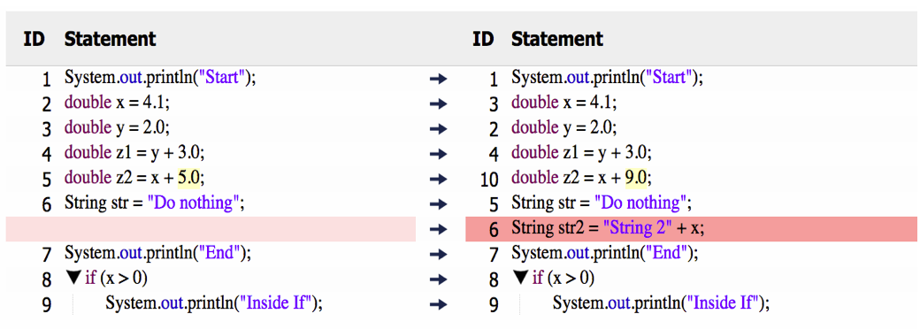
Pairwise matching (Example)

Slide 28
Approach
Clone Detection Tool
Clone Parsing
Project Parsing
Project
Common Structure
Clone Groups
Information Extraction
Sub Groups
Clustering
Differences
Refactorability Assessment
Statement Alignment
Pairwise Matching

Slide 29
Statement alignment
The results from previous step (Pairwise Matching) are matched pairs.
The goal of this step is to connect the mapped statements in these pairs and to find all common statements across the fragments in the cluster.
The alignment process follows a transitive approach, so in our example:
Cluster contains three clones: Clone (2), Clone (3), Clone (4)
Pairwise Matching return two pairs:
Pair1: Clone (2) and Clone (3)
Pair2: Clone (3) and Clone (4)
Alignment results in the next slide.

Slide 30
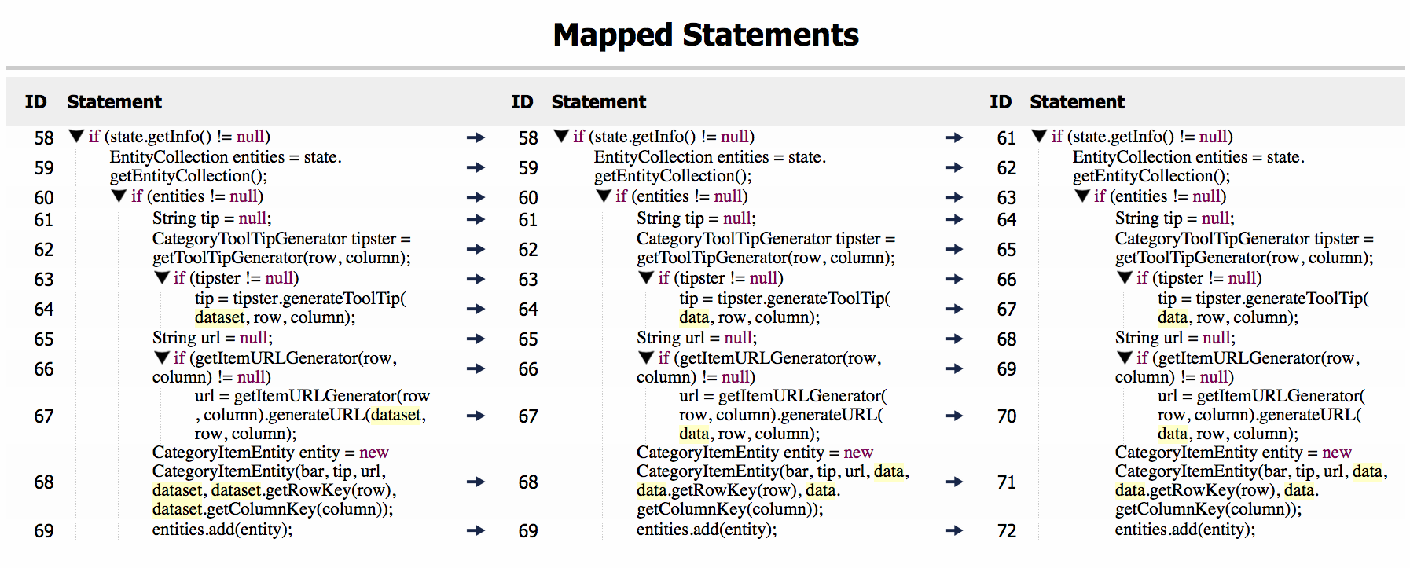

Slide 31
Approach
Clone Detection Tool
Clone Parsing
Project Parsing
Project
Common Structure
Clone Groups
Information Extraction
Sub Groups
Clustering
Differences
Refactorability Assessment
Statement Alignment
Pairwise Matching

Slide 32
Refactorability Assessment
To validate if the clones within the same cluster can be refactored
We extended the work of Tsantalis et al. [TsantalisTSE2015] to accept more than two fragments and return refactorability status
A cluster is refactorable if it passes all the 8-Preconditions proposed by Tsantalis et al. [TsantalisTSE2015]

Slide 34
Qualitative study

Slide 35
Qualitative study (Setup)
Project: JFreeChart 1.0.10
Clone Set: Clones were detected by Deckard in production code only.
Total clone instances: 2306
Total groups: 847
Pairwise matching is done to all pair combination for clones within the same cluster
Group Size | Number of Groups
2 | 591
3 | 92
4 | 98
5 | 21
>5 | 45

Slide 36
Qualitative study (Discussion)
Accuracy Evaluation
If pairs are similarly matched by Our work and Tsantalis et al. [TsantalisTSE2015] work.
Performance Evaluation
Compare the time for our work to Tsantalis et al. work [TsantalisTSE2015] time.
Clustering Evaluation
The impact of the second step of clustering (Differences) in improving groups refactorability.
Clone Group level Evaluation
We assess the Grous refactorability, along with the execution time for the whole approach.
Group time is in compare to Tsantalis et al. work [TsantalisTSE2015]

Slide 37
Accuracy Evaluation
Clone Type | Number of clone pairs | Identical mapping at Pair level | Identical mapping at statement level
Type I | 326 | 100% | 100%
Type II | 732 | 94% | 98%
Type III | 24 | 62.5% | 93%
For Clone Type I our work has an identical matching to Tsantalis et al.
For Type II and Type III there are differences:
Clone Type | Number of clone pairs | Different mapping | More mapped statements | Less mapped statements | Different mapping & more mapped statements
Type II | 44 | 24 | 15 | 1 | 4
Type III | 8 | 3 | 4 | 1 | 0

Slide 38
Different statement Mapping
Our Mapping
Tsantalis et al. Mapping

Slide 39
More statements mapped
Our Mapping
Tsantalis et al., Mapping

Slide 40
Less statements mapped
Our Mapping
Tsantalis et al., Mapping

Slide 41
Accuracy Evaluation
We have differences in statements mappings, but:
These differences didn’t affect the refactorability of the pairs.
For the refactorable pairs we need to extend our work to perform actual refactoring.

Slide 42
Performance Evaluation
Mean or Median? Decide based on the distribution of the data
Skewness: This measure describes the symmetry of the data points around the Mean (skewness = 0).
Kurtosis: This measure describes if the shape of the data is the same as the Gaussian distribution (kurtosis = 0), or if it has a tail.
Skewness
Kurtosis
Median
Our work
Tsantalis et al.
0.9
6.3
69.1 (ms)
6.6
82.5
72.3 (ms)

Slide 43
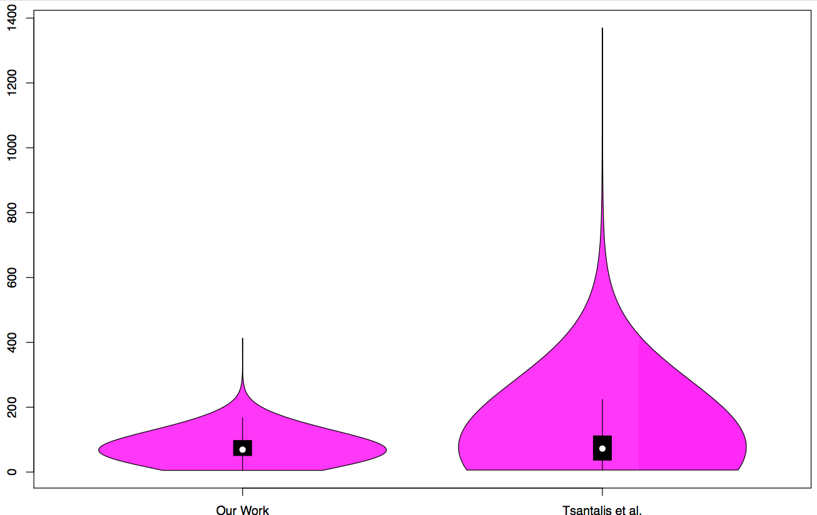
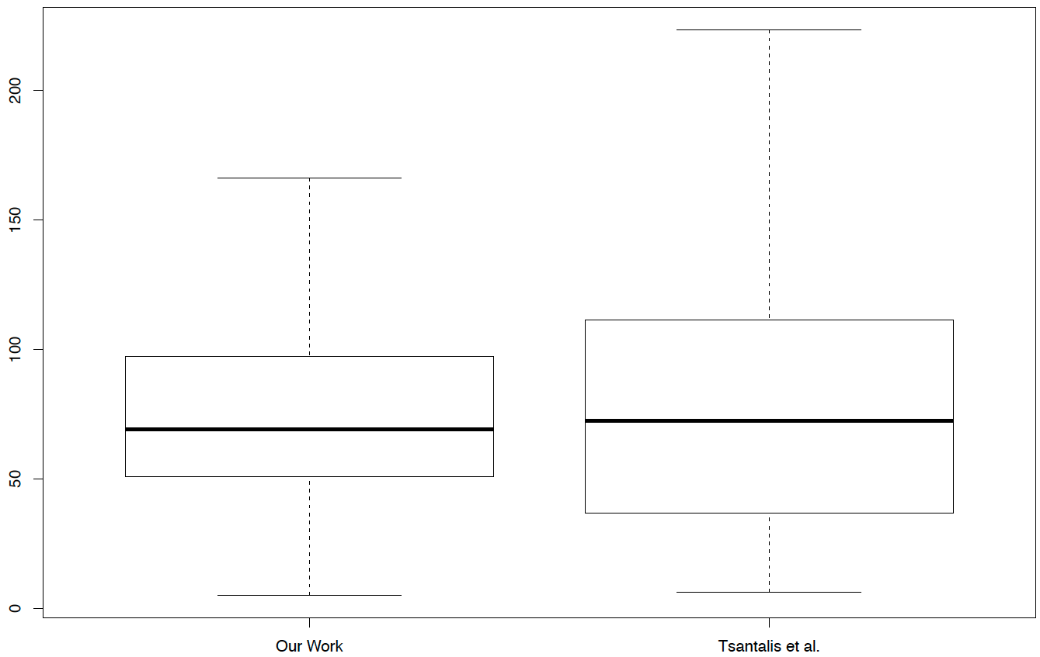
Performance Evaluation
Millisecond

Slide 44
Performance Evaluation
Medians
Our work: 69.1 (ms)
Tsantalis et al.: 72.3 (ms)
Time distribution (ms)
Our work: (5.1 - 170)
Tsantalis et al.: (6.2 - 225)
Medians are almost the same but the time distribution shows our time is better.

Slide 45
Clustering Evaluation
In this evaluation we compare the clusters resulted from Common Structure to the clusters after applying Differences, and we found that:
Change | # Cases
No changes to the clusters resulting from clustering based on Common Structure
25
Removing clone fragments from the clusters resulting from clustering based on Common Structure increased the number of refactorable clusters
10
The clusters resulting from clustering based on Differences were more and/or smaller from the clusters resulting from clustering based on Common Structure
19
Removing a clone fragment from the clusters resulting from clustering based on Common Structure increased the number of mapped statements
1
Notes:
Goal evaluate the contribution of clustering using differences in our approach

Slide 46
Clustering Evaluation (Example 1)

Slide 47
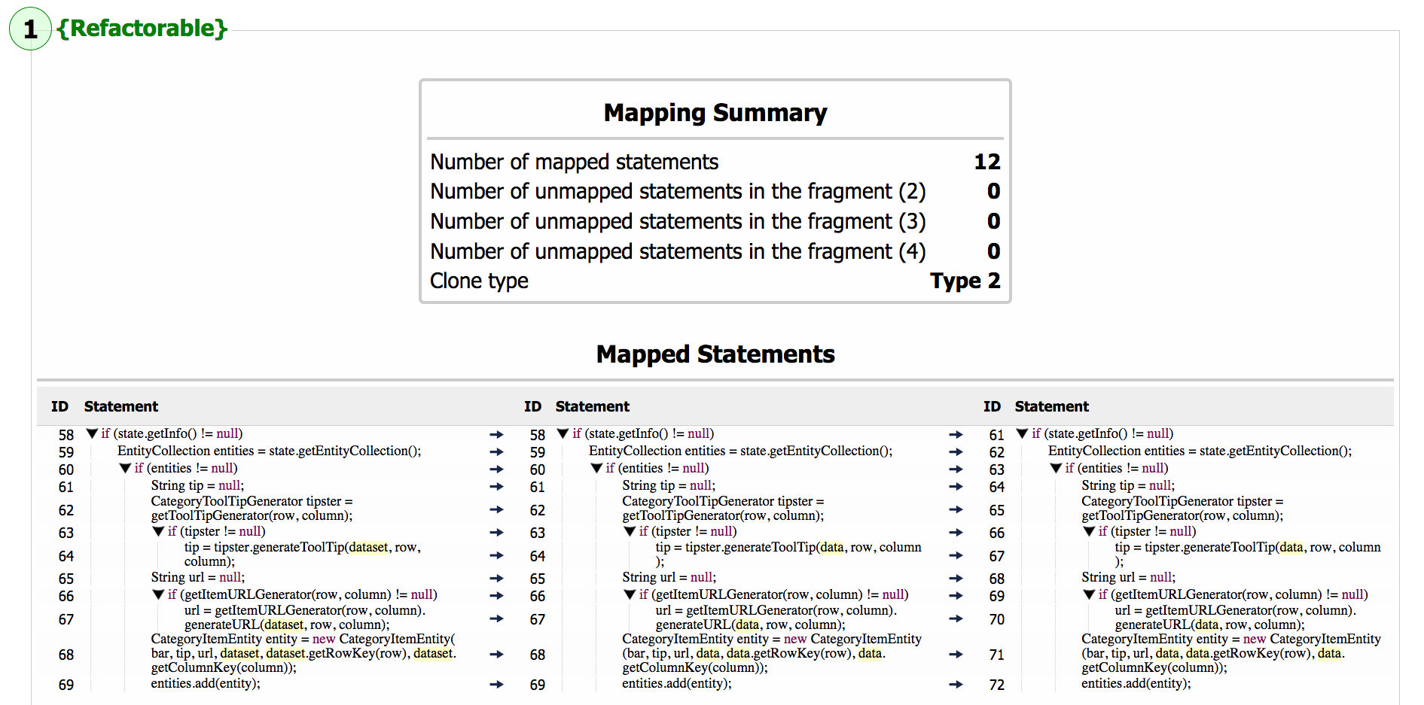

Slide 48
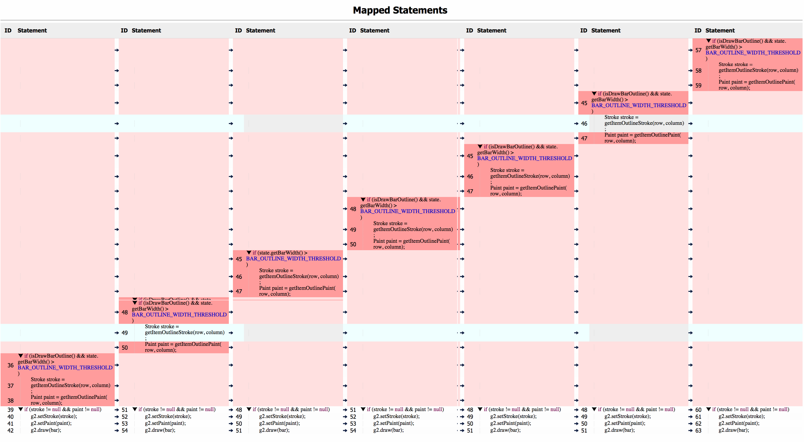

Slide 50
Clone Group level Evaluation
In terms of refactorability:
Initial Groups:
256 Groups containing 3 clones or more
60 Groups excluded (Class level or repeated group)
196 groups in the comparison
Results:
98 Clusters (containing 3 clone instances or more)
48 (out of 98) Refactorable Clusters
41 clone groups (~21% refactorable groups)
In terms of group execution time
Cluster Size | # of Clusters | # of Refactorable Clusters
3 | 44 | 22
4 | 37 | 14
5 | 8 | 5
6 | 2 | 2
7 | 4 | 3
8 | 1 | 1
9 | 1 | 1
>9 | 1 | 0

Slide 51
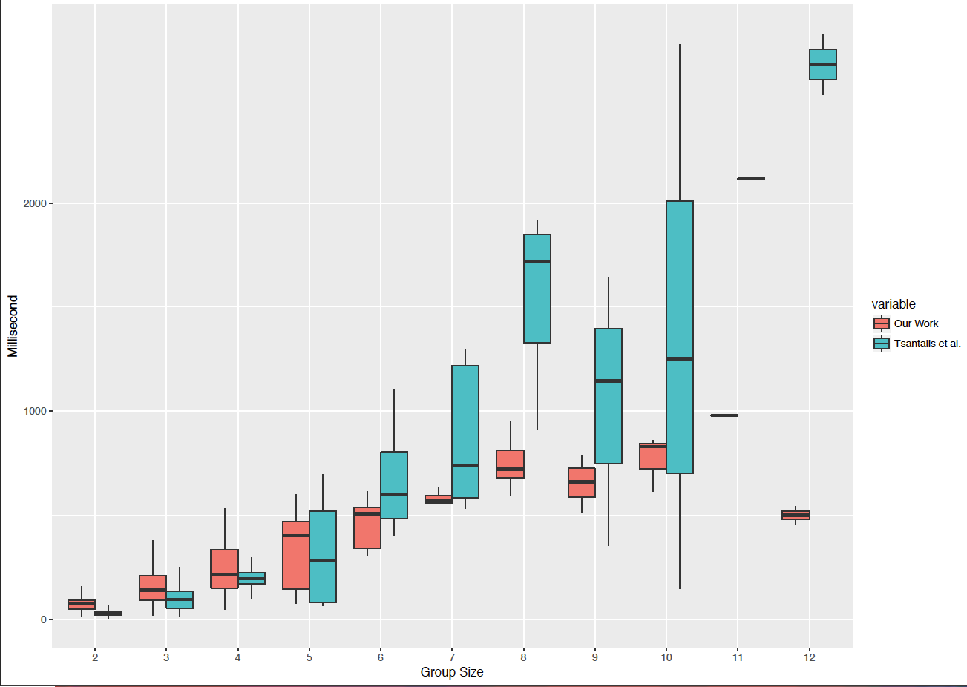

Slide 52
Clone Group Level Evaluation
In terms of Refactorability:
21% (out of 196) refactorable groups were found
In terms of Time:
For groups containing 2-5 clone instances both times are almost the same
For groups containing 6 clone instances or more our approach does better (A huge improvement)

Slide 53
Empirical Study

Slide 54
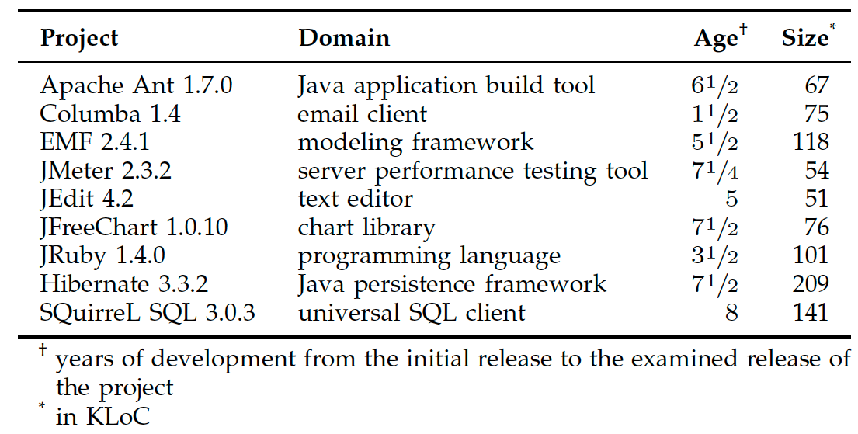
Experiment Setup
To evaluate on large scale projects from different domains.
We ran the experiment on clones detected by NiCad, CCFinder, Deckard, and CloneDR on the 9 projects
44k clone groups, where 13.6k contain 3 clone instances or more.
 | CCFinder | CloneDR | Deckard | NiCad Blind | NiCad Consistent
Clone Type I | 4,875 | 16,156 | 2,456 | 3,278 | 3,844
Clone Type II | 94,354 | 51,927 | 68,231 | 84,320 | 65,286
Clone Type III | 986 | 35 | 1,821 | 30,174 | 6,996
Total Pairs | 100,215 | 68,118 | 72,508 | 117,772 | 76,126
Total pairs in the comparison:

Slide 55
Accuracy Evaluation | CCFinder |  | CloneDR |  | Deckard |  | NiCad Blind |  | NiCad Consistent
 | P | S | P | S | P | S | P | S | P | S
Clone Type I | 100% | 100% | 100% | 100% | 100% | 100% | 100% | 100% | 100% | 100%
Clone Type II | 87.5% | 94.8% | 97% | 98.4% | 89.9% | 96.8% | 85.2% | 95.2% | 89% | 96.3%
Clone Type III | 85.8% | 92.9% | 70.4% | 87.5% | 60.9% | 89.4% | 77.6% | 90.8% | 77.6% | 93.3%
P: Pairs that our work and Tsantalis et al. have the same mapping
S: Statements that our work and Tsantalis et al. have the same mapping
Performance Evaluation | CCFinder |  | CloneDR |  | Deckard |  | NiCad Blind |  | NiCad Consistent
 | O | T | O | T | O | T | O | T | O | T
Clone Type I | 59.69 | 46.78 | 52.6 | 41.95 | 52.71 | 46.67 | 46.82 | 49.2 | 43.81 | 46.11
Clone Type II | 51.79 | 50.32 | 52.54 | 44.77 | 43.92 | 40.21 | 46.96 | 47.67 | 43.16 | 40.48
Clone Type III | 55.44 | 42.45 | 54.53 | 45.31 | 48.41 | 67.47 | 44.08 | 47.24 | 28.97 | 32
Average | 55.64 | 46.52 | 53.22 | 44.01 | 48.35 | 51.45 | 45.95 | 48.04 | 38.65 | 39.53
O: Our execution time in milliseconds
T: Tsantalis et al. execution time in milliseconds

Slide 56
Clone Group Refactorability
A total of 7,217 subgroup we were able to find
Out of the total subgroups 2,833 subgroup were refactorable that contain a total of 13,398 clone instances.
 | CCFinder |  | CloneDR |  | Deckard |  | NiCad Blind |  | NiCad Consistent
 | T | R | T | R | T | R | T | R | T | R
Apache Ant | 115 | 50.4% | 195 | 72.3% | 67 | 38.81% | 96 | 35.42% | 121 | 38.84%
Columba | 100 | 45% | 185 | 55.7% | 82 | 69.51% | 114 | 48.25% | 111 | 54.95%
EMF | 186 | 24.2% | 232 | 59.9% | 71 | 8.45% | 185 | 27.57% | 229 | 24.0%
Hibernate | 201 | 40.8% | 220 | 61.8% | 81 | 37.04% | 137 | 24.09% | 113 | 35.4%
JEdit | 26 | 26.9% | 54 | 51.9% | 16 | 25% | 34 | 32.35% | 24 | 29.17%
JFreechart | 596 | 18.8% | 436 | 56% | 346 | 24.28% | 266 | 25.56% | 293 | 27.65%
JMeter | 69 | 49.3% | 21 | 38.1% | 67 | 41.79% | 79 | 37.97% | 82 | 41.46%
JRuby | 151 | 29.1% | 153 | 47.1% | 96 | 29.17% | 163 | 17.79% | 143 | 23.78%
SQuirreL SQL | 205 | 37.1% | 394 | 64.5% | 96 | 45.83% | 274 | 39.42% | 292 | 41.1%
Average(Tool) | 34.4% |  | 59.5% |  | 33.3% |  | 31.1% |  | 34.0%
T: Total subgroups
R: Refactorable subgroups

Slide 57
Threats to Validity
Internal threats
Clone Detection configurations
No actual refactoring is done
Clustering step might create redundant clusters or discard some refactorable fragments
External threats
In ability to generalize our findings beyond the 9-projects we examined and the four clone detection tools we used

Slide 58
conclusion and Future work

Slide 59
conclusion
Pairwise Matching
Clone Type I: 100% at pair and statement level
Clone Type II: 85.2% - 97% at pair level, and 94.8%-98.4% at statement level
Clone Type III: 60.9%-85.8% at pair level, and 87.5%-93.3% at statement level
Map reordered statements
No thresholds were used in any step of our work
Subgroups Refactorability
We achieved 59.5% for clones detected by CloneDR, and around 31.1%-34.4% for the rest of the tools.
We found for some groups removing a single fragment through clustering make them refactorable.

Slide 60
Future work
Address some of the internal threats to validity.
Add the support for actual refactoring.
Extend our work to support clone refactoring using Lambda expressions.
Improve the steps in our approach.
Create an Eclipse plug-in for clone group refactoring.
Thanks

