Slide 1
Improving the Unification of Software Clones
Using Tree & Graph Matching
Algorithms
Giri Panamoottil Krishnan
Supervisor: Dr. Nikolaos Tsantalis
22.04.14

Slide 2

Outline
Motivation
Goal
Approach
Evaluation
Conclusion
Publications
Future work

Slide 3



Motivation
Harmful effects of software clones
  They are error-prone due to inconsistent updates
  Increase maintenance effort and cost
  They are change-prone
Notes:
There is evidence that clones may be harmful.
So, what is the support we can get from clone refactoring tools?

Slide 4

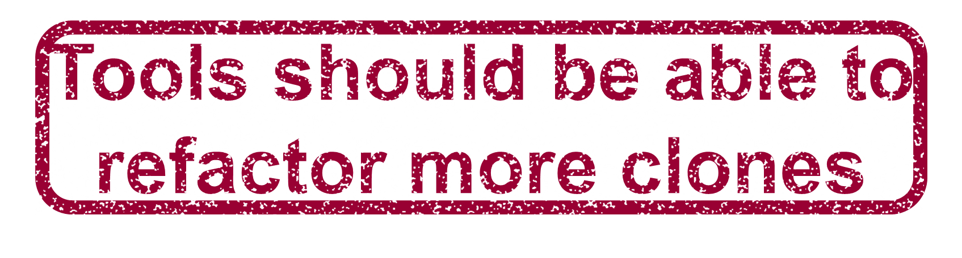

Motivation
Poor performance of current refactoring tools
Eclipse | 10.6%
CeDAR | 18.7%
Notes:
Our position is that tools should be able to refactor more clones

Slide 5
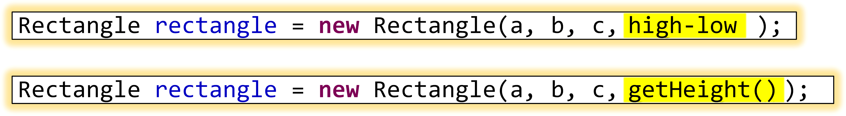
Motivation
Limitations of current refactoring tools
Current tools can parameterize only a small set of differences in clones.
Eg: Identifiers, literals, simple method calls.
Tools should be able to parameterize non-trivial differences.
Eg: Expression replaced by a method call.
Notes:
In this example, we can see two clones that call the same constructor Rectangle,
but there are differences in the passed arguments. For instance method call getHeight() is replaced with infix expression “high - low”. This is a case that is not supported by current clone refactoring tools.

Slide 6
Motivation
Limitations of current refactoring tools
They may not return the best matching solutions.
  They do not explore the entire search space of possible matches. In case of multiple possible matches, they select the “first” or “best” match at that point.
  They face scalability issues due to the problem of combinatorial explosion.

Slide 7

Clone #1
Clone #2
if (orientation == VERTICAL) {
Line2D line = new Line2D.Double();
double y0 = dataArea.getMinY();
double y1 = dataArea.getMaxY();
g2.setPaint(im.getOutlinePaint());
g2.setStroke(im.getOutlineStroke());
if (range.contains(start)) {
line.setLine(start2d, y0, start2d, y1);
g2.draw(line);
}
if (range.contains(end)) {
line.setLine(end2d, y0, end2d, y1);
g2.draw(line);
}
}
else if (orientation == HORIZONTAL) {
Line2D line = new Line2D.Double();
double x0 = dataArea.getMinX();
double x1 = dataArea.getMaxX();
g2.setPaint(im.getOutlinePaint());
g2.setStroke(im.getOutlineStroke());
if (range.contains(start)) {
line.setLine(x0, start2d, x1, start2d);
g2.draw(line);
}
if (range.contains(end)) {
line.setLine(x0, end2d, x1, end2d);
g2.draw(line);
}
}
if (orientation == VERTICAL) {
Line2D line = new Line2D.Double();
double x0 = dataArea.getMinX();
double x1 = dataArea.getMaxX();
g2.setPaint(im.getOutlinePaint());
g2.setStroke(im.getOutlineStroke());
if (range.contains(start)) {
line.setLine(x0, start2d, x1, start2d);
g2.draw(line);
}
if (range.contains(end)) {
line.setLine(x0, end2d, x1, end2d);
g2.draw(line);
}
}
else if (orientation == HORIZONTAL) {
Line2D line = new Line2D.Double();
double y0 = dataArea.getMinY();
double y1 = dataArea.getMaxY();
g2.setPaint(im.getOutlinePaint());
g2.setStroke(im.getOutlineStroke());
if (range.contains(start)) {
line.setLine(start2d, y0, start2d, y1);
g2.draw(line);
}
if (range.contains(end)) {
line.setLine(end2d, y0, end2d, y1);
g2.draw(line);
}
}
24 differences
Notes:
Here we can see two clones (in JFreeChart) as matched by current clone unification techniques.
As we can observe, there are several differences between the matched statement, which make more difficult the refactoring of the clones.
For each difference a parameter has to be added in the extracted method, and in some cases there are differences that cannot be parameterized.
So, this matching solution is not acceptable for the purpose refactoring.

Slide 8
Clone #1
Clone #2
if (orientation == VERTICAL) {
}
if (orientation == VERTICAL) {
Line2D line = new Line2D.Double();
double y0 = dataArea.getMinY();
double y1 = dataArea.getMaxY();
g2.setPaint(im.getOutlinePaint());
g2.setStroke(im.getOutlineStroke());
if (range.contains(start)) {
line.setLine(start2d, y0, start2d, y1);
g2.draw(line);
}
if (range.contains(end)) {
line.setLine(end2d, y0, end2d, y1);
g2.draw(line);
}
}
Line2D line = new Line2D.Double();
double x0 = dataArea.getMinX();
double x1 = dataArea.getMaxX();
g2.setPaint(im.getOutlinePaint());
g2.setStroke(im.getOutlineStroke());
if (range.contains(start)) {
line.setLine(x0, start2d, x1, start2d);
g2.draw(line);
}
if (range.contains(end)) {
line.setLine(x0, end2d, x1, end2d);
g2.draw(line);
}
else if (orientation == HORIZONTAL) {
}
else if (orientation == HORIZONTAL) {
Line2D line = new Line2D.Double();
double x0 = dataArea.getMinX();
double x1 = dataArea.getMaxX();
g2.setPaint(im.getOutlinePaint());
g2.setStroke(im.getOutlineStroke());
if (range.contains(start)) {
line.setLine(x0, start2d, x1, start2d);
g2.draw(line);
}
if (range.contains(end)) {
line.setLine(x0, end2d, x1, end2d);
g2.draw(line);
}
}
Line2D line = new Line2D.Double();
double y0 = dataArea.getMinY();
double y1 = dataArea.getMaxY();
g2.setPaint(im.getOutlinePaint());
g2.setStroke(im.getOutlineStroke());
if (range.contains(start)) {
line.setLine(start2d, y0, start2d, y1);
g2.draw(line);
}
if (range.contains(end)) {
line.setLine(end2d, y0, end2d, y1);
g2.draw(line);
}
Notes:
If we have a closer look to the clones, we will notice that the bodies of the if statements are symmetrically exactly the same

Slide 9

Clone #1
Clone #2
if (orientation == VERTICAL) {
Line2D line = new Line2D.Double();
double y0 = dataArea.getMinY();
double y1 = dataArea.getMaxY();
g2.setPaint(im.getOutlinePaint());
g2.setStroke(im.getOutlineStroke());
if (range.contains(start)) {
line.setLine(start2d, y0, start2d, y1);
g2.draw(line);
}
if (range.contains(end)) {
line.setLine(end2d, y0, end2d, y1);
g2.draw(line);
}
}
else if (orientation == HORIZONTAL) {
Line2D line = new Line2D.Double();
double x0 = dataArea.getMinX();
double x1 = dataArea.getMaxX();
g2.setPaint(im.getOutlinePaint());
g2.setStroke(im.getOutlineStroke());
if (range.contains(start)) {
line.setLine(x0, start2d, x1, start2d);
g2.draw(line);
}
if (range.contains(end)) {
line.setLine(x0, end2d, x1, end2d);
g2.draw(line);
}
}
if (orientation == HORIZONTAL) {
Line2D line = new Line2D.Double();
double y0 = dataArea.getMinY();
double y1 = dataArea.getMaxY();
g2.setPaint(im.getOutlinePaint());
g2.setStroke(im.getOutlineStroke());
if (range.contains(start)) {
line.setLine(start2d, y0, start2d, y1);
g2.draw(line);
}
if (range.contains(end)) {
line.setLine(end2d, y0, end2d, y1);
g2.draw(line);
}
}
else if (orientation == VERTICAL) {
Line2D line = new Line2D.Double();
double x0 = dataArea.getMinX();
double x1 = dataArea.getMaxX();
g2.setPaint(im.getOutlinePaint());
g2.setStroke(im.getOutlineStroke());
if (range.contains(start)) {
line.setLine(x0, start2d, x1, start2d);
g2.draw(line);
}
if (range.contains(end)) {
line.setLine(x0, end2d, x1, end2d);
g2.draw(line);
}
}
2 differences
Notes:
As a result, we can find a better matching for the clones by parameterizing the differences in the conditional expressions of the “if” statements.
This solution is easier to refactor, since a smaller number of differences has to be parameterized.

Slide 10
Minimizing differences
Minimizing the differences during the matching process is critical for refactoring.
Why?
  Less differences means less parameters for the extracted method (i.e., a more reusable method).
  Less differences means also lower probability for precondition violations (i.e., higher refactoring feasibility)
Matching process objectives:
  Maximize the number of matched statements
  Minimize the number of differences between them
Notes:
It directly affects the number of parameters that have to be introduced in the extracted method containing
the common functionality, as well as the feasibility of the refactoring transformation.

Slide 11
Motivation
Limitations of current refactoring tools
There are no preconditions to determine whether clones can be safely refactored.
  The parameterization of differences might change the behavior of the program.
  Statements in gaps need to be moved before the cloned code. Changing the order of statements might also affect the behavior of the program.

Slide 12

Goal
Improving the state-of-the-art in the Refactoring of Software clones
Optimal mapping with minimum differences
Exhaustive search without compromising the performance
Preserve code behavior by extensive rules
Find the most appropriate refactoring strategy to eliminate the clones
Notes:
Point 1: The clones may not necessarily expand over the entire methods; The methods may not necessarily have the same control structure.
Point 2: An optimal mapping should have the maximum number of mapped statements with the minimum number of differences between them.
Point 3: Define preconditions to be examined before refactoring application.
Point 4: Based on the location of clones (i.e., same or different classes) and their particular characteristics (i.e., gaps) we can decide to Extract method, Extract and Pull Up method in a common superclass, apply Template Method design pattern to handle gaps, or extract a static method in a Utility class (if the clones do not access instance variables or methods).

Slide 13

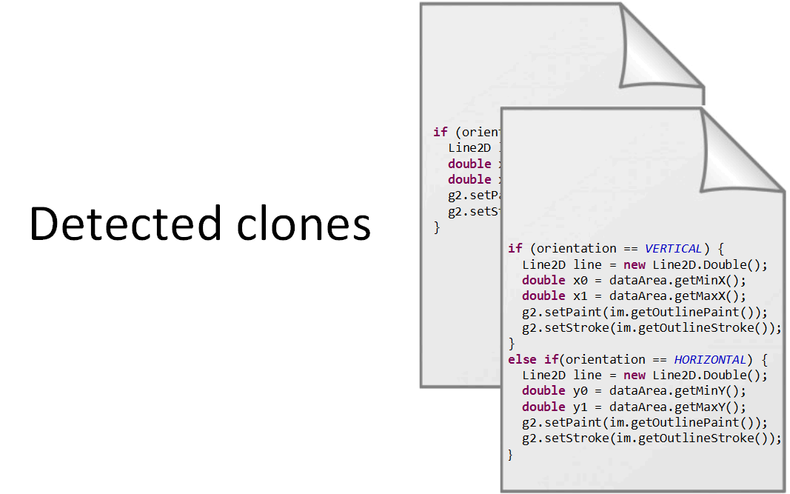
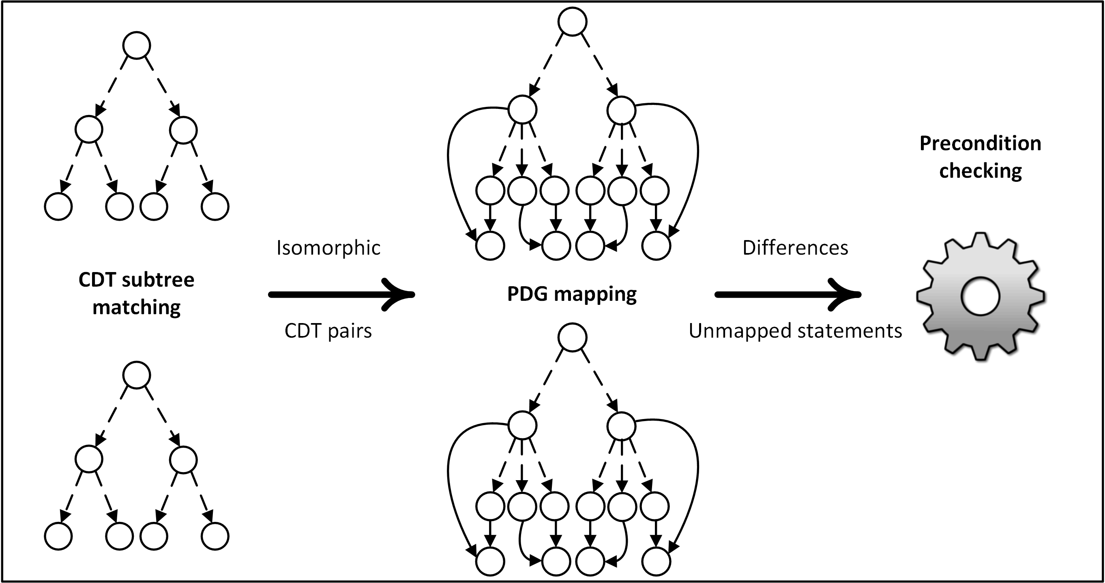
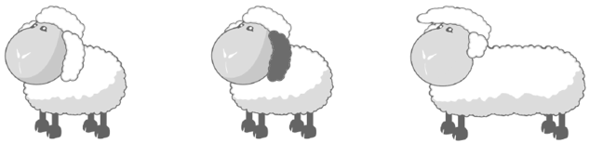
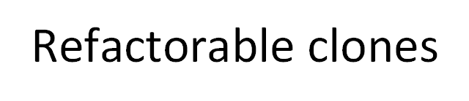
Approach
Notes:
Our approach takes as input clone fragments (detected by tools) or entire methods containing clones.
First, it extracts the control structure of the input code fragments and tries to find matching subtrees.
Next, for each pair of matched subtrees, it generates the corresponding PDG subgraphs and tries to find an optimal mapping.
In the final step, the differences resulting from the mapping solution are examined against some preconditions.
If all preconditions are satisfied the clones can be refactored.

Slide 14
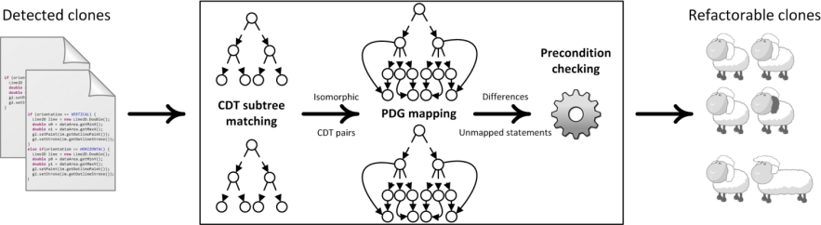
Phase 1
Control Structure Matching
Assumption
Two pieces of code can be merged only if they have an identical control structure.
We extract the Control Dependence Trees (CDTs) representing the control structure of the input methods or clones.
We find all non-overlapping largest common subtrees within the CDTs in a bottom-up manner.
Each subtree match will be treated as a separate refactoring opportunity.

Slide 15
CDT Subtree Matching
CDT of Fragment #1
CDT of Fragment #2
x
A
a
y
B
C
b
c
D
E
F
G
f
g
d
e
Notes:
Assuming that these are the CDTs of two code fragments, the largest common subtree corresponds to the highlighted nodes.

Slide 16
Phase 2
PDG Mapping
We extract the PDG subgraphs corresponding to the matched CDT subtrees.
We want to find the common subgraph that satisfies two conditions:
  It has the maximum number of matched nodes
  The matched nodes have the minimum number of differences.
This is an optimization problem that can be solved using an adaptation of a Maximum Common Subgraph algorithm [McGregor, 1982].

Slide 17

MCS Algorithm
Builds a search tree in depth-first order, where each node represents a state of the search space.
Explores the entire search space.
It has an factorial worst case complexity.
As the number of possible matching node combinations increases, the width of the search tree grows rapidly (combinatorial explosion).

Slide 18
Divide-and-Conquer
We break the original matching problem into smaller sub-problems based on the control dependence structure of the clones.
The sub-problem is the mapping of PDG subgraphs corresponding to the set of statements nested under two control predicate nodes.
Finally, we combine the sub-solutions to give a global solution to the original matching problem.
Notes:
Starting from the control node pairs nested deeper in the control structure of the clones, we perform a Bottom-up Divide-and-Conquer approach to find the best sub-solutions at each level.

Slide 19
Bottom-up Divide-and-Conquer
CDT subtree of Clone #1
CDT subtree of Clone #2
A
a
B
C
b
c
D
E
F
G
f
g
d
e
Level 2
D
d
Best sub-solution from (D, d)
Notes:
Assuming that these are the two CDT subtrees that have been matched in the previous phase,
Our approach starts from node D of the first tree and tries to find all possible matching nodes (at the same level) in the second tree.
Every pair of matched nodes is used as starting point for the MCS algorithm, which returns a sub-solution.
At the end, we select the best sub-solution and continue the same process in a bottom-up fashion.

Slide 20
Bottom-up Divide-and-Conquer
CDT subtree of Clone #1
CDT subtree of Clone #2
A
a
B
C
b
c
E
F
G
f
g
e
Level 2
E
e
Best sub-solution from (E, e)

Slide 21
Phase 3
Precondition checking
Preconditions related to clone differences:
  Parameterization of differences should not break existing data dependences in the PDGs.
  Reordering of unmapped statements should not break existing data dependences in the PDGs.

Slide 22
Phase 3
Precondition checking
Preconditions related to method extraction:
  The unified code should return one variable at most.
  Matched branching (break, continue) statements should be accompanied with the corresponding matched loops in the unified code.
  If two clones belong to different classes, these classes should extend a common superclass.

Slide 23

Evaluation
We compared our approach with a state-of-the-art tool in the refactoring of Type-II clones, CeDAR [Tairas & Gray, IST’12].
2342 clone groups, detected in 7 open-source projects by Deckard clone detection tool.
CeDAR is able to analyze only clone groups in which all clones belong to the same Java ﬁle.
Notes:
As a result, we first focused on these clone groups to enable a fair comparison with CeDAR

Slide 24
Clone groups within the same Java file
Project | Clone groups | Eclipse |  | CeDAR |  | Our tool (JDeodorant) |  | Δ
Ant 1.7.0 | 120 | 14 | 12% | 28 | 23% | 50 | 42% | +79%
Columba 1.4 | 88 | 13 | 15% | 30 | 34% | 41 | 47% | +37%
EMF 2.4.1 | 149 | 8 | 5% | 14 | 9% | 54 | 36% | +286%
JMeter 2.3.2 | 68 | 3 | 4% | 11 | 16% | 20 | 29% | +82%
JEdit 4.2 | 157 | 15 | 10% | 20 | 13% | 57 | 36% | +185%
JFreeChart 1.0.10 | 291 | 29 | 10% | 62 | 21% | 87 | 30% | +40%
JRuby 1.4.0 | 81 | 23 | 28% | 23 | 28% | 33 | 41% | +43%
Total | 954 | 105 | 11% | 188 | 20% | 342 | 36% | +82%

Slide 25
Clone groups within different Java files
Project | Clone groups | JDeodorant
Ant 1.7.0 | 211 | 40 | 20%
Columba 1.4 | 275 | 66 | 24%
EMF 2.4.1 | 58 | 17 | 29%
JMeter 2.3.2 | 225 | 68 | 30%
JEdit 4.2 | 101 | 35 | 35%
JFreeChart 1.0.10 | 337 | 121 | 36%
JRuby 1.4.0 | 181 | 46 | 25%
Total | 1388 | 393 | 28.3%
Clones in different
files are more
difficult to refactor
36% vs. 28%

Slide 26
Clone groups violating only one pre-condition
Project | Clone groups | Returning more than one variable
Ant 1.7.0 | 239 | 27 | 11%
Columba 1.4 | 256 | 7 | 3%
EMF 2.4.1 | 141 | 6 | 4%
JMeter 2.3.2 | 205 | 6 | 3%
JEdit 4.2 | 180 | 14 | 8%
JFreeChart 1.0.10 | 420 | 57 | 14%
JRuby 1.4.0 | 184 | 18 | 10%
Total | 1607 | 135 | 8.4%
If we consider these cases as refactorable, the total % of
refactorable clone groups found by JDeodorant would be equal to 37%

Slide 27
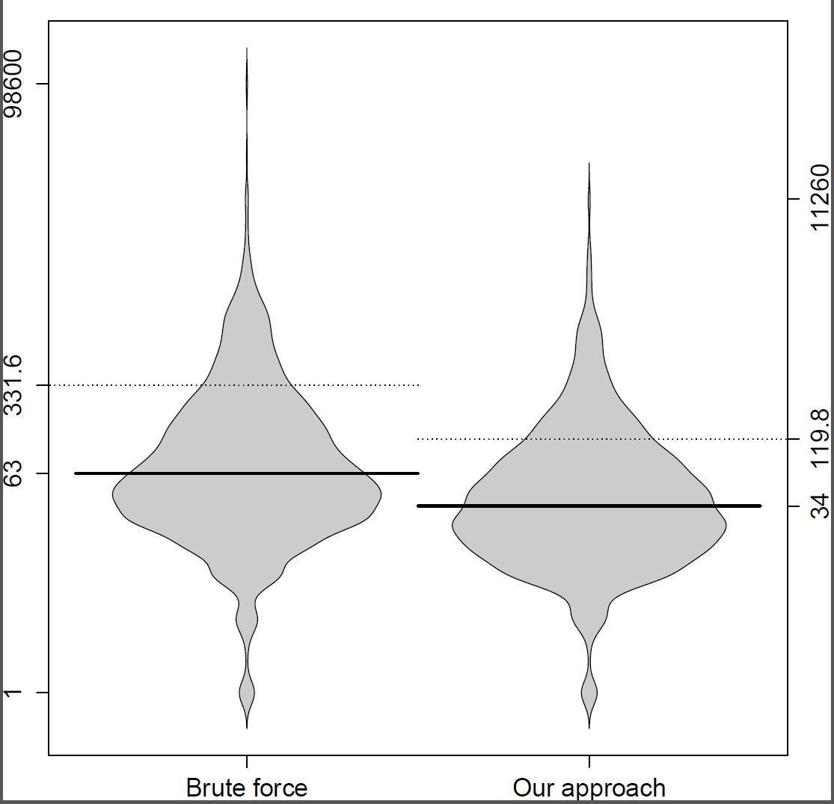
Performance analysis: Node comparisons
Notes:
In this picture, we can see two bean plot graphs. Here, we analyze the number of node comparisons which we perform during PDG mapping in the clone refactoring process we did in the 7 open source projects.
The one on the left side shows the number of node comparisons in all those clone groups using a brute force approach. For example, suppose if we have 10 nodes in the PDG of clone 1 and 20 nodes in the PDG of clone 2, the total number of node comparisons will be the product 10*20 = 200. And suppose, in that case, we take only 60 node comparisons, we show that in the right side plot graph.

Slide 28
Performance analysis:
Total time
The CPU time taken for the execution of the PDG mapping process for each of the clone groups was calculated.
The mean value is found to be 354.7 ms.

Slide 29

Conclusion
The approach was able to refactor 82% more clone groups (in which clones are in the same file) than CeDAR.
The approach could refactor 28% of the clone groups, in which clones are in different files.
The experiment revealed that 37% of the clone groups can be refactored directly or by decomposing original clones into sub-clones.

Slide 30

Publications
1. Nikolaos Tsantalis and Giri Panamoottil Krishnan,
"Refactoring Clones: A New Perspective"
7th International Workshop on Software Clones (IWSC'2013),
San Francisco, California, USA, May 19, 2013.
2. Giri Panamoottil Krishnan and Nikolaos Tsantalis,
"Refactoring Clones: An Optimization Problem"
29th IEEE International Conference on Software Maintenance (ICSM'2013),
Eindhoven, The Netherlands, September 22-28, 2013.
3. Giri Panamoottil Krishnan and Nikolaos Tsantalis,
"Unification and Refactoring of Clones",
IEEE CSMR-WCRE 2014 Software Evolution Week (CSMR-WCRE'2014),
Antwerp, Belgium, February 3-7, 2014.
http://www.jdeodorant.com/

Slide 31

What’s next?
An extensive empirical study on the refactorability of clones detected from different clone detection tools such as ConQat, NiCad and CCFinder
More challenging cases of Type-3 clones with more complex refactoring transformations
To extend our AST matching mechanism in order to support the matching of different types of control predicate statements
Unification of semantically equivalent expressions

Slide 32
Thank you
Motivation
Goals
Optimal mapping with minimum differences
Exhaustive search
Preserve code behavior by preconditions
Harmful effects of software clones
Poor performance of current refactoring tools
Approach
Evaluation
Findings
Comparison with the state-of-the-art tool CeDAR
2342 clone groups from 7 open-source Java projects
Refactor 82% more clone groups than CeDAR
Refactor 28% of the clone groups additionally
37% of the clone groups can be refactored
Future
Extensive empirical study on the refactorability of clones
Challenging cases of Type-3 and Type-4 clones

