Slide 1

Automatic Motivation Detection for Refactoring Operations
Mohammad Sadegh Aalizadeh
Supervisor: Dr. Nikolaos Tsantalis
Aug 2021

Slide 2
Why investigating motivations behind refactoring?
It helps build refactoring recommenders that propose suitable refactoring solutions that fits the developer’s real purpose and needs.
Previous studies are limited to surveys or manual analysis of Pull Requests (PRs) or analysis of commit messages.
There is no research to automate the detection of Refactoring Motivations according to the changes in the refactoring context in large scale.

Slide 3
Research Goal
    Building Motivation Detection Rules and Decision Trees for most common Extract Method Motivations.
    Performing A large-scale study to investigate motivations in practice.

Slide 4
Studied Systems
A total of 346,776 (346k) Extract Method and Extract and Move Method refactoring actions automatically identified in the entire commit history of the projects studied in:
1. Silva, D., Tsantalis, N., and Valente, M. T. Why we refactor? confessions of github contributors. (FSE 2016)
2. Pantiuchina, J., Zampetti, F., Scalabrino, S., Piantadosi, V., Oliveto, R., Bavota, G., and Penta, M. D. Why developers refactor source code: A mining-based study. (ACM 2020)
132,897 commits
325 open-source projects

Slide 5
Research Questions
RQ1: How accurate is the Extract Method Refactoring motivation detection tool?
RQ2: What are the most prevalent motivations among developers that perform Extract Method Refactoring?
RQ3: What are the characteristics of the Extract Method refactorings having Facilitate Extension as motivation?
RQ4: Are there multiple or concurrent motivations for developers to Extract Methods?

Slide 6
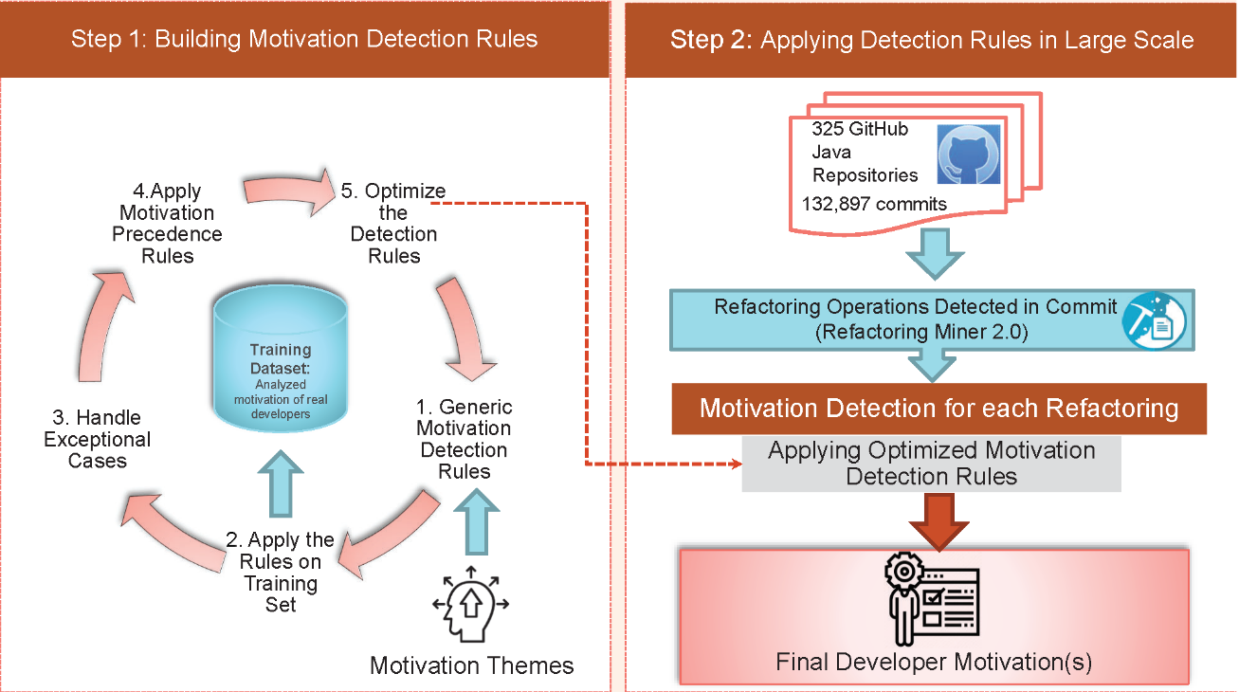
Automatic Motivation Detection Process

Slide 7
Extract Method Motivation Detection Themes
Reusable Method Theme Description:
Extract a piece of reusable code from a single place and call the extracted method in multiple places.
Used to Build Optimized Detection Rules and Decision Trees

Slide 8
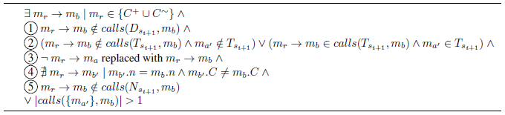
Detection Rules and Decision Trees
(Example: Reusable Method)
Generic Rule
Rule Exceptions
SOBE: Source Operation Before Extraction
SOAE: Source Operation After Extraction

Slide 9
How accurate is automatic Extract Method motivation detection?(RQ1)
1. Accuracy on Training Dataset
Oracle of real developer answers for refactoring motivation in a survery by Silva et al. (2016)
2. Accuracy on Test Dataset
Manually analyzed and tagged pull requests motivations (PRs) by Pantiuchina et al.(2020)
Optimized the motivation detection rules based on the Training Dataset.
Ensure that Precision and Recall of the detection rules have no overfitting problem.

Slide 10
Accuracy on Training Dataset (RQ1 continued)
Accuracy was evaluated based on Why we refactor? oracle Silva et al. (2016)
Oracle was costructed from the answer of developers on 222 commits
Commits contained 261 Extract Methods with 307 motivations.
Reconstruction of Oracle from commit-level to refactoring-level motivations.
Training Oracle accuracy:
Precision : 97.2%
Recall: 95.9%

Slide 11

Accuracy on Testing Dataset (RQ1 continued)
Test Dataset:
Manually tagged Pull Request (PRs) motivations (Pantiuchina et al.)
PR- motivations to Refactoring-Level motivations conversion:
Step 1 (Filteration):
Selected 56 PRs with only Extract Method or Extract and Move Method refactoring.
Step 2 (Mapping):
Categorized and mapped PR motivations to 11 major Extract Method motivations.
NOTE:
Risk of assigning PR motivations to commit(s) with multiple refactoring types.
Computed Test Oracle Precision and Recall based on the Refactoring-Level Motivations.

Slide 12
Motivation Mapping (RQ1 Continued)
(11 items)
(29 items)
18 PR motivations Mapped to
8 Extract Method motivations
3 Extract Method motivations not mapped to PR motivations
8 PR motivations not mapped to Extract Method motivations

Slide 13
21 Matched (based on mapping)
82 Unmatched (based on mapping)
5 sub-categories
  True Positive:
  8 Super : more general motivations
  12 Sub
  more specific
  motivations
  True Negative:
  50 Non EM Motivations: Not related to Extract Method or Extract and Move Method
  False Negative:
  4 Filtered: Filtered out in automatic detection (less priority)
  8 (FN): PR motivation not automatically detected.

Slide 14
Test Oracle Accuracy (RQ1 Continued)
Test Oracle Accuracy for refactoring-level motivations
No overfitting problem based on Test Oracle Results.
Test Oracle accuracy:
Precision : 98.4%
Recall: 93.5%

Slide 15
What are the most prevalent Extract Method motivations?(RQ2)
Reusable Methods are the topmost motivation in both studies a big difference
Top 5 motivations remained top with not much change.
Introduce factory method improved significantly.(6th and 10th )
Refactoring Recommendation Tools
Remove Duplication: CEDAR,Jdeodorant,CREC, etc.
Decompose Method to Improve Redability: Jdeodorant,Jextract,SEMI,GEMS , etc.
Reusable Methods, Facilitate Extension and Introduce Alternative Method need more attention.

Slide 16
Reusable Extracted Methods (RQ2 continued)
About 41% (142k of refactoring instances) are reusable in the same commit.
69% (97.7k EXTRACT METHOD)
31% (44.4k EXTRACT AND MOVE METHOD)
Visibility Changes in Reusable Extracted Methods:
Access Modifiers from higher to lower visibility
( public > protected > package > private)
Local Reuse for method extraction in same the class.
58% Extracted Methods visibility decrease
More accessible outside its original class.
In 27% of Extract and Move Methods visibility increases

Slide 17
Remove Duplication (RQ2 continued)
Extract Method has an important role in removing duplicated code:
About 25% (89k refactoring instances) are for duplication removal.
Among which:
  63% multiple source methods.
  37% single source method.

Slide 18
Decompose Method to Improve Readability (RQ2 continued)
About 18% (62.7K refactoring instances) are detected having Decompose to Improve Readability as motivation.
65% multiple methods extracted
35% single method is extracted
Developers generally decompose multiple methods from the source method to improve readability.

Slide 19
Characteristics of the Extract Methods that Facilitat Extension (RQ3)
20.51% (71K refactoring instances) are related to the Facilitate Extension motivation
New code is added to:
    61.30% (Extracted Method).
    26.66% (Source Operation After Extraction)
    8.41% (Extracted Method and Source Operation After Extraction)
    3.74% (Use of a Ternary Operator in the Extracted Method)
Developers usually intend to extend code in the Extracted Method.
Commit Message Analysis
89 Self Affirmed Refactoring Patterns (AlOmar et al.)
At least 28% are related to fixing a bug.

Slide 20
Are there multiple or concurrent motivations for developers to Extract Methods? (RQ4)
About 56% Single Motivation
Multiple Motivtions:
  34% had 2 motivations
  2.5% had 3 motivations.
No motivation (6.9% of all instances)
50% only one statement in the extracted method.
25%, the entire body of the source method was extracted.
25% were not related to any of the 11 major Extract Method motivations.

Slide 21
Association Rule Mining for Extract Method instances with Multiple Motivations (RQ4)
Association Rule Mining :
  All instances with multiple motivations
  Instances with 2 motivations.
  Instances with 3 motivations.
Strong association between Remove Duplication and Reusable Method (confidence > 0.8).
Overall, 30% of Reusable Methods also used to Remove Duplication.

Slide 22
Conclusion
We proposed a novel Method to automatically detect 11 major Extract Method and Extract and Move Methods motivations.
Performed a large scale study on 346k refactoring instances and ranked motivations.
Motivations with higher ranks respectively: Reusable Methods, Remove Duplication, Facilitate Extension and Decompose Method to Improve Readability , etc.
Refactoring recommender systems should focus on important motivations that did not receive much attention. (i.e. Reusable Method, Facilitate Extension, Alternative Method Signature)
Remove Duplication and Reusable Method have concurrence in the Extracted Method Motivations.

Slide 23

Thank you!
Any Questions???

