Slide 1
COMP 442 / 6421
Compiler Design
Code Generation II
Instructor: TAs:
Dr. Joey Paquet Dhaval Patel Hamed Jafarpour
paquet@cse.concordia.ca p_haval@encs.concordia.ca hamed.jafarpour@concordia.ca
1

Slide 2
Content
Commands for running moon code
Important notes for Assignment 4
Code generation for function definitions and function call stack

Slide 3
Commands for running moon code
require c compiler. on linux system following commands can be runnable
gcc moon.c -o moon
./moon sample.m lib.m

Slide 4
Example
source code → assembly code

Slide 5
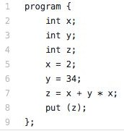
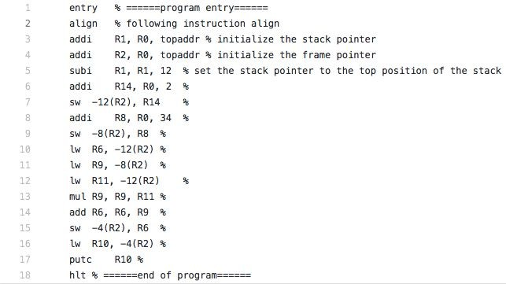

Slide 6
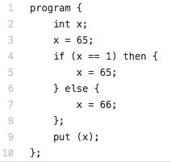
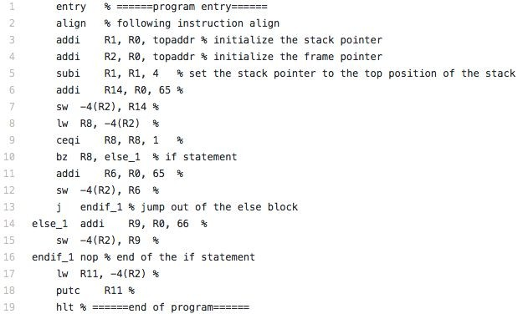

Slide 7
How to do Assignment 4 ?
Assignment 4 is fairly involved
You will likely not have time to implement every feature of the language.
Familiarize yourself with the Moon processing environment
Implement simple statements for compiler code generation
Read/Write critical for testing
Simple arithmetic requires few memory considerations
Pick a static memory scheme
Use Tags or stack-based approach
Prioritize the implementation of language features
◦By difficulty
◦By utility
◦By grade weight

Slide 8
Important notes for Tag based approach
Tags in moon code are necessary for jumping between functions and conditional structures
They are straightforward to use, but make sure generated tags are always unique
Prefixes can help with this
Be careful of tricky edge cases:
Function overloading
Function overriding and inheritance
Similar free functions and member functions
If using tag for memory, uniqueness is much harder
Example
class_function_functionName_param1Type_param2Type
if_22, then_22, else_227

Slide 9
Code generation: suggested sequence
Suggested sequence:
variable declarations (integers first)
expressions (one operator at a time)
assignment statement
read and write statements
conditional statement
loop statement
Tricky parts:
function calls
expressions involving arrays and classes (offset calculation)
floating point numbers (non-native in Moon)
function call stack
expressions involving access to object members (offset calculations)
calls to member functions (access to object’s data members)

Slide 10
Code generation: Function definitions
Solution:
Branching to the function’s code
Passing/storing the parameter values
Storing/passing the return value

Slide 11
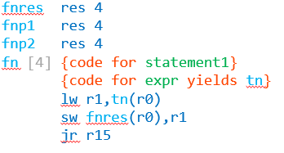
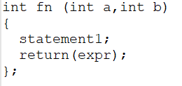
Code generation: Function definitions
Example:

Slide 12
Code generation: Function definitions
previous example uses static memory allocation for a function, which is assuming that there can be at most one instance of a function being executed at any time.
To allow more than one instance of a function to execute at the same time, a dynamic memory allocation scheme is necessary, i.e. a function call stack

Slide 13
multiple function call instances
with recursive function calls, the problem is that several instances of the same function can be running at the same time, hence there is a need to store a separate state of each function instances of the same function.
To enable more than one function instance to run at the same time, all the variables and parameters of a running function are stored in a stack frame which is dynamically allocated on a function call stack.
Another problem with multiple function instances is that r15 is used to store the return address that is going to be branched upon after a call. If there is more than one consecutive call (i.e. main calls f1, then f1 calls f2), then the return address needs to be stored in the function call’s stack frame.

Slide 14
function call stack and stack frames
The location of the stack frame on top of the stack (topofstack) is managed by adding/subtracting stack frame sizes as an accumulated offset from the base address of the stack (fstack).
Before a function is called, topofstack is incremented by the stack frame size of the function currently being executed.
Then, when the functions’ code uses its local variables, it refers to them using offsets relative to topofstack.
After the function returns, the calling function “removes” the called function’s stack frame, i.e. topofstack is decremented by its function call stack frame size.

Slide 15
function call stack and stack frames
program{
int a;
float b;
… f1(…) … }
int f1(…){
float a[2];
int b;
… f2(…) …}
int f2(…){
int x,y; }

Slide 16
function call stack: compute variables/block sizes and offsets
The first step is to compute the size of all variables involved in the compiled program.
These can be stored in the symbol tables.
Memory also needs to be reserved for intermediate results, and literal values used in the compiled program.
Then you can compute the offset of each element in a reserved block

Slide 17
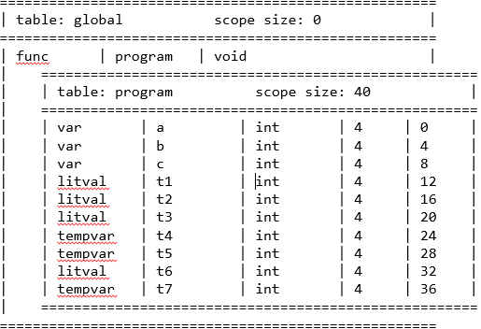
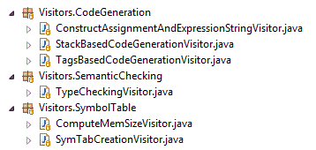
function call stack: compute variables/block sizes and offsets
Example
program{
int a;
int b;
int c;
a = 1;
put(a);
b = 2;
put(b);
c = 3;
put(c);
a = a + b c;
put(a + 6);
} // result = 13

Slide 18
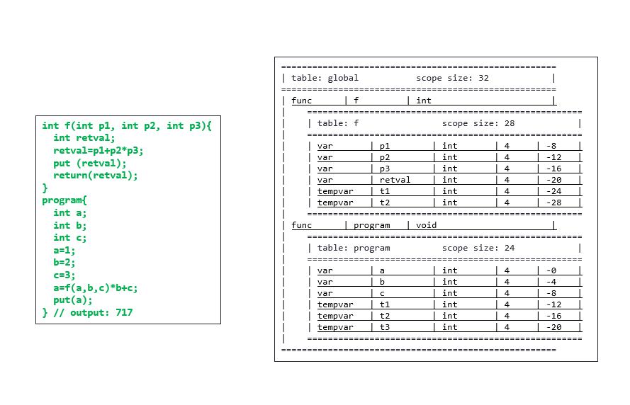
Function calls using stack: full example

Slide 19
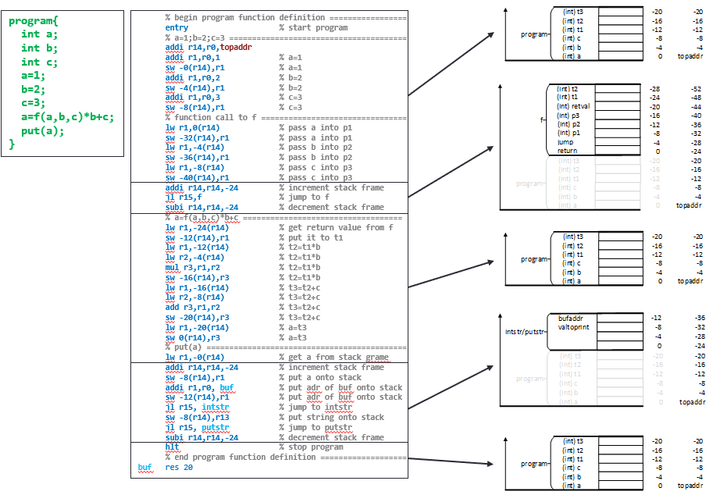
Function calls using stack: full example

Slide 20
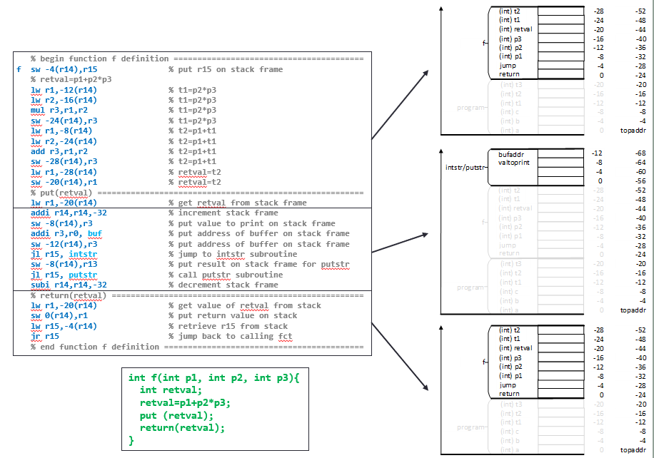
Function calls using stack: full example

Slide 21
Thanks!

