Slide 1
COMP 442 / 6421
Compiler Design
Tutorial 1
Instructor: Dr. Joey Paquet paquet@cse.concordia.ca
TAs: Haotao Lai h_lai@encs.concordia.ca
Jashanjot Singh s_jashan@cs.concordia.ca

Slide 2
A useful tool --- AtoCC
The learning environment can be of use in teaching abstract automata, formal languages, and some of its applications in compiler construction. From a teacher's perspective AtoCC aims to address a broad range of different learning activities forcing the students to actively interact with the subjects being taught.
Note: We will need to use it for assignment 2 for grammar verification (will explain into detail when you receive assignment 2)
http://www.atocc.de/cgi-bin/atocc/site.cgi?lang=en&site=main

Slide 3
AtoCC --- RegExp Edit
It is a powerful tool that we can use to generate DFA from regular expression and validate your work. In the following slides you will find screenshots on how to use this tool in order to create a DFA from a regular expression that should conform to the lexical specification of the language.

Slide 4
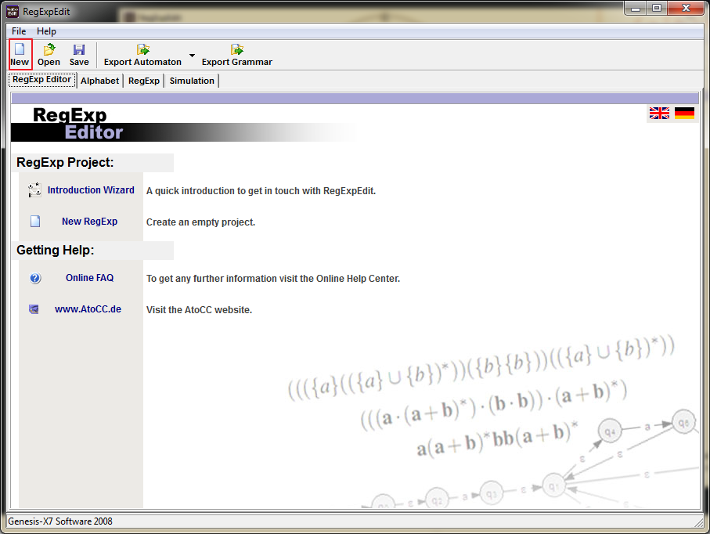

Slide 5
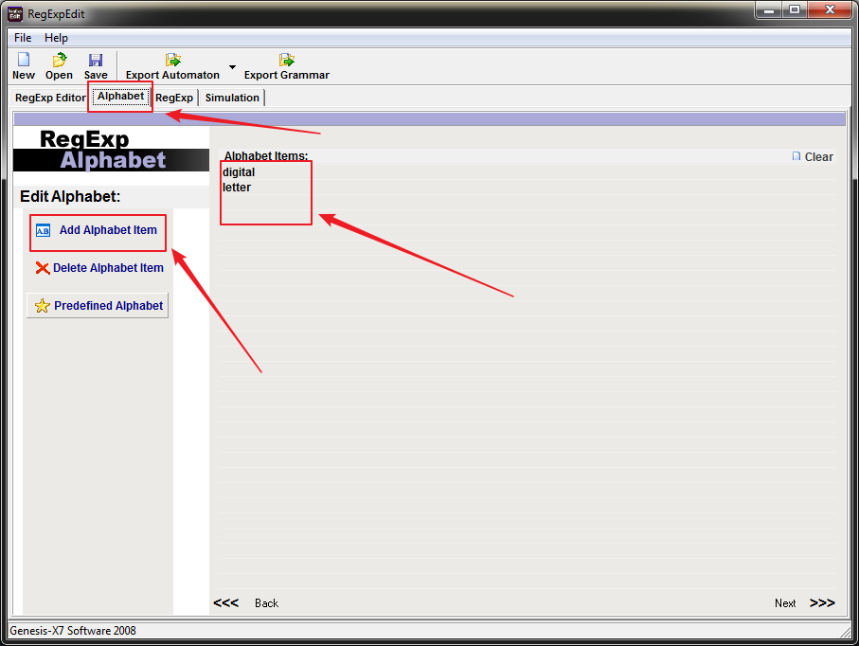

Slide 6
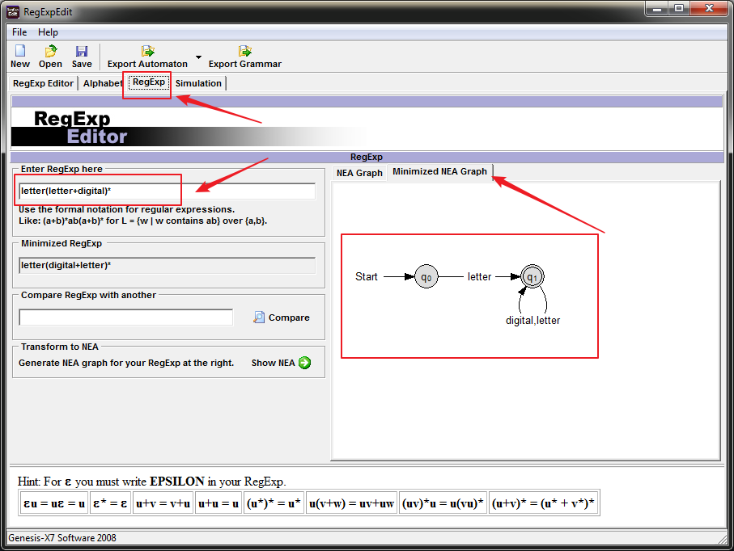

Slide 7
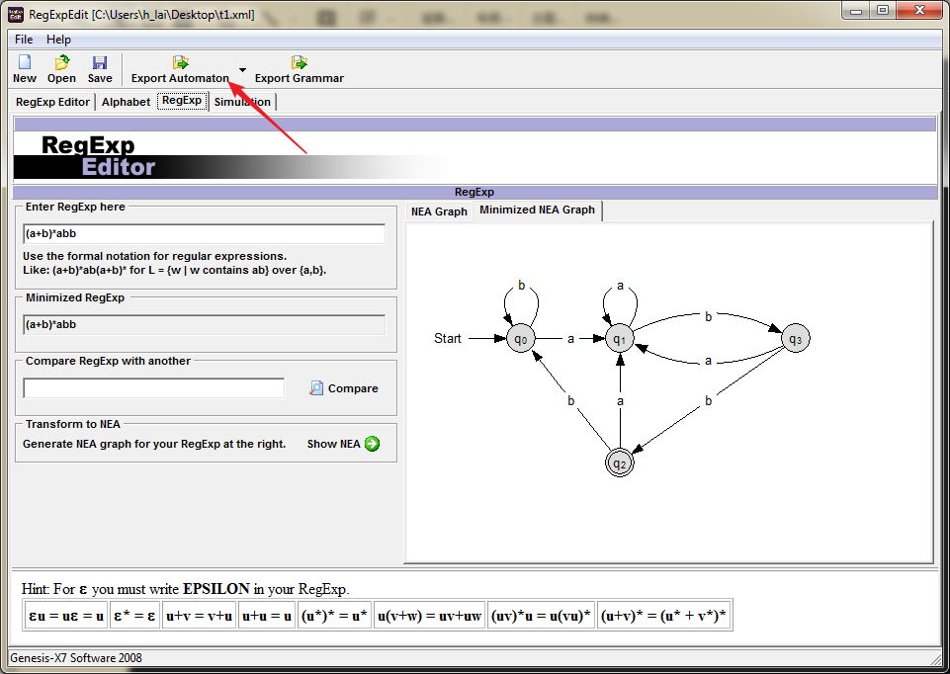

Slide 8
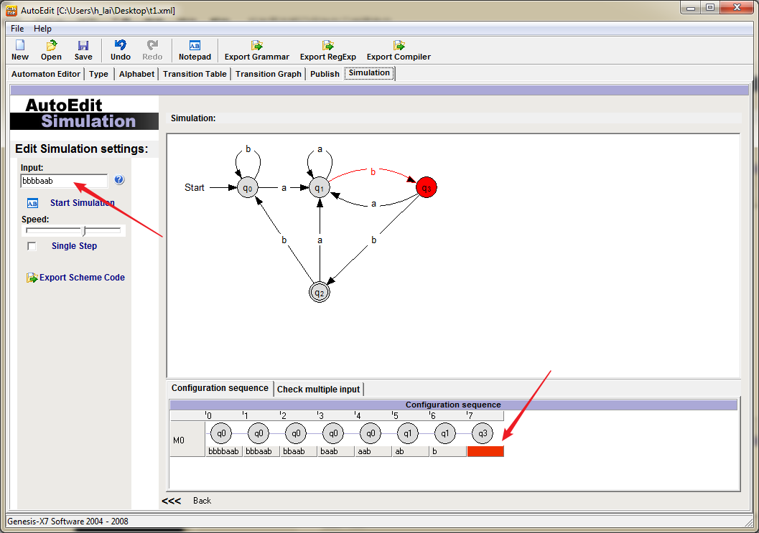

Slide 9
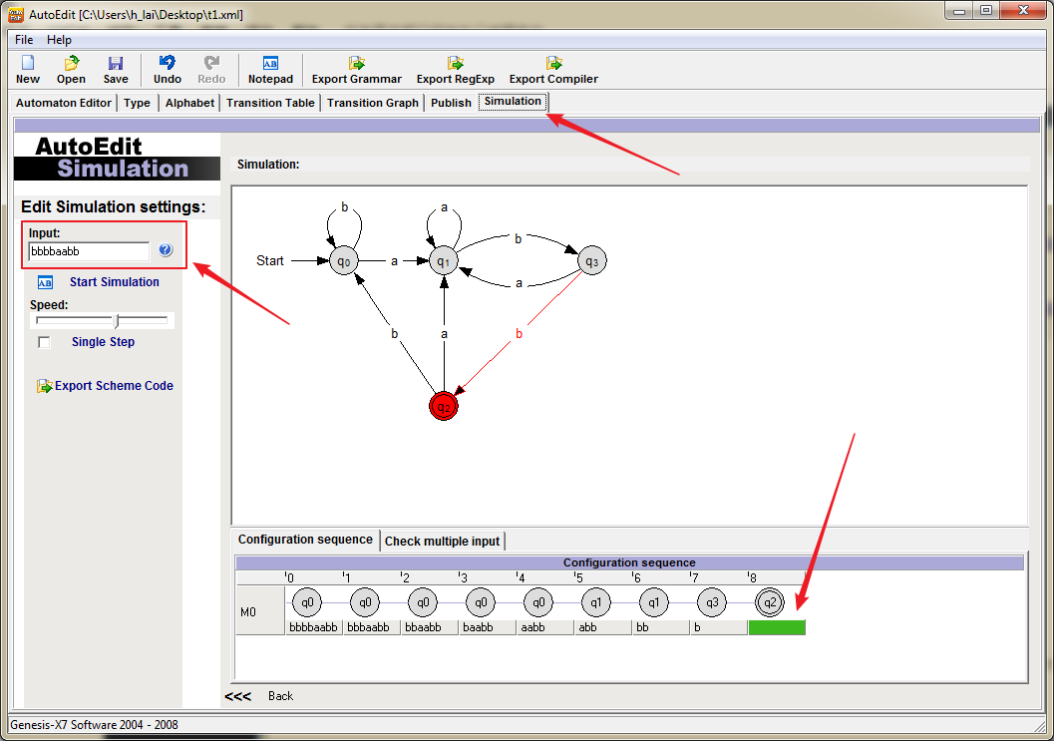

Slide 10
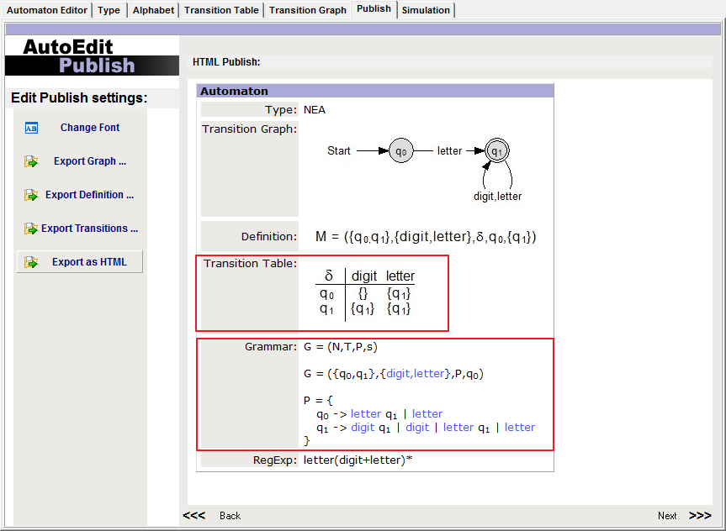

Slide 11
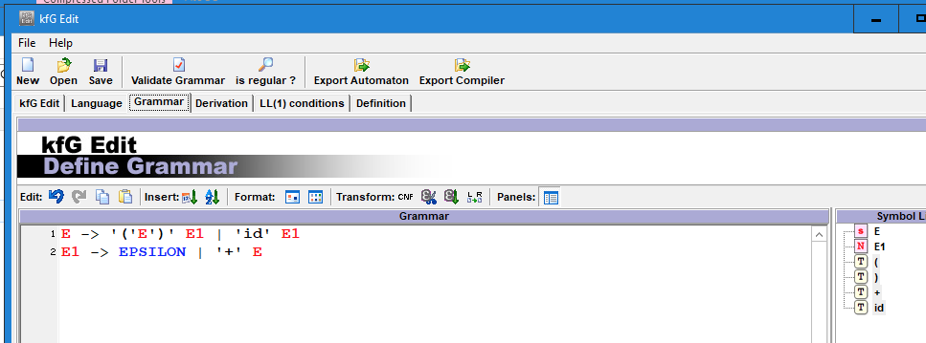
AtoCC Format
In assignment 2, you will have to use AtoCC to verify your grammar. For example, you will enter your grammar in the kfgEdit tool like this (simple grammar shown):

Slide 12
Continued --- AtoCC Format
Then, one very convenient thing that this tool allows is to verify a string against the grammar, by inputting a string in the "input sentence" field in the Derivation tab window (see the image in the next page)
This allows the tool to verify if this string is parsable or not. If the string is parseable, it generates a tree and a derivation for it. In order to use the feature, your lexical analyzer needs to output a string that you can copy in the"input sentence" box. This way, you can verify if your grammar is correct by using your lexical analyzer to output a string representing the tokenized version of the input program, and the kfgEdit tool to verify that you grammar can parse it.

Slide 13
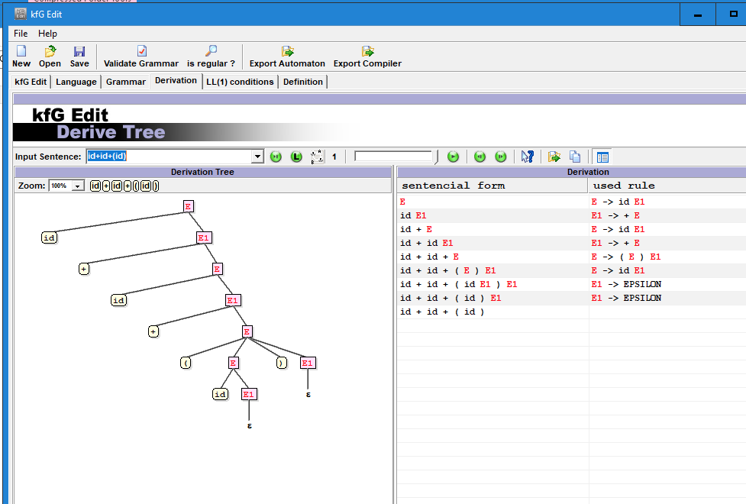

Slide 14
Implementation of lexical analyzer
Two ways to implement the lexical analyzer:
Table driven (but constructing a transition table by hand is not an easy job)
Handwritten (it require you to be very careful considering all the possible situations)
Note: It is your choice to pick one of the methods to implement and your choice will not affect the following assignments. The output of the Scanner is the stream of tokens which can be accessed when the nextToken() method is being called repeatedly.

Slide 15
Continued --- Implementation
You need to think about the ambiguity problem (you should already know that the solution is i.e. backtracking) and how to implement a backtracking mechanism.
Also there is an advanced problem, how to make the lexical analyzer faster (read each character from the disk when you need a new one or there is some other ways to do it)?

Slide 16
Continued --- Implementation
Obviously, we need to use buffers instead of reading when necessary, and there are two ways provided by the “Dragon book” (its real name is Compilers: Principles, Techniques, and Tools):
Buffer in Pair
Sentinel
You can refer to the book in order to know more about these ways and how they can be leveraged in your project work. Although, you can have your own way to implement that.

Slide 17
Buffer in Pair
Involves two buffers that are alternately reloaded, Each buffer is of the same size N, and N is usually the size of a disk block, e.g., 4096 bytes.
we see forward has passed the end of the next lexeme, ** (the Fortran exponentiation operator), and must be retracted one position to its left.

Slide 18
Continued --- Buffer in Pair

Slide 19
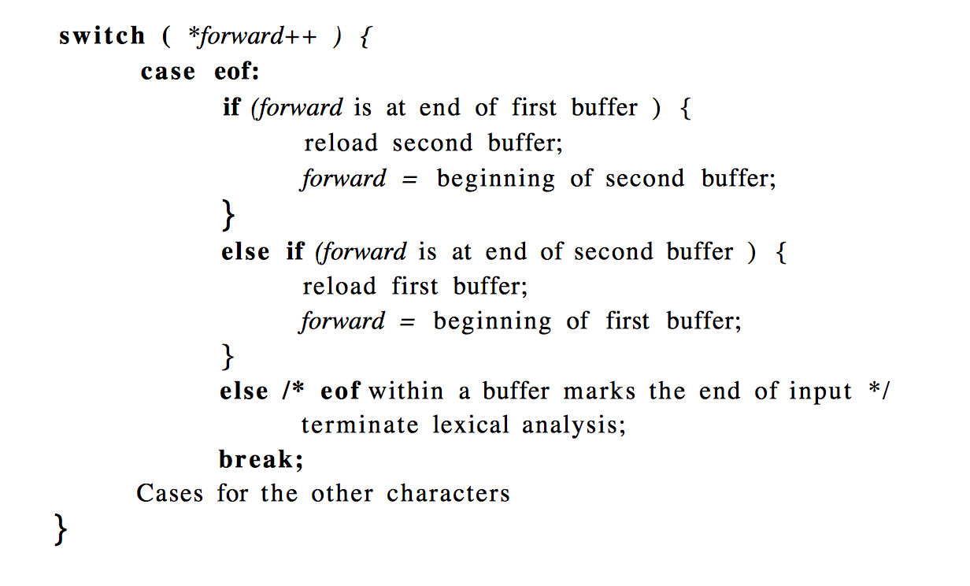
Sentinel

Slide 20
Thanks!
You are not allowed to use any tool like Lex can generate a Scanner automatically.

