Slide 1
COMP 442 / 6421
Compiler Design
Tutorial 2
Instructor: Dr. Joey Paquet paquet@cse.concordia.ca
TAs: Haotao Lai h_lai@encs.concordia.ca
Jashanjot Singh s_jashan@cs.concordia.ca

Slide 2
Tutorial Slides
You can access the tutorial slide sets through the following link:
http://laihaotao.me/ta/

Slide 3
Assignment 2 : syntax analysis
This lab material is about helping you achieve assignment #2, which is done in two stages:
Transform the grammar into an LL(1) grammar
Implement the parser
The implementation absolutely cannot start before the grammar has been transformed.
We propose a set of tools to help achieve the transformation
Sample usage of these tools is depicted in this slide set

Slide 4
AtoCC kfgEdit
Tool that allows you to analyze your grammar and locate possible ambiguities in the grammar.
After you grammar is entered, it also allows you to enter a string representing a token stream and verify if this token stream is derivable from the grammar. If it is, it generates a parse tree and a derivation for it.

Slide 5
Installing AtoCC

Slide 6
Installing AtoCC
AtoCC can be downloaded at the following web site:
http://www.atocc.de
You can either download an installer, or precompiled applications.

Slide 7
You don’t have Windows machine?
Check the following link out:
http://atocc.de/AtoCCFAQ/index.php?option=com_content&task=category&sectionid=11&id=25&Itemid=34
Works, for example, for macOS High Sierra version 10.13.1

Slide 8
Install AtoCC without administration rights ?
These are portable executables, but they often crash, so save your work frequently!

Slide 9
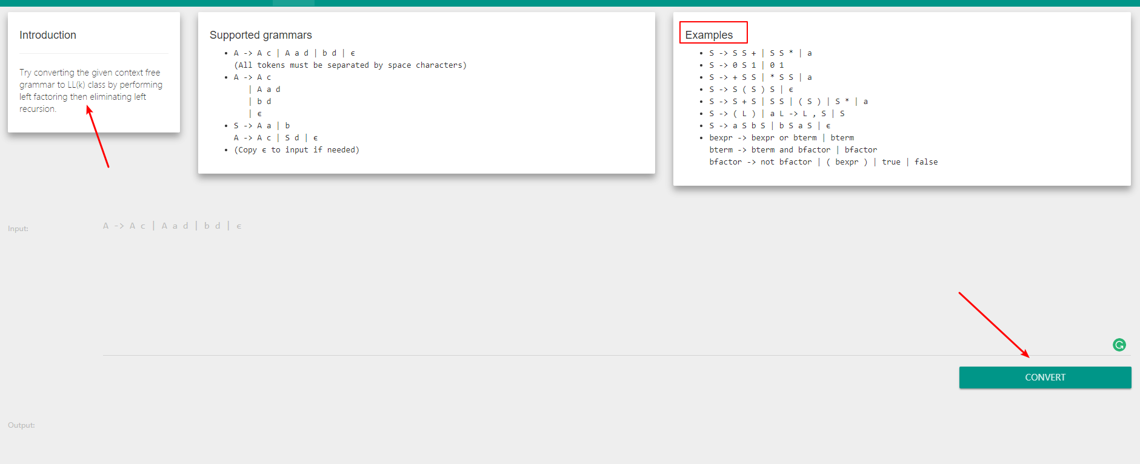
Automated grammar transformation tools
CyberZHG’s Compiler contruction toolkit:
https://cyberzhg.github.io/toolbox/
Can help you apply specific transformations
Use in conjunction with kfgEdit
However, it does not use the same grammar representation conventions

Slide 10
Example grammars in kfgEdit format
Includes some before-after transformation examples.

Slide 11
The Goal of Assignment 2
Convert the given CFG to an LL(1) grammar
Use tools to help your transformation procedure
Remove the grammar from EBNF to non-EBNF representation
Remove ambiguities and left recursions
After each transformation step, verify that your grammar was not broken
Implement a LL(1) parser
Recursive descent predictive parsing
Table-driven predictive parsing

Slide 12
Example: removing EBNF constructs
Assume you was given a grammar as following, with EBNF repetition:
commaSeparatedList -> a {,a} | EPSILON
You should remove the EBNF repetition and come up with the following grammar:
commaSeparatedList -> a commaSeparatedListTail | EPSILON commaSeparatedListTail -> ,a commaSeparatedListTail | EPSILON

Slide 13
Example: removing left recursion
After removal of all EBNF format instances, assume you have something like:
expr -> expr + term | term term -> term * factor | factor factor -> '(' expr ')' | 'x'
Remove left recursions (on expr and term) using the transformation shown in class:

Slide 14
How to come up with the proper grammar?
You receive the initial grammar in EBNF in assignment 2 description already
You need to remove the EBNF since AtoCC kfgEdit cannot understand this form
Perform left factoring (if necessary)
Remove left recursion (if exist, unfortunately, they exist in the given grammar)
It is strongly suggested that every time you make a single transformation step, that you use AtoCC to check whether your transformation broke the grammar or not.
Don’t try to correct many errors in one shot, it is easy to get lost. Plus, if you make a mistake in one transformation step and you carry on without checking, your further transformation will be made on a wrong grammar and thus be invalid.

Slide 15
Example
--- How to use AtoCC for verification

Slide 16
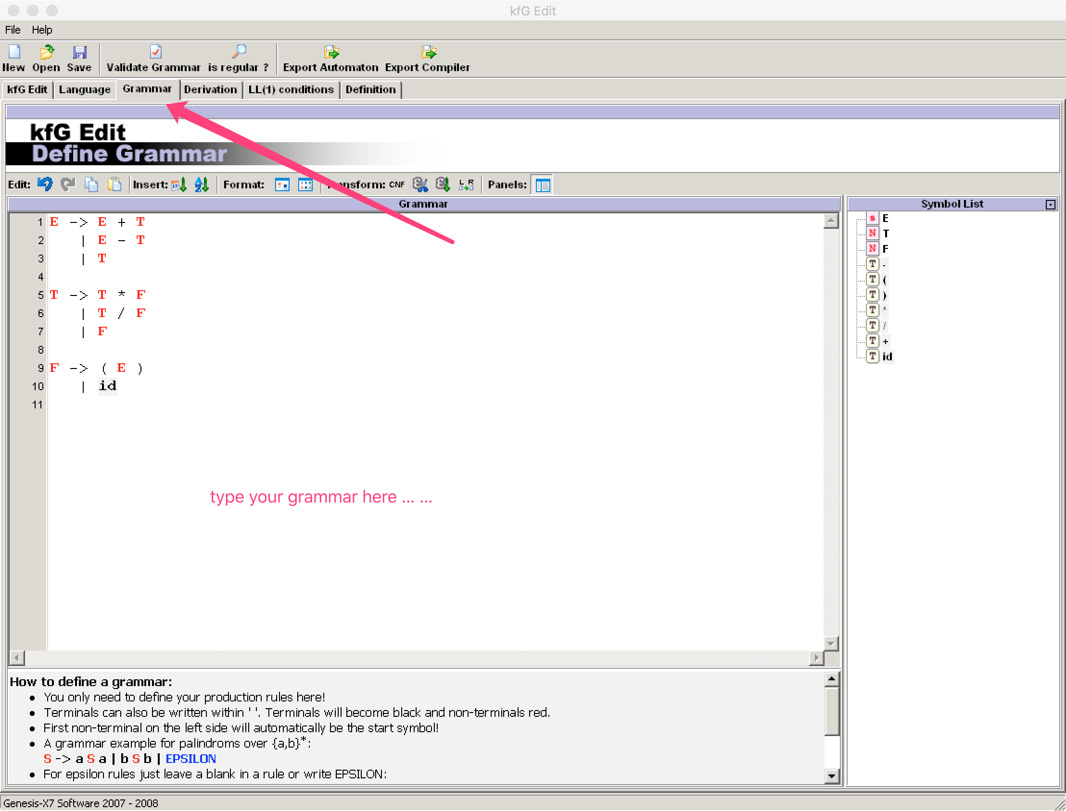

Slide 17
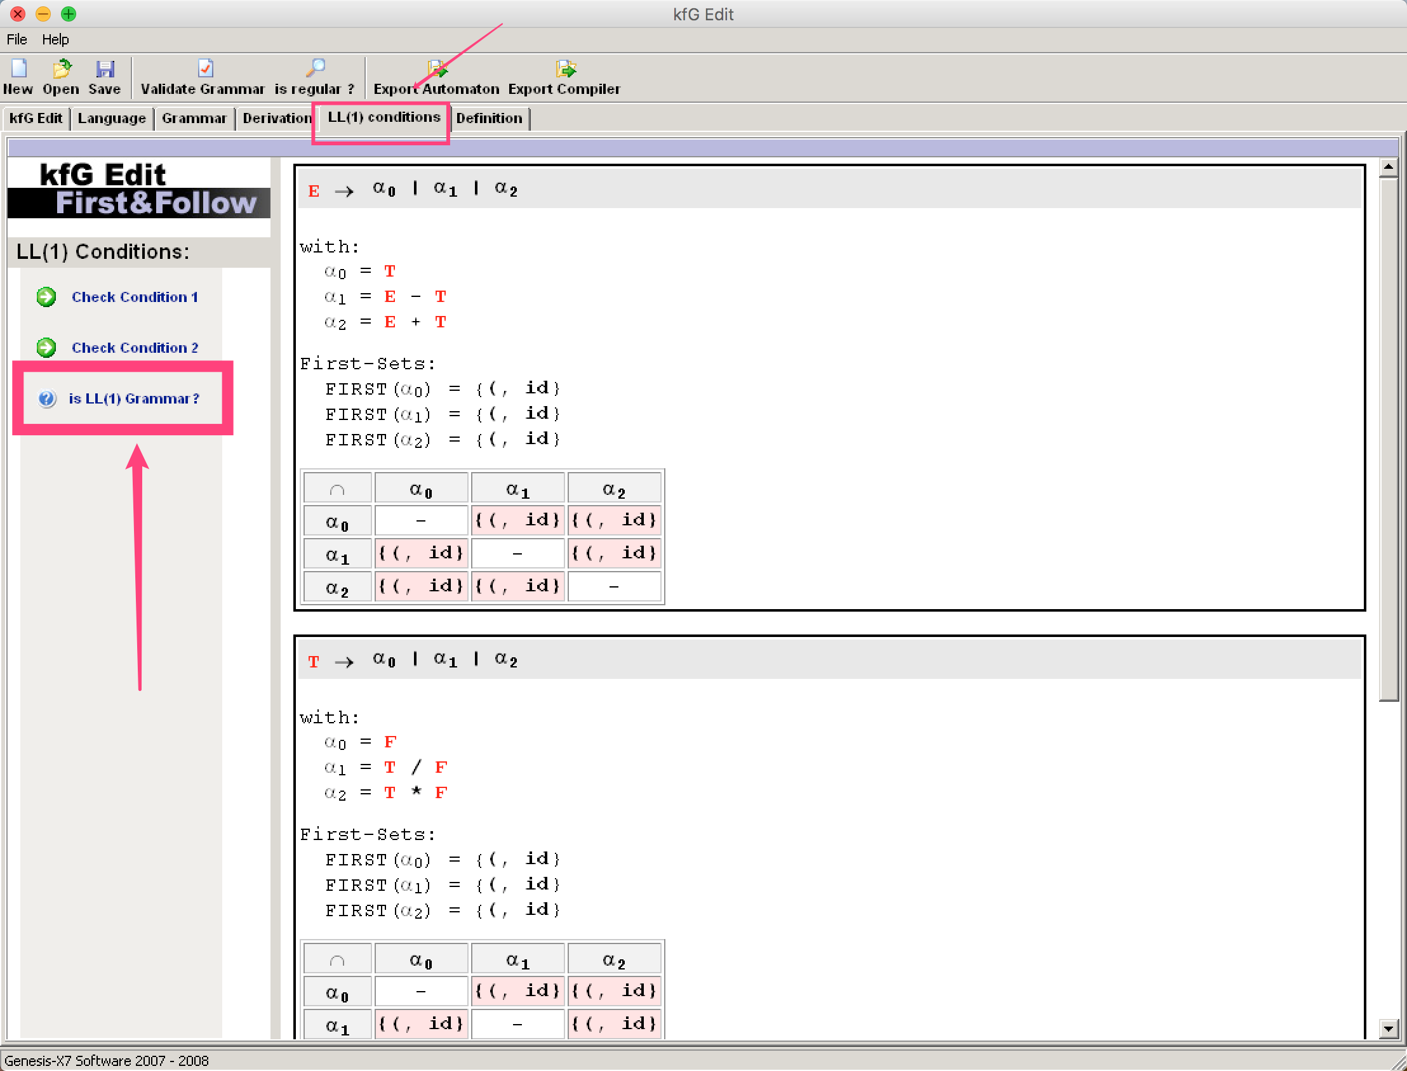

Slide 18
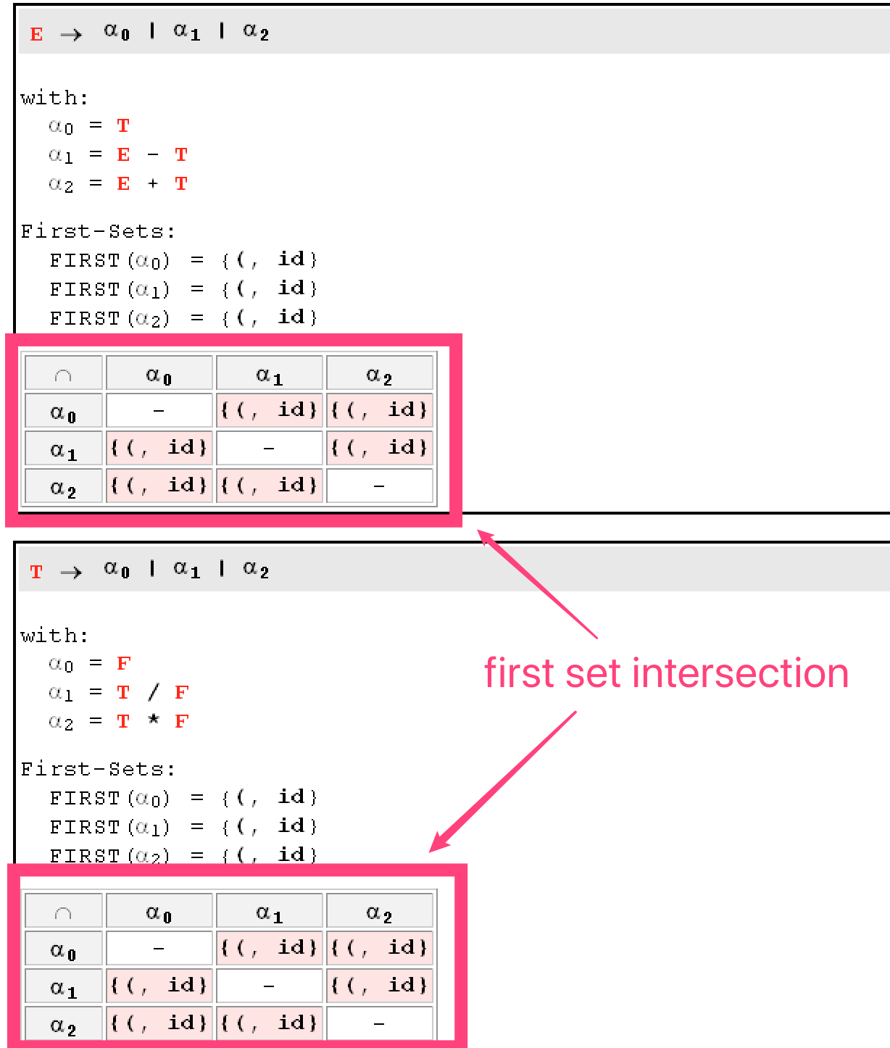

Slide 19
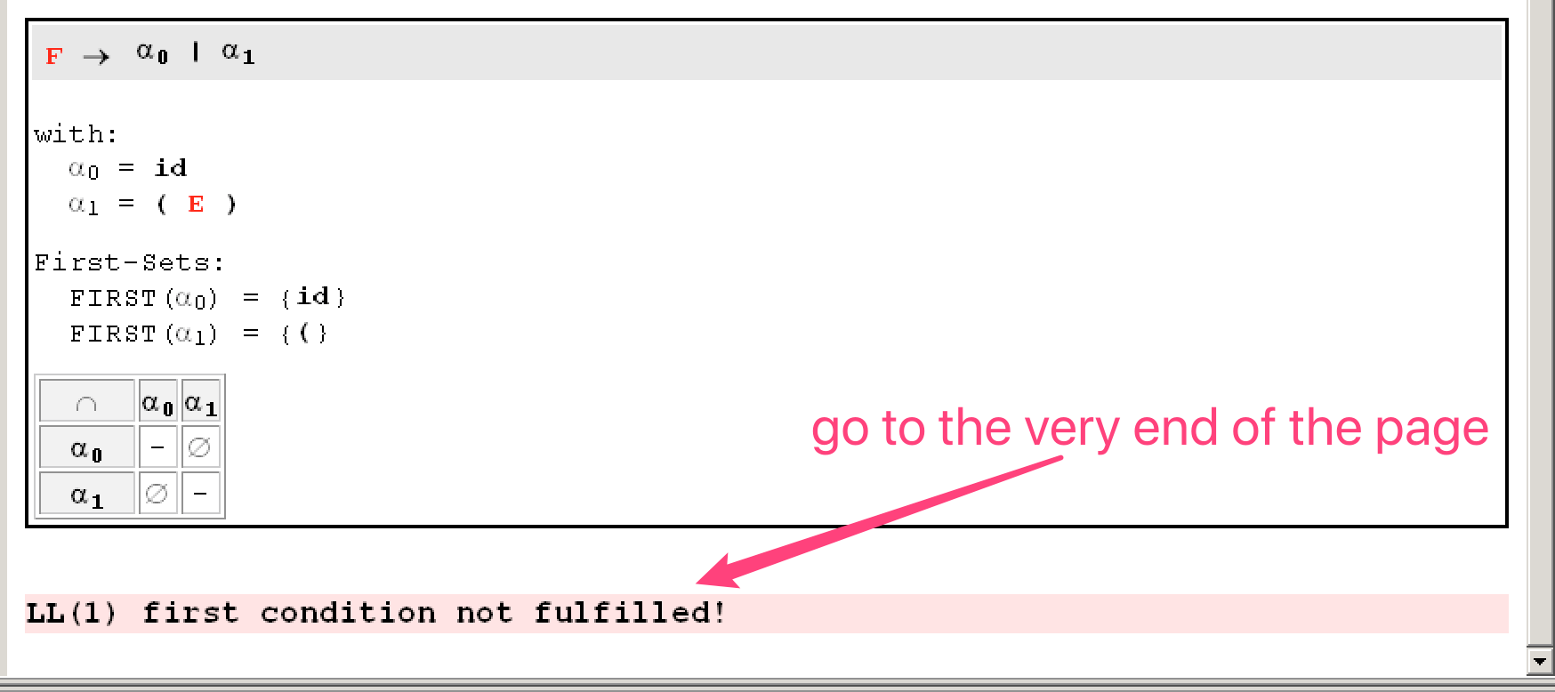

Slide 20
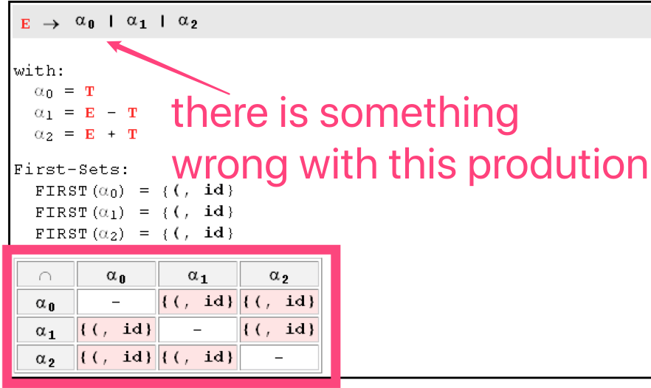
What you should do?
Locate a specific error and identify the faulty productions (shown in red)
Copy the related productions into the grammar transformation tool mentioned above (https://cyberzhg.github.io/toolbox/cfg2ll).
Copy the correction from the tool and paste it into AtoCC
Do some modification to adapt to AtoCC format
Check the grammar again
Note: Don’t try to solve more than one production at a time. When you solve one production’s error, use the tool to check to make sure you are not bringing new errors.

Slide 21
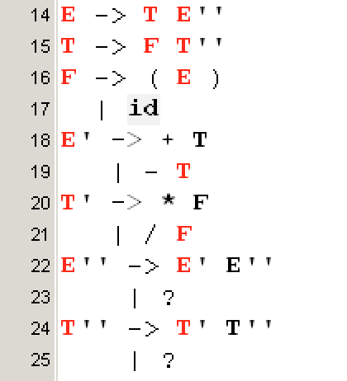
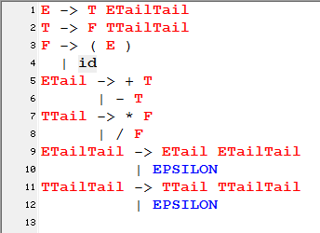
result from the tool
after modification, adapted to AtoCC

Slide 22
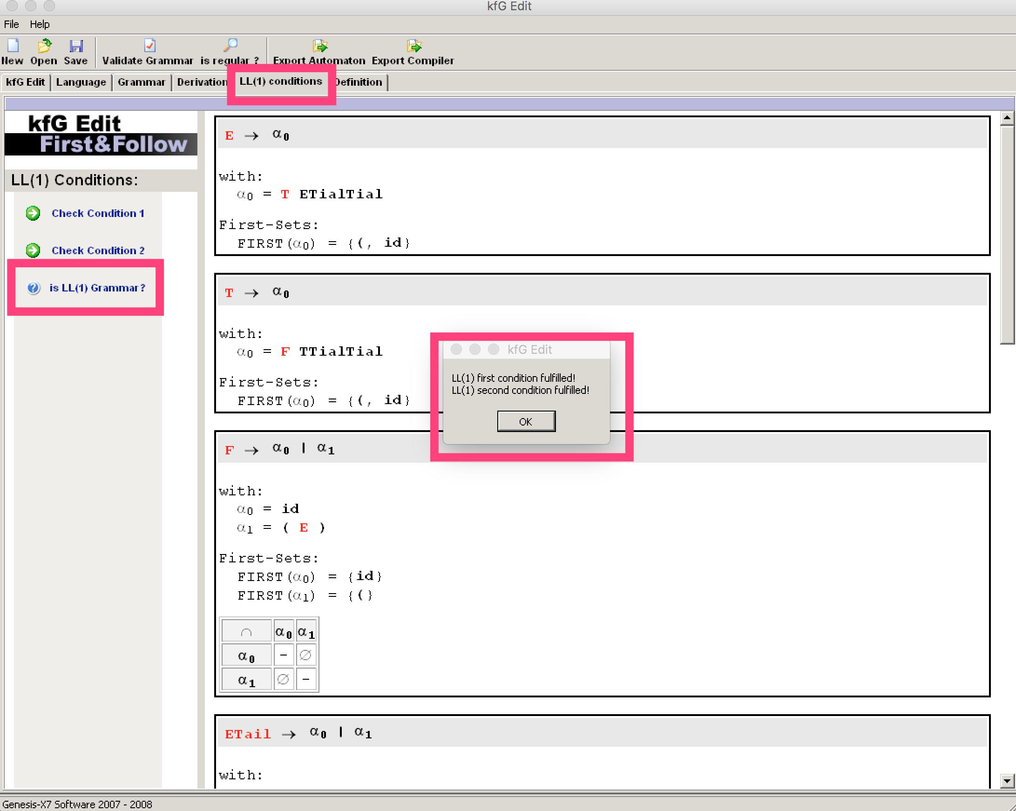

Slide 23
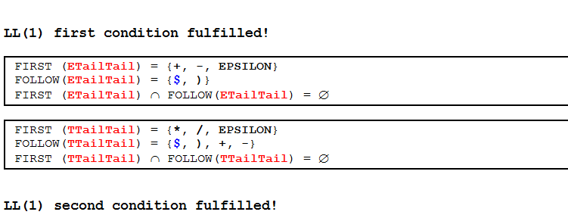

Slide 24
Thanks

