Slide 1
COMP 442 / 6421
Compiler Design
Tutorial 3
Instructor: Dr. Joey Paquet paquet@cse.concordia.ca
TAs: Haotao Lai h_lai@encs.concordia.ca
Jashanjot Singh s_jashan@cs.concordia.ca

Slide 2
Recall Assignment2
Convert the given CFG to LL(1) grammar
Need to use tools to verify your converting procedure
Remove the grammar from EBNF to non-EBNF presentation
Remove ambiguity and left recursion
Implement a LL(1) parser
Recursive descent predictive parsing
Table-driven predictive parsing
In the following slides, I use step 1 to refer point No. 1, step 2 to refer point No. 2;
Question: What is exactly a LL parser and what is the 1 stand for?

Slide 3
Three Roadblocks in Assignment 2 Step 1
Quick review
Ambiguity
Non-deterministic
Left recursion
For theoritical detail, see the lecture slide set [syntax analysis: introduction].

Slide 4
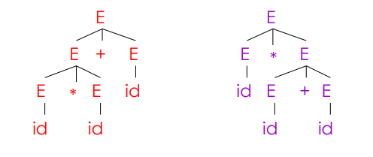
Ambiguity Grammar
Grammar: E -> E + E | E * E | id
Input string: id * id + id
Requirement of the parse tree:
A tree that its in order traversal should give the string same as the input string

Slide 5
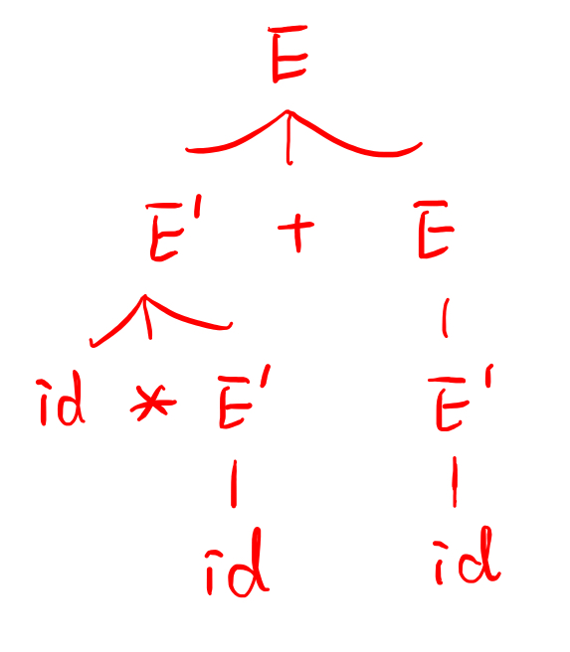
Ambiguity Grammar
The solution for ambiguity is rewrite the grammar (that’s exactly what you need to do in assignment 2) to make it unambiguous.
In this case, we want to enforce precedence of multiplication over addition.
original: E -> E + E | E * E | id
modified:
E -> E’ + E | E’
E’ -> id * E’ | id
Note
The modified grammar here is not a LL(1) grammar, the example here just show how to remove ambiguity.
If you look carefully, you will find it is actually a LL(2) grammar

Slide 6
Non-deterministic Grammar
backtracking can solve this problem, but it is inefficient;
introduce a new non-terminal which we refer as left factoring

Slide 7
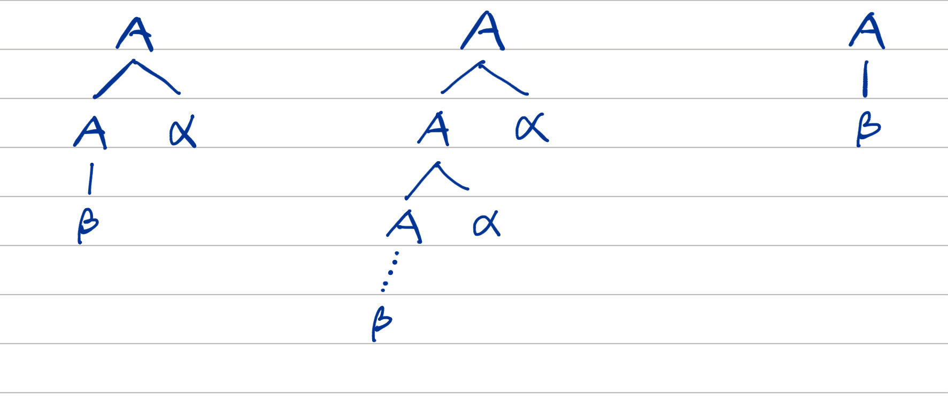
Left Recursion
Garmmar: A -> Aα | β
By analyze these three possibilities, our goal is to construct something like: A -> βα*
But we don’t allow * in the grammar, so we can replace a* with a new non-terminal A’, so we have:
A -> βA’
A’ -> αA’ | ε

Slide 8
Big Tip
When you implement the assignment 2, the online tool we introduced in the tutorial 2 can solve the non-deterministic and left recursion problems!
But as the theoretical part of the course you should also be able to fix the grammar by hand.

Slide 9
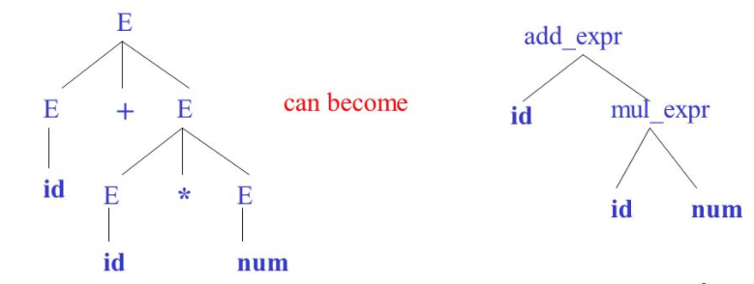
Parse Tree
concrete syntax tree (left)
abstract syntax tree (right)

Slide 10
First Set and Follow Set
example 1:
S -> A B C D E
A -> a | ε
B -> b | ε
C -> c
D -> d | ε
E -> e | ε

Slide 11
First Set and Follow Set
example 2:
S -> B b | C d
B -> a B | ε
C -> c C | ε

Slide 12
First Set and Follow Set
example 3:
S -> A C B | C b B | B a
A -> d a | B C
B -> g | ε
C -> h | ε
the note shows what I did in the lab can access: http://laihaotao.me/ta/w18_comp442_fst_flw_set.pdf

Slide 13
Tool
If you plan to use the table-driven approach, you will need a parse table. Of course you can generate your own parse table, or put a proper grammar into a tool and it will give you the table.
We propose an online tool to do that:
http://hackingoff.com/compilers/ll-1-parser-generator
note: you need to use EPSILON to repersent ε

Slide 14
Thanks

