Slide 1
COMP 345: Advanced Program Design with C++
Control Statements, Loops, Functions, Parameters, Arrays
Stuart Thiel
sthiel@cs.concordia.ca
12-Sep-12

Slide 2
Selection Structure: if
Statement to express conditions
If student’s grade is greater than or equal to 60
Print “Passed”
if ( grade >= 60 ) cout << "Passed";
Indenting makes programs easier to read
C++ ignores whitespace characters (tabs, spaces, etc.)

Slide 3
Selection Structure: if-else
Pseudocode
if student’s grade is greater than or equal to 60 print “Passed”
else
print “Failed”
C++ code
if ( grade >= 60 ) cout << "Passed"; else cout << "Failed";

Slide 4
Ternary Conditional Operator (?:)
Three arguments (condition, value if true, value if false)
Code could be written:
cout << ( grade >= 60 ? “Passed” : “Failed” );
Condition
Value if true
Value if false

Slide 5
Ternary Conditional Operator (?:)
Allows embedded conditional in expression
Essentially "shorthand if-else" operator
Example: if (n1 > n2) max = n1; else max = n2;
Can be written: max = (n1 > n2) ? N1 : n2;
"?" and ":" form this "ternary" operator

Slide 6
Multi Selection: The switch statement
Selection between multiple courses of actions based on possible values of a variable or expression (switch value)
switch value must be a constant integral expression, e.g.,
integer
character constant
enumeration

Slide 7
switch Statement (cont.)
switch (integral expression)
{
case ‘value_1’:
statement 1;
statement 2;
break;
case ‘value_2’:
…
break;
case ‘value_n’:
…
default:
}
Executed if integral expression is of ‘value_1‘
Ensures that the remaining cases are skipped
Optional! Taken, if the integral expression corresponds to none of the case values.
Notes:
no need for {} for each case.
consists of a series of labes and a default case.
break makes the control flow of the program jump the first statement following the case statement.
Optional case does not require a break statement, however many programmers include it for symmetry.

Slide 8
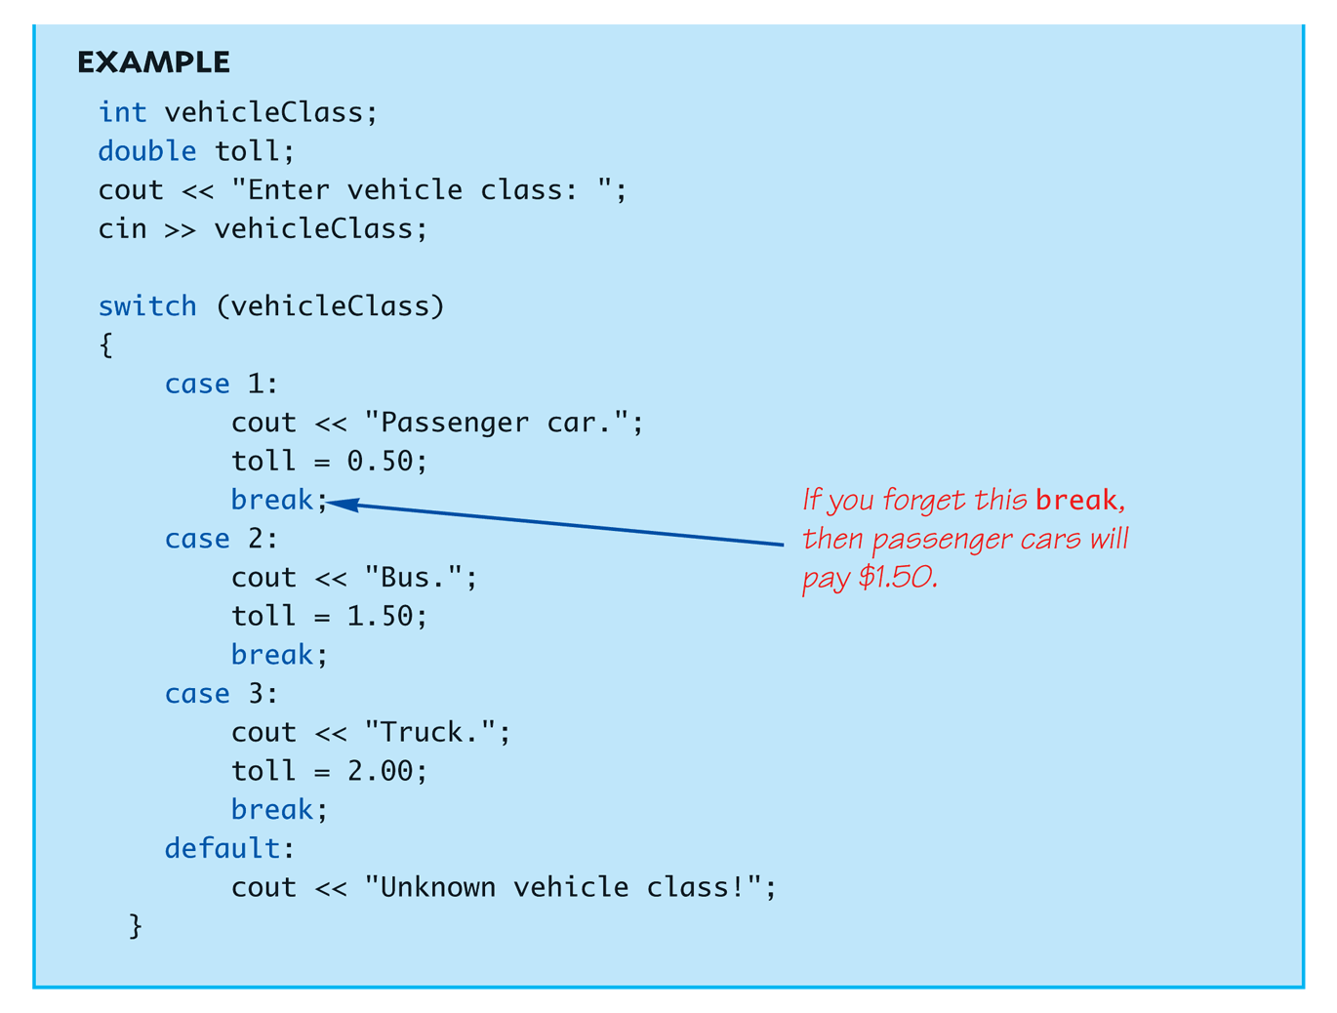
switch Statement (cont.)

Slide 9
Repetition Structures
Enable programs to perform statements repetitively as long as the loop-continuation condition remains true.
while – loop
loop body may or may not be executed
do...while loop
loop body is executed at least once
for loop
ideal for counter controlled repetition
loop body may or may not be executed

Slide 10
The while loop
while (condition)
{
statement 1;
statement 2;
etc...
}
Repeatedly executed as long as condition is true
Notes:
-important to note that the code on the loop body should eventually make condition false...otherwise the loop will continue forever.

Slide 11
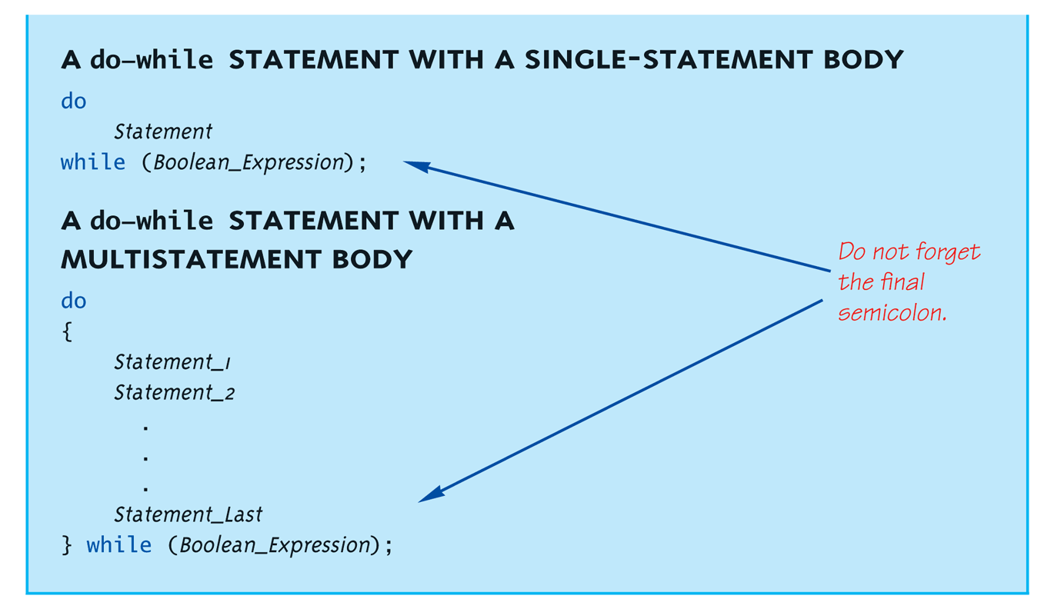
do-while Loop Syntax

Slide 12
do-while Loop Example
count = 0; // Initialization do { cout << "Hi "; // Loop Body count++; // Update expression } while (count < 3); // Loop Condition
Loop body executes how many times?
do-while loops always execute body at least once!

Slide 13
while vs. do-while
Very similar, but…
One important difference
Issue is "WHEN" boolean expression is checked
while: checks BEFORE body is executed
do-while: checked AFTER body is executed
After this difference, they’re essentially identical!
while is more common, due to it’s ultimate "flexibility"

Slide 14
The for loop
for (initialization; condition; increment)
{
statement 1;
statement 2;
etc...
}
Executed repeatedly as long as condition is true
Notes:
note that increment is not mean to be taken literally

Slide 15
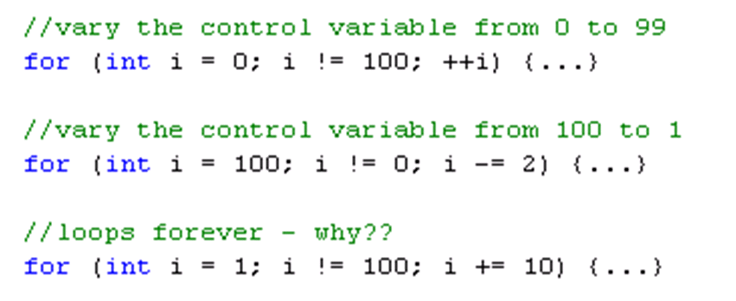
The for loop (cont.)
Examples:

Slide 16
break and continue
break statement:
causes immediate exit from loop
program execution continues with the first statement after the loop statement
continue statement:
skips remaining statements in loop body and proceeds with the next iteration

Slide 17
C++ User-defined Data Types
C++ features several techniques to defines user-defined data types. Two ways are:
Type synonymous (typedef)
defines an alternative name for an already existing type
Enumeration
defines a (finite) set of integer constants

Slide 18
Type Synonymons
typedef [type expression] [identifier]
defines [identifier] to be synonymous for [type expression]
e.g.,
typedef unsigned int uint;
//defines uint be synonymous to unsigned int
typedef int integer;
//defines integer to by synonymous to int

Slide 19
Enumerations
enum [identifer] {enum_0, enum_1, enum_2...}
variables of enum type can have values only from the list of enumerators.
values corresponds to consecutive integers starting from 0, unless otherwise specified.
e.g.,
enum Grades = {A, B, C, D, E, F}
enum Days = {SUN = 1, MON, TUE, WED, THU, FRI, SAT}

Slide 20
Functions
Programs can be quite large, we need to break them down into smaller functions.
Functions call other functions to complete specific tasks.
Divide and Conquer principle: Divide the problem into smaller pieces, you conquer the complexity of the problem.
Functions allow for code reuse

Slide 21
C++ Math Library Functions
C++ has many libraries that are predefined that you can simply use.
The math library has tens of math functions you can call.
You need to include the header file <#include cmath>
E.g. sqrt, ceil, etc.
You call a function by specifying its name, and the list of arguments it takes
E.g. sqrt(4) will return the square root of 4

Slide 23
Function Definitions
You can create your own functions
Format for function definition
return-value-type function-name( parameter-list ) { declarations and statements }
Parameter list
Comma separated list of parameters
Data type needed for each argument
If no parameters, use void or leave blank
Return-value-type
Data type of result returned (use void if nothing returned)

Slide 24
Function Definitions
Example function
int square( int y )
{
return y * y;
}
return keyword
Returns data, and control goes to function’s caller
If no data to return, use return;
Function ends when reaches right brace
Control goes to caller
Notes:
talk about when the compiler finds the function….and how compilation usually takes place.

Slide 25
Function Prototypes
Tells compiler argument type and return type of function
Function prototype contains
Function name
Parameters (number and data type)
Return type (void if returns nothing)
Only required, if function definition after function call (although it is good practice to always include them in separate header file (*.h)
Prototype must match function definition
Function prototype
double maximum( double, double, double );
Definition
double maximum( double x, double y, double z )
{
…
}

Slide 26
Parameter Passing
In C++ arguments can passed to a function in a number of ways: The following three are most popular
Call by value
e.g., void passByValue(int k)
Call by reference
e.g., void passByReference (int & k)
Call by constant reference
e.g., void passByConstantValue(const int & k)

Slide 27
Call by Value
Parameter is unqualified
When function is called, run-time system makes copy of the arguments and passes the copy to the function
Function can change value of its parameters, but these changes have no effect on the original arguments (prevents unwanted side-effects)
Usually used to pass ‘small’ arguments

Slide 28
Call by Reference
Parameter is qualified by & (which is read as “reference to”
e.g., sqr (int & x)
When function is called, run-time system, passes a reference to the argument to the function
When parameter is used in the function, it is effectively a synonym for the argument
Any change made to the parameter is also a change to the argument
Literals cannot be passed as arguments
e.g., sqr (x); // allowed
e.g., sqr (4); // not allowed
Used only, when changes made by the function must be passed back to the caller.

Slide 29
Call by Constant Reference
Parameter is qualified by const and &
e.g., sqr (const int & x)
When function is called, run-time system, passes a reference to the argument to the function
When parameter is used in the function, it is effectively a synonym for the argument
Compiler ensures that parameter is never changed
Any attempted changes will result in a compiler error
Usually considered the “default” way of value passing for large objects

Slide 30
The Function Call Stack
Internal data structure, which supports the function call / return mechanism
i.e., each function must eventually return to the function that called it.
Last IN –First Out (LIFO) principle
Supports creation, maintenance and destruction of variables defined as function scope.
Each time a function is called, an activation record (containing the return address and all necessary information for function execution) is pushed (added) onto the stuck
When function terminates, the activation record is popped (removed) from the stack.
Notes:
write an example onto the board.

Slide 31
Inline Functions
Reduce function call overhead—especially for small functions
Qualifier inline before a function’s return type in the function definition
“Advises” the compiler to generate a copy of the function’s code in place (when appropriate) to avoid a function call
Trade-off of inline functions
Multiple copies of the function code are inserted in the program (often making the program larger)
The compiler can ignore the inline qualifier and typically does so for all but the smallest functions
Notes:
usually doesn’t work for recursive functions…unless the compile first translates the recursion into iteration and then uses inlining

Slide 32
Function Overloading
Overloaded functions
Overloaded functions have
Same name
Different sets of parameters
Compiler selects proper function to execute based on number, types and order of arguments in the function call
Function must be unambiguously identifiable
Commonly used to create several functions of the same name that perform similar tasks, but on different data types
Notes:
little example here…..

Slide 33
Recursive Functions
A function that "calls itself"
Said to be recursive
In function definition, call to same function
Recursive Functions have two parts
Recursive part: Computation involves a recursive call
Base case: Computation without recursive calls
Code Example

Slide 34
Recursive Function: Example
int faculty(int n) {
if (n <= 1) return 1; //base case
return n * faculty(n-1); //recursive case
}

Slide 35
Infinite Recursion
Base case MUST eventually be entered
If it doesn’t → infinite recursion
Recursive calls never end!

Slide 36
Stacks for Recursion
Recursion uses stacks
Each recursive call (like each ordinary functional call) placed on stack
When one completes, last call is removed from stack

Slide 37
Recursion—A Closer Look
Computer tracks recursive calls
Stops current function
Must know results of new recursive call before proceeding
Saves all information needed for current call
To be used later
Proceeds with evaluation of new recursive call
When THAT call is complete, returns to "outer" computation

Slide 38
Function Definition for power()
int power(int x, int n) { if (n<0) { cout << "Illegal argument"; exit(1); } if (n>0) return (power(x, n-1)*x); else return (1); }

Slide 39
Calling Function power()
Example calls:
power(2, 0); → returns 1
power(2, 1); → returns (power(2, 0) * 2); → returns 1
Value 1 multiplied by 2 & returned to original call

Slide 40
Calling Function power()
Larger example: power(2,3); → power(2,2)*2 → power(2,1)*2 →power(2,0)*2 →1
Reaches base case
Recursion stops
Values "returned back" up stack

Slide 41
Recursion Versus Iteration
Recursion not always "necessary"
Not even allowed in some languages
Any task accomplished with recursion can also be done without it
Nonrecursive: called iterative, using loops
Recursive:
Runs slower, uses more storage
Elegant solution; less coding

Slide 42
Arrays
Aggregate data type
A collection of data of same type
Declare the array → allocates memory int score[5];
Declares array of 5 integers named "score"
Similar to declaring five variables: int score[0], score[1], score[2], score[3], score[4]

Slide 43
Accessing Arrays
Access using index/subscript
cout << score[3];
Note two uses of brackets:
In declaration, specifies SIZE of array
Anywhere else, specifies a subscript
Size, subscript need not be literal
int score[MAX_SCORES];
score[n+1] = 99;
If n is 2, identical to: score[3]

Slide 44
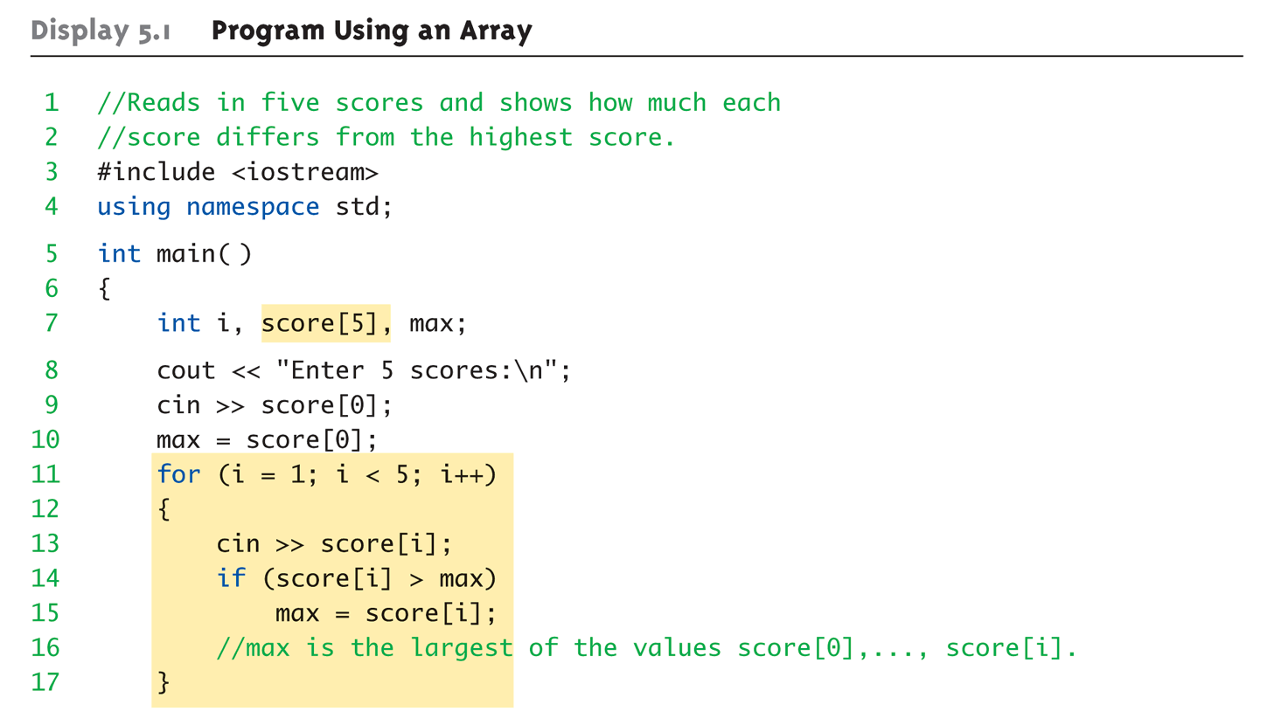
Array Program Example:

Slide 45
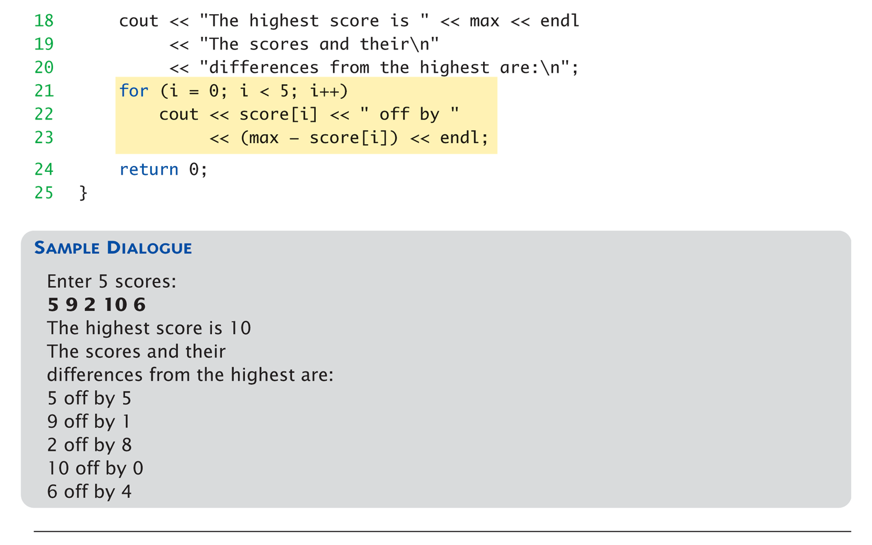
Array Program Example (cont)

Slide 46
Major Array Pitfall
Array indexes always start with zero!
Zero is "first" number to computer scientists
C++ will "let" you go beyond range
Unpredictable results
Compiler will not detect these errors!
Up to programmer to "stay in range"

Slide 47
Major Array Pitfall Example
Indexes range from 0 to (array_size – 1)
Example: double temperature[24]; // 24 is array size // Declares array of 24 double values called temperature
They are indexed as: temperature[0], temperature[1] … temperature[23]
Common mistake: temperature[24] = 5;
Index 24 is "out of range"!
No warning, possibly disastrous results

Slide 48
Defined Constant as Array Size
Always use defined/named constant for array size
Example: const int NUMBER_OF_STUDENTS = 5; int score[NUMBER_OF_STUDENTS];
Improves readability
Improves versatility
Improves maintainability

Slide 49
Initializing Arrays
As simple variables can be initialized at declaration: int price = 0; // 0 is initial value
Arrays can as well: int children[3] = {2, 12, 1};
Equivalent to following: int children[3]; children[0] = 2; children[1] = 12; children[2] = 1;

Slide 50
Auto-Initializing Arrays
If fewer values than size supplied:
Fills from beginning
Fills "rest" with zero of array base type
If array-size is left out
Declares array with size required based on number of initialization values
Example: int b[] = {5, 12, 11};
Allocates array b to size 3

Slide 51
Arrays in Functions
As arguments to functions
Indexed variables
An individual "element" of an array can be function parameter
Entire arrays
All array elements can be passed as "one entity"
As return value from function
Can be done → later in the semester

Slide 52
Entire Arrays as Arguments
Formal parameter can be entire array
Argument then passed in function call is array name
Called "array parameter"
Send size of array as well
Typically done as second parameter
Simple int type formal parameter

Slide 53
Entire Array as Argument Example

Slide 54
Array as Argument: How?
What’s really passed?
Think of array as 3 "pieces"
Address of first indexed variable (arrName[0])
Array base type
Size of array
Only 1st piece is passed!
Just the beginning address of array
Very similar to "pass-by-reference"

Slide 55
The const Parameter Modifier
Recall: array parameter actually passes address of 1st element
Similar to pass-by-reference
Function can then modify array!
Often desirable, sometimes not!
Protect array contents from modification
Use "const" modifier before array parameter
Called "constant array parameter"
Tells compiler to "not allow" modifications

Slide 56
Multidimensional Arrays
Arrays with more than one index
char page[30][100];
Two indexes: An "array of arrays"
Visualize as: page[0][0], page[0][1], …, page[0][99] page[1][0], page[1][1], …, page[1][99] … page[29][0], page[29][1], …, page[29][99]
C++ allows any number of indexes
Typically no more than two

Slide 57
Multidimensional Array Parameters
Similar to one-dimensional array
1st dimension size not given
Provided as second parameter
2nd dimension size IS given
Example: void DisplayPage(const char p[][100], int sizeDimension1) { for (int index1=0; index1<sizeDimension1; index1++) { for (int index2=0; index2 < 100; index2++) cout << p[index1][index2]; cout << endl; } }

Slide 58
Flash Questions
#1:
Write down the output of the following code snippets.
int c = 5;
cout << c << endl;
cout << c++ << endl;
cout << c << endl;
int c = 5;
cout << c << endl;
cout << ++c << endl;
cout << c << endl;

Slide 59
Flash Questions
#2:
Write down the output of the following code snippets.
int c = 0;
if (c = 1)
cout << "YES" << endl;
else
cout << "NO" << endl;
int c = 0;
if (c == 1)
cout << "YES" << endl;
else
cout << "NO" << endl;
Notes:
assignment expression returns a value… which however is scraped by using the subsequent semicolon statement
-better to use != instead to avoid assignment – equality in the first place.
--turn compiler warnings level to highest level (level 4 in VS C++)

Slide 60
Flash Questions
#3:
Write down the output of the following code snippet.
Do you see a problem?
bool outerCond = false;
bool innerCond = true;
if (outerCond)
if (innerCond)
cout << "Outer and inner Conditions are True" << endl;
else
cout << "Outer condition is false" << endl;
Notes:
else always associates with the nearest if statement.
languages such as PHP enforce the proper indentation of nested if statements

Slide 61
Flash Questions - Solutions
#1: Post-increment vs. Pre-increment:
Write down the output of the following code snippets.
int c = 5;
cout << c << endl;
cout << c++ << endl;
cout << c << endl;
int c = 5;
cout << c << endl;
cout << ++c << endl;
cout << c << endl;
5
5
6
5
6
6
Morale:
Always use pre-increment, unless you really need the ‘old’ value
Pre-increment tends to be more efficient (post-increment may force the compiler to create a temporary variable)

Slide 62
Flash Questions - Solutions
#2: Assignment vs. Equality
Write down the output of the following code snippets.
int c = 0;
if (c = 1)
cout << "YES" << endl;
else
cout << "NO" << endl;
int c = 0;
if (c == 1)
cout << "YES" << endl;
else
cout << "NO" << endl;
YES
NO
Morale:
Assignments are expressions and thus return a value (i.e., value of the right hand side)
Better to use ‘!=“ or to reverse the arguments to avoid assignment – equality mismatch
Recommendation: Make compile spot these mismatches
Notes:
assignment expression returns a value… which however is scraped by using the subsequent semicolon statement
-better to use != instead to avoid assignment – equality in the first place.
--turn compiler warnings level to highest level (level 4 in VS C++)
-what happens to the value of assignments, if there are stand-a-lone?

Slide 63
Flash Questions - Solutions
#3: Dangling else Problem
Write down the output of the following code snippet.
What is the problematic here?
bool outerCond = false;
bool innerCond = true;
if (outerCond)
if (innerCond)
cout << "Outer and inner Conditions are True" << endl;
else
cout << "Outer condition is false" << endl;
--no output--
Morale:
else always associates with the nearest condition.
Use brackets {} to ‘overwrite’ this rule
Notes:
else always associates with the nearest if statement.
langauges such as php enforce the proper indentation of nested if statements

