Slide 1

Experimental Investigation of the Phase Equilibria in the
Mg-Mn-{Ce, Nd} and Ce-Mg-Zn Ternary Systems and Diffusivity Measurements of the Mg-{Ce, Nd, Zn}
and Zn-{Ce, Nd} Binary Systems
Doctoral Thesis Defense Presentation
May 20th , 2014
Mechanical Engineering
at
Concordia University
Montreal, Quebec, Canada
By
Ahmad O. Mostafa
Supervisor
Dr. Mamoun Medraj
Notes:
بسم الله الرحمن الرحيم

Slide 2

Outlines
Introduction
Literature review
Methodology
Results and discussion
  Part 1: Ce-Mg-Zn ternary system
    Mg-Mn-{Ce, Nd} ternary systems
  Part 2: Binary diffusivity measurements of the Mg-Ce system
Conclusions
Contributions
Suggestions for future works

Slide 3


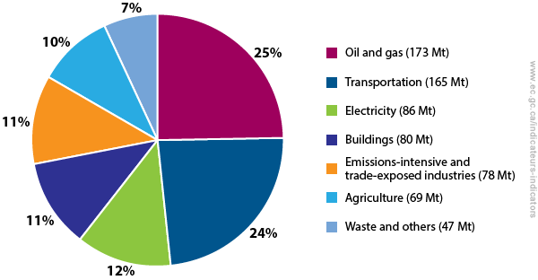
Introduction
The worldwide trend is towards more sustainable energy sources instead of the traditional fuel.
Distribution of greenhouse gas emissions by economic sector, Canada, 2012.
1- Innovate design for high performance vehicles.
2- Substitution of materials with lighter weight alternatives.
Mg
http://ec.gc.ca/indicateurs-indicators/default.asp?lang=en&n=F60DB708-1
Notes:
A breakdown of Canada’s emissions by economic sector shows the sources of Canada’s greenhouse gas (GHG) emissions in 2012. The emissions can be attributed to seven key areas of the economy
Promising

Slide 4
Introduction
New Mg alloy systems provide promising opportunities for improved properties and performance suitable for demanding applications.
Alloying elements, added to Mg, improve its mechanical properties by solid-solution strengthening and/or by precipitation hardening.
Mn
Improve corrosion resistance and mechanical properties at room temperature
Zn
Ce
Improve the mechanical properties at elevated temperatures
Nd
It is essential to understand the phase relationships resulting from these additions.
Notes:
Specific strength= strength/density
Drives us to the following objectives

Slide 5
Objectives
Experimental investigation of the phase equilibria in the:
  Mg-Mn-{Ce, Nd} systems at 450°C
  Ce-Mg-Zn system at 300°C
Diffusivity measurements of the Mg-{Ce, Nd, Zn} and Zn-{Ce, Nd} binary systems.

Slide 6
Literature
review

Slide 7
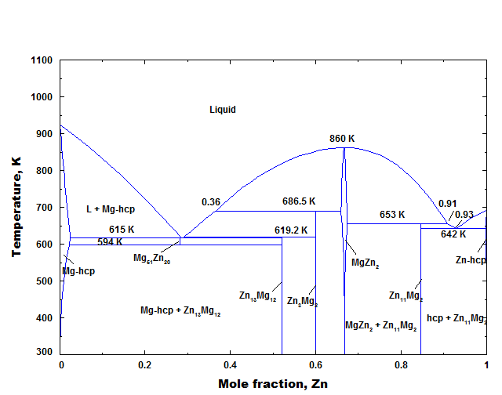
Ce-Mg-Zn system
Melnik et al., Magnievye Splavy. Mater.Vses. Soveshch. Issled., Razrab. Primen. Magnievyhk Splavov 1978, 95-99
Kevorkov and Pekguleryuz, J. Alloy. Compnd. 2009, 478, 427-436.
300°C
350°C
Literature review
?
?
Pavlyuk et al., Intermetallics 2012, 20, 8-15.
197°C
It is important to
Reveal the phase equilibrium in the Zn-rich corner
Verify the ternary compounds at 300°C
Investigate the unstudied regions
197°C
M. Mezbahul-Islam et al. , Journal of Materials, (2014) Article ID: 704283

Slide 8
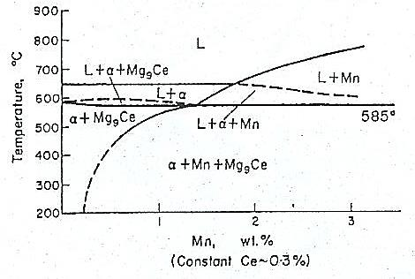
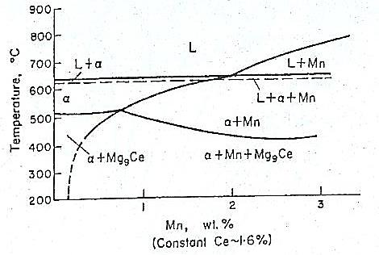
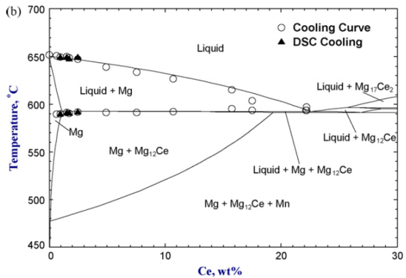
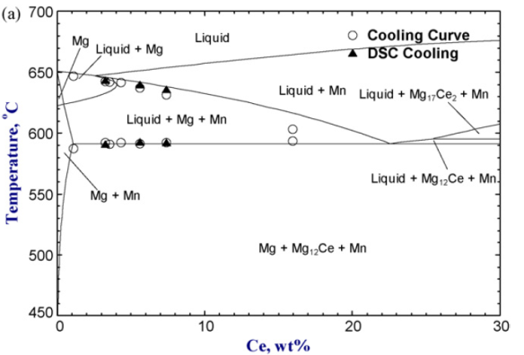
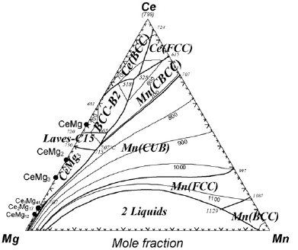
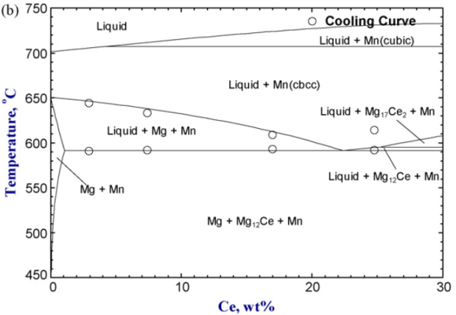
Ce-Mg-Mn system
Using thermal and metallographic methods
Phase equilibrium
α-Mg+Mn
α-Mg+Mg₉Ce
Mg₉Ce=Mg₁₂Ce
Literature review
Petrov et al., Baikov Institute of Metallurgy and Materials Science, 1 (1957) 144-147
0.6 wt.% Mn
1.8 wt.% Mn
Using CALPHAD method
- Mg-rich corner only
- Few experimental data
- Predicted projection
2.5 wt.% Mn
Zhang et al., Journal of Alloys and Compounds 482 (2009) 420–428

Slide 9
Mg-Mn-Nd system
Only one study was found in the literature
The study was limited to Mg-rich corner up to 4 wt.% Mn and 10 wt.% Nd.
The objective was to determine the solid solubility of Mn and Nd in Mg.
Literature review
Phase equilibrium
α-Mg+Mn
α-Mg+Mg₄₁Nd₅
Because Mg-Mn-{Ce, Nd} systems are not completely studied, it is necessary to investigate them in the full composition range.
M. Drits et al, Journal of Inorganic Chemistry, 7 (1963) 2771-2777.

Slide 10
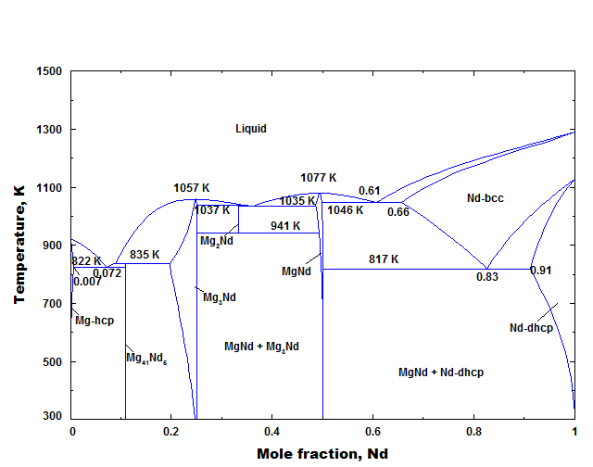
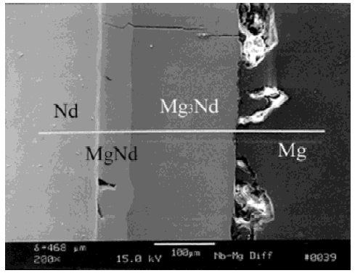
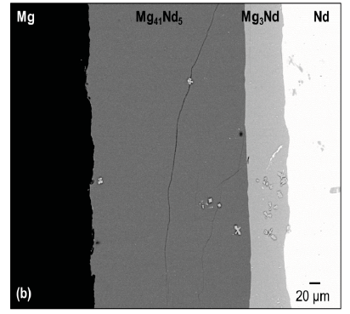
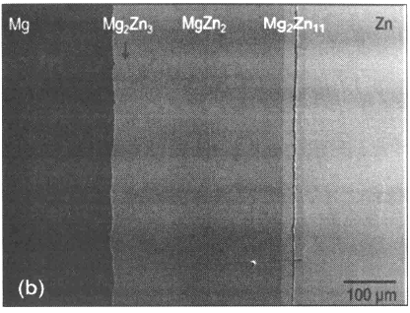
Binary diffusivity
No diffusion information could be found about the Zn-{Ce, Nd} systems
The available coefficients of the Mg-{Nd, Zn} in the literature were found inaccurate due to missing phases.
Literature review
Mg₄₁Nd₅?
MgNd?
500°C
500°C
400°C
400°C
Xu et al., Journal of Materials Research, 16 (2001) 3287-3292
S. Brennan et al., ICCMA, 2012, pp. 417-421
It is necessary to provide accurate diffusion measurements.
315°C
315°C
315°C
Mg₁₂Zn₁₃?
S. Brennan et al., Magnesium Technology 2012, John Wiley & Sons, Inc., 2012, pp. 323-327
M. Mezbahul-Islam et al. , Journal of Materials, (2014) Article ID: 704283

Slide 11
Methodology
Mg-Mn-{Ce, Nd} and Ce-Mg-Zn ternary systems
Ce
Ce-Mg-Mn
Ternary
diffusion couples
Mn
Mg
Nd
Isothermal
sections
Mg-Mn-Nd
Key alloys
Zn
Ce
Ce-Mg-Zn
Mg-{Ce, Nd, Zn} and Zn-{Ce, Nd} binary systems
Ce
Ce-Mg
Binary interdiffusion
coefficients
Binary
diffusion couples
Mg
Nd
Mg-Nd
Zn
Mg-Zn
Activation energies
Boltzmann-Matano
analysis
Ce
Ce-Zn
Pre-exponential
factors
Zn
Nd
Nd-Zn

Slide 12
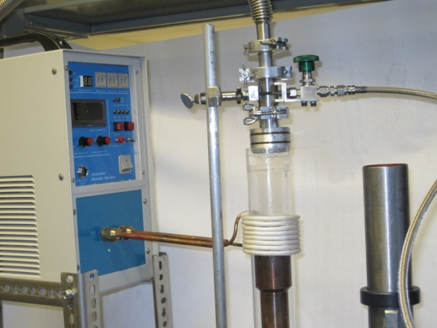
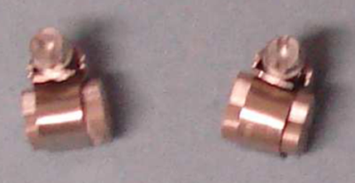
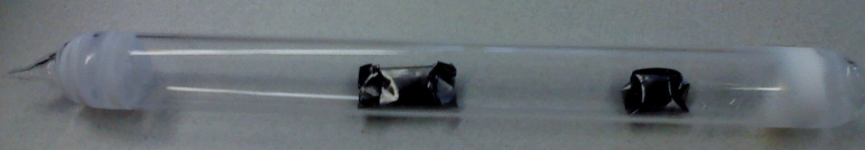
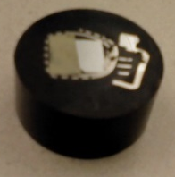
Phase diagram determination methods
Key alloys preparation
Methodology
Alloys were prepared in arc-melting and/or induction-melting furnaces
Chemical composition→ ICP-OEM and/or EDS
Diffusion couples preparation
Induction melting furnace
Diffusion couples prepared from pure metals and/or alloys
  End-members were selected to cover large area of the studied system
  Polishing up to 1μm diamond suspension → clamping → annealing
Analysis
XRD (Phase identification and relative phase amount)
WDS/EDS (Phase composition)
SEM (microstructural studies)
Notes:
Talk about different annealing time intervals.

Slide 13
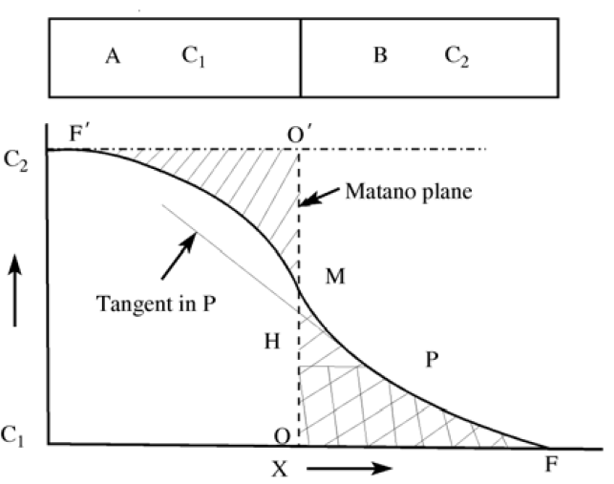
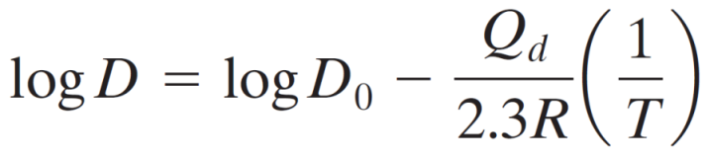
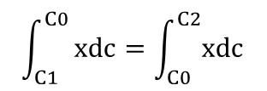
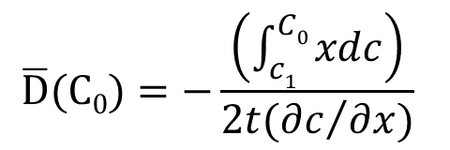
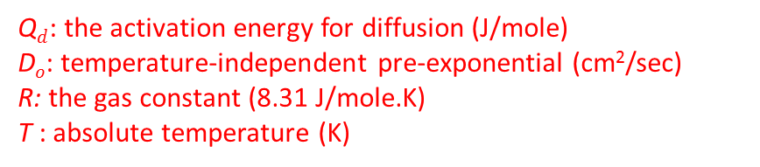
Binary diffusivity measurements
The magnitude of the diffusion coefficient (D) is indicative of the rate which atoms diffuse.
Methodology
Calculating the coefficients directly from the composition profile
$$\overline{D}(C0)=−\frac{\left(\int_{c1}^{C0}{xdc}\right)}{2t({∂c}/{∂x})}$$
Ď(c): interdiffusivity at the composition C (cm²/sec)
t: annealing time (sec)
dc/dx : slope at the composition C (at.%/cm),
x: layer thickness (cm).
Q_{d} and D_{o} can be calculated using diffusion couples annealed at different temperatures and Arrhenius plot.
Y. Du et al., Atomic Mobilities and Diffusivities in Al alloys, Sci. China Tech. Sci., 55 (2012) 1-23.
logD vs. 1/T
$$\int_{C1}^{C0}{xdc=\int_{C0}^{C2}{xdc}}$$
Q$d$: the activation energy for diffusion (J/mole)
D$o$: temperature-independent pre-exponential (cm²/sec)
R: the gas constant (8.31 J/mole.K)
T : absolute temperature (K)
The slope is -Q_{d}/2.3R, and
the intersection with y axis is logD_{o} .
Notes:
This is another option for an Overview slides using transitions.

Slide 14
Results part 1:
Phase equilibria of the Ce-Mg-Zn at 300°C
Results
And
discussion
Results and discussion
Ce
Ce-Mg-Mn
Mn
Mg
Nd
Mg-Mn-Nd
Zn
Ce
Ce-Mg-Zn
(1) Diffusion multiple
(3) Diffusion couples
(28) Key alloys
Tie-line interpolation technique

Slide 15
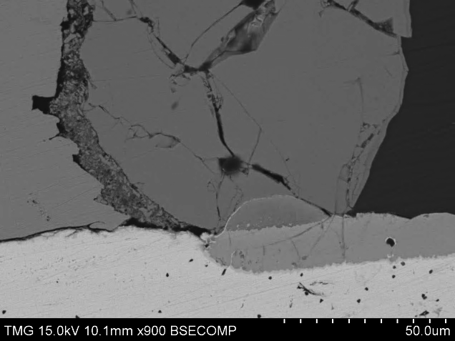
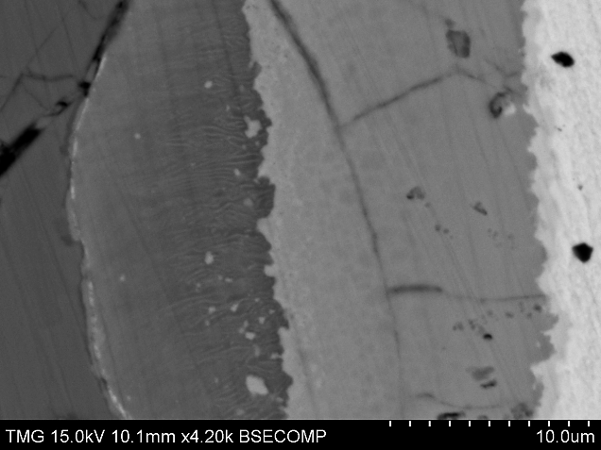
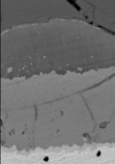
Diffusion multiple- Ce/Mg/Zn
Annealing temp.: 300°C
Annealing time: 21 days
Mg-Zn
Results: Part 1
2
3
1
4
2
5
6
7
8
9
Zn
Mg
Line-scan
Ce-Zn
X
Ce-Mg
Ce
Diffusion path
Composition profile
Notes:
Diffusivity of different elements

Slide 16
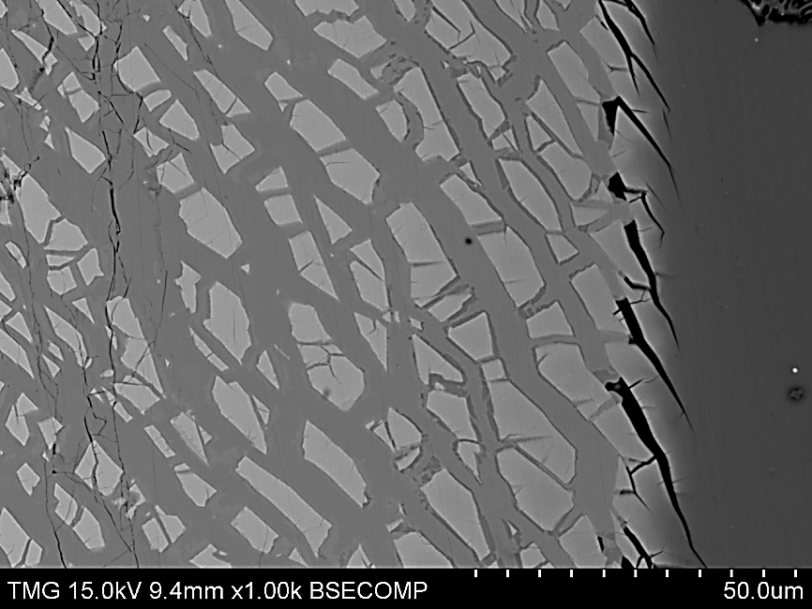
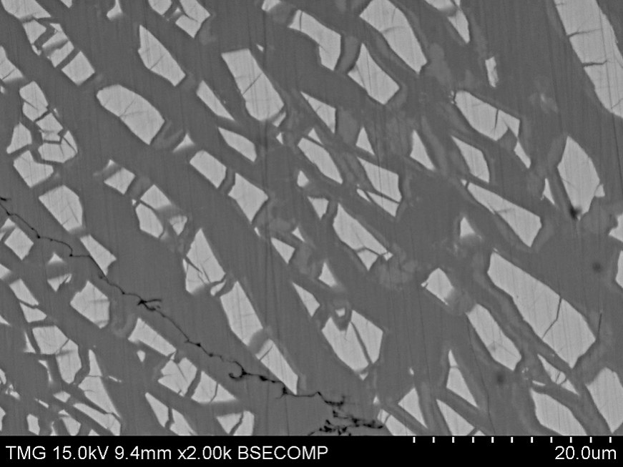
Diffusion couple #1- Mg+CeMg₁₂/Zn
Annealing temp.: 300°C
Annealing time: 21 days
CeMg₁₂
MgZn₂
τ₅
Results: Part 1
τ₈
Mg+CeMg₁₂
CeMg₁₂
τ₂
Original interface
Ce(Mg,Zn)₁₂
CeMg₁₂
Mg
Mg₂Zn₃
Zn
Remarks
Four ternary compounds were found (τ₂, τ₅, τ₆ and τ₈)
Mg was found in equilibrium with:
  CeMg₁₂
  (CeMg₁₂)
  τ₂
  τ₈
  Mg₁₂Zn₁₃
Mg₂Zn₁₁+(Ce₂Zn₁₇)
τ₆
τ₅
Mg+CeMg₁₂
Zn
Mg₂Zn₁₁
MgZn₂+(Ce₂Zn₁₇)
MgZn₂
Notes:
Single phase layer and two-phase layer

Slide 17
Diffusion couple #1- Mg+CeMg₁₂/Zn
EDS elemental mapping
A
B
C
D
E
A
B
C
D
E
Results: Part 1
Almost constant at ~8 at.%
Ce
A
B
C
D
E
A
B
C
D
E
Mg
Zn

Slide 18
Diffusion couple #1- Mg+CeMg₁₂/Zn
Annealing temp.: 300°C
Annealing time: 21 days
Phase equilibrium
Results: Part 1
Phase relationships analysis
WDS line-scans/spots
EDS elemental maps

Slide 19
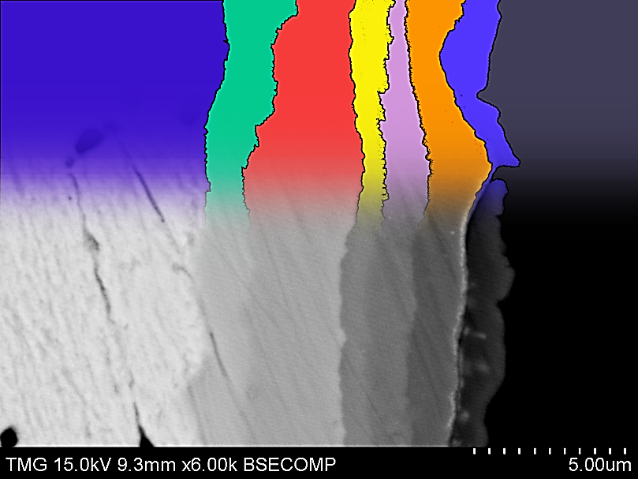
Diffusion couples #2 and 3
Phase equilibria representation
Three ternary compounds were found (τ₃, τ₅ and τ₆)
Results: Part 1
Zn
CeMg₃+CeMg
Zn/(CeMg₃+CeMg) diffusion couple
Annealed at 300°C for 21 days
Four ternary compounds were found (τ₂, τ₃, τ₅ and τ₇)
Ce
CeZn
CeZn₂
τ₃
τ₇
τ₅
τ₂
(Mg)^{Zn}
Ce/(Mg+Mg₁₂Zn₁₃) diffusion couple
Annealed at 300°C for 40 days

Slide 20
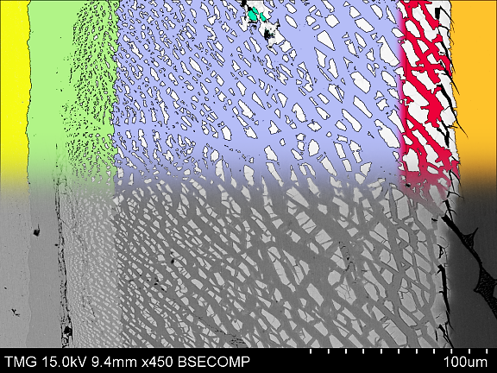
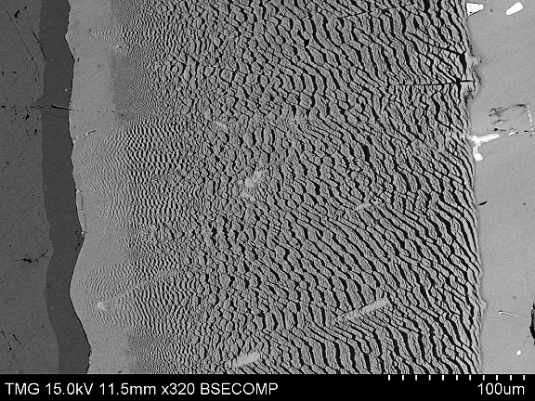
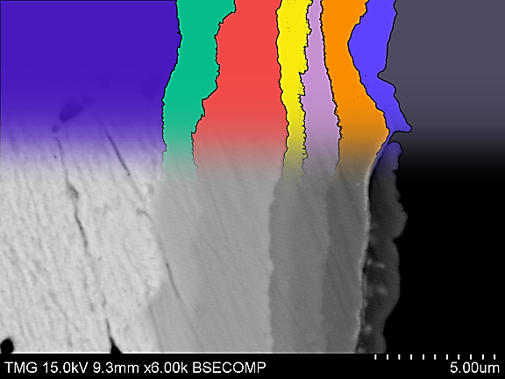
Combined diffusion multiple/couples results
Results: Part 1
Key alloys
Phase equilibrium obtained from a diffusion multiple and three diffusion couples at 300°C
Melnik et al., Magnievye Splavy. Mater.Vses. Soveshch. Issled., Razrab. Primen. Magnievyhk Splavov 1978, 95-99
Notes:
I am proud

Slide 21
Key alloys
To confirm the obtained phase relationships
To verify the ternary compounds
To investigate the unstudied regions
To determine the solid solubilities
Results: Part 1
28 key alloys
WDS and XRD
Annealing
For ≥ 30 days
2
12
1

Slide 22
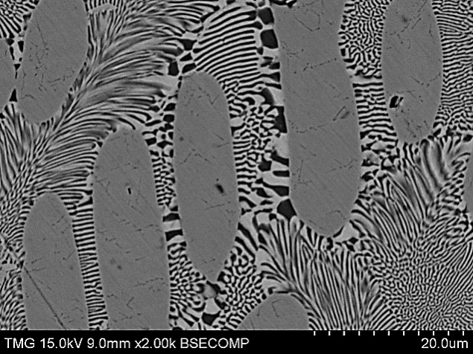
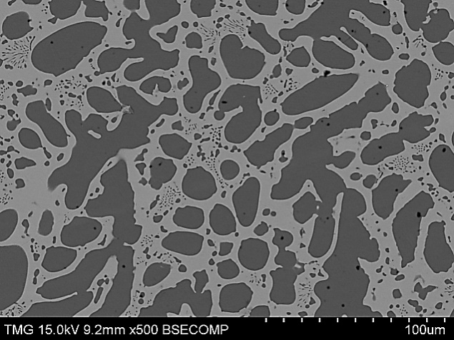
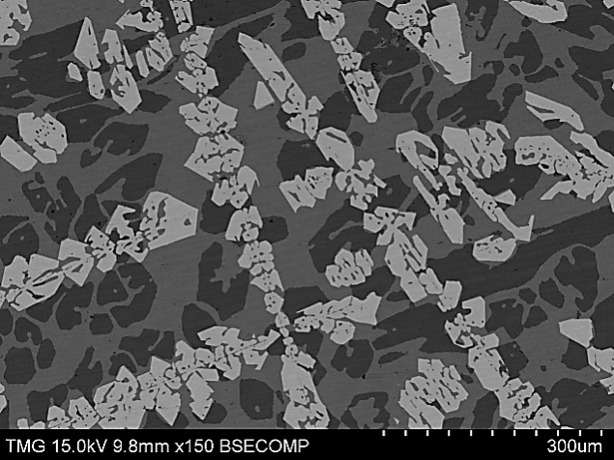
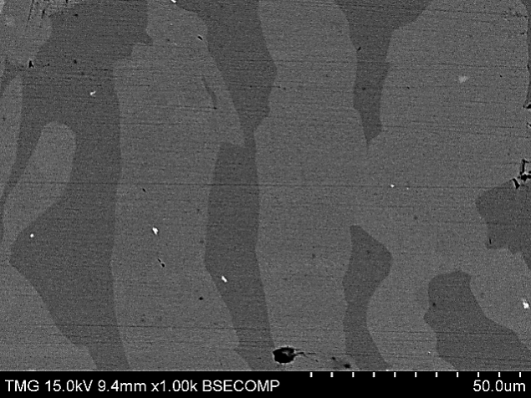
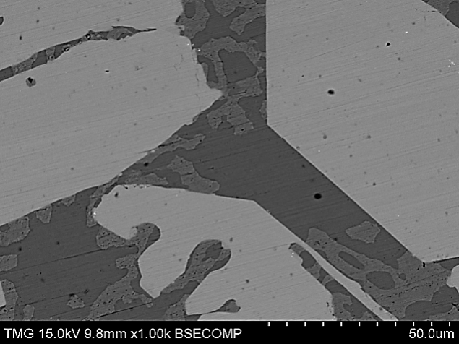
Alloys with three-phase equilib.
Alloys with two-phase equilib.
Sample #23
Sample #12
WDS and XRD analysis are consistent
Two-phase alloys give tie-lines
τ₃
MgZn₂
(CeZn₂)
(Ce₂Zn₁₇)
Ce(Mg,Zn)
Results: Part 1
2
12
Sample #10
1
Sample #2
(Ce₂Zn₁₇)
Ce(Mg,Zn)
Mg₂Zn₁₁
MgZn₂
Ce(Mg,Zn)₃
Sample #1
Sample #3
(Ce₂Zn₁₇)
(Ce₃Zn₂₂)
Mg₂Zn₁₁
(Ce₂Zn₁₇)
Zn

Slide 23
Interpolation of tie-lines on a ternary system
Boundary tie-lines
Interior tie-lines
Results: Part 1
B
A
C
D

Slide 24
Ce-Mg-Zn isotherm at 300°C
Remarks
Isothermal section constructed in the full composition range
Eight ternary compounds were found at 300°C
(1) Diffusion multiple
(3) Diffusion couples
(28) Key alloys
Tie-line interpolation technique
Results: Part 1
Published as: Ahmad Mostafa and Mamoun Medraj , Phase equilibria of the Ce-Mg-Zn ternary system at 300°C, Metals, accepted on May 15, 2014.

Slide 25
Mg-Mn-{Ce,Nd} and Ce-Mg-Zn ternary systems
CHAPTER 2: Ce-Mg-Mn (450°C)
Published as: Ahmad Mostafa and Mamoun Medraj , Experimental investigation of the Ce-Mg-Mn isothermal section at 723K (450°C) via diffusion couples technique, Metallurgical and Materials Transactions A, Vol. 45 (7), pp. 3144-3160, 2014.
CHAPTER 3: Mg-Mn-Nd (450°C)
Results: Part 1
Remarks
Isothermal sections were constructed in the full composition range at 450°C
No ternary compound was found
Ternary solid solubilities were determined
Mn was found in equilibrium with most of the phases in both systems
CHAPTER 4: Ce-Mg-Zn (300°C)
Ce
Ce-Mg-Mn (450°C)
Degree of complexity
Mn
Diffusion couples
Key alloys
WDS and XRD
Ce-Mg-Mn system at 450°C
Mg
Nd
Mg-Mn-Nd (450°C)
Zn
Ce
Ce-Mg-Zn (300°C)
Published as: Ahmad Mostafa and Mamoun Medraj Experimental investigation of the Mg-Mn-Nd isothermal section at 450°C, Journal of Alloys and Compounds; Vol. 608, pp. 247-257, 2014.
Mg-Mn-Nd system at 450°C
Ce-Mg-Zn system at 300°C

Slide 26
Results part 2:
Mg-{Ce, Nd, Zn} and Zn-{Ce, Nd} binary systems
Ce
Mg-Ce
Results and discussion
Mg
Nd
Mg-Nd
Zn
Mg-Zn
Ce
Ce-Zn
Zn
Nd
Nd-Zn
Published as: Ahmad Mostafa and Mamoun Medraj , On the atomic interdiffusion in Mg-{Ce, Nd, Zn} and Zn-{Ce, Nd} binary systems, Journal of Materials Research, submitted March, 2014.
Notes:
Moving to diffusivity

Slide 27
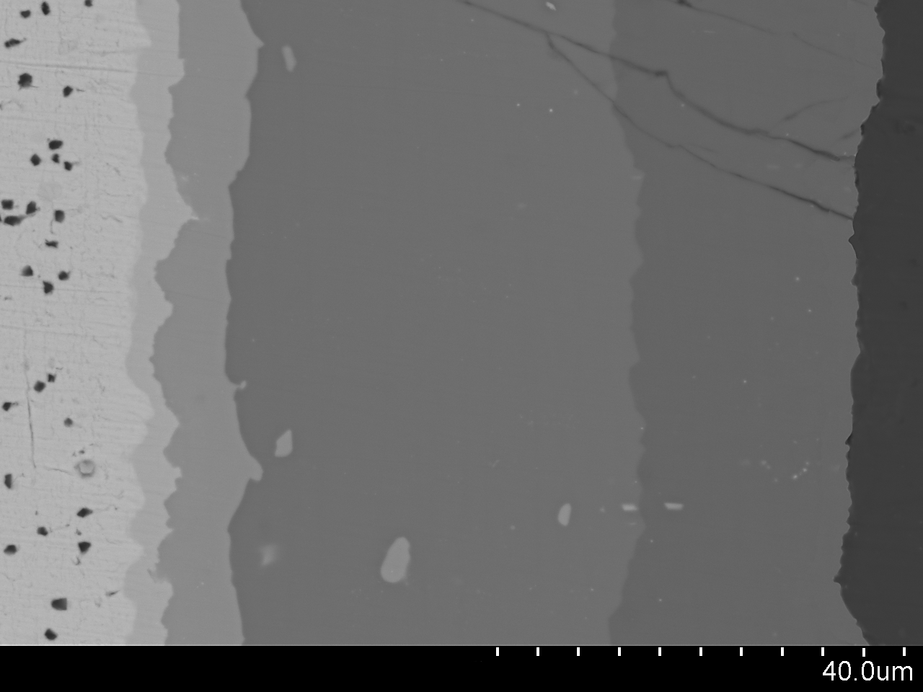
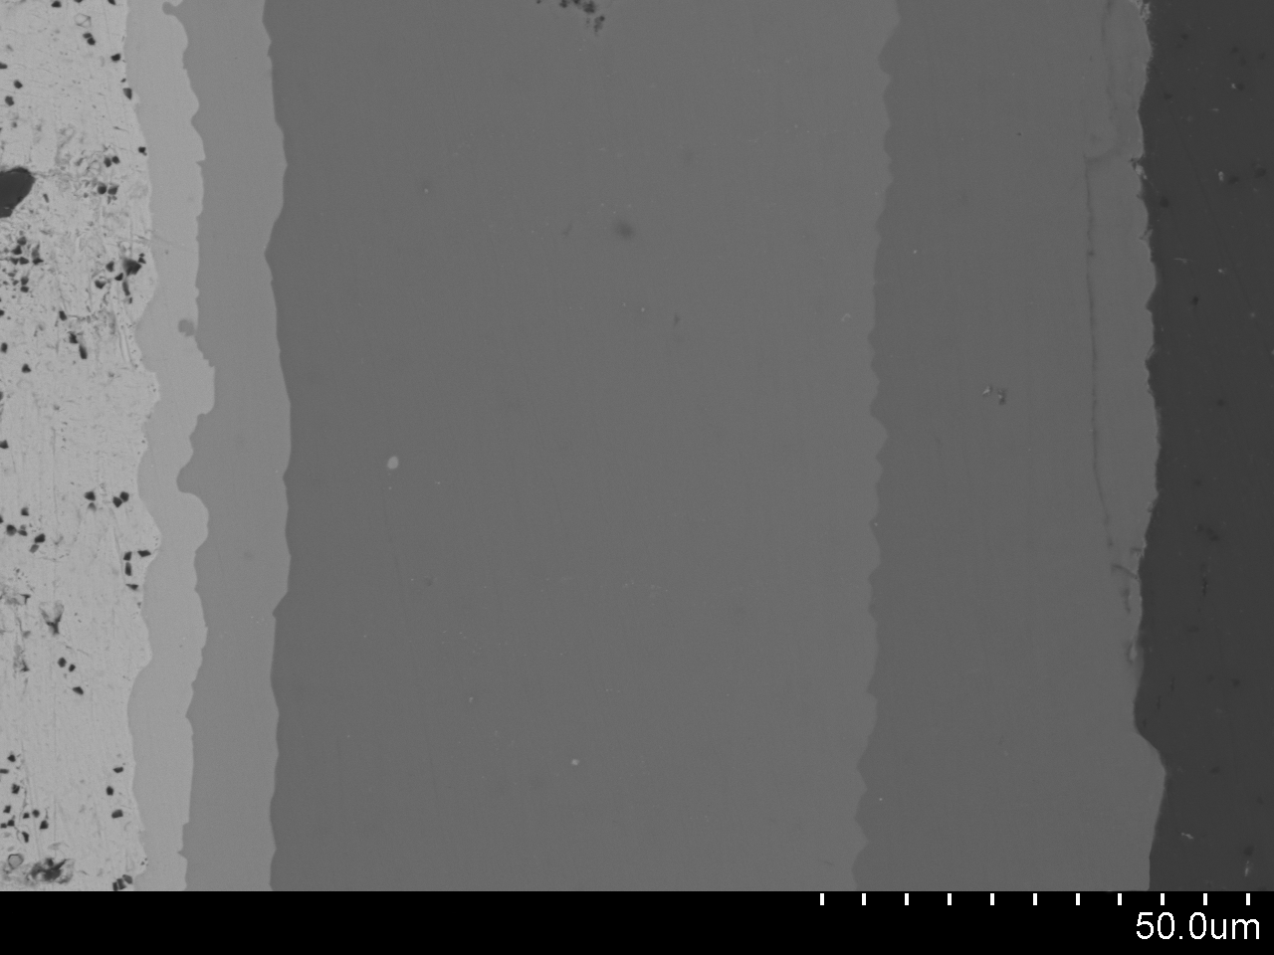
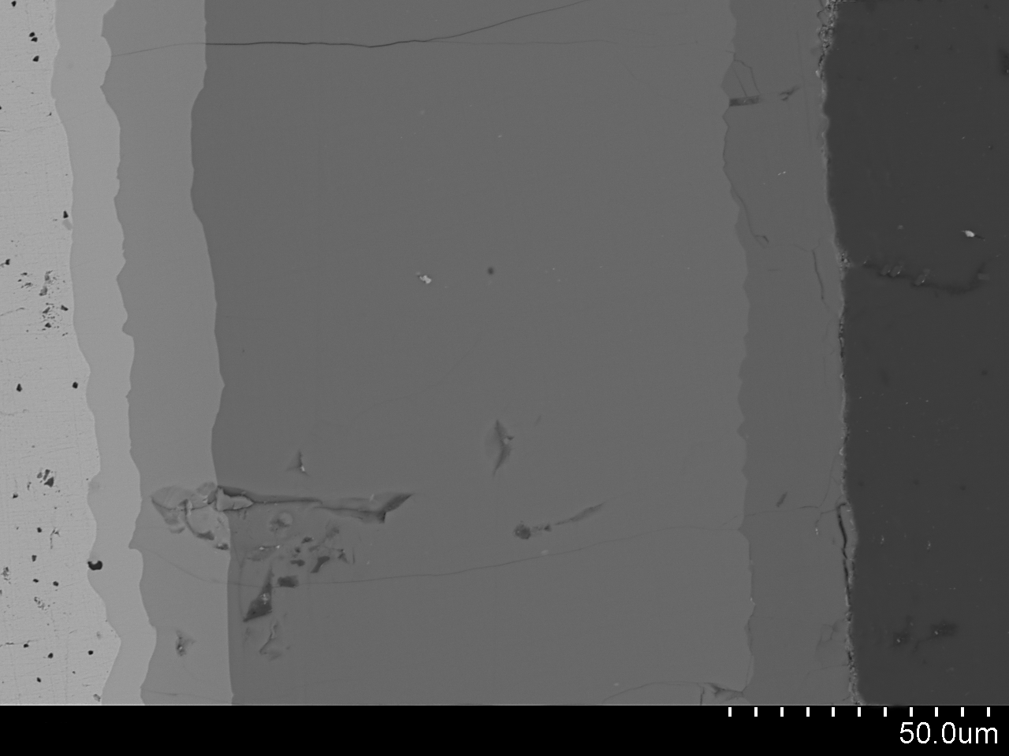
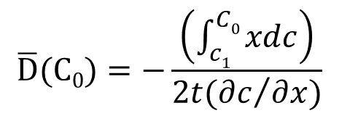
Mg-Ce binary system
Diffusivity measurements
Mg₃Ce
Mg
Line-scan
Ce
Mg₄₁Ce₅
Mg₁₂Ce
Ce
Mg₃Ce
Mg₄₁Ce₅
Mg₁₂Ce
Mg₃Ce
Mg₄₁Ce₅
Mg₁₂Ce
Results: Part 2
Ce
Mg
MgCe
Mg
MgCe
400°C for 120hr
450°C for 96hr
MgCe
490°C for 48hr
Activation energy and pre-exponential factor
logD vs. 1/T
System | Intermetallic interface | Cº | 400°C |  | 450°C |  | 490°C
 |  | Mg (at.%) | x_{o} (µm) | D_{o}(C) (cm²/s) | x_{o} (µm) | D_{o}(C) (cm²/s) | x_{o} (µm) | D_{o}(C) (cm²/s)
Mg-Ce | Ce/MgCe | 25 | 9.7 | 1.8×10⁻¹³ | 4.1 | 3.5×10⁻¹³ | 9.8 | 6.0×10⁻¹³
 | MgCe/Mg₃Ce | 62.5 | 12.6 | 8.7×10⁻¹⁴ | 9.2 | 1.6×10⁻¹³ | 16.2 | 3.2×10⁻¹³
 | Mg₃Ce/Mg₄₁Ce₅ | 82 | 22.0 | 1.6×10⁻¹³ | 19.5 | 3.2×10⁻¹³ | 33.5 | 5.6×10⁻¹³
 | Mg₄₁Ce₅/Mg₁₂Ce | 90.7 | 60.8 | 1.1×10⁻¹³ | 89.6 | 2.3×10⁻¹³ | 133.3 | 4.2×10⁻¹³
 | Mg₁₂Ce/Mg | 96 | 84.4 | 2.1×10⁻¹³ | 118.0 | 4.8×10⁻¹³ | 150.9 | 7.3×10⁻¹³
Mg₂Ce
System | Intermetallic interface | Q_{d} (kJ/mole) | D_{o} (cm²/s)
Mg-Ce | Ce/MgCe | 56.1 | 4.2×10⁻⁹
 | MgCe/Mg₃Ce | 61.9 | 5.4×10⁻⁹
 | Mg₃Ce/Mg₄₁Ce₅ | 58.9 | 5.6×10⁻⁹
 | Mg₄₁Ce₅/Mg₁₂Ce | 61.3 | 6.6×10⁻⁹
 | Mg₁₂Ce/Mg | 58.1 | 7.3×10⁻⁹
x_{o}
Mg
C_{o}
490°C
ΔlogD
The slope is -Q_{d}/2.3R, and
the intersection with y axis is logD_{o} .
Y. Du et al., Atomic Mobilities and Diffusivities in Al alloys, Sci. China Tech. Sci., 55 (2012) 1-23.
450°C
Δ(1/T)
400°C
$$\overline{D}(C0)=−\frac{\left(\int_{c1}^{C0}{xdc}\right)}{2t({∂c}/{∂x})}$$
A. Nayeb-Hashemi and J. Clark: ASM Handbook, Volume 03—Alloy Phase Diagrams, ASM International, Materials Park, OH, 1992
Notes:
We understood the shortcoming of the literature and we could discover all the expected phases
Results were comparable to the literature

Slide 28
Conclusions
Diffusion couples combined with equilibrated key alloys are used to investigate the phase equilibria of the studied systems.
The isothermal sections of the Mg-Mn-{Ce, Nd} are established at 450°C and of the Ce-Mg-Zn is established at 300°C in the full composition range.
Eight ternary compounds are observed in the Ce-Mg-Zn system at 300°C.
The binary interdiffusion coefficients of the Mg-{Ce, Nd, Zn} and Zn-{Ce, Nd} systems are measured.
The activation energies and pre-exponential factors of the growth of the Mg-{Ce, Nd, Zn} compounds are also calculated.
Conclusions

Slide 29
Contributions
Other journal publications
Ahmad Mostafa and Mamoun Medraj, “Phase equilibria of the Mg-Nd-Zn ternary system at 300°C by means of diffusion couples and key alloys techniques,” (In preparation).
A. O. Mostafa, A. E. Gheribi, D. Kevorkov, M. Mezbahul-Islam, and M. Medraj, “Experimental Investigation and Thermodynamic Modeling of Mn-Nd Phase Diagram,” CALPHAD, 2013, Vol. 42, pp. 27-37.
Tian Wang, Dmytro Kevorkov, Ahmad Mostafa, and Mamoun Medraj “Experimental investigation of the phase equilibria in the Al-Mn-Zn system at 400°C,” Journal of Materials, submitted April, 2014.
Md. Mezbahul-Islam, Ahmad Mostafa, and Mamoun Medraj, "Essential Magnesium Alloys Binary Phase Diagrams and their Thermochemical Data", Journal of Materials, Volume 2014, Article ID 704283.
Md. I. Khan, A. Mostafa, M. Aljarrah, E. Essadiqi and M. Medraj, "Influence of cooling rate on microsegregation behavior of magnesium alloys", Journal of Materials, Volume 2014, Article ID 657647, 18 pages.

Slide 30
Conference publications
“The Mg-Mn-Nd system: Experimental Investigation and Thermodynamic Modeling”, The 9th International Conference on Magnesium Alloys and their Applications, Vancouver, 2012, p.p. 245-250.
Contributions
Symposium records
“Experimental Investigation of the Ce-Mg-Mn Isothermal Section at 450°C via Diffusion Couples and Key Alloys Techniques,” MIE-Concordia University, Montreal, April, 2014. Poster Presentation. PhD Seminar Award.
“Experimental investigation of the Mg-{Mn,Zn}-{Ce-Nd} ternary phase diagrams,” MagNET AGM2013, University of British Colombia, Vancouver. Oral presentation.
“The Assessment of Atomic Interdiffusion of the Mg-Mn-Nd Ternary System and its Constituent Binaries”, The 9th MagNET workshop at McGill University, Montreal, November, 2012. Poster Presentation.
“Isothermal Section of the Mg-Mn-Nd system at 450C: Experimental Investigation and Thermodynamic Modeling”, MagNET AGM, Waterloo, June 2012. Poster Presentation. Best Poster Award.
“Experimental Investigation and Thermodynamic Modeling of Mg-{Mn, Zn}-{Ce, Nd} Ternary systems”, MagNET AGM, Vancouver, June 2011.

Slide 31
Future works
Crystallographic studies of the newly discovered intermetallic compounds in the Ce-Mg-Zn at 300°C are essential.
Thermodynamic description is essential for establishing a self-consistent database of all ternary systems.
Liquidus projections are also essential for the thermodynamic description of the studied ternary systems. This can be achieved by the thermal analysis using DSC.
Diffusivity of the Mg-Mn-{Ce, Nd} and Ce-Mg-Zn ternary systems are important to be measured.

Slide 32

Acknowledgements
Prof. Mamoun Medraj (thesis supervisor)
PhD committee members and examiners
Mr. Mazen Samara
Dr. Dmytro Kevorkov
Dr. Md. Mezbahul-Islam
TMG members
MagNET-NSERC (funding)
My family

Slide 33



Thank you
Questions

