Slide 1



Experimental investigation of the Mg-{Mn, Zn}-{Ce, Nd} ternary phase diagrams
MagNET AGM
Vancouver, June 12-13, 2013
Presented by
Ahmad Mostafa
Supervisor
Dr. Mamoun Medraj

Slide 2


Acknowledgement
NSERC MagNET
Dmytro Kevorkov – Research associate – Concordia University
Aimen Gheribi – Research fellow – École Polytechnique de Montréal
Pampa Ghosh – Research fellow – Concordia University
Md. Mezbahul-Islam – PhD candidate – Concordia University

Slide 3
Outlines
Scope
Methodology
Results
Summary
Contributions

Slide 4

Scope
The construction of the Mg-{Mn, Zn}-{Ce, Nd} ternary phase diagrams experimentally, by means of key alloys and diffusion couples, using DSC, XRD and SEM/EDS/WDS.
Studying the interdiffusion coefficients of the binary and ternary species of the Mg-{Mn, Zn}-{Ce, Nd} systems using diffusion couple experiments and Boltzmann-Matano analysis.

Slide 5
Mg-{Mn, Zn}-{Ce, Nd} systems
Ce
Ce-Zn
Ce-Mg
Ce-Mn
Ce-Mg-Zn
Ce-Mg-Mn
Experimental
Investigation
Zn
Mg-Zn
Mg
Mg-Mn
Mn
Literature
Data
Mg-Nd-Zn
Mg-Mn-Nd
Nd-Zn
Mg-Nd
Nd-Mn
Nd
Self-consistent Mg-{Mn, Zn}-{Ce, Nd} ternary phase diagrams
Binary and ternary diffusion coefficients database

Slide 6
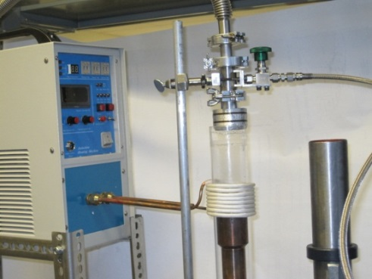
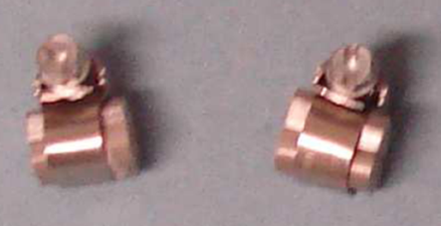
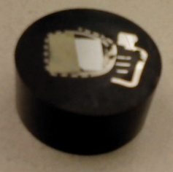
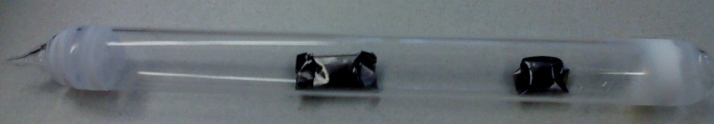
Methodology
Key samples Preparation
Pure metals (Ce, Mg, Mn, Nd and Zn) were initially used
Alloying processes:
  Arc-melting furnace
  Induction-melting furnace
Diffusion couples Preparation
Diffusion couples prepared from pure metals and/or alloys.
  Contacting surfaces polished up to 1μm diamond suspension
  End-members clamped together using stainless steel rings
XRD, WDS/EDS, SEM, DSC and ICP key experiments
Notes:
Talk about the outcomes of each experiment. DSC, to detect the phase transformation and the liquidus temperatures. XRD, to know the relative amount of each phase.

Slide 7
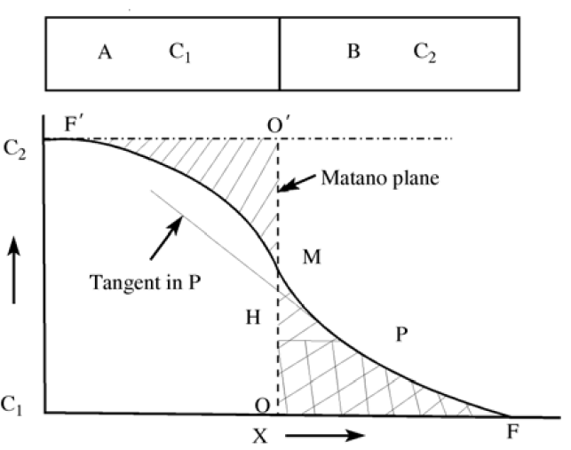
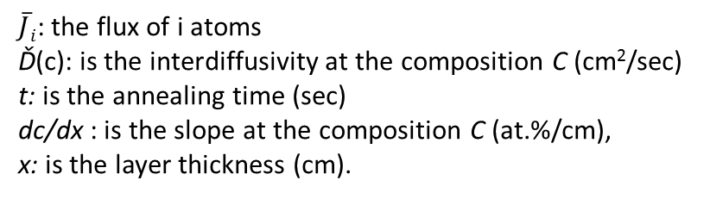
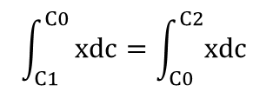
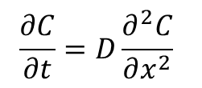
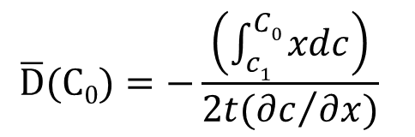
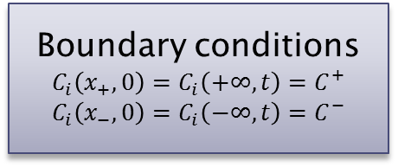
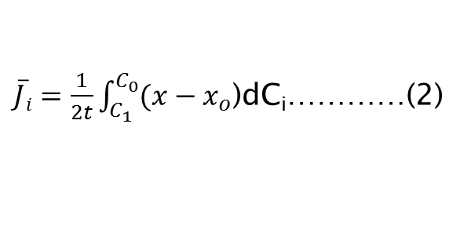

Methodology
Interdiffusion coefficient measurements
$\overline{J}i=−\overline{D}i\frac{∂C_{i}(x, t)}{∂x}$ …….…(1)
$$\frac{∂C}{∂t}=D\frac{∂^{2}C}{∂x^{2}}$$
Boundary conditions
$$C_{i}\left(x_{+}, 0\right)=C_{i}\left(+∞, t\right)=C_{}^{+}$$
$$C_{i}\left(x_{−}, 0\right)=C_{i}\left(−∞, t\right)=C_{}^{−}$$
$\overline{J}i=\frac{1}{2t}\int_{C_{1}}^{C_{0}}{(x−x_{o}}$)dC_{i}…………(2)
Y. Du et al., Atomic Mobilities and Diffusivities in Al alloys, Sci. China Tech. Sci., 55 (2012) 1-23.
$$\overline{D}(C0)=−\frac{\left(\int_{c1}^{C0}{xdc}\right)}{2t({∂c}/{∂x})}$$
$$\int_{C1}^{C0}{xdc=\int_{C0}^{C2}{xdc}}$$
$\overline{J}i$: the flux of i atoms
Ď(c): is the interdiffusivity at the composition C (cm²/sec)
t: is the annealing time (sec)
dc/dx : is the slope at the composition C (at.%/cm),
x: is the layer thickness (cm).
Notes:
The phenomenon of diffusion can be demonstrated with the use of diffusion couple technique.

Slide 8
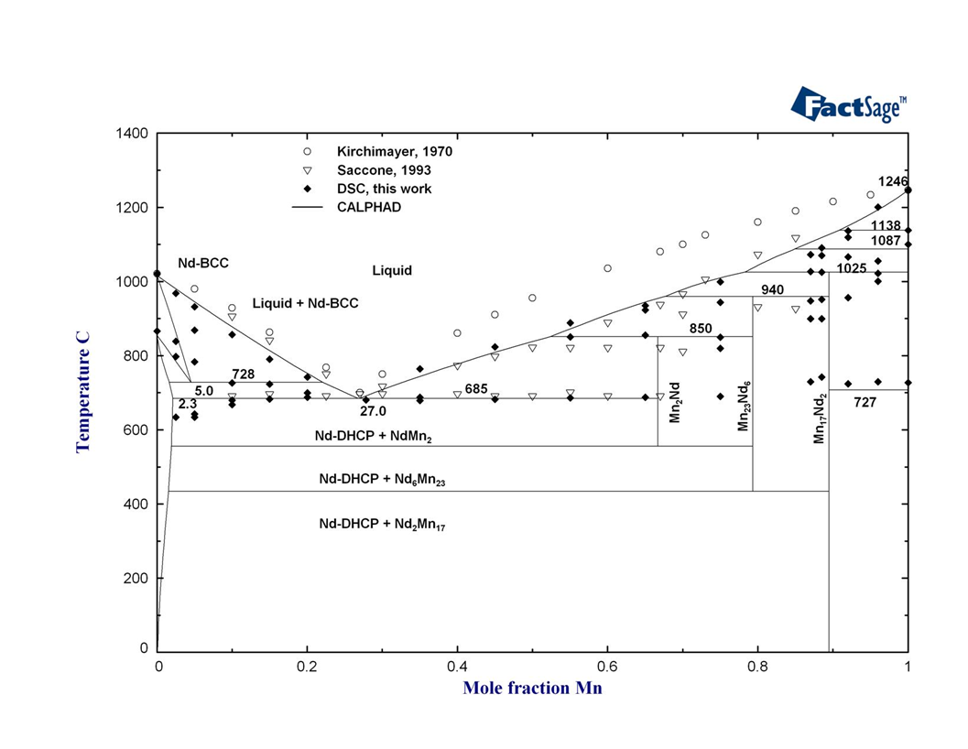
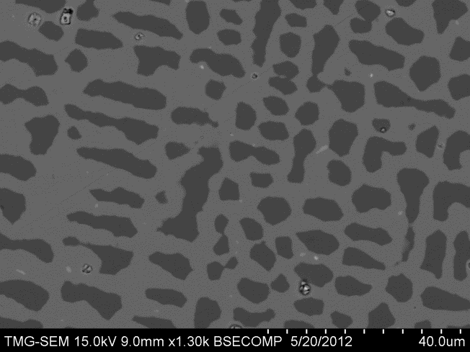
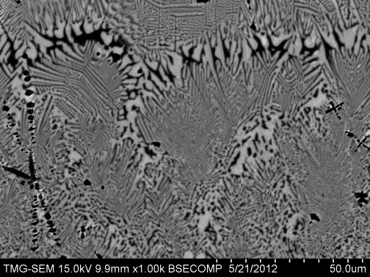
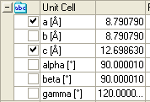
Results
Mn-Nd binary phase diagram
Mn₂₃Nd₆
Mn₁₇Nd₂
β-Mn
Lattice parameters of Mn₁₇Nd₂
Mn₂₃Nd₆
Mn₁₇Nd₂
Mn₂Nd
Mn₂₃Nd₆
β-Mn
Mn₁₇Nd₂

Slide 9
Results
Mg-Mn-Nd ternary phase diagram
Diffusion couples experiments
(Nd)
Mg₃Nd
Mg₃Nd
MgNd
Mg
Mg₃Nd
Mn₂₃Nd₆
Mn
Mg₃Nd
Mn
Mn
Mg₄₁Nd₅
Mg₄₁Nd₅
Mn
Mn
(Nd)
450°C-for 9 days
450°C-for 20 days

Slide 10
Results
Mg-Mn-Nd ternary phase diagram
Key alloys experiments
Mn
Mn
Nd(Mg_{1-x}Mn_{x})
Mg₃Nd
(Nd)^{Mg,Mn}
Mg₄₁Nd₅
450°C-for 14 days
450°C-for 14 days
Notes:
Talk about the outcomes of each experiment. DSC, to detect the phase transformation and the liquidus temperatures. XRD, to know the relative amount of each phase.

Slide 11
Results
Isothermal section of the Mg-Mn-Nd system at 450°C
By means of:
Key alloys and diffusion couples and using XRD, EPMA and metallography

Slide 12
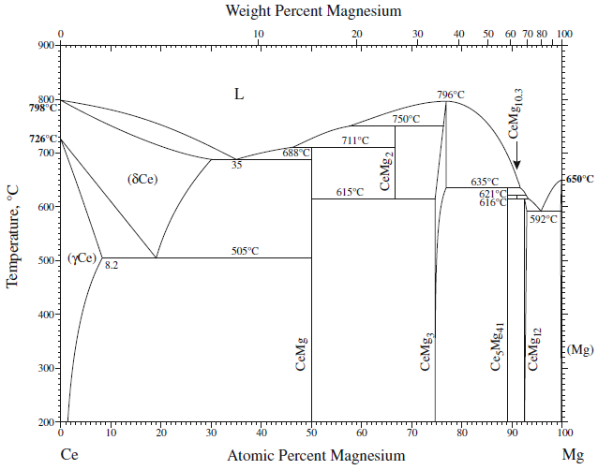
Results
Interdiffusion coefficients of Ce in Mg
400°C- 120h
450°C- 96h
490°C
450°C
MgCe
400°C
Mg₃Ce
Mg₄₁Ce₅
Mg₁₂Ce
490°C- 48h
H Okamoto, Ce-Mn (Cerium-Manganese), Journal of Phase Equilibria and Diffusion, 2008; 29: 381-2

Slide 13
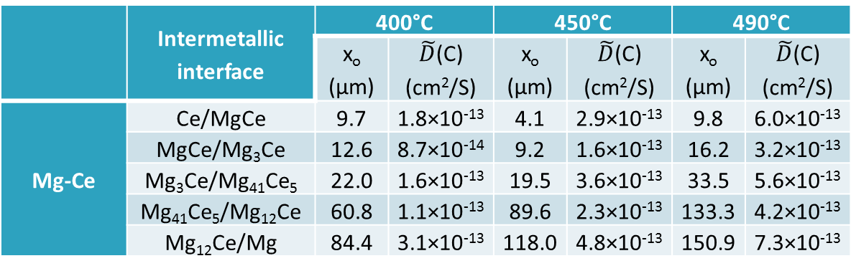
Results
Interdiffusion coefficients of Ce in Mg
 |  | Thickness (µm)
 | Temperature (°C) | 400 | 450 | 490
 | Time (h) | 120 | 96 | 48
Mg-Ce | MgCe | 3.5 | 5.9 | 8.7
 | Mg₃Ce | 5.8 | 8.6 | 16.7
 | Mg₄₁Ce₅ | 39.7 | 71.5 | 101.4
 | Mg₁₂Ce | 21.6 | 31.2 | 19.6
 | Total thickness | 70.6 | 117.2 | 145.4
 | Intermetallic interface | 400°C |  | 450°C |  | 490°C
 |  | x_{o} (µm) | $\tilde{D}$(C) (cm²/S) | x_{o} (µm) | $\tilde{D}$(C) (cm²/S) | x_{o} (µm) | $\tilde{D}$(C) (cm²/S)
Mg-Ce | Ce/MgCe | 9.7 | 1.8×10⁻¹³ | 4.1 | 2.9×10⁻¹³ | 9.8 | 6.0×10⁻¹³
 | MgCe/Mg₃Ce | 12.6 | 8.7×10⁻¹⁴ | 9.2 | 1.6×10⁻¹³ | 16.2 | 3.2×10⁻¹³
 | Mg₃Ce/Mg₄₁Ce₅ | 22.0 | 1.6×10⁻¹³ | 19.5 | 3.6×10⁻¹³ | 33.5 | 5.6×10⁻¹³
 | Mg₄₁Ce₅/Mg₁₂Ce | 60.8 | 1.1×10⁻¹³ | 89.6 | 2.3×10⁻¹³ | 133.3 | 4.2×10⁻¹³
 | Mg₁₂Ce/Mg | 84.4 | 3.1×10⁻¹³ | 118.0 | 4.8×10⁻¹³ | 150.9 | 7.3×10⁻¹³

Slide 14
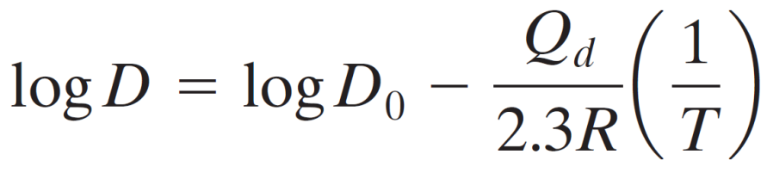
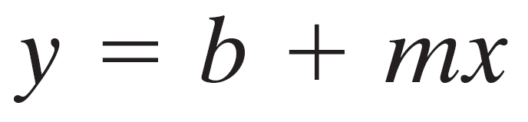
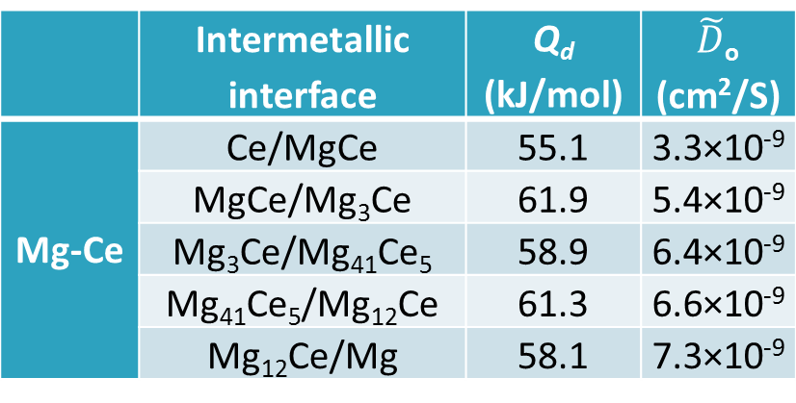
Results
Activation energies and pre-exponent factors
Arrhenius relationship
1/T vs. logD
The slope represents –Q_{d}/2.3R and the intersection with y axis represents the log D_{o} value.
 | Intermetallic interface | Q_{d} (kJ/mol) | $\tilde{D}$_{o} (cm²/S)
Mg-Ce | Ce/MgCe | 55.1 | 3.3×10⁻⁹
 | MgCe/Mg₃Ce | 61.9 | 5.4×10⁻⁹
 | Mg₃Ce/Mg₄₁Ce₅ | 58.9 | 6.4×10⁻⁹
 | Mg₄₁Ce₅/Mg₁₂Ce | 61.3 | 6.6×10⁻⁹
 | Mg₁₂Ce/Mg | 58.1 | 7.3×10⁻⁹

Slide 15
Summary
The Mn-Nd binary phase diagram was constructed in the complete composition range using experimental work and first-principles calculations coupled with thermodynamic modeling.
The isothermal sections of the Mg-Mn-{Ce,Nd} ternary systems, at 450°C, were established by means of key alloys and diffusion couples.
The interdiffusion coefficients of Ce, Nd and Zn in Mg were determined using diffusion couple experiments and Boltzmann-Matano analysis.
Notes:
Talk about the outcomes of each experiment. DSC, to detect the phase transformation and the liquidus temperatures. XRD, to know the relative amount of each phase.

Slide 16
Contributions
Journal papers
A. Mostafa, A.E. Gheribi, D. Kevorkove, Md. Mezbahul-Islam, M. Medraj, “Experimental Investigation and First Principle Calculations Coupled with Thermodynamic Modeling of the Mn-Nd phase diagram”, CALPHAD, submitted, March 2013.
P. Ghosh and M. Medraj, “Thermodynamic Calculation of the Mg-Mn-Zn and Mg-Mn-Ce Systems and Re-optimization of their Constitutive Binaries”, CALPHAD, Vol. 41, 89-107 (2013)
P. Ghosh, Md. Mezbahul-Islam and M. Medraj,"Critical assessment and thermodynamic modeling of Mg–Zn, Mg–Sn, Sn–Zn and Mg–Sn–Zn system", CALPHAD (Computer Coupling of Phase Diagrams and Thermochemistry), Vol. 36, 28-43 (2012).
Conference proceedings
A. Mostafa, D. Kevorkove, A.E. Gheribi, M. Medraj, “The Mg-Mn-Nd system: Experimental Investigation and Thermodynamic Modeling”, The 9th International Conference on Magnesium Alloys and their Applications, Vancouver, 2012, p.p. 245-250.
Notes:
Talk about the outcomes of each experiment. DSC, to detect the phase transformation and the liquidus temperatures. XRD, to know the relative amount of each phase.

Slide 17

THANK YOU
MagNET AGM
Vancouver, June 12-13, 2013

