Slide 1
Strongly Connected Components (SCC) in a Graph
Hamed Pouya

Slide 2
Strongly Connected Components
A subset of a directed graph is called strongly connected
if there is a path in each direction between each pair of vertices of the subset.
2
5
7
1
3
4
6

Slide 3
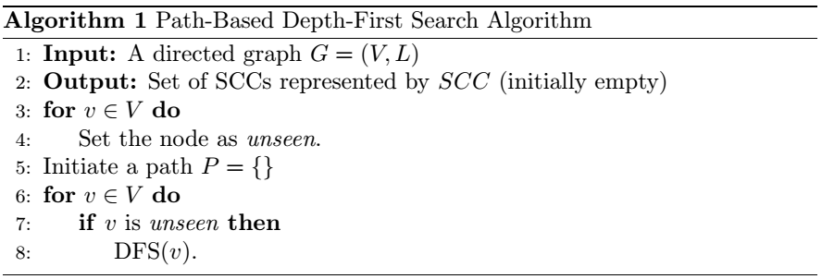
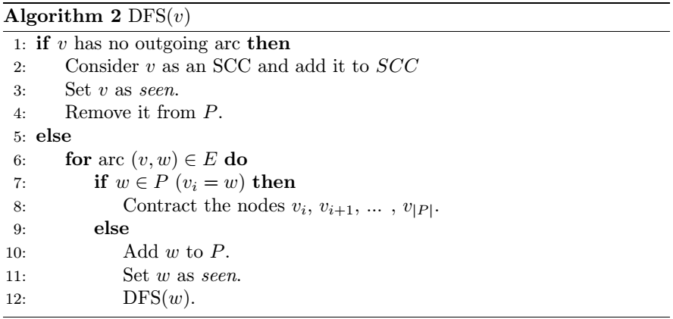
Path-Based Depth-First Search Algorithm [1]

Slide 4
Path-Based Depth-First Search Alg.
SCCs
P
a
b
c
d
e
f

Slide 5
Path-Based Depth-First Search Alg.
SCCs
P
a
a
b
c
d
e
f

Slide 6
Path-Based Depth-First Search Alg.
SCCs
P
a
a
b
b
c
d
e
f

Slide 7
Path-Based Depth-First Search Alg.
SCCs
P
a
a
b
c
b
c
d
e
f

Slide 8
Path-Based Depth-First Search Alg.
SCCs
P
$$\left\{c\right\}$$
a
a
b
b
d
e
f

Slide 9
Path-Based Depth-First Search Alg.
SCCs
P
$$\left\{c\right\}$$
a
a
b
d
b
d
e
f

Slide 10
Path-Based Depth-First Search Alg.
SCCs
P
$$\left\{c\right\}$$
a
a
b
d
b
e
d
e
f

Slide 11
Path-Based Depth-First Search Alg.
SCCs
P
$$\left\{c\right\}$$
a
a
b
d
b
e
d
e
f

Slide 12
Path-Based Depth-First Search Alg.
SCCs
P
$$\left\{c\right\}$$
a
a
b,d,e
b
d
e
f

Slide 13
Path-Based Depth-First Search Alg.
SCCs
P
$$\left\{c\right\}$$
a
a
b,d,e
f
b
d
e
f

Slide 14
Path-Based Depth-First Search Alg.
SCCs
P
$$\left\{c\right\}$$
a
a
b,d,e
f
b
d
e
f

Slide 15
Path-Based Depth-First Search Alg.
SCCs
P
$$\left\{c\right\}$$
a
a
b,d,e,f
b
d
e
f

Slide 16
Path-Based Depth-First Search Alg.
SCCs
P
$$\left\{c\right\}$$
a
a
b,d,e,f
b
d
e
f

Slide 17
Path-Based Depth-First Search Alg.
SCCs
P
$$\left\{c\right\}$$
a
a
$$\left\{b\text{,}d\text{,}e\text{,}f\right\}$$

Slide 18
Path-Based Depth-First Search Alg.
SCCs
P
$$\left\{c\right\}$$
a
a
$$\left\{b\text{,}d\text{,}e\text{,}f\right\}$$
$$\left\{a\right\}$$

Slide 19
Path-Based Depth-First Search Alg.
SCCs
P
$$\left\{c\right\}$$
$$\left\{b\text{,}d\text{,}e\text{,}f\right\}$$
$$\left\{a\right\}$$

Slide 20
Complexity
$$O(E+V)$$

Slide 21
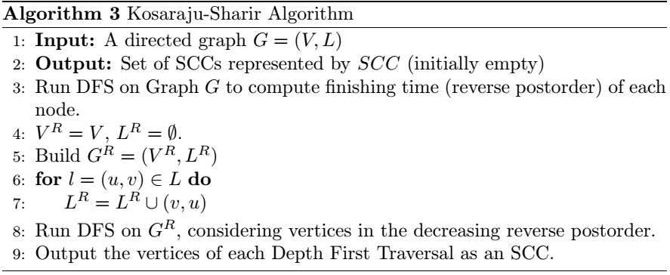
Kosaraju-Sharir algorithm [2]

Slide 22
Kosaraju-Sharir algorithm [2]
a
0
-
Seen, not finished yet.
b
c
0
-
Finished.
d
e
f

Slide 23
Kosaraju-Sharir algorithm [2]
a
1
-
b
c
d
e
f

Slide 24
Kosaraju-Sharir algorithm [2]
a
1
-
b
2
-
c
d
e
f

Slide 25
Kosaraju-Sharir algorithm [2]
a
1
-
b
2
3
c
d
e
f

Slide 26
Kosaraju-Sharir algorithm [2]
a
1
-
b
2
3
c
d
e
f

Slide 27
Kosaraju-Sharir algorithm [2]
a
1
-
b
4
-
2
3
c
d
e
f

Slide 28
Kosaraju-Sharir algorithm [2]
a
1
-
b
4
-
2
3
c
d
5
-
e
f

Slide 29
Kosaraju-Sharir algorithm [2]
a
1
-
b
4
-
2
3
c
d
5
-
e
6
-
f

Slide 30
Kosaraju-Sharir algorithm [2]
a
1
-
b
4
-
2
3
c
d
5
-
e
6
-
f

Slide 31
Kosaraju-Sharir algorithm [2]
a
1
-
b
4
-
2
3
c
d
5
-
e
6
-
f

Slide 32
Kosaraju-Sharir algorithm [2]
a
1
-
b
4
-
2
3
c
d
5
-
e
6
-
7
-
f

Slide 33
Kosaraju-Sharir algorithm [2]
a
1
-
b
4
-
2
3
c
d
5
-
e
6
-
7
-
f

Slide 34
Kosaraju-Sharir algorithm [2]
a
1
-
b
4
-
2
3
c
d
5
-
e
6
-
7
-
f

Slide 35
Kosaraju-Sharir algorithm [2]
a
1
-
b
4
-
2
3
c
d
5
-
e
6
-
7
-
f

Slide 36
Kosaraju-Sharir algorithm [2]
a
1
-
b
4
-
2
3
c
d
5
-
e
6
-
7
8
f

Slide 37
Kosaraju-Sharir algorithm [2]
a
1
-
b
4
-
2
3
c
d
5
-
e
6
9
6
-
7
8
f

Slide 38
Kosaraju-Sharir algorithm [2]
a
1
-
b
4
-
2
3
c
d
5
-
e
6
9
6
-
7
8
f

Slide 39
Kosaraju-Sharir algorithm [2]
a
1
-
b
4
-
2
3
c
d
5
-
e
6
9
6
-
7
8
f

Slide 40
Kosaraju-Sharir algorithm [2]
a
1
-
b
4
-
2
3
c
d
5
5
-
10
e
6
9
6
-
7
8
f

Slide 41
Kosaraju-Sharir algorithm [2]
a
1
-
b
4
-
2
3
c
d
5
5
-
10
e
6
9
6
-
7
8
f

Slide 42
Kosaraju-Sharir algorithm [2]
a
1
-
b
4
-
2
3
c
d
5
5
-
10
e
6
9
6
-
7
8
f

Slide 43
Kosaraju-Sharir algorithm [2]
a
1
-
4
11
2
3
b
4
-
c
d
5
5
-
10
e
6
9
6
-
7
8
f

Slide 44
Kosaraju-Sharir algorithm [2]
a
1
1
-
12
4
11
2
3
b
4
-
c
d
5
5
-
10
e
6
9
6
-
7
8
f

Slide 45
Kosaraju-Sharir algorithm [2]
a
$$\left\{a,b,d,e,f,c\right\}$$
1
1
-
12
4
11
2
3
b
4
-
c
d
5
5
-
10
e
6
9
6
-
7
8
f

Slide 46
Kosaraju-Sharir algorithm [2]
a
b
c
d
e
f

Slide 47
Kosaraju-Sharir algorithm [2]
a
b
c
d
e
f

Slide 48
Kosaraju-Sharir algorithm [2]
a
$$\left\{a,b,d,e,f,c\right\}$$
b
c
d
e
f

Slide 49
Kosaraju-Sharir algorithm [2]
SCCs
a
$$\left\{a,b,d,e,f,c\right\}$$
$$\left\{a\right\}$$
b
c
d
e
f

Slide 50
Kosaraju-Sharir algorithm [2]
SCCs
a
$$\left\{a,b,d,e,f,c\right\}$$
$$\left\{a\right\}$$
b
c
d
e
f

Slide 51
Kosaraju-Sharir algorithm [2]
SCCs
a
$$\left\{a,b,d,e,f,c\right\}$$
$$\left\{a\right\}$$
$$\left\{b,d,e,f\right\}$$
b
c
d
e
f

Slide 52
Kosaraju-Sharir algorithm [2]
SCCs
a
$$\left\{a,b,d,e,f,c\right\}$$
$$\left\{a\right\}$$
$$\left\{b,d,e,f\right\}$$
b
c
d
e
f

Slide 53
Kosaraju-Sharir algorithm [2]
SCCs
a
$$\left\{a,b,d,e,f,c\right\}$$
$$\left\{a\right\}$$
$$\left\{b,d,e,f\right\}$$
$$\left\{c\right\}$$
b
c
d
e
f

Slide 54
Complexity
$$O(E+V)$$

Slide 55
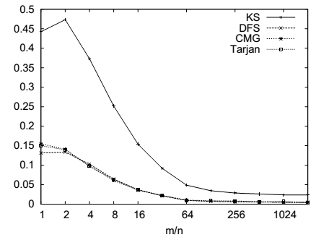
Comparison
Tarjan’s Alg. | Path-Based Alg. | Kosaraju-Sharir Alg.
$$O(E+V)$$ | $$O(E+V)$$ | $$O(E+V)$$

Slide 56
References
[1] H. N. Gabow, “Path-based depth-first search for strong and biconnected components,” Information Processing Letters, vol. 74, no. 3-4, pp. 107–114, 2000.
[2] M. Sharir, “A strong-connectivity algorithm and its applications in data flow analysis,” Computers & Mathematics with Applications, vol. 7, no. 1, pp. 67–72, 1981.

