Slide 1
Efficient Make Before Break Defragmentation
Huy Duong, Dr. B. Jaumard, Dr. D. Coudert

Slide 2
Outline
Network reconfiguration
Elastic Flexible Bandwidth Network
Reconfiguration
Progressive MBB Reconfiguration
Compact model (Klopfenstein 2008)
CG model
Results

Slide 3
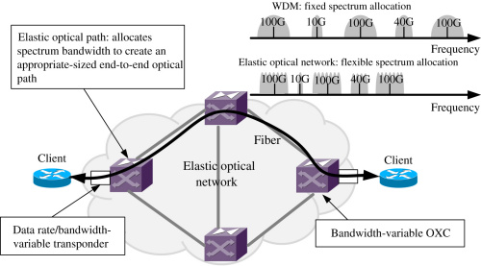
Elastic Flexible Bandwidth Network
Granularity is significantly small or continuous
Elastic Optical Network (EON) (12.5 GHZ – 6.25 GHZ)
MPLS network
Software defined network
NO continuous and contiguous conditions

Slide 4
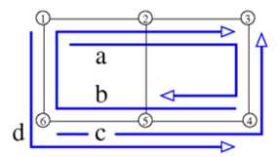
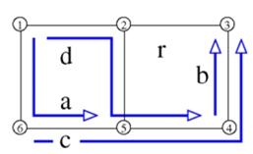
Network Reconfiguration
Break Before Make ( Project 1)
Make Before Break ( Project 2)
Current Configuration
New Configuration
Reconfiguring Process

Slide 5
MBB Reconfiguration
Make Before Break:
3
1
4
2

Slide 6
MBB Reconfiguration
Make Before Break:
3
1
4
2

Slide 7
MBB Reconfiguration
Make Before Break:
3
1
4
2

Slide 8
MBB Reconfiguration
Make Before Break:
3
1
4
2

Slide 9
MBB Schedule Strategies
Defined target configuration
MBB sequence is based on Target Configuration
Current Configuration
Target Configuration
MBB Sequence

Slide 10
MBB Schedule Strategies
Progressive reconfiguration
“Sequence” of configurations (or sequence of MBB switches)
One-connection reconfiguration at an action
Each MBB decision is based on previous configurations
Current Configuration
Best-reachable Configuration by MBBs
Configuration Sequence

Slide 11
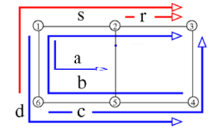
MBB Schedule Strategies
Progressive reconfiguration
Intermediate Configuration
Current Configuration
1 MBB
Best-reachable Configuration by MBBs
Intermediate Configurations

Slide 12
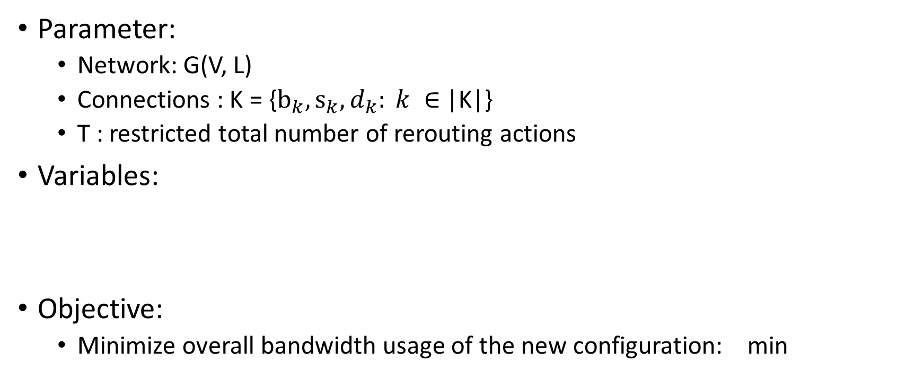
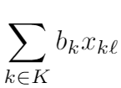
Compact model (Klopfenstein 2008)

Slide 13
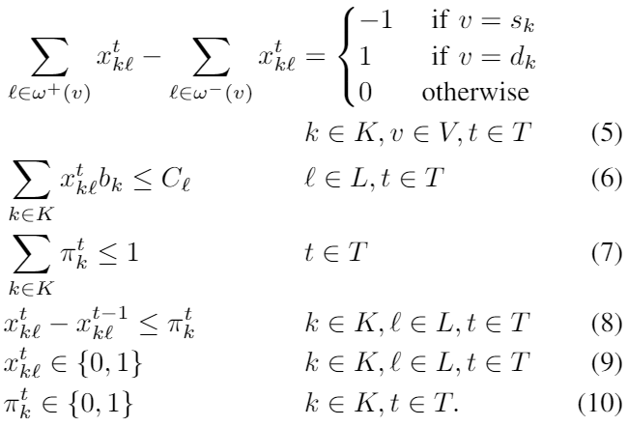
Compact model (Klopfenstein 2008) (II)
Constraints:
Flow conservation
Capacity constraints
At most 1 reroute per action

Slide 14
Column Generation Model

Slide 15
Column Generation Model (Master) (I)

Slide 16
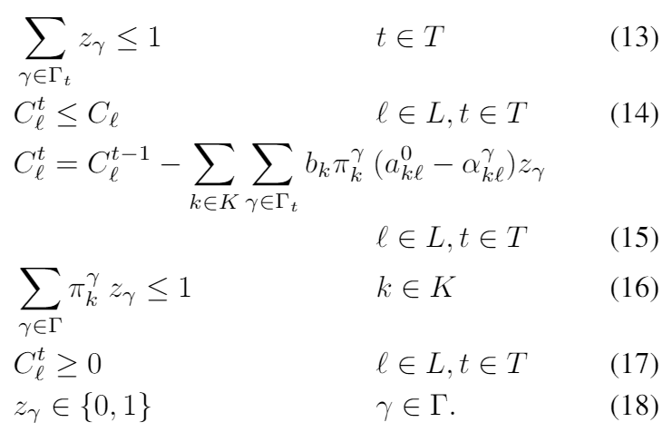
Column Generation Model (Master)
Constraints
At most 1 rerouting per time slot
Capacity is never exceeded
Capacity is updated from previous configuration
At most 1 rerouting per connection

Slide 17
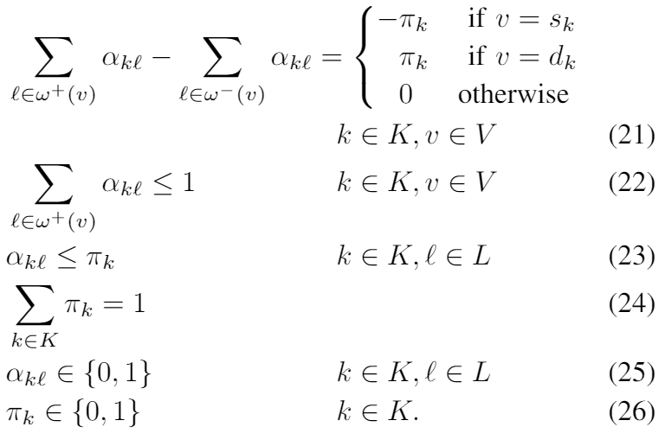
Column Generation Model (Pricing Problem)
Elementary Pricing PP_{t}:
Self-looping avoidance
Only new path of rereouted connection is considered
At most 1 rerouting per time slot

Slide 18
Pricing Problem Reduction 1

Slide 19
Pricing Problem Reduction 2
s.t.

Slide 20
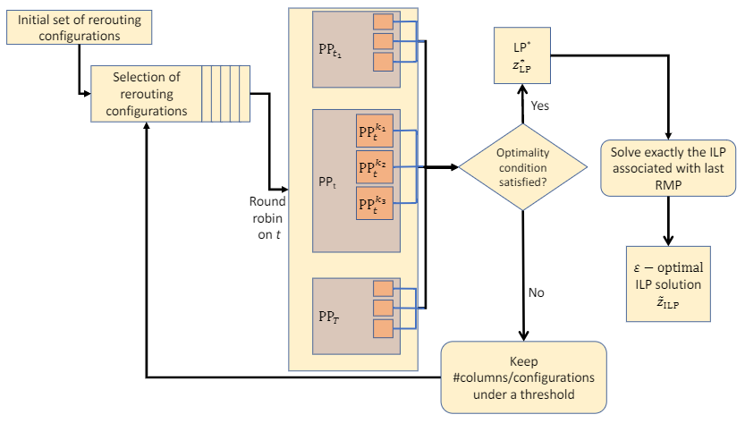
Solution Process

Slide 21
Comparison with Klopfenstein’s model

Slide 22
Impact of Initial Configurations & Overall # of Configurations

Slide 23
# Rerouting and Accuracy

Slide 24
Defragmentation Performance

