Slide 1
COMP6321 MACHINE LEARNING PROJECT PRESENTATION
ANH TUAN, TRAN
Msc. Computer Science
Concordia University, Fall 2017

Slide 2
OUTLINE
PROJECT OVERVIEW
MACHINE LEARNING
BOOTSTRAP

Slide 3
PROJECT OVERVIEW (1)
ROLLING-SHIFT WORKERS’ LEVEL OF FATIGUE AFFECTED BY
WORK SCHEDULE
SLEEP PATTERNS
LEVEL OF FATIGUE MEASURED BY (AMONG OTHERS)
PVT (PSYCHOMOTOR VIGILANCE TEST)
DATA COLLECTED BY
SUBJECTIVE MEASURES: QUESTIONNAIRES (5 TIMES DAILY)
OBJECTIVE MEASURES: ACTIWATCH (WEARABLE DEVICE)
Sleep measurements in time series

Slide 4
PROJECT OVERVIEW (2)
OBJECTIVES
PREDICT THE LEVEL OF FATIGUE AS A RESULT OF SLEEP DEPRIVATION
HOW WE DO IT?
Decision Tree
Random Forests

Slide 5

MACHINE LEARNING
Simple understanding?
How good is $\hat{\text{α}}$?
Is it good?
Is it too good?
# | X | Y
1 | 1.5 | 2
2 | 1.7 | 2.2
3 | 2 | 2.5
Model
$$\hat{\text{α}}$$
Cross-Validation
Bootstrap

Slide 6
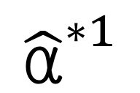
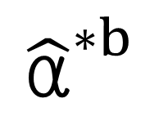
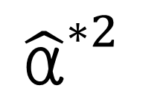
Bootstrap How-to? (1)
# | X | Y
1 | 1.5 | 2
1 | 1.5 | 2
3 | 2 | 2.5
$${\hat{\text{α}}}^{∗1}$$
$$Z^{∗1}$$
# | X | Y
1 | 1.5 | 2
2 | 1.7 | 2.2
3 | 2 | 2.5
# | X | Y
1 | 1.5 | 2
2 | 1.7 | 2.2
2 | 1.7 | 2.2
$${\hat{\text{α}}}^{∗2}$$
$$Z^{∗2}$$
Original
Data set (Z)
# | X | Y
1 | 1.5 | 2
2 | 1.7 | 2.2
3 | 2 | 2.5
$${\hat{\text{α}}}^{∗b}$$
$$Z^{∗b}$$

Slide 7
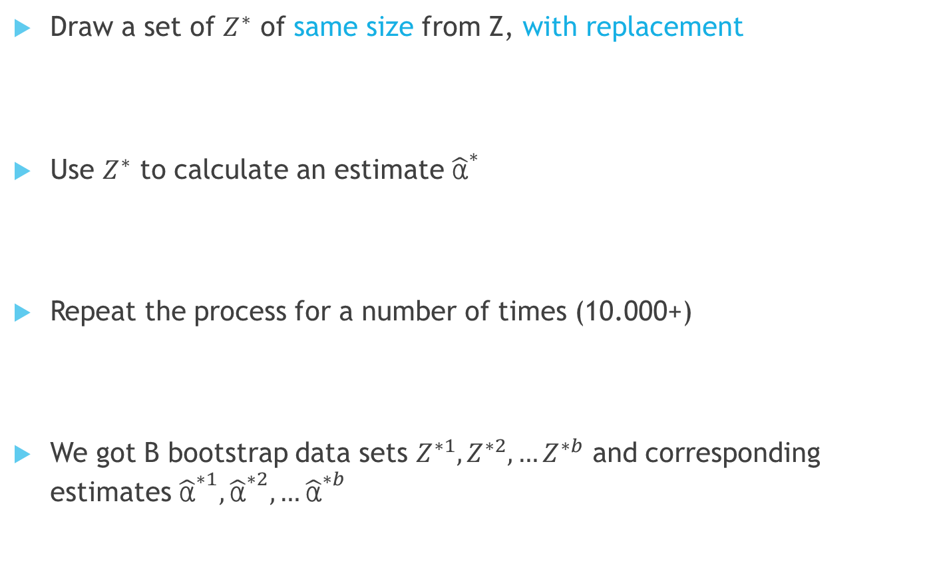
Bootstrap How-to? (2)
Draw a set of $Z^{∗}$ of same size from Z, with replacement
Use $Z^{∗}$ to calculate an estimate ${\hat{\text{α}}}^{∗}$
Repeat the process for a number of times (10.000+)
We got B bootstrap data sets $Z^{∗1},Z^{∗2}{,…Z}^{∗b}$ and corresponding estimates ${\hat{\text{α}}}^{∗1}, {\hat{\text{α}}}^{∗2}, …{\hat{\text{α}}}^{∗b}$

Slide 8
Using Bootstrap in Error prediction
Bootstrap data sets as training data
Original sample as validation data
Problems?
Yes! Observations appear both in bootstrap AND validation data
This will underestimate true prediction error

Slide 9
A little bit comparison (1)
Data set
497 records, in 3 classes
479 in Green class
13 in Yellow class
5 in Red class
Decision Tree gives: 93.8% accuracy
21 Green classified as Yellow
10 Green classified as Red

Slide 10
A little bit comparison (2)
Random Forests gives: 96.8% accuracy
14 Green classified as Yellow
2 Green classified as Red
Random Forests with Bootstrap gives: 99.2% accuracy
4 Green classified as Yellow
0 Green classified as Red

