Slide 1
Network Design Problem
Several Slides are removed from this presentation to protect the intellectual property associated with this project. We provide here a high level description of the problem and references from the literature for research students to learn and explore.
Industrial Project
Wael Nassief
This is a joint work with:
Brigitte Jaumard, Professor in Computer Science and Software Engineering

Slide 2
Agenda
Company’s Profile (removed)
Literature
Problem Statement
Notations
Assumptions
Network Transformations
Time spaced network
Mathematical Formulations (removed)
Column Generation Algorithm (removed)
Initial Results (removed)
References

Slide 3
Literature*
Shortest Path Problem with Time Windows (SPPTW) [k=1].
Ioachim et al. 1998 (SPPTW + Linear cost). [1]
Irnich and Desaulniers 2004 (Review paper). [2]
Feillet et al. 2004 (SPP with Resource Constraints). [3]
Pugliese and Guerriero 2013 (Review paper). [4]
Multi-commodity Network Design Problem (MNDP) [k>1].
Desrosiers et al. 1995 (See P. 118). [5]
Desaulniers et al. 1998 (generic). [6]
Hewitt et al. 2010 (nicely written & interesting approach). [7]
Chouman et al. 2017 (recent work). [8]
*References are detailed at the end of this presentation.

Slide 4
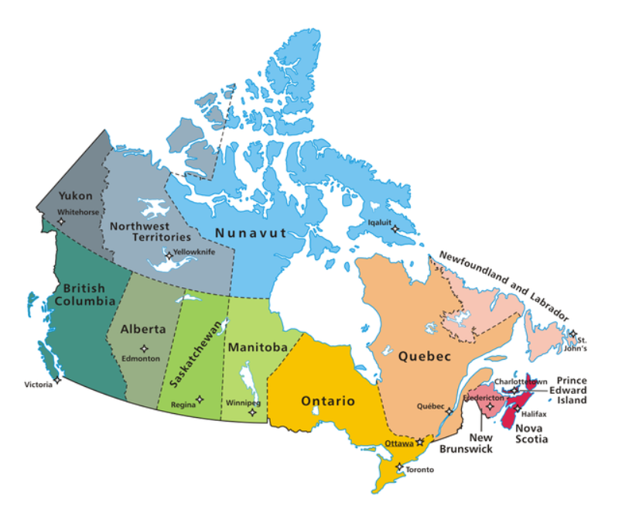
Problem Statement: notations
Given directed graph $G\left(N,A\right)$, we have:
$iεN$ nodes, with:
Usage/setup cost $f_{i}$
Processing capacity $Q_{i}$
Time window $\left[a_{i},b_{i}\right]$
$(i,j)∈A$ arcs or directed edges, with:
Transportation cost $c_{ij}$
Traveling time $t_{ij}={dist}_{ij}+{st}_{i}$
Capacity $u_{ij}$
$k∈K$ commodities, with:
Demand/quantity $q^{k}$
Origin $o(k)$ & Destination $d(k)$
Node parameter $δ_{i}^{k}=\left\{1, 0, −1\right\}$
Goal => Find the best paths for all commodities respecting capacities on nodes & arcs.
Map 1: Reproduced from http://www.sokocanada.com/why-canada/map-of-canada/

Slide 5
Problem Statement: assumptions
Planning period:
Single (e.g., 1 week, 1 group of days).
Time related:
Earlier arrival is allowed but no late arrival (i.e., hard time windows).
Service could start upon arrival within the time window.
Several time windows per node.
Commodities:
Multiple (e.g., different types, suppliers or origin-destination points).
Each with a demand or quantity.
Map 1: Reproduced from http://www.sokocanada.com/why-canada/map-of-canada/

Slide 6
Network Transformation: time spaced network
Arrival time window
[5am, 12pm]
Global Distribution Centers (GDCs)
Local Distribution Centers (LDCs)
Mon
Tue
Wed
Vendors
$$\left[a_{i},b_{i}\right]$$
GDC with different working days
$$\left[a_{i},b_{i}\right]$$
$$\left[a_{i},b_{i}\right]$$
$$\left[a_{i},b_{i}\right]$$
$$\left[a_{i},b_{i}\right]$$
$$\left[a_{i},b_{i}\right]$$
$$\left[a_{i},b_{i}\right]$$
[5am, 12pm]
Mon
Tue
Wed
Vendors → GDCs → LDCs
Fig 1: adapted from Manzini, R., Bortolini, M., Gamberi, M. and Montecchi, M., 2011. A supporting decision tool for the integrated planning of a logistic network. In Supply Chain Management-New Perspectives. InTech.
[5am, 12pm]
Mon
Tue
Wed

Slide 7
References
Ioachim, I., Gelinas, S., Soumis, F. and Desrosiers, J., 1998. A dynamic programming algorithm for the shortest path problem with time windows and linear node costs. Networks, 31(3), pp.193-204.
Irnich, S. and Desaulniers, G., 2005. Shortest path problems with resource constraints. Column generation, pp.33-65.
Feillet, D., Dejax, P., Gendreau, M. and Gueguen, C., 2004. An exact algorithm for the elementary shortest path problem with resource constraints: Application to some vehicle routing problems. Networks, 44(3), pp.216-229.
Pugliese, L.D.P. and Guerriero, F., 2013. A survey of resource constrained shortest path problems: Exact solution approaches. Networks, 62(3), pp.183-200.
Desrosiers, J., Dumas, Y., Solomon, M.M. and Soumis, F., 1995. Time constrained routing and scheduling. Handbooks in operations research and management science, 8, pp.35-139.
Desaulniers, G., Desrosiers, J., Solomon, M.M., Soumis, F. and Villeneuve, D., 1998. A unified framework for deterministic time constrained vehicle routing and crew scheduling problems. In Fleet management and logistics (pp. 57-93). Springer US.
Hewitt, M., Nemhauser, G.L. and Savelsbergh, M.W., 2010. Combining exact and heuristic approaches for the capacitated fixed-charge network flow problem. INFORMS Journal on Computing, 22(2), pp.314-325.
Chouman, M., Crainic, T.G. and Gendron, B., 2017. Commodity Representations and Cut-Set-Based Inequalities for Multicommodity Capacitated Fixed-Charge Network Design. Transportation Science, 51(2), pp.650-667.

