Slide 1
Migrating CSS to Preprocessors by Introducing Mixins
Davood Mazinanian Nikolaos Tsantalis
ASE’16

Slide 2
What is CSS?

Slide 5
CSS is a Style Sheet language
Defines how documents are presented

Slide 6
Simple syntax…
Target document (e.g., HTML)
<html>
…
<p>My cool paragraph</p>
…
</html>
CSS

Slide 7
… yet inadequate!
Missing traditional code reuse constructs
e.g., functions and {variables}

Slide 8
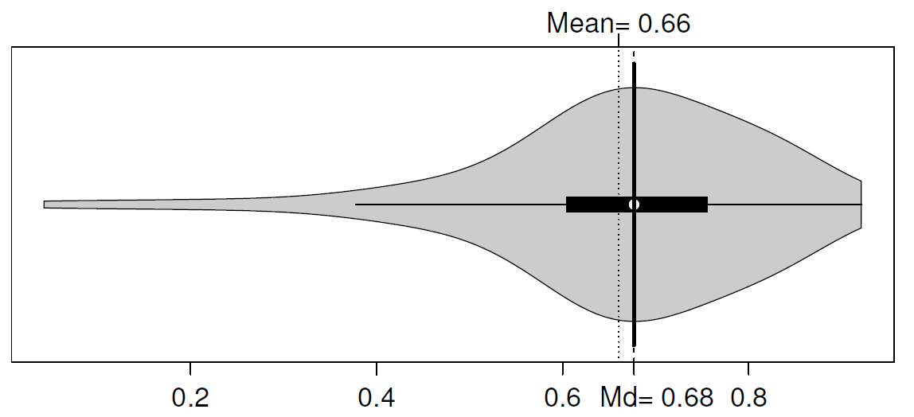
Duplication is pervasive!
[Mazinanian et al. 2014]

Slide 9
CSS preprocessors
Add the missing features to CSS!
DRY: using Extend or Mixin constructs
Developers prefer Mixins! [SANER’16]

Slide 10
Mixins = functions!
Preprocessor code
CSS code
.s1 {
text-align: center;
.mixin1(8pt; Tahoma; 100px);
}
.s2 {
float: left;
.mixin1(10pt; Arial; 70px);
}
.s3 {
float: right;
font: 9pt Tahoma
}
.mixin1(@fontS; @fontN; @colW) {
font: @fontS @fontN;
-moz-columns: @colW 3;
columns: @colW 3;
}
.s1 {
text-align: center;
font: 8pt Tahoma;
-moz-columns: 100px 3;
columns: 100px 3
}
.s2 {
float: left;
font: 10pt Arial;
-moz-columns: 70px 3;
columns: 70px 3;
}
.s3 {
float: right;
font: 9pt Tahoma
}
Transpile

Slide 11
Can we do the reverse?!

Slide 12
Extracting Mixins
CSS code
Preprocessor code
.s1 {
text-align: center;
font: 8pt Tahoma;
-moz-columns: 100px 3;
columns: 100px 3
}
.s2 {
float: left;
font: 10pt Arial;
-moz-columns: 70px 3;
columns: 70px 3;
}
.s3 {
float: right;
font: 9pt Tahoma
}
.s1 {
text-align: center;
.m1(8pt; Tahoma; 100px);
}
.s2 {
float: left;
.m1(10pt; Arial; 70px);
}
.s3 {
float: right;
font: 9pt Tahoma
}
.m1(@fontS; @fontN; @colW) {
font: @fontS @fontN;
-moz-columns: @colW 3;
columns: @colW 3;
}
Extract Mixin

Slide 13
Why should we do the reverse?!

Slide 14
Why?
A core for Migration
For the people who still like ‘Vanila’
Preprocessors are under-utilized
More opportunities than what is actually used

Slide 15
How?
1) Group duplicated declarations
2) Detect differences
3) Extract the mixin
Make mixin calls!

Slide 16
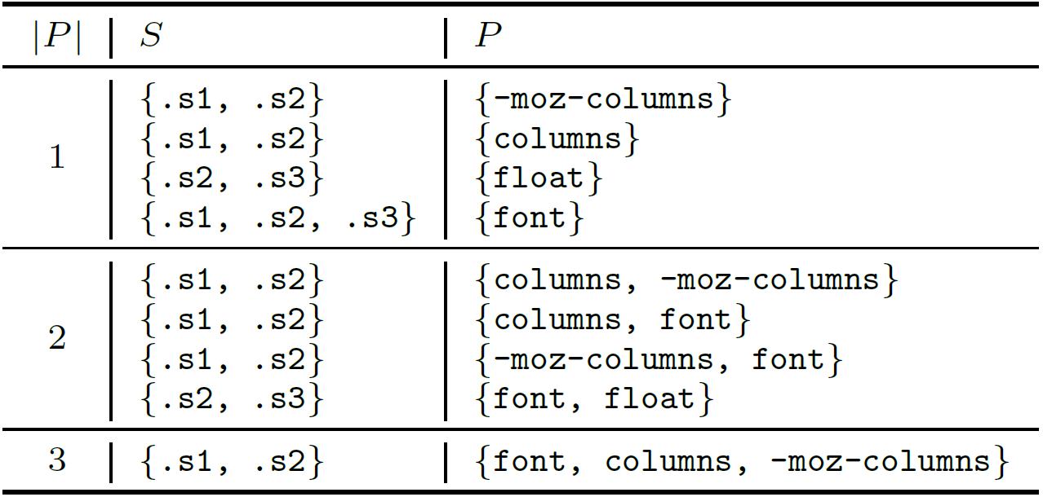
1) Grouping declarations
.s1 {
text-align: center;
font: 8pt Tahoma;
-moz-columns: 100px 3;
columns: 100px 3
}
.s2 {
float: left;
font: 10pt Arial;
-moz-columns: 70px 3;
columns: 70px 3;
}
.s3 {
float: right;
font: 9pt Tahoma
}
Brute force ⟹ combinatorial explosion

Slide 17
1) Grouping declarations
.s1 {
text-align: center;
font: 8pt Tahoma;
-moz-columns: 100px 3;
columns: 100px 3
}
.s2 {
float: left;
font: 10pt Arial;
-moz-columns: 70px 3;
columns: 70px 3;
}
.s3 {
float: right;
font: 9pt Tahoma
}
Using frequent itemset mining!

Slide 18
1) Grouping declarations
Frequent Itemsets:
Set of items bought together (in a store)
in at least s transactions (|s| ⩾ 2)

Slide 19
1) Grouping declarations
Frequent Declarations:
Set of declarations appearing together
In more than s selectors (|s| ⩾ 2)

Slide 20
1) Grouping declarations
.s1 {
text-align: center;
font: 8pt Tahoma;
-moz-columns: 100px 3;
columns: 100px 3
}
.s2 {
float: left;
font: 10pt Arial;
-moz-columns: 70px 3;
columns: 70px 3;
}
.s3 {
float: right;
font: 9pt Tahoma
}
Application of the FP-Growth algorithm

Slide 21
2) Detecting differences in values
.mixin(@v1; @v2; @v3) {
border: @v1 @v2 @v3;
}
.s1 {
float: left;
will-change: transform;
.mixin(#f00; 1px; solid);
}
.s2 {
color: red;
.mixin(dotted; red; thin);
}
.s1 {
float: left;
will-change: transform;
border: #f00 1px solid;
}
.s2 {
color: red;
border: dotted red thin;
}
3 differences = 3 parameters

Slide 22
2) Detecting differences in values
.mixin(@style) {
border: #f00 1px @style;
}
.s1 {
float: left;
will-change: transform;
.mixin(solid);
}
.s2 {
color: red;
.mixin(dotted);
}
.s1 {
float: left;
will-change: transform;
border: #f00 1px solid;
}
.s2 {
color: red;
border: dotted red thin;
}
1 difference = 1 parameter

Slide 23
2) Detecting differences in values
.s1 {
float: left;
will-change: transform;
border: #f00 1px solid;
}
.s2 {
color: red;
border: dotted red thin;
}
ISP: border-style
Detecting
Individual Style Properties
ISP: border-style

Slide 24
Extract mixin!
Add the grouped declarations to the mixin
Parameterize declarations
Each difference = 1 parameter
Make mixin calls and put them in selectors…
where?!

Slide 25
Are these transformations safe?

Slide 26
What can go wrong?
Expected output
Extract Mixin
Transpile
Resulting
output

Slide 27
Preserving Presentation
Precondition:
Preserve all order dependencies [Mazinanian et al. 2014]
.a {
...
border: solid 3px red;
border-bottom: none;
padding: 1px;
...
}
Mixin call position: A CSP!
pos(.mixin()) < pos(border-bottom)
Variables: .mixin(), border-bottom
Values’ domain: 1, 2

Slide 28
Evaluation
Dataset:
21 Websites from [SANER’16] dataset
8 CSS Libraries
For every pair of matching style rules (S, S’) defined in C
and C’, respectively, style-map(S) == style-map(S’).
style-map(S) : what styles are assigned
to an individual style property

Slide 29
Evaluation
RQ1: Is the presentation preserved?
CSS Before (C)
Preprocessor Code
CSS After (C’)
Extract Mixin
Transpile
For every pair of matching style rules (S, S’) defined in C
and C’, respectively, style-map(S) == style-map(S’).
style-map(S) : what styles are assigned
to an individual style property
Test the presentation preservation conditions

Slide 30
RQ1: Preserving Presentation
The main condition:
Select the same elements,
Same ISPs should get equivalent styles
<html>
…
<></>
…
<></>
…
<></>
…
<></>
<></>
…
<></>
<></>
…
</html>
<html>
…
<></>
…
<></>
…
<></>
…
<></>
<></>
…
<></>
<></>
…
</html>
ISP1: border-left-color
Value: green
ISP1: border-left-color
Value: #0f0
Before
After

Slide 31
RQ1 Results
RQ1: All tests were eventually passed!
9555 opportunities were tested
Bugs related to implementation
Bugs related to assigning correct ISPs

Slide 32
Evaluation
RQ2: Can we detect all manually-developed mixins?
Preprocessor
(Manually developed)
Preprocessor
(Automatically Generated)
CSS
Transpile
Extract Mixin
Compare mixins

Slide 33
RQ2 Results
Almost 98% recall
189 / 193 manually developed mixins
2 advanced features (in 4 mixins) that we do not support

Slide 34
Libraries are better coded!

Slide 35
Limitations
High number of opportunities
Filter out based on box plot outliers

Slide 36
Conclusions and Future Work
An approach for extracting mixins
Safe to apply
High recall
Filters can reduce the number of opportunities, while keeping recall high
Yet we need a ranking mechanism
Conducting a user study is crucial

Slide 37
Let’s collaborate!
Check my tool out!
/dmazinanian
dmazinanian.me

Slide 38
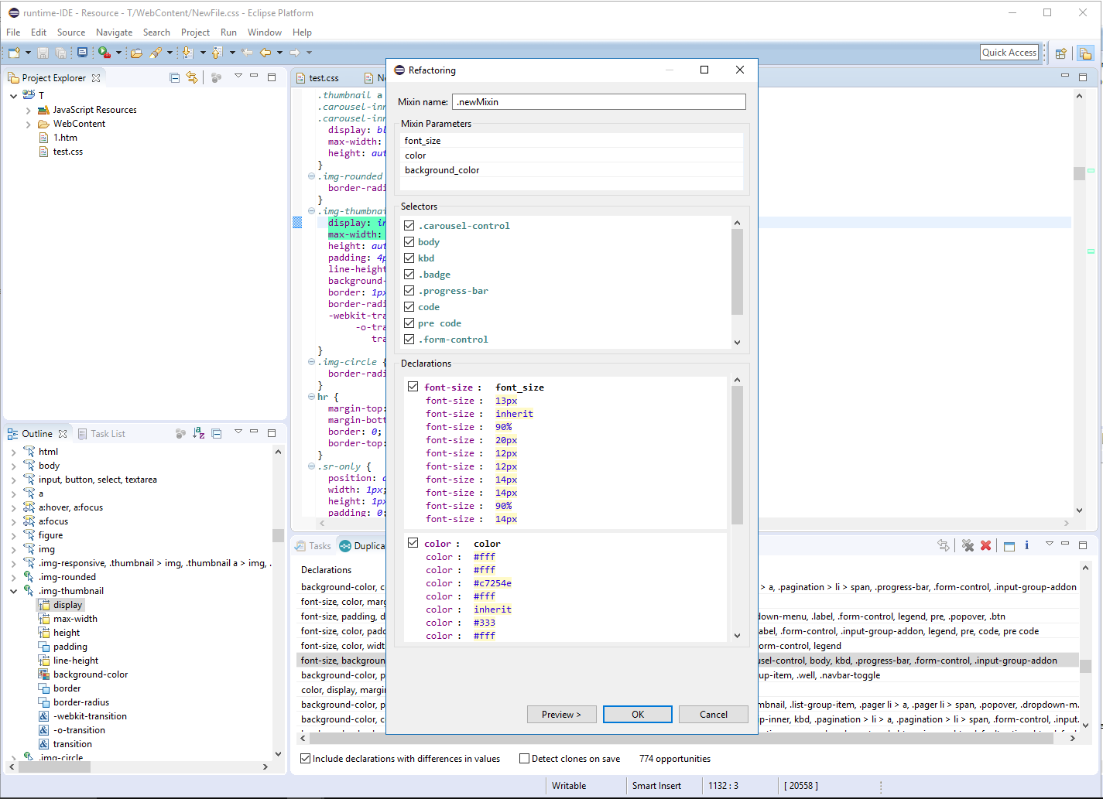

Slide 39
What we don’t support
String interpolation

Slide 40
Preserving Presentation
Precondition II:
The ordering of the style declarations inside a mixin should preserve their original order dependencies in the style rules from which they are extracted
The “template” ensures that
The only possibility: conflicting dependencies

Slide 41
2) Detecting differences in values
.mixin(@mtop; @mbottom) {
margin: @mtop 5px @mbottom 5px;
}
.s1 {
...
.mixin(3px; 3px);
...
}
.s2 {
...
.mixin(2px; 1px);
...
}
.s1 {
...
margin-left: 5px;
margin-right: 5px;
margin-top: 3px;
margin-bottom: 3px;
...
}
.s2 {
...
margin: 2px 5px 1px;
...
}
Shorthand Declaration

Slide 42
References
[FSE’14] Davood Mazinanian, Nikolaos Tsantalis, and Ali Mesbah, "Discovering Refactoring Opportunities in Cascading Style Sheets," 22nd ACM SIGSOFT International Symposium on the Foundations of Software Engineering (FSE'2014), pp. 496-506, 2014
[SANER’16] Davood Mazinanian, and Nikolaos Tsantalis, "An Empirical Study on the Use of CSS Preprocessors," 23rd IEEE International Conference on Software Analysis, Evolution, and Reengineering (SANER'2016), pp. 168-178, 2016.

