Slide 1
A Multidimensional Empirical Study on Refactoring Activity
Nikolaos Tsantalis, Victor Guana, Eleni Stroulia, and Abram Hindle
Department of Computer Science and Software Engineering - Concordia University,
Department of Computing Science - University of Alberta, Edmonton, Alberta, Canada

Slide 2
What do we want to understand?
Code Refactoring:
“Disciplined technique for restructuring an existing body of code, altering its internal structure without changing its external behavior” ….
“to improve some of the non-functional attributes of the software”…
“code readability and reduced complexity to improve the maintainability of the source code, as well as a more expressive internal architecture or object model to improve extensibility”
Martin Fowler in http://refactoring.com
SSRG Lab – University of Alberta

Slide 3
What do we want to understand?
Five research questions that explore the different types of refactorings applied to different types of sources.
Dimensions:
The individual contribution of team members on refactoring activities.
The alignment of refactoring activity with release dates and testing periods.
The motivation behind the applied refactorings.
SSRG Lab – University of Alberta

Slide 4
Why do we want to understand it?
Help the community better reflect on the actual refactoring practice.
Increase the awareness of the software maintenance community about the drivers behind the application of refactorings.
Help motivate the creation of refactoring tools (e.g., code smell detectors, IDEs) addressing the actual needs of developers in a principled and empirical manner.
Why!!
SSRG Lab – University of Alberta

Slide 5
How do we want to understand it?
Three Case Studies (Git Repositories)
Dev. Time
Analyzed Rev.
JUnit | 12 years (4 analyzed) | 1018 Revisions
Jakarta HTTP Core | 7 years (7 analyzed) | 1588 revisions
Jakarta HTTP Client | 6 years (6 analyzed) | 1838 revisions
Detecting Refactorings: Lightweight version of the UMLDiff algorithm for differencing object-oriented models.
Detecting Testing Activity: Semi-automatic testing activity in software evolution through package organization analysis, keyword and topic analysis and manual inspection.
SSRG Lab – University of Alberta

Slide 6
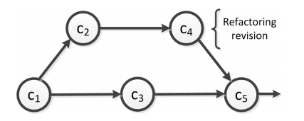
RQ1: Do software developers perform different types of refactoring operations on test code and production code?
We needed to determine successive revisions in the repositories, given the nature of the non-linear commit history of GIT
Implicit Branching.
But.. how?
Lightweight version of the UMLDiff algorithm for differencing object-oriented models + refactoring detection rules defined by Biegel et al. [1]
SSRG Lab – University of Alberta
Notes:
JUNIT: 383 detected refactorings, 219 (57%) were production code refactorings, while 164 (43%) were
test code refactorings.
HTTPCore, 421 (80%) were applied to production code, while 106 (20%) were applied to test code
HTTPClient, 161 (81%) where applied to production code and 37 (19%)
The goal of the applied refactorings on test code was often to organize the tests into new packages, reorganize inner classes, rename some test classes by giving a more meaningful name and move methods between test classes for conceptual reasons.
Conversely, the refactorings that were applied to production code, of the examined systems, were intended to improve the design of the system by modularizing
the code and removing design problems. The three most dominant refactorings on production code were Move Class, Extract Method and Rename Class followed by refactorings related to the reallocation of system's behavior (Move and Pull Up Method). The refactorings related to the reallocation of system's state (Move and
Pull Up Field) as well as the introduction of additional inheritance levels (Extract Superclass/Interface) are less frequent. Finally, the refactorings that move state or behavior to subclasses (Push Down Method/Field) are rarely applied.

Slide 7
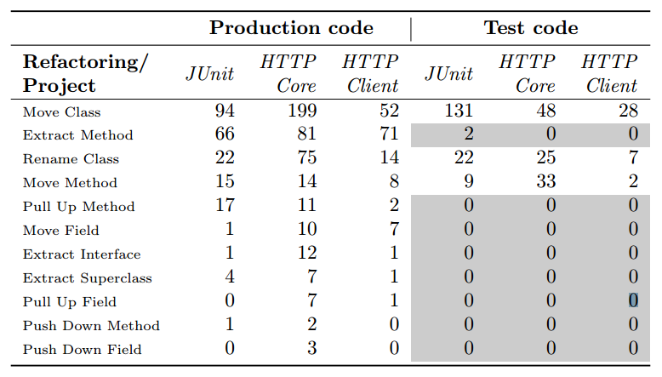
RQ1: Do software developers perform different types of refactoring operations on test code and production code?
SSRG Lab – University of Alberta
Notes:
JUNIT: 383 detected refactorings, 219 (57%) were production code refactorings, while 164 (43%) were
test code refactorings.
HTTPCore, 421 (80%) were applied to production code, while 106 (20%) were applied to test code
HTTPClient, 161 (81%) where applied to production code and 37 (19%)
The goal of the applied refactorings on test code was often to organize the tests into new packages, reorganize inner classes, rename some test classes by giving a more meaningful name and move methods between test classes for conceptual reasons.
Conversely, the refactorings that were applied to production code, of the examined systems, were intended to improve the design of the system by modularizing
the code and removing design problems. The three most dominant refactorings on production code were Move Class, Extract Method and Rename Class followed by refactorings related to the reallocation of system's behavior (Move and Pull Up Method). The refactorings related to the reallocation of system's state (Move and
Pull Up Field) as well as the introduction of additional inheritance levels (Extract Superclass/Interface) are less frequent. Finally, the refactorings that move state or behavior to subclasses (Push Down Method/Field) are rarely applied.

Slide 8
RQ2: Which developers are responsible for refactorings?
Identify test-specific and production-specific code entities
JUnit:
Test code is well organized and classes, methods, fields are located in a junit.tests package since
the beginning of the project.
HTTP Core & Client:
Classes had a prefix of Test or a suffix of Mock
Hybrid approach automatically collecting test classes following the pattern matching approach, and manually inspecting the results.
But.. how?
SSRG Lab – University of Alberta
Notes:
It is worth noticing that although HTTPCore (with 8 committers) and HTTPClient (with 9 committers) share almost the same
team of developers, only Oleg Kalnichevski contributes refactorings in both projects. This means that the rest of the developers, although
they commit code in both projects, they contribute refactorings in only one of them (probably the project they are more familiar with).
We can conclude that most of the applied refactorings are performed by specific developers that usually have a key role in the management of the project.
Moreover, we did not notice any substantial change in the distribution of the refactoring commits by the developers to the product code
and test code of the three projects under study.

Slide 9
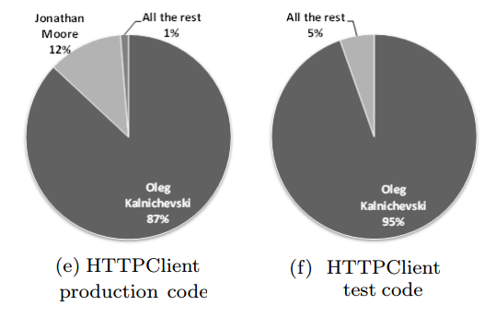
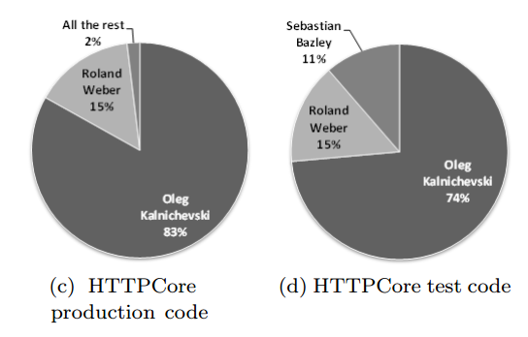
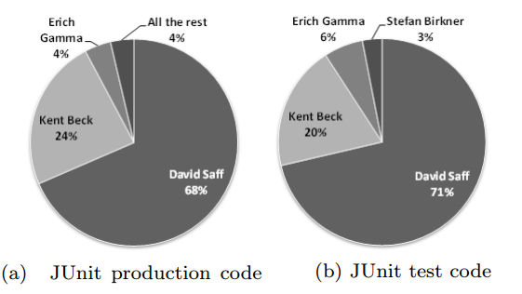
RQ2: Which developers are responsible for refactorings?
SSRG Lab – University of Alberta
Notes:
It is worth noticing that although HTTPCore (with 8 committers) and HTTPClient (with 9 committers) share almost the same
team of developers, only Oleg Kalnichevski contributes refactorings in both projects. This means that the rest of the developers, although
they commit code in both projects, they contribute refactorings in only one of them (probably the project they are more familiar with).
We can conclude that most of the applied refactorings are performed by specific developers that usually have a key role in the management of the project.
Moreover, we did not notice any substantial change in the distribution of the refactoring commits by the developers to the product code
and test code of the three projects under study.

Slide 10
RQ3: Is there more refactoring activity before major project releases than after?
We tracked each project major release dates in the public software release dates + Manually examined their relevance to filter minor releases such as
Isolated application of patches
Major documentation migration
Change of license types
But.. how?
HTTPCore: project had major releases every 2 months.
JUnit: commit activity decreased substantially 30 days after the release dates
observation window
40 days before
40 days after
release
SSRG Lab – University of Alberta

Slide 11
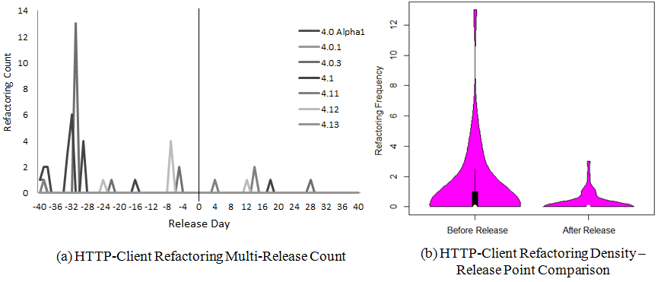
RQ3: Is there more refactoring activity before major project releases than after?
HTTP-Client
SSRG Lab – University of Alberta

Slide 12
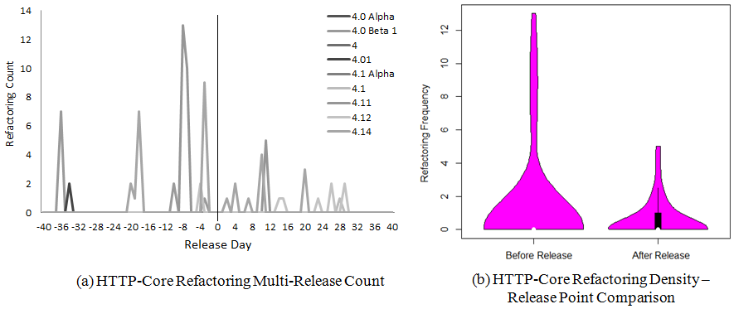
RQ3: Is there more refactoring activity before major project releases than after?
HTTP-Core
SSRG Lab – University of Alberta

Slide 13
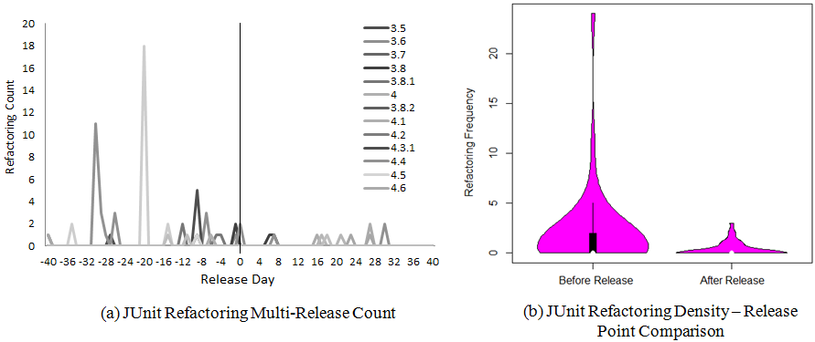
RQ3: Is there more refactoring activity before major project releases than after?
JUnit
SSRG Lab – University of Alberta

Slide 14
RQ4: Is refactoring activity on production code preceded by the addition/modification of test code?
Extraction of test code update periods
Detected additions/modifications of Test classes in the commit history
Created plots of activity
Focused on periods with contiguous and intense activity
Manually inspected the periods to discard False positives
The last day of each period was set as the pivot point in our window analysis
SSRG Lab – University of Alberta
Notes:
For the 4th RQ we investigated whether the refactoring activity on production code is accompanied with the addition/modification of test code.
To answer this question, we had to extract periods of test code updates.

Slide 15
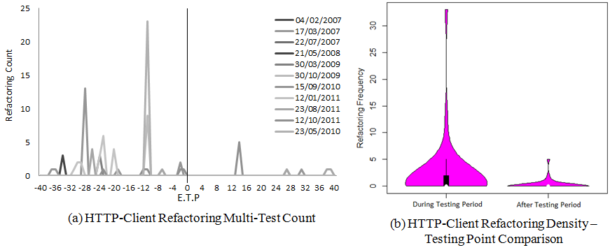
RQ4: Is refactoring activity on production code preceded by the addition/modification of test code?
HTTP-Client
SSRG Lab – University of Alberta
Notes:
For all examined projects, we found a significantly higher refactoring activity during the test update periods compared to the activity after the end of test periods.

Slide 16
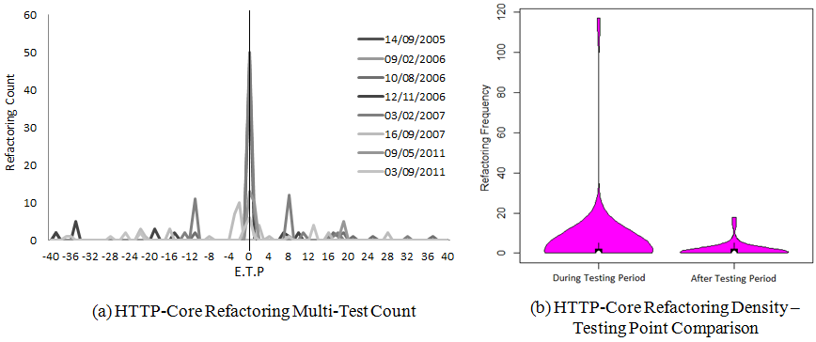
RQ4: Is refactoring activity on production code preceded by the addition/modification of test code?
HTTP-Core
SSRG Lab – University of Alberta
Notes:
In particular, for project HTTP-Core we found that most refactorings actually coincide with the end of test update periods.

Slide 17
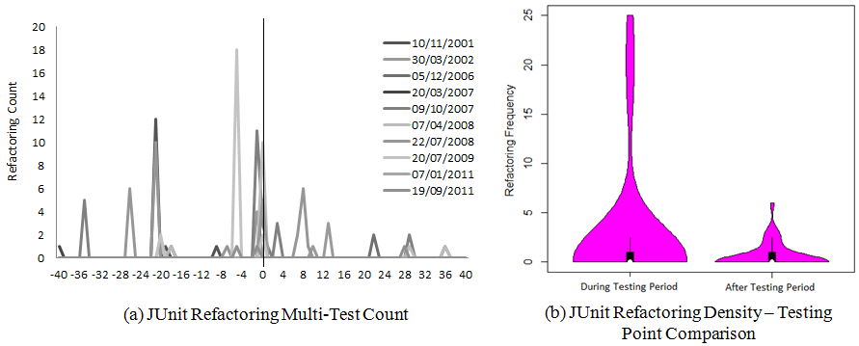
RQ4: Is refactoring activity on production code preceded by the addition/modification of test code?
JUnit
SSRG Lab – University of Alberta

Slide 18
RQ5: What is the purpose of
the applied refactorings?
Goal: Find the reason behind the application of the detected refactorings.
Inspected a randomly selected subset of refactorings to come up with some basic categories of motivations.
Defined rules to classify a refactoring instance in each of the basic categories.
Labeled all refactoring instances applying the classification rules.
In the case of new emerging categories, the classification rules were updated and all instances were re-labelled.
SSRG Lab – University of Alberta
Notes:
For the 5th RQ, our goal what to find the reasons behind the application of the detected refactorings.
We applied a two-phase process. In the first phase…

Slide 19
We classified 210
Extract Method instances in total
Extract Method is known as the
“Swiss Army knife” of refactorings
SSRG Lab – University of Alberta
Notes:
Our first focus was the Extract Method refactoring which is considered as the Swiss Army Knife of refactorings, since it can be used to solve many design problems
such as removing code duplication and decomposing long/complex methods, as well as it is used in combination with other refactorings to solve more complex design problems (Feature Envy, God Class). We classified 210 Extract Method instances in total.
I will now show some indicative cases from the examined projects motivating the application of Extract Method refactoring.

Slide 20
Facilitate Extension
private boolean isShadowed(Method method, List<Method> results) {
for (Method each : results) {
if (each.getName().equals(method.getName()))
return true;
}
return false;
}
BEFORE
private boolean isShadowed(Method method, List<Method> results) {
for (Method each : results) {
if (isShadowed(method, each))
return true;
}
return false;
}
private boolean isShadowed(Method current, Method previous) {
if (! previous.getName().equals(current.getName()))
return false;
//additional conditions examined
if (...)
}
AFTER

Slide 21
Backward Compatibility
public void writeTo(final OutputStream out, int mode) {
InputStream in = new FileInputStream(this.file);
byte[] tmp = new byte[4096];
int l;
while ((l = in.read(tmp)) != -1) {
out.write(tmp, 0, l);
}
out.flush();
}
unused
BEFORE
@Deprecated
public void writeTo(final OutputStream out, int mode) {
writeTo(out);
}
public void writeTo(final OutputStream out) {
InputStream in = new FileInputStream(this.file);
byte[] tmp = new byte[4096];
int l;
while ((l = in.read(tmp)) != -1) {
out.write(tmp, 0, l);
}
out.flush();
}
AFTER

Slide 22
Encapsulate Field
public static Properties fPreferences;
private static void readPreferences() {
fPreferences = new Properties(fPreferences);
fPreferences.load(is);
}
public static String getPreference(String key) {
return fPreferences.getProperty(key);
}
BEFORE
private static Properties fPreferences;
private static void readPreferences() {
setPreferences(new Properties(getPreferences()));
getPreferences().load(is);
}
public static String getPreference(String key) {
return getPreferences().getProperty(key);
}
protected static void setPreferences(Properties preferences) {
fPreferences = preferences;
}
protected static Properties getPreferences() {
return fPreferences;
}
AFTER
Notes:
The encapsulation restricts the access to other classes

Slide 23
Hide Message Chain
public boolean isShadowedBy(FrameworkField otherMember) {
return otherMember.getField().getName().equals(this.getField().getName());
}
BEFORE
public boolean isShadowedBy(FrameworkField otherMember) {
return otherMember.getName().equals(getName());
}
private String getName() {
return this.getField().getName();
}
AFTER

Slide 24
Introduce Factory Method
public Runner runnerForClass(Class<?> testClass) throws Throwable {
List<RunnerBuilder> builders= Arrays.asList(
new IgnoredBuilder(),
new AnnotatedBuilder(this),
suiteMethodBuilder(),
new JUnit3Builder(),
new JUnit4Builder());
}
BEFORE
public Runner runnerForClass(Class<?> testClass) throws Throwable {
List<RunnerBuilder> builders= Arrays.asList(
ignoredBuilder(),
annotatedBuilder(),
suiteMethodBuilder(),
junit3Builder(),
junit4Builder());
}
protected AnnotatedBuilder annotatedBuilder() {
return new AnnotatedBuilder(this);
}
AFTER
Notes:
This was done for extension purposes, because factory methods can also return subclass instances of the returned type.

Slide 25
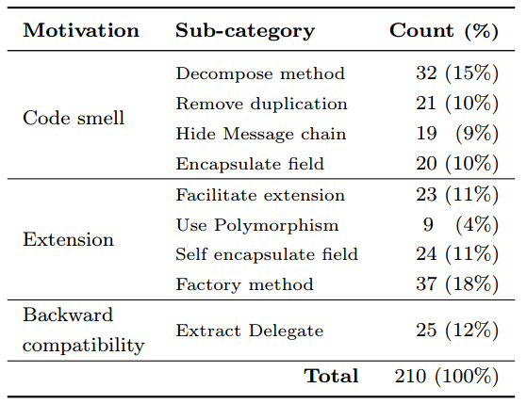
RQ5: What is the purpose of
the applied refactorings?
We found three main motivations for the application of the extract method refactoring: code smell resolution, extension and backward compatibility.
44%
Extract
Method
Refactoring
44%
12%
SSRG Lab – University of Alberta
Notes:
Facilitate functionality extension: The extracted/original method contains newly added code apart from the extracted/removed one.
Introduce polymorphism: The extracted method is abstract and the extracted code is moved to a subclass providing a concrete implementation for the newly introduced abstract method.

Slide 26
We classified 70
Inheritance-related refactorings in total
What about Inheritance related refactorings?
SSRG Lab – University of Alberta

Slide 27
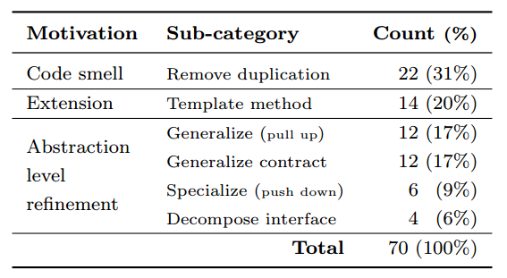
RQ5: What is the purpose of
the applied refactorings?
We found three main motivations for the application of the extract method refactoring: code smell resolution, extension and refinement of abstraction level.
31%
Inheritance
Related
Refactorings
20%
49%
SSRG Lab – University of Alberta

Slide 28
Bird's-eye-view Conclusions
RQ1: Do software developers perform different types of refactoring operations on test code and production code?
In production code: Design improvements such as, resolution of code smells and modularization.
In test code: Internal reorganization of the classes of each project into packages and renaming of classes for conceptual reasons.
RQ2. Which developers are responsible for refactorings?
Refactorings were mainly fulfilled by a single developer acting as a refactoring manager.
Managers share refactoring responsibilities in both production and test code.
SSRG Lab – University of Alberta

Slide 29
Bird's-eye-view Conclusions
RQ3. Is there more refactoring activity before major project releases than after?
Refactoring activity is significantly more frequent before a release than after. We believe this activity is motivated by the desire to improve the design, and prepare the code for future extensions, right before releasing a stable API.
RQ4: Is refactoring activity on production code preceded by the addition or modification of test code?
A tight alignment between refactoring activities and test code updates.
Testing and refactoring are dependent implying the adoption of test-driven refactoring practices in the examined projects.
SSRG Lab – University of Alberta

Slide 30
Bird's-eye-view Conclusions
RQ5: What is the purpose of the applied refactorings?
Extract Method refactoring:
Code smells: The decomposition of methods was the most dominant motivation
Facilitating Extension: Introduction of Factory Methods
Inheritance related refactorings:
Removal of duplicate code and the generalization of abstraction.
Decomposition of interfaces and specialization of abstraction were rarely applied practices.
SSRG Lab – University of Alberta

Slide 31
Bird's-eye-view Conclusions
RQ1: Do software developers perform different types of refactoring operations on test code and production code?
RQ2. Which developers are responsible for refactorings?
RQ3. Is there more refactoring activity before major project releases than after?
RQ4: Is refactoring activity on production code preceded by the addition or modification of test code?
RQ5: What is the purpose of the applied refactorings?
tsantalis@cse.concordia.ca
guana@ualberta.ca
SSRG Lab – University of Alberta

