Slide 1
Ranking Refactoring Suggestions
based on Historical Volatility
Nikolaos Tsantalis Alexander Chatzigeorgiou
University of Macedonia
Thessaloniki, Greece
15th European Conference on Software Maintenance and Reengineering (CSMR 2011)

Slide 2

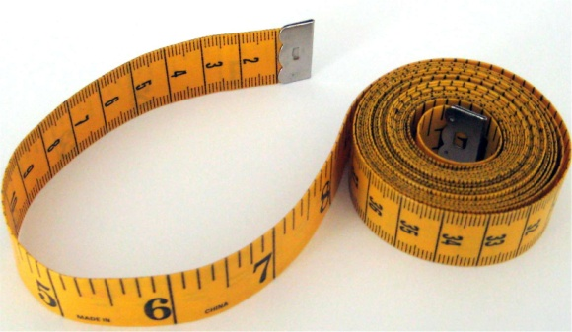
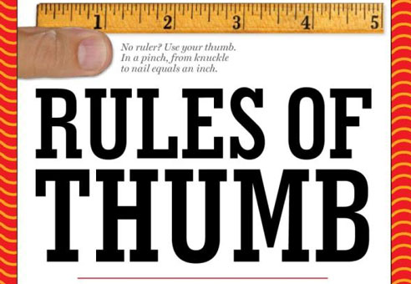

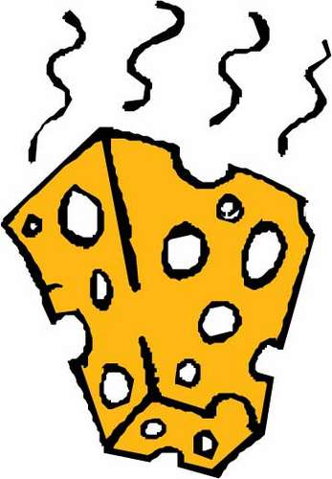
Design Problems
non-compliance with design principles
excessive metric values
violations of design heuristics
lack of design patterns
Fowler’s bad smells

Slide 3
Design Problems … can be numerous

Slide 4
Motivation
Are all identified design problems worrying?
Example: Why would it be urgent to improve a method suffering from Long Method if the method had never been changed?
Need to define (quantify) the urgency to resolve a problem
One possible source of information: Past code versions
Underlying Philosophy: code fragments that have been subject to maintenance tasks in the past, are more likely to undergo changes → refactorings involving the corresponding code should have a higher priority.

Slide 5
Goal
To rank refactoring suggestions based on the urgency to resolve the corresponding design problems
The ranking mechanism should take into account:
  the number of past changes
  the extent of change
  the proximity to the current version

Slide 6

Inspiration

Slide 7
Forecasting in Financial Markets vs. Software
Financial Markets
Trends in volatility are more predictable than trends in prices
Volatility is related to risk and general stability of markets
defined as the relative rate at which prices move up and down
time: trading days
Software – Preventive Maintenance
Risk lies in the decision to invest on resolving design problems
volatility based on changes involving code affected by a smell
time: successive software versions

Slide 8
Code Smell Volatility

Slide 9
Forecasting Models
Random Walk (RW)
Historical Average (HA)
Exponential Smoothing (ES)
Exponentially-Weighted Moving Average

Slide 10
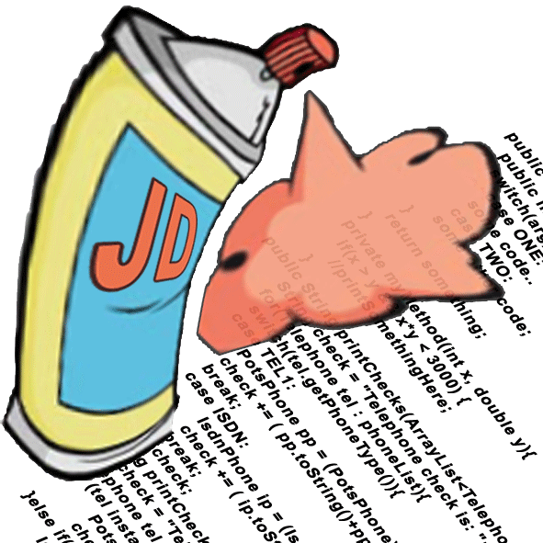
Examined Smells
Detection tool: JDeodorant
Identified smells:
  Long Method
  Feature Envy
  State Checking

Slide 11
Long Method
Pieces of code with large size, high complexity and low cohesion
int i;
int sum = 0;
for(i = 0; i < N; ++i) {
sum = sum + i;
}
System.out.println(sum);
int i;
int product = 1;
for(i = 0; i < N; ++i) {
product = product *i;
}
System.out.println(product);

Slide 12
What to look for
The presence of Long Method implies that it might be difficult to maintain the method
→ perform refactoring if we expect that the intensity of the smell will change
Previous versions: detect changes in the implementation of the method that affect the intensity of the smell
change

Slide 13

Long Method
Version i
Version i+1
int i;
int sum = 0;
int product = 1;
for(i = 0; i < N; ++i) {
sum = sum + i;
product = product *i;
}
System.out.println(sum);
System.out.println(product);
int i;
int sum = 0;
int product = 1;
int sumEven = 0;
for(i = 0; i < N; ++i) {
sum = sum + i;
product = product *i;
if(i%2 == 0)
sumEven += i;
}
System.out.println(sum);
System.out.println(product);
System.out.println(sumEven);
Extend of Change: number of edit operations to convert method_{i} to method_{i+1}

Slide 14
Feature Envy
A method is “more interested in a class other than the one it actually is in”
Target
Source
m(Target t) {
t.m1();
t.m2();
t.m3();
}
m1()
m2()
m3()
m() {
m1();
m2();
m3();
}

Slide 15

Feature Envy
The Intensity of the smell is related to the number of “envied” members
Version i
Version i+1
Source
Source
m(Target t) {
t.m1();
t.m2();
t.m3();
}
m(Target t) {
t.m1();
t.m2();
t.m3();
t.m4();
}
envies 3 members
envies 4 members
Extend of Change: variation in the number of “envied” members

Slide 16
State Checking
State Checking manifests itself as conditional statements that select an execution path based on the state of an object
Context
Context
Type
- type : int
- STATE_A : int = 1
- STATE_B : int = 2
type
- type : int
- STATE_A : int = 1
- STATE_B : int = 2
+method()
  + method() {
  }
  + method() {
  type.method();
  }
  switch(type) {
  case STATE_A:
    break;
  case STATE_B:
    break;
  }
    doStateA();
StateA
StateB
    doStateB();
+method() {
}
+method() {
}

Slide 17
What to look for
State Checking: implies a missed opportunity for polymorphism
State
if (state == StateA) {
. . .
. . .
}
else if (state == StateB) {
. . .
. . .
}
StateA
StateB
StateC
. . .
. . .
. . .
else if (state == StateC) {
. . .
. . .
}
. . .
. . .
. . .
+
+
(additional statements)

Slide 18
State Checking
The intensity of the smell is primarily related to the number of conditional structures checking on the same states
Version i
Version i+1
ClassX
ClassY
ClassZ
- type : int
- STATE_A : int = 1
- STATE_B : int = 2
- type : int
- STATE_B : int = 2
- STATE_C : int = 3
- type : int
- STATE_A : int = 1
STATE_B : int = 2
STATE_C : int = 3
  + method() {
  switch(type) {
  case STATE_A:
  doStateA();
  break;
  case STATE_B:
  doStateB();
  break;
  }
  }
  + method() {
  switch(type) {
  case STATE_B:
  doStateB();
  break;
  case STATE_C:
  doStateC();
  break;
  }
  }
  + method() {
  switch(type) {
  case STATE_A:
  doStateA();
  break;
  case STATE_B:
  doStateB();
  break;
  case STATE_C:
  doStateC();
  break;
  }
  }
1 cond. structure
2 cond. structures
Extend of Change: variation in the number of conditional structures

Slide 19
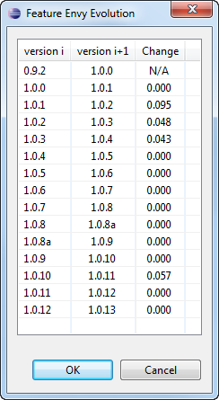
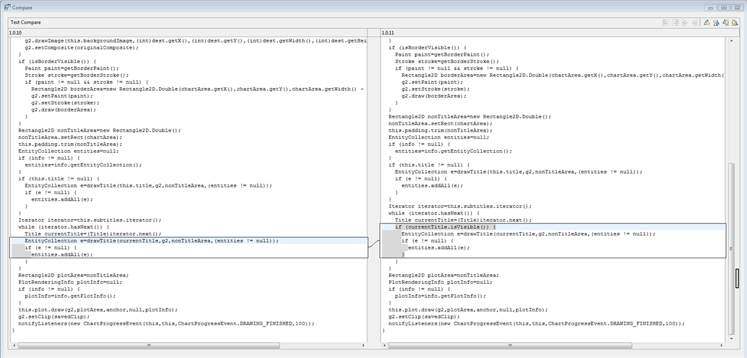
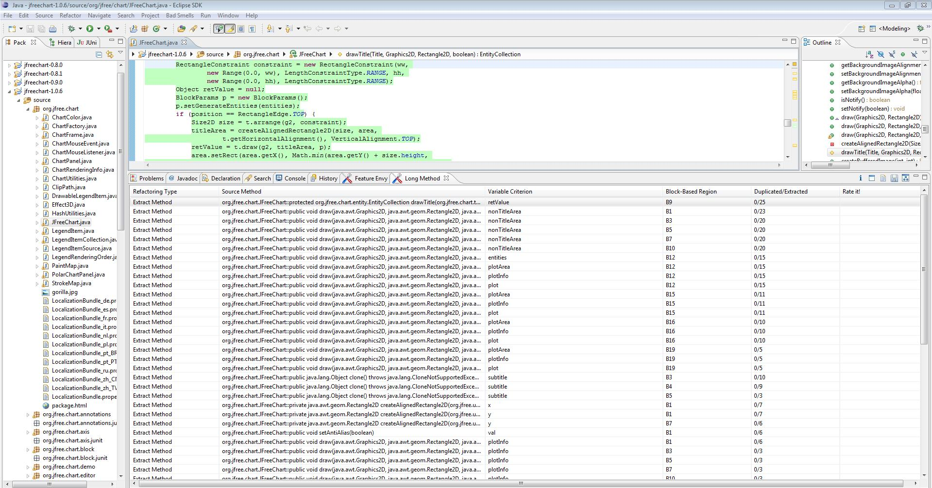
Application
Calculate past volatility values (for each refactoring opportunity)
Estimate future volatility
Rank suggestions according to this estimate

Slide 20
Evaluation
Goal: To compare the accuracy of the four examined models
performed along two axes:
  direct comparison of forecast accuracy (RMSE)
  comparison of rankings produced by each model and according to the actual volatility
Context: two open source projects
  JMol: 26 project versions (2004 ..)
  JFreeChart: 15 project versions (2002 ..)

Slide 21
JMol

Slide 22
JFreeChart

Slide 23
Comparison of Forecast Accuracy
Long Method / JFreeChart
both consider the average of all historical values

Slide 24
Comparison of Forecast Accuracy
Feature Envy / JMol
Peaks in RMSE when versions with zero volatility are followed by abrupt change
Random Walk is being favored by successive versions with zero volatility

Slide 25
Comparison of Forecast Accuracy
Overall RMSE for each smell and forecasting model
 | Random Walk | Historical Average | Exponential Smoothing | EWMA
Long Method (JFreeChart) | 0.032646 | 0.031972 | 0.032176 | 0.032608
Feature Envy (JMol) | 0.003311 | 0.003295 | 0.003309 | 0.003301
State Checking (JMol) | 0.052842 | 0.052967 | 0.053051 | 0.053879
HA achieves the lowest error for Long Method and Feature Envy
more sophisticated models that take proximity into account do not provide higher accuracy
Simplicity and relatively good accuracy of HA →
appropriate strategy for ranking refactoring suggestions

Slide 26
Ranking Comparison
Forecasting models extract the anticipated smell volatility for future software evolution
Therefore, estimated volatility for the last transition can be employed as ranking criterion for refactoring suggestions
Evaluation:
Compare
Rankings produced by each model
Rankings produced by actual volatility in the last transition

Slide 27
Ranking Comparison
To compare the similarity between alternative rankings (of the same set) we used Spearman’s footrule distance
A
B
C
D
E
F
A
B
C
D
E
F
A
B
C
D
E
F
F
E
D
C
B
A
A
B
C
D
E
F
A
C
B
E
F
D
NFr = 0
NFr = 1
NFr = 0.333

Slide 28
Ranking Comparison - Spearman’s footrule
high frequency of changes
(Long Method / JFreeChart)
 | Random Walk | Historical Average | Exponential Smoothing | EWMA
Actual | 0.6220 | 0.3255 | 0.5334 | 0.3238
low frequency of changes
(Feature Envy / JMol)
 | Random Walk | Historical Average | Exponential Smoothing | EWMA
Actual | 0.0096 | 0.0210 | 0.0199 | 0.0213
(State Checking / JMol)
low frequency of changes
 | Random Walk | Historical Average | Exponential Smoothing | EWMA
Actual | 0.07 | 0.13 | 0.14 | 0.13

Slide 29
Conclusions
Refactoring suggestions can be ranked:
according to design criteria
according to past source code changes (higher priority for pieces of code that have been the subject of maintenance)
Simple forecasting models, such as Historical Average
lowest RMSE error
similar rankings to those obtained by actual volatility (frequent changes)
Future Work #1: Analyze history at a more fine-grained level
Future Work #2: Combination of structural and historical criteria

Slide 30
Thank you for your attention
15th European Conference on Software Maintenance and Reengineering (CSMR 2011)

