Slide 1
Feature Detection in Ajax-enabled Web Applications
Natalia Negara
Nikolaos Tsantalis
Eleni Stroulia

Slide 2
Motivation
Sitemaps and meta-keywords are essential for communicating the content of a website to its users and search engines.
The manual extraction is a tedious and quite subjective task.
Current solutions support static and dynamic websites, where the states are determined by unique URLs (URL-based approaches)

Slide 3
The problem
In traditional dynamic web applications the states are explicit and correspond to pages with unique URLs.
Ajax technology allows to dynamically manipulate the DOM tree rendered in the client’s browser.
This means that user actions may generate multiple DOM states under the same URL.
Notes:
The dynamic manipulation of the DOM tree is achieved through Javascript and asynchronous server communication.

Slide 4
The idea
Why don’t we group the DOM states based on their structural similarity?
Assumptions
DOM states having a strong similarity should be part of the same feature.
Clustering the DOM states ⇒ each cluster should represent a unique feature.
However, determining similarity is not always easy.

Slide 5
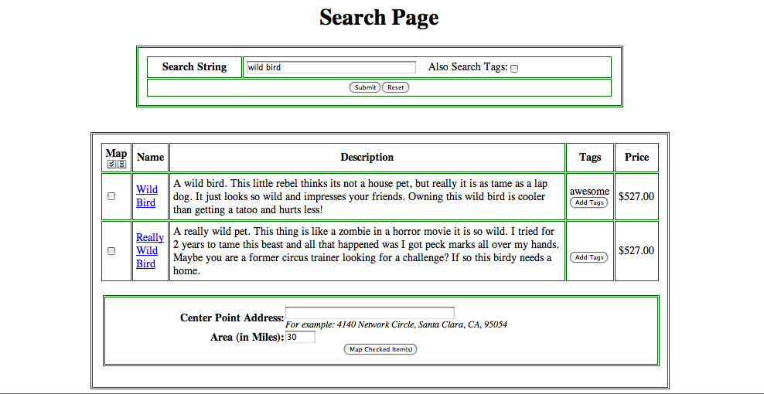
/petstore/faces/search.jsp
/petstore/faces/search.jsp

Slide 6
String-edit distance
Most previous approaches assessed webpage structural similarity using the Levenshtein distance
S₁: <html><body><form><table>…</body></html>
S₂: <html><body><form><ol>…</body></html>
$$d_{L}=\frac{L\left(S_{1},S_{2}\right)}{max\left(length\left(S_{1}\right), length\left(S_{2}\right)\right)}$$
In the example, $d_{L}=0.606$
Notes:
For two sequences S₁ and S₂, it computes the minimum number of insert, delete, and replace operations required to transform the first sequence into the second.

Slide 7
Tree-edit distance
Apply a tree-alignment algorithm that takes as input two trees T₁ and T₂, and computes an edit script transforming T₁ to T₂
The node-level edit operations in the edit script are:
Match
Change
Insert
Remove
Move

Slide 8
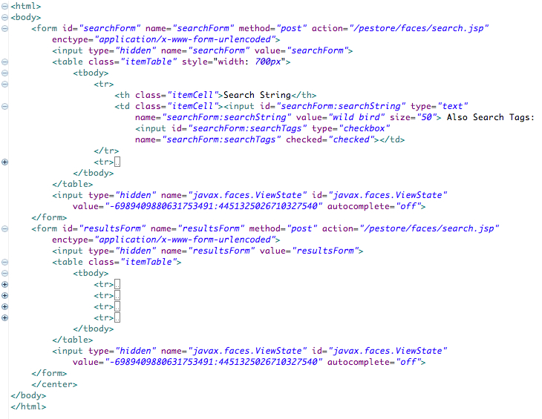
Tree-edit distance
1 node
76 nodes
changed
inserted

Slide 9
Tree-edit distance
$$d_{S}=\frac{\left|diff\left(T_{1},T_{2}\right)\right|}{\left|diff\left(T_{1},T_{2}\right)\right|+\left|match\left(T_{1},T_{2}\right)\right|}$$
In the example, $\left|diff\left(T_{1},T_{2}\right)\right|=77$ and $\left|match\left(T_{1},T_{2}\right)\right|=45$ out of $122$ nodes in total
$$d_{S}=\frac{77}{122}=0.63$$
Give a lower weight to composite edit operations

Slide 10
What is a composite edit operation?
Composite edit operation
changed
inserted

Slide 11
Composite-change-aware Tree-edit distance
$$d_{C}=\frac{\left|diff′\left(T_{1},T_{2}\right)\right|+comp}{\left|diff′\left(T_{1},T_{2}\right)\right|+comp+\left|match\left(T_{1},T_{2}\right)\right|}$$
$comp$ is the number of composite edit operations
$diff′\left(T_{1},T_{2}\right)$ is the original set of edit operations excluding those that belong to composite ones
In the example, $\left|diff′\left(T_{1},T_{2}\right)\right|=77−76=1$ $\left|match\left(T_{1},T_{2}\right)\right|=45$ and $comp=1$
$$d_{C}=\frac{2}{47}=0.042$$

Slide 12
Feature extraction process
Collect DOM states
Compute distances between states
Apply clustering
Determine the number of clusters
Crawljax
hierarchical
agglomerative
1. L method
2. Silhouette
Notes:
Crawljax is a framework for crawling and testing Ajax-enabled web applications

Slide 13
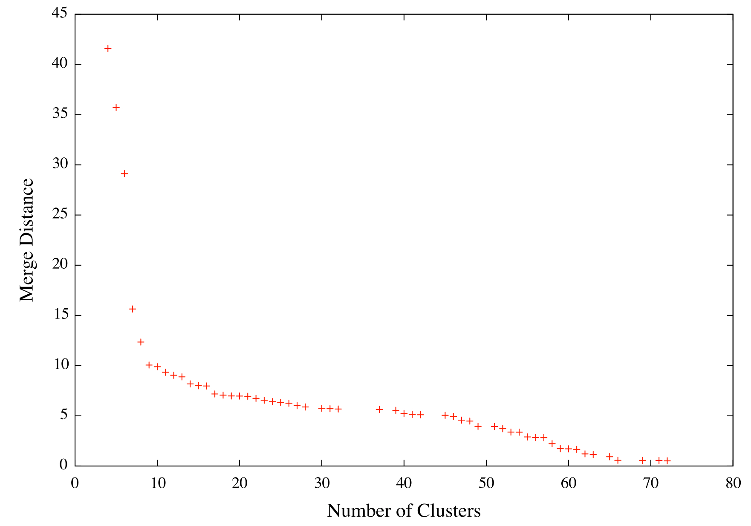
L method [Salvador & Chan, 2004]
knee
$$\hat{c}$$
Notes:
The data points on the right of the graph (forming an almost straight line) denote that similar clusters are merged (the merging distances are very close)
The abrupt change in the merging distance denotes that dissimilar clusters start getting merged.
The point of the abrupt change is called the “knee” of the graph and it’s x-value corresponds to the correct number of clusters.

Slide 14
Silhouette
Silhouette for data point $i$ is $s\left(i\right)=\frac{b\left(i\right)−a\left(i\right)}{max\left(a\left(i\right),b\left(i\right)\right)}$
$a\left(i\right)$ is the average dissimilarity between $i$ and the other data points in the same cluster.
$b\left(i\right)$ is the average dissimilarity between $i$ and the data points in the nearest neighbor cluster.
The value of $s\left(i\right)$ ranges over the interval [-1, 1]
The closer its value to 1, the more appropriately the data point $i$ is clustered within the partition
Notes:
Is a clustering evaluation metric

Slide 15
Silhouette coefficient
Silhouette coefficient for all data points $I$ in a partition of $k$ clusters is
$$\overline{s_{k}}=\frac{1}{\left|I\right|}\sum_{i=1}^{\left|I\right|}{s\left(i\right)}$$
The higher the value of $\overline{s_{k}}$, the better the quality of the clustering.
Notes:
Is a clustering evaluation metric

Slide 16
Evaluation Process
RQ: Does the feature extraction process produce better results when a composite-change-aware tree-edit distance ($d_{C}$) is used?
Select Ajax web apps
Create reference sets of features
Perform feature extraction
Compare the results
Using 3
distance
metrics
Precision
Recall
F-measure

Slide 17
Google Maps
 | # DOM nodes | DOM depth
Average | 968 | 20
Median | 1080 | 20
Standard deviation | 231.8 | 0.59
Notes:
Google Maps has a very stable and consistent user interface

Slide 18
Garage.ca
 | # DOM nodes | DOM depth
Average | 547 | 12
Median | 540 | 12
Standard deviation | 111.3 | 1.6
Notes:
online shopping application

Slide 19
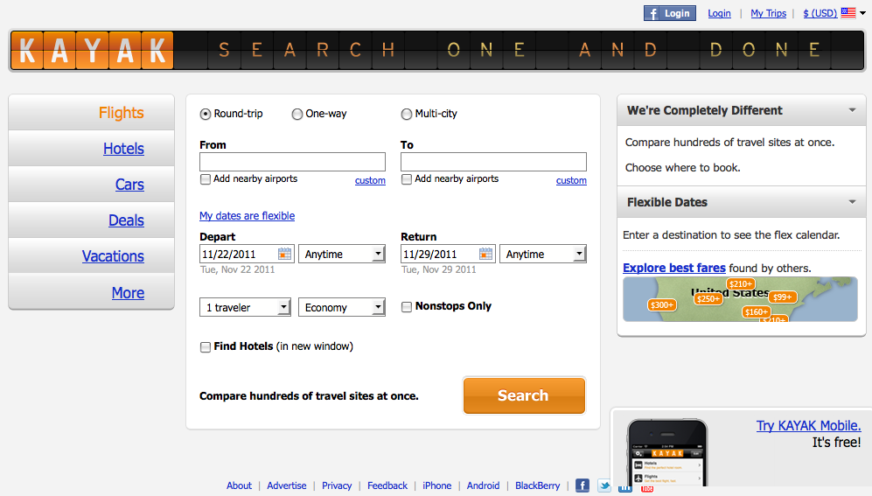
Kayak
 | # DOM nodes | DOM depth
Average | 894 | 26
Median | 887.5 | 29
Standard deviation | 541.6 | 6.36
Notes:
online travel booking application, has a very diverse user interface with respect to the size and complexity of the generated DOM trees.
The selected web application vary in terms of their domain, as well as their structural characteristics.

Slide 20
Reference sets
Screenshots of the DOM states as rendered in the browser.
Two authors independently grouped the DOM states according to their visual perception of the feature they take part in.
The initial agreement was 0.887 for Garage, 0.890 for Google Maps and 0.993 for Kayak.
The results were merged by decomposing higher-level features to lower-level ones.
Notes:
Initial agreement was determined using Jaccard Index

Slide 21
Evaluation Results
distance | L method |  |  |  | Silhouette
 | k | F-measure | Precision | Recall | k | F-measure | Precision | Recall
d_{S} | 13 | 0.448 | 0.963 | 0.292 | 12 | 0.458 | 0.964 | 0.300
d_{C} | 6 | 0.832 | 0.985 | 0.721 | 5 | 0.930 | 0.937 | 0.924
d_{L} | 15 | 0.396 | 0.957 | 0.250 | 15 | 0.396 | 0.957 | 0.250
Actual number of clusters: 4

Slide 22
Evaluation Results
distance | L method |  |  |  | Silhouette
 | k | F-measure | Precision | Recall | k | F-measure | Precision | Recall
d_{S} | 25 | 0.861 | 0.972 | 0.774 | 15 | 0.852 | 0.834 | 0.872
d_{C} | 19 | 0.960 | 0.973 | 0.947 | 17 | 0.937 | 0.920 | 0.955
d_{L} | 14 | 0.856 | 0.849 | 0.872 | 13 | 0.854 | 0.837 | 0.872
Actual number of clusters: 19

Slide 23
Evaluation Results
distance | L method |  |  |  | Silhouette
 | k | F-measure | Precision | Recall | k | F-measure | Precision | Recall
d_{S} | 24 | 0.832 | 1.000 | 0.713 | 15 | 0.994 | 0.996 | 0.992
d_{C} | 17 | 0.996 | 1.000 | 0.992 | 12 | 0.992 | 0.984 | 1.000
d_{L} | 29 | 0.770 | 1.000 | 0.626 | 21 | 0.820 | 1.000 | 0.694
Actual number of clusters: 16

Slide 24
Conclusions & Future Work
We have shown that a composite-change-aware tree-edit distance is more suitable for detecting features in Ajax-enabled web applications compared to traditional distance measures.
Automatic labeling of the discovered features
By applying Latent Dirichlet allocation (LDA) on the textual content of the DOM states in each group.
Giving higher weight to text inside headings and other emphasis-related tags.

Slide 25
Thank you!

