Slide 1
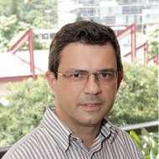
Why We Refactor? Confessions of GitHub Contributors
Danilo Silva
Nikolaos Tsantalis
Marco Tulio Valente

Slide 3
Empirical research has extended our knowledge on refactoring
How developers refactor
Murphy-Hill et al., IEEE TSE, 2012
Refactoring tools usage
Negara et al., ECOOP, 2013
Refactoring challenges and benefits
Kim et al., IEEE TSE, 2014

Slide 4
However…
… there is a limited number of studies investigating the motivations driving refactoring

Slide 5
In this study, we investigate the
motivations behind refactoring based on the actual explanations of developers on
specific refactorings they have recently applied

Slide 6
Highlights
Large scale study
463 refactorings of 12 different types
124 popular Java-based projects
Catalogue of 44 distinct motivations

Slide 7
Study Design

Slide 8
1
Select code repositories
Repeat daily
2
Mine recent refactorings
3
4
Inspect manually
Contact developers
5
Analyze and classify responses

Slide 9
Selection of code repositories
1
1,000 most popular Java repositories
Filter by number of commits
748 repositories
Spring-framework
Intellij-community
...
elasticsearch
Notes:
Remember not to say “relevant” projects

Slide 10
Mining refactorings
2
Refactoring Miner
An automated refactoring detection tool
98% precision and 93% recall
12 well-known refactoring types
Move Class | Extract Superclass
Rename Package | Extract Interface
Extract Method | Inline Method
Pull Up Method | Push Down Method
Move Method | Move Attribute
Pull Up Attribute | Push Down Attribute
Notes:
98% precision and 93% recall using an independent dataset (Chaparro et al., ICSME 2014)

Slide 11
git repository
previous revision
revision
Refactoring Miner
List of refactorings
Move Class X to Y
Extract Method a from b
...

Slide 12
Manual Inspection
3
Filter false positives (63% precision)
Notes:
98% precision and 93% recall using an independent dataset (Chaparro et al., ICSME 2014)

Slide 13
Contacting developers
4
Dear xxxx,
(…) I found that you recently performed the following refactoring on yyyy project:
Move Class PropertyRule from org.yyyy.wfs.xml to org.yyyy.util
This is the GitHub link to the commit: https://github.com/yyyy/commit/abcd
(…) I am wondering if you could answer the following brief questions:
Could you describe why did you perform this refactoring?
Did you perform this refactoring using automated refactoring support of your IDE?

Slide 14
Analysis of the responses
5
Thematic Analysis
A technique for identifying and recording patterns (or “themes”) within a collection of documents

Slide 15
“The common interface for those classes lived in store.record, while most of it’s implementors lived in store, which did not make sense because all of them are actually records.”

Slide 16
“The common interface for those classes lived in store.record, while most of it’s implementors lived in store, which did not make sense because all of them are actually records.”
Move a class to a package that is more functionally or conceptually related to it

Slide 17
Thematic Analysis performed independently by the first two authors
Divergent themes were then discussed to reach a consensus
58% of the themes were equivalent, 42% required a discussion

Slide 18
Some numbers
185 | repositories with confirmed refactoring activity
1,411 | confirmed refactoring instances
465 | e-mails sent to unique developers
195 | responses received (42% response rate)
+27 | commit messages explaining the motivation

Slide 19
Final data analyzed
222 | commits
436 | refactoring instances
124 | repositories

Slide 20
Why do Developers Refactor?

Slide 21
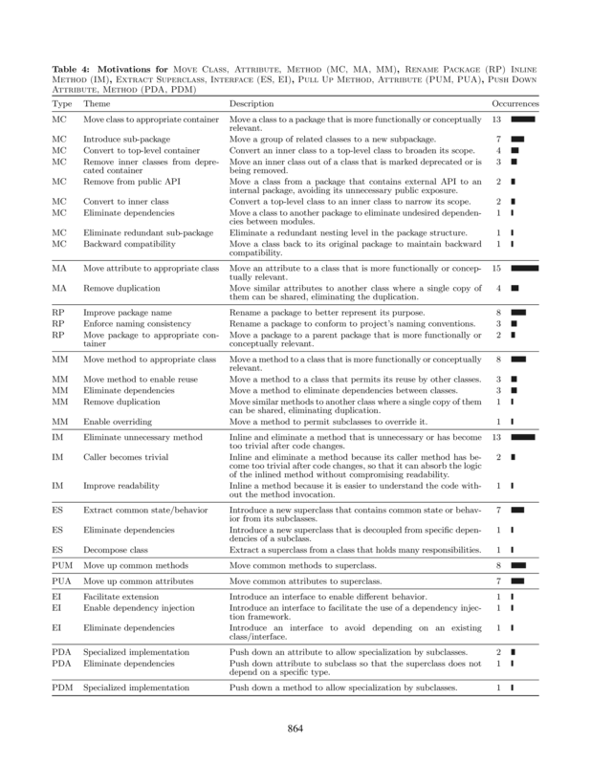
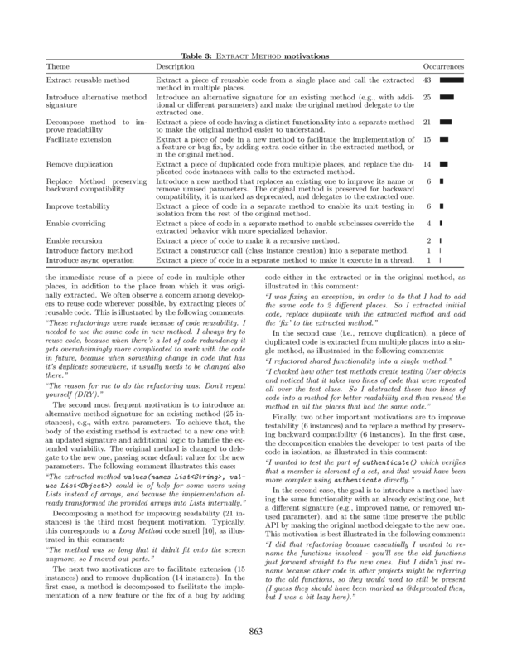
We found 44 reasons

Slide 22
Extract Method motivations

Slide 23
Examples
“The method was so long that it didn’t fit onto the screen anymore, so I moved out parts.”
Decompose method to improve readability

Slide 24
“I was fixing an exception, in order to do that I had to add the same code to 2 different places. So I extracted initial code, replace duplicate with the extracted method and add the ‘fix’ to the extracted method.”
Extract reusable method
Facilitate extension

Slide 25
Lessons learned
Refactoring activity is mainly driven by the need to add new features and fix bugs, and much less by code smell resolution
Extract Method is the “swiss army knife” of refactoring
Notes:
Extract Method is the “Swiss army knife of refactorings” (11 different motivations)

Slide 26
Do developers use refactoring tools?

Slide 27
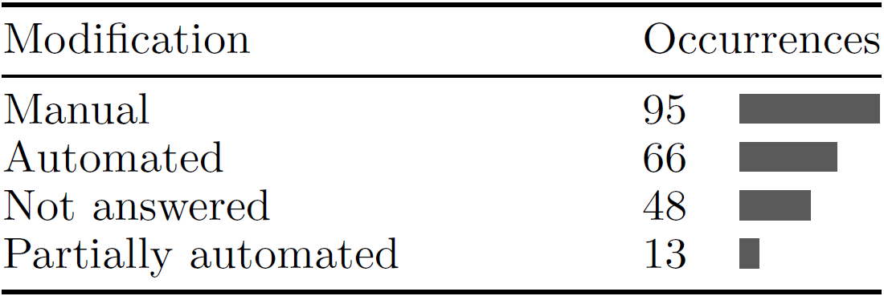
Manual vs. automated refactorings

Slide 28
“I don’t trust the IDE for things like this, and usually lose other comments, notation, spacing from adjacent areas.”

Slide 29
“Automated refactoring is overkill for moving some private fields.”

Slide 30
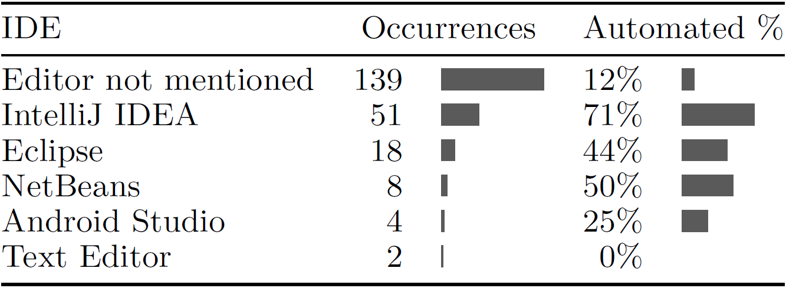
The influence of the IDE

Slide 31
Lessons learned
Refactoring tools are still underused, as suggested by previous studies
Main reasons:
Lack of trust
Devs consider tools unnecessary
Unsupported refactorings
Lack of tool awareness
Tool usage differs in different IDEs

Slide 32
Take home message
Refactoring recommendation systems should refocus from code-smell-oriented to maintenance-task-oriented solutions
The way a refactoring tool is designed and offered to the user makes a big difference

Slide 33
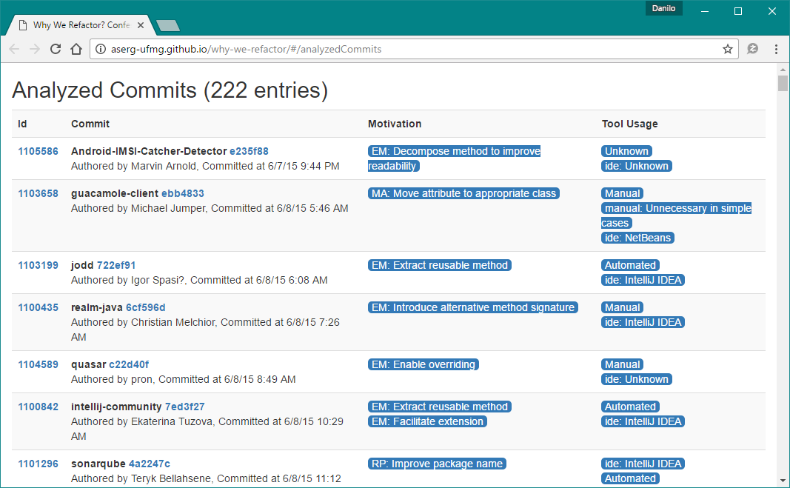
Final remarks
Visit our complementary web site:
http://aserg-ufmg.github.io/why-we-refactor
Notes:
refactoring recommendation systems should refocus from code-smell-oriented to maintenance-task-oriented solutions

