Slide 1







: Clone Refactoring
38th International Conference on Software Engineering (ICSE'2016)
Formal Tool Demonstration Session
Davood Mazinanian
Nikolaos Tsantalis
Raphael Stein
Zackary Valenta
Department of Computer Science and Software Engineering
Concordia University

Slide 2

Clones are harmful
Error-prone due to inconsistent updates
(Juergens et al. @ ICSE’09)
Increase maintenance effort and cost
(Lozano et al. @ ICSM’08)
Change-prone
(Mondal et al. @ ACM SAC’12)

Slide 3

Clones are good
Positive impact on maintainability
(Kasper & Godfrey @ EMSE’08)
Less buggy
Less effort to fix bugs
(Rahman, Bird & Devanbu @ EMSE’12)

Slide 4
Clone management
Clones that change frequently & are buggy might need some refactoring
Notes:
so that we don’t have to apply the same changes multiple times.

Slide 5

Motivation
Current clone refactoring support is poor
Tairas & Gray (IST’12) studied 1,200 Type-II clones detected in 9 open-source projects:
  10% could be refactored by Eclipse
  CeDAR (IST’12) refactored 19%
We need better clone refactoring tools

Slide 6
Our goal
Help developers:
Explore clone groups and understand their relations
Inspect and understand the differences between clones
Refactor safely the clones

Slide 7
Clone Group Exploration
features

Slide 8
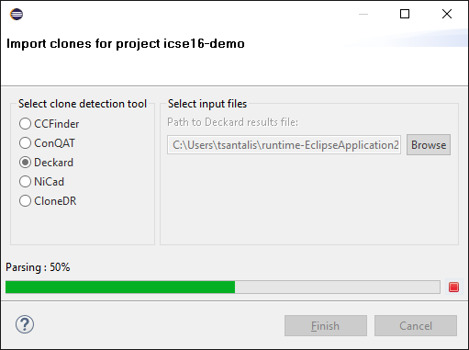
Clone import
Notes:
The import wizard checks if the clone fragments actually exist in the examined project.
And fixes the clone instances that are syntactically incomplete (e.g., missing closing brackets, incomplete statements)

Slide 9
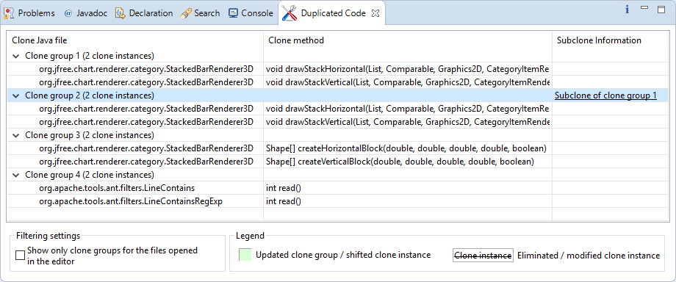
Subclone information
Notes:
Group A is a subclone of group B, if every clone instance in A is a subclone (i.e., a partial code fragment) of an instance in B.

Slide 10
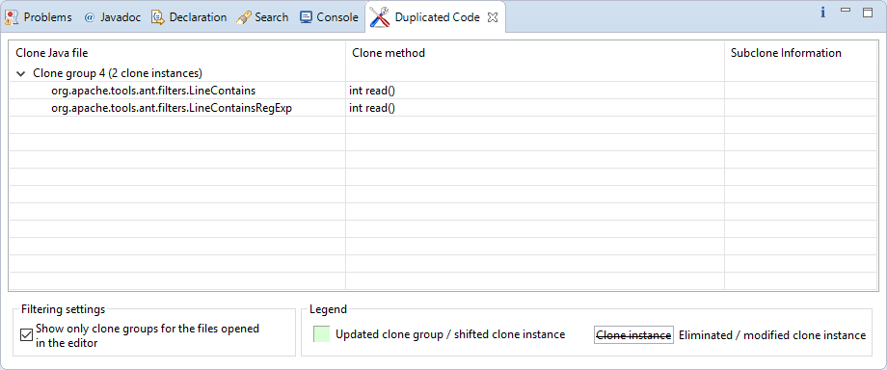
Clone filtering
Notes:
Group A is a subclone of group B, if every clone instance in A is a subclone (i.e., a partial code fragment) of an instance in B.

Slide 11
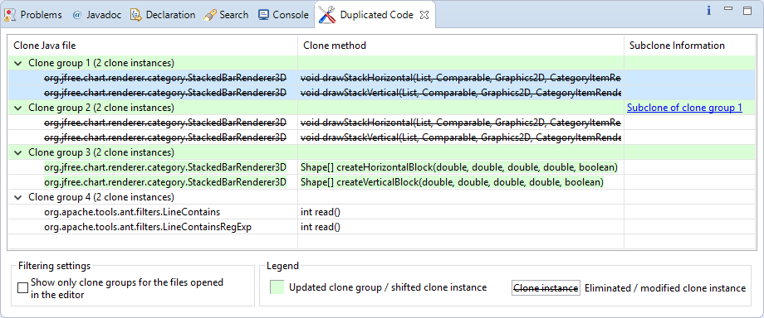
Clone monitoring

Slide 12
Clone Pair Visualization
features

Slide 13

Our approach
Assessing the Refactorability of Software Clones, IEEE TSE, Nov. 2015
common
nesting trees
differences
unmapped
statements
Control Structure
Matching
PDG
Mapping
Precondition
Examination

Slide 14
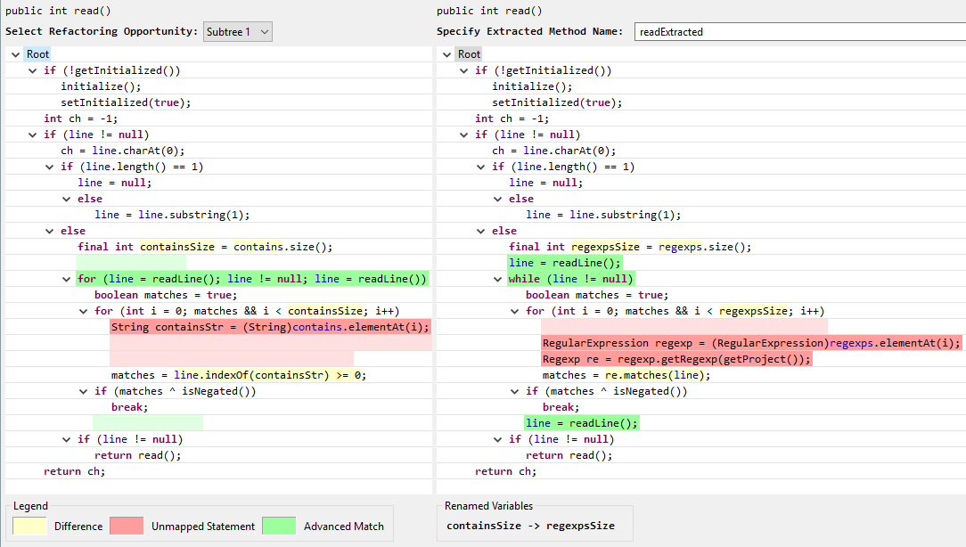
Clone pair visualization
Notes:
In yellow color, we highlight the differences between matched statements.
In red color, we highlight the statements that could not be matched.
In green color we highlight semantically equivalent statements (statement having a different AST structure, but identical functionality)

Slide 15
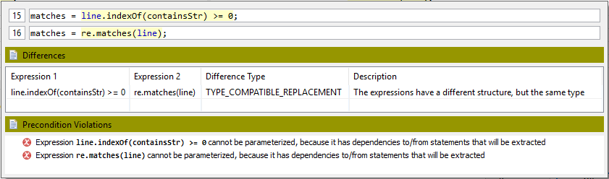
Semantic tooltips

Slide 16
Renamed variables

Slide 17
Clone Pair Refactoring
features

Slide 18
Automatic clone refactoring
Based on the location of the clones, the best refactoring strategy is automatically determined
Extract Method (same file)
Pull Up Method (common superclass)
  Template Method (clones call local methods)
  Extract Superclass (external common superclass)
Introduce Utility Method (static clones)

Slide 19
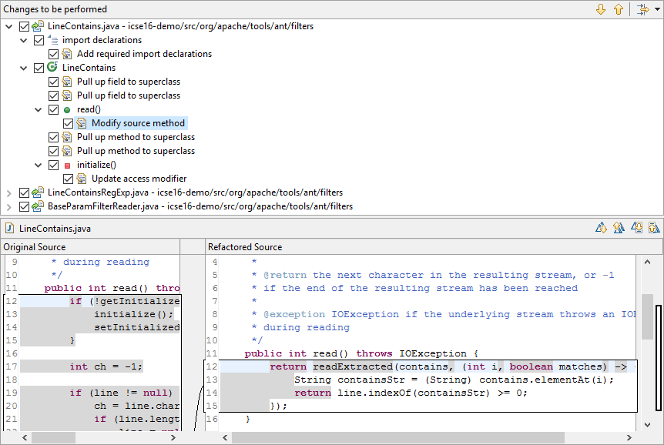
Refactoring Preview

Slide 20
Future work
Support multi-clone refactoring (>2 clones)
Explore lambda expressions
Automated refactoring engine testing

Slide 21

Visit our project at
http://jdeodorant.org

Slide 22
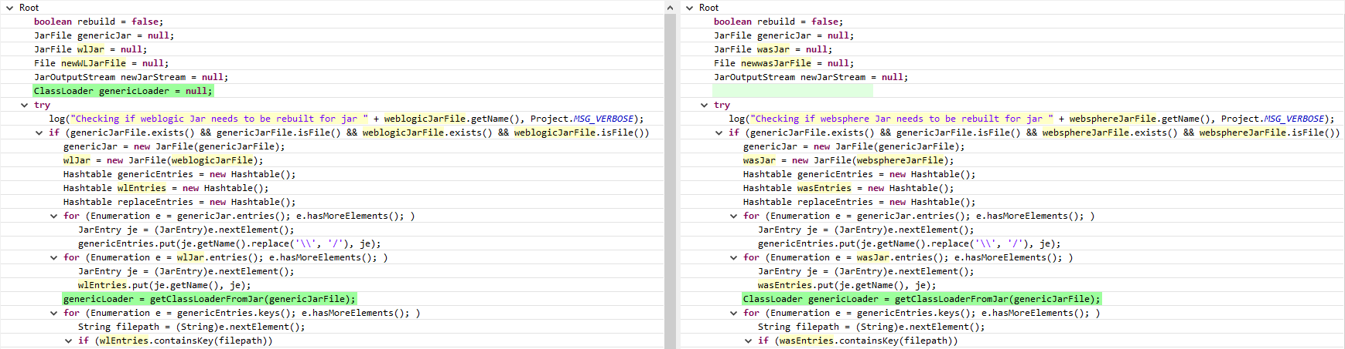
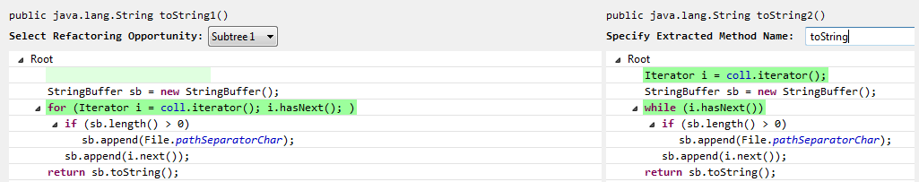
Advanced matches

Slide 23
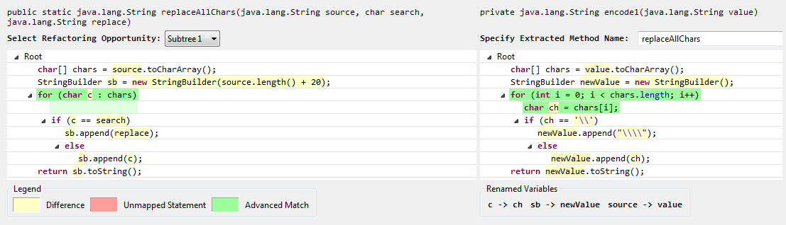
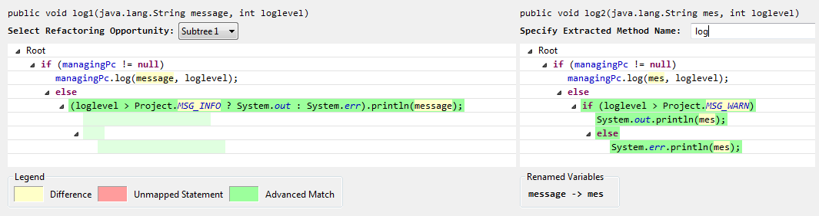
Advanced matches

