Slide 1
Clone Refactoring with Lambda Expressions
Nikolaos Tsantalis Davood Mazinanian Shahriar Rostami
May 24, 2017

Slide 2
Motivation
Studied 1M+ clones detected by 4 clone detectors in 9 open-source projects [Tsantalis et al., TSE 2015]
94% of the clones are either Type-2 or Type-3
Out of those, only 14% could be safely refactored

Slide 3
Because
The clones have differences that cannot be parameterized with regular parameters.
Method calls or object instantiations (side-effects)
Unmatched statements
public void testGetFirstMillisecond() {
Locale saved = Locale.getDefault();
Locale.setDefault(Locale.UK);
TimeZone savedZone = TimeZone.getDefault();
TimeZone.setDefault(TimeZone.getTimeZone("London"));
assertEquals( , d.getFirstMillisecond());
Locale.setDefault(saved);
TimeZone.setDefault(savedZone);
}
public void testGetFirstMillisecond() {
Locale saved = Locale.getDefault();
Locale.setDefault(Locale.UK);
TimeZone savedZone = TimeZone.getDefault();
TimeZone.setDefault(TimeZone.getTimeZone("London"));
assertEquals( , h.getFirstMillisecond());
Locale.setDefault(saved);
TimeZone.setDefault(savedZone);
}
Day d = new Day(1, 3, 1970);
Hour h = new Hour(15, 1, 4, 2006);
5094000000L
114390000000L

Slide 4
Regular parameters
public void testGetFirstMillisecond() {
extracted( , );
}
public void testGetFirstMillisecond() {
extracted( , );
}
new Day(1, 3, 1970)
5094000000L
new Hour(15, 1, 4, 2006)
114390000000L
public void extracted( , long arg1) {
Locale saved = Locale.getDefault();
Locale.setDefault(Locale.UK);
TimeZone savedZone = TimeZone.getDefault();
TimeZone.setDefault(TimeZone.getTimeZone("London"));
assertEquals( , p.getFirstMillisecond());
Locale.setDefault(saved);
TimeZone.setDefault(savedZone);
}
RegularTimePeriod arg0
RegularTimePeriod p = arg0;
arg1

Slide 5
Lambda parameters
public void testGetFirstMillisecond() {
extracted( , );
}
public void testGetFirstMillisecond() {
extracted( , );
}
()-> new Day(1, 3, 1970)
5094000000L
()-> new Hour(15, 1, 4, 2006)
114390000000L
public void extracted( , long arg1) {
Locale saved = Locale.getDefault();
Locale.setDefault(Locale.UK);
TimeZone savedZone = TimeZone.getDefault();
TimeZone.setDefault(TimeZone.getTimeZone("London"));
assertEquals( , p.getFirstMillisecond());
Locale.setDefault(saved);
TimeZone.setDefault(savedZone);
}
Supplier<RegularTimePeriod> arg0
RegularTimePeriod p = arg0.get();
arg1

Slide 6
Contributions
Method assessing if two clones can be refactored with Lambda expressions.
Eclipse plug-in automating the method
Refactoring implementation
Study 46K+ clones (Lambda refactorability)
Dataset and tools publicly available

Slide 7
Approach in a Nutshell
Differences between two clones
input
Unification
output
Refactorable?

Slide 8
Input [Tsantalis et al., TSE 2015]
public int read() throws IOException {
if (!getInitialized()) {
initialize();
setInitialized(true);
}
int ch = -1;
if (line != null) {
ch = line.charAt(0);
if (line.length() == 1) {
line = null;
} else {
line = line.substring(1);
}
} else {
final int size = contains.size();
for (line = readLine(); line != null; line = readLine()) {
boolean matches = true;
for (int i = 0; matches && i<size; i++) {
matches =
}
if (matches ^ isNegated()) {
break;
}
}
if (line != null) {
return read();
}
}
return ch;
}
public int read() throws IOException {
if (!getInitialized()) {
initialize();
setInitialized(true);
}
int ch = -1;
if (line != null) {
ch = line.charAt(0);
if (line.length() == 1) {
line = null;
} else {
line = line.substring(1);
}
} else {
final int size = regexps.size();
for (line = readLine(); line != null; line = readLine()) {
boolean matches = true;
for (int i = 0; matches && i<size; i++) {
matches =
}
if (matches ^ isNegated()) {
break;
}
}
if (line != null) {
return read();
}
}
return ch;
}
String containsStr = (String)contains.elementAt(i);
RegularExpression regexp =
(RegularExpression)regexps.elementAt(i);
Regexp re = regexp.getRegexp(getProject());
line.indexOf(containsStr)>=0;
re.matches(line);

Slide 9
Unification principle
Two code fragments can be abstracted into a common functional interface if they:
Have same input parameter types
Have same output type
Throw same exception types
Unification Strategy
Starting from two differences, we perform:
Backward expansion, until input is the same
Forward expansion, until output is the same

Slide 10
Input: int i
Input: int i
Output: String containsStr
Output: Regexp re
public int read() throws IOException {
if (!getInitialized()) {
initialize();
setInitialized(true);
}
int ch = -1;
if (line != null) {
ch = line.charAt(0);
if (line.length() == 1) {
line = null;
} else {
line = line.substring(1);
}
} else {
final int size = contains.size();
for (line = readLine(); line != null; line = readLine()) {
boolean matches = true;
for (int i = 0; matches && i<size; i++) {
matches = line.indexOf(containsStr)>=0;
}
if (matches ^ isNegated()) {
break;
}
}
if (line != null) {
return read();
}
}
return ch;
}
public int read() throws IOException {
if (!getInitialized()) {
initialize();
setInitialized(true);
}
int ch = -1;
if (line != null) {
ch = line.charAt(0);
if (line.length() == 1) {
line = null;
} else {
line = line.substring(1);
}
} else {
final int size = regexps.size();
for (line = readLine(); line != null; line = readLine()) {
boolean matches = true;
for (int i = 0; matches && i<size; i++) {
matches = re.matches(line);
}
if (matches ^ isNegated()) {
break;
}
}
if (line != null) {
return read();
}
}
return ch;
}
String containsStr = (String)contains.elementAt(i);
RegularExpression regexp =
(RegularExpression)regexps.elementAt(i);
Regexp re = regexp.getRegexp(getProject());

Slide 11
Input: int i
Input: int i
Output: boolean matches
Output: boolean matches
public int read() throws IOException {
if (!getInitialized()) {
initialize();
setInitialized(true);
}
int ch = -1;
if (line != null) {
ch = line.charAt(0);
if (line.length() == 1) {
line = null;
} else {
line = line.substring(1);
}
} else {
final int size = contains.size();
for (line = readLine(); line != null; line = readLine()) {
boolean matches = true;
for (int i = 0; matches && i<size; i++) {
}
if (matches ^ isNegated()) {
break;
}
}
if (line != null) {
return read();
}
}
return ch;
}
public int read() throws IOException {
if (!getInitialized()) {
initialize();
setInitialized(true);
}
int ch = -1;
if (line != null) {
ch = line.charAt(0);
if (line.length() == 1) {
line = null;
} else {
line = line.substring(1);
}
} else {
final int size = regexps.size();
for (line = readLine(); line != null; line = readLine()) {
boolean matches = true;
for (int i = 0; matches && i<size; i++) {
}
if (matches ^ isNegated()) {
break;
}
}
if (line != null) {
return read();
}
}
return ch;
}
String containsStr = (String)contains.elementAt(i);
matches = line.indexOf(containsStr)>=0;
RegularExpression regexp =
(RegularExpression)regexps.elementAt(i);
Regexp re = regexp.getRegexp(getProject());
matches = re.matches(line);

Slide 12
Lambda parameterization
protected int extracted(Vector vector,
) throws IOException {
if (!getInitialized()) {
initialize();
setInitialized(true);
}
int ch = -1;
if (line != null) {
ch = line.charAt(0);
if (line.length() == 1) {
line = null;
} else {
line = line.substring(1);
}
} else {
final int size = vector.size();
for (line = readLine(); line != null; line = readLine()) {
boolean matches = true;
for (int i = 0; matches && i<size; i++) {
}
if (matches ^ isNegated()) {
break;
}
}
if (line != null) {
return read();
}
}
return ch;
}
Function<Integer, Boolean> matcher
matches = (boolean)matcher.apply(i);

Slide 13
Evaluation
Correctness (compilation errors, behavior preservation)
Applicability (location, clone type, Template Method)
Characteristics (number, size, functional interface types)

Slide 14
RQ1. Correctness
Refactored 12.6K clones assessed as Lambda parameterizable and covered by unit tests.
Executed the entire test suite after each refactoring
JFreeChart test suite (less than 10 seconds)
Zero compilation errors
One test failure

Slide 15
RQ2. Applicability
Analyzed 46.7K Type-2 & Type-3 clones from 9 projects
non-refactorable with regular parameters
60% Type-2 (differences in expressions)
40% Type-3 (unmatched statements a.k.a. clone gaps)
Clone source code Location
58% lambda applicability
72% in test clones
51% in production clones
Clone Type
57% applicability in Type-2 clones
60% applicability in Type-3 clones

Slide 16
RQ2. Applicability
Template Method pattern alternative to Lambdas
clones extracted to a new or existing abstract superclass
Template Method can be used as an alternative in only $1/3$ of the cases refactored with Lambda expressions
Clones existing in the same class, or classes without common superclass
Existing common superclass cannot be made abstract, because it is instantiated or has other subclasses

Slide 17
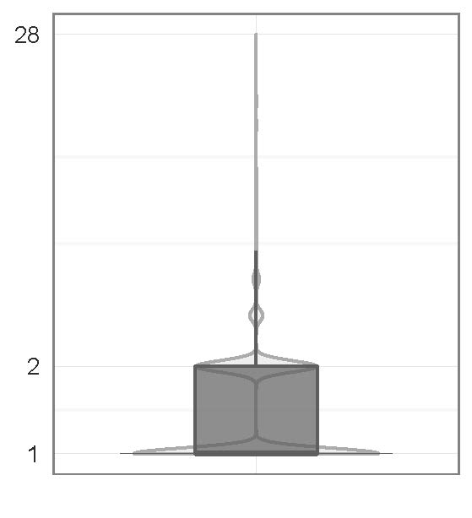
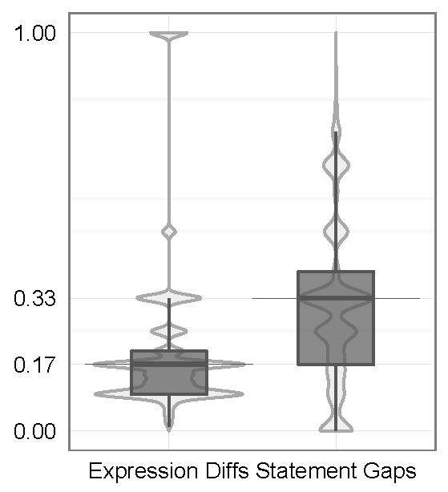
RQ3. Characteristics
Analyzed 27.2K refactored clones
Number of lambda expressions
Relative size of lambda expression to clone fragment
Functional interface types
Number of Lambdas
Relative Lambda Size

Slide 18
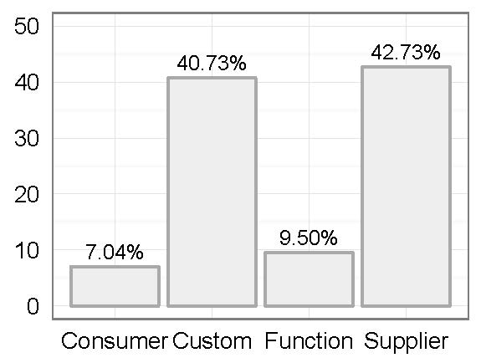
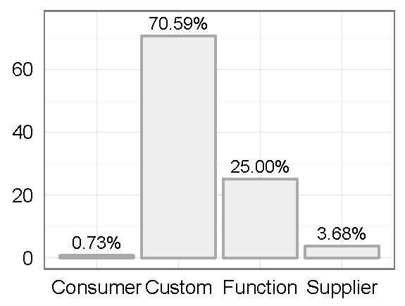
RQ3. Characteristics
Built-in functional interfaces
Function<T,R>
Supplier<T>
Consumer<T>
Actual functional interface types
Custom types break-down

Slide 19
Take-home message
Lambdas are very effective for parameterizing clones with behavioral differences, esp. test clones
Lambdas are equally beneficial for parameterizing Type-2 and Type-3 clones
The vast majority of clones require one or two Lambdas
60% of the Lambdas can be parameterized using just three of the Java built-in functional interface types
If these functional interface types supported exception throwing, 72% of the clones could be parameterized with built-in functional interfaces

Slide 20
http://tiny.cc/ICSE17
https://github.com/tsantalis/JDeodorant
https://github.com/tsantalis/jdeodorant-commandline

