Slide 1
Are Refactorings to Blame? An Empirical Study of Refactorings in Merge Conflicts
Mehran Mahmoudi
Sarah Nadi
Nikolaos Tsantalis
mehran@ualberta.ca
nadi@ualberta.ca
tsantalis@cse.concordia.ca
Hangzhou, China
SANER ‘19

Slide 2
Version Control Systems
Keep track of the software development history
Became more popular with the rise of distributed software development
Offer practices that facilitate collaborative software development
Notes:
The use of version control systems is prevalent, because

Slide 3
Branching
Developers create multiple branches to apply their changes in parallel
A branch is an instance of the source code
Reasons: isolate development tasks (e.g., bug fixes, new features)
Image credit: scandio.de
Notes:
Branching is a common practice in team development

Slide 4
Merging
Developers need to merge their changes with the rest of the team’s work
We refer to these situations as a merge scenarios
Notes:
Eventually, developers need to merge their changes

Slide 5
Merge Conflicts
Merge conflicts may arise, because of inconsistent changes to the code
16% of merge scenarios lead to conflicts¹
Developers have to resolve such conflicts before proceeding
Wastes their time and distracts them from their main tasks
1. Y. Brun, R. Holmes, M. D. Ernst, and D. Notkin, “Proactive detection of collaboration conflicts,” ESEC/FSE 2011

Slide 6
Refactoring
Code transformations made to the internal structure of software
Makes it easier to understand and cheaper to modify
Used to enhance software reusability, modularity, extensibility, and maintainability
There are more than 70 types of refactorings¹
1. M. Fowler, Refactoring: Improving the Design of Existing Code, 1999

Slide 7
Refactoring
Some common refactorings:
Moving a class, renaming an attribute, extracting a method
refactoring.guru
Extract Method Example

Slide 8
Refactoring can cause merge conflicts

Slide 9
Foo.java
Base
FooHelper.java
Alice
...
foo() {
int x = getX();
int y = getY();
calcDist(x, y);
}
...
...
+foo() {
+ int x = getX();
+ int y = getY();
+ calcDist(x, y);
+}
...
Foo.java
Bob
Foo.java
Alice
...
foo() {
int x = getX();
+ x += 2;
int y = getY();
calcDist(x, y);
}
...
...
-foo() {
- int x = getX();
- int y = getY();
- calcDist(x, y);
-}
...
Foo.java
Merged Version
...
++<<<<<<< refs/bob
+foo() {
+ int x = getX();
+ x+= 2;
+ int y = getY();
+ calcDist(x, y);
+}
++=======
++>>>>>>> refs/alice
...
Notes:
Why Textual merge doesn’t work for refactorings

Slide 10
Motivation
Dig et al.¹ proposed a refactoring-aware merging technique:
Revert refactoring operations
Perform textual merge
Re-apply refactoring operations
They never evaluated their technique in a large scale
Their method can be problematic for some refactoring types (e.g. Extract Method)
1. D. Dig, K. Manzoor, R. Johnson, and T. N. Nguyen, “Refactoring-aware configuration management for object-oriented programs,” in Proceedings of the 29th International Conference on Software Engineering, 2007.

Slide 11
Motivation
Refactorings can be problematic, however…
How often refactorings cause conflicts?
Do refactorings actually result in more complex conflicts?
How effective is the refactoring-aware merging technique proposed by Dig et al.?
Understanding this relationship on a large-scale is important to drive researchers’ efforts in the right direction

Slide 12
Study Overview
Analyzed about 3,000 well-engineered open-source Java repositories
Used the state-of-the-art refactoring detection tool, RefactoringMiner
Tracked conflict-inducing code changes
Determined whether refactorings were involved in conflicts

Slide 13
Research Questions
RQ1. Do merge conflicts often involve refactored code?
RQ2. Are conflicts that involve refactoring more difficult to resolve?
RQ3. What types of refactoring are more commonly involved in conflicts?

Slide 14
Methodology
Refactorings and Merge Conflicts

Slide 15
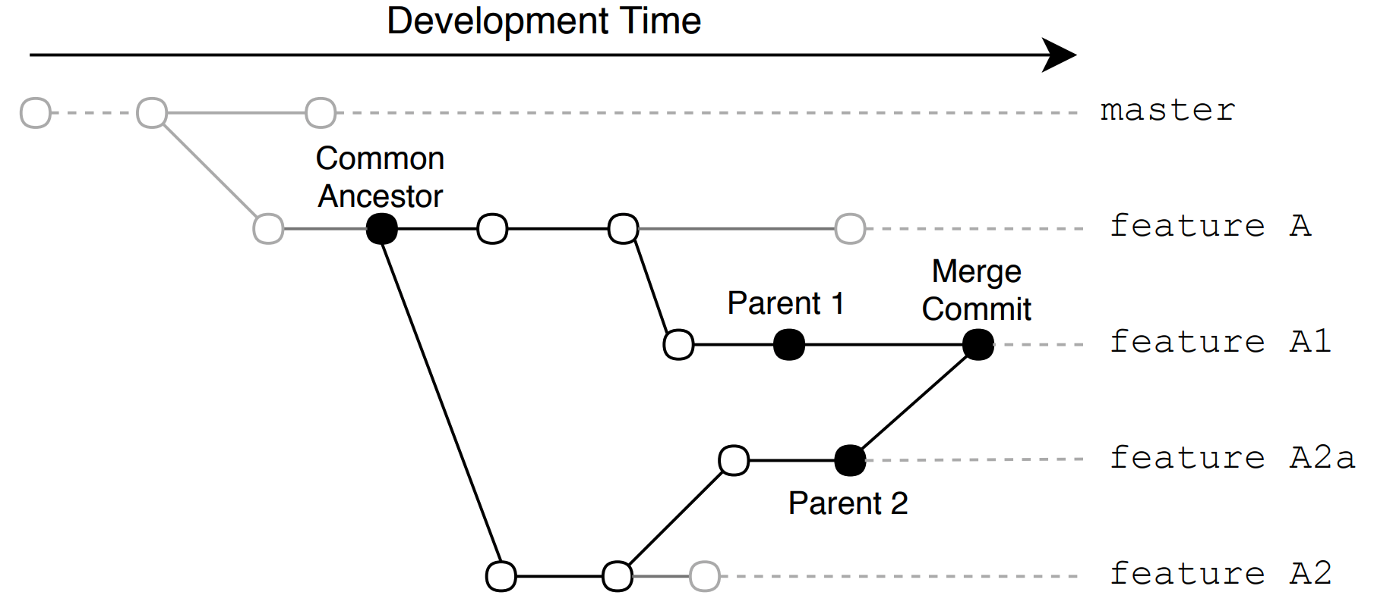
Terminology
A Merge Scenario

Slide 16
Step 1. Detecting Conflicting Regions
We detect all merge scenarios using Git history
We replay the merge scenario using the following commands:
git checkout P1
git merge P2
If conflicting, git diff will output all conflicting regions
We record the information to the database

Slide 17
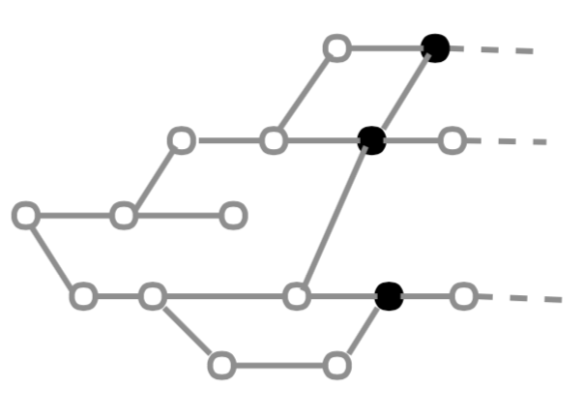
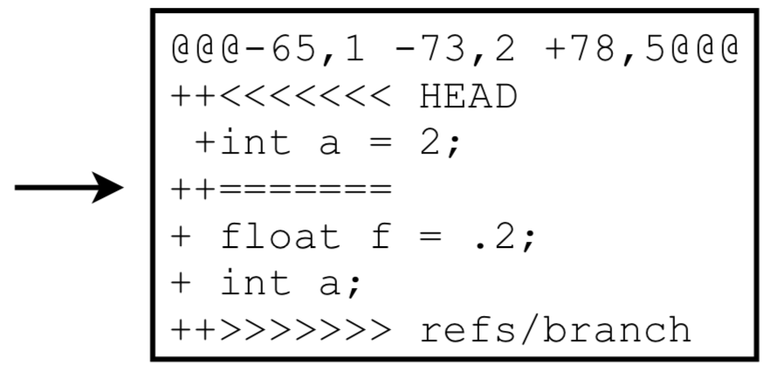
Step 1. Detecting Conflicting Regions
Find merge commits
Find conflicting regions
Notes:
The first pair of numbers corresponds to the region in P1, while the second pair corresponds to P2. The third pair of numbers is the conflicting region in the conflicting merged file with the markers

Slide 18
Step 2. Detecting Evolutionary Changes
For each conflicting region, we detect all commits that have touched this region
We call those commits evolutionary commits
We use the following commands:
git log -L start_{P1},end_{P1}:file P2..P1
git log -L start_{P2},end_{P2}:file P1..P2
We save the code range information for each change to the database

Slide 19
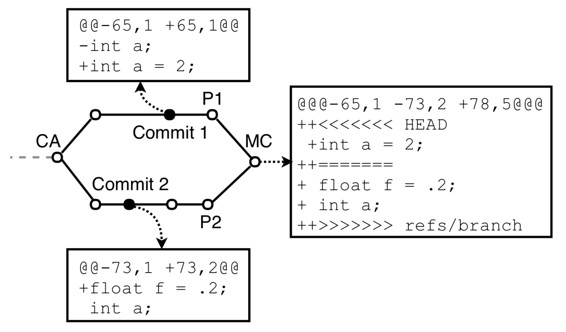
Step 2. Detecting Evolutionary Changes

Slide 20
Step 3. Detecting Refactorings
We use RefactoringMiner¹ in all of evolutionary commits
We record the types and code regions of each refactoring to the database
1. N. Tsantalis, M. Mansouri, L. M. Eshkevari, D. Mazinanian, and D. Dig, “Accurate and efficient refactoring detection in commit history,” in Proceedings of the 40th International Conference on Software Engineering, 2018

Slide 21
Step 4. Detecting Involved Refactorings
We use the code range information for refactorings and evolutionary changes
If there is an intersection between a refactoring and an evolutionary change, we call that refactoring an involved refactoring

Slide 22
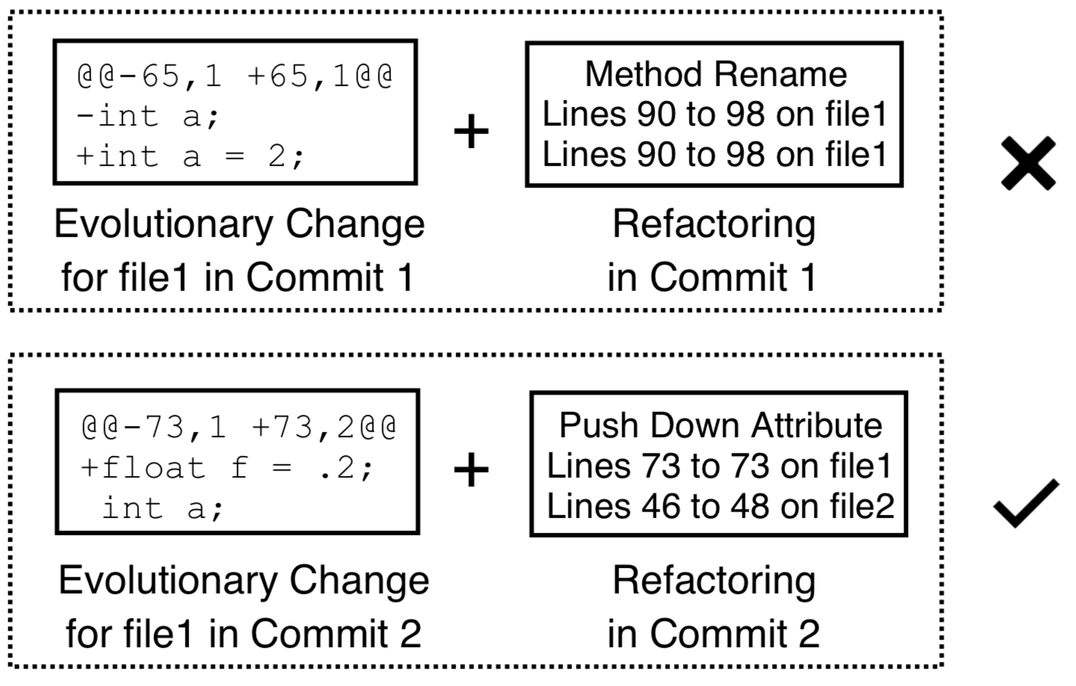
Step 4. Detecting Involved Refactorings
Involved
Refactoring

Slide 23
Results
Refactorings and Merge Conflicts

Slide 24
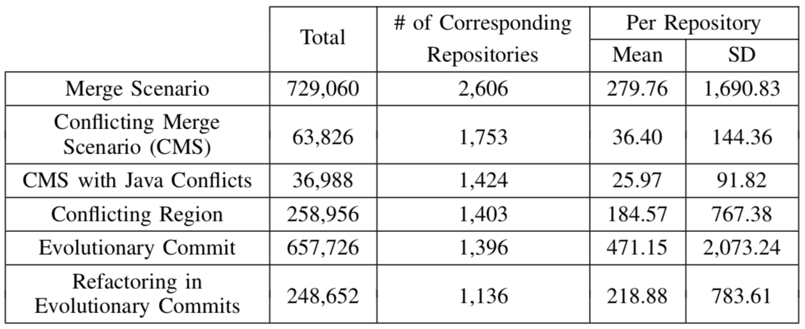
Overview of Extracted Data

Slide 25
RQ1. Do merge conflicts often involve refactored code?
22% of conflicting merge scenarios involve refactorings (8,155 / 36,988)
11% of conflicting regions have at least one involved refactoring (28,670 / 258,956)
When resolving merge conflicts, practitioners’ top needs include¹:
Tools to help them explore the project history
A Refactoring Explorer tool will be very useful in resolving merge conflicts
1. S. McKee, N. Nelson, A. Sarma, and D. Dig, “Software practitioner perspectives on merge conflicts and resolutions”

Slide 26
RQ2: Are conflicts that involve refactoring more difficult to resolve?
We use two proxies for measuring the difficulty of a merge conflict:
The size of conflicting region
The number of evolutionary commits
Notes:
Give intuition why these matter

Slide 27
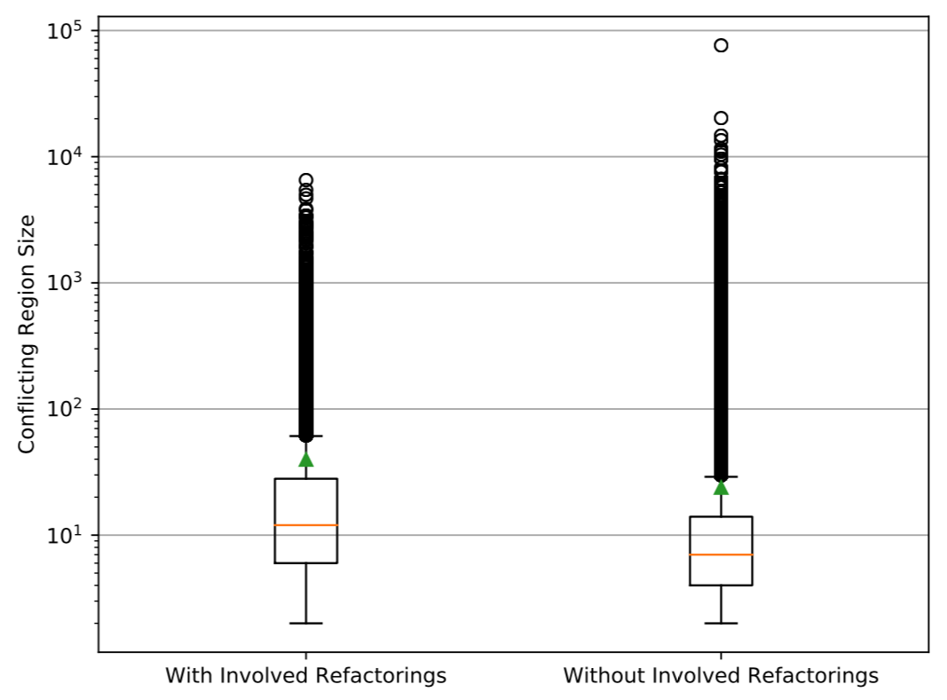
RQ2: Are conflicts that involve refactoring more difficult to resolve?
Conflicting region size with and without involved refactorings
Notes:
The mean and median for conflicting regions with involved refactorings are 39.63 and 12 respectively.
The same values are lower for conflicting regions without involved refactorings, with a mean and median of 26.63 and 7, respectively.
The unpaired Wilcoxon rank-sum test shows that these distributions are statistically different (p-value = 0.00)
A 95% confidence interval for the difference between the two population medians is between 3 and infinity, suggesting that the median of the size of conflicting regions with involved refactorings is at least 3 lines larger than the median size of the remaining conflicting regions.

Slide 28
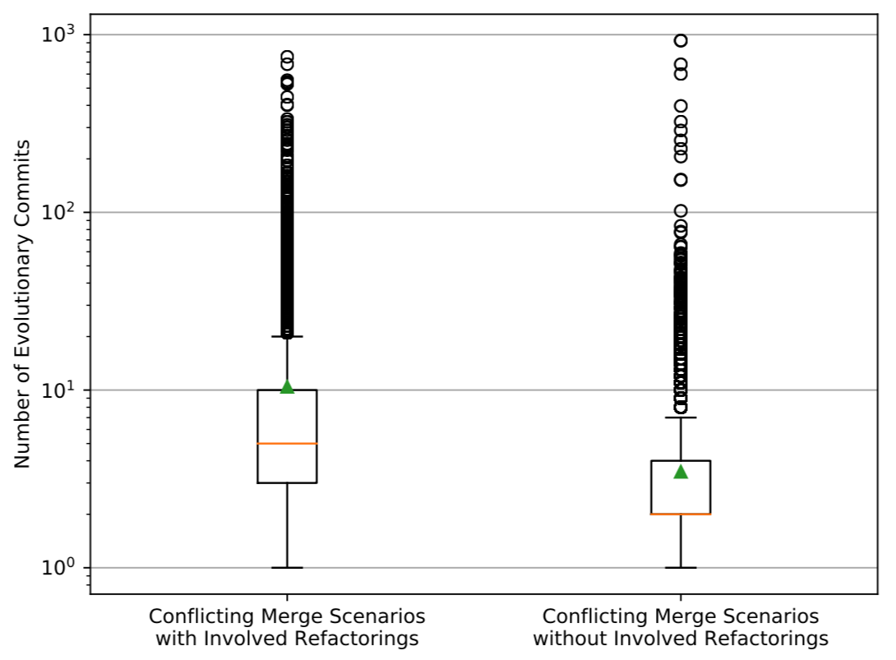
RQ2: Are conflicts that involve refactoring more difficult to resolve?
Evolutionary commits per merge scenario
Notes:
Conflicting merge scenarios with involved refactorings have a larger number of evolutionary commits (median: 5, mean: 10.43)
compared to conflicting merge scenarios with no involved refactoring changes (median: 2, mean: 3.46).
Furthermore, the Wilcoxon rank-sum test shows that this difference is significant (p-value = 0.00).

Slide 29
RQ3: What types of refactoring are more commonly involved in conflicts?
Refactoring types occur with different frequencies
If a refactoring type occurs frequently in general, it is more likely to occur frequently in conflicts.
We compare the “overall” percentage-distribution of refactorings types with the percentage-distribution of refactoring types for refactorings involved in conflicts
Notes:
Refactoring types occur with different frequencies. As a result, we cannot take the raw frequency of refactoring types to determine which refactoring types participate more in conflicts. If a refactoring type occurs frequently in general, it is more likely to occur frequently in conflicts.

Slide 30
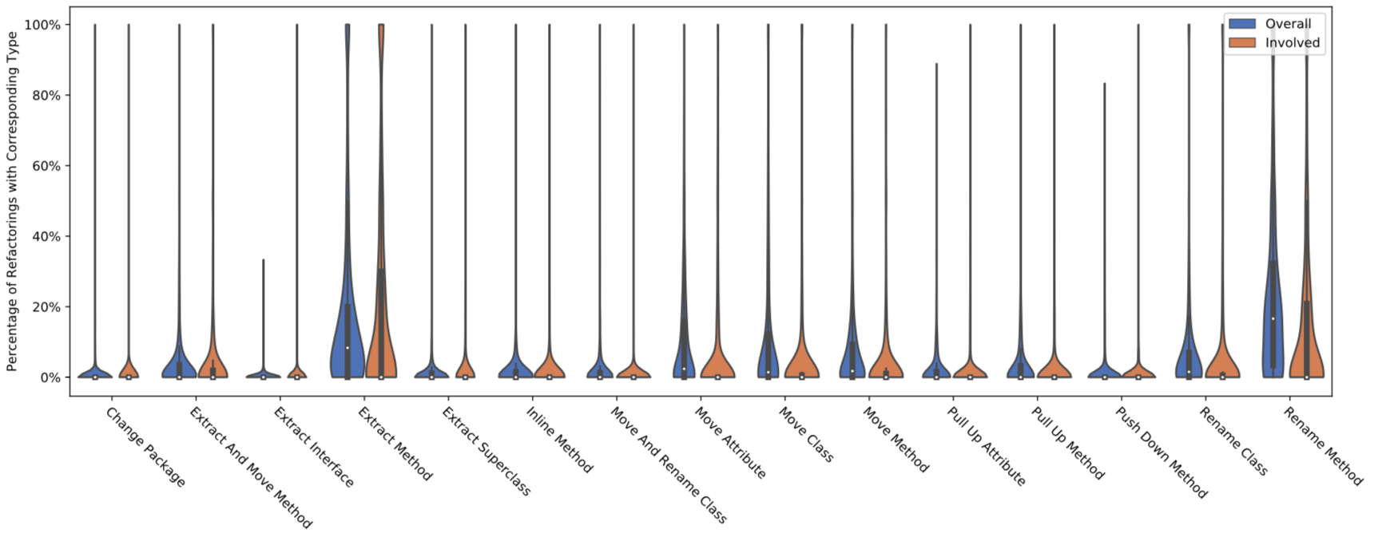
RQ3: What types of refactoring are more commonly involved in conflicts?
We compare the pair of percentage-distributions for each refactoring type,
to find if a particular refactoring type is more involved in conflicts than its typical frequency.
Notes:
In blue color, we see the overall percentage-distribution of refactoring types. As you can see, Extract Method and Rename Method occur more frequently. In orange color, we see the percentage-distribution of refactoring types when taking into account only refactorings involved in conflicts. By comparing the pair of percentage-distributions for each refactoring type, we can find if a particular refactoring type is more involved in conflicts than its typical frequency.

Slide 31
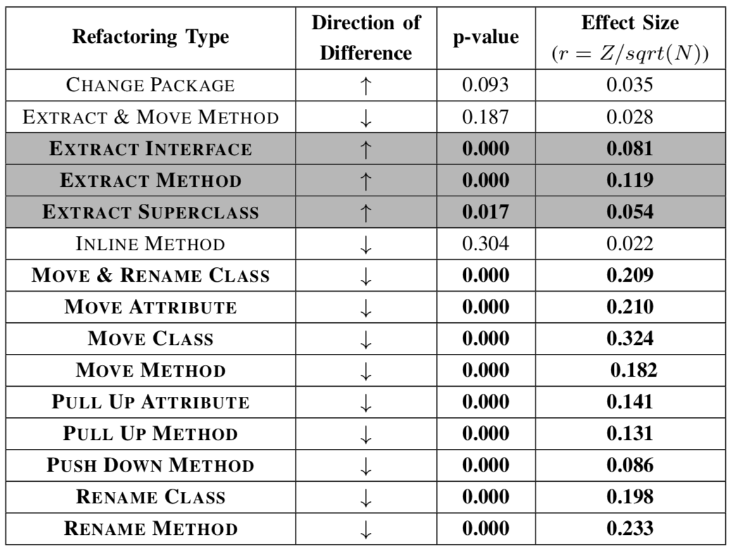
RQ3: What types of refactoring are more commonly involved in conflicts?
Notes:
two-sided paired Wilcoxon signed-rank test
r as small (≥ 0.1), medium (≥ 0.3), and large (≥ 0.5)
EXTRACT METHOD is more involved in conflicts than its typical overall frequency, with a small effect size.
EXTRACT INTERFACE and EXTRACT SUPERCLASS are also more involved in conflicts, but with negligible effect sizes.

Slide 32
Insights
Refactoring operations are involved in 22% of merge conflicts
Conflicts that involve refactorings are often more complex
Different refactoring types affect conflicts differently
Notes:
Empirical motivation for future research in refactoring-aware software merging
to understand the relationship between refactorings and merge conflicts

Slide 33
Contributions
An empirical study on almost 3,000 open-source Java repositories to investigate the role of refactoring operations in merge conflicts
A methodology for detecting refactorings in evolutionary changes that lead to merge conflicts
Open-source implementation of our methodology for both studies

Slide 34
Mehran Mahmoudi
mehran@ualberta.ca
Sarah Nadi
nadi@ualberta.ca
Nikolaos Tsantalis
tsantalis@cse.concordia.ca

