Slide 1
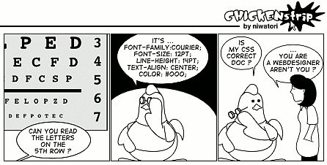
An Empirical Study of Duplication in Cascading Style Sheets
Davood Mazinanian, Nikolaos Tsantalis
Concordia University, Montreal

Slide 2
Outline
CSS: characteristics, syntax, usage
Three types of duplication in CSS
Detection of duplication in CSS
Results of the empirical study
Conclusions and future works

Slide 3
What's CSS
Definition
CSS is a domain specific language:
A styling language
CSS level 1 Recommendation was published in 1996 by W3C
It enabled the separation of concerns for the web
It made responsive design easy
By supporting different media types (screen, printer, handheld, etc)
And media queries in CSS3

Slide 4
Exploiting CSS
Pure CSS + HTML

Slide 5
CSS is widely used…
90 percent of web developers use CSS [w3techs.com, Mozilla survey]
Large number of CSS contributors in open source world [ohloh.net]
Mozilla survey results: What programming language do you use?

Slide 6
Syntax
No variables or functions…
So we may have duplication in value, declaration and selector level

Slide 7
CSS Development
Developers use server side languages (like PHP) or preprocessors
Easy CSS generation using variables and functions
SASS, LESS, Google Closure Stylesheets, etc.
They have their own syntax
But the generated CSS files still have significant duplication
@nice-blue: #5B83AD;
@light-blue: (@nice-blue + #111);
#header { color: @light-blue; }
#header { color: #6c94be; }
LESS
CSS

Slide 8
CSS Tools
Static validators
W3C validator
Removing unused CSS
Tools (dust-me-selectors Firefox add-on, etc.)
Academic papers (CILLA, Tree logics)
Removing duplication
Tools (CSSCSS, CSS purge, etc.)
They support trivial types of duplication!
CSS maintenance cannot be considered as a disciplined and systematic practice.

Slide 9
Our goal
Short term
Detect non-trivial duplications in the CSS files
And eventually refactor them
Long term
Improve the state of the art of the CSS maintenance

Slide 10
Our motivation
Why duplication in CSS is bad?
Maintenance
In the case of changes due to new requirements, all instances off duplicated code should be found and updated
Inconsistent updates lead to inconsistent presentation
Efficiency
Waste of bandwidth and slower download / upload time
Increased computation cost for the processing of CSS files by web browsers

Slide 11
Types of duplications
We defined Three types of declaration duplication

Slide 12
TYPE I
Gmail’s main CSS file had more than 18000 LOC, when formatted
There are 23 repeated declarations for three different selectors!
.z-b-ua { /* 17972 */
…
color: #fff;
cursor: default;
font-size: 11px;
font-weight: bold;
text-align: center;
white-space: nowrap;
border: 1px solid transparent;
border-radius: 2px;
…
transition-duration: .218s;
…
.z-b-ga { /* 16871 */
…
color: #fff;
cursor: default;
font-size: 11px;
font-weight: bold;
text-align: center;
white-space: nowrap;
border: 1px solid transparent;
border-radius: 2px;
…
transition-duration: .218s;
…
Declarations with the lexically same property and values.

Slide 13
TYPE II
.iF9mle { /* 8742 */
…
background: white;
…
}
.c-S-aa { /* 14120 */
…
background: #fff;
…
}
Declarations with the:
Same properties with equivalent values
Or same properties with missing default values that are implied.
.c-i { /* 18213 */
…
-webkit-transition: opacity .218s;
transition: opacity .218s;
…
}
.kz { /* 10691 */
…
-webkit-transition: opacity .218s ease;
transition: opacity .218s ease
}

Slide 14
TYPE III
.qfacj { /* 8723 */
…
border-style: solid;
border-width: 1px;
border-color: #ccc;
…
}
Individual declarations
Set of individual declarations, and the equivalent shorthand declaration in another selector
.c-i { /* 18213 */
…
border: 1px solid #ccc;
…
}
Shorthand declaration

Slide 15
Method
Parsing CSS
We enhanced Flute CSS parser (from W3C) to comply with CSS3
Parse CSS to a simple but effective model
Detect duplications from it,
Map it to the HTML document
Refactor the CSS using it (in the future)
Format CSS code using it,
Compare Stylesheets
And many more…

Slide 16
Method
Preprocessing of declarations
For type II
Replacing all values which have different representation with reference values
For type III
Creating new shorthand declarations for individual declarations (virtual shorthand declarations)
Detection
Pairwise comparison of all declarations in the model, considering order of values

Slide 17
Grouped selectors
It is possible for two or more selectors to have more than one declaration in common. In these cases we might be able to use CSS grouping to eliminate duplication
.Selector_A {
color: #fff;
cursor: default;
font-size: 11px;
font-weight: bold;
}
.Selector_A, .Selector_B {
color: #fff;
cursor: default;
font-size: 11px;
font-weight: bold;
}
.Selector_B {
color: #fff;
cursor: default;
font-size: 11px;
font-weight: bold;
}

Slide 18
Data mining metaphor
Lets consider:
CSS file is a transaction database,
Every selector is a transaction,
Every declaration is an item
.Selector_A {
color: #fff;
cursor: default;
font-size: 11px;
}
Transaction ID | Items
Selector_A | color: #fff; cursor: default; font-size: 11px;
Selector_B | color: #fff; font-size: 11px; font-weight: bold;
.Selector_B {
color: #fff;
font-size: 11px;
font-weight: bold;
}

Slide 19
Frequent Itemset generation
Applying the first phase in association rule mining
Generate every set of items (declarations) which appear together in more than a specific number (the support count) of transactions (selectors)
We are interested in the group of declarations which appear in at least 2 selectors

Slide 20
Frequent itemset generation
.Selector_A {
color: #fff;
cursor: default;
font-size: 11px;
}
Transaction ID | Items
.Selector_A | color: #fff; cursor: default; font-size: 11px;
.Selector_B | color: #fff; font-size: 11px; font-weight: bold;
Frequent Itemset | Support
{ color: #fff, font-size: 11px; } | .Selector_A, .Selector_B
.Selector_B {
color: #fff;
font-size: 11px;
font-weight: bold;
}

Slide 21
Frequent itemset generation
Apriori algorithm
Generates every possible combination of items
For every combination, checks the database to see whether it is frequent
Eclat algorithm
It is using previous results to compute the support count of new itemsets
Eclat and Apriori may lead to combinatorial explosion, due to the low support count (2)
Gmail is an example (3 selectors had 23 declarations in common)
FP-Growth algorithm
Creates a tree, in which the nodes are items and paths represent all itemsets along with their frequency
Uses the tree to compute frequent itemsets
Doesn’t generate every possible combination of items in the search space
Notes:
Eclat uses set intersection…

Slide 22
Empirical Study
Data:
199 CSS files from 28 Open source web systems
Mostly content management systems
183 CSS files collected from top websites
from top 50 Alexa websites
Using Crawljax
Notes:
Extracted by crawler

Slide 23
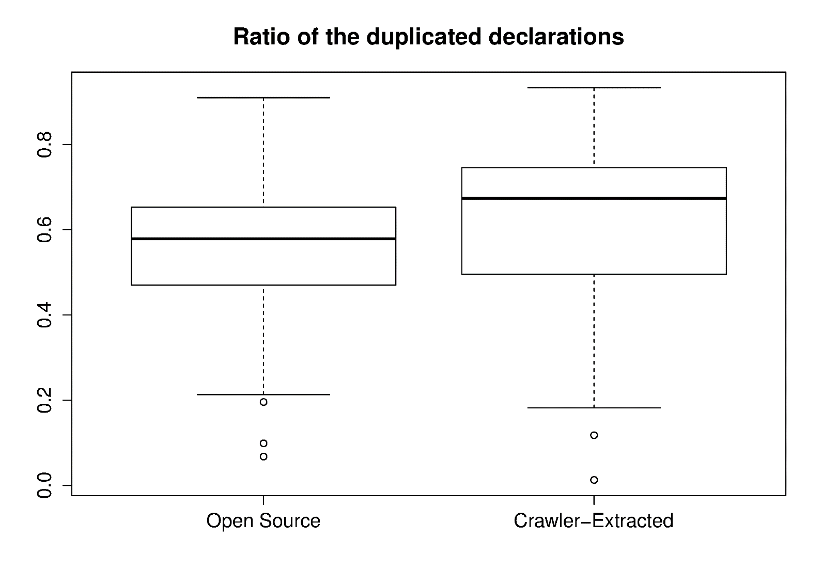
Duplication at declaration level
About 60% of declarations are duplicated

Slide 24
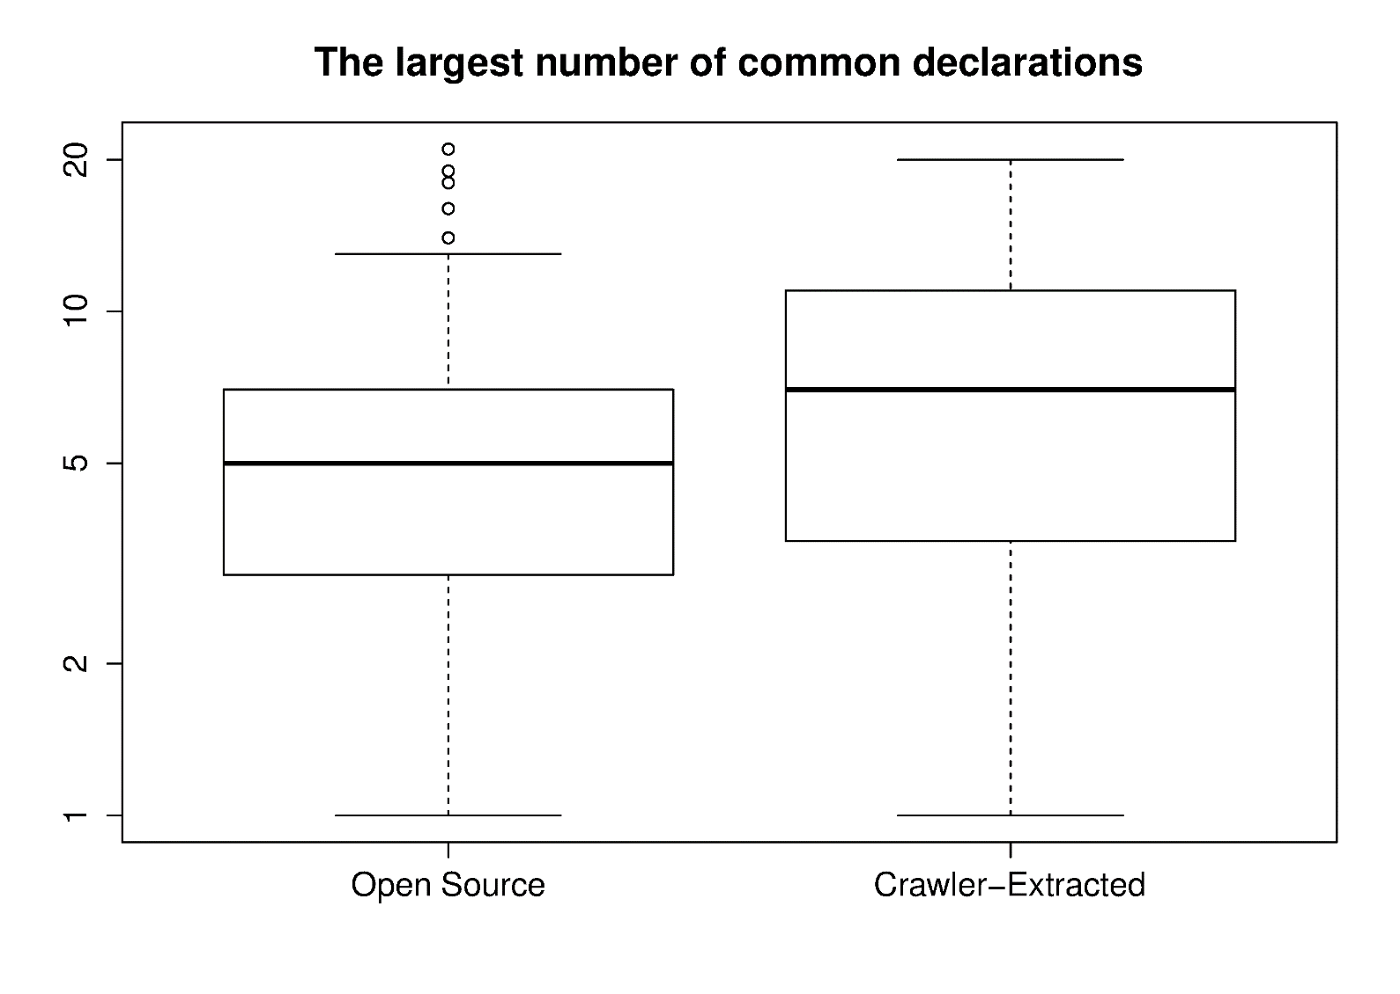
Largest duplications
The median of the largest number of common declarations is 5 and 7 respectively

Slide 25
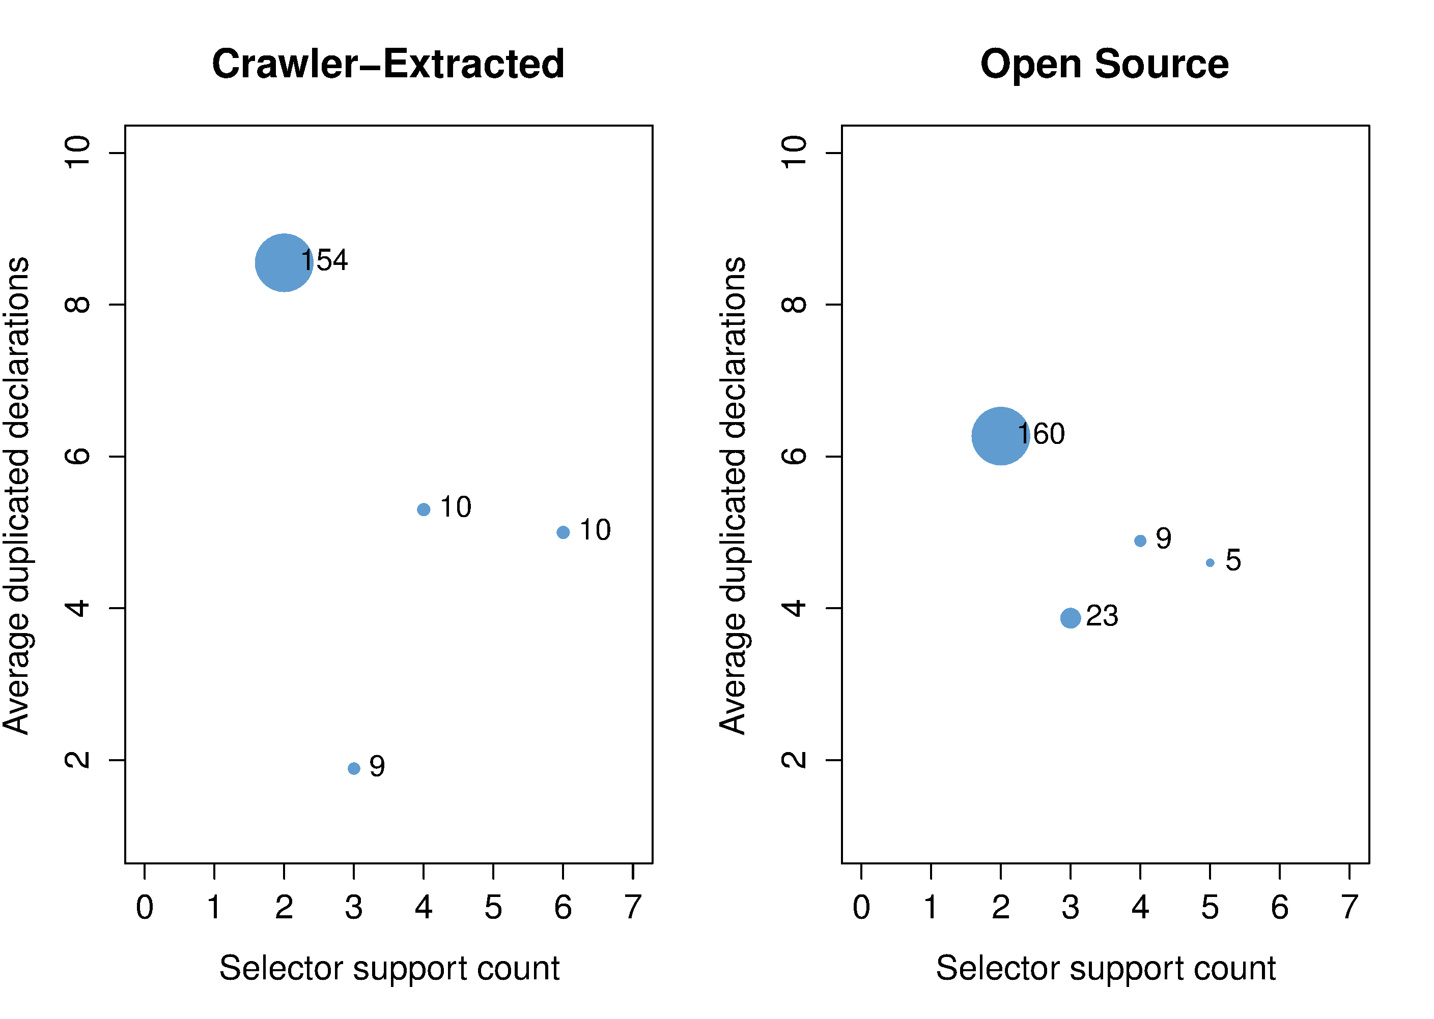
Largest duplications
The majority of duplication is between two selectors.
There is also duplication between 3 - 6 selectors
Outliers were deleted when creating this figure

Slide 26
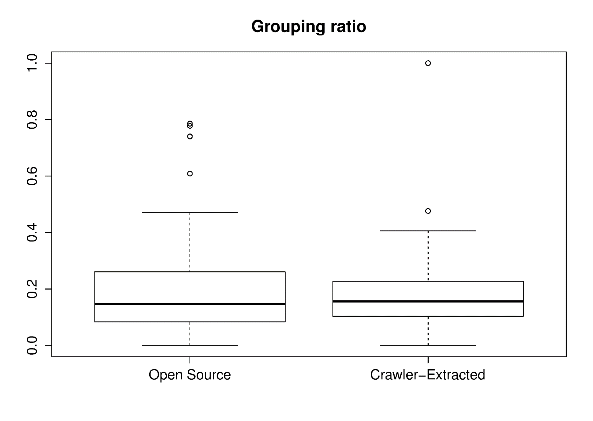
Grouping adoption
In average, less than 20% of all selectors of today’s CSS are grouped selectors.
Open Source
Extracted by Crawler
Notes:
Add the conclusions

Slide 27
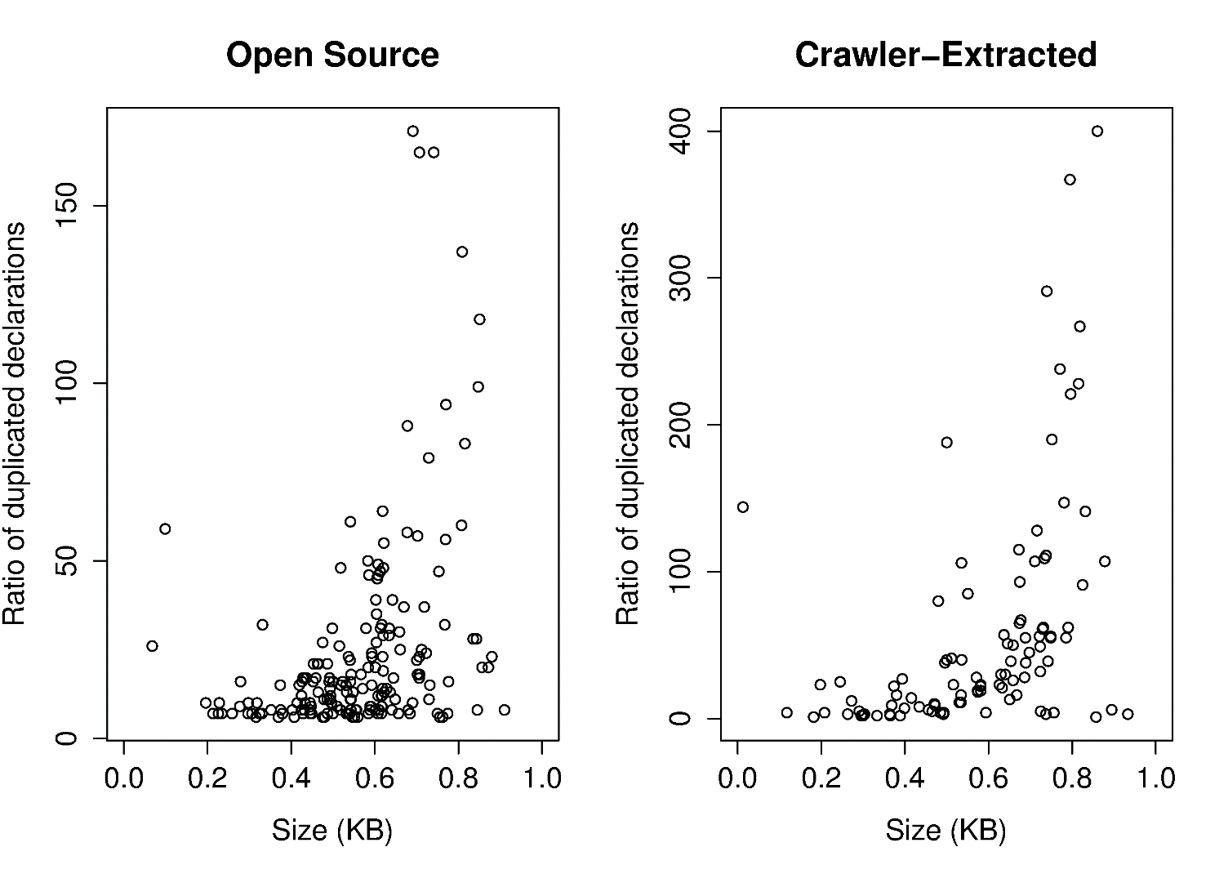
Size and duplication
Spearman test of correlation between size and duplicated declaration ratio
 | Rho | p-value
Crawler-Extracted | 0.3923908 | 3.935e-08
Open Source | 0.4170468 | 8.921e-10

Slide 28
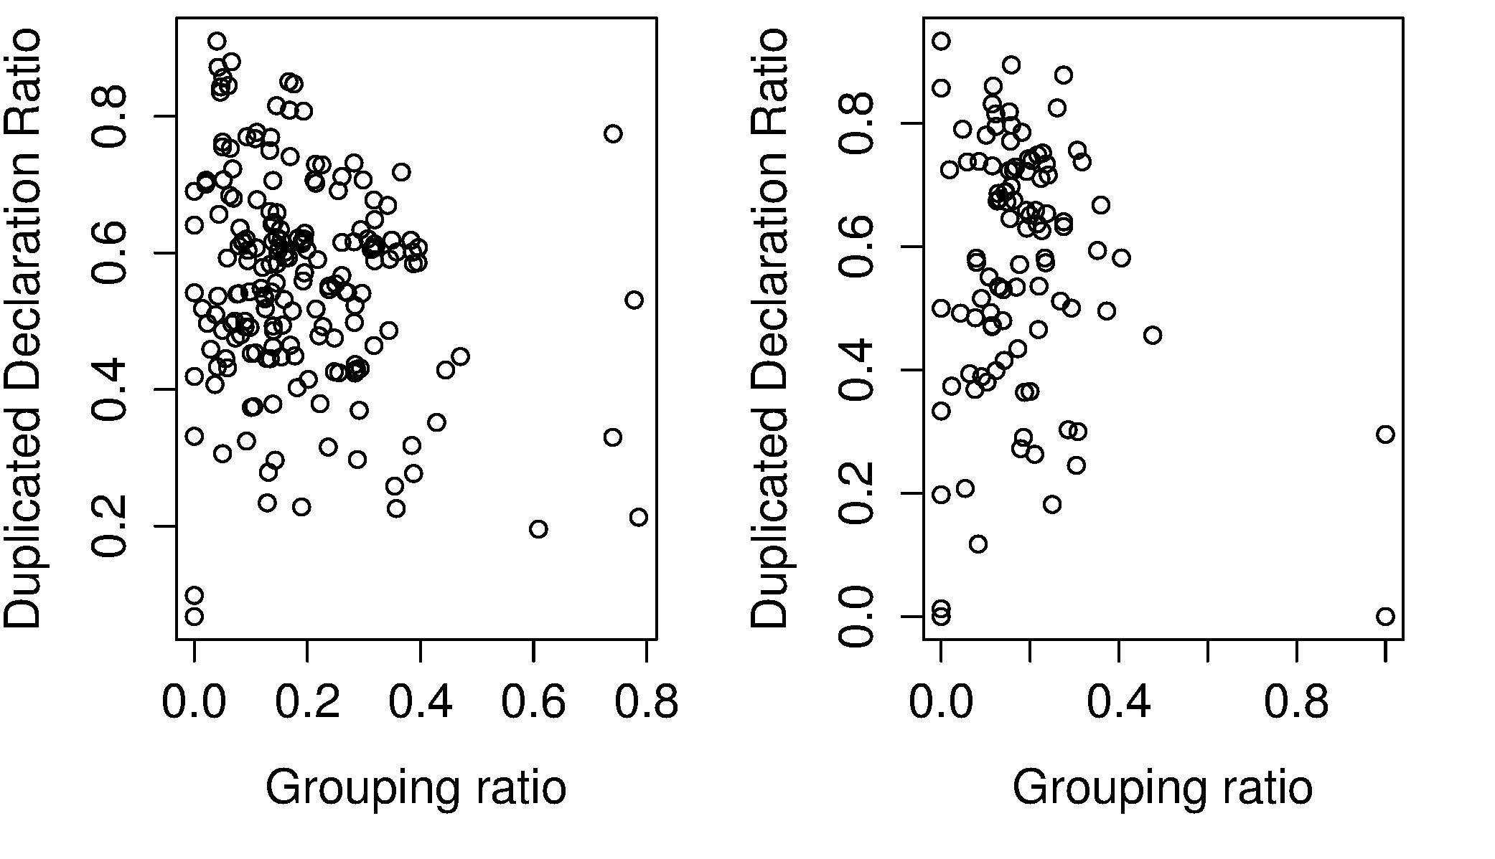
Grouping and duplication
Open Source
Extracted by Crawler
Spearman test of correlation between grouping and duplicated declaration ratio
 | Rho | p-value
Extracted by Crawler | 0.07309612 | 0.3254
Open Source | -0.1423606 | 0.04488

Slide 29
Conclusion and Future Works
CSS is widely used, but there is a limited research on it
Declarations of today’s CSS are about 60 percent duplicated in average
You can find two or more selectors in a CSS file which have more than 5 shared declarations In average
There is not a strong correlation between size and grouping ratio with the ratio of the duplicated declarations in CSS files
We may:
Refactor these duplications
using grouping in CSS, creating classes, or taking advantage of the hierarchy of DOM elements
Use duplication info to migrate from CSS to preprocessors
An many more…

Slide 30
Thank You
d_mazina@encs.concordia.ca
http://users.encs.concordia.ca/~d_mazina/

