Slide 1
Preventive Software Maintenance: The Past, the Present, the Future
Nikolaos Tsantalis
Computer Science & Software Engineering
Notes:
In this talk I will present the past and present research highlights in the area of preventive software maintenance.
I will then focus on the current challenges related to the management of maintenance activities and finish with some future research directions.

Slide 2
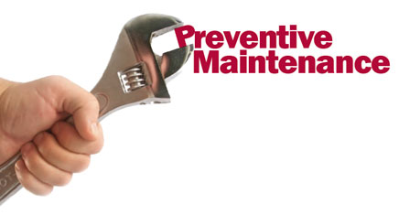
Preventive Software Maintenance
Changes aiming to improve the future maintainability and reliability of the software system.
Why is it so necessary?

Slide 3
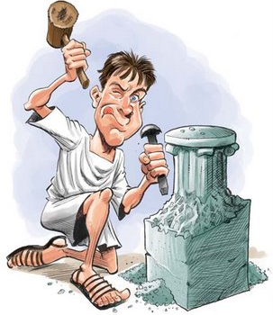
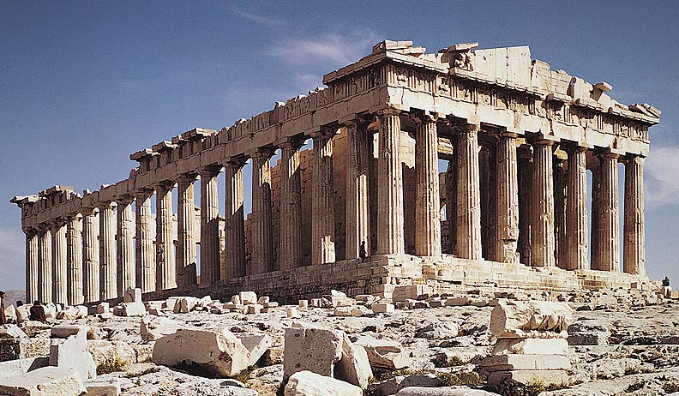
Software aging
Refactoring
Notes:
Software is aging. It has been observed that the design quality of a software system deteriorates throughout its evolution
The reason is that developers do not always apply the best design solutions due to time pressure to deliver new features, or
because they are new developers joining the development team and are unfamiliar with the system’s architecture & design decisions)
As a result, it becomes more and more difficult to perform maintenance tasks, such as the addition of new requirements, fixing of bugs.
Refactorings constitute the main form of preventive maintenance and are source code transformations that can improve the design quality of a system and gradually bring it back to its original design state.

Slide 4
The Past
1999
Notes:
It all started back in ’99 with the book by Martin Fowler on Refactorings.

Slide 5
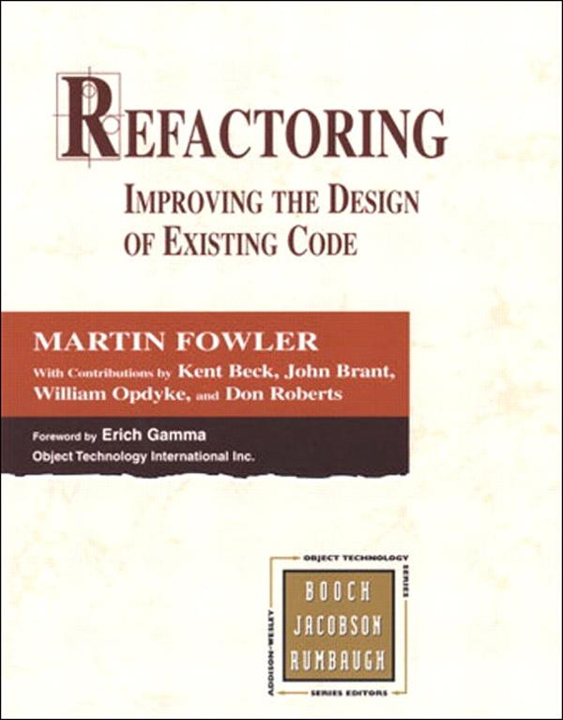
Martin Fowler Refactoring
Duplicated Code:
“If you see the same code structure in more than one place, … find a way to unify them.”
Notes:
In this book they introduced the concept of “code smells”, which are essentially design flaws, and proposed refactorings that can resolve them.
However, the code smell definitions are very abstract and vague.
For example, in the definition of duplicated code we can see that both the detection and resolution steps are vague.

Slide 6
The Past
2001
1999
Notes:
The first attempt to turn refactoring into science was performed by Simon and Lewerentz in 2001.

Slide 7
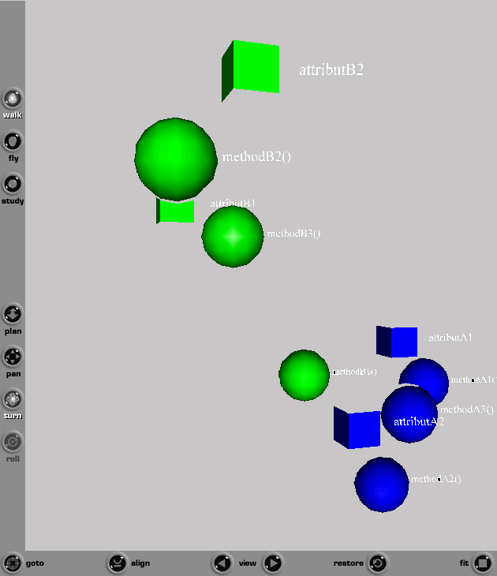
Frank Simon, Claus Lewerentz Metrics Based Refactoring
CSMR Most
Influential
Paper Award
Notes:
They defined a metric based on Jaccard distance to quantify the cohesion between attributes and methods
and place them in a three-dimensional space. The developer could visually identify methods or attributes that have been misplaced.
Limitation: The visual interpretation can be quite subjective. This kind of visualization does not scale for large systems.

Slide 8
The Past
2003
2001
1999
Notes:
In 2003, Tourwe and Mens proposed an approach based on Logic Meta Programming

Slide 9
Tom Tourwé, Tom Mens Logic Meta Programming
Code smell definition for Inappropriate Interface
inappropriateInterface(?class,?interface,?subclasses) :-
findall(<?itf,?scs>,
commonSubclassInterface(?class,?itf,?scs),
?result),
removeDuplicates(?result,?nodups),
member(<?interface,?subclasses>,?nodups)
Notes:
They expressed object-oriented programs as logic-terms and facts and defined logic rules for the detection of code smells that can be evaluated as Prolog queries.
Limitation: The definition of code smells requires the knowledge of logic programming languages (Prolog)
The logic rules used to define code smells may not be able to capture actual instances that deviate from the standard definition.

Slide 10
The Past
2005
2003
2001
1999
Notes:
In 2005, Radu Marinescu introduced the “detection strategies” for code smells.

Slide 11
Radu Marinescu Detection Strategies
Notes:
A detection strategy is a composition of various metric rules (i.e., metrics that should comply with proper threshold values) combined with AND/OR operators into a single rule that expresses a violation of a design heuristic.
Limitation: Threshold values should be manually determined and are project-specific. Different threshold values return different results.

Slide 12
The Past
2008
2005
2003
2001
1999

Slide 13
Mel O’Keeffe, Mel Ó Cinnéide Search-based Refactoring
Treat the improvement of object-oriented design as a search problem in the space of alternative designs
The move in the search space is achieved by modeling refactorings (inheritance-related)
Apply search algorithms using QMOOD as the fitness function (rank alternative designs)
The outcome is a sequence of refactorings leading to the optimal design
Notes:
Limitation: The outcome is a sequence of refactorings that the designer of the system has to accept in its entirety.
From our experience, developers prefer step-wise approaches in which they have total control of the refactorings being applied.

Slide 14
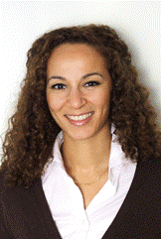
The Past
2009
2008
2005
2003
2001
1999

Slide 15
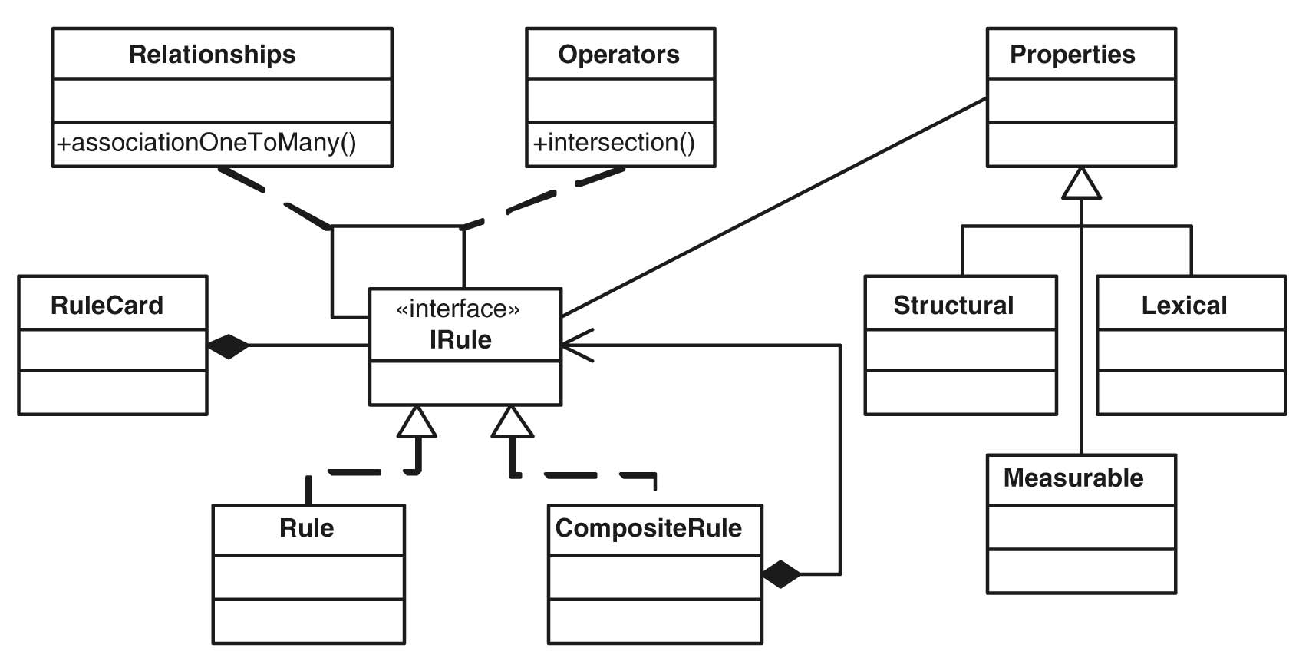
Naouel Moha, Yann-Gaël Guéhéneuc DECOR
Notes:
They defined a domain-specific language (DSL) for the specification and detection of code smells.
This is the most formal approach so far.

Slide 16
The Past
2009
2008
2005
LIMITATION
2003
2001
1999

Slide 17
Refactoring Opportunities
Advantages:
Feasible and behavior preserving solutions to design problems
Ranking and prioritizing solutions based on their expected effect on design quality
A more holistic approach for preventive maintenance
Notes:
This limitation led to another research area that focused on the detection of refactoring opportunities as a means to remove code smells and design problems from software systems.

Slide 18
My research
Focused on the automatic detection
of refactoring opportunities
for 4 major design problems
Notes:
My research during my PhD studies and afterwards focused on the detection of refactoring opportunities for 4 major design problems.

Slide 19
#1 Misallocated behavior in classes
IEEE TSE, 2009
Notes:
The first design problem refers to misallocated behavior in classes.
In this example, we can see a method that is using significantly more data from another class (LegendItem) compared to the data used from the class it belongs to (LegendTitle). Thus, moving this method will improve the cohesion of both classes and decrease the strength of coupling between them.

Slide 20
#2 Conditional logic vs. Polymorphism
Context
Context
State
- state : int
- STATE_A : int = 1
- STATE_B : int = 2
state
- type : int
- STATE_A : int = 1
- STATE_B : int = 2
+method()
+ method() {
}
+ method() {
state.method();
}
if state == STATE_A
else
if state == STATE_B
doStateA();
StateA
StateB
doStateB();
+method() {
}
+method() {
}
JSS, 2010
Notes:
The second design problem refers to the use of conditional logic instead of polymorphism.
This design problem usually appears in the form of “if/else if” statements that examine the value of a variable representing the state of an object and execute the corresponding branch.
The alternative solution is to create an inheritance hierarchy representing the states and replace the conditional logic with a single polymorphic method call.
The polymorphic solution facilitates extension, since the introduction of a new state simply requires the addition of a new subclass in the hierarchy without changing the rest of the system.

Slide 21
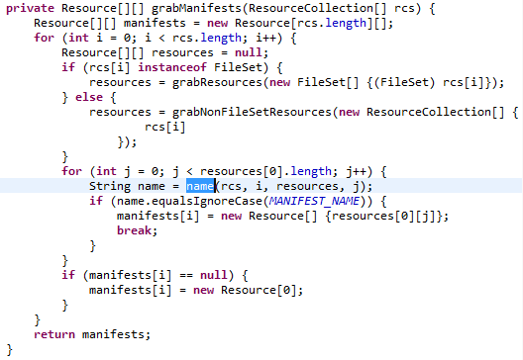
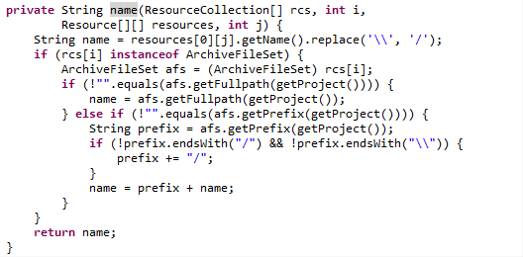
#3 Long & Complex methods
JSS, 2011
Notes:
The third design problem refers to long and complex methods.
Our goal was to detect code fragments within the method implementing a distinct functionality (a set of statements containing the computation of a variable, or a set of statements affecting the state of an object) and extract them into a separate method.
In this way we can reduce the complexity of the original method and introduce a potentially reusable method.

Slide 22
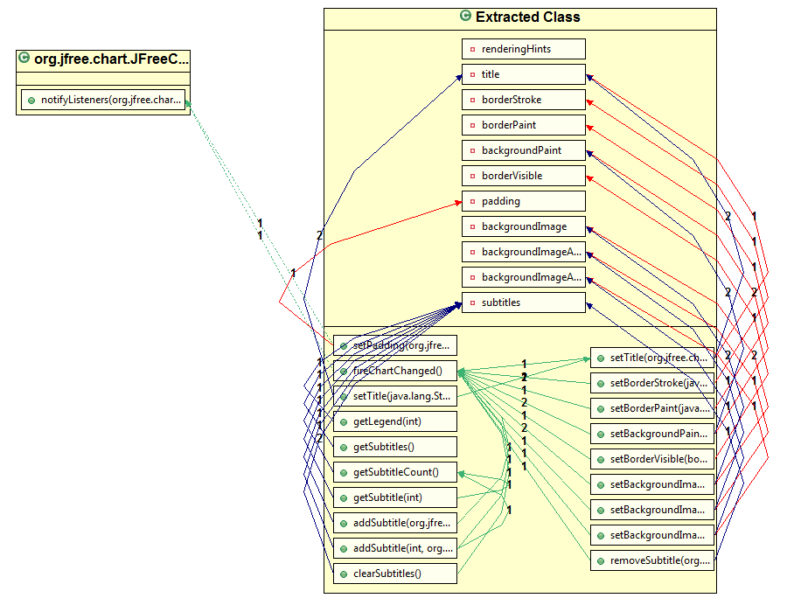
#4 Large & Complex classes
19 methods
11 fields
70 methods
15 fields
900 LOC
JSS, 2012
Notes:
The fourth design problem refers to Large and Complex classes, also known as God classes. These classes usually violate the single responsibility principle.
Our goal was to detect strongly cohesive groups of methods and attributes in the God class that can be extracted to a separate class.
In this example, the original class had 70 methods, 15 fields, and over 900 LOC. The extracted class contains 19 methods and 11 fields which are strongly dependent with each other, while the dependencies to elements of the original class is very weak.

Slide 23
#5 Software Clones
Goal: Given two clones, find the optimal way to refactor them:
Matching by minimizing the differences
Explain the rationale of the solution to the user
Apply the solution automatically in a behavior preserving way
Suggest possible design changes to make the clones “refactorable”
Notes:
Currently, we are working on the detection of refactoring opportunities for software clones.

Slide 24
Since the beginning of 2011 …
16 academic licenses
5,000 applied refactorings
Notes:
All these techniques for the detection of refactoring opportunities have been implemented as an Eclipse plug-in named JDeodorant.

Slide 25
State-of-the-art commercial tools
Computer-aided refactoring
Notes:
There are also some commercial tools focusing on design quality assessment and improvement.
In 2008, Radu Marinescu co-founded a spin-off company and created inCode, a tool that detects code smells based on the detection strategies he proposed. One of his most well-known customers is HuaWei, a Chinese multinational telecommunications company.
Another company is Tocea which is based in France and Quebec. It is offering technical debt assessment and computer-aided refactoring

Slide 26
So, tools are adopted
What’s next?
Management of
Maintenance Activities
Notes:
Right now we have several tools detecting design problems, which may produce a very large number of suggestions.
Obviously, inspecting all of them is quite overwhelming. So, we need automatic approaches to tell us which are the most important ones.

Slide 27
The present
Technical debt management
“Debt” is the effect of incomplete, immature, or inadequate maintenance activities
Delayed tasks may bring a short-term benefit (higher productivity, shorter release time)
Might have to be paid back in the future with “Interest” (increased effort)
“Principal” is the effort to pay off the debt
Notes:
There have been some ideas on the management of maintenance activities.
The first is based on the metaphor of technical debt.
Limitation: The principal and interest for each maintenance activity have to be manually determined and are assigned with coarse-grained values (i.e., high, medium, or low)

Slide 28
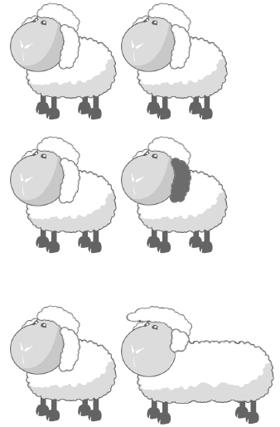
The present
Clone management
Tracking clones as project evolves
Verifying the consistent modification of clones
Updating clones and groups as project evolves
Assessing the harmfulness of clones
Notes:
The clone detection community has introduced clone management.
Limitation: Tailored to the design problem of duplicated code

Slide 29
My perspective
Every code smell involves a certain risk
for future maintainability
What is the risk of leaving
a code smell in the system?
Notes:
With respect to future maintainability

Slide 30
Risk Assessment
Likelihood of occurrence of the risky event
Exposure of the system to the event
Consequence of the event
Risk =
Likelihood × Exposure × Consequence

Slide 31
Likelihood estimation
Risky events ⇒ changes driven by code smells
Ex. 1: Fixing the same bug in a clone group
Ex. 2: Making a method more “envy” to another class
Intuition: code that changes frequently due to a design flaw imposes a high risk to the maintainability of a system
Likelihood ⇒ proneness to code smell driven changes (estimated from the history of changes)
Notes:
Within the context of maintenance, risky events correspond to changes driven by code smells.
On the other side, there is no urgent need to refactor code that never changed after its initial introduction in a system.

Slide 32
Exposure estimation
Intuition: the more extensively a module is used, the more extensive the propagation of code smell driven changes to dependent modules
Exposure ⇒ the number and strength of incoming dependencies (estimated from static and dynamic analysis)
Notes:
On the other side, there is no urgent need to refactor a piece of code that is not used by other system modules (e.g., dead code).

Slide 33
Consequence estimation
Consequence ⇒ cost of code smell driven changes (effort, time, money).
From the opposite perspective:
Consequence ⇒ effect of removing the code smell.
Estimated by computing the impact of the corresponding refactoring on metrics.

Slide 34
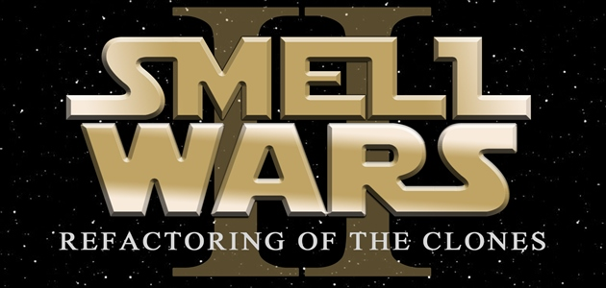
Thank you!!
Visit our project at
http://jdeodorant.com

