Slide 1
An empirical study on the use of CSS Preprocessors
Davood Mazinanian - Nikolaos Tsantalis
Department of Computer Science and Software Engineering
Concordia University - Montreal

Slide 2
Agenda
Introduction to CSS and CSS preprocessors
Motivation
The main research question:
How developers use CSS preprocessor features?

Slide 3
Cascading Style Sheets (CSS)
The standard styling language
Target documents
Limitations of CSS
Was initially designed for non-developers!
Duplication is pervasive!
selector { property: value; }
Declaration
Introduction
Motivation
Empirical Study
Notes:
60% of css codes are duplicated (FSE paper)

Slide 4
CSS Preprocessors
Super-language for CSS for generating CSS
Adding missing features:
Variables, functions, loops, conditional statements, mathematical operations, etc.
Introduction
Motivation
Empirical Study
Notes:
No variables and functions
Generates pure CSS code

Slide 5
Motivation
Credits: css-tricks.com/poll-results-popularity-of-css-preprocessors/
Introduction
Motivation
Empirical Study
Notes:
Are they used?
There was a poll request which 13K web developers responded to, and it turned out that 54% of them used.
Among them, Less and Sass were the most-used ones.

Slide 6
Motivation
Collecting information to:
Support devising automatic migration techniques
Support developing preprocessor refactoring approaches
Introduction
Motivation
Empirical Study

Slide 7
Empirical Study
Subjects
80 websites (40 websites for Less, 40 for Sass)
220 Less and 738 Sass files (total 958 files)
Found preprocessor files using Google! ☺
E.g.: filetype:less
AST
Results
Parse
Query
Analysis
LESS
SASS
CSV
files
Introduction
Motivation
Empirical Study

Slide 8
Feature #1: Nesting
Goals: better organization, avoiding duplication in selector names
table {
border: none;
outline: 0;
}
table:hover {
font-weight: bold;
}
table td {
margin: 3px;
}
table {
border: none;
outline: 0;
&:hover {
font-weight: bold;
}
td {
margin: 3px;
}
}
CSS
Preprocessor
Introduction
Motivation
Empirical Study

Slide 9
Feature #1: Nesting
By far the most-used feature of CSS preprocessors!
Out of all 34065 selectors, 21870 are nested, or have nested selectors (65%)
Question: Are they used even for shallow nesting?
Introduction
Motivation
Empirical Study

Slide 10
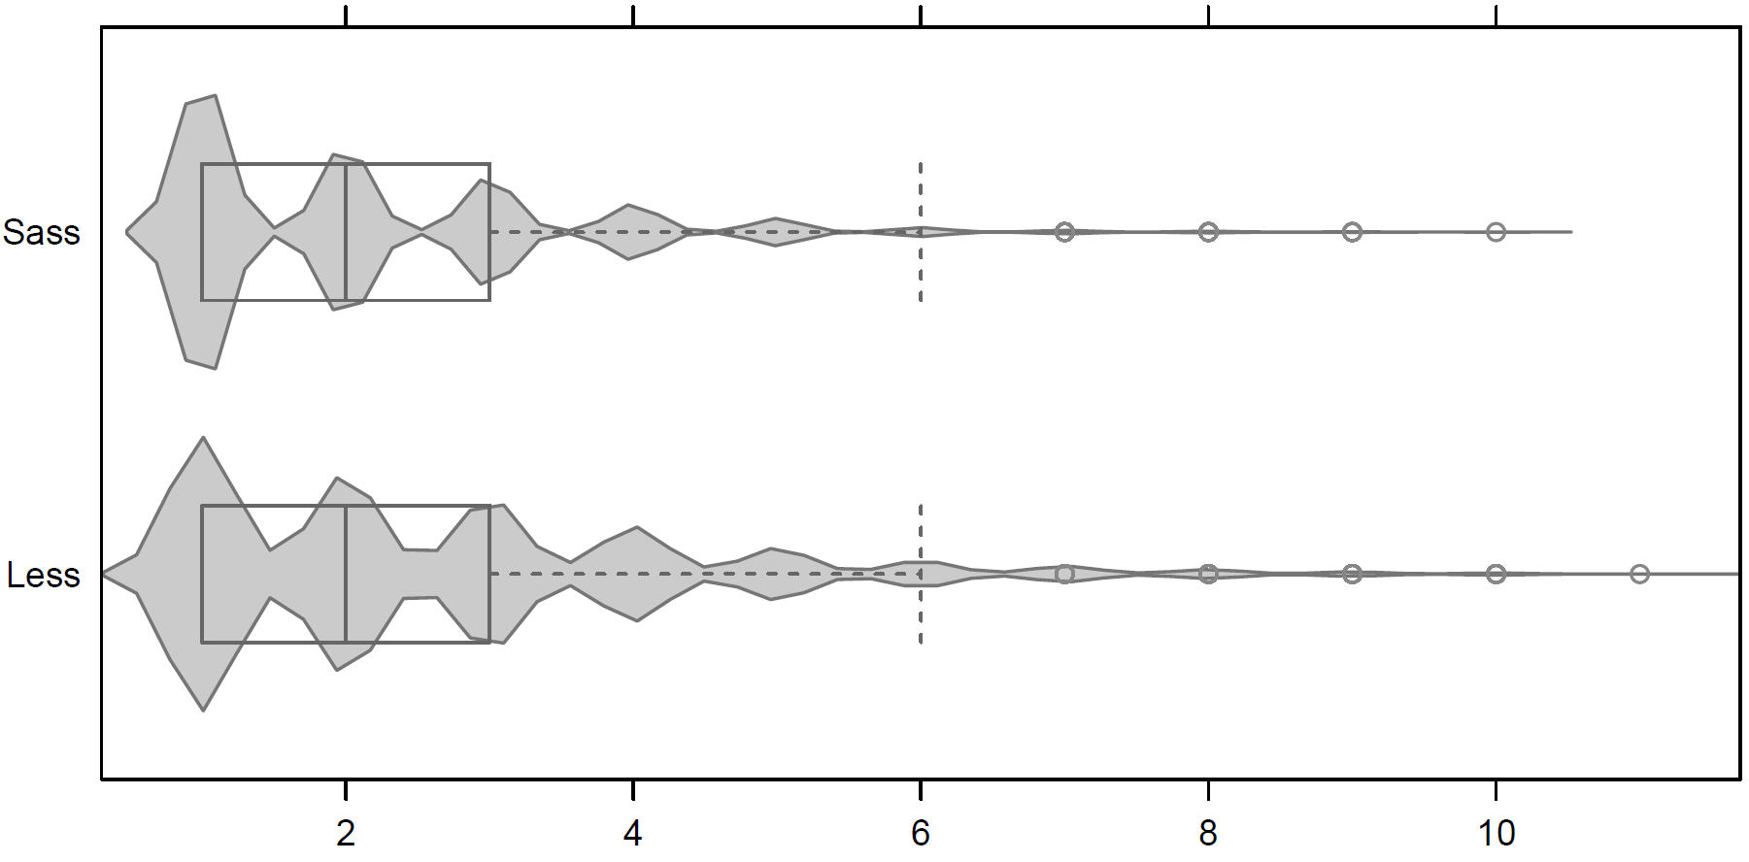
Feature #1: Nesting
How deep was nesting?
Introduction
Motivation
Empirical Study

Slide 11
Feature #1: Nesting
Conclusions
Every migration tool / technique should support “migration to nesting”!
Developers nest selectors, even if the level of nesting is not very deep!
Introduction
Motivation
Empirical Study

Slide 12
Feature #2: Mixins
Goal: increasing re-usability and comprehensibility of code
table {
margin: 5px;
.border(1px, 3px, 0)
}
.border(@b, @r, @o) {
border: solid @b black;
border-radius: @r;
outline: ridge black @o;
}
table {
margin: 5px;
border: solid 1px black;
border-radius: 3px;
outline: ridge black 0;
}
Preprocessor
CSS
Introduction
Motivation
Empirical Study

Slide 13
Feature #2: Mixins
Mixin calls: how much re-usability?
Introduction
Motivation
Empirical Study

Slide 14
Feature #2: Mixins
Size of Mixins
80% of Mixins have less than 5 declarations
Introduction
Motivation
Empirical Study

Slide 15
Feature #2: Mixins
Size of Mixins
Introduction
Motivation
Empirical Study

Slide 16
Feature #2: Mixins
Number of parameters
30%
31%
25%
36%
Introduction
Motivation
Empirical Study

Slide 17
Feature #2: Mixins
Parameter re-use
Mixins with parameters used in more than one type of declaration
Sass: 13%
Less: 18%
# Parameters and # declarations inside Mixins are not correlated
Spearman Rho = 0.17 with p-value = 3.471e-05
.mixin(@param1) {
top: @param1;
margin-left: @param1
}
Introduction
Motivation
Empirical Study

Slide 18
Feature #2: Mixins
65% of Mixins are used for cross-browser declarations!
.rounded(@radius: 2px) {
-webkit-border-radius: @radius;
-moz-border-radius: @radius;
border-radius: @radius;
}
Introduction
Motivation
Empirical Study

Slide 19
Feature #2: Mixins
Conclusions
Mixins having cross-browser declarations are preferred
Perhaps because they have greater impact on minimizing duplication (to be researched)
Mixins do not tend to have
Large number of parameters
Large number of declarations
Thus, it is not preferred to have large Mixins with too many parameters
Introduction
Motivation
Empirical Study

Slide 20
Feature #3: Extend
Minimizing duplication by grouping selectors
table {
float: left;
&:extend(.zeroSpacing)
}
.zeroSpacing {
margin: 0;
padding: 0;
}
table {
float: left;
}
.zeroSpacing , table {
margin: 0;
padding: 0;
}
Preprocessor
CSS
Introduction
Motivation
Empirical Study

Slide 21
Feature #3: Extend
Much less used than Mixins
No usages in the Less dataset,
Only 15% of Sass files had an Extend usage inside
Reason: order dependencies
Using Extend will change the order of the selectors that may lead to breaking the presentation
Introduction
Motivation
Empirical Study

Slide 22
Feature #3: Extend
Breaking the presentation by using Extend!
table {
float: left;
&:extend(.zeroSpacing)
}
table {
margin: 2px;
}
.zeroSpacing {
margin: 0;
padding: 0;
}
table {
float: left;
}
table {
margin: 2px;
}
.zeroSpacing, table {
margin: 0;
padding: 0;
}
Preprocessor
CSS
Introduction
Motivation
Empirical Study

Slide 23
Feature #3: Extend
Conclusions
Prefer to use Mixin instead of Extend
Even though it may produce more duplication in the resulting file
If removing duplication by using Extend, check the overriding dependencies!
Introduction
Motivation
Empirical Study

Slide 24
Summary
Using preprocessors is a trend!
Developers use Nesting whenever possible!
Mixins:
Are short (less than 5 declarations),
Mostly have zero or one parameters
Are usually used for cross-browser declarations!
Developers prefer using Mixins over Extends!
It is not always safe to use Extend

