Slide 1
Accurate Program Element Tracking in Commit History
Mehran Jodavi
Supervisor: Dr. Nikolaos tsantalis
Notes:
Hello everyone.
My name is Mehran and I am a Master student under supervision of Dr tsantalis.
Today I am going to present an accurate program element tracker named CodeTracker

Slide 2
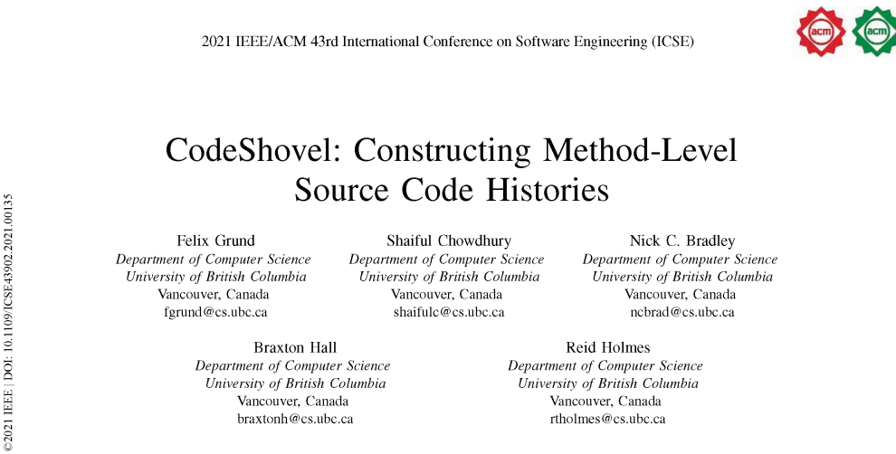
Introduction
Developers and researchers frequently have questions that they try to answer using source code histories
But existing tools do not support them in accessing the historical data they need
Notes:
Grund et al performed a survey with industrial and academic developers and found that they frequently have questions that they try to answer using source code histories
but existing tools do not support them in accessing the historical data they need

Slide 3
Introduction
existing tools return results at the wrong granularity
file-based or line-based rather than element-based
results are incomplete
File move
File rename
Restructuring code
Notes:
Specifically, existing tools return results at the wrong granularity
they are file-based or line-based rather than element-based
and results are often incomplete due to file move or rename which is a common practice in software development.
So, developers have to perform multiple queries and manually filter to identify the changes

Slide 4
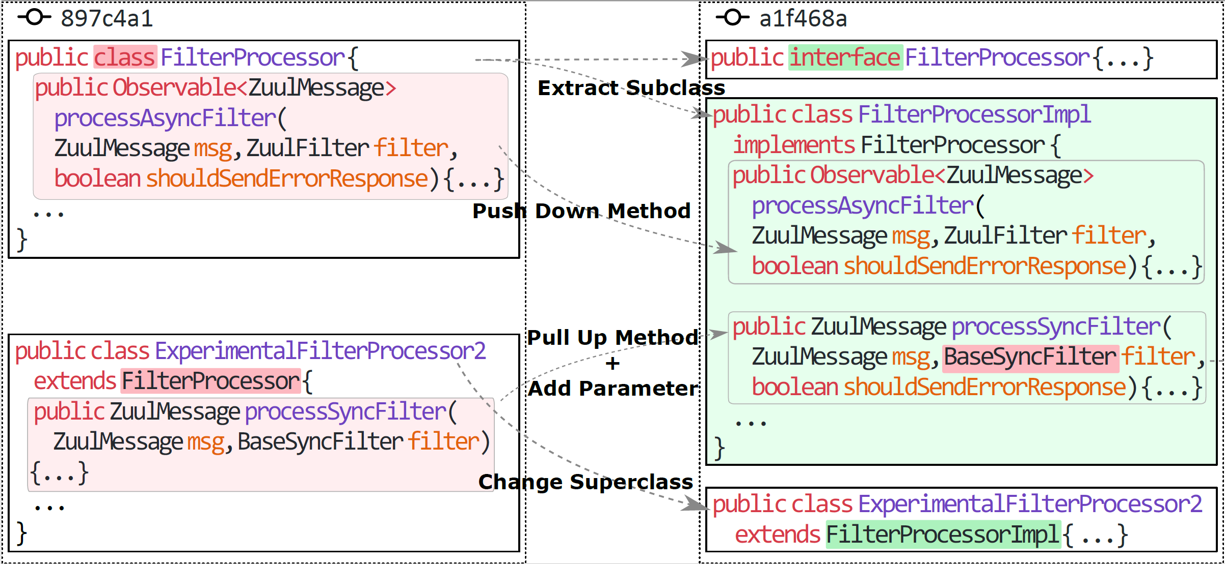
Introduction
Notes:
In addition, in this work, we found that code tracking challenges is not limited to rename or file move, it can be very complex just like this real scenario that is detected in project Netflix Zuul by our tool.
In commit this new subclass named FilterProcessorImpl was extracted from class FilterProcessor, which was then declared as an interface.
Method processAsyncFilter was among the methods pushed down from FilterProcessor, and method processSyncFilter was moved from class ExperimentalFilterProcessor2
The moved method was also slightly modified by adding a new parameter

Slide 5
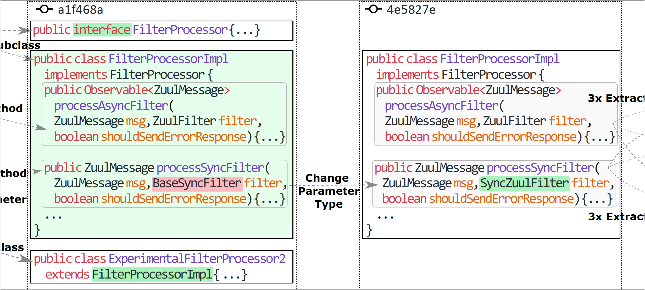
Introduction
Notes:
In commit \texttt{4e5827e}, the type of parameter \texttt{filter} changed from \texttt{BaseSyncFilter} to \texttt{SyncZuulFilter} in method \texttt{processSync\\Filter}.

Slide 6
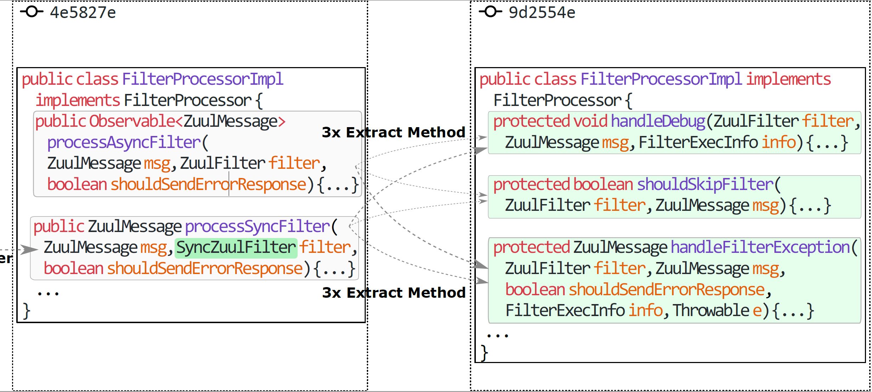
Introduction
Notes:
Finally, in commit 9d2554e three duplicated code fragments were extracted from processSyncFilter and processAsyncFilter in methods handleFilterException, handleDebug, and shouldSkipFilter.
So, as it is clear here, the evolution complexity is not limited to simple refactoring activities. And none of the method tracking tools can track these extracted methods.
Lets say there is a bug in one of the extracted methods and it was introduced prior to the first commit,
without tracking the origin of these methods we would not be able to find the commit(s) and author(s) that introduced this bug,
and more importantly would not be able to find that this bug was duplicated in two different origin files and methods.

Slide 7
Introduction
CodeShovel
Partially Refactoring-aware
Fast
Uses thresholds
fails to track properly methods from which a significant part of their body has been extracted to new methods
FinerGit (2020) – Historage (2011)
create a finer-grained Git repository
Need pre-processing and extra disk space
Not accurate and efficient
None of the currently available tools can track the evolution of all elements.
The evolution tracking of methods is limited.
Notes:
Let's see what are the existing tools.
There is CodeShovel, it is the most accurate tool for uncovering Java method histories.
It supports tracking methods with changes in their signature, methods whose parent file has been moved/renamed, and methods moved to another file
It is fast. it has a median runtime of 2 seconds
It uses a similarity algorithm for matching methods across file versions, so it uses thresholds.
our experiments have shown that it fails to track properly methods from which a significant part of their body has been extracted to new methods, as it uses a 75\% body similarity threshold to match modified methods, and thus erroneously matches the original method with the extracted one.
$$$$$$$$$$$
The other tools are FinerGit and Historage.
FinerGit is an improved version of Historage and it improves on the limited capability of Historage to track renamed or moved methods.
They both create a finer-grained Git repository in which each Java method exists in its own file, and take advantage of Git mechanisms to track changes on each individual file that represent a mehtod.
Pre-processing an entire repository to place each method in its own file, is computationally expensive and requires additional hard disk space, which can be prohibitive, especially for large repositories with many files and a long commit history.
These are the most important tools for element tracking however there are some other techniques that we discussed in the related work chapter of the thesis in detail.
$$$$$$$$$$$$$$$$$$
In summary, None of the currently available tools can track the evolution of all elements.
Moreover, the evolution tracking of methods is limited, as commonly applied refactoring types, such as Extract Method, are not supported by the currently available tools.

Slide 8
Code Tracker
Completeness
Works for all code elements(Class, field, method, variable!)
Accuracy
Takes advantage of RefactoringMiner accuracy
As Fast as CodeShovel
Partial and incremental commit analysis
Notes:
So, the importance of the element tracking, and the limitation of current tools motivate us to develop CodeTracker.
$$$$$$$$$$$$$$$$$$$
Our tool not only is able to track methods, but also is able to track the variables, classes and attributes.
$$$$$$$$$$$$$$$$$
It is accurate. CodeTracker is uses RefactoringMiner which is the most accurate refactoring finder tool to find refactoring activities.
$$$$$$$$$$$$$$$$$
Although RefactoringMiner is fast, but some commits are too big and costly to analyse, so we analyse commits partially and incrementally and we show that our tool is as fast as CodeShovel

Slide 9
Element IDENTIFIER - class
Notes:
Simply, to track a program element, we need to identify different transition of an element in the history of a software.
To uniquely identify a program element in the history of a software repository, we defined the program element identifier.
$$$$$$$$$$$$
It is a tuple that we can define it like this
$$$$$$$$$$$$
where $V_{e}$ is the version of $e$ corresponding to the SHA-1 Git commit ID in which a change took place on $e$,
$$$$$$$$$
$CON_{e}$ is the signature of the container in which $e$ belongs to,
$$$$$$$$$$$$
and $SIG_{e}$ is the signature of $e$.
$$$$$$$$$$$$$
The typical container structure in Java programs is shown in this example.
$$$$$$$$$$
The container of a type declaration or class $c$ is the tuple $CON_c = (SRC_c, PKG_c)$, where $SRC_c$ is the source folder path and $PKG_c$ is the package name in which $c$ belong to.
$$$$$$$$$$$$$
And for the signature of a class we considered all possible features of a class declaration like annotation, visibility, parameterized type and so on
===============================
where $N_c$ is the name of $c$,
$K_c$ is the kind of $c$, which is a categorical variable taking four possible values, namely \textit{class}, \textit{interface},
\textit{enum} and \textit{@interface} (for annotation type declarations),
$S_c$ is the super-class type of $c$,
$I_c$ is the list of super-interfaces of $c$,
$T_c$ is the list of type parameters of $c$ in the case that $c$ is a parameterized type,
$A_c$ is the list of annotations of $c$,
$V_c$ is the visibility of $c$, which is a categorical variable taking four possible values (\textit{public}, \textit{protected}, \textit{private}, or \textit{package-private}),
and finally $M_c$ is the list of modifiers of $c$ (\textit{final}, \textit{static}, \textit{abstract}).

Slide 10
Element IDENTIFIER - field
Notes:
We have similar concept for the fields but this time the container is the class where f belong to.
$$$$$$$$$$$$$$$$$$$$$$$
And in the signature we have other attributes like name, type, annotation, visibility and modifier.

Slide 11
Element IDENTIFIER - method
Notes:
Same Idea for the method, the container is its class just like fields. In this case FilterProcessorImpl is the container of getErrorEndPointMethod
$$$$$$$$$$$$$$$$$
For the signature we have name, return type, parameter, method body and documentation.
============================================================
$N_m$ is the name of $m$,
$R_m$ is the return type of $m$,
$P_m$ is the ordered parameter list of $m$,
$E_m$ is the list of thrown exception types of $m$,
$T_m$ is the list of type parameters of $m$ in the case that $m$ is a parameterized method,
$A_m$ is the list of annotations of $m$,
$V_m$ is the visibility of $m$,
$M_m$ is the list of modifiers of $m$ (\textit{final}, \textit{static}, \textit{abstract}, \textit{synchronized}),
$B_m$ is the hashed value of $m$'s body string representation,
$D_m$ is the hashed value of $m$'s Javadoc and inline comments.

Slide 12
Element IDENTIFIER - VARIABLE
Notes:
And finally, the container of a variable like String endpointName in this example is getErrorEndPoint method that it is belongs to,
$$$$$$$$$$$$$$$$
The signature of a variable consists of the name, type, annotation list, modifier like final and scope of that variable.
$$$$$$$$$$$$
Scope includes all statements that the variables is visible to, and it can be referenced from. In this example all te statements inside the box can see the endPointName variable.

Slide 13
Tracking process
Input
Start Commit id (or HEAD by default)
File path containing the program element of interest
the name of the program element
start line number of the program element's declaration
Output
A graph
nodes represent program elements with their unique identifiers
edge connecting two nodes includes the list of changes between the corresponding program elements
Git repository URL
Notes:
What is the input of our tool?
CodeTracker needs
a Git repository URL, a starting commit hash ID (or HEAD by default),
the file path containing the program element of interest,
the name of the program element, and the start line number of the program element's declaration.
$$$$$$$$$$$$$$$$$$$$$$$
The output is a graph in which the nodes represent program elements with their unique identifiers and each edge connecting two nodes includes the list of changes
We decided to model the output as a graph, because it is possible to have forks.
For example, when multiple methods from different subclasses are pulled up in a single superclass method, the same program element (i.e., superclass method) is connected with multiple program elements

Slide 14
Tracking Process
Start Commit or Head Commit
File Path
Element name and line number
Start
Notes:
By using the input parameters like start commit and file path, we first locate the start element. And create a start node.
Now we need to find the changes and create the output graph

Slide 15
Tracking Process
CodeTracker uses RefactoringMiner to find changes in code element level
RefactoringMiner finds refactoring activities and changes in commit level
Running RefactorignMiner for all commits is expensive and impractical
What is the proper subset of commits to track a code element?
if there are no changes in the file containing the element in a given commit, then we can skip this commit
We find all commits in which the file containing the element is changed by using git log command
Notes:
As I mentioned before CodeTracker uses RefactoringMiner to find changes in code element level
$$$$$$$$$$$$$$$$$$$$$$$$$
And RefactoringMiner finds refactoring activities and changes in commit level
$$$$$$$$$$$$$$$$$$$$$$$$$
But Running RefactorignMiner for all commits is not practical and is costly
$$$$$$$$$$$$$$$$$$$$$$$$$
So we need somehow find the most optimal subset of commits
$$$$$$$$$$$$$$$$$$$$$$$$$
On the other hand, we knew that if there are no changes in the file containing the element in a given commit, then we can skip that commit
$$$$$$$$$$$$$$$$$$$$$$$$$
Therefore, thanks to git log command, we can limit the commits we need to analyse to a subset in which the file containing the element is changed

Slide 16
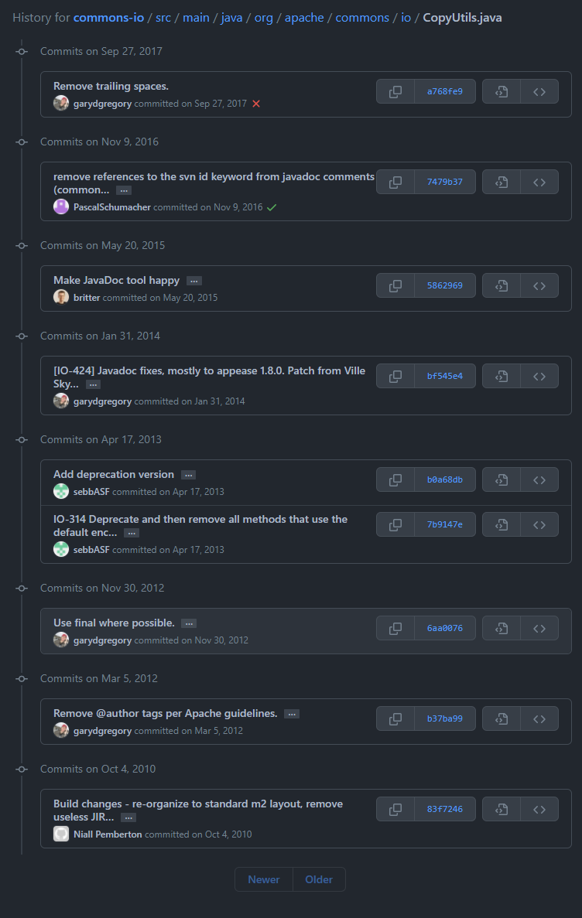
Tracking Process
Start
ID1
ID2
NoChange
NoChange
Notes:
After that for every single commit in the subset, we create a partial source code model for the commit and its parent commit by parsing only the source file corresponding to the input file path.
$$$$$$$$$$$$$$$$$$$$$$
From the right side model or commit model we try to locate a program element with the same signature of element from previous iteration, in this example, the start node, and link them together with noChange edge.
$$$$$$$$$$$$$$$$$$$$$$
Then, we attempt to locate a program element with the same signature and container in patenrt's model.
If a match is found, then we link the two program elements and report NoChange

Slide 17
Tracking Process
Start
ID1
ID2
ID3
ID4
NoChange
NoChange
Parameter Change,
Body Change
Notes:
And we continue this process until we find a change in the signature or container of the element. Like this example in which the parameters and the body of copy method is changed.
At this stage we don’t need to run refactoring miner for all changed files in this commit. We can just run it with just CopyUtils.java file in this example. The less files we get to RefactoringMiner as input, the less computational cost it has. So it will provide the results for us faster.
$$$$$$$$$$$$$$$$$$$$$$$$$$$$$$$$$$$$$$$
We use that results to link the nodes with proper change types and refactorings

Slide 18
Tracking Process
Start
ID1
ID2
ID3
ID4
ID5
ID6
NoChange
NoChange
Parameter Change,
Body Change
Introduced
Notes:
We continue this process until we reach the introduce commit for a code element. At this point the process is complete and we return the graph as result.

Slide 19
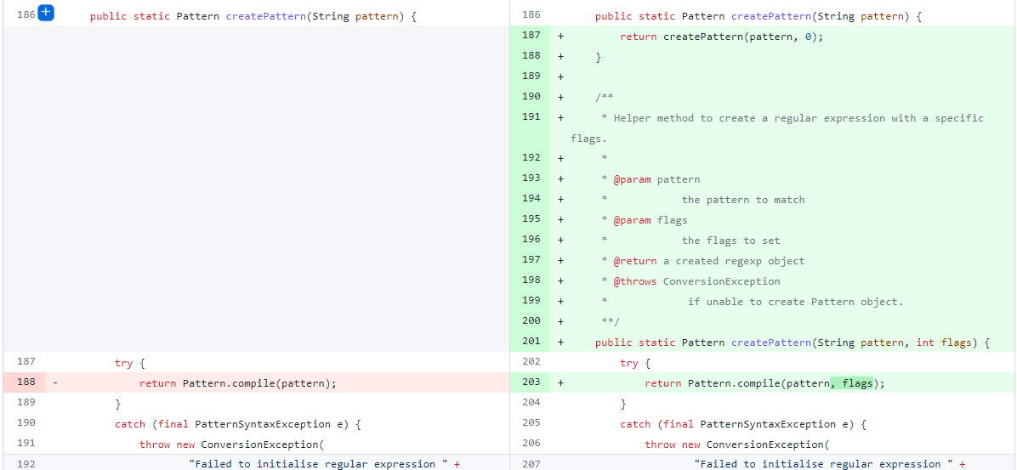
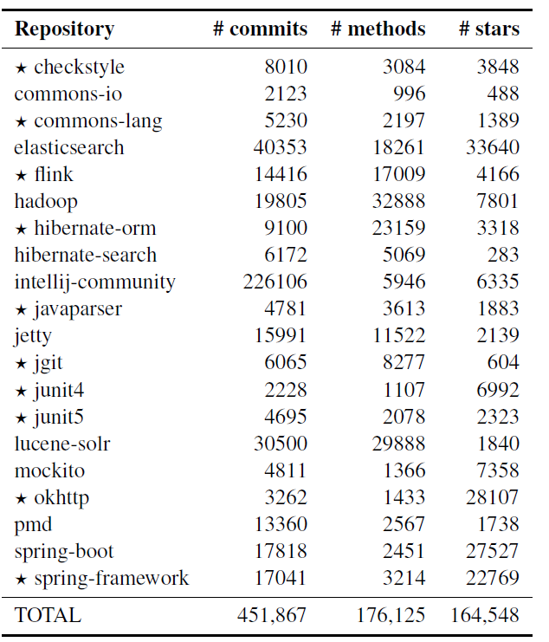
Evaluation-Method
Notes:
For the evaluation we used CodeShovel’s oracle. It consists of the change history of 200 methods from 20 open-source project.
They used 100 samples to optimize their thresholds and another 100 as test dataset.
We used both to evaluate our tool.
$$$$$$$$$$$$$$$$$$$$$$$$$$$$$$
After executing our tool, we found major differences for some methods.
We manually inspect the difference and realize that for most cases CodeShovel cannot correctly match an extracted method.
Like this example in which create pattern method with two parameter obviously extracted from the other method with same name and one parameter. So COdeShovel consider this as parameter change and body change which is not a correct results.

Slide 20
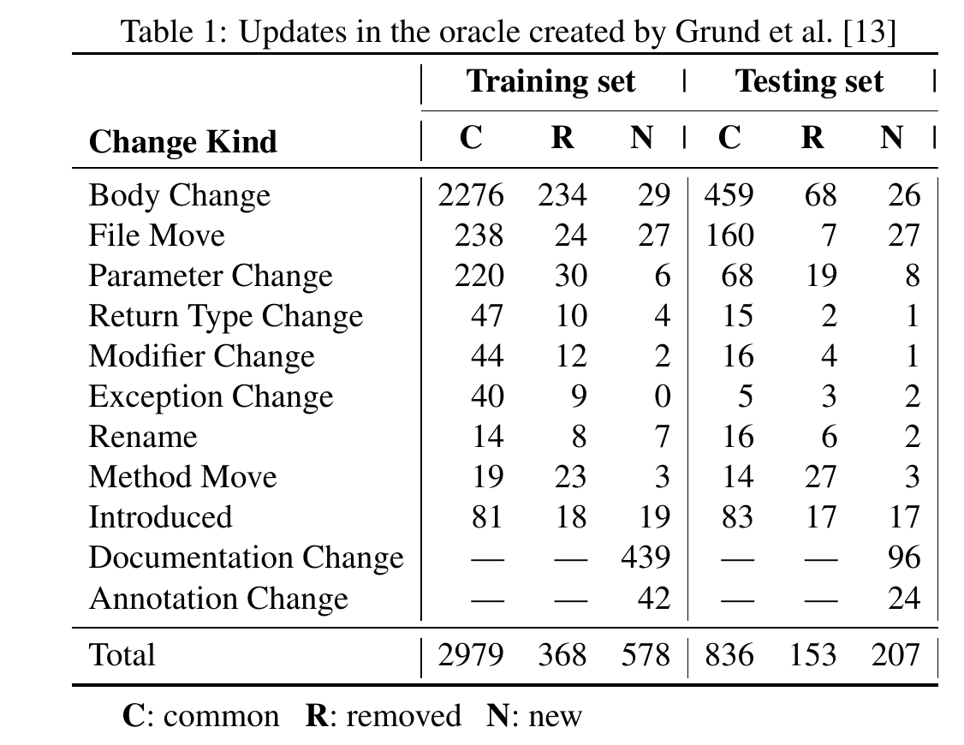
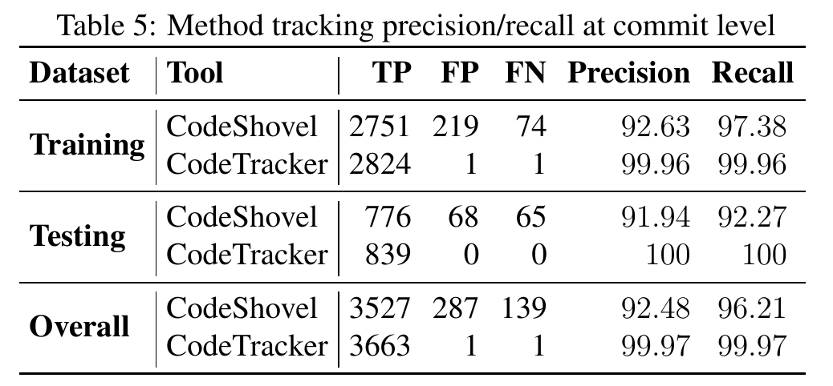
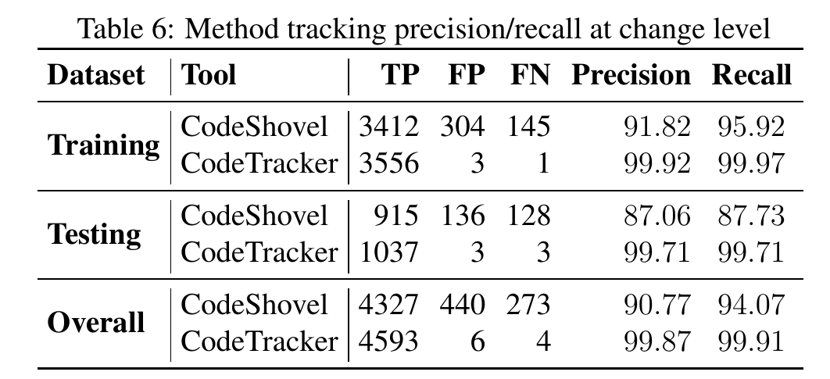
Evaluation-Method
Precision +7.5%
REMOVED 400+
ADDED 750+
Recall +3.7%
Precision +9%
Recall +5.5%
Notes:
So as another contribution, We corrected all problems found in the oracle by removing the false change and adding the new and correct change and we report it in this table, in total we removed move than 400 false and add around 800 correct changes to the oracle.
$$$$$$$$$$$$$$$$$$$$$$$$$$$$$
We computed the precision and recall of CodeTracker and CodeShovel at two commit and change levels
Based on the results we outperform CodeShovel by 7.5 percent in percistion and 3.7 percent in recall at commit level.
By commit level I mean if a tool can find a commit as a changed commit for a code element.
$$$$$$$$$$$$$$$$$$$$$$$$$$
In change level we even have better performance, we have 9 percent better precision and 5.5 percent better recall at change level.

Slide 21
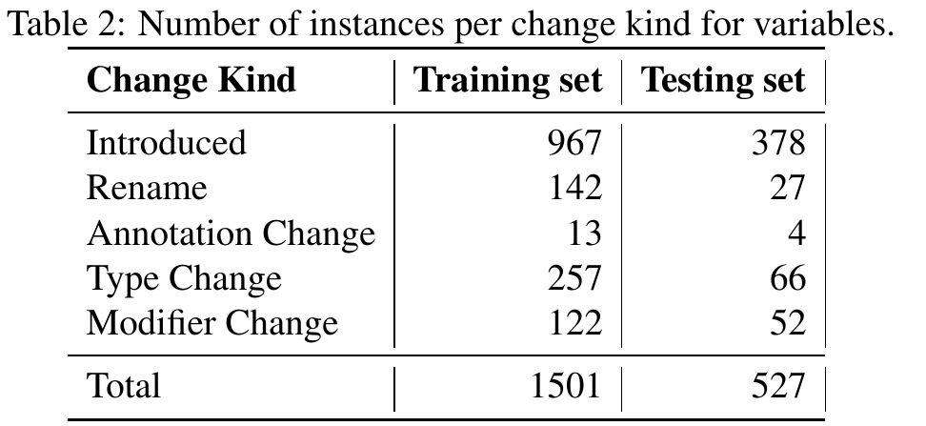
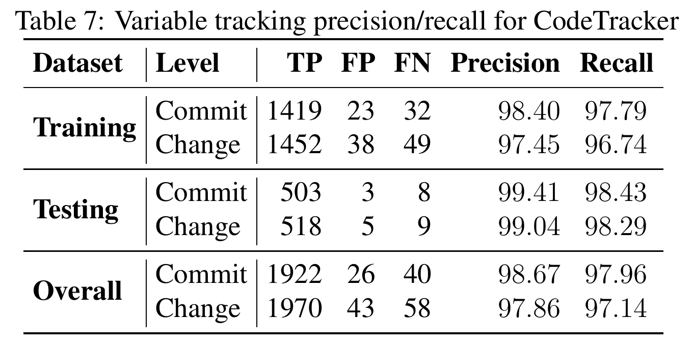
Evaluation-Variable
Notes:
We created an oracle for variables by using the local variables and parameters declared in the methods oracle because we know for sure that the commits in which a variable changed is a subset of the commits in which its container changed. So we can reuse the confirmed information from methods oracle.
In total we found more than 2000 changes.
$$$$$$$$$$$$$$$$$$$$$$$
Overall the precession is 98% and and recall is 97% in variable oracle.

Slide 22
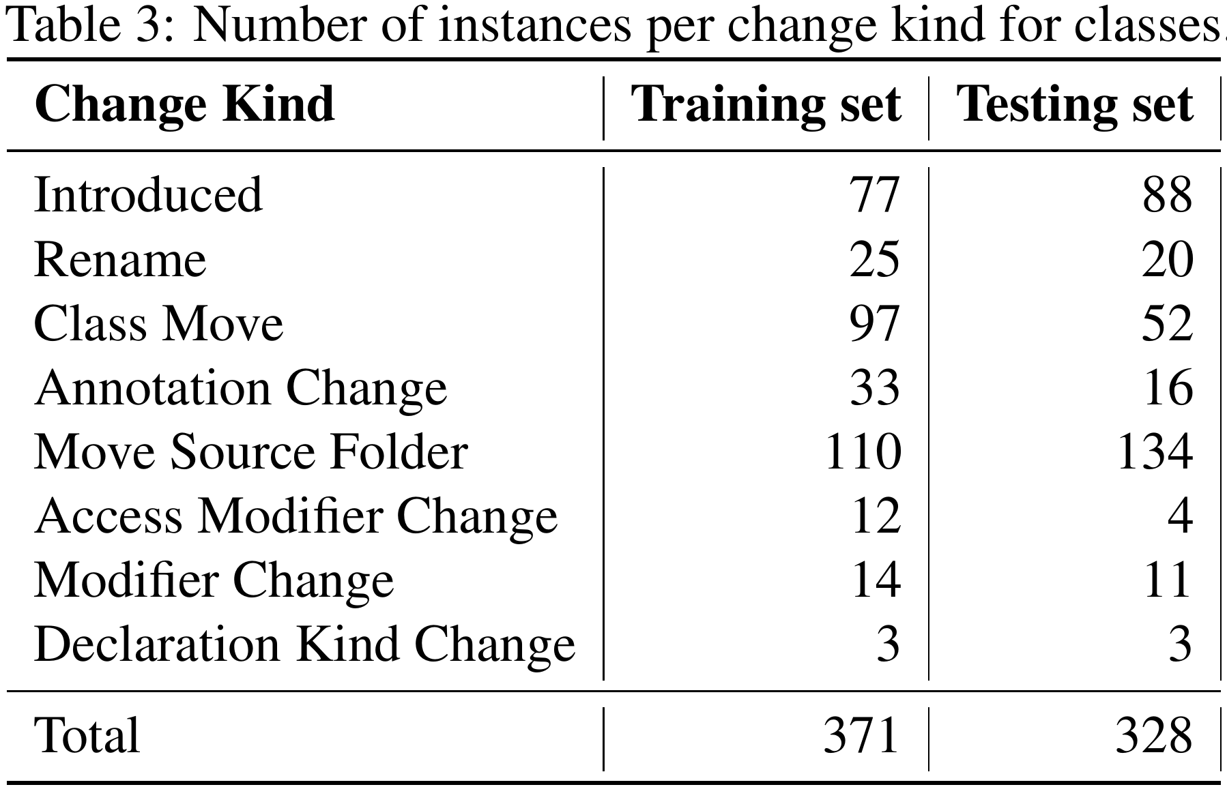
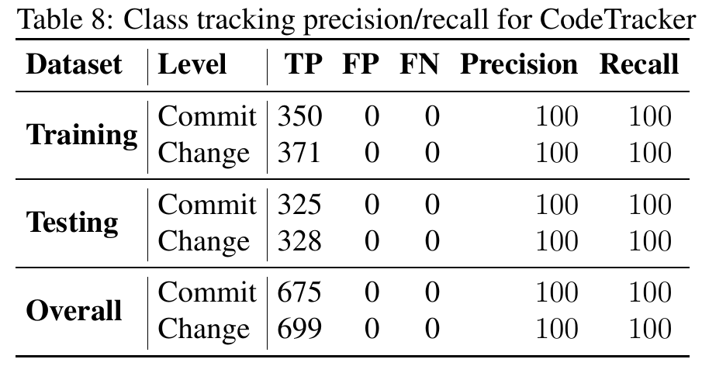
Evaluation-Class
Notes:
We continued extending the oracle with the change history of the classes that containing 200 methods of the original oracle. We found 165 classes in total.
Just like variable oracle, We reuse information from the method tracking oracle, as we know that the commit sets in which a class changed contains the commits in which a container change is performed on a method of that class.
In total we found around 400 changes.
$$$$$$$$$$$$$$$$$$$$
Our tool can find all these changes correctly.

Slide 23
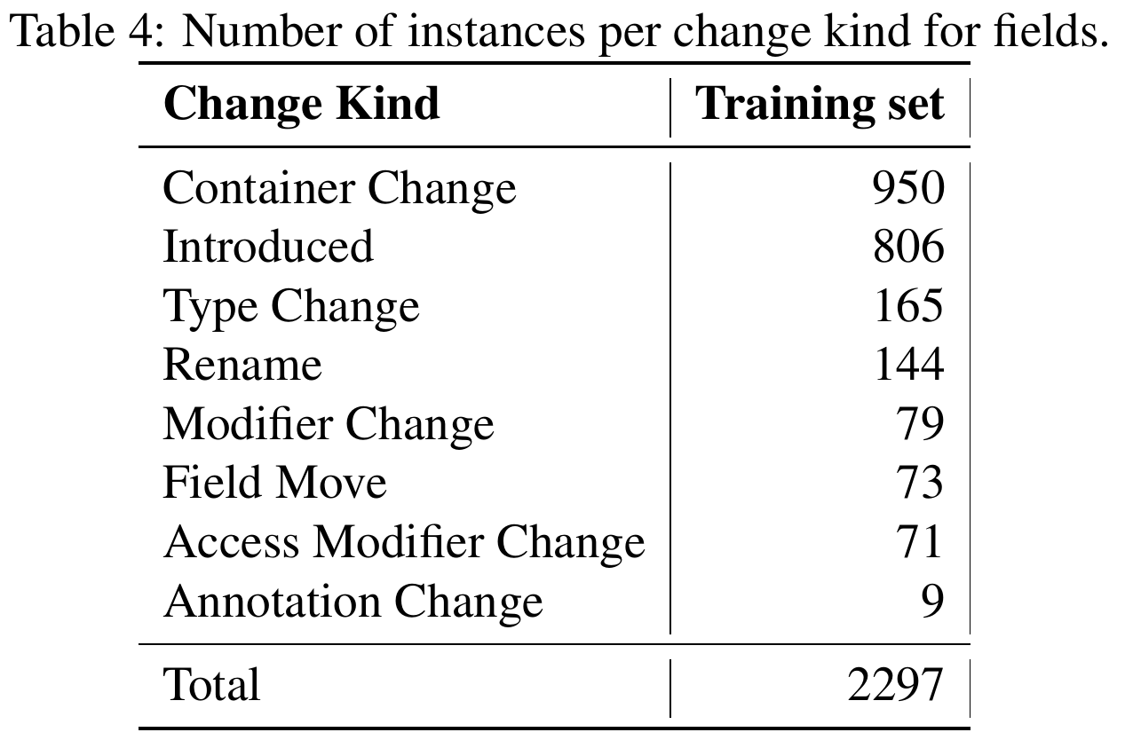
Evaluation-FIELD
Notes:
Finally, we built an oracle containing the change history of all fields declared in the class’s oracle, we just used the training oracle because the number of instances was too much. We found 806 items from the training oracle and around twenty-three hundred changes.
$$$$$$$$$$$$$$$
In overall, the precision of field tracking is 98 percent and recall is around 97 %.

Slide 24
Evaluation-Execution Time
Notes:
We also conduct a performance evaluation and realize that although CodeTracker having a little bit slower execution time relative to CodeShovel, both tools have execution times within the same order of magnitude.

Slide 25
Conclusion
CodeTracker is the first tool that can track the history of all kind of code elements with a high accuracy and a reasonably processing time
It supports a finer-grained change reporting
We built a more accurate Oracle for element tracking
Notes:
SO:
CodeTracker is the first tool that can track the history of all kind of code elements with a high accuracy and a reasonably processing time
$$$$$$$$$$$$$$$$$$$$$
It supports a finer-grained change reporting
$$$$$$$$$$$$$$$$$$$$$
And we put lots of efforts to create a more accurate and reliable oracle for element tracking which is publicly available on our project repository

Slide 26
Thank You
Any Questions?
Notes:
Thank you so much.

Slide 27
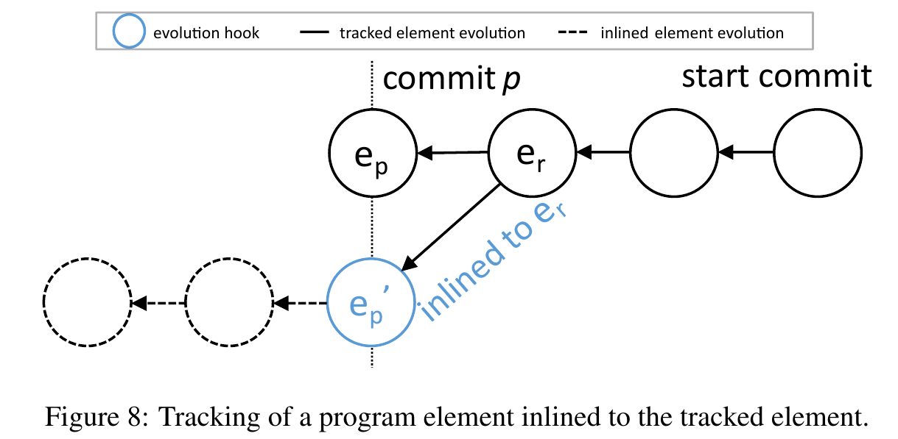
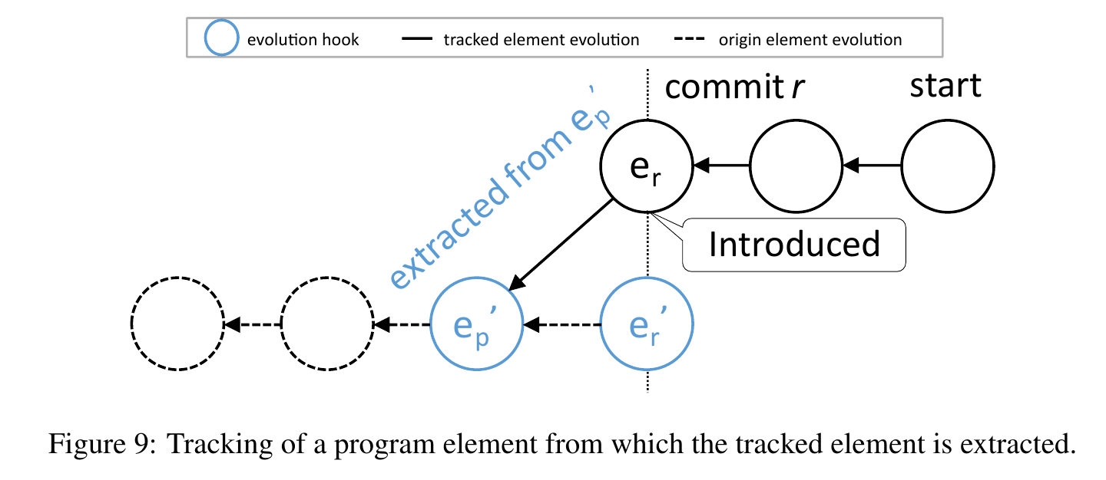
Tracking Process - Evolution Hooks
Notes:
It is very likely that a developer would like to inspect the evolution of program elements which are extracted from or inlined to the main tracked program element because extracted/inlined program elements were originally part or became part of the tracked program element at some point in its evolution.
To support this feature we specified the extracted/inlined program elements as evolution hooks.
$$$$$$$$$$$$$$$$$$$$$$$$$$$$$$$$
It is also very likely that a developer would like to inspect the evolution of the method(s) from which the tracked program element is extracted,
similar to the evolution scenario shown in our motivating example. This figure shows how we model this scenario in our graph.

Slide 28
Tracking Process
In case of Body or Document Change we just need to check if there is any method inlined to or extracted from this method
We call RefactoringMiner with limited number of files to improve performance
Notes:
We developed some heuristics to make our tool as fast as possible.
For example In case of Body or Document Change we just need to check if the tracked method is involved in an Extract Method or Inline Method refactoring. To avoid an unnecessary execution of RefactoringMiner, we check all method calls to see if an extract or inline is possible or not.
$$$$$$$$$$$$$$$$$$$$$$$$$$$$
In addition to call RefactoringMiner as limited as possible strategy, we also try to call it whenever is need with as limited files as possible. For example, we filter out most of the irrelevant files in the right side when we had to run refactoring miner in full mode.

Slide 29
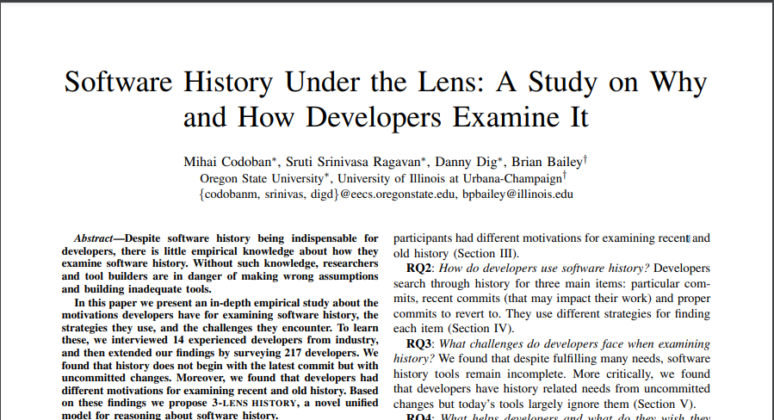
Introduction
Developers routinely track code snippets in the commit history to:
recover the rationale behind a snippet of code
find the commits that introduced a bug
find who are the knowledgeable peers on certain modules and patterns
reverse engineer requirements from code
keep up with how the code state evolves
apply changes from other branches into the main branch
Notes:
Developers routinely track code snippets in the commit history to facilitate various software engineering tasks.
The most common reasons are to
a) recover the rationale behind a snippet of code,
b) find the commits that introduced a bug,
c) find who are the knowledgeable peers on certain modules and patterns,
d) reverse engineer requirements from code,
e) keep up with how the code state evolves,
f) apply changes from other branches into the main branch.

Slide 30
Introduction
Code snippet tracking is also essential in many areas of software engineering research
empirical studies investigating the characteristics of bug-introducing changes
automatic source code merging tools
automatic migration tools
Notes:
Accurate code snippet tracking is also essential in many areas of software engineering research.
Some studies pointed out that bug-inducing analysis algorithms suffer from broken historical links due to file moves and renames.
automatic source code merging tools also often fail to track the changed program elements correctly due to overlapping refactoring operations, and so are unable to perform the auto-merging.
The automatic migration of client software to newer library and framework versions, also, requires to track the updated API program elements like public methods and fields from the source to the target version

