Slide 1
Identification of JavaScript Classes
Shahriar Rostami
Master’s Thesis
Supervisor: Dr. Nikolaos Tsantalis
August 2016

Slide 2
Outline
Context of the study (goal, background)
Contribution
Approach
Evaluation of precision and recall
Case study
Tool features
Future work

Slide 3
Goal
To study existence of classes in JavaScript
Try to improve program comprehension
Long-term goal: Impact of OOP on maintenance of JavaScript applications

Slide 4
Why JavaScript
The most used language on Github (2013-2015)
Everywhere: client-side, server-side (Node.JS), libraries, IOT and databases
Dynamic, untyped and interpreted programming language
No syntactical support for Classes, Namespaces, and import/export packages (prior to ES2015)
It needs better tooling
Notes:
Tell story about not having standard
But people are using OOP in it
And developers made their own patterns
Motivation:
Whether or not developers are using JavaScript OO practic the long term goalof this research is to see the impact of oop on maintenance

Slide 5
Class Emulation

Slide 6
Class Emulation

Slide 7
Namespace
(IIFE with return)
To prevent collision
To better organize code
Notes:
Tell why we need namespace -> Collison and Organization

Slide 8
Namespace
(IIFE with parameter)

Slide 9
Namespace
(Nested object literals)
Notes:
Say somethings about object literal

Slide 10

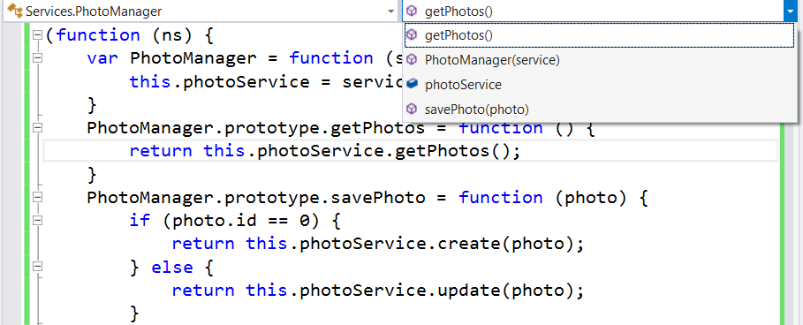
Class and Namespace
Class emulation techniques: 4
Namespace emulation techniques: 5
Total: combination of 20 styles or more…
Notes:
I show different way to create class now how should we detetc them

Slide 11
Contributions
A technique for identifying class emulations (JSDeodorant)
Build an oracle
Comparison with the state-of-the-art tool, JSClassFinder
Quantitative and Qualitative evaluation of the results to identify limitations
Case study on open source JavaScript programs
Notes:
Oracle: For precision and recall (evaluate) and comparison and then if it’s good -> case study

Slide 12
Approach
Notes:
explain the enhanced model

Slide 13
Identifying Classes
Binding object creations: With a light weight data-flow analysis, match instance creation with function constructor
              Simple Name Identifiers: i.e. new MockWindow()
              Composite Name Identifier: i.e. new namespace.PublicClass()
                Inferring function constructors: Analyzing the body and prototype object of functions
              Applies to unresolved functions
              Function with a method or an attribute is inferred as class

Slide 14
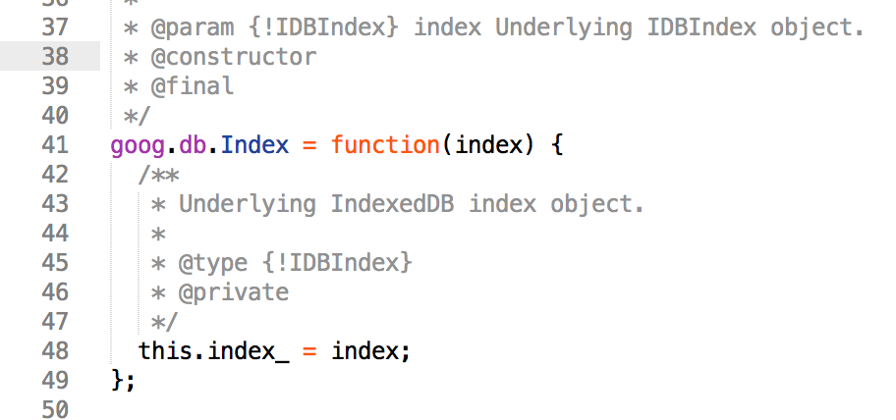
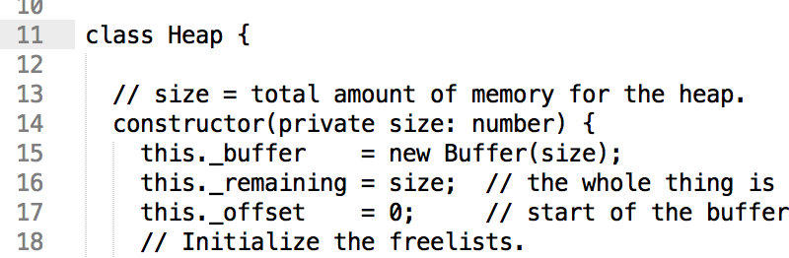
Unbiased Oracle for Evaluation
Using JSDoc Annotations
  @Constructor annotation on a function means that is a class
    Using Transpiled Code: automatically transpile projects to vanilla JS
      TypeScript
      CoffeScript
Notes:
What is a unbiased oracle, what is biased
How you build it

Slide 15



Codes we analyze
Project | Version | Size (KLOC) | #JS Files | #Functions | #Classes
Closure-library | 20160315 | 605 | 1,502 | 23,535 | 946
Doppio | Rev:7229e7d | 17.7 | 47 | 1,977 | 154
Atom | V1.7.0.beta5 | 34 | 116 | 3,175 | 102
Notes:
What is a unbiased oracle, what is biased
How you build it

Slide 16

Precision and Recall
Program | Identified function constructors | TP | FP | FN | Precision | Recall
Closure-library | 1,008 | 907 | 101 | 39 | 90% | 96%
Doppio | 154 | 153 | 1 | 1 | 99% | 99%
Atom | 106 | 101 | 5 | 1 | 95% | 99%
Notes:
TP: chizi ke bayad peyda mikardi, peyda ham kardi.
FP: chizi ke nabayad peyda mikardi, vali peyda kardi.
FN: chizi ke bayad peyda mikardi, peyda nakardi.
TN: chizi ke nabayad peyda mikardi, peyda ham nakardi.
Precision: az beine chizayi ke peyda kardi, chandtashoon dorostan?
Recall: az beine chizayi ke bayad peyda mikardi chandta ro dorost peyda kardi?
Explian the results, talk about qualitative, analysis + limitation (may be in next slide)
FP: Az in 101 > 18 tash interface budan (our bug) 82 tash class budan annotation nadashtan
FN : No instantiation , nor methods and attribtues

Slide 17
Qualitative analysis
Two independent evaluators
  Classes that are not in Oracle but we found (Extra)
  Classes that we can’t find, but are in Oracle (FN)
Limitations:
  Inheritance
  Interface VS Class
Notes:
For Extra: Consensus whether they are class or not (Some of them for test and lack of @constructor)
For FN: lack of implementation like interface, inheritance, empty class

Slide 18
Comparison with the
State-of-the-art
Project | JSClassFinder [1] |  | JSDeodorant
 | Precision | Recall | Precision | Recall
Closure-library | 99% | 76% | 98% | 96%
Doppio | 96% | 14% | 99% | 99%
Atom | 100% | 93% | 95% | 98%
Average | 98% | 61% | 97% | 98%
Both tools have high precision on average, but JSDeodorant greatly outperforms JSClassFinder for recall
[1]: Silve et.al. Does JavaScript Software Embrace Classes? SANER’15
Notes:
JSClassFinder: 1) They can’t infer classes , 2) Because they don’t have dependency, they match each name once!

Slide 19
JSDeodorant is Accurate!
JSDeodorant
Precision: 97%
Recall: 98%
JSClassFinder
Precision: 98%
Recall: 61%
>

Slide 20

Empirical Study
Build a dataset (NodeJS, Website and Library)
Preprocess (removal of test and document folder)
Any difference of class adaptation among these three groups?
Eyeball analysis: Yes
Statistically?
Notes:
Make a transition slide :
Our tool is accurate and out perfom the state of the art so it is reliable to use it for empirical study
Why you choose these categories? because other researchers also analyzed these categories [ali mesbah and kim work
Also mention for websites which they minify code, JSDeodorant does not break

Slide 21


Analyzed Systems
 | Project | #Classes
NodeJS | Express | 8
 | Forever | 0
 | Less.js | 77
 | Node-browserify | 2
 | NPM | 35
 | PM2 | 11
 | Statsd | 11
 | Yo | 0
 | Project | #Classes
Website | Google | 128
 | Facebook | 312
 | Baidu | 54
 | Yahoo! | 15
 | Amazon | 124
 | Twitter | 147
 | Project | #Classes | Project | #Classes
Libraries | Ace | 5 | Jquery | 45
 | Angular | 109 | PDF | 306
 | Backbone | 18 | Underscore | 25
 | Ember | 32
Notes:
Make a transition slide :
Our tool is accurate and out perfom the state of the art so it is reliable to use it for empirical study
Why you choose these categories? because other researchers also analyzed these categories [ali mesbah and kim work
Also mention for websites which they minify code, JSDeodorant does not break

Slide 22

The Distribution of Data
Normalize number of #classes with #files
Appropriate statistical test
Shapiro Walk test to assess whether the distribution is normal or not
P-values
  NodeJS: 0.02699
  Websites: 0.0468
  Libraries: 0.01349

Slide 23
Appropriate Test?
Wilcoxon rank sum test (MannWhitney U test)
Statistically significant difference between #Classes?
NodeJS < Websites (P-value: 0.0011)
Libraries < Websites (P-value: 0.006993)
NodeJS < Libraries (P-value: 0.02799)
NodeJS < Libraries < Websites
Notes:
Why NodeJS has less,
Why Websites are top
Try to normalize with number of statements

Slide 24
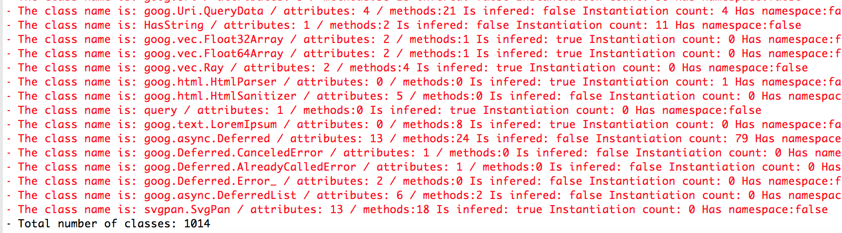
JSDeodorant
CLI Mode
  CSV
  Database
Notes:
Making CSVs
Database
Many flags and so on

Slide 25
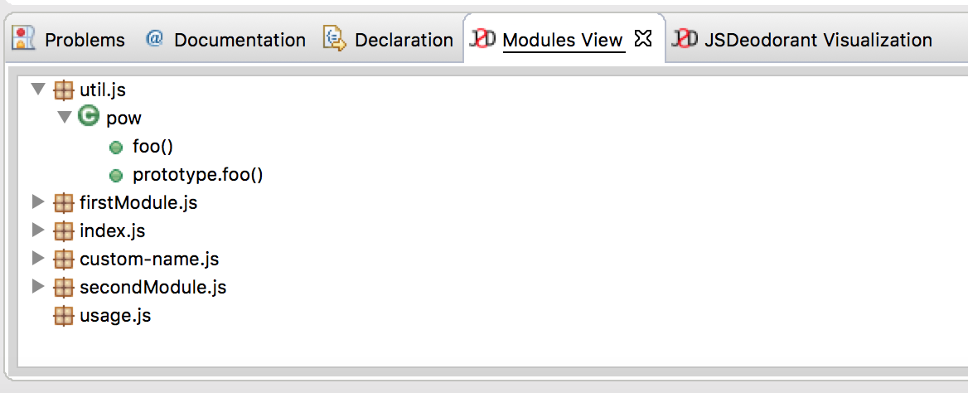
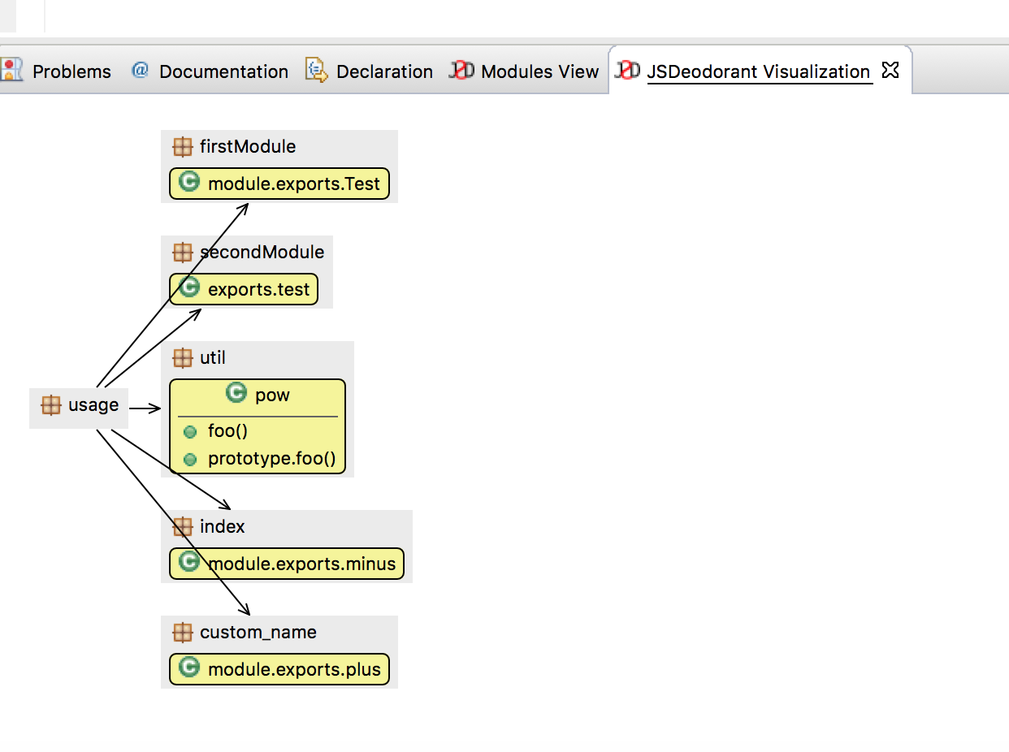
JSDeodorant
Eclipse plugin
  Navigation
  Module View
  Module Visualization
Notes:
Explain we have code navigation

Slide 26
Conclusion
An approach for identifying JavaScript classes
  Supporting Namespace, Import/Export
  High precision and Recall
    An unbiased oracle
NodeJS < Libraries < Websites
An infrastructure for other studies
Eclipse Plugin

Slide 27
Future work
Finding code smells
      God Class, Data Class, Feature Envy
Support for inheritance
Transform classes to new version of JavaScript
  ES2015 syntactically supports Class, Namespace and Import/Export

Slide 28


To appear in ICSME’16 ERA Track
/sshishe/jsdeodorant
Notes:
Link to Github and dataset

