Slide 1
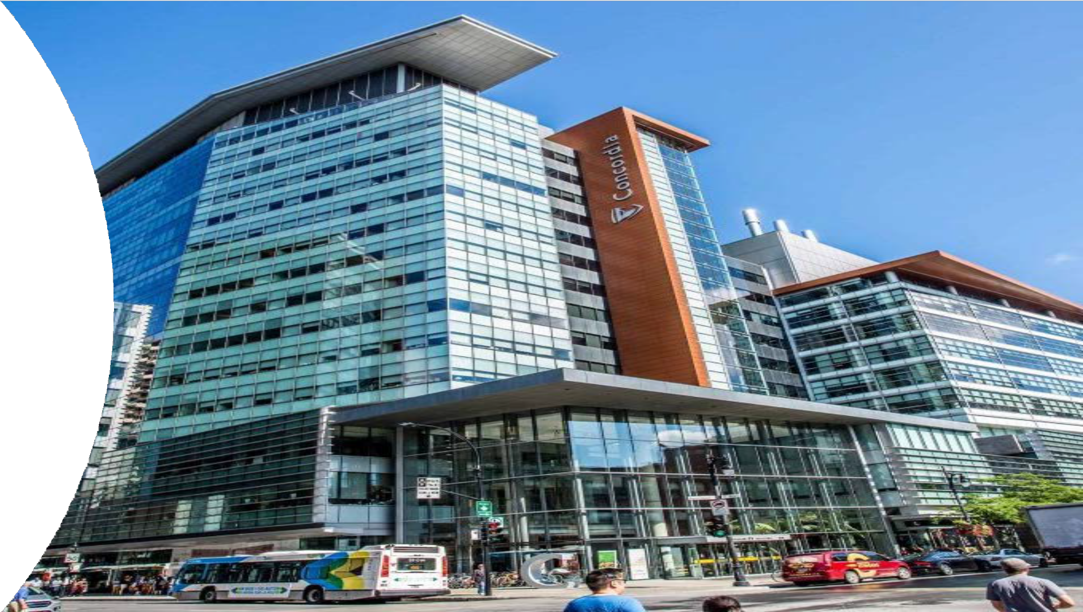
Department of Computer Science and Software Engineering

Slide 2
Department Contact Information:
Chair of the department: Dr. Paquet joey.paquet@concordia.ca
Program Director for Bachelor of Computer Science: Dr. Wang ugpd-compsci@concordia.ca
Program Director for Software Engineering: Dr. Rigby peter.rigby@concordia.ca
Undergraduate program assistants: Natallia Lapko & Carly Carruthers cse-ugrad@concordia.ca
Our department webpage:
https://www.concordia.ca/ginacody/computer-science-software-eng.html

Slide 3
Admission Requirements:
Bachelor of Computer Science
Bachelor of Computer Science in Health and Life Sciences
Bachelor of Computer Science Joint Major in Data Science
Bachelor of Computer Science Joint Major in Computation Arts and Computer Science
Minor in Computer Science
Bachelor of Engineering, Software Engineering

Slide 4
Program Requirements:
Bachelor of Engineering, Software Engineering
Bachelor of Computer Science
Bachelor of Computer Science Joint Major in Data Science
Bachelor of Computer Science Joint Major in Computation Arts and Computer Science
Bachelor of Computer Science in Health and Life Sciences
Minor in Computer Science
Extended Credit Program (BCompSc, including Joint Majors)
Extended Credit Program (BCompSc Health and Life Sciences)
Extended Credit Program (SOEN)

Slide 5
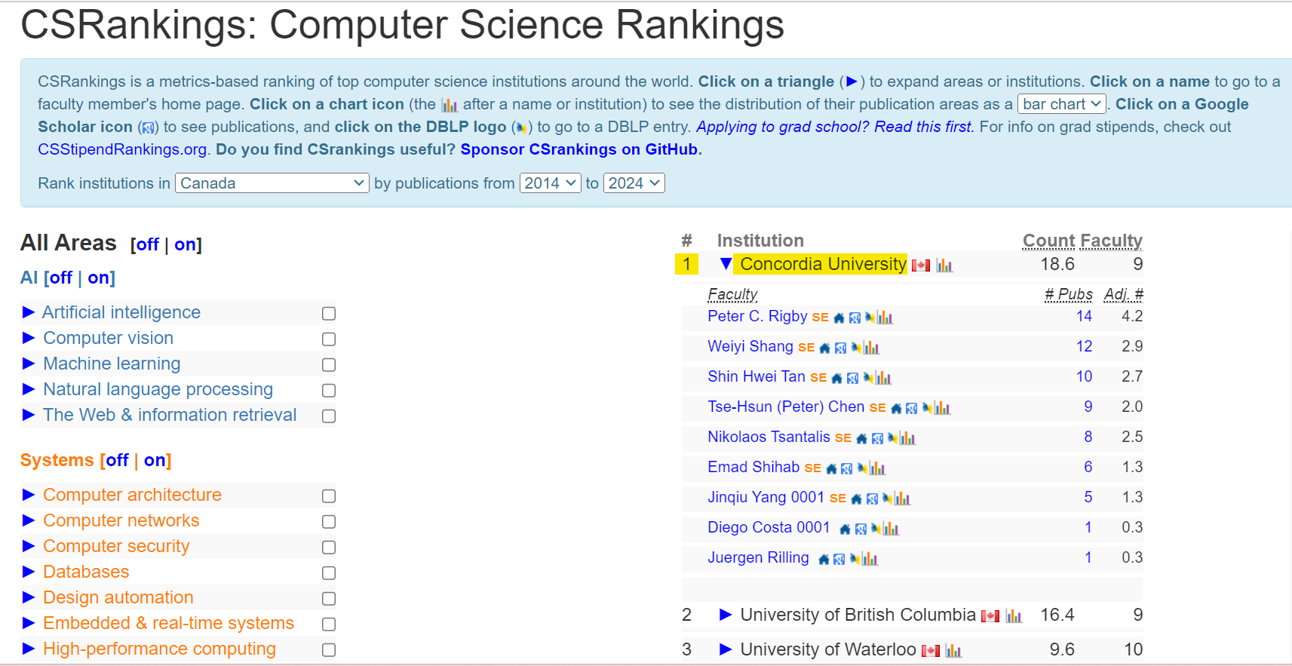
Why study with us?
In the recently released 2023 Computer Science Rankings (CSRankings), Concordia’s software engineering researchers placed number one in Canada, second in North America and fourth in the world. The CSRankings identify international institutions and faculty actively engaged in research across several computer science areas.

Slide 6
What do we do in Artificial Intelligence?
Software Engineering:
How to use AI to help software development practice (AI for SE)
How to improve AI using Software Engineering principles (SE for AI)
Computer Science:
How to develop new models for AI
Pattern matching Federated/cooperative learning
Machine learning Supervised/unsupervised learning
Neural networks Reinforcement learning
Deep learning Genetic algorithms
How to improve existing AI models
Consume less resources Scalability
Faster results Explainability
Privacy Reliability
Applications:
Computer vision Natural language processing
Computational linguistics Medical imaging
Computational pathology Neuroimaging
Data science Conversational AI
Handwriting analysis Bioinformatics
Computer games

Slide 7
What do we do in Artificial Intelligence?
Concordia Applied AI Institute
Goals:
coordination of research across Concordia's four faculties
collaboration with business, civil society, governments
demystify and enable real-world applications of artificial intelligence
105 researchers in 9 research groups:
Society
Develop AI applications while questioning their impact on all members of society.
Science
Create deep learning methods for medical imaging which have evolved to the point where these AI systems outperform expert clinicians in several areas.
Emerging technology
Integrate AI into smart cities, industry and manufacturing and aerospace.

Slide 8
Why study Software Engineering?
Software Engineering (120 credits) (SOEN) is a four-year program leading to the degree of Bachelor of Engineering (Software Engineering).
Teaches you how to solve practical problems from an Engineering perspective
Accredited by the Canadian Engineering Accreditation Board, enabling you to become a Professional Engineer after graduating.
Many courses focus on various aspects of large-scale software development:
Development processes, specifications, architecture, design, implementation, maintenance, and project management.
“Soft skills” that all engineers must possess, such as technical writing, communicating, working in a team and leadership.

Slide 9
Why study Computer Science?
Computer Science (90 credits) (COMP) is a three—year program
Flexible program, allowing students to combine with a minor in another subject
Computer science uses theoretical and mathematical foundations of computation to understand both software and hardware structure for effective and creative design.
Through labs, lectures and projects, you will:
Design and create new software
Modify and test existing software used in a broad range of application domains
Explore emerging software/hardware technologies

Slide 10
Hands-on experience
Both COMP and SOEN programs have good Co-Op program where you alternate school semesters and work semesters. The Co-op program gives you the opportunity to complete paid work terms that last 12 to 16 weeks. As a Co-op student, you will assist in projects designed and implemented by professionals
Hands-on experience: We have laboratories and other specific labs equipped with state-of-the-art software and computation resources.
Support from the professors and the department
Diversity in ethnic background

Slide 11
Student Hub
Birks Student Centre
Student Academic Services – Gina Cody School
Academics & Library resources
Co-op & Student Exchange
Student Associations & Clubs
Financial services & funding
IT support & software
Sports, fitness & recreation
Safety & security
Housing & food
Student Services

