Slide 1
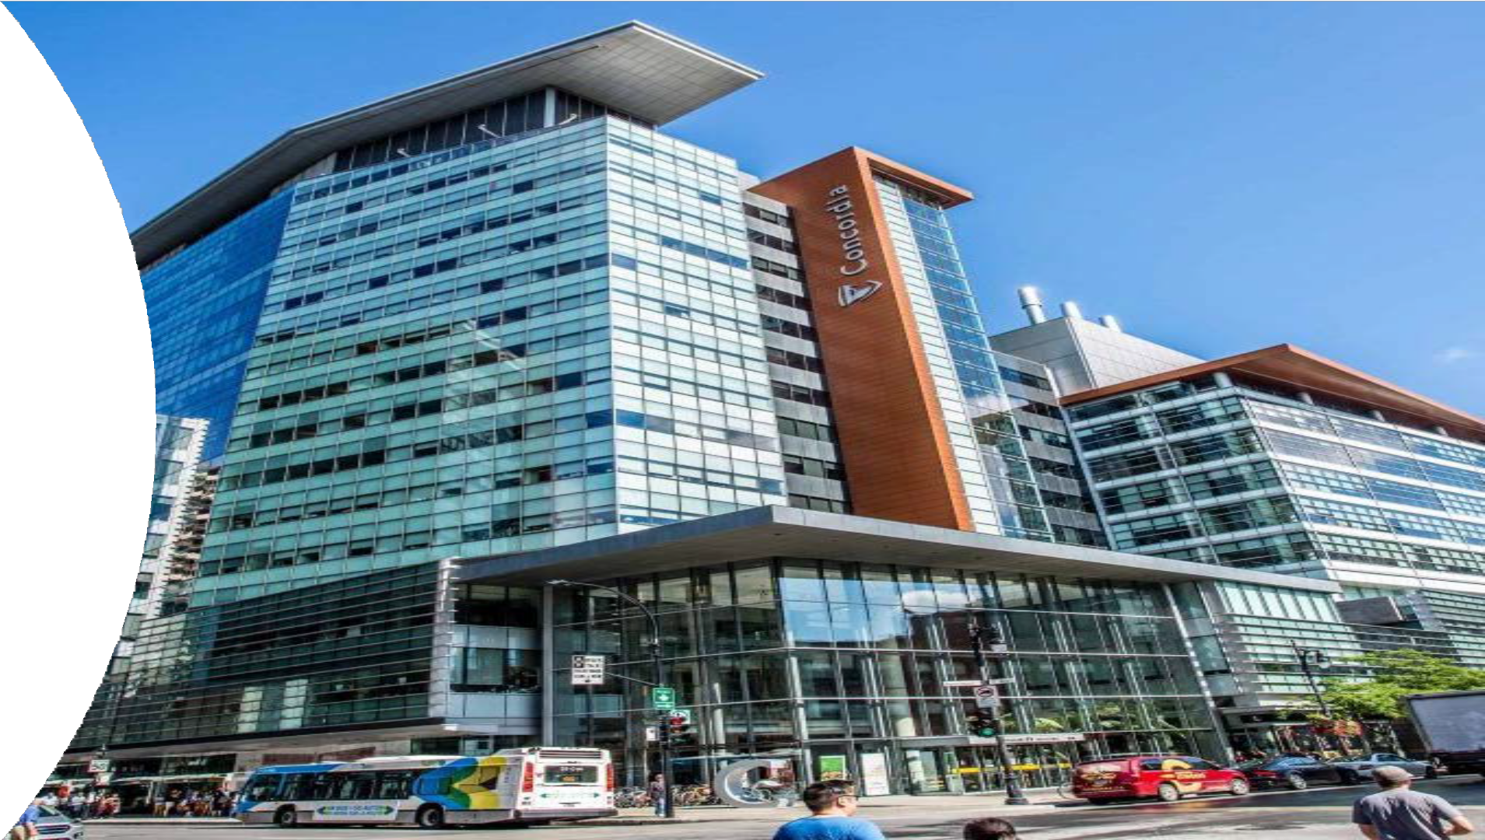
Department of Computer Science and Software Engineering

Slide 2
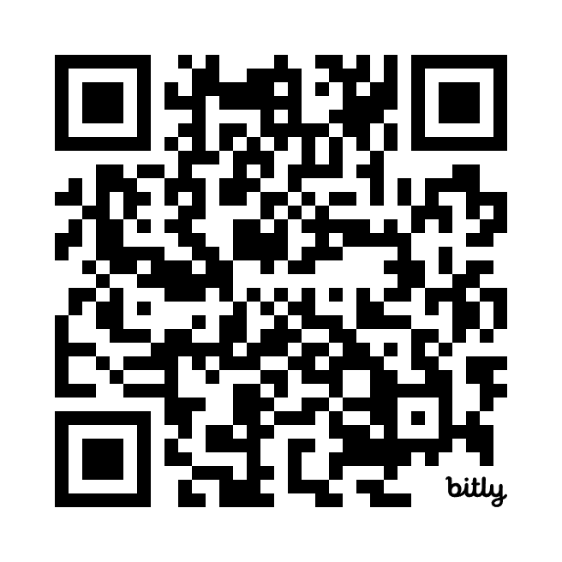
Download this presentation:

Slide 3
Topics
Information for potential students
Department Contact information
Admission Requirements
Program Requirements
Why study SOEN?
Why study COMP?
Why study at CSSE?
Student achievements
Potential work settings
Potential positions
Student services
Information for newly-admitted students
Concordia terms
Activating Accounts - ENCS & Concordia
Undergraduate calendar
ESL
EWT
Full time vs part-time
Deadlines
C- rule
Admission Letter
How to register
Course sequences
ECP SOEN
ECP COMP
ECP HLS
CEdge & Coop
Useful resources

Slide 4
Department Contact Information:
*Always provide your full name and 8-digit Concordia student number when communicating with the University.
Chair of the department: Dr. Paquet joey.paquet@concordia.ca
Program Director for Bachelor of Computer Science: Dr. Wang ugpd-compsci@concordia.ca
Program Director for Software Engineering: Dr. Rigby peter.rigby@concordia.ca
Undergraduate program assistants: Natallia Lapko & Carly Carruthers cse-ugrad@concordia.ca
Our department webpage: https://www.concordia.ca/ginacody/computer-science-software-eng.html

Slide 5
Admission Requirements
Bachelor of Computer Science
Bachelor of Computer Science in Health and Life Sciences
Bachelor of Computer Science Joint Major in Data Science
Bachelor of Computer Science Joint Major in Computation Arts and Computer Science
Minor in Computer Science
Bachelor of Engineering, Software Engineering

Slide 6
Program Requirements
Bachelor of Engineering, Software Engineering
Bachelor of Computer Science
Bachelor of Computer Science Joint Major in Data Science
Bachelor of Computer Science Joint Major in Computation Arts and Computer Science
Bachelor of Computer Science in Health and Life Sciences
Minor in Computer Science
Extended Credit Program (BCompSc, including Joint Majors)
Extended Credit Program (BCompSc Health and Life Sciences)
Extended Credit Program (SOEN)

Slide 7
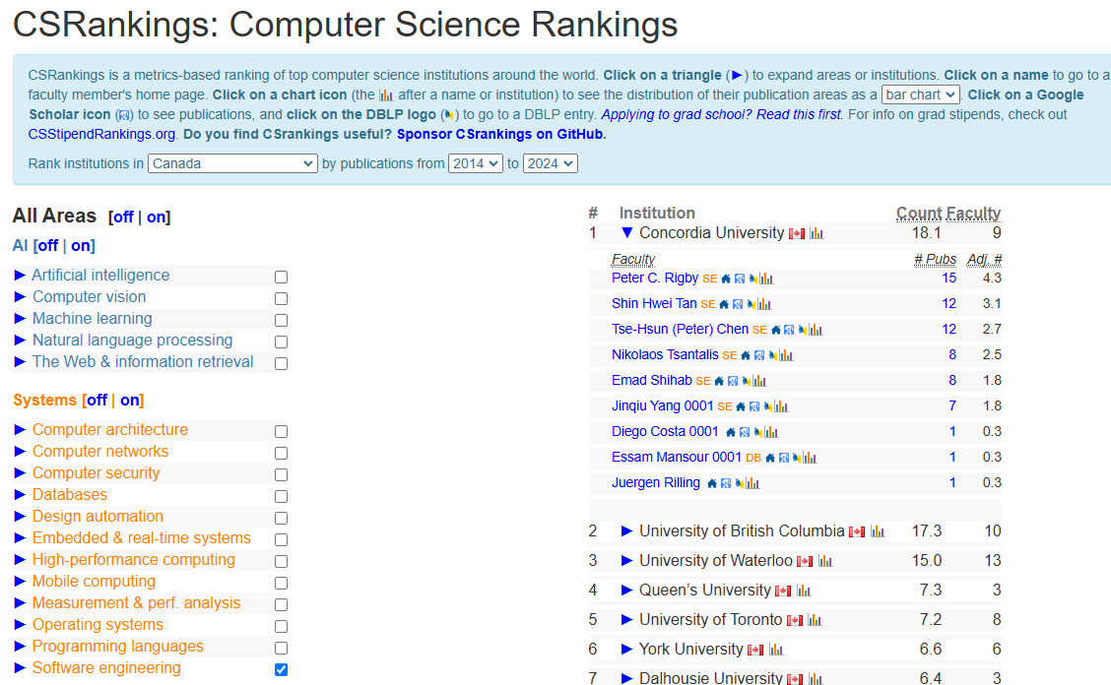
Why study with us?
In the recently released 2025 Computer Science Rankings (CSRankings), Concordia’s software engineering researchers placed number one in Canada, third in North America and eighth in the world. The CSRankings identify international institutions and faculty actively engaged in research across several computer science areas.

Slide 8
Why study Software Engineering?
Software Engineering (120 credits) (SOEN) is a four-year program leading to the degree of Bachelor of Engineering (Software Engineering).
Teaches you how to solve practical problems from an Engineering perspective
Accredited by the Canadian Engineering Accreditation Board, enabling you to become a Professional Engineer after graduating.
Many courses focus on various aspects of large-scale software development:
Development processes, specifications, architecture, design, implementation, maintenance, and project management.
“Soft skills” that all engineers must possess, such as technical writing, communicating, working in a team and leadership.

Slide 9
Why study Computer Science?
Computer Science (90 credits) (COMP) is a three—year program
The program is flexible, allowing students to combine with a minor in another subject
Computer science uses theoretical and mathematical foundations of computation to understand both software and hardware structure for effective and creative design.
Through labs, lectures and projects, you will:
Design and create new software
Modify existing software used in a broad range of application domains
Explore emerging software/hardware technologies

Slide 10
Hands-on experience
Both COMP and SOEN programs have good Co-Op program where you alternate school semesters and work semesters. The Co-op program gives you the opportunity to complete paid work terms that last 12 to 16 weeks. As a Co-op student, you will assist in projects designed and implemented by professionals
We have laboratories and other specific labs equipped with state-of-the-art software and computation resources.
Support/collaboration from the professors and the department
Projects in courses
Capstone projects
Research

Slide 11
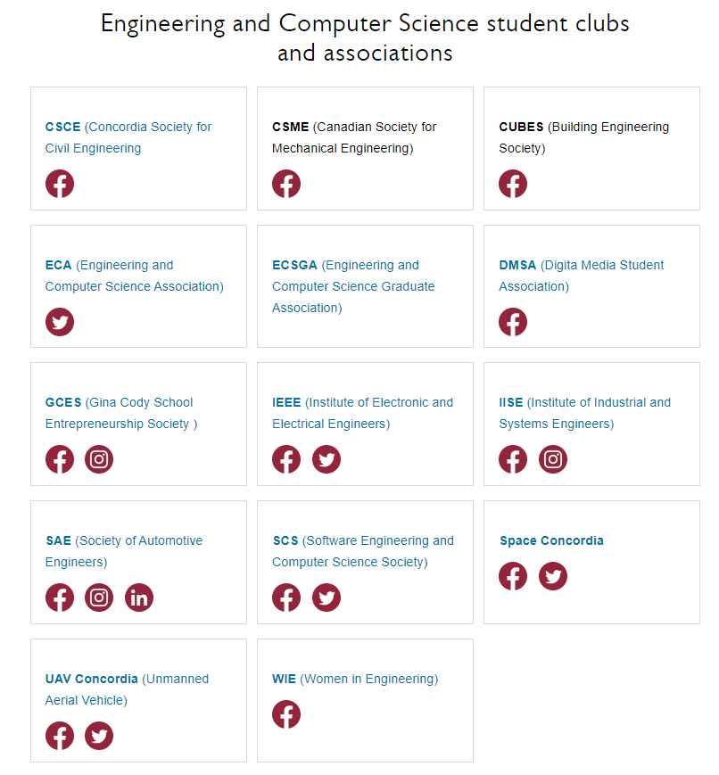
Student community
Student Associations

Slide 12
Potential work settings
Computer Science professionals typically work for software manufacturers, information technology consulting firms, information technology research and development firms, and in information technology units in private and public sectors.
Software Engineering: In most countries including Canada, only a Professional Engineer (P.Eng.) is licensed to practice engineering in the province or territory where it was granted. The license also gives you the right to use the Engineer title after your name. Engineering companies require an Engineering license for many key positions.

Slide 13
Student Hub
Birks Student Centre
Student Academic Services – Gina Cody School
Academics & Library resources
Co-op & Student Exchange
Student Associations & Clubs
Financial services & funding
IT support & software
Sports, fitness & recreation
Safety & security
Housing & food
Student Services

Slide 14
For newly-admitted students
Next slides are for students who have just been accepted in the programs

Slide 15
Your need-to-know Concordia terms
As a new student, you might have a hard time navigating all the administrative terms and acronyms used by the university.
With that in mind, here's a list of Concordia-specific terms that will come in extra handy as you register for classes and begin your first year.
Need-to-know Concordia lexicon: https://www.concordia.ca/students/registration/advising/your-undergraduate-student-lexicon.html

Slide 16
Activating your Accounts
ENCS account (@encs.concordia.ca):
The ENCS account is an account that is created specifically for Gina Cody School students.
Register here: https://www.concordia.ca/it/services/encs-user-account.html
Students require this account to register for the EWT test.
Office 365 Education (@mail.concordia.ca):
The Office 365 Education and Concordia email account is free of charge for all current Concordia students.
Registration opens on the first day of class for new students:
https://www.concordia.ca/ctl/digital-teaching/microsoft-office-365.html
Students require this account to submit Student Requests for example.
Add @Concordia.ca to your SAFE Sender list and check your junk mail folder regularly to not miss important information!

Slide 17
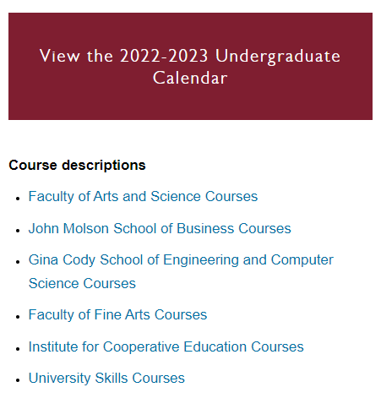
Undergraduate Calendar
The Undergraduate Calendar is an official University document. It defines academic programs and the regulations that pertain to them.
Undergraduate Calendar: https://www.concordia.ca/academics/undergraduate/calendar.html

Slide 18
English as a Second Language (ESL)
*Not required for all students – verify your Offer of Admission.
English as a Second Language (ESL) courses are listed in the Deficiencies
section of your Offer of Admission.
If ESL courses are required at admission, they should be completed within the first academic year and before registering for Engineering Writing Test (EWT) or ENCS 272.
The ConCEPT test is a “second look” at your skills in English. A strong performance can potentially exempt you from one or more of the ESL courses assigned.
English as a Second Language (ESL) and ConCEPT test:
https://www.concordia.ca/artsci/education/programs/esl.html

Slide 19
Engineering Writing Test (EWT)
*Required for ALL students.
All undergraduate students at GCS must satisfy the School's writing skills requirement (EWT). If you have ESL requirements, you must pass those courses before attempting the exam.
There are two ways to satisfy (complete) the writing skills requirement:
Take the Engineering Writing Test (EWT) and receive a PASS result (two attempts are allowed)
or
Take ENCS 272 and pass with a C- or better
Note: You must receive confirmation that you passed the EWT, and your unofficial record reflect the PASS, before you will be able to register ENCS 282.
EWT: https://www.concordia.ca/ginacody/students/new-students/writing- test.html?utm_source=redirect&utm_campaign=writing-test-encs

Slide 20
Full-time vs. Part-time
A student’s status is determined by the number of credits for which she or he is registered at the end of the tuition refund period, in the following way:
Full-time = registered in 12 or more credits per term
Part-time status = registered in less than 12 credits in a term
If you are an International Student or receive Financial Aid & Awards, be mindful that your credit load could have an impact, so you would need to contact those offices directly for inquiries on this topic.

Slide 21
DNE & DISC Deadlines
Important deadlines (check the Academic Calendar for dates):
DNE (Did Not Enter): The DNE deadline is the date by which you can officially withdraw from a course without having to pay for it. If you drop a course before this deadline it won’t appear on either your student record or official transcript.
DISC (Discontinued): If you miss the DNE deadline but still want to drop a course you can, as long as it’s done before the University DISC deadline. It won’t affect your GPA, a DISC notation will appear on your official transcript and you are financially responsible for the payment and other fees pertaining to the course. (If the course is a co-requisite, you are also registered in, you will need to DISC both courses.)
Important Academic Dates:
https://www.concordia.ca/students/undergraduate/undergraduate-academic-dates.html

Slide 22
“C-”rule for 200-level courses
Minimum grade of C- :
All 200-level courses within the program which are prerequisites for other courses must be completed with a C- or higher.
A 200-level course within the program which is a prerequisite for other courses in which a student has obtained a D+ or lower must be repeated before attempting a course for which it is a prerequisite.
Example:
ENGR 213 is part of the BEng. core and is a pre-requisite to ENGR 290, therefore a grade of C- or better is required in ENGR 213 to register for ENGR 290.
Undergraduate Calendar, Section 71.10.4 Registration Regulations
https://www.concordia.ca/academics/undergraduate/calendar.html

Slide 23
Admission Letter
The Admission Letter is the contract between you and the University. The letter includes your admission type, your program requirements and any additional requirements that may be needed.
Pay particular attention to your Admission type and the details under the page outlining Transfer credits, Exemptions, and Deficiencies.
Admission type: •
Transfer credits are courses you have received credit for.
Exemptions are courses you can't take at Concordia and receive credit.
Deficiencies are courses you must complete in ADDITION to your program.
Regular
Extended Credit Program (ECP)
Mature Entry Program (MEP)
Deficiencies
Refer to Understanding your offer:
https://www.concordia.ca/students/your-sis/offer-of-admission.html

Slide 24
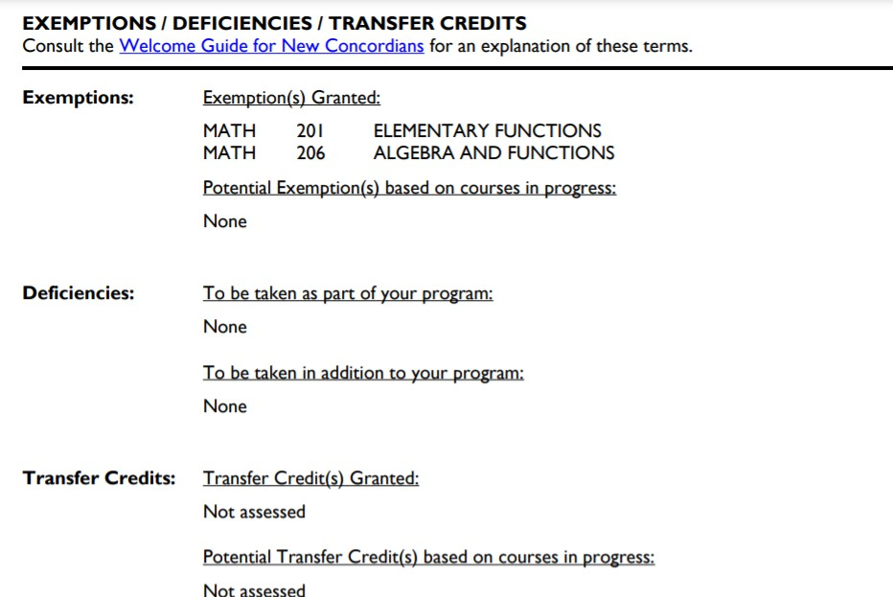
Exemptions are courses you do not need to take.
Deficiencies must be completed in addition to your program min. credits.
Transfer credits are courses you do not need to take and you have received credit for them.

Slide 25
Course registration
Course registration guide:
https://www.concordia.ca/students/registration.html
Pay particular attention to understanding:
Pre-requisites and co-requisites
Waitlist
Swap function
DNE (Add/Drop) & DISC deadlines

Slide 26
Registration tips!
Pay particular attention to understanding:
DNE (Add/Drop) and DISC deadlines (review Academic Calendar dates)
Register for all open terms (Fall and Winter) when registration opens
If applicable, complete all ECP, MEP and/or deficiencies in your first year
Follow your program course sequence
Register for open sections! If your preferred section is waitlisted use:
Course Swap: Allows you to switch courses without dropping a course and then adding another. This tool eliminates risk when needing to make a change.
A pre-requisite is a specific course you need to take before another course,
A co-requisite is when a specific course must be taken in the same academic
term as another course unless you’ve already successfully completed it.
If you need help figuring out how to use the registration system, email new@concordia.ca to speak with a Welcome Crew student mentor.
Course registration guide: https://www.concordia.ca/students/registration.html

Slide 27
Course sequences
Following your course sequence becomes very important to make sure you stay on track and complete the necessary requisites before moving on to another course.
Computer Science
Software Engineering
Health and Life Sciences
Data Science
Computation Arts
ECP Computer Science
MEP Computer Science
ECP/MEP Software Engineering

Slide 28
Bachelor of Engineering: Extended Credit Program (ECP)
Total: 30 credits
* 9 credits: MATH 203, MATH 204, MATH 205
* 6 credits: PHYS 204, PHYS 205
* 3 credits: CHEM 205
* 6 credits: chosen from courses in Humanities and Social Sciences from Section 71.110 Complementary Studies for Engineering and Computer Science Students.
* 6 credits of Natural Science electives must be chosen from the list in the Undergraduate calendar.
Undergraduate Calendar:
Section 71.20.2 Extended Credit Program

Slide 29
Computer Science:
Extended Credit Program (ECP)
Total: 30 credits
9 credits: MATH 203, MATH 204, MATH 205
Humanities or Social Science courses (6 credits) must be chosen from the two corresponding lists found in Section 71.110 of the Undergraduate Calendar. - Those credits cannot be chosen from the list of Other Complementary Studies.
Electives (15 credits):
Bachelor of Computer Science students: must be chosen from outside the Gina Cody School of Engineering and Computer Science AND the ECP Electives Exclusion List
Joint Major in Computation Arts and Computer Science: must be chosen from outside the Gina Cody School of Engineering, the Department of Design and Computation Arts AND the ECP Electives Exclusion List
Joint Major in Data Science: must be chosen from outside the Gina Cody School of Engineering, the Department of Mathematics and Statistics AND the ECP Electives Exclusion List
Undergraduate Calendar:
Section 71.70.3 Extended Credit Program

Slide 30
Computer Science Health and Life Sciences: Extended Credit Program (ECP)
Total: 30 credits
9 credits: MATH 203, MATH 204, MATH 205
12 credits: PHYS 204, PHYS 224, PHYS 205, PHYS 225, PHYS 206, PHYS 226
6 credits: CHEM 205, CHEM 206
3 credits: BIOL 201
Undergraduate Calendar
Section 71.75.3 Computer Science in Health and Life Sciences ECP

Slide 31
C.Edge and Co-op
Admitted in Co-op? Meet with your Co-op Director and follow the coop sequence.
Already a Concordia student? Applications to join Co-op for current Concordia students are reviewed twice a year — in September for fall, and in January for winter. How to apply?
C.Edge: https://www.concordia.ca/academics/co-op/programs/career- edge.html#eligibility
Co-op: https://www.concordia.ca/academics/co-op.html

Slide 32
Useful Resources
Welcome Guide for New Concordians
Health & Wellness
Student Success Centre – Learning services & workshops
International Student Office (ISO)
The Otsenhákta Student Centre
The Black Perspectives Office
Access Centre for Students with Disabilities (ACSD)
LIVE Centre – Leadership-Initiative- Volunteer Engagement
Réussir en Français
VIEW A-Z LIST OF SERVICES & PROGRAMS

