Slide 1
COMP 442 / 6421
Compiler Design
Tutorial 6
Instructor: Dr. Joey Paquet paquet@cse.concordia.ca
TAs: Haotao Lai h_lai@encs.concordia.ca
Jashanjot Singh s_jashan@cs.concordia.ca

Slide 2
Content
Important parts in code generation
How to use MOON
Example

Slide 3
Code Generation

Slide 4
The key of code generation → offset
Recall
How can you know whether a variable has been declared or not when you try to use it ?
How many column you have in your symbol table ? What do they use for ?
Offset
It represent how far a variable away from a base address;
For example, a member variable of a class, offset of the variable means how far this variable’s first address away from the first address of the class;
In order to achieve code generation:
Add a new column to your symbol table → offset
Calculate the offset of each data type when you add that entry into your table

Slide 5
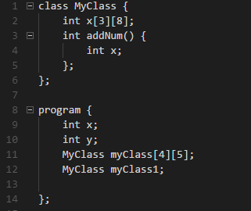
Offset Example → the forth column

Slide 6
Stack Mechanism

Slide 7
What is the stack?
The stack we talk about here is not the real “data structure stack”. It is a function invoke stack. When a function being called, its frame will be push into the stack and when the function return the corresponding frame will be popped out.
In our case, we treat the MOON’s memory as a stack.

Slide 8
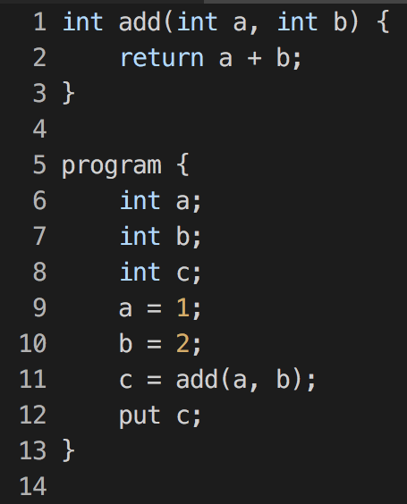
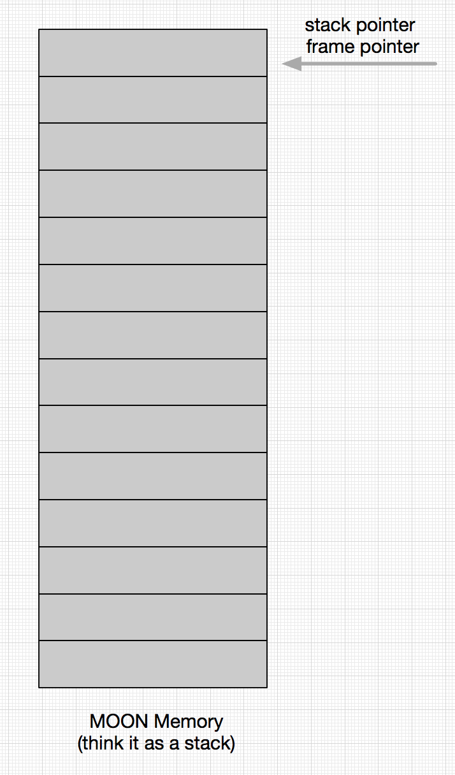
Stack-based Function Call Mechanism

Slide 9
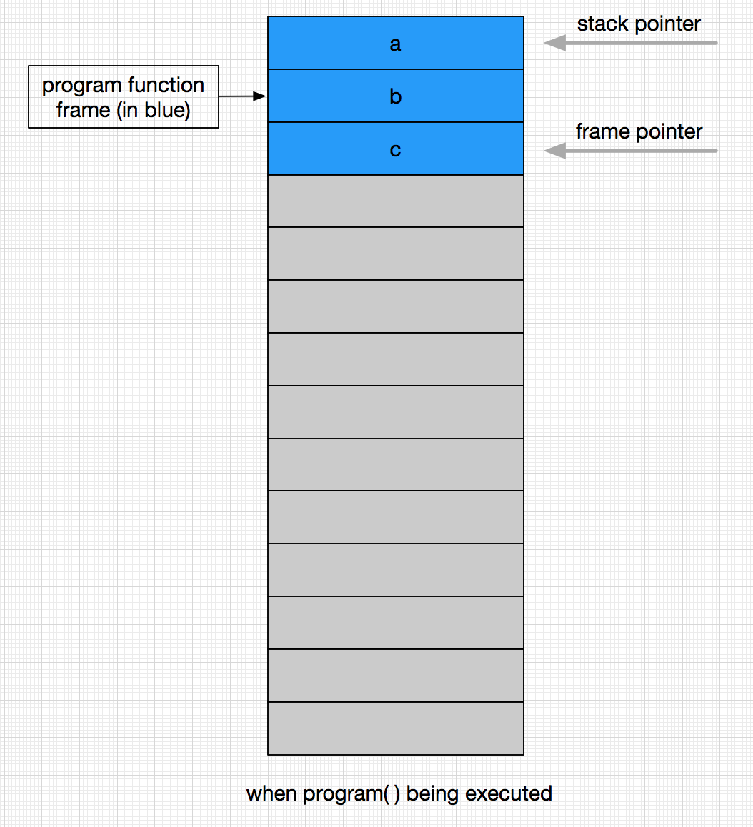
Stack-based Function Call Mechanism

Slide 10
How you can know where you should put
a, b, c and how to locate them?

Slide 11
Remember we have offset!
offset → the distance from the variable cell to the stack pointer (current function’s base address).
frame pointer → where the new function frame should be put.

Slide 12
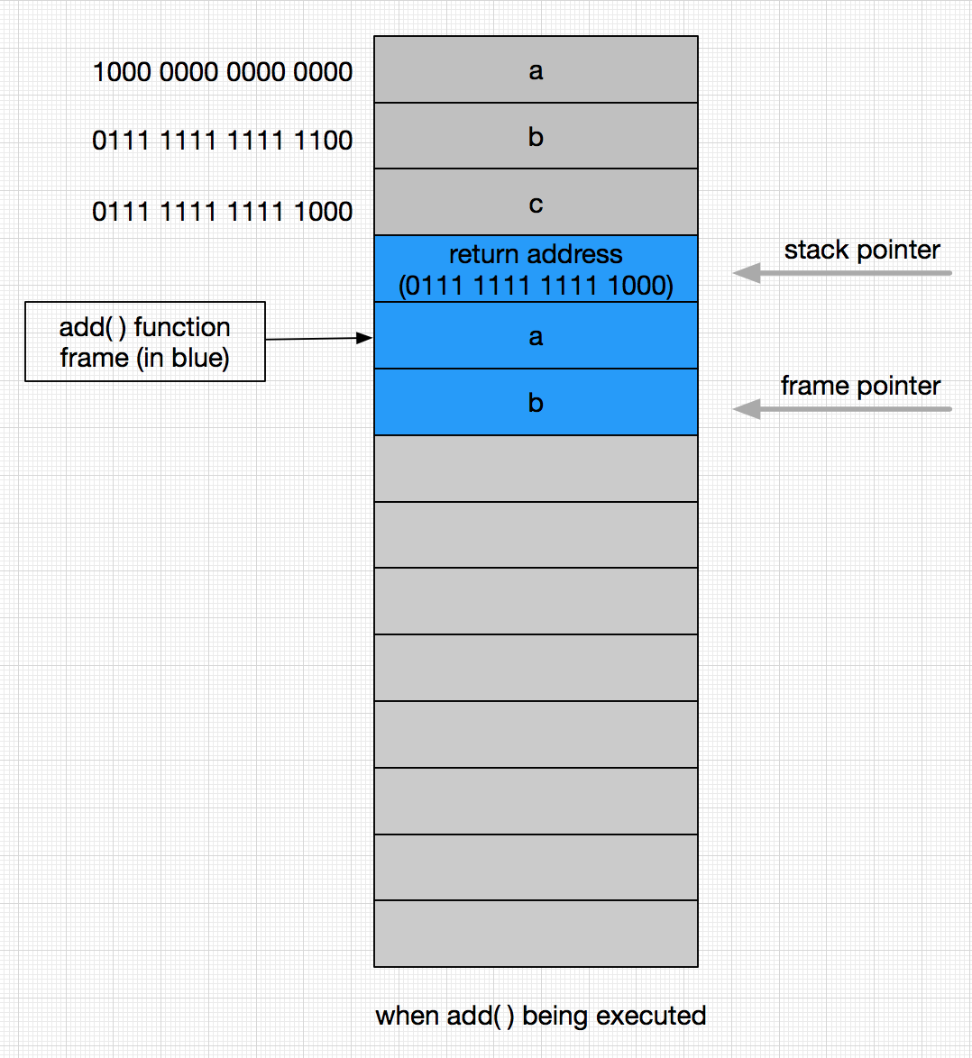
Stack-based Function Call Mechanism

Slide 13
MOON Processor

Slide 14
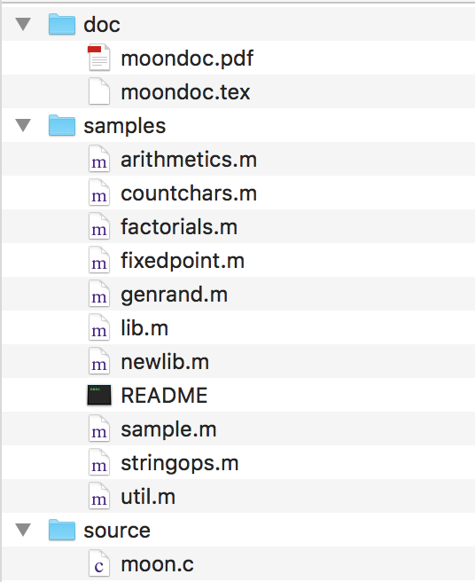
Background
The MOON processor is wrote by Dr. Peter Grogono, the last modification is on 30 January 1995;
It is a kind of “virtual machine” we used to run our generated code (assembly language)
You can get the source code of Moon in the bottom of the course website
You need to have the very basic idea of assembly language

Slide 15
How to compile MOON?
You need to have a C compiler (eg. gcc)
Download the source code and unzip it
Open Terminal, change your working directory to where you put the source code
Compile it using the very basic compile command
For example, if you are using gcc, just type the following command in the terminal:
gcc [-o executable_file_name] moon.c
If you don’t specify the name, the executable will be named “a” in Unix, Linux or macOS.
Note: there is a PDF file accompanying with the source code, you are strongly suggested to read that file before you ask any question.

Slide 16
Important Parameters of MOON
All instructions of MOON occupy one word
There are total 16 registers from R0 to R15, R0 always contains zero
Program counter is 32-bit and contains the address of next instruction to be executed
Memory address in the range of [0, 2^31], the usable memory is less than that

Slide 17
How to use MOON?
There are three types of instruction:
Data access instructions
Arithmetic instructions
Input and output instructions
Control instructions
Terminology
M₈[K]: it denotes the byte stored at address K;
M₃₂[K]: it denotes the word stored at address K, K + 1, K + 2 and K + 3;
An address is aligned if it is a multiple of 4;
An address is legal if the address byte exists;
The name PC denotes the program counter;
The name R0, R1, … denotes the registers;
The symbol ← denotes data transfer;
Note: the slide cannot show all instructions provided by MOON, please consult the documentation for more detailed !

Slide 18
Data Access Instructions
Take load word as an example:
R(i) ← ³² M₃₂[R(j) + K] means take one word data stored in the address ( R(j) + K ) and put it into register R(i)
where K in the range of [-16384, 16384)

Slide 19
Arithmetic Instructions
There are two types of arithmetic instructions:
R ( i ) ← R ( j ) + R ( k ), sum up the second and third register’s value and put the result into the first register;
R ( i ) ← R ( j ) + k, sum up the second register’s value and the third value then put the result into the first register;
We call all productions like the second one shown above “instruction with immediate operand”.

Slide 20
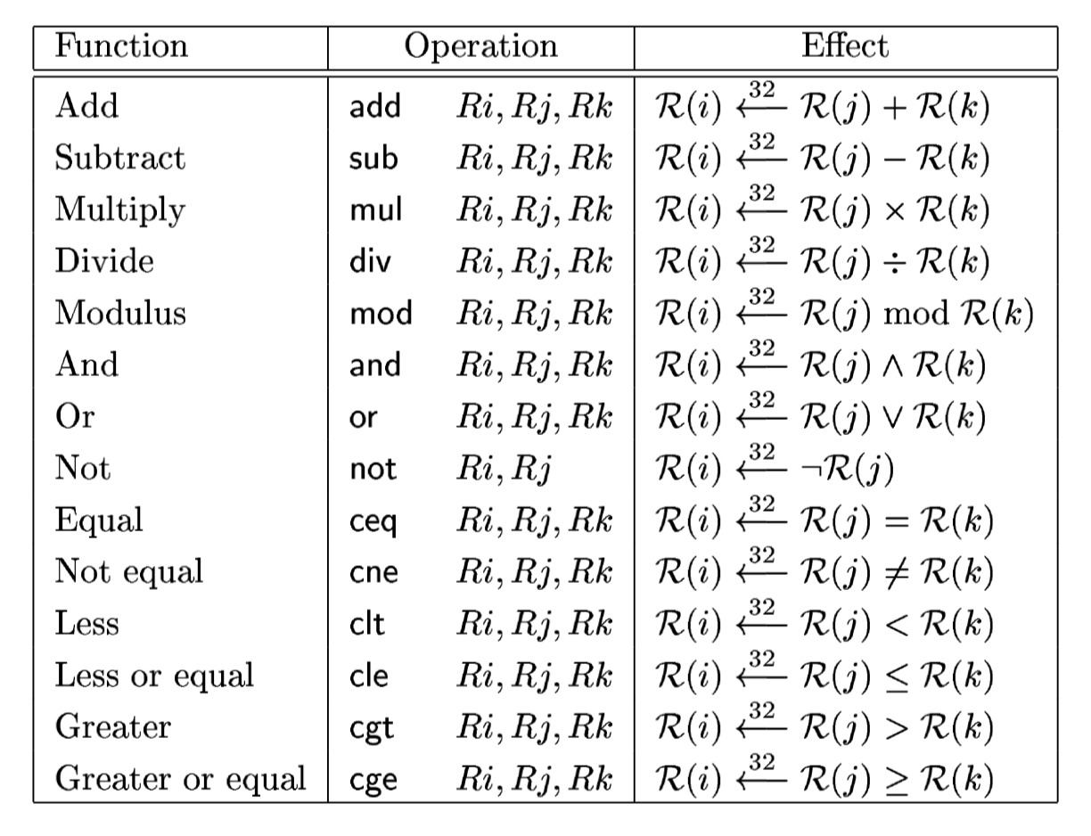
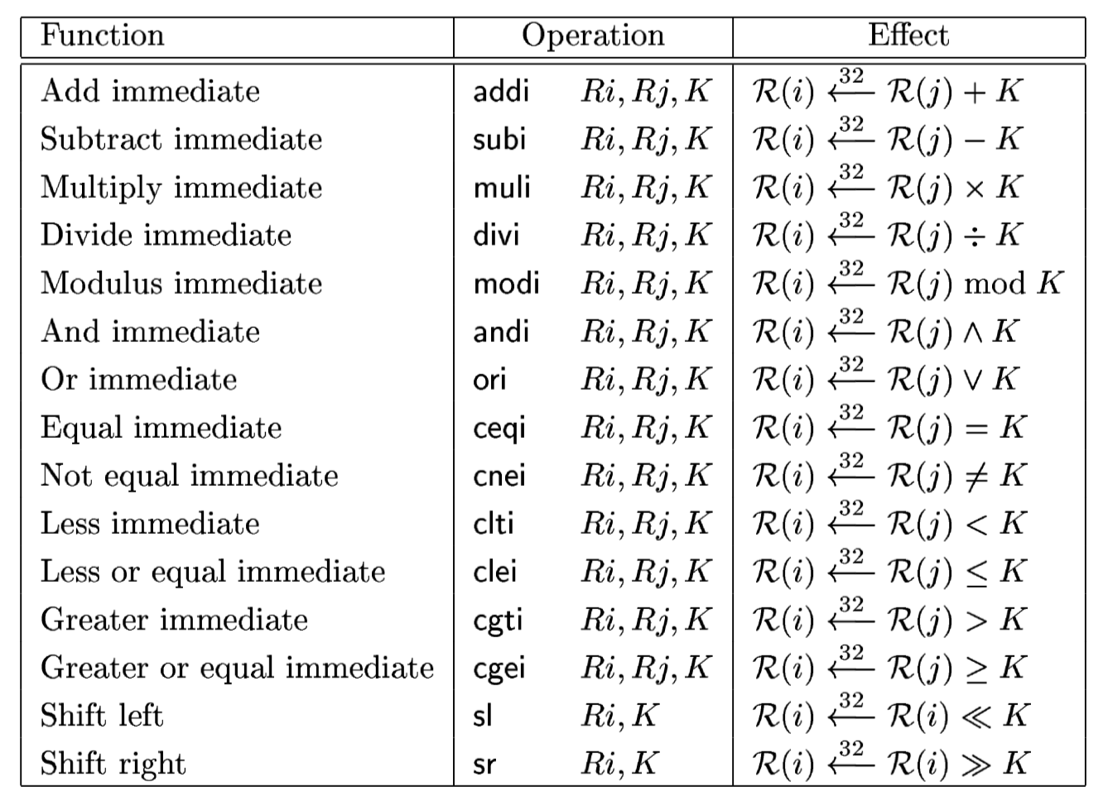
Arithmetic Instructions
the logical operation operate on each bit of the word
the comparison operator store result either “1” (true) or “0” (false)
in the right side table, the operand K is a signed 16-bit quantity, negative numbers like -1 is interpreted as -1 not 65535

Slide 21
Input and Output Instructions
This two instructions are useful when you try to out the result of your program to show it really worked during the final demo.

Slide 22
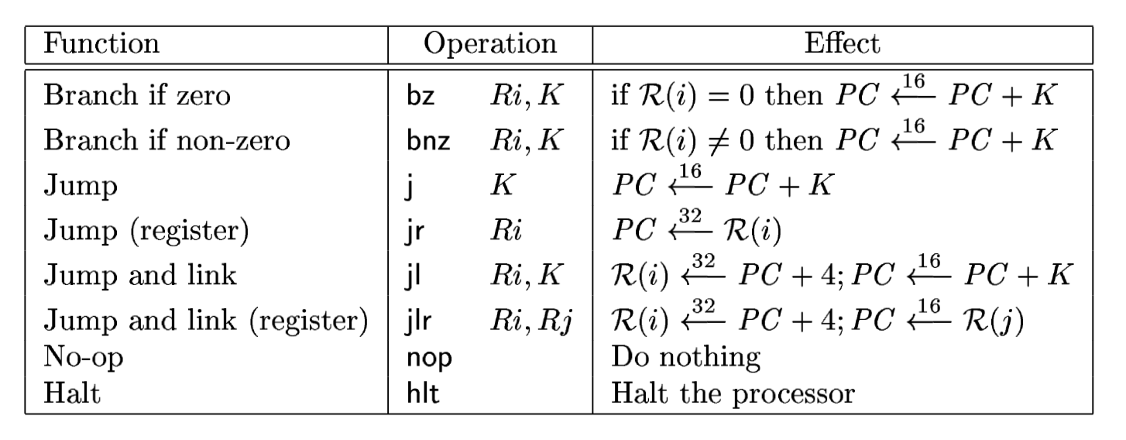
Control Instructions
when you use branch, remember to set the PC (program counter) correctly
jump instruction will be useful when you generate function code, you need to store the return address properly

Slide 23
MOON Example

Slide 24
Refer to the sample folder
the most simple one is the sample.m, I strongly recommend you begin with this example in order to get familiar with MOON.

Slide 25
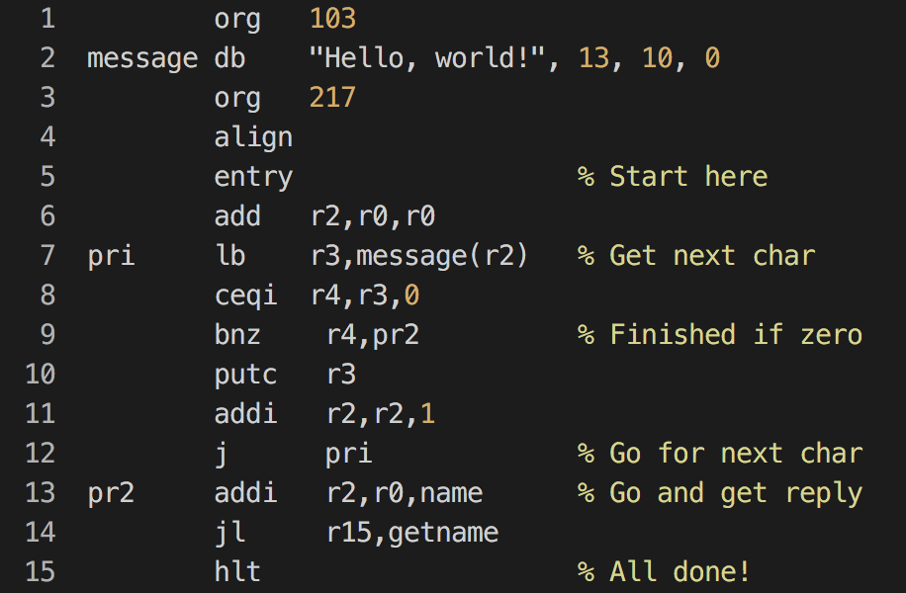
sample.m

Slide 26
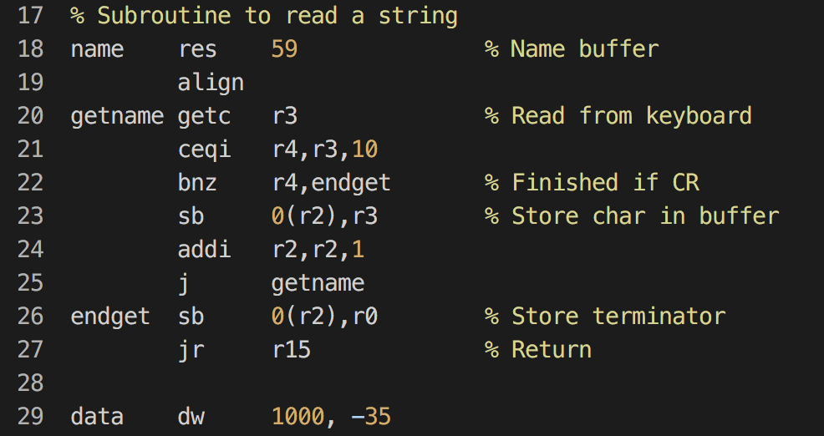
sample.m

Slide 27
Final Example
source code → assembly code

Slide 28
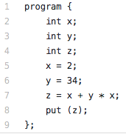
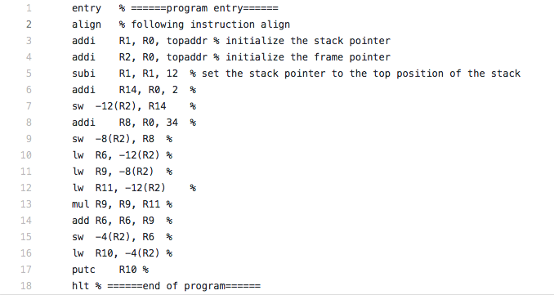

Slide 29
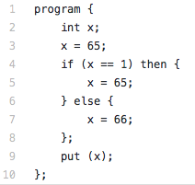
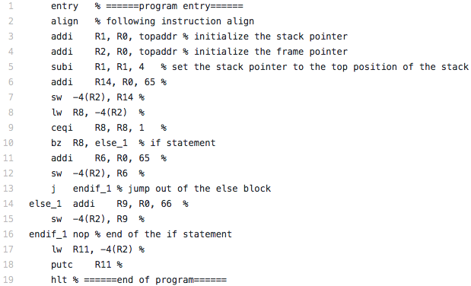

Slide 30
Thanks!
Good Luck for your project . . .

