Slide 1
COMP 442 / 6421
Compiler Design
Tutorial 2
Instructor: Dr. Joey Paquet paquet@cse.concordia.ca
TAs: Haotao Lai h_lai@encs.concordia.ca
Jashanjot Singh s_jashan@cs.concordia.ca

Slide 2
Tutorial Slides
You can access the tutorial slide set through the following link:
http://laihaotao.me/ta/

Slide 3
You don’t have Window machine?
Check the following link out:
http://atocc.de/AtoCCFAQ/index.php?option=com_content&task=category&sectionid=11&id=25&Itemid=34
I tried it on macOS High Sierra version 10.13.1 and it worked!

Slide 4
How to access AtoCC without administration right ?
There is a portable version, but sometime it will crash, save your work frequently!

Slide 5
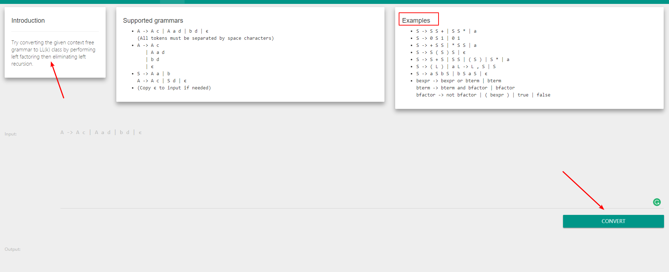
Another powerful tool
https://cyberzhg.github.io/toolbox/cfg2ll

Slide 6
Some examples of the grammar

Slide 7
The Goal of Assignment 2
Convert the given CFG to LL(1) grammar
Need to use tools to verify your converting procedure
Remove the grammar from EBNF to non-EBNF presentation
Remove ambiguity and left recursion
Implement a LL(1) parser
Recursive descent predictive parsing
Table-driven predictive parsing

Slide 8
Example (1)
Assume you was given a grammar as following:
commaSeparatedList -> a {,a} | EPSILON
You should remove the EBNF format and come up with the following grammar:
commaSeparatedList -> a commaSeparatedListTail | EPSILON commaSeparatedListTail -> ,a commaSeparatedListTail | EPSILON

Slide 9
Example (2)
After remove EBNF format, assume you have something like:
You will need to perform the operation: remove left recursion.

Slide 10
How to come up with the proper grammar?
You receive the initial grammar in EBNF in assignment 2 description already;
You need to remove the EBNF since the compiler cannot understand this form;
Perform left factoring (if necessary);
Remove left recursion (if exist, unfortunately, they exist in the given grammar);
Strongly suggest that every time you correct a grammar please use AtoCC to check whether you correction worked or not.
Don’t try to correct many errors within one shot, it is easy to get lost.

Slide 11
Example
--- How to use AtoCC for verification

Slide 12
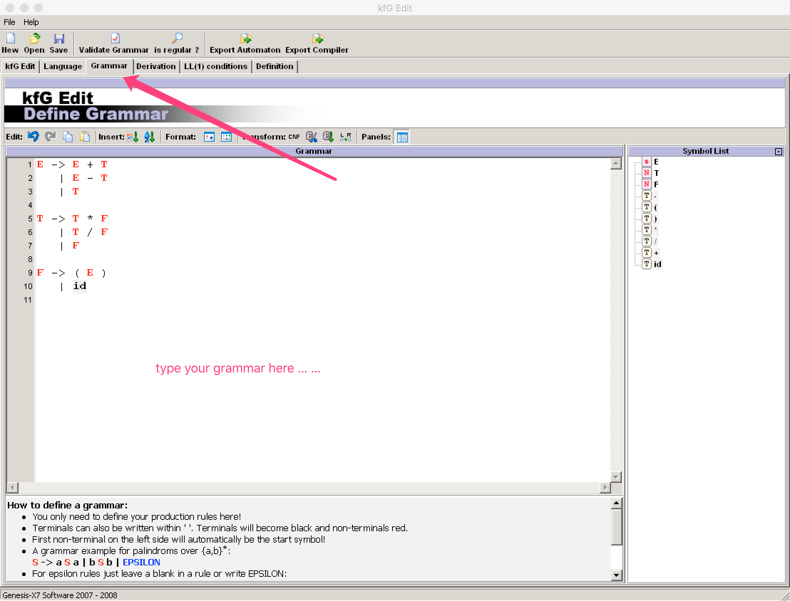

Slide 13
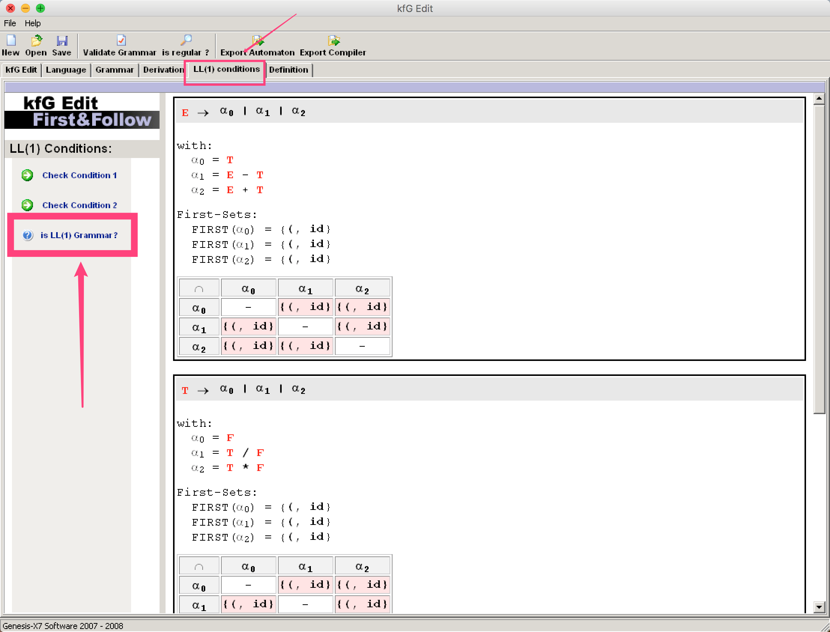

Slide 14
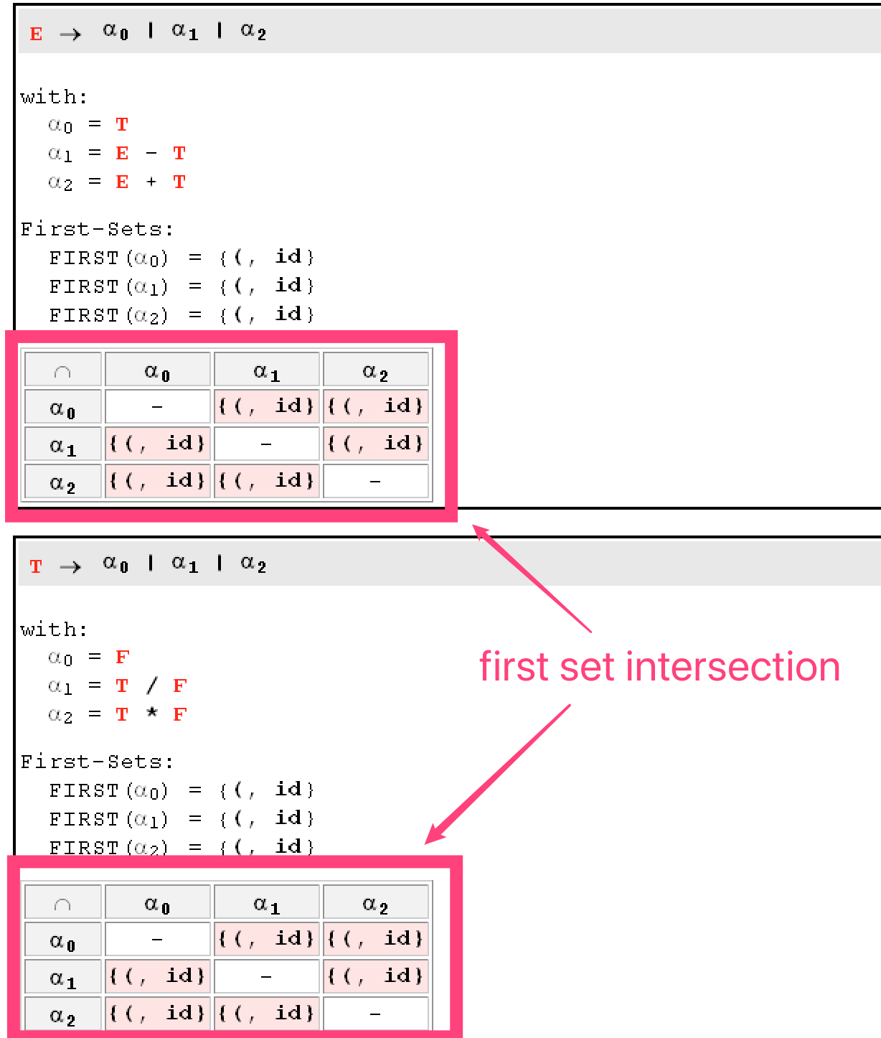

Slide 15
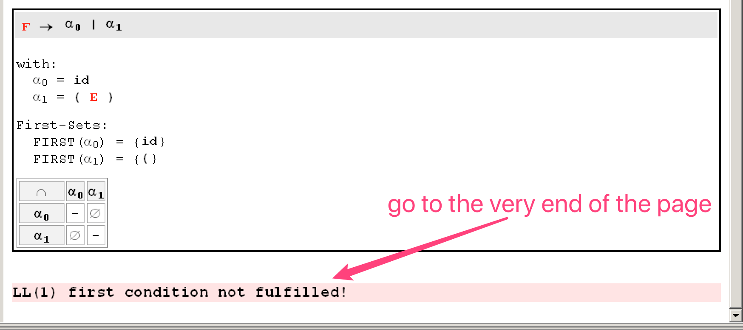

Slide 16
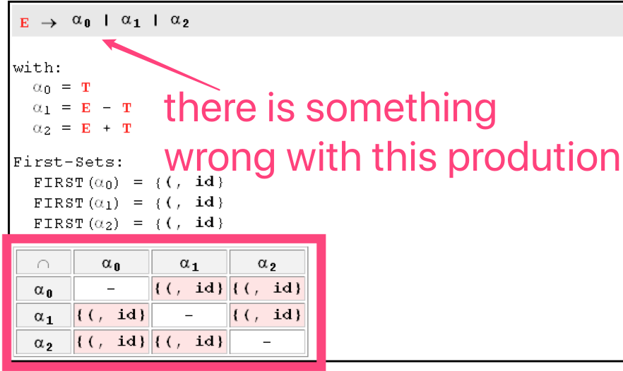
What you should do?
Locate where the error, you can check the production
Copy the relate production put into the second tool we mention above (https://cyberzhg.github.io/toolbox/cfg2ll).
Copy the correction from the tool and paste it into AtoCC
Do some modification to adapt AtoCC format
Check the grammar again
Note: Don’t try to solve more than one production at a time. When you solve one production’s error, use the tool to check to make sure you are not bringing new errors.

Slide 17
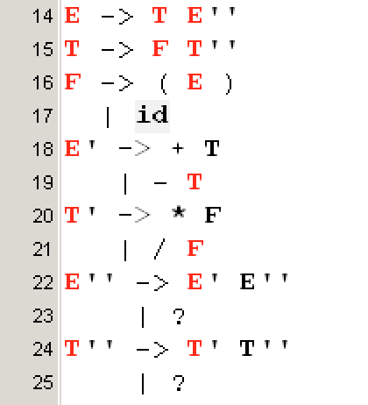
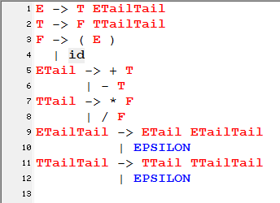
result from the tool
after modification adapt to AtoCC

Slide 18
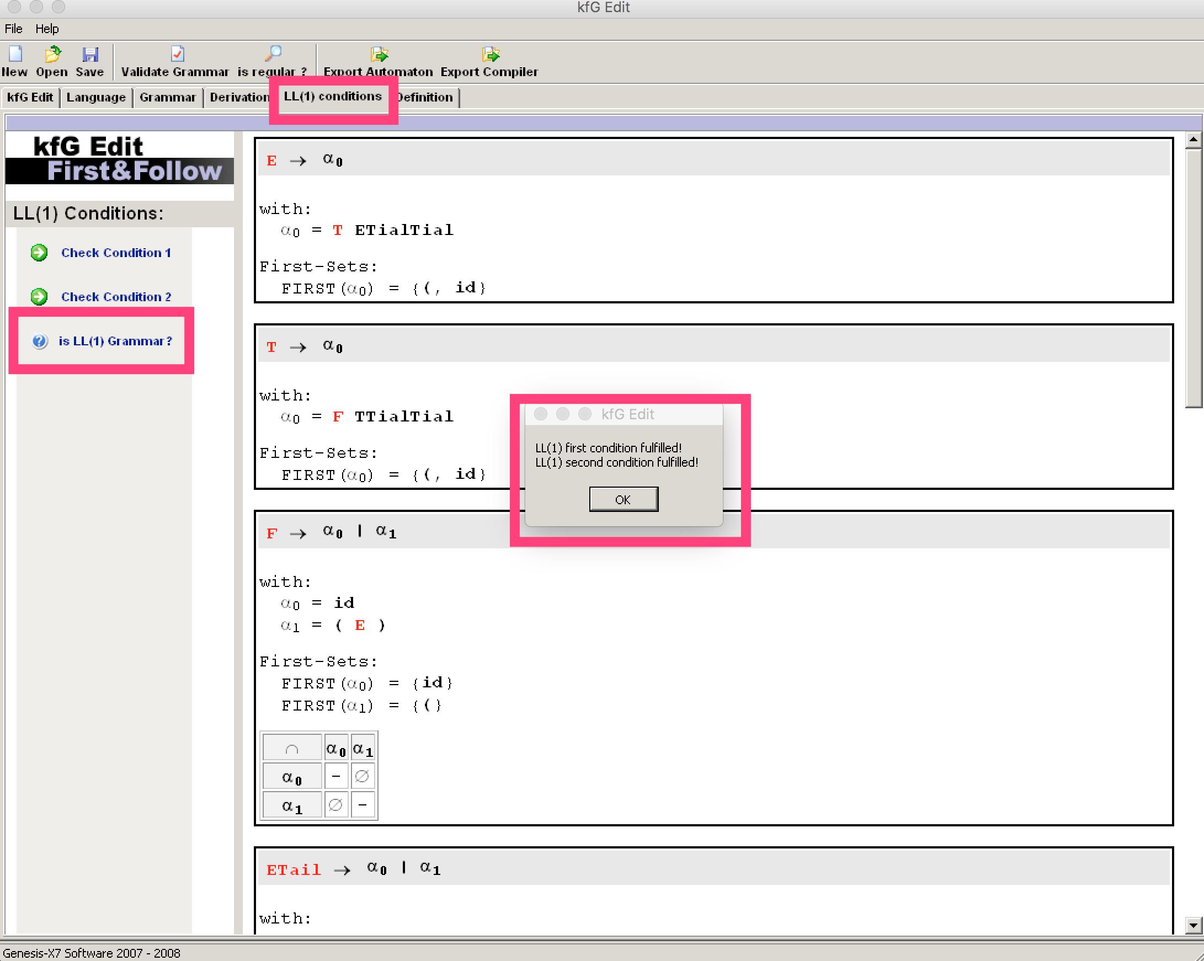

Slide 19
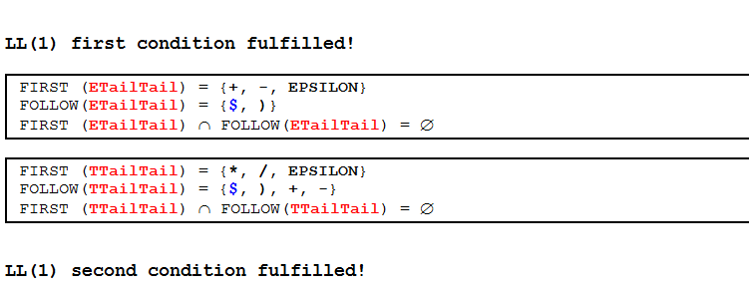

Slide 20
Thanks

