Slide 1


Experimental Investigation of the Ternary Mg-Zn-Zr System
Xin Zhang
Supervisor: Dr. Mamoun Medraj
Department of Mechanical and Industrial Engineering
Concordia University
Montreal, Quebec
June 4th, 2015

Slide 2
Outline
Introduction
Objectives
Literature review
Methodology
Results and discussion
Conclusions
Suggestions for future works

Slide 3



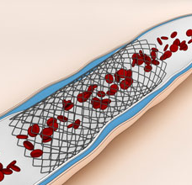
Introduction
The application of Mg alloys has been increasing in automotive, aircraft, electronic and biomaterial industries.
Automotive
Aircraft
Electronic
Biomaterial
[1] http://www.mercedes-benz.ca
[2] http://www.rsc.org/chemistryworld

Slide 4
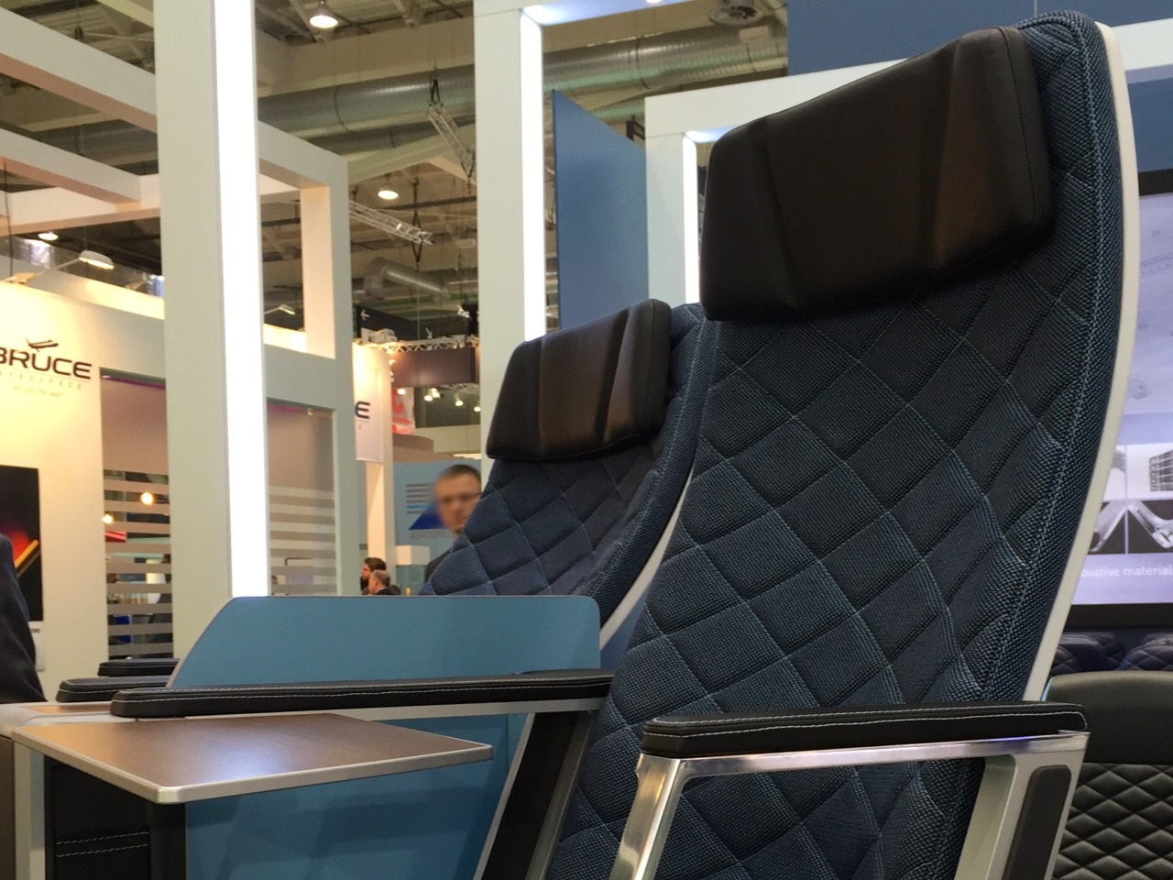

Introduction
The application of Mg alloys has been increasing in automotive, aircraft, electronic and biomaterial industries.
Fuel
http:// www.toovia.com

Slide 5
Introduction
Alloying elements, added to Mg, improve its properties.
Zn
castability
creep resistance
yield strength
Zr
mechanical properties
ductility
corrosion resistance
Mg
Zn
Zr
Mg-Zn-Zr

Slide 6
Introduction
Alloying elements, added to Mg, improve its properties.
Mg-Zn-Zr
(ZK Series)
ZK60
ZK51
ZK40
ZK61
ZK30
Mg
Zn
Zr
Mg-Zn-Zr

Slide 7
Objectives
To study the phase equilibria of the various phases in the Mg-Zn-Zr ternary system.
To determine the formation of the ternary compounds, and their crystal structures.
To investigate the solubility limits of the ternary and the binary compounds.
To construct the isothermal section of the Mg-Zn-Zr ternary phase diagram at 450°C experimentally.

Slide 8
Literature review
Mg-Zn
450ºC
Mg-Zn, P. Ghosh, M. Mezbahul-Islam, M. Medraj, 2012

Slide 9
Literature review
Mg-Zr
450ºC
Mg-Zr, R. Arroyave, D. Shin, Z. K. Liu, 2005

Slide 10
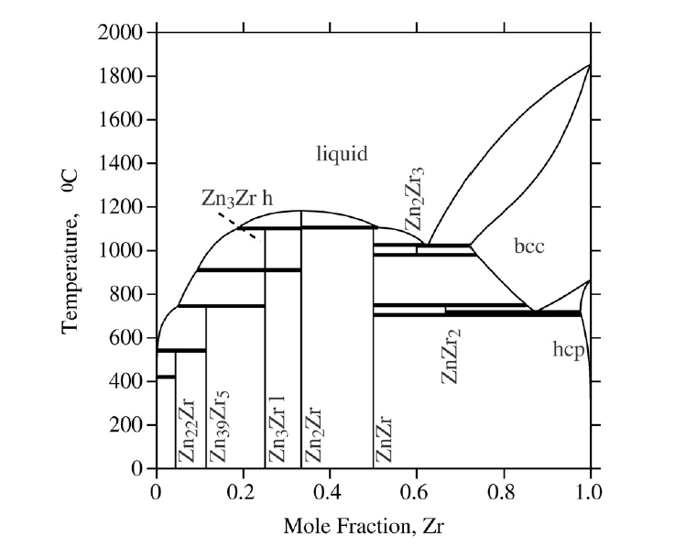
Literature review
Zn-Zr
450ºC
450ºC
Zn-Zr, R. Arroyave, Z. K. Liu, 2006

Slide 11
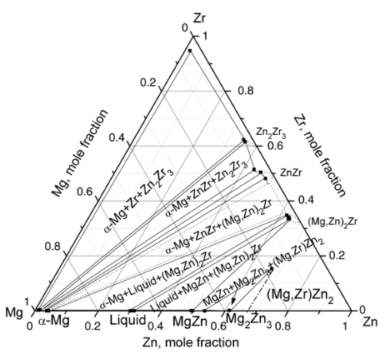
Literature review
Prediction of the phase equilibria at 450ºC
345ºC
Mg-Zn-Zr 345ºC Y. P. Ren et al. 2011

Slide 12
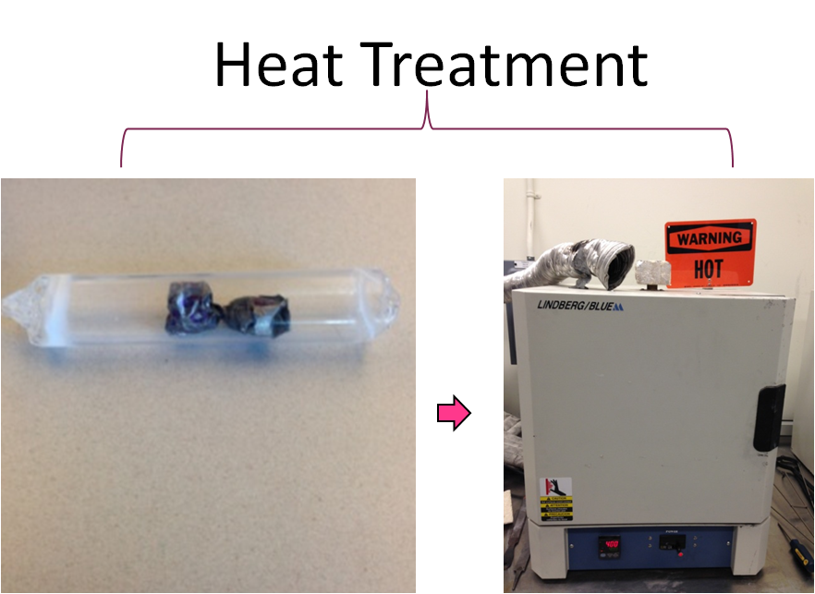
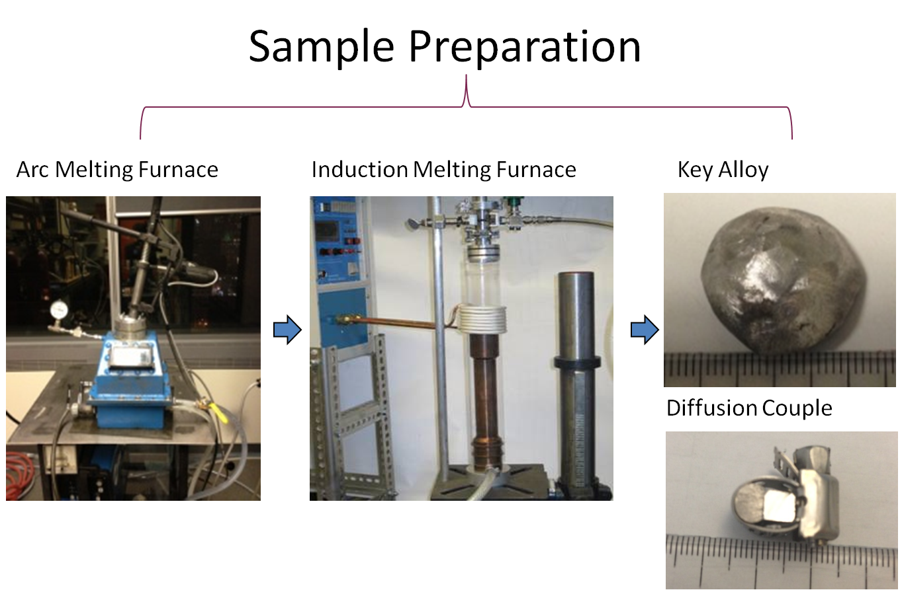
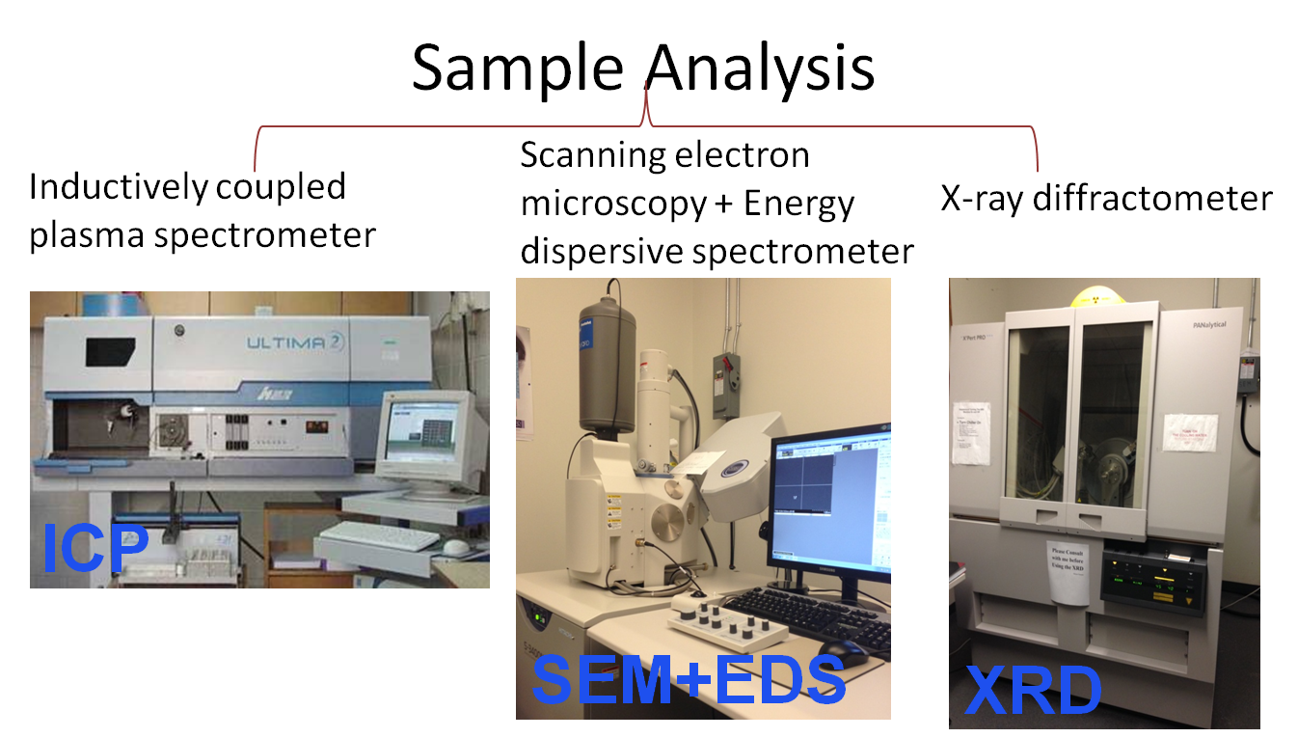
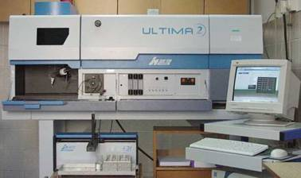
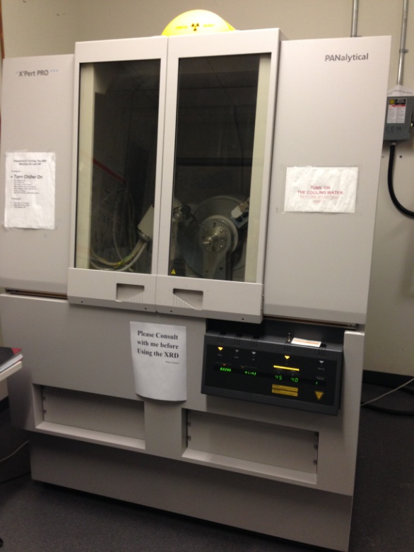
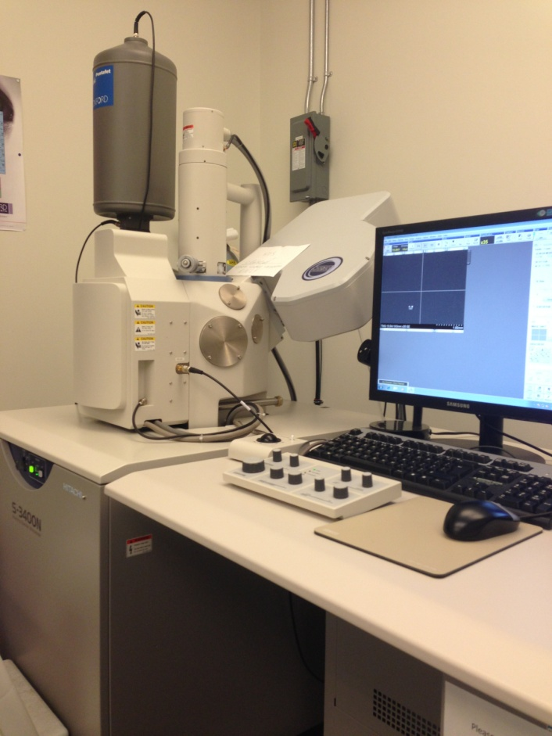
Methodology
Sample Preparation
Heat Treatment
Sample Analysis
Sample Preparation
Heat treatment
Sample analysis
ICP
XRD
SEM

Slide 13
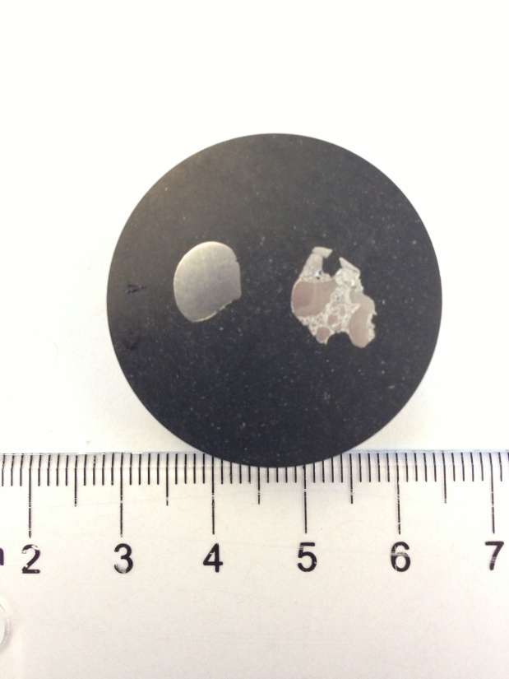
Challenge and solutions
Composition shifting
Inhomogeneous sample
Pure Zr
Elements | Melting Point | Boiling Point
Mg | 650℃ | 1107℃
Zn | 420℃ | 907℃
Zr | 1852℃ | 4377℃

Slide 14
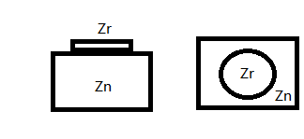
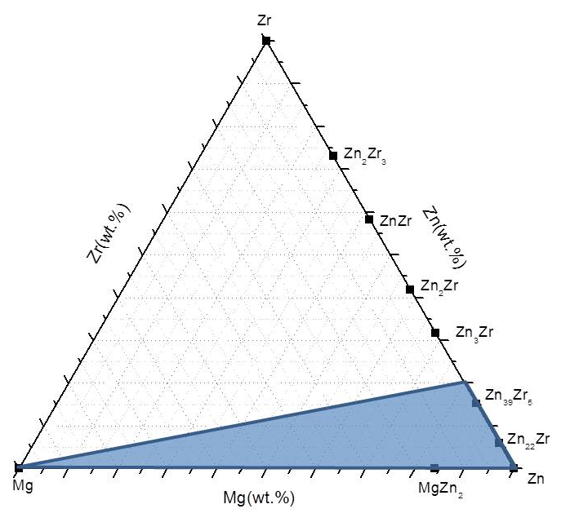
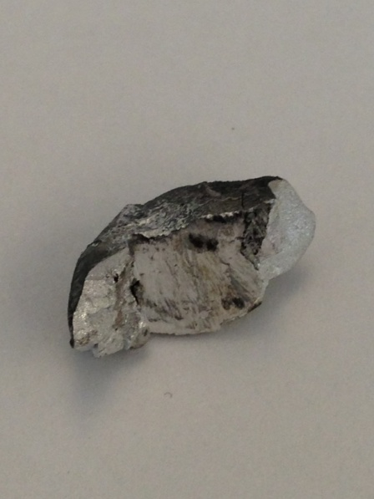
Challenge and solutions
Ternary key alloy
Elements | Melting Point | Boiling Point
Mg | 650℃ | 1107℃
Zn | 420℃ | 907℃
Zr | 1852℃ | 4377℃
Zn-Zr master alloy

Slide 15
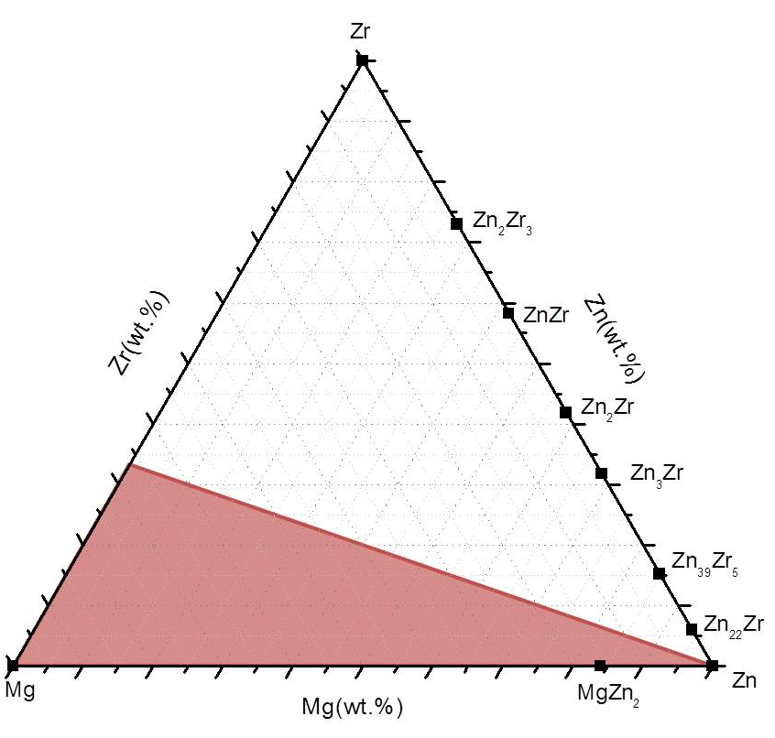
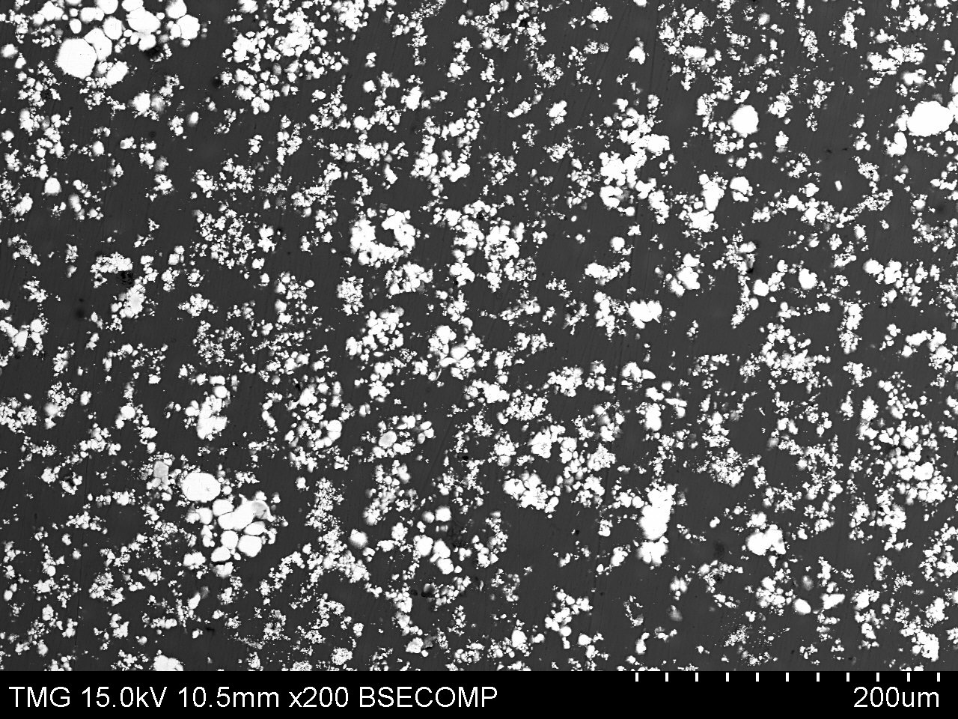
Methodology
Zn-Zr master alloy
Zn-Zr master alloy
Mg-Zr master alloy

Slide 16
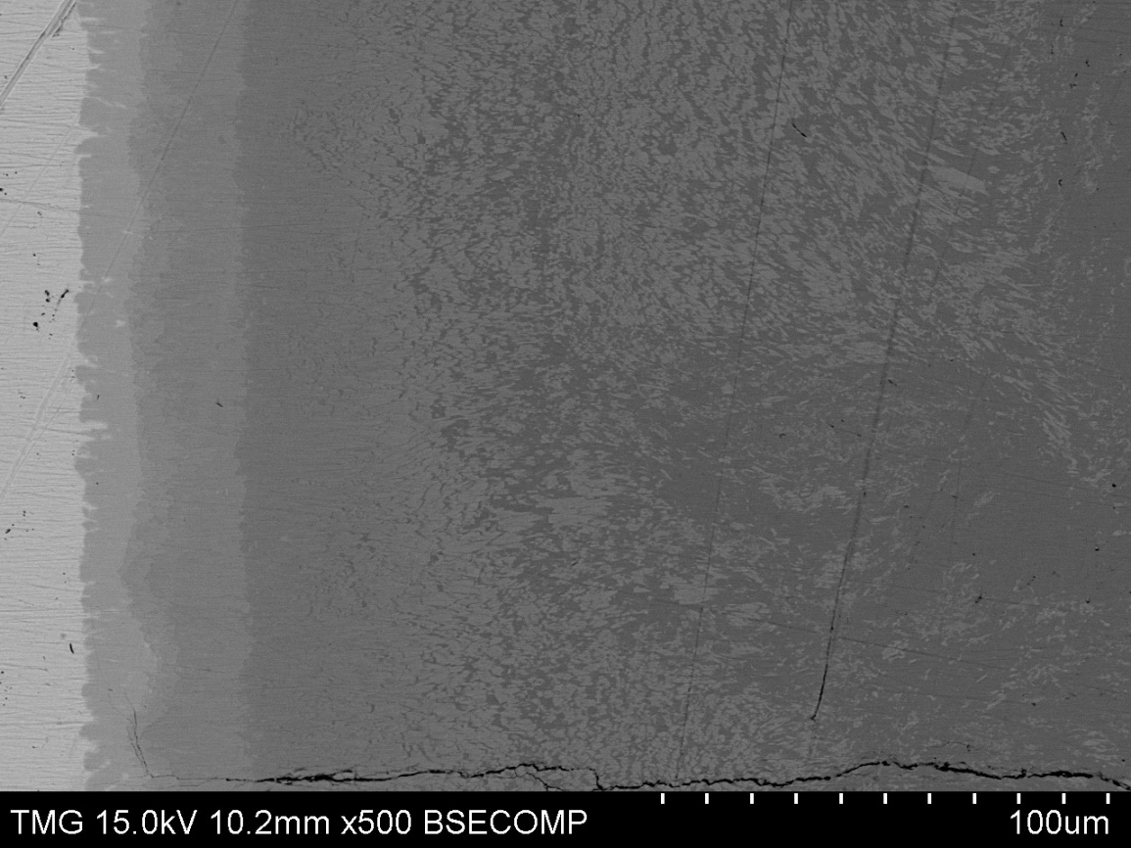
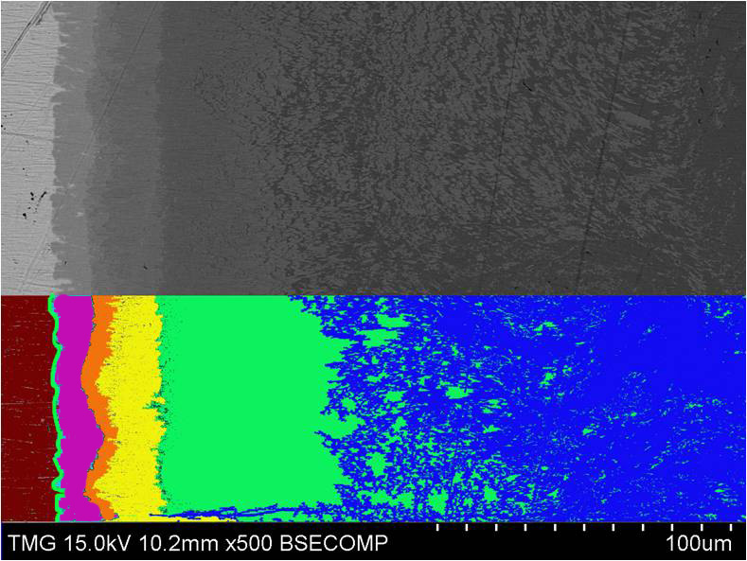
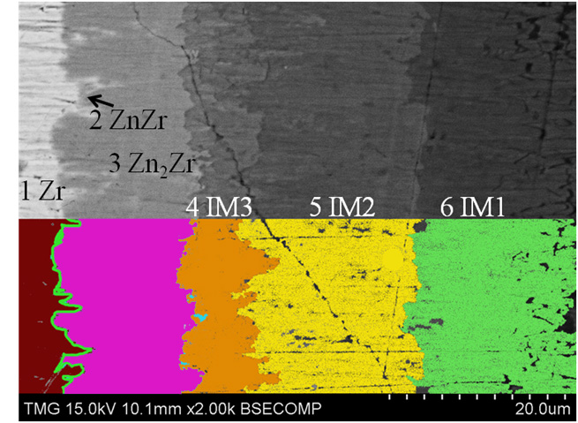
Results and discussion
Zr-Mg36Zn64 at.%
Annealing temp.: 450°C
Annealing time: 7 days
3
Zn₂Zr
1
Zr
4
IM3
5
IM2
6
IM1
7
MgZn₂
2
ZnZr

Slide 17
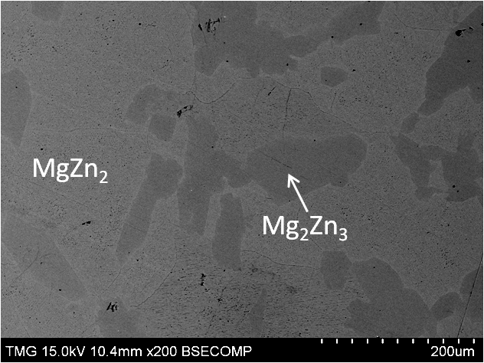
Results and discussion
Zr-Mg36Zn64 at.%
Annealing temp.: 450°C
Annealing time: 7 days
As cast end-member
3
Zn₂Zr
1
Zr
4
IM3
5
IM2
6
IM1
7
MgZn₂
2
ZnZr

Slide 18
Results and discussion
Zr-Mg36Zn64 at.%
Annealing temp.: 450°C
Annealing time: 7 days
EDS line scan
3
Zn₂Zr
1
Zr
4
IM3
5
IM2
6
IM1
7
MgZn₂
2
ZnZr

Slide 19
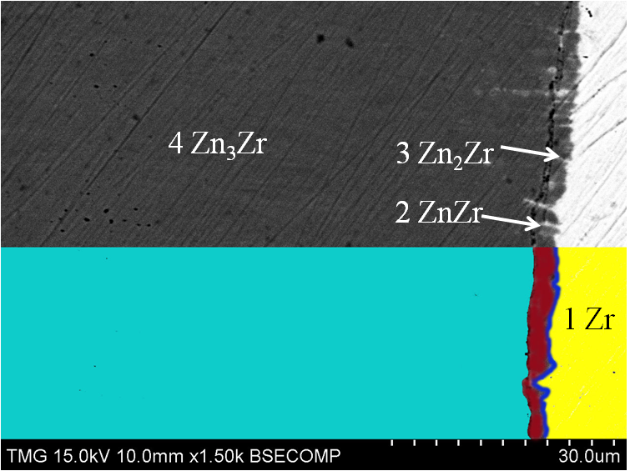
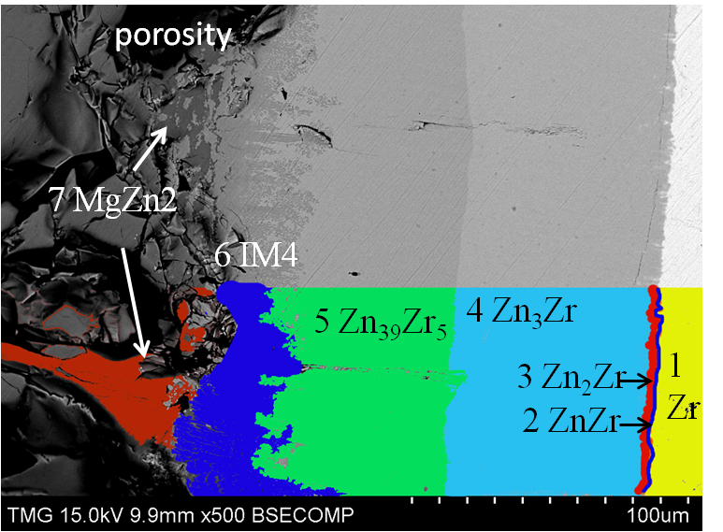
Results and discussion
Zr-Mg20Zn80 at.%
Annealing temp.: 450°C
Annealing time: 2 days

Slide 20
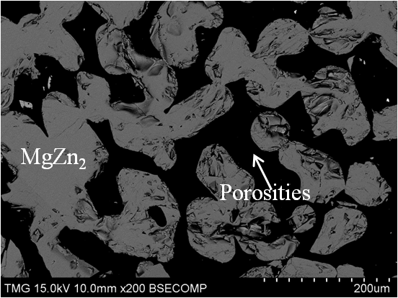
Results and discussion
Zr-Mg20Zn80 at.%
Annealing temp.: 450°C
Annealing time: 2 days
450ºC
End Member

Slide 21
Results and discussion
Zr-Mg20Zn80 at.%
Annealing temp.: 450°C
Annealing time: 2 days
EDS line scan

Slide 22
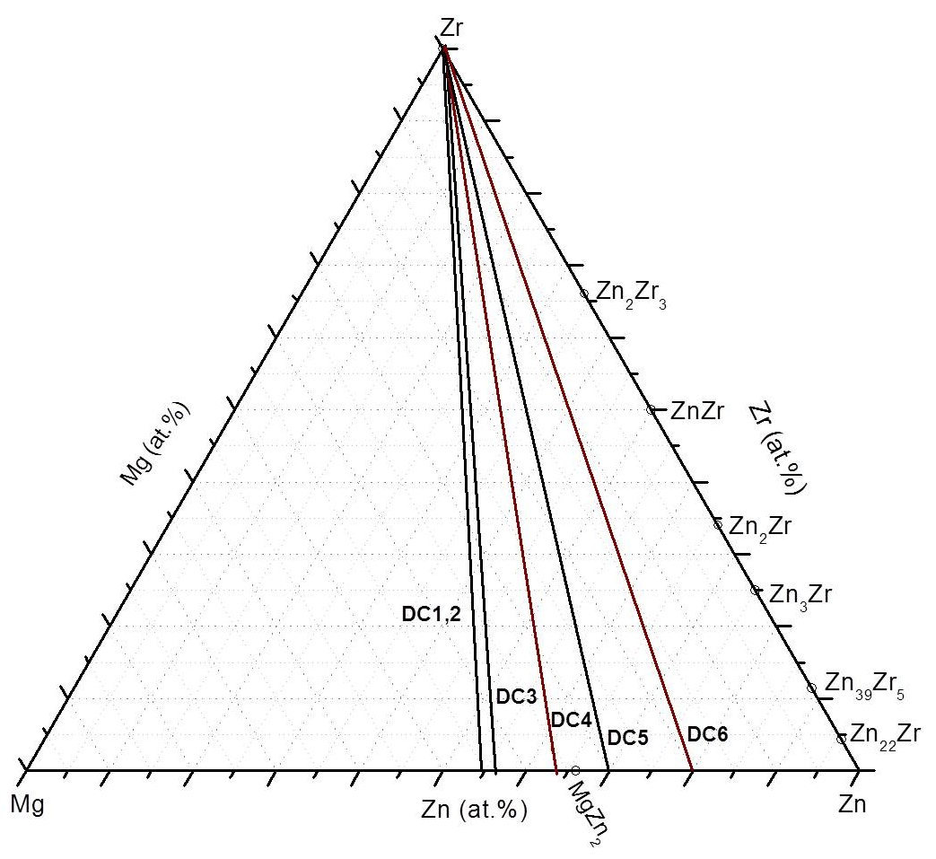
Results and discussion
Diffusion couple | End member 1 | End member 2 | Annealing condition
1 | Zr | Mg45Zn55 at.% | 450ºC 3 days
2 | Zr | Mg45Zn55 at.% | 450ºC 7 days
3 | Zr | Mg43Zn57 at.% | 450ºC 7 days
4 | Zr | Mg36Zn64 at.% | 450ºC 7 days
5 | Zr | Mg30Zn70 at.% | 450ºC 10 days
6 | Zr | Mg20Zn80 at.% | 450ºC 2 days
DC 1,2
DC 3
DC 4
DC 5
DC 6

Slide 23
Results and discussion
Key alloys

Slide 24
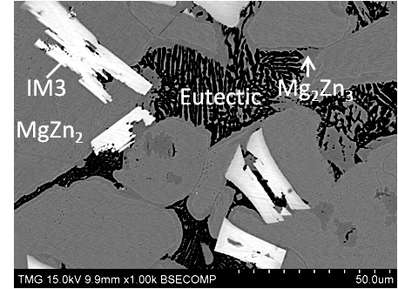
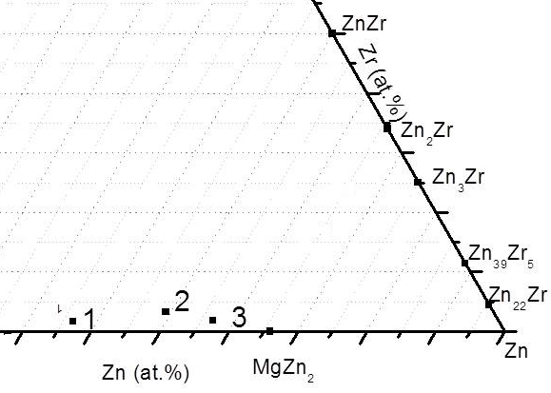
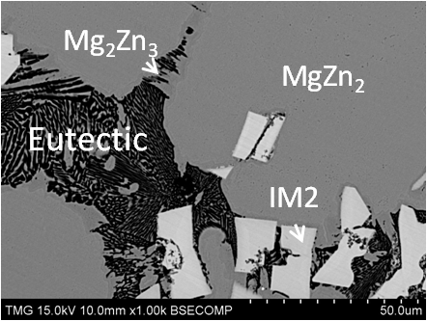
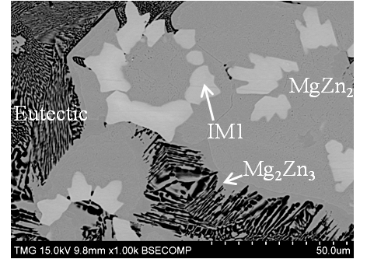
Results and discussion
No. 1 450ºC 4 weeks
Some samples of the key alloys 1,2 and 3 did not reach equilibrium.
No. 2 450ºC 4 weeks
No. 3 450ºC 4 weeks

Slide 25
Results and discussion
Some samples of the key alloys 1,2 and 3 did not reach equilibrium.
As cast key sample
ICP, SEM, XRD
Annealed at 450ºC for 2 weeks
ICP, SEM, XRD
Annealed at 450ºC for 2 more weeks
ICP, SEM, XRD

Slide 26
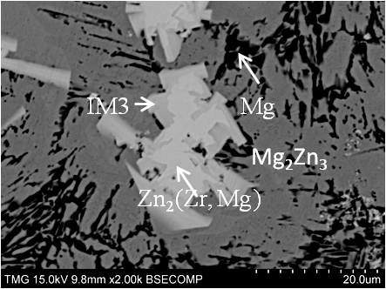
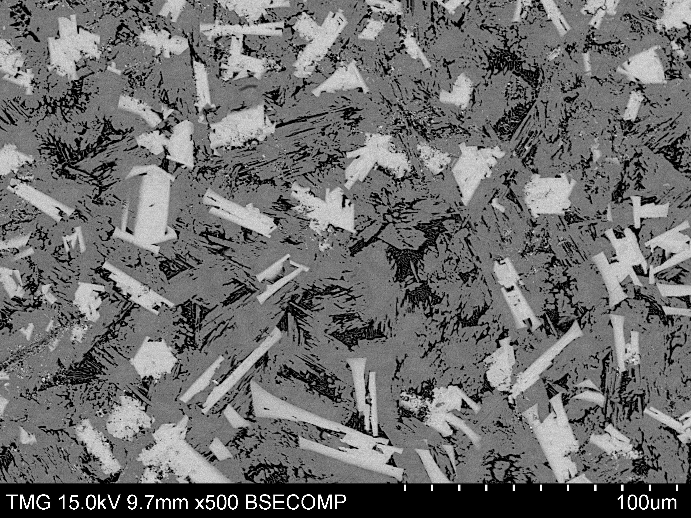
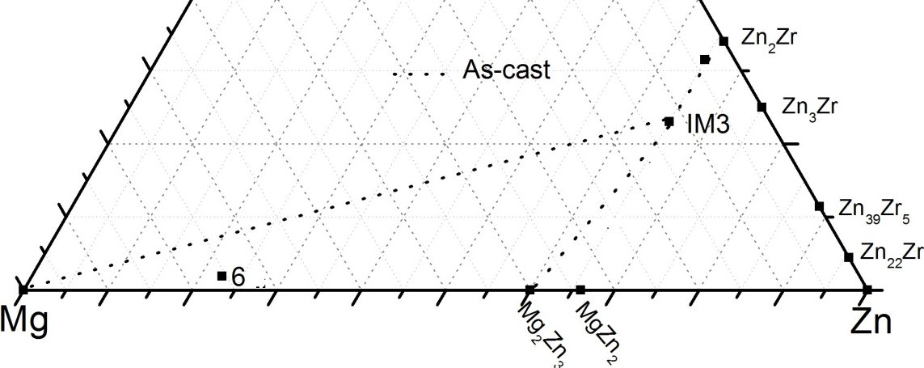
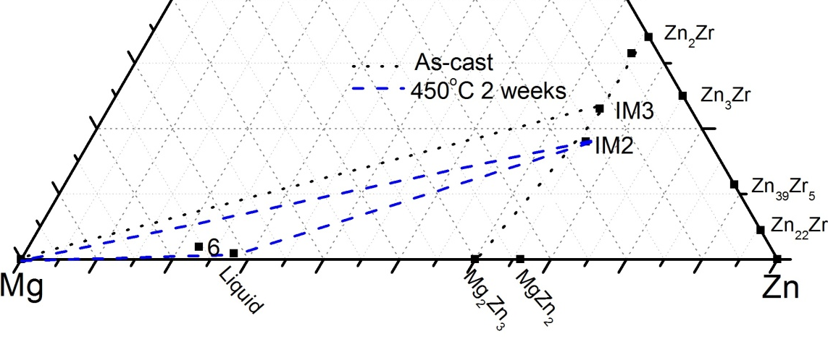
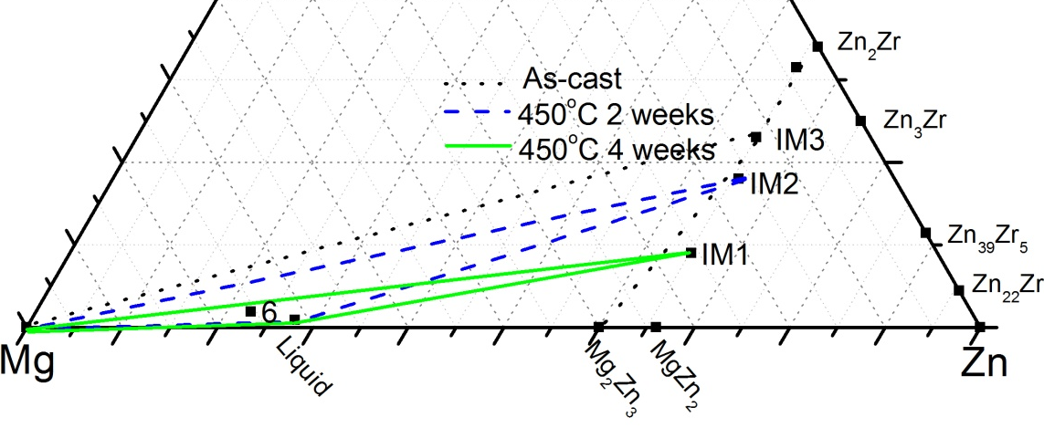
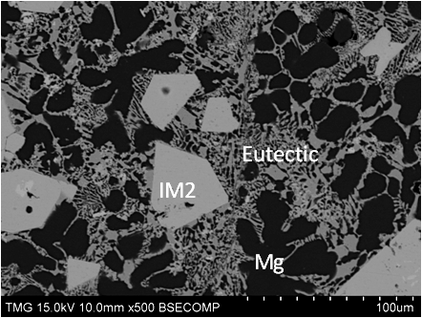
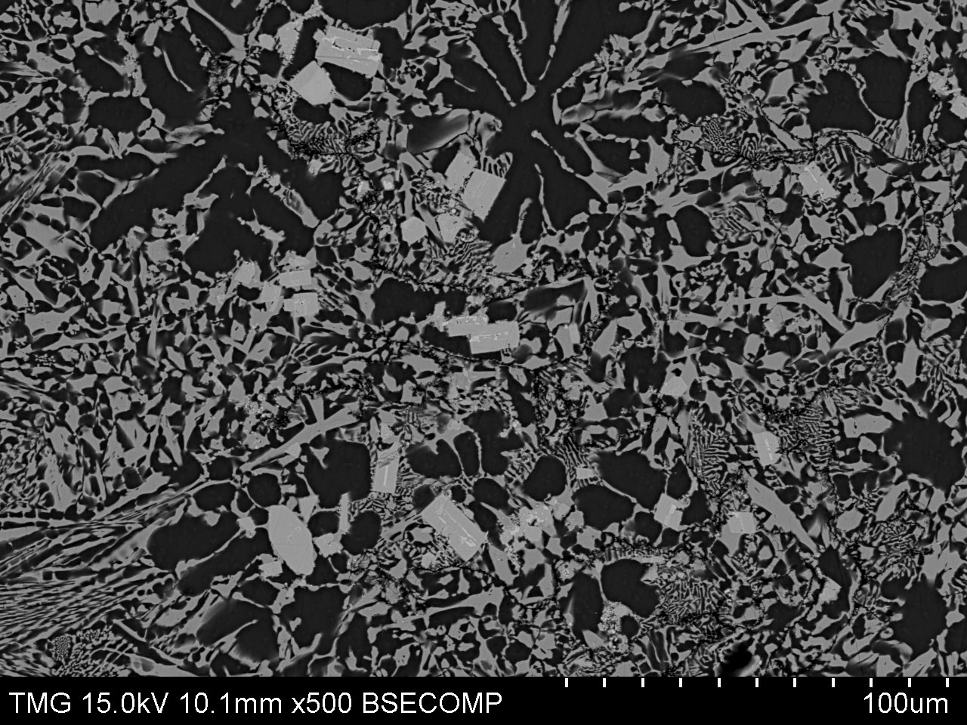
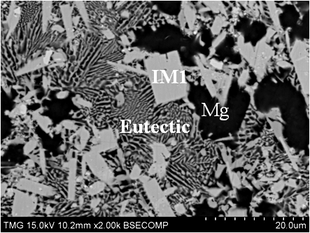
Results and discussion
No. 6 as cast
No. 6 450ºC 2 weeks
No. 6 450ºC 4 weeks

Slide 27
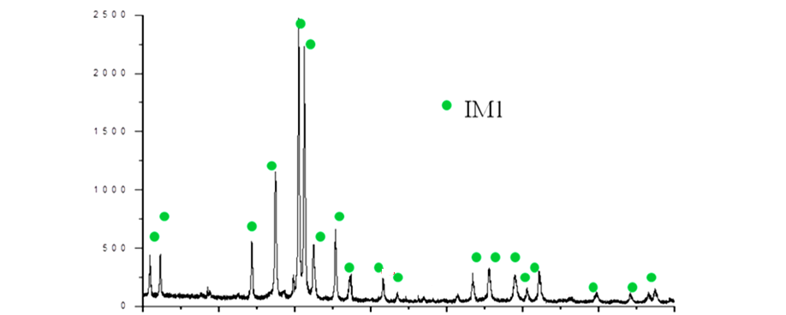
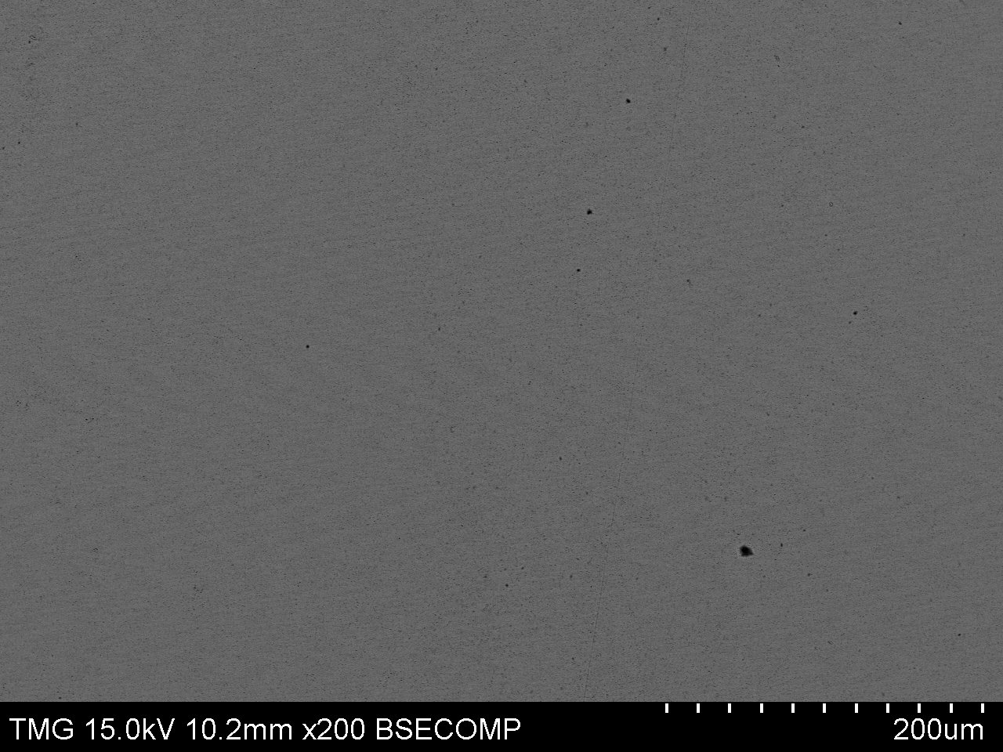
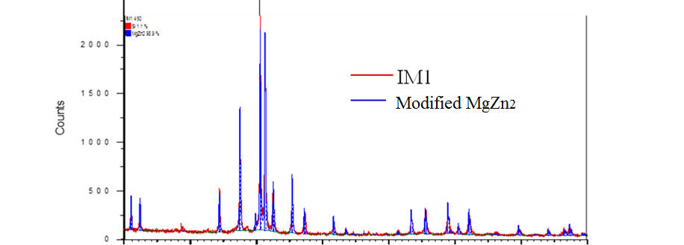
XRD study of the ternary compounds
No. 7 450ºC 4 weeks
IM1
20
30
40
50
60
70
80
90
Position (2θ)
 | IM1 | MgZn₂
Crystal structure | Hexagonal
Space group | P6₃/mmc
Occupancy | 30%Zr, 70%Mg
20
30
40
50
60
70
80
90
Position (2θ)

Slide 28
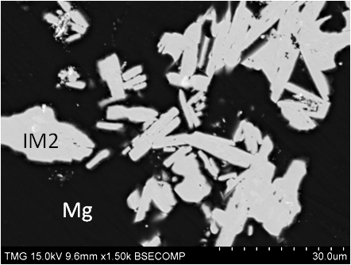
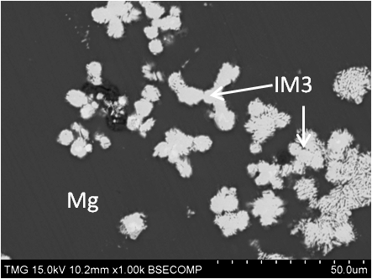
XRD study of the ternary compounds
No. 7 450ºC 4 weeks
No. 8 450ºC 4 weeks
IM2
IM1
No. 9 450ºC 4 weeks
IM3

Slide 29
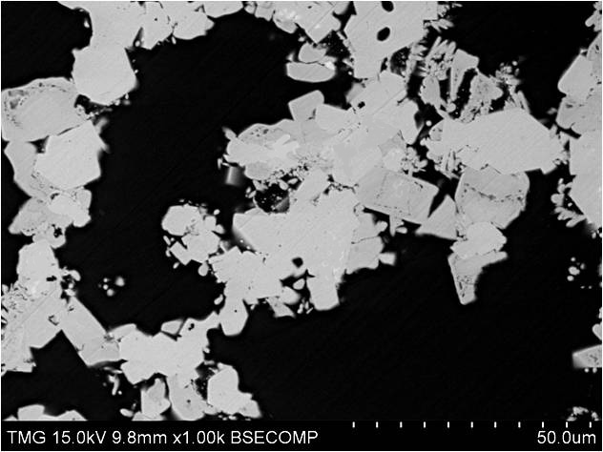
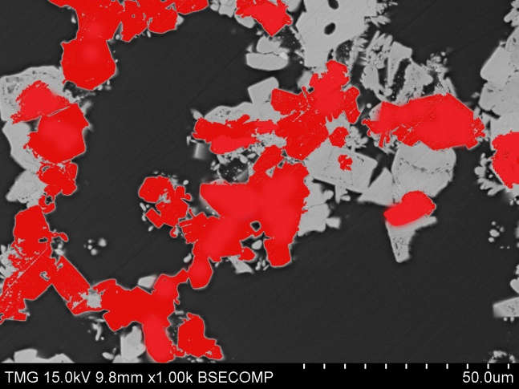
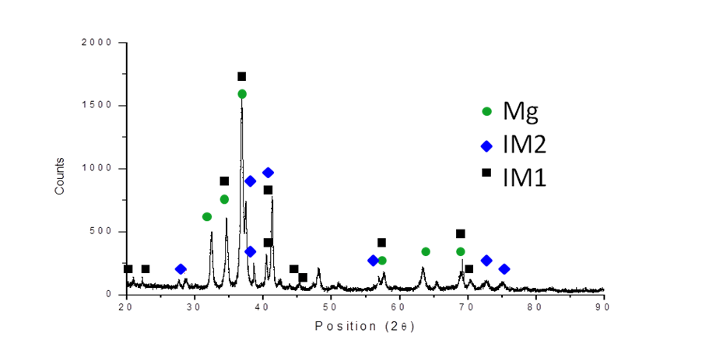
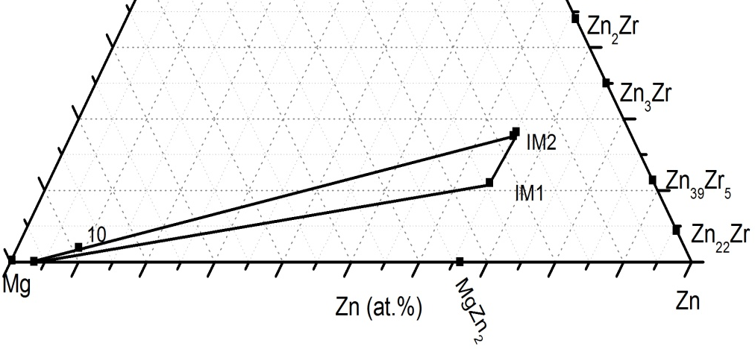
Results and discussion
No. 10 450ºC 4 weeks
IM1
IM1
IM2
IM2
Mg
Mg

Slide 30
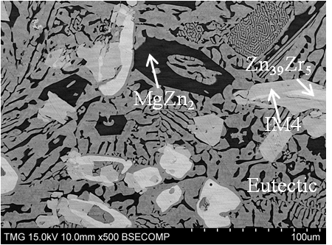
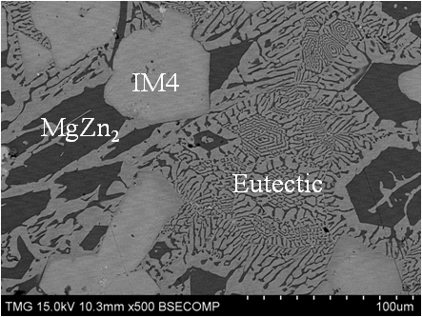
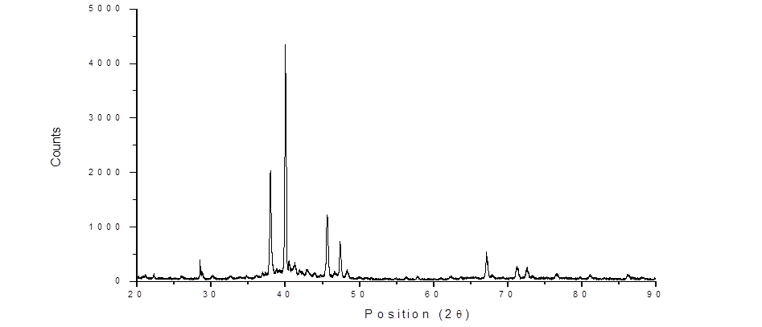
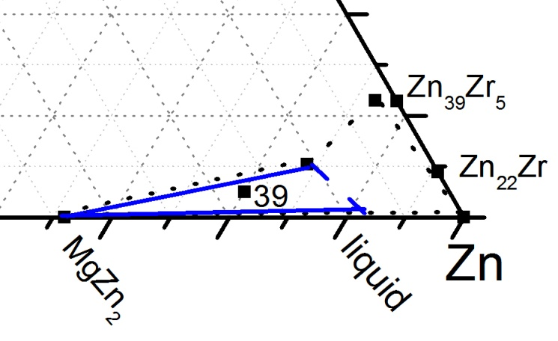
Results and discussion
No. 13 as cast
No. 13 450ºC 2 days
Zn
MgZn₂
IM4
IM4
IM4

Slide 31
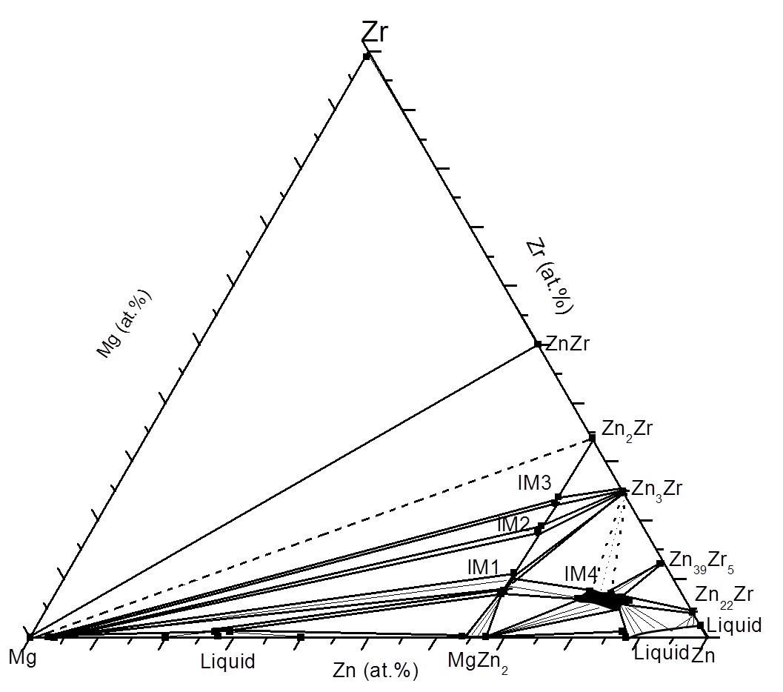
Conclusion
Four ternary compounds of IM1, IM2, IM3 and IM4 are detected for the first time in the Mg-Zn-Zr system；
450ºC
The compositions, homogeneity ranges and XRD patterns of the ternary compounds are determined by SEM, EDS and XRD techniques;
The crystal structure of IM1 has been determined by the XRD analysis of a single phase key alloy.

Slide 32
Suggestions for future work
XRD analysis to determine the crystal structures of the IM2, IM3 and IM4 compounds;
DSC study to determine the liquidus surface and
the invariant reactions of the Mg-Zn-Zr system;
Thermodynamic modeling of the Mg-Zn-Zr ternary system with full range of concentrations and temperatures;
Development of the methodology for preparation of Zr rich alloys.

Slide 33
THANK YOU
QUESTIONS

Slide 34







Results and discussion
No. 5 as cast
No. 3 450ºC 4 weeks
5
IM1
5 (4 weeks)
No. 5 450ºC 2 weeks
No. 5 450ºC 4 weeks
IM2
Eutectic
MgZn₂

Slide 35

Liquid

Slide 36


No. 4 450ºC 1 week

Slide 37


Area to prepare samples
at. %
at. %

