Slide 1


Hydrogen Storage Properties of Mg-Ni-H through Pressure Composition Isotherms Combined with Thermodynamic Calculations
Guy-Joël Rocher
Master’s Thesis Defense Presentation
Supervisors: Dr. M. Medraj
Dr. H.D. Ng
December 6th , 2012
Thermodynamics of Materials Group
Department of Mechanical & Industrial Engineering
Concordia University

Slide 2
Outline
Introduction
Motivation
Experimental Procedures
Results & Discussion
Concluding Remarks & Future Work

Slide 3
1.
Introduction

Slide 4
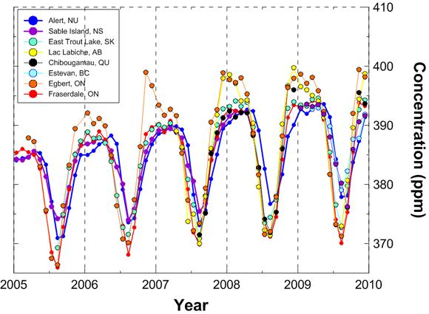

Environmental Concerns
Introduction
Canada ranks 3rd in the world CO₂ emissions per capita
16.33 metric tons/capita
(Statistics Canada 2008)
Environment Canada, 2011
Environment Canada, 2011
Notes:
Behind USA, Australia
Future trends : mining & oil

Slide 5
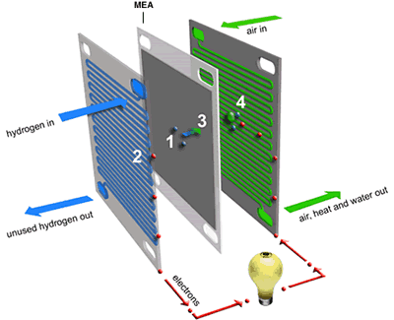
Hydrogen Energy
Introduction
What is Hydrogen Energy?
  2H₂ + ½ O₂ + 2e⁻ → H₂O
  H₂ is an Energy Carrier
  Hydrogen = Electrification
Advantages
  Reduction in emission
  Energy efficiency increase
  Localized energy production
  Strengthen large scale electrical grid
  H₂→2H⁺ + 2e⁻
http://www.alternative-energy-news.info/technology/fuel-cells/
Notes:
Fuel Cell Technology is mature
Reduction of oil dependency

Slide 6








Hydrogen Energy Barriers
Introduction
Safety
Storage
Hydrogen
Gasoline
t = 3 sec.
t = 60 sec.
Dr. Michael Swain, University of Miami, 2001
Metal/Complex Hydride
Chemical
Reactions
Adsorption
Carbon
H₂
(Liquid)
H₂
(750bar)
http://jksalescompany.com/ken/toyotayaris2012.html

Slide 7


Metal Hydrides
introduction
Theory
Advantages
Storage performance: compact & safe
Fully Reversible
Cycling stability
Drawbacks
Operating temperature (>150°C)
Slow reaction
Absorption/Desorption Schematic
T (°C)
P (bar)
Notes:
Room temperature hydrides have transitions metals, lightweight

Slide 8
2.
Motivation

Slide 9
Research Efforts H₂ Storage
motivation
The Metal Hydride Center of Excellence – DOE Hydrogen Program
Identified promising lightweight elements
B - H - Li - Mg - Ni
B-H
B-Ni
H-Ni
B-H-Li
B-Li-Mg
H-Li-Mg
B-Li
H-Li
Li-Mg
B-H-Mg
B-Li-Ni
H-Li-Ni
B-Mg
H-Mg
Li-Ni
B-H-Ni
B-Mg-Ni
H-Mg-Ni
H-Mg-Ni
Mg-Ni
Li-Mg-Ni
Notes:
Room temperature hydrides have transitions metals, lightweight

Slide 10
Metal Hydride Investigation
Motivation
Experimental investigation of metal hydrides:
    Time consuming experiments (slow kinetics)
    Sampling of full composition range
Therefore, we combined thermodynamic modeling with key experiments to investigate Mg-Ni-H system.
    Reduces experimental load
    Prediction by extrapolation
Project collaborators:
  MaSc - Guy-Joël Rocher - Experiments
  PhD - Saida Abdessameud - Thermodynamic Modelling

Slide 11
3.
Experimental Procedures

Slide 12
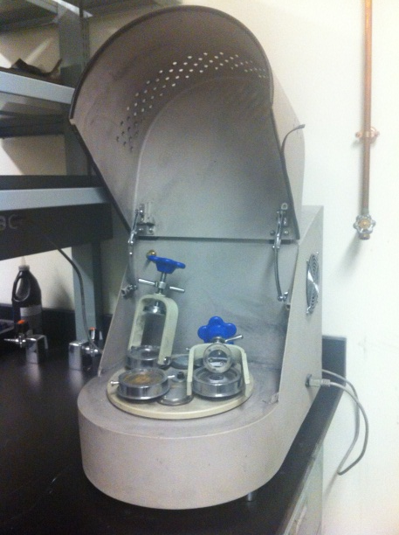
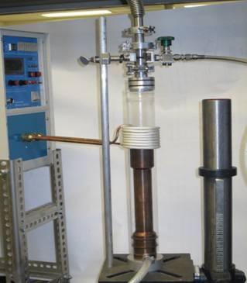
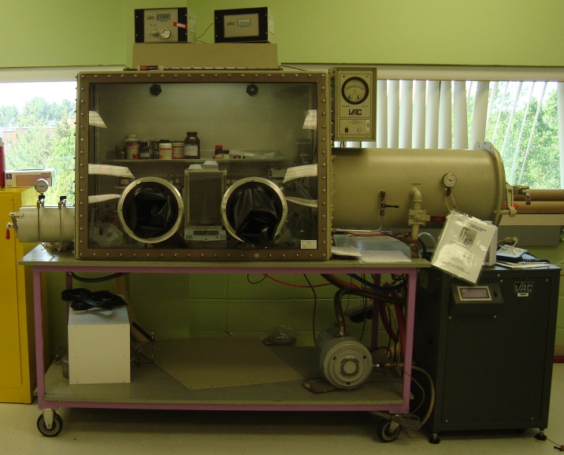
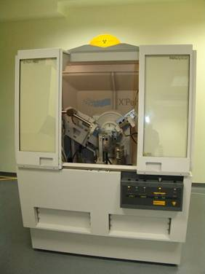
Equipment
Experimental procedures
Planetary Ball Mill
Induction Furnace
Glove box
X-ray Diffractometer
PCT-Pro 2000

Slide 13
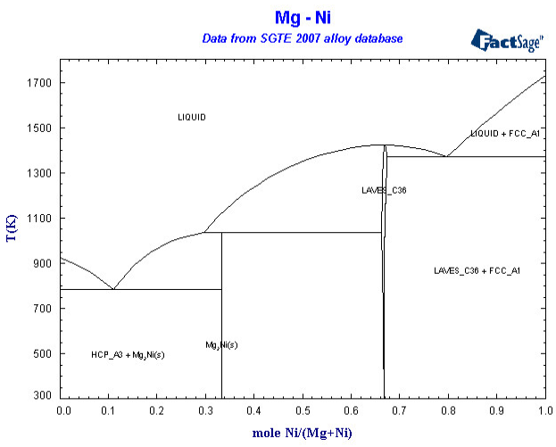
Sample Preparation
Experimental procedures
Main Challenges:
Homogeneity
Oxidation
Contamination
Optimized Procedures
Sample Alloying:
Planetary Ball Milling (1hr) + Induction Melting (dissolve Ni)
Glove box:
Crushing of button sample
Load powder in test cell
Hydrogen Sorption Testing:
Volume Calibration
Activation cycles (3)
Ni 1728K
Mg 923K

Slide 14
4.
Results and Discussion

Slide 15
Results & Discussion
Phase Identification
XRD as cast Mg₇₂Ni₂₈

Slide 16
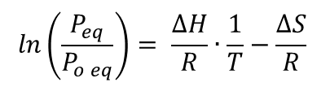
Results & Discussion
Hydrogen Sorption Testing
Van’t Hoff equation
$$\ln\left(\frac{P_{eq}}{P_{o eq}}\right)= \frac{∆H}{R}∙\frac{1}{T}−\frac{∆S}{R}$$
PCI Mg₇₂Ni₂₈
Mg₂NiH₄
Solid solution
MgH₂
Notes:
Compare equilibrium constants, diff samples operate at diff temp & pressures

Slide 17
Van’t Hoff Plot
Results & Discussion
Van’t Hoff Plot Mg₇₂Ni₂₈
Notes:
Eq. used to compare equilibrium constants

Slide 18
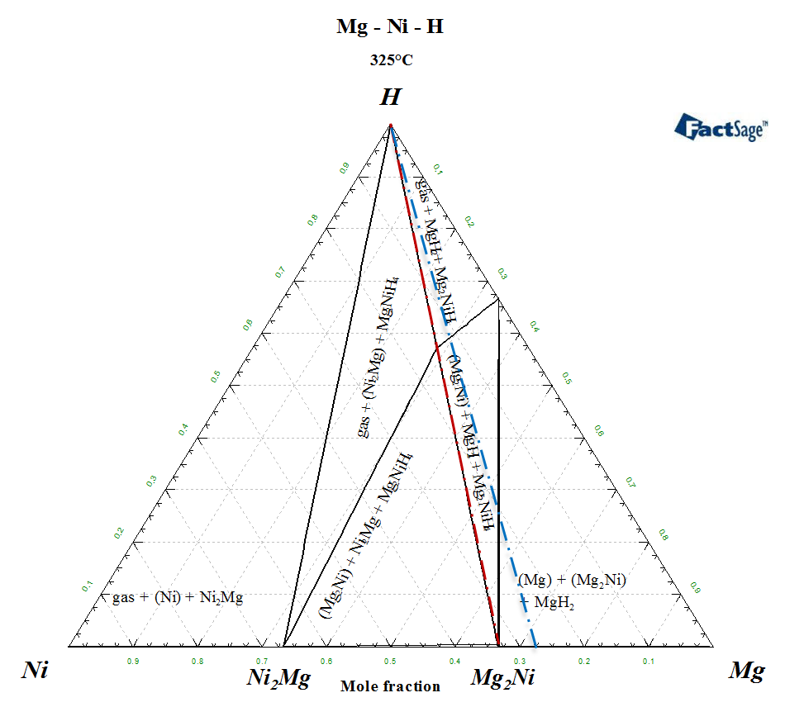
Results & Discussion
PCI to Phase Diagram
PCI Mg₆₇Ni₃₃
Phase Diagram Mg-H

Slide 19
Results & Discussion
PCI compared to thermodynamic calculations

Slide 20
Results & Discussion
Thermodynamic Data Mg₇₂Ni₂₈
Sample | Reaction | Experimental ΔH (kJ/mol) | Calculated ΔH (kJ/mol) | Reported ΔH (kJ/mol) [Reilley,79]
Mg₇₂Ni₂₈ | Mg₂NiH₄ Absorption | -64.4 | - | -
 | Mg₂NiH₄ Desorption | -73.0 | - | -
 | Mg₂NiH₄ Average | -68.7 ± 5.5 | -66.4 | -64.5
 | MgH₂ Absorption | -74.0 | - | -
 | MgH₂ Desorption | -82.1 | - | -
 | MgH₂ Average | -79.8 ± 5.5 | -78.8 | -77.4

Slide 21
5.
Concluding Remarks &
Future Work

Slide 22
Concluding Remarks
conclusion
Successful PCI experiments were carried out on the Mg-Ni-H system.
Resolved the difficulties with sample preparation.
Demonstrated effectiveness of the novel methodology
  Mg₆₇Ni₃₃ good agreement with literature
  Mg₇₂Ni₂₈ good agreement with thermodynamic calculations
Comprehensive literature review on hydrogen storage

Slide 23
Future Work
conclusion
Complete the investigation of promising systems to find ideal candidate for commercial applications
Testing of composite samples made of metal hydrides and complex metal hydrides
2LiBH₄+MgH₂
Volumetric and gravimetric capacity
Good reversibility
B - H - Li - Mg - Ni

Slide 24

Acknowledgements
Funding H₂Can Network
Dr. Huot group at UQTR (IRH)
Dr. Ottenwaelder & M. Askari access to glove box
S. Abdessameud for thermodynamic modeling

Slide 25
THANK YOU
? ? Questions ??

