Slide 1
Redundant Service Removal in QoS-aware Service Composition
Min Chen, and Yuhong Yan
Concordia University, Montreal, Canada
Presentation at ICWS 2012
June 24-29, 2012, Hawaii (Honolulu), USA

Slide 2
Outline
Background
Motivation
Redundant Service Removal in QoS-aware Service Composition
Analysis of redundant service removal
Model redundant service removal problem
Redundant service removal algorithm
Experiment
Conclusion
Notes:
2

Slide 3
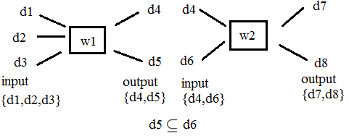
Background
Web Service Composition (WSC) problem : (W, D_{in}, D_{out})
Composition Query: (D_{in}, D_{out})
Service model
w = (in(w), out(w))

Slide 4
Background
QoS criteria
Response time
Throughput
Execution cost

Slide 5
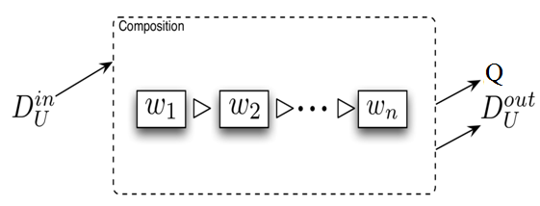
Background
QoS-aware service composition
Composition Query: (D_{in}, D_{out},Q)
Objective: achieve both functional goals and QoS optimization
The solution
Service model:
w = (in(w), out(w), Q(w))

Slide 6
Background
QoS-aware service composition
It is widely studied in Web Service Challenge (WSC) competition.
Using WSC data set, several systematic algorithms have been proposed for single QoS criterion.

Slide 7
Motivation
In the context of QoS-aware service composition, a solution with optimal response time (or throughput) may be not cost-optimized
Redundant services may be found in the solution
Removing redundant services
Keeping response time (or throughput) still optimal
Reducing the total execution cost of a solution.

Slide 8
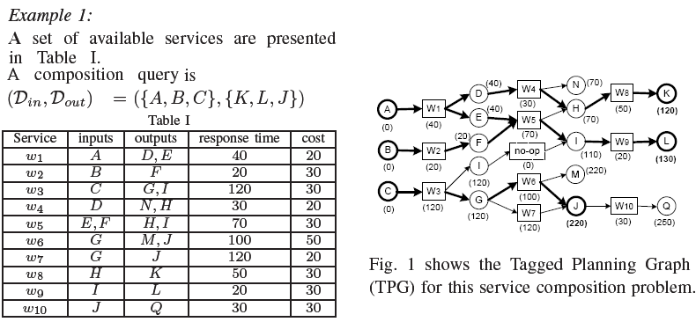
A Motivating Example

Slide 9
A Motivating Example

Slide 10
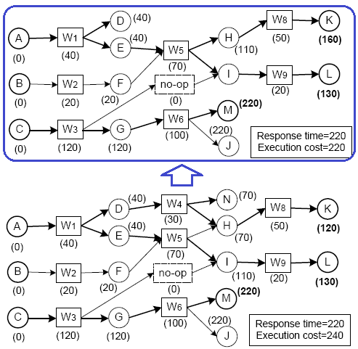
A Motivating Example
Case 1: Service W4 is removed

Slide 11
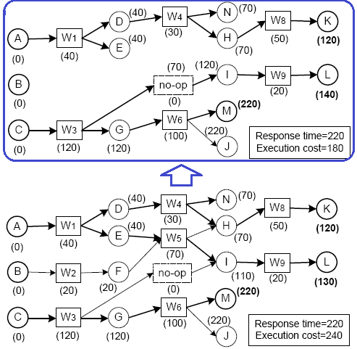
A Motivating Example
Case 2: Service W5 is removed

Slide 12
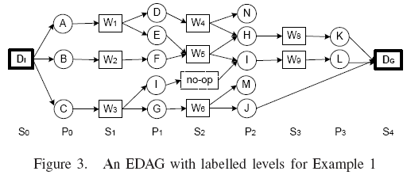
Redundant Service Removal in QoS-aware Service Composition
Analysis of redundant service removal
Extended Direct Acyclic Graph (EDAG)
An EDAG example:

Slide 13
Redundant Service Removal in QoS-aware Service Composition
Analysis of redundant service removal
Key parameters:
Example:

Slide 14
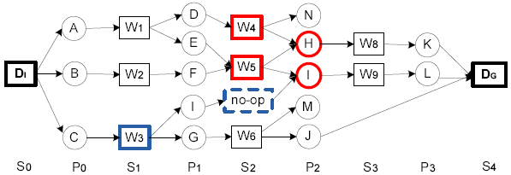
Redundant Service Removal in QoS-aware Service Composition
Analysis of redundant service removal
Discovery of redundant services (Case 1)
Example:

Slide 15
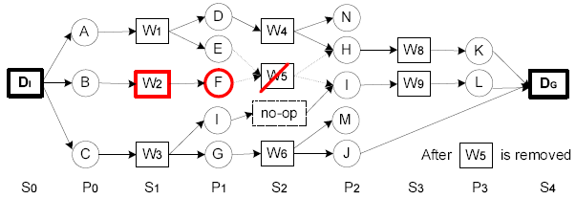
Redundant Service Removal in QoS-aware Service Composition
Analysis of redundant service removal
Discovery of redundant services (Case 2)
Example:

Slide 16
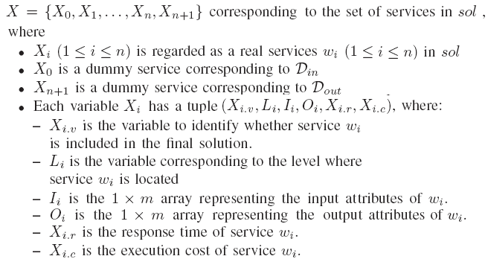
Redundant Service Removal in QoS-aware Service Composition
Model redundant service removal problem
Variables and domains :

Slide 17
Redundant Service Removal in QoS-aware Service Composition
Model redundant service removal problem
Objective function: is the minimum total cost of the solution
Constrains: the solution needs to satisfy after redundancy removal
Initial inputs constraint:

Slide 18
Redundant Service Removal in QoS-aware Service Composition
Model redundant service removal problem
Constrains:
Goal constraint:
Service invokable constraint:
Key outputs constraint:

Slide 19
Redundant Service Removal in QoS-aware Service Composition
Model redundant service removal problem
Constraints:
Constraint on response time or throughput
Constraint on response time
Constraint on throughput

Slide 20
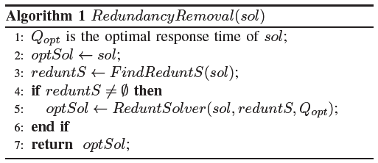
Redundant Service Removal in QoS-aware Service Composition
Redundant service removal algorithm

Slide 21
Experiment
Objective
Compare our results with another redundancy removal method
Removing redundant services from solutions with optimal response time
Removing redundant services from solutions with optimal throughput
Set up:
Select a dataset
Run our algorithms to remove redundant services
Compare the results

Slide 22
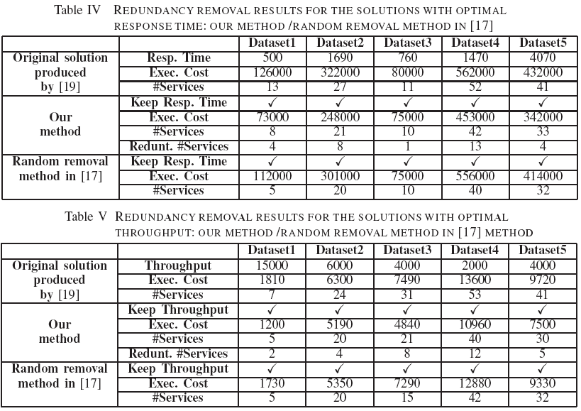
Experiment

Slide 23
Conclusion
Our proposed algorithm: optimizes the solution obtained by QoS-aware service composition methods taking advantage of redundancy removal
Our proposed algorithm: model redundant service removal problem as a integer optimization problem

Slide 24
Thank you !

